Slide 1
FDI, multinationals and domestic companies in emerging markets
Svetlana Ledyaeva
Aalto University School of Business

Slide 2
Just return to our first lecture… Interesting Figure!

Slide 3
Traditional view of multinational enterprise (from Avinash Dixit public lecture at Oxford)
NORTH MNE invests to SOUTH
MNE is from advanced country – North. Has advantage in R&D, high-tech, management. Information makes it non-contractible.
Southern host country has cost advantage in low-tech production. Also non-contractible.
FDI can reduce contracting costs: FDI is a specific organizational choice made by investing firms to take advantage of opportunities for earning profits in the host country and in response to the challenges posed by the contracting.

Slide 4
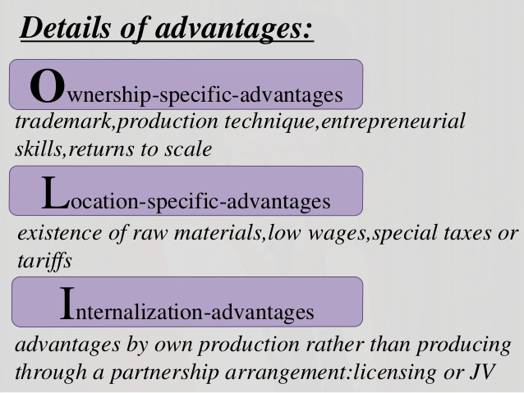
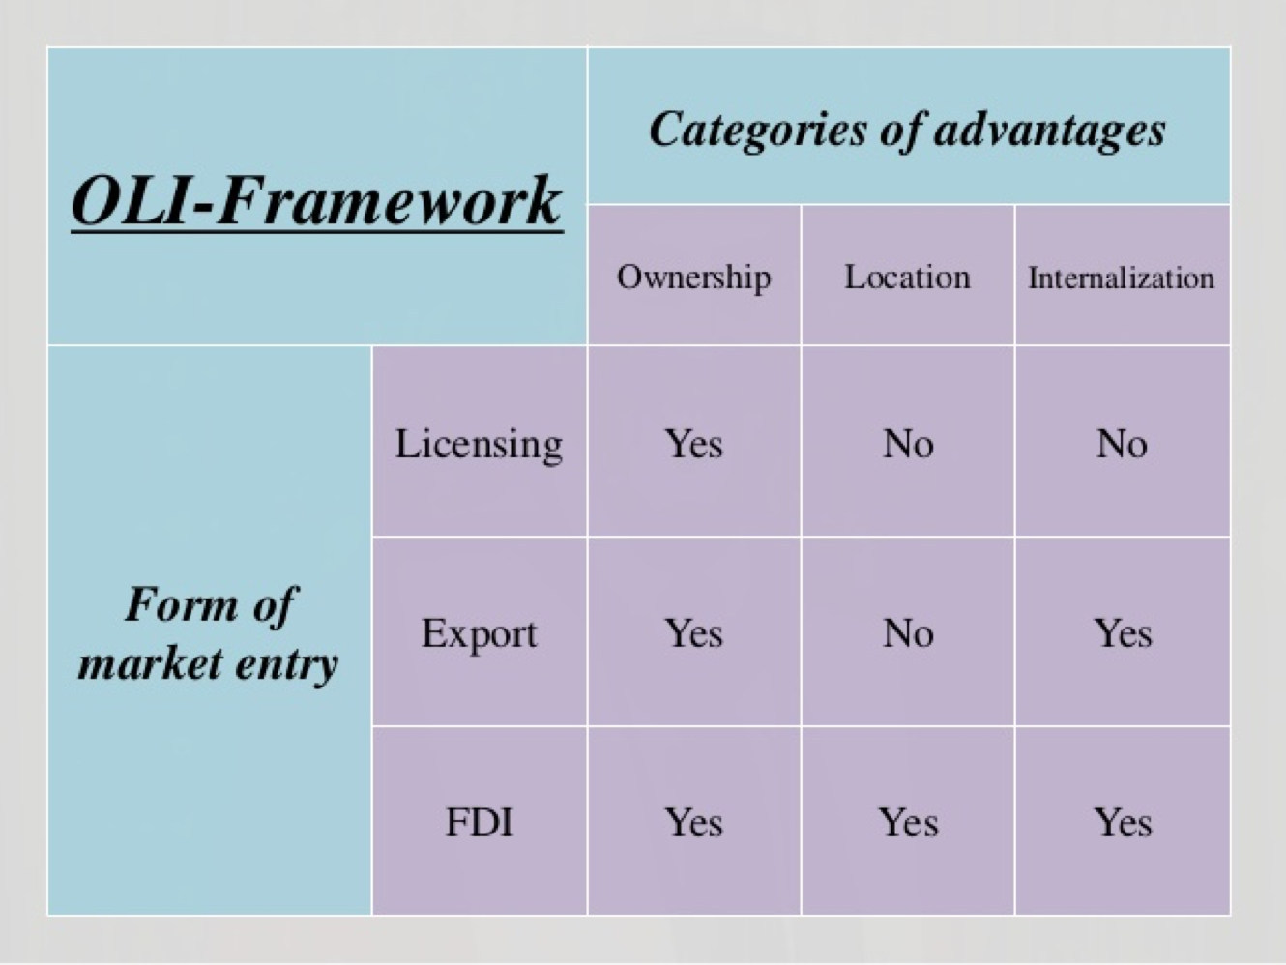
patent, copyright, blueprint, managerial talent, brand reputation, intangible assets.
OLI paradigm suggested by John Dunning

Slide 5
Developed countries´ MNEs investing in EMs
For years, economists have been talking about a structural shift in the global economy.
Do you increase spending in the United States, or do you open a new factory and service center in Asia?
That question was answered in 2013: For the first time ever, global corporations invested more in emerging markets than the core economies of U.S., Europe and Japan, according to UNCTAD in their 2013 World Investment Report.

Slide 6
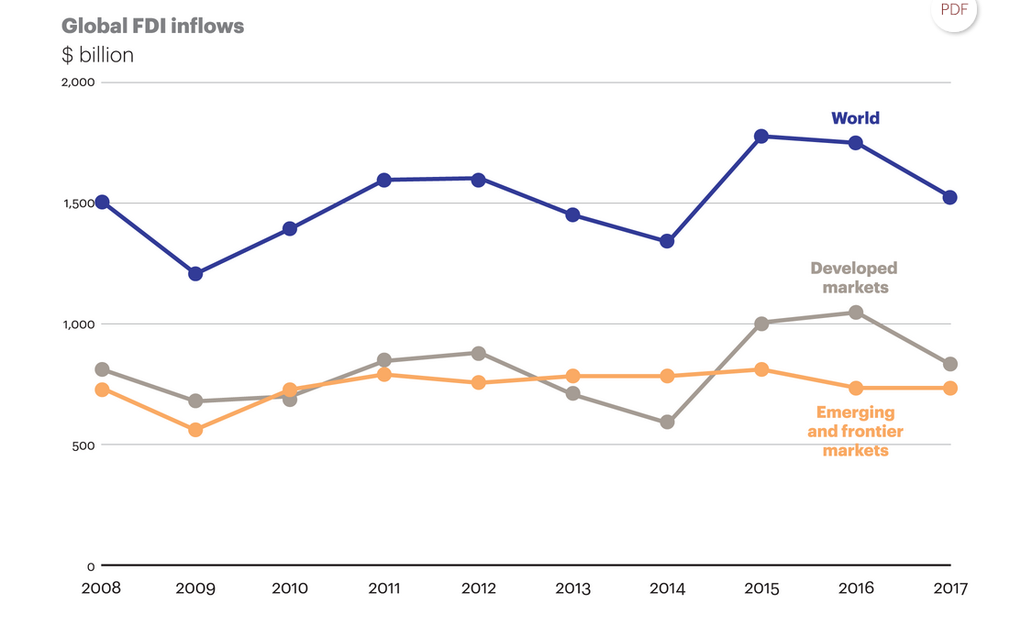

Slide 7
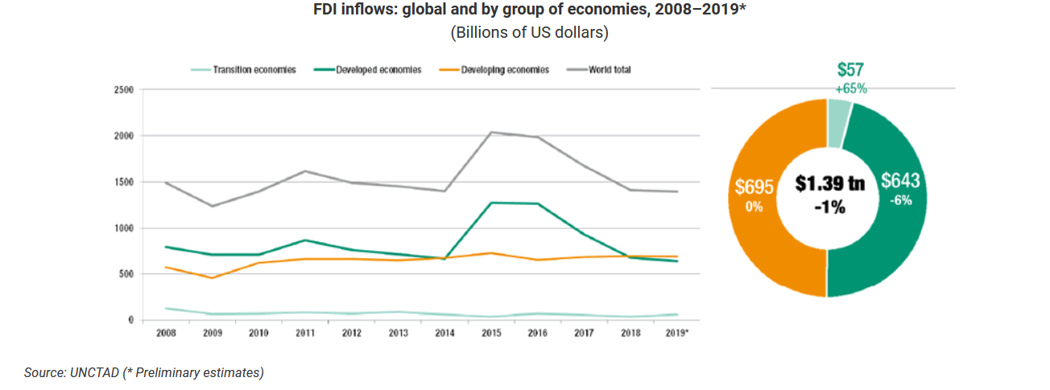

Slide 8
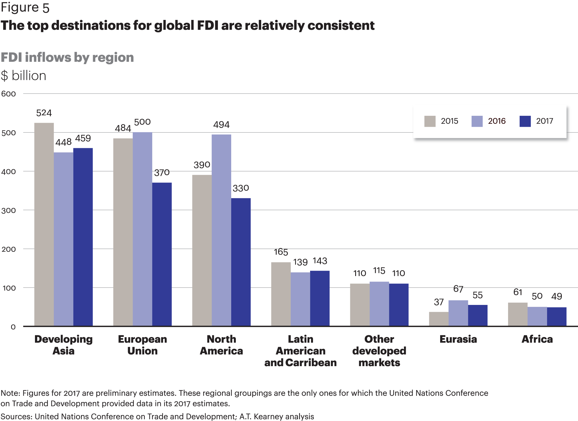

Slide 9
Business/investment strategies of MNCs/investors from advanced markets in emerging markets (London and Hart 2004)
Most MNCs have focused on the wealthy elite at the top of the economic pyramid, with products and business models similar to those used in the developed world.
Largely ignored until recently is a huge base of potential customers whose annual purchasing power parity (PPP) is less than $1500 per year.
The four billion customers in these base-of-the-pyramid markets represent a vast potential. ➔ Present both tremendous opportunities and unique challenges.
A growing number of MNCs start to explore the enormous business opportunity at the base of the economic pyramid

Slide 10
The base of the economic pyramid: opportunities 1 (London and Hart 2004)
The vast majority of the populations operate primarily in the large, but hidden, informal economies that are not recorded in official gross national product (GNP) statistics.
The informal sector includes more than $9 trillion in hidden (or unregistered) assets ➔ equivalent to the total value of all companies listed on the 20 most developed countries' main stock exchanges (de Soto, 2000: 35).

Slide 11
The base of the economic pyramid: opportunities (London and Hart 2004)
In addition to assets, the value of economic transactions in these markets may match or even exceed what is recorded in the formal economic sectors in developing countries (Henderson, 1999).
In Mexico, for example, the informal economy represented roughly 30–40% of the economic activity in the country in the late 1980s, and has continued to grow rapidly (de Soto, 2000: 78).
Not necessarily illegal activities! It is simply too costly or complicated for many entrepreneurs to enter the formal economy. For example, de Soto (2000) found that it takes 289 days and $1231 to register a business in Peru.

Slide 12
Informal employment, % of non-agricultural employment; Emerging markets
Country | Informal employment, % | Year | Type of country (FTSE 2018)
Bangladesh | 91,30 | 2017 | Frontier
Cote d'Ivoire | 87,70 | 2016 | Frontier
Ghana | 83,18 | 2016 | Frontier
Indonesia | 78,55 | 2017 | Secondary Emerging
India | 74,82 | 2012 | Secondary Emerging
Pakistan | 71,23 | 2015 | Secondary Emerging
Peru | 59,01 | 2017 | Secondary Emerging
Vietnam | 56,06 | 2017 | Frontier
Colombia | 55,78 | 2017 | Secondary Emerging
Egypt, Arab Rep. | 50,57 | 2016 | Secondary Emerging
Argentina | 47,93 | 2017 | Frontier
Chile | 41,13 | 2017 | Secondary Emerging
Brazil | 38,27 | 2015 | Advanced Emerging
South Africa | 34,47 | 2017 | Advanced Emerging

Slide 13
Informal employment, % of non-agricultural employment; other countries
Country | Informal employment, % | Year | Type of country
Nepal | 99,01 | 2008 | NC - developing
Benin | 94,54 | 2011 | NC - Offshore jurisdiction
Mali | 92,09 | 2015 | NC - Offshore jurisdiction
Senegal | 90,44 | 2015 | NC - developing
Cambodia | 90,20 | 2012 | NC - developing
Mozambique | 86,71 | 2015 | NC - developing
Niger | 86,36 | 2011 | NC - developing
Uganda | 83,24 | 2012 | NC - developing
Bolivia | 78,72 | 2017 | NC - developing
Myanmar | 78,08 | 2017 | NC - developing
Liberia | 77,58 | 2010 | NC - developing
Nicaragua | 74,91 | 2012 | NC - developing
Honduras | 73,84 | 2016 | NC - developing
Guatemala | 73,50 | 2016 | NC - developing
Tanzania | 71,79 | 2014 | NC - developing
Yemen, Rep. | 68,41 | 2014 | NC - developing
Gambia, The | 68,19 | 2012 | NC - developing
Paraguay | 65,42 | 2017 | NC - developing
Ecuador | 64,85 | 2017 | NC - developing
El Salvador | 63,15 | 2016 | NC - Offshore jurisdiction
Zimbabwe | 62,50 | 2011 | NC - developing
Namibia | 61,07 | 2016 | NC - developing
Timor-Leste | 53,70 | 2013 | NC - Offshore jurisdiction
Eswatini | 53,40 | 2016 | NC - developing
Dominican Republic | 53,20 | 2016 | NC - offshore jurisdiction
Mauritius | 52,87 | 2016 | NC - Offshore jurisdiction
West Bank and Gaza | 51,96 | 2017 | NC - developing
Samoa | 50,22 | 2012 | NC - Offshore jurisdiction
Maldives | 47,03 | 2016 | NC - Offshore jurisdiction
Panama | 41,21 | 2016 | NC - Offshore jurisdiction
Costa Rica | 35,45 | 2017 | NC - offshore jurisdiction
Albania | 33,11 | 2013 | NC-developing
Brunei Darussalam | 32,99 | 2014 | NC - offshore jurisdiction
Mongolia | 30,08 | 2016 | NC - developing
Armenia | 24,88 | 2016 | NC-Transition, Post-Soviet
Uruguay | 23,64 | 2017 | NC - developing
Serbia | 16,11 | 2017 | NC - Transition

Slide 14
The base of the economic pyramid: challenges (London and Hart 2004)
Entering low-income markets in emerging economies may require a different strategic approach.
bridging the formal and informal economies.
relationships are grounded primarily on social, not legal, contracts.
MNCs have tended to partner with the minority of individuals and businesses in the developing world that participate in the formal economy ➔ local business elite.
non-profit organizations and other socially oriented institutions can play an important role in business development in developing countries. Grameen Bank and Grameen Phone, for instance, have combined commercial and non-profit operations to successfully provide banking and cellular services to rural areas in Bangladesh.
Increasing pressure for corporations to take a greater role in addressing global societal issues such as eradicating poverty and environmental protection in developing countries.
firms without a capacity to appreciate and create social value or to become locally embedded in the social infrastructure that dominates low-income markets may struggle to overcome their liability of foreignness.

Slide 15
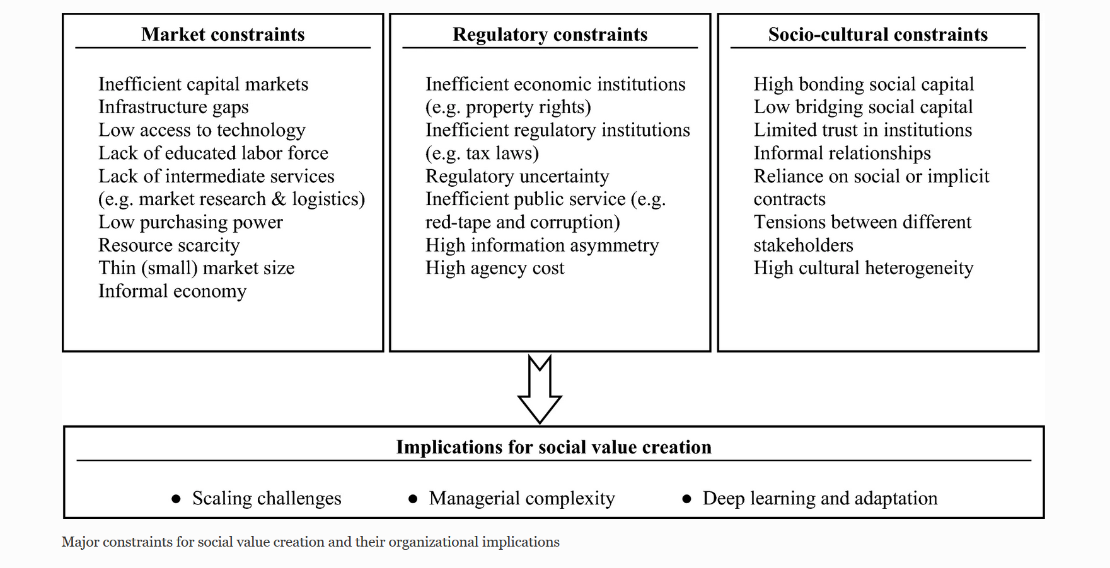

Slide 16
Ordinary/previous EM strategy (London and Hart 2004)
Looking for partner organizations that have substantial capability to fill voids in the business environment.
Firms can address gaps in the business environment through forming alliances, joining network, using interpersonal ties.
Some prominent scholars emphasize that developing country adaptation to Western practices is crucial to attracting investment by MNCs from the developed world.
Other prominent scholars say that “MNC managers and academics must move beyond the ‘imperialist mindset’ that everyone must want to look and act like Westerners”.

Slide 17
Perspective EM strategy (London and Hart 2004)
It might be more appropriate to develop separate strategies for wealthy, rising middle class, and poor customers across country markets.
Entry into base-of-the-pyramid markets may require:
a global capability beyond the adaptive skills of national responsiveness or the centralized control inherent in global efficiency
and
a market entry strategy that moves past a reliance on imported business models.

Slide 18
Advice for essay-report from the above part, i.e. multinational strategies
Assess the presence of foreign MNCs in your chosen country: Names, industries, size. Would there be a room for new investments? Which sectors?
Assess the income inequality; the share of shadow economy; “the base of pyramid” size. What segments of population are targeted by already presented investors/MNCs?
➔
This analysis can help you to make conclusions about the perspective investment in this country.

Slide 19
Video: A New Model for Emerging Markets

Slide 20
Emerging Giants: Local companies in Emerging Markets
Entrepreneurs and domestic companies in EMs are aggressively pursuing growth opportunities at home and overseas.
Successful emerging companies regularly register double-digit annual revenue growth.
Some of these local companies went global.
A small but growing set of these companies has built world-class capabilities to challenge global rivals in their home countries and even in developed markets.

Slide 21
Fortune global 500, 2018, World

Slide 22
Fortune global 500, 2018, Asia, EM

Slide 23
Fortune global 500, 2018, Latin America, EM

Slide 24
Fortune global 100, 2018, Emerging markets companies; number of companies

Slide 25
New development in MNEs over last four decades (from Avinash Dixit public lecture at Oxford)
MNEs from Southern home countries investing in both Northern and Southern host countries.
Prominent recent examples:
Chinese Lenovo buys IBM PC.
Mittal, Tata invest in steel.
Tata, Geely invest in autos in UK, Sweden.
Chinese resource investments in Africa.

Slide 26
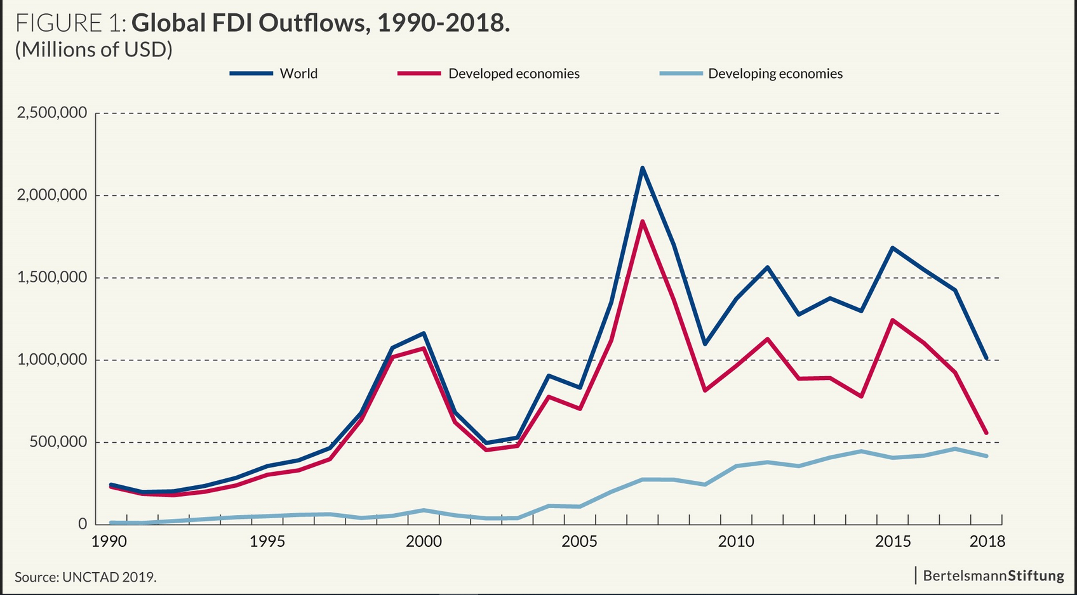

Slide 27
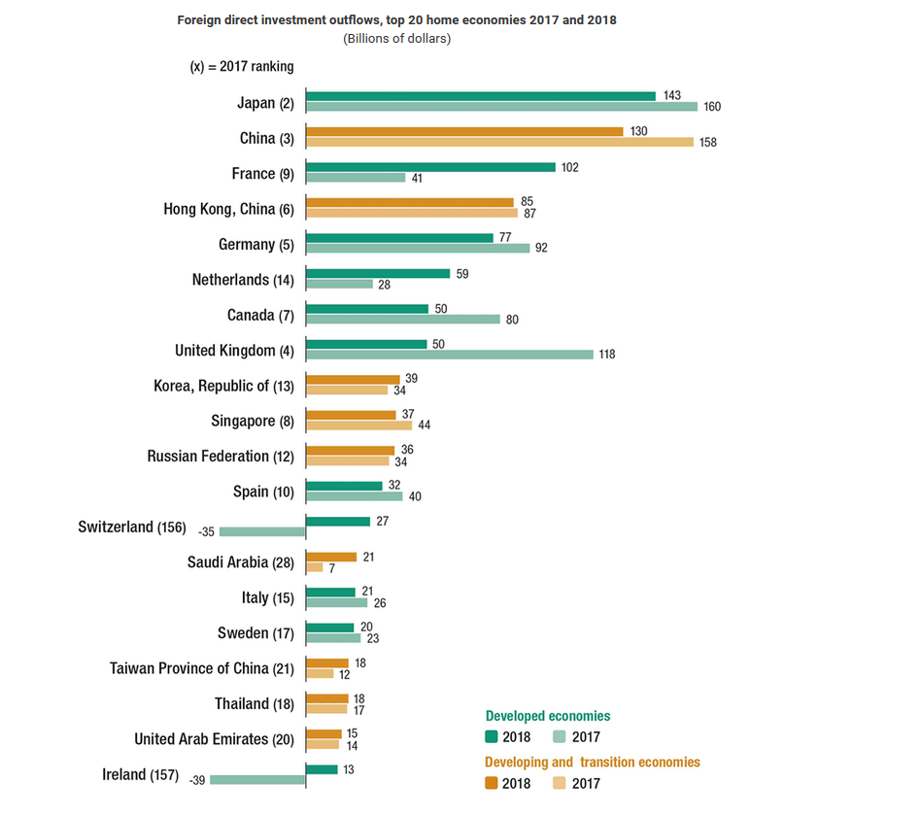

Slide 28
Question (from Avinash Dixit public lecture at Oxford)
Outward FDI from EMs growing fast and now important part of World FDI.
It is now just like any other FDI, or does it still require separate analyses, explanation?
Special features still important but may become less so in coming decades if EMs improve their governance, integrate into world economy.

Slide 29
Previous explanations (not mutually excluded) (from Avinash Dixit public lecture at Oxford)
Poor home-country governance makes FDI more attarctive
(relevant for India 1970s & 80s)
Southern host country firms or governments preferred Southern non-colonial investors
Use FDI to acquire modern technology: More relevant for Southern FDI into North
To acquire natural resources or land rights (especially relevant for Chinese investments in Africa, etc.)
Home governments encourage or subsidize FDI

Slide 30
New features of South to North FDI (from Avinash Dixit public lecture at Oxford)
From Thite et al (2016) book on Indian MNEs.
Newer Emerging Markets MNEs:
Have higher ambitions – not marginal players.
Less constrained by foreign exchange.
Less constrained by home regulations.
More adaptable, nimble, have no scared cows!
Great heterogeneity of firms in EMs. Not all have these strengths; FDI from selected subset.

Slide 31
Weak home environment turns into strength abroad (from Avinash Dixit public lecture at Oxford)
”One of the core strengths of Indian firms is to extract maximum value from even ailing business by applying innovative and cost effective methods that they have developed over the years in an extremely resource constrained and uncertain domestic environment … [to] extract value from the bottom of the [income] pyramid” – Thite, Wilkinson, Budhwar (eds.) 2016
”If you can make money in India, you can make it anywhere” – The Economist, 22 Oct. 2011

Slide 32
Skills for coping with bad governance (from Avinash Dixit public lecture at Oxford)
Bad governance in host country creates new kind of non-contractability
Southern MNEs have skill, experience at home; can better handle similar issues in host countries:
Technology, management better adapted to cope.
Know-how to build and use relationships.
Have better ethnic, linguistic networks.
More willing and able to bribe.
Asymmetric: Easier if host governance better than home.

Slide 33
Local EMs companies and local competition
2003-2014: In Asia 6 fold increase of large (1 billion plus) and medium companies.
In Africa, Middle East, Latin America – doubled to almost 700.
Local companies:
Cost advantage.
Nimble/tactical/clever players which understand local markets deeply.
Very good understanding and relationships with suppliers.

Slide 34
Expert opinion: Nenad Pacek, President, Global Success Advisors GmbH; Co-Founder, CEEMEA Business Group
It is not easy to compete against local companies in EMs. ➔
Accelerate at unbeleivable speed – they have a lot of money to go abroad even.
They sell same quality almost but cheaper.
They close tech, talent gap + they pay bribes to win business ➔ foreign companies cannot.
Some local companies are very cash rich & they can buy western knowledge at extremely high prices.

Slide 35
Professor Ravi Ramamurti, Northeastern University
Local competitors are very tough.
Their products better suit their customers.
They know that workforce can have not appropriate education, they are ready to educate them.
They better deal with bad infrastructure, week isntitutions, opportunistic governments.

Slide 36
Advice for essay-report
Analyze the presence of other emerging markets MNCs in your chosen emerging country. Analyze local largest companies.
Stress the following:
Their competitive advantages and disadvantages;
Their sectoral patterns;
The niches they occupy: middle class, base of pyramid or elite consumers?
Link the above analysis to investment perspectives in your chosen country.

Slide 37
New challengies for developed countries MNCs in Emerging Markets (Boston Consulting Group)
Global environment has changed with commodity prices dropping, currencies flactuating, equity markets in flux.
How MNCs that already were successful in EMs can adapt and re-engage?
Do drivers for growth still exist in EMs for multinationals?

Slide 38
Recent trends in emerging markets
Corporate concensus – where growth of sales will be – EMs, not in USA, Western Europe, Japan.
Sales and profits growth – will be coming from EMs in near 10 years.
In advanced economies – very high debt (60% is threshold). ➔ increasing taxes, sifting spending.
Population rises in EMs but not in developed countries: EMs populations will grow 4 times higher than in developed countries

Slide 40
