Slide 1
Effectual Strategy
Peter Kelly
Senior Lecturer, High Growth Entrepreneurship, Aalto University
Visiting Faculty, Sydney School of Entrepreneurship
Visiting Professor of Business, Trinity College Dublin
Visiting Professor of Design, Pontificia Universidad de Chile

Slide 2
Notes:
Strategies are designed by people – lets dig into a little bit about Bob Reiss

Slide 3
Why the hunch for
a trivia game?

Slide 4
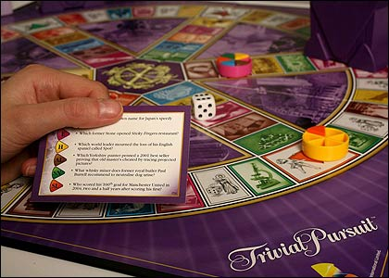
Notes:
Hot selling game developed by university professors in canada at a pub (trivia night) ---
NOT UNKNOWN --- lower risk

Slide 5
what
makes
robert
reiss
credible?
Notes:
Elements of acumen – and insight

Slide 6
Skills
Experience
Networks
Notes:
Skills (negotiator, interpersonal, people, leader, managing risk - bootstrapping)
Experience (Sales, GM, New Venture, Trade Sale, Stationary Industry, Games Industry)
Networks (Manufacturers, Designers, Suppliers, Retailers, Wholesalers)

Slide 7
☑

Slide 8
“I am a graduate of Columbia and Harvard
who started his own national rep firm in 1959,
specializing in adult games, when it became
a distinct category in 1968. I sold the
company in 1973 to an American Stock
Exchange Company. I remained there for
5 years and built Reiss Games to a
dominant position in the adult-game field.
For the last 3 years, I have been consulting
in the game/toy industry and recently acted
as a broker in the sale of one of my clients,
Pente Games, to Parker Bros.”
Notes:
Carefully crafted and worded sales pitch --- how does this help ---

Slide 9
is it doable?
is it worth doing?

Slide 10
is it doable?
PROTOTYPING

Slide 11
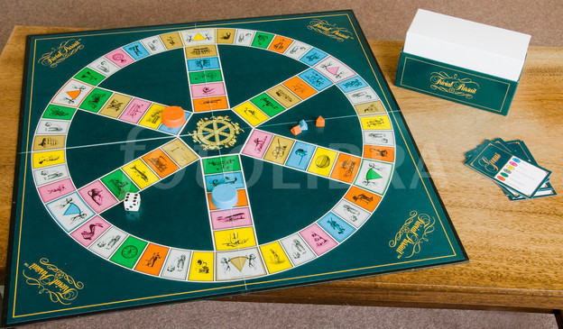
Corollory version
Notes:
Empathy through play – then be prepared to ask how it will be different (40 USD)

Slide 12
higher resolution version
Notes:
Hop in the car and build it yourself – PUBLIC ACCESS WORKSHOP

Slide 13
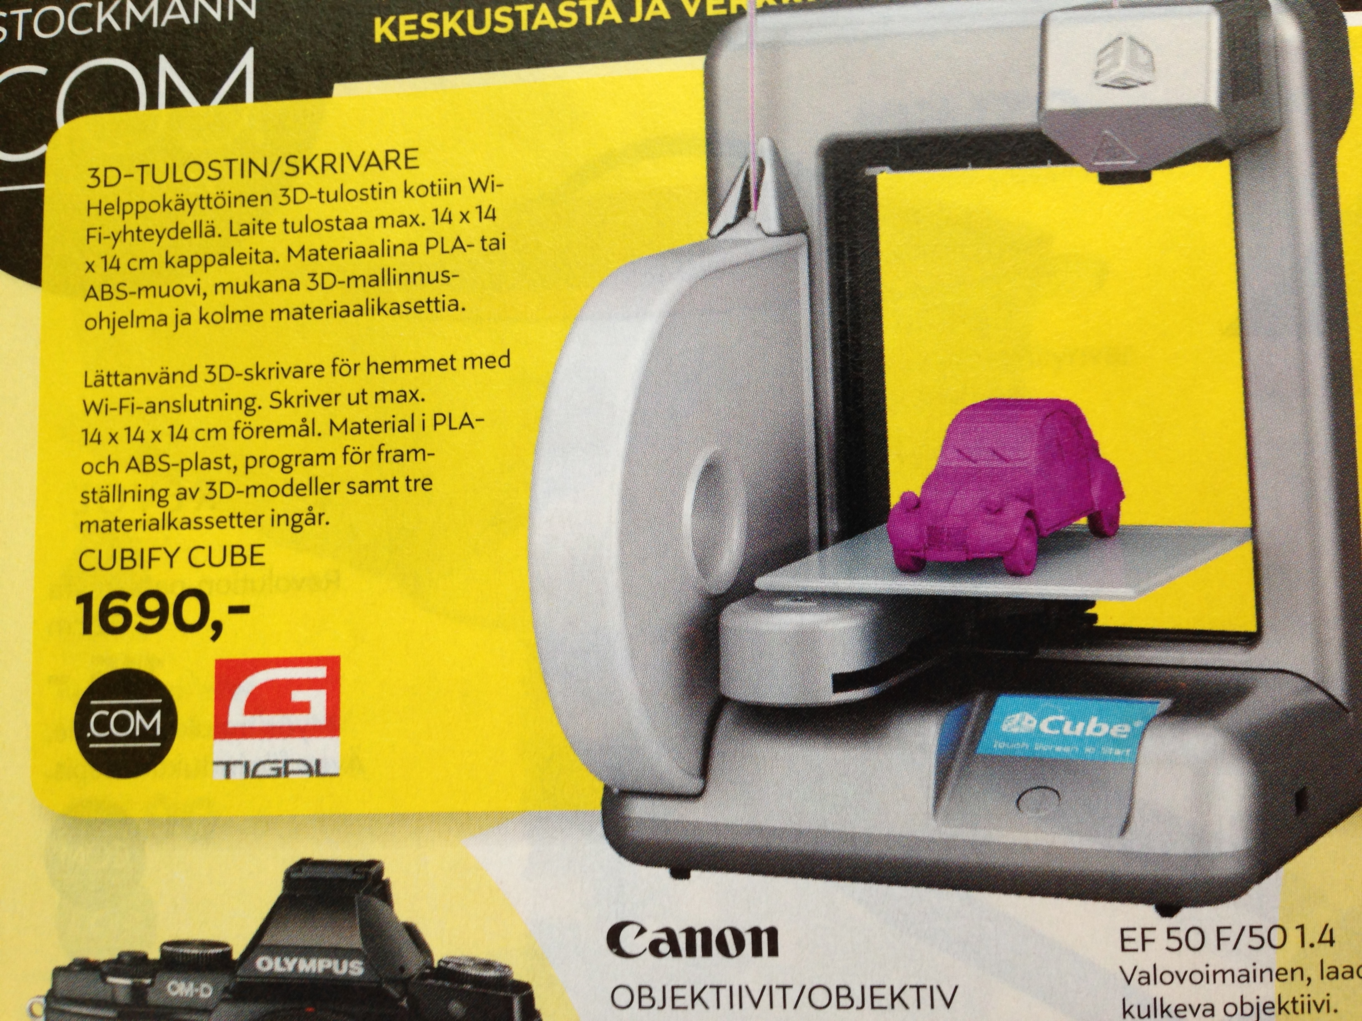
3d version
Notes:
Paper, plastic or metal ---

Slide 14
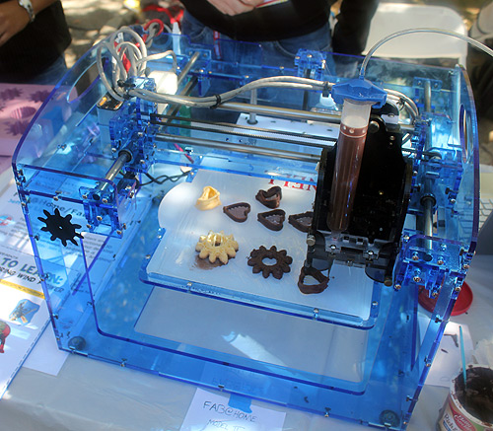
3d version
Notes:
Or chocolate ---

Slide 15
Notes:
Would not take you long to develop a prototype – real value is what?
Brand name + investment in database of questions

Slide 16
PROTOTYPING
supports play
Notes:
So much more tactile than power point slides

Slide 17
TRADE SHOWS =
playground
Notes:
February there is a TOY FAIR – when all the decisions are made for the Christmas season!
WHAT IS YOUR TOY FAIR?

Slide 18
Why is this doable for Reiss?
Notes:
Knew business, investors, buyers, designers

Slide 19
is it worth doing?
PROFITABILITY
RISK

Slide 20
How much are you prepared to lose?
Notes:
Time and money

Slide 21
Your time is
valuable
Notes:
Time and money

Slide 22
why is TV Guide
critical?
Notes:
Branded platform to leverage, the game is essentially an “ad in store”
Make money out of the deal --- lend credibility to proposal to go raise money elsewhere
ATTENTION GRABBER --- INVESTOR-ENTREPRENEUR-CUSTOMER ALIKE

Slide 23
Winning over
TV Guide
Notes:
Pitch is made from a credible source + Trivial Pursuit exists + other major games manufacturers are introducing new games +
None of them have contacted TV Guide (pre-emptive) + we will make money + flatter the hell out of you --

Slide 24
sharing risk =
co-creation
Notes:
Find willing parties who bring resources and perspective to the table
Engage them in shaping the offering
Sharing upside (what is in it for me to play?) Do I even want to play with somebody like you?

Slide 25
How much is he risking?
Notes:
6 months + 30.000-50.000 development costs (TIME)

Slide 26
what is TV Guide risking?
Notes:
5 ads @ 85k each (IN-KIND) + working with a guy who may not close deals at Toy Fair in February

Slide 27
what could TV Guide gain?
Notes:
In store advertising, new subscribers, publicity

Slide 28
development
manufacturing
fulfillment
Notes:
750.000 ---

Slide 29
An inventor friend develops game for 5% royalty
Notes:
750.000 ---

Slide 30
An investor friend finances for 50% equity
Notes:
Provides offices, relationships with printers

Slide 31
cheese company does fulfillment for fixed fee
Notes:
Known to investor – they have skills and slack capacity –
SURPRISE --- LOOK FOR SOLUTIONS IN MOST UNEXPECTED PLACES

Slide 32
working capital is managed by a factor 1% sales
Notes:
SOCIAL CAPITAL ACCELERATES VENTURE DEVELOPMENT

Slide 33
Why is this a sensible risk management strategy?
Notes:
Minimizes capital outlay

Slide 34
FAD
Notes:
Minimizes capital outlay get your money out as quickly as possible ---
No exit --- run it for cash

Slide 35
Notes:
SO HOW DID HE MAKE OUT?

Slide 36
Sales $ 7.000.000
TV Guide $ 700.000
Developer $ 350.000
Cheese Co $ 150.000
Salesforce $ 500.000
Notes:
Minimizes capital outlay

Slide 37
Reiss Sales
Commission $ 900.000
Kaplan & Reiss
Capital Gain $ 1.250.000 *
* each pre-tax
Notes:
Minimizes capital outlay

