Slide 1
Designing & Producing virtual reality (VR) Storyboarding
By Lily Díaz-Kommonen
Professor of New Media,
Building Virtual Worlds, UWAS-C0056
17 November, 2020

Slide 2
Storyboards
A storyboard is an artist's concept of a succession of scenes to be filmed for a segment of a motion picture. The artist, guided by the director, translates the script into a series of renderings that represent a sequence of camera shots. Usually in narrative form, the artist's visual conception indicates camera distances and angles that will depict the action and evoke the proper mood. The format of a storyboard is, therefore, somewhat like a comic strip.
Storyboards are working drawings, preparatory to a more "finished" work of art, that is, the film.
Beauman Murphy, S. 1987. “The Treatment of a Storyboard from the Movie Gone With the Wind”, Historical Background”, The Book and Paper Annual, Vol. 6, American Institute for Conservation, https://cool.culturalheritage.org/coolaic/sg/bpg/annual/v06/bp06-10.html
Notes:
A storyboard is a graphic organizer that plans a narrative. Storyboards are a powerful way to visually present information; the linear direction of the cells is perfect for storytelling, explaining a process, and showing the passage of time.
William Cameron Menzies, 1st “production designer.

Slide 3
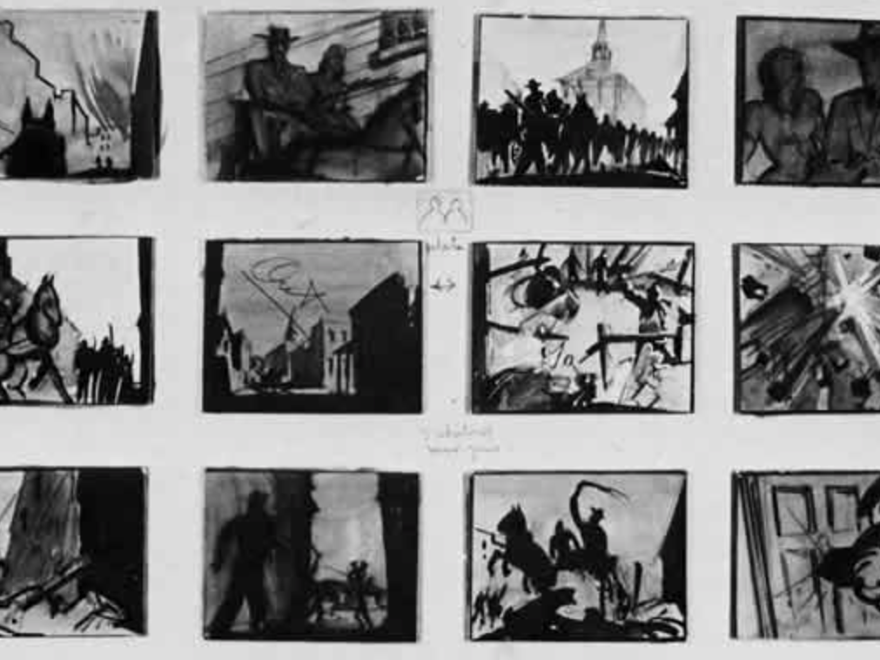
Storyboards
Gone with the Wind storyboard
20X30 inches
A very important consideration in the treatment of a working drawing is the potential loss of historical evidence of the artist's working process. In an attempt to save as much evidence of the working process as the treatment would allow, it was decided that there should be no removal of marks or lines which may have occurred during the creation of the storyboard. Even fingerprints and smudges in the margins would be retained if at all possible.
Beauman Murphy, S. 1987, ibid.

Slide 4
Storyboards
In the form that we know it today, that is as a “graphic organizer that consists of illustrations or images displayed in sequence for the purpose of pre-visualising a motion picture, animation, motion graphic or interactive media sequence” the storyboard was created at Disney Studios.
Animator Webb Smith is credited with developing form by creating the idea of drawing scenes on separate sheets of paper and pinning them up on a bulletin board to tell a story in sequence.*
It was at Disney Studios also where separate "story department" with specialized storyboard artists (that is, a new occupation distinct from animators) was developed.
The focus of this artists was to develop the story so as to target audiences who “would not watch a film unless its story gave them a reason to care about the characters”.
* Finch, C. 1974 . The Art of Walt Disney, Abrams.
** Lee, N.; K. Madej (2012). Disney Stories: Getting to Digital. London: Springer Science+Business Media. pp. 55–56.

Slide 5
Creating your own storyboard
Create a simplified version of your narrative.
Identify the key scenes in your story.
Each frame should represent a full scene
Render all the elements of each scene, clarifying how the details (and behaviour) of each scene further divide it into episodes. These elements can be described in the annotations. For example:
Beginnings/endings (transitions)
Who, what, where (people, sets, props).
You might decide to also render episodes for each scene as quick wire drawings.
Think about the overall ‘form’ of the narrative.
Ex: Is there a climax in the story? Where is it?
Consider the length of each scene.

Slide 6
Thank you!
Kiitos!
¡Gracias!

