Slide 1
creativity inspired innovation
Peter Kelly (peter.kelly@aalto.fi)
Senior Lecturer, High Growth Entrepreneurship, Aalto University
Visiting Faculty, Sydney School of Entrepreneurship
Visiting Professor of Business, Trinity College Dublin
Visiting Professor of Design, MADA, Pontificia Universidad Catolica de Chile

Slide 2
I
D
E
A
P
L
A
N
€
$
£
¥
E
X I T
Notes:
Who thinks this way? Engineers and business people
Approach works well when you have a well defined brief and a roadmap
DESIGN BRIEF IS WELL DETAILED ---

Slide 3
I
D
E
A
P
L
A
N
€
$
£
¥
E
X I T
Notes:
Who thinks this way? Engineers and business people
Approach works well when you have a well defined brief and a roadmap
DESIGN BRIEF IS WELL DETAILED ---

Slide 4
Notes:
We think the problem or challenge is to capture the roadrunner for food …

Slide 5
I
D
E
A
P
L
A
N
€
$
£
¥
E
X I T
Notes:
Who thinks this way? Engineers and business people
Approach works well when you have a well defined brief and a roadmap
DESIGN BRIEF IS WELL DETAILED ---

Slide 6
Notes:
Every problem requires a step-by-step approach to solve –
Engineers (and profs) typically love this approach --- RECIPE

Slide 7
I
D
E
A
P
L
A
N
€
$
£
¥
E
X I T
Notes:
Who thinks this way? Engineers and business people
Approach works well when you have a well defined brief and a roadmap
DESIGN BRIEF IS WELL DETAILED ---

Slide 8
Notes:
What is the budget? Comparative analysis of alternative solutions. Investment analysis of ACME ---
PRESUMED WE HAVE USED APPROACH BEFORE – WHAT ABOUT THE UNTRIED

Slide 9
I
D
E
A
P
L
A
N
€
$
£
¥
E
X I T
Notes:
Who thinks this way? Engineers and business people
Approach works well when you have a well defined brief and a roadmap
DESIGN BRIEF IS WELL DETAILED ---

Slide 10
$62 billion
Notes:
$73 billion as of 5 March 2018

Slide 11
only 6 of 1.000 business plans get venture funding
of those 60% go bankrupt
fewer than 2% of ventures reach an IPO
Notes:
Primacy of plan, venture financing, exit, and prediction

Slide 12
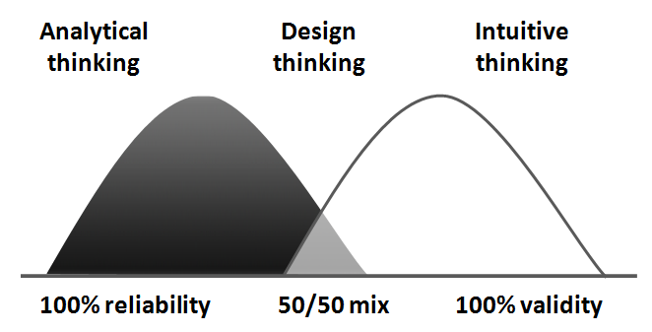
Notes:
Validity is about finding solutions that could work (probe and learn) STUDIO
Reliability is about finding solutions that have demonstrably worked before (wait and see)
WHERE DOES CREATIVITY FALL … INNOVATION …
Analysts track company progress – which style do they prefer?

Slide 13
Buy food
Notes:
We can understand his motivation or need --- I AM HUNGRY
The roadrunner could be an opportunity for a MEAL provided you can catch him
BUT WHY BOTHER ---

Slide 14
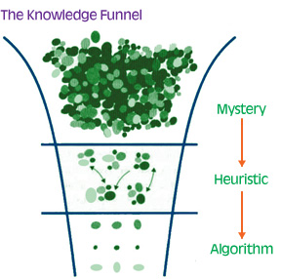
Notes:
Creativity is key to unlocking mysteries –
An ability to discern patterns is critical to developing heuristics (information gets stripped out)
Analytical minds and attention to detail is required to perfect algorithms or routines

Slide 15
see opportunity
sense customer pain
believe you can make a go of it
feel time is right to act
Notes:
This is appealing to the primal intuitive senses of human beings ---

Slide 16
Notes:
Validity is about finding solutions that could work (probe and learn) STUDIO
Reliability is about finding solutions that have demonstrably worked before (wait and see)
WHERE DOES CREATIVITY FALL … INNOVATION …
Analysts track company progress – which style do they prefer?

Slide 17
novelty

Slide 18
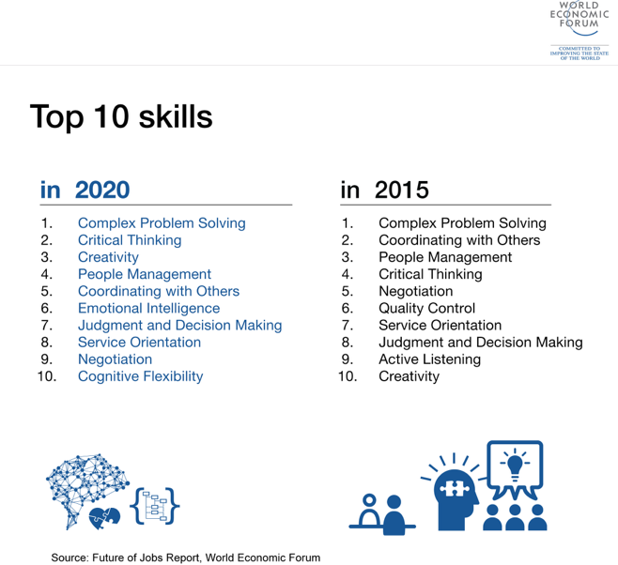

Slide 19
neophobia
Notes:
Human beings display aversion to new things

Slide 20
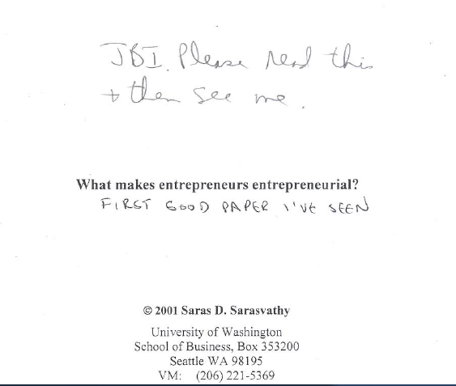
Notes:
Note the dates

Slide 21
means
Notes:
Creative exploration

Slide 22
passions
skills
networks
Notes:
Creative exploration

Slide 23
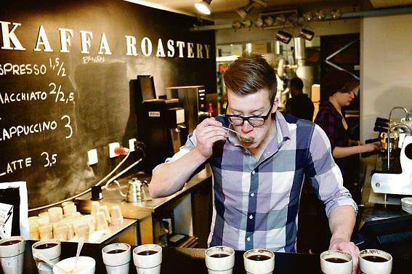

Slide 24
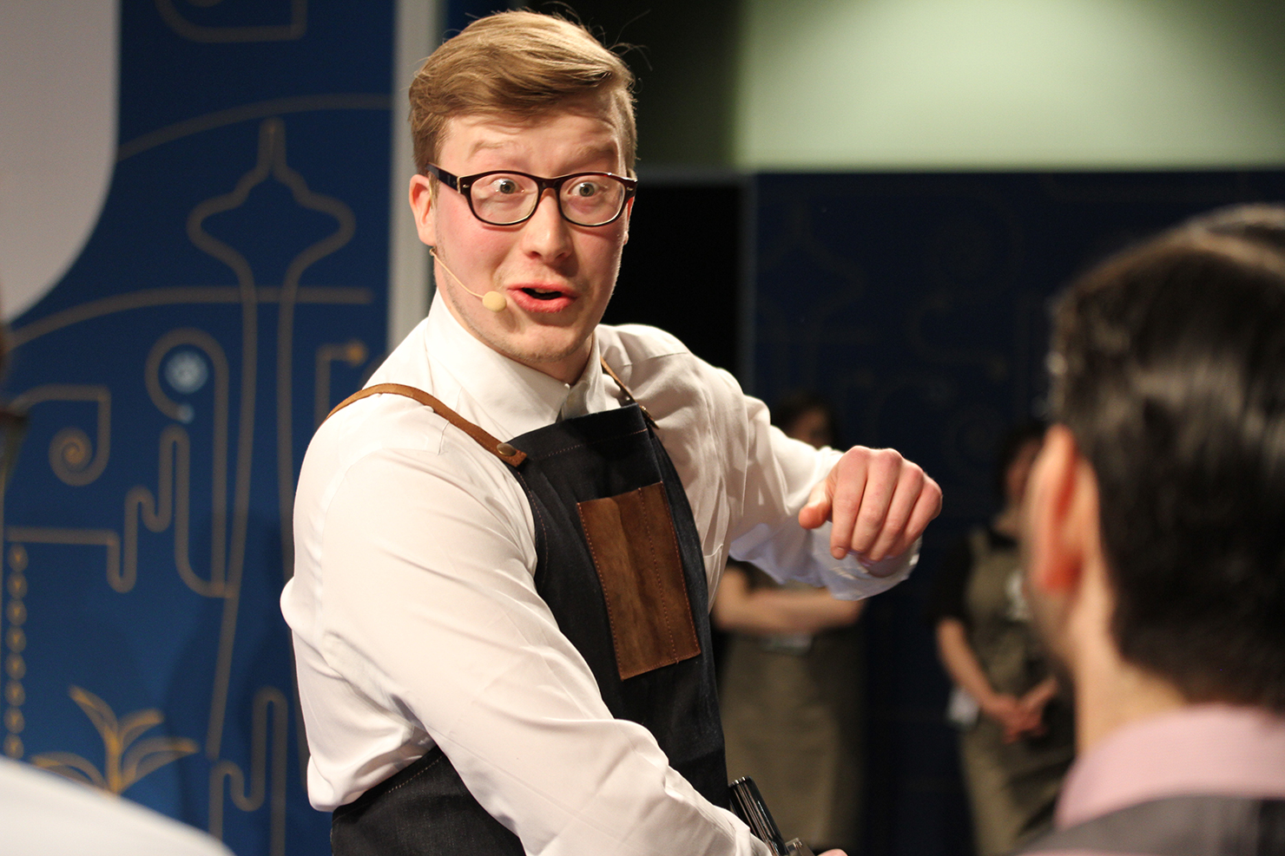
Notes:
2013 & 2015 Nordic Barista of Year #9 in world
Look at those eyes – you know he is into coffee – BUT WHAT ABOUT FOR ELISA 3000 EMPLOYEES!

Slide 25
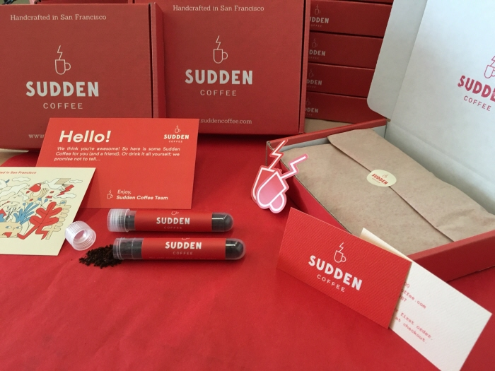
Notes:
Sudden Coffee – on a mission to create the world’s best instant coffee

Slide 26
passions
skills
networks
Notes:
Creative exploration

Slide 27
Notes:
MIT Professor Pierre Azoulay (and others) looked at new firms established in US 2007-2014
AVERAGE AGE AT START 41,9 YEARS
HIGH TECH 43,2 (41,5 SILICON VALLEY)
VENTURE CAPITAL BACKED 41,9 (40,2 SILICON VALLEY)
TOP 0,1% PERFORMERS (45)

Slide 28
Notes:
Bill Burnett & Dale Evans (on my book list)

Slide 29
affordable
loss
Notes:
Creative exploration

Slide 30
experiment
prototype
Notes:
Creative exploration

Slide 31
5127
Notes:
Creative exploration

Slide 32
Notes:
15 years of working in the basement, 5127 prototypes before hitting on the one launched in 1993
Filed 1100 patents on 175 inventions --- existing players wanted to sell BAGS

Slide 33
co-creation
Notes:
Creative exploration

Slide 34
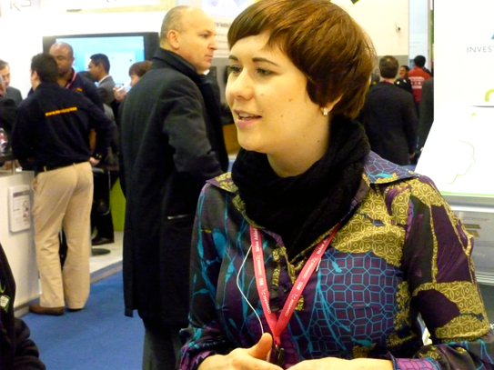
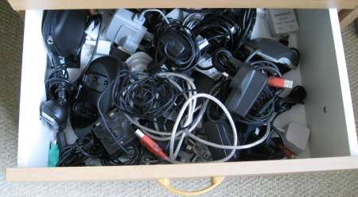
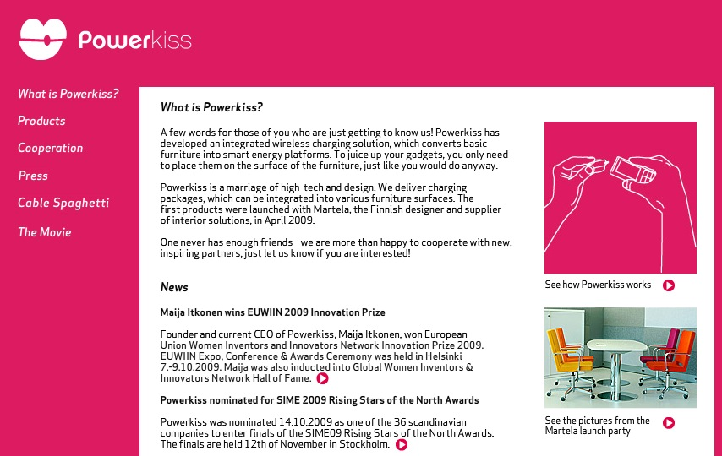
Notes:
INVESTORS ARE CO-CREATORS, FOUNDERS, PARTNERS, CUSTOMERS

Slide 35
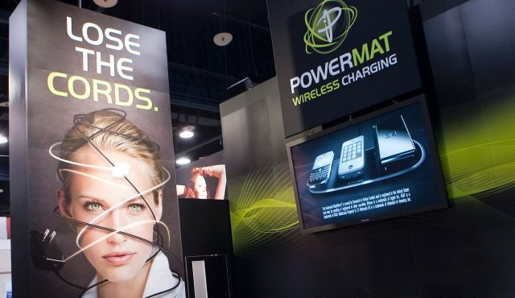
Notes:
As seen at JFK airport terminal 8 –
May 2013 they buy the business ---
Entrepreneur reported a 600k capital gain (36)

Slide 37
Notes:
As seen at JFK airport terminal 8 –
May 2013 they buy the business ---
Entrepreneur reported a 600k capital gain (36)

Slide 38
surprise

Slide 39
youth
hostel
Notes:
What pops to mind?

Slide 40
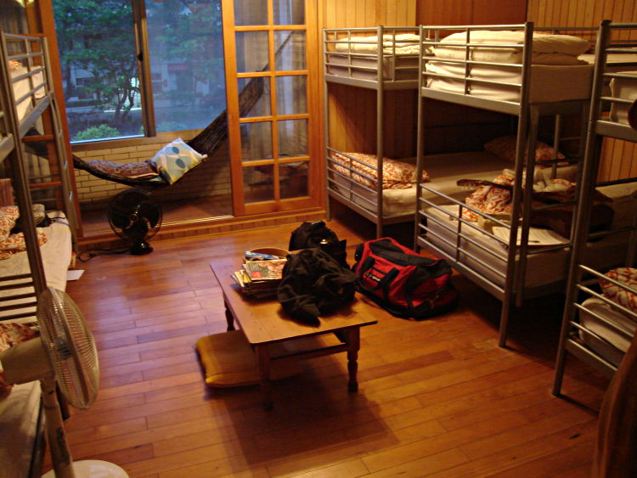
Notes:
OSKAR DIOS OPERATES A YOUTH HOSTEL IN UPPSALA –

Slide 41
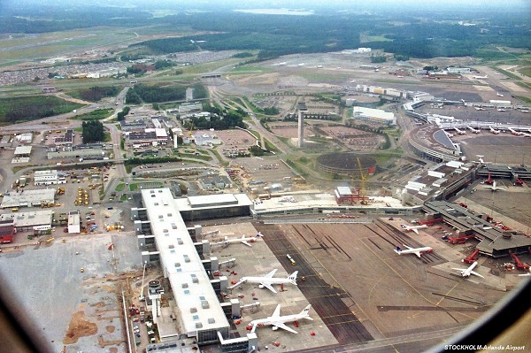
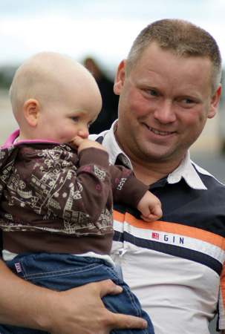
Notes:
OSKAR DIOS OPERATES A YOUTH HOSTEL IN UPPSALA –

Slide 42
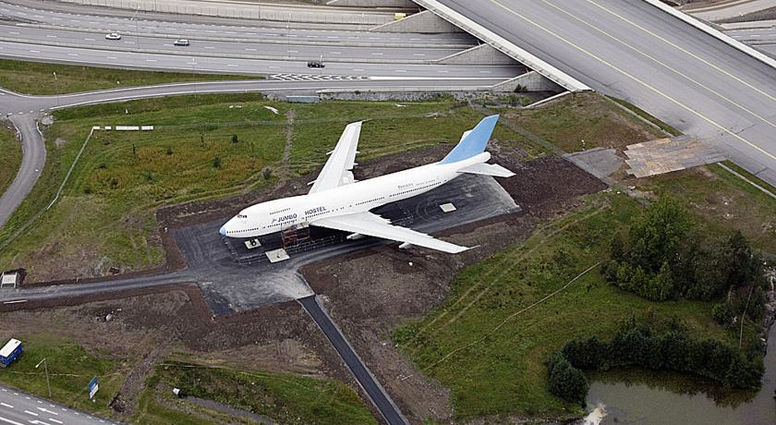
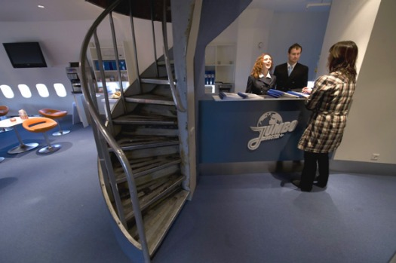
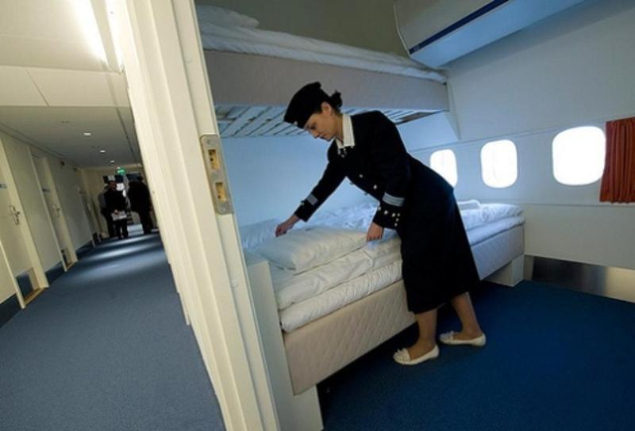
Notes:
So negotiate the parking fines, cut down some fence, move it and retrofit (including staff)

Slide 43
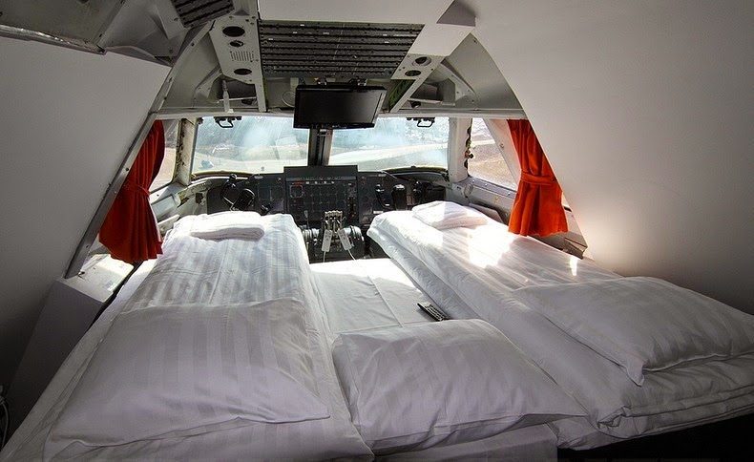
Notes:
Cockpit – aka the honeymoon suite

Slide 44
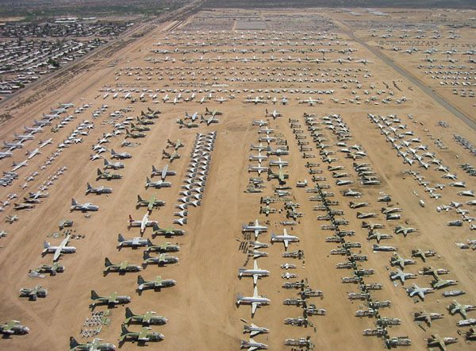
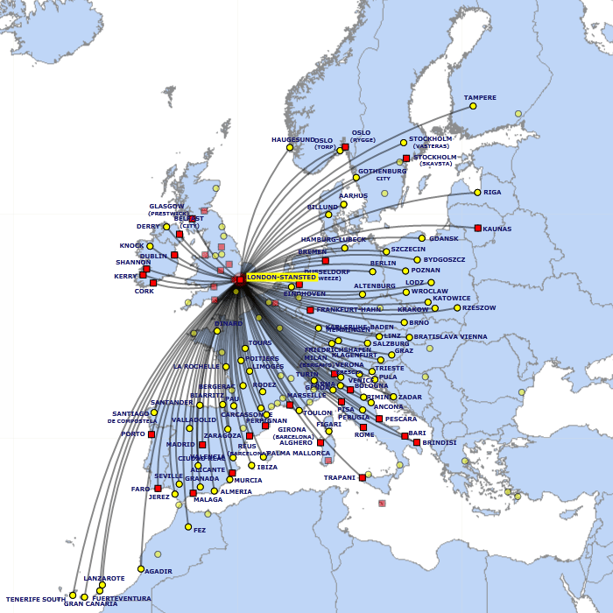
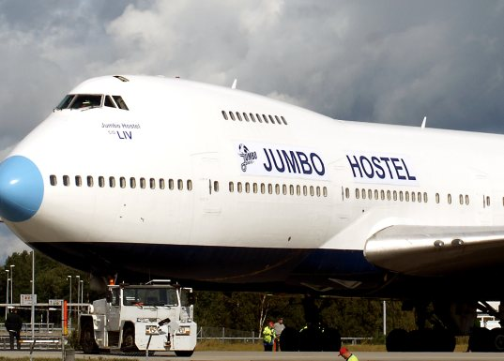
Notes:
WHAT IS THE NATURE OF THE PROBLEM AND WHY IS THIS A CREATIVE SOLUTION

Slide 45
Notes:
Validity is about finding solutions that could work (probe and learn) STUDIO
Reliability is about finding solutions that have demonstrably worked before (wait and see)
WHERE DOES CREATIVITY FALL … INNOVATION …
Analysts track company progress – which style do they prefer?

Slide 46
Notes:
Validity is about finding solutions that could work (probe and learn) STUDIO
Reliability is about finding solutions that have demonstrably worked before (wait and see)
WHERE DOES CREATIVITY FALL … INNOVATION …
Analysts track company progress – which style do they prefer?

Slide 47
Notes:
Validity is about finding solutions that could work (probe and learn) STUDIO
Reliability is about finding solutions that have demonstrably worked before (wait and see)
WHERE DOES CREATIVITY FALL … INNOVATION …
Analysts track company progress – which style do they prefer?

Slide 48
think
lemonade

Slide 49
Notes:
LETS TALK ABOUT THE LEMONADE BUSINESS – IS A GREAT ILLUSTRATION OF THIS PRINCIPLE – A BUSINESS THAT IS STARTED BY SOMEONE YOUNG –
IN FACT AN 8 YEAR OLD IN THE US SOLD $7.000 IN A WEEK AT A FARMER’S MARKET AND IS NOW DEVELOPING A FRANCHISE CONCEPT FOR OTHER KIDS

Slide 50
Is this a viable business opportunity ?
Notes:
UNIVERSITY IS A GREAT PLACE TO LEARN ABOUT THE SCIENCE OF CREATING A GOOD LEMONADE (THE RECIPE); DESIGN SCHOOL IS A GREAT PLACE TO LEARN HOW TO CREATE A POP UP DISPLAY AND BUSINESS SCHOOL TEACHES STUDENTS ABOUT RAISING MONEY, DETERMINING PRICES & COSTS WHICH YOU NEED TO KNOW TO CREATE A PROFIT --- SO YOU ARE ABLE TO SET UP 1 STAND

Slide 51
Is this a viable business opportunity ?
Notes:
BUT GABBY’S INTENT IS TO ADOPT A STARBUCKS APPROACH – AND I AS A POTENTIAL BIG INVESTOR WOULD BE MORE IMPRESSED IF GABY DREW NOT ONLY INSPIRATION BUT ACTUAL EXPERIENCE AND DATA FROM STARBUCKS AS TO HOW THEY OPERATE – WHAT ARE THEIR SECRETS OF SUCCESS – AND I MAINTAIN THAT CREDIBILITY IS BUILT FROM PERSONAL EXPERIENCE WITHIN THE DOMAIN

Slide 52
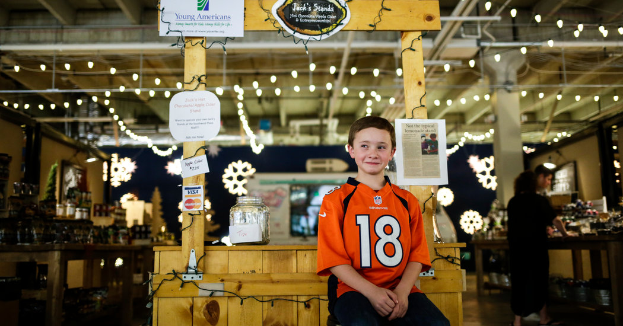
Notes:
Jake Bonneau (10) – set up a stand at farmer’s market in Colorado with the help of his father (8) - $2000 sales $900 profit FINANCIAL LITERACY
Next year (9) named operation Jack’s Stands, built a website and set up 3 more stands at other markets
Raised loan of $5000 from Young Americans Bank – and they recruited a sales team in exchange for tips and cut of the profits ($30-$50)
2015 sales were $25.000 with plans to expand in Denver and Detroit financed by crowdfunding

Slide 53
Notes:
Why are customers the best source of funding?
1) FOCUS IS ON CUSTOMERS 2) ADVOCATES 3) FRUGALITY (LEAN) 4) LOWERS RISK FOR VCS, 5) GUT TEST FOR MARKET

Slide 54
https://www.youtube.com/watch?v=ulCn8xUTTUI

Slide 55
Notes:
Note the dates

Slide 56
opportunity
perception
is personal

Slide 57
develop &
test hypotheses
quickly & cheaply

Slide 58
engage others
to shape
opportunity

Slide 59
the unexpected
often unlocks
key insights

Slide 60
design
thinking
AND doing
Notes:
Entrepreneurship (and design) is an intuitive endeavour

Slide 61
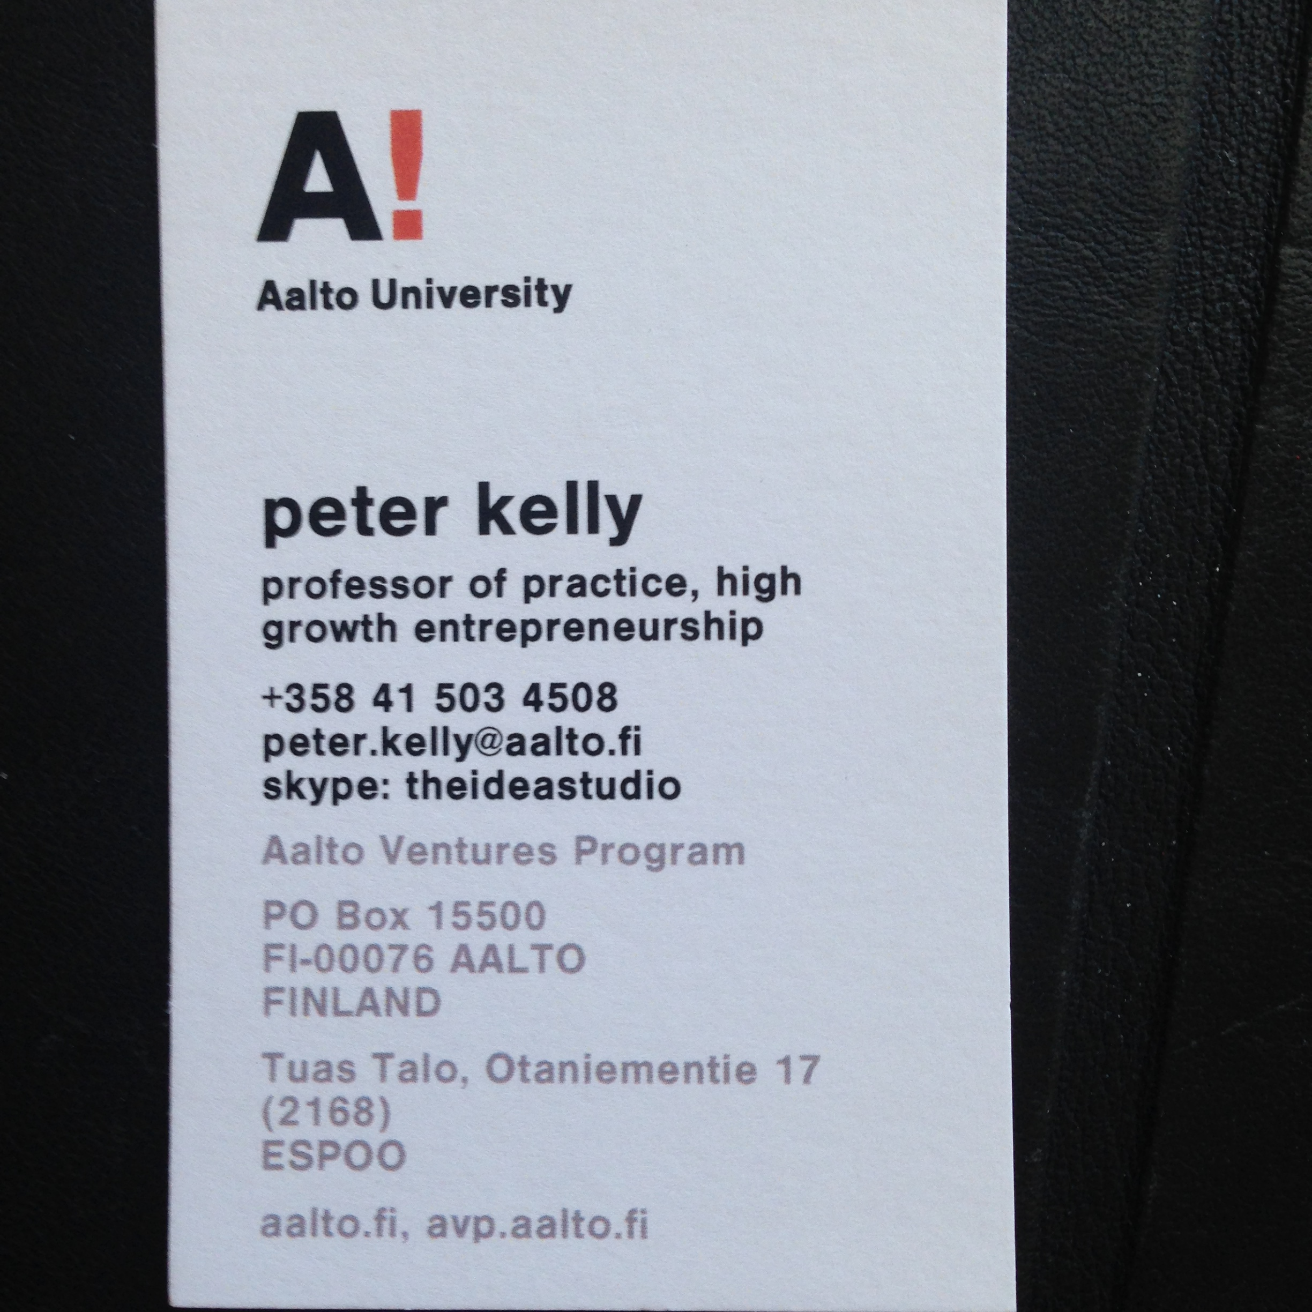
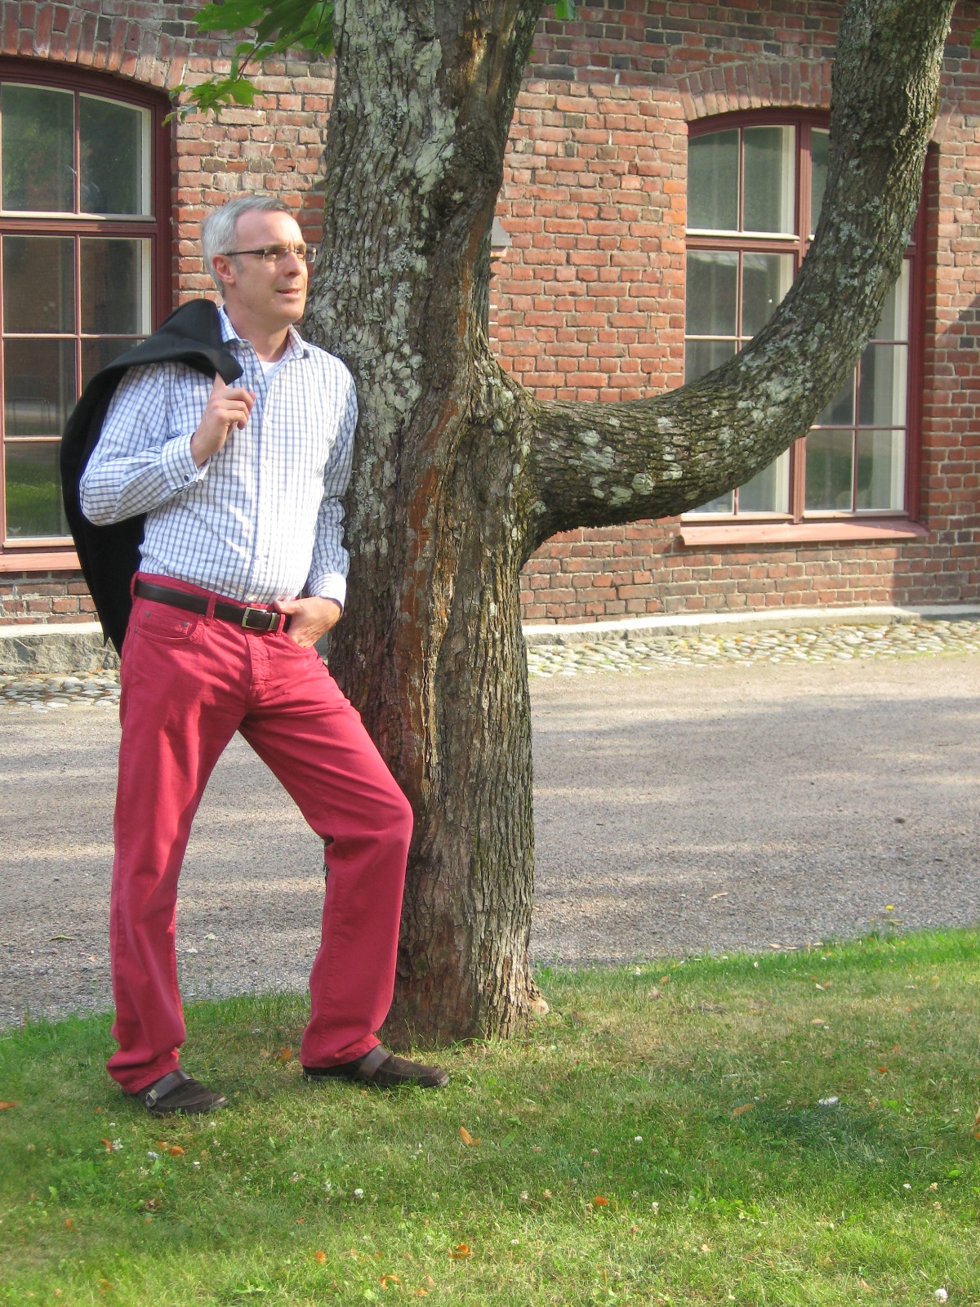
Notes:
Have a great demo day

