Slide 1
Topic 1: In-memory computing using resistance-based memory or analog elements.
ELEC-L352001 - Postgraduate Course in Electronic Circuit Design II V D
Omar Numan
omar.numan@aalto.fi
20.04.2022

Slide 2
Outline
Conventional and In-memory computing
ARCHON
SOT-MRAM
Tiny CNN

Slide 3
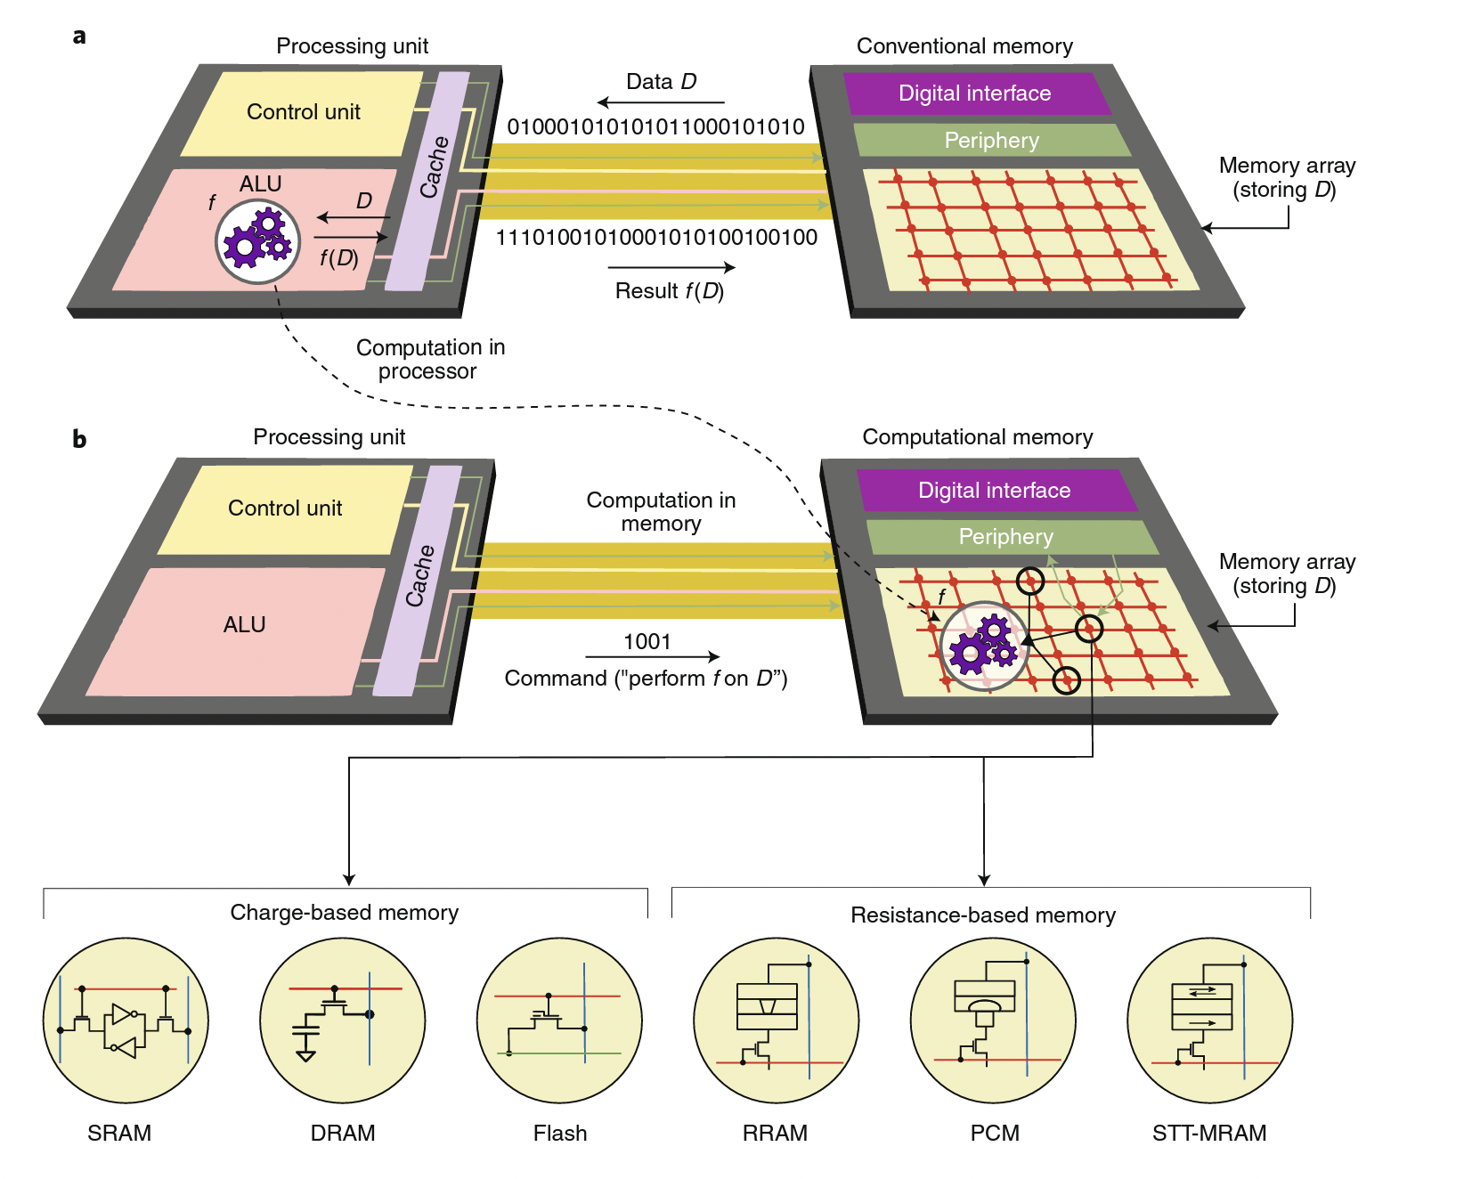
Conventional and In-memory computing
Conventional computers use von Neumann architecture.
Data movement requires energy and time.
In-memory computing breaks the von Neumann bottleneck.
Types of memory elements

Slide 4
ARCHON: A 332.7-TOPS/W, 5-Bit Variation-Tolerant Analog CNN Processor Featuring Analog Neuronal Computation Unit and Analog Memory
Jin-O Seo, Mingoo Seok, and SeongHwan Cho
KAIST, Daejeon, Korea

Slide 5
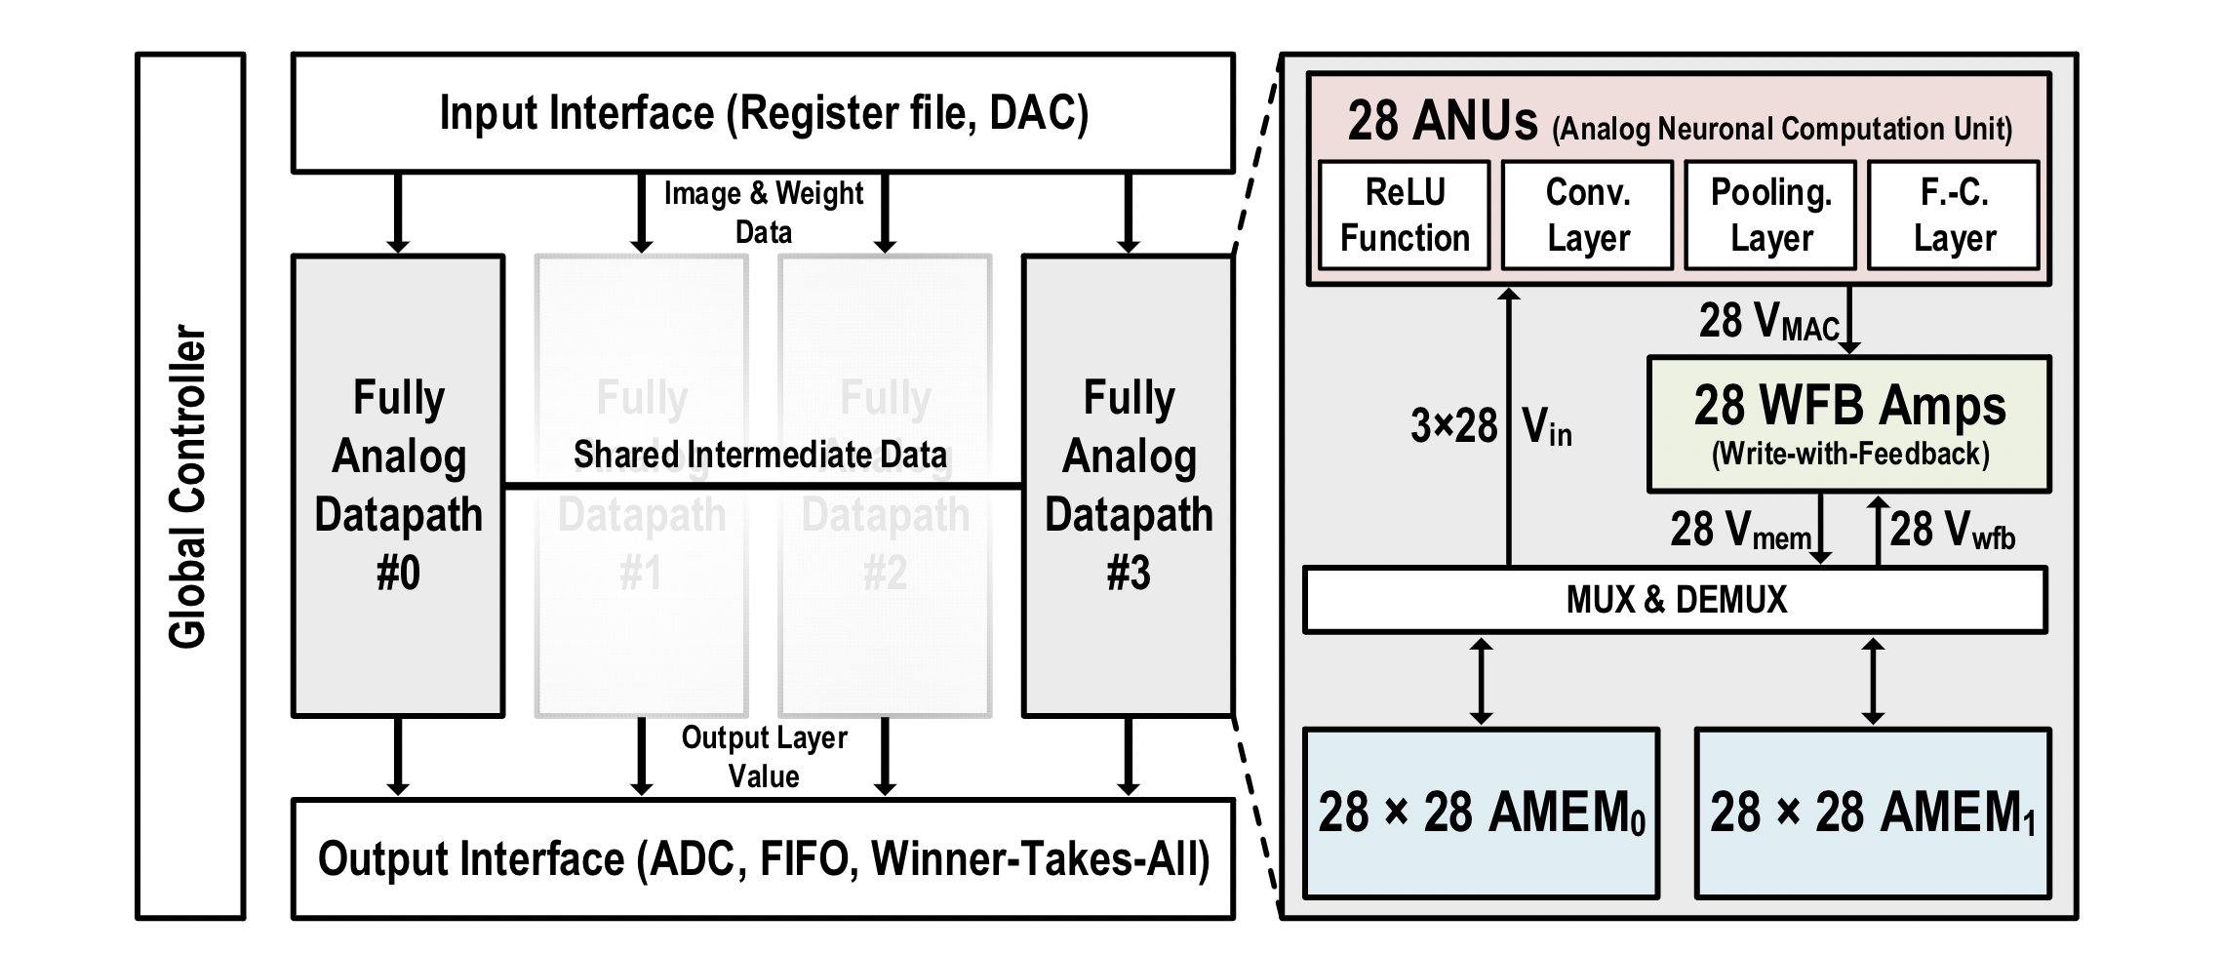
Architecture of the Processor
Fully analog datapath without data converters to compute convolution operations.
Input DAC and output ADC only operate once per image.

Slide 6
Detailed Architecture of ARCHON
Various layer operations and activation can be processed with ANU

Slide 7
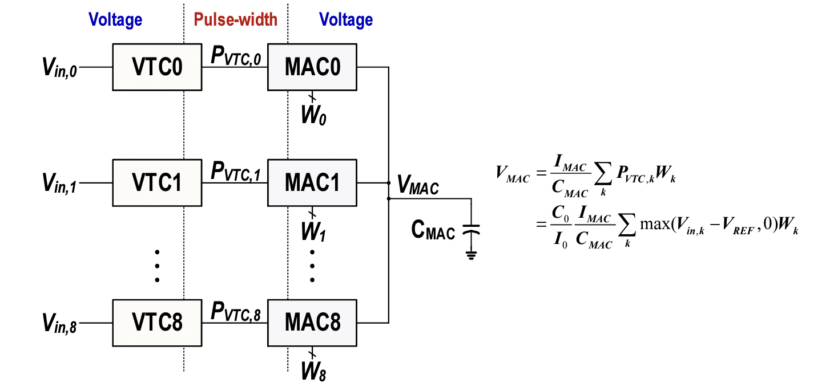
3x3 Multiply-and-accumalte (MAC) in ARCHON
As C_{MAC} is shared by 9 VTC-MAC units, a 3x3 MAC is performed.

Slide 8
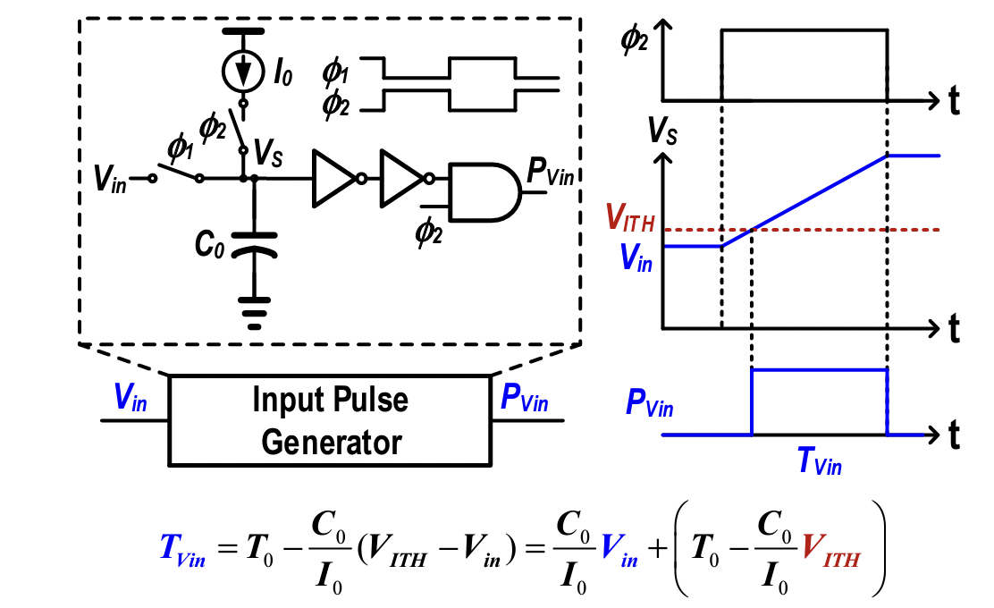
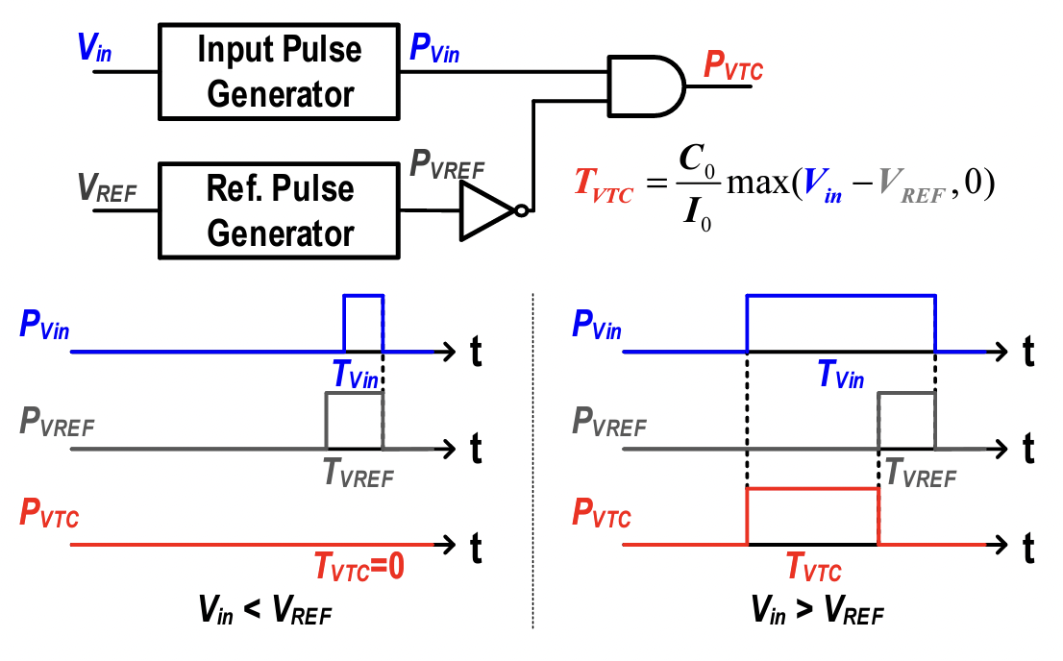
ReLU-Embedded Voltage-to-Time Converter (VTC)
Converts input voltage (Vin) to the pulse-width (P_{Vin}) with offset.
Performs ReLU to Vin and converts to the pulse-width (P_{VTC})

Slide 9
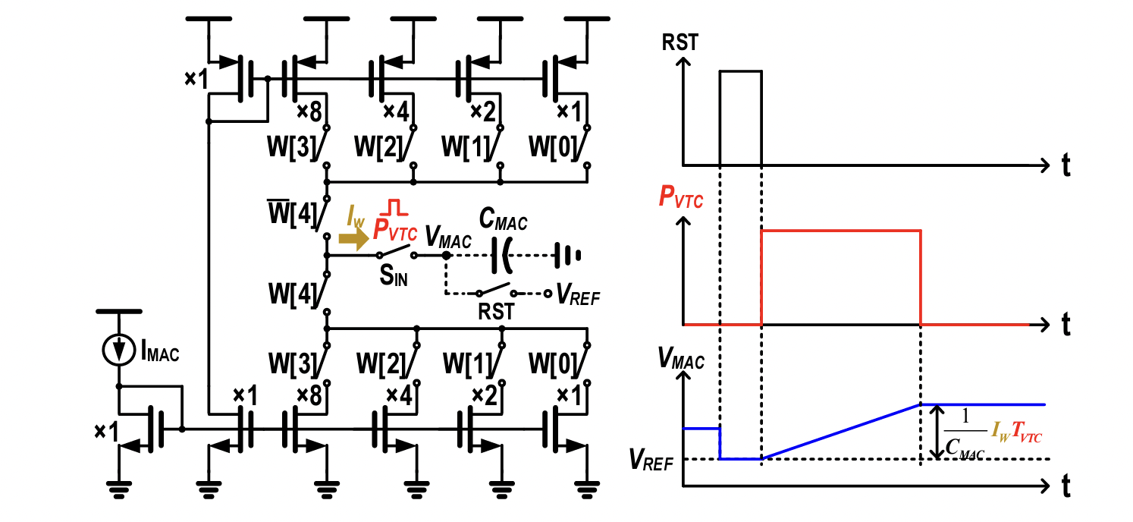
Charge Accumulating MAC
Charge proportional to IN×W is accumulated to C_{MAC}

Slide 10
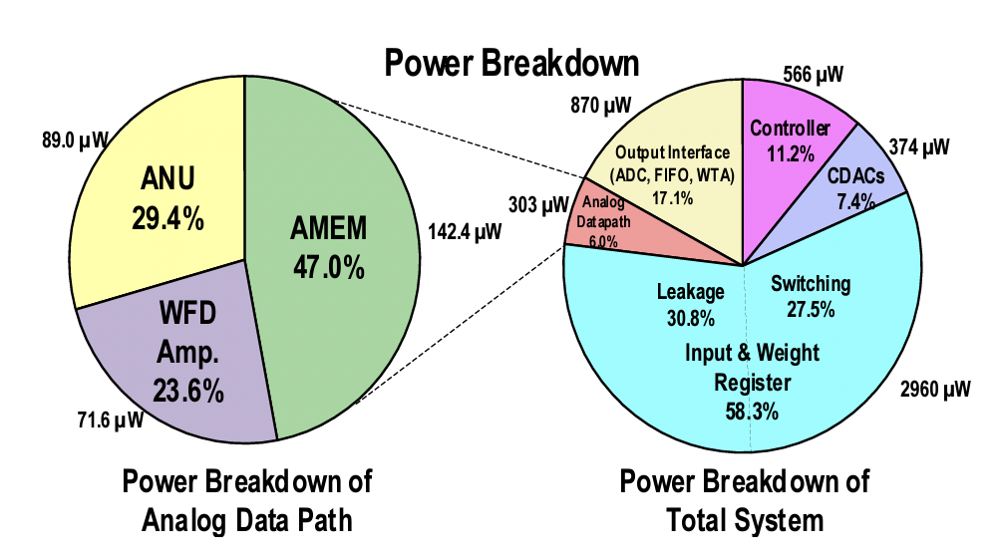
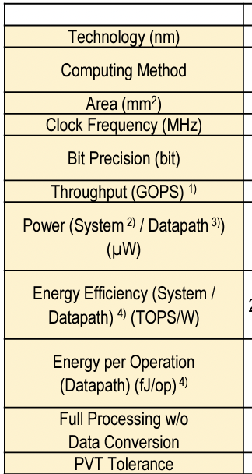
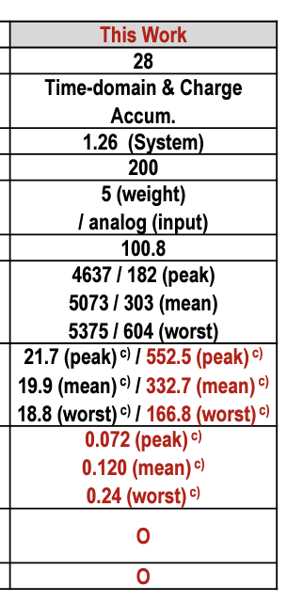
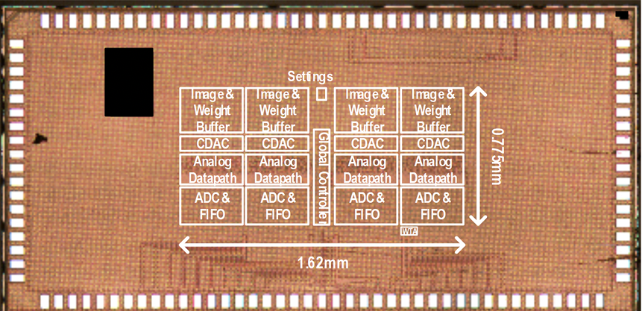
Chip Micrograph and design metrics

Slide 11
An In-Memory Analog Computing Co-Processor for Energy-Efficient CNN Inference on Mobile Devices
Mohammed Elbtity, Brendan Reidy, Ramtin Zand
University of South Carolina, Columbia, SC 29208, USA

Slide 12
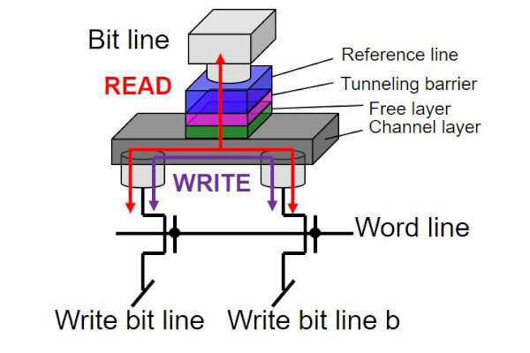
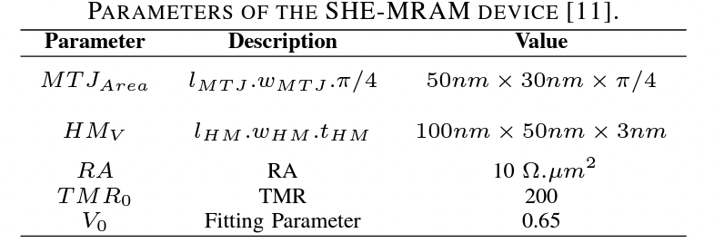
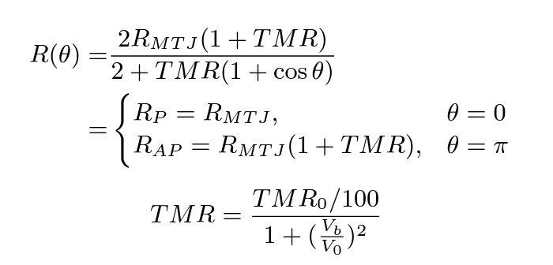
spin-orbit torque (SOT) magneto-resistive random-access memory (MRAM)
ferromagnetic layers
Spin hall effect
SOT-MRAM
thin oxide layer
14nm FinFet

Slide 13
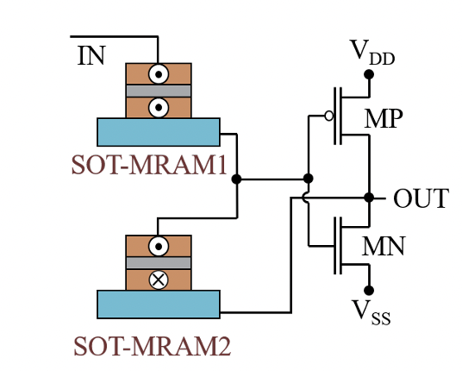
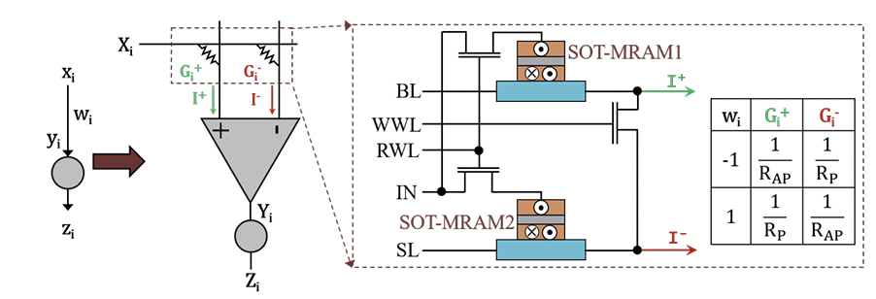
SOT-MRAM Based Synapse and neuron
SOT-MRAM Based Synapse
SOT-MRAM Based neuron
and

Slide 14
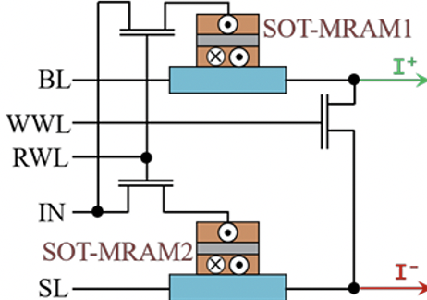
(a) IMAC architecture, (b) The read path of an n × m IMAC subarray.
Configuration phase:
Tune SOT-MRAM resistance
Computing phase:
bit-line →input signals
Source-Line → high-impedance state
read word line → VDD
Write world line → VSS

Slide 15
A 0.8V Intelligent Vision Sensor with Tiny Convolutional
Neural Network and Programmable Weights Using
Mixed-Mode Processing-in-Sensor Technique for Image
Classification
Tzu-Hsiang Hsu, Guan-Cheng Chen
National Tsing Hua University, Hsinchu, Taiwan

Slide 16
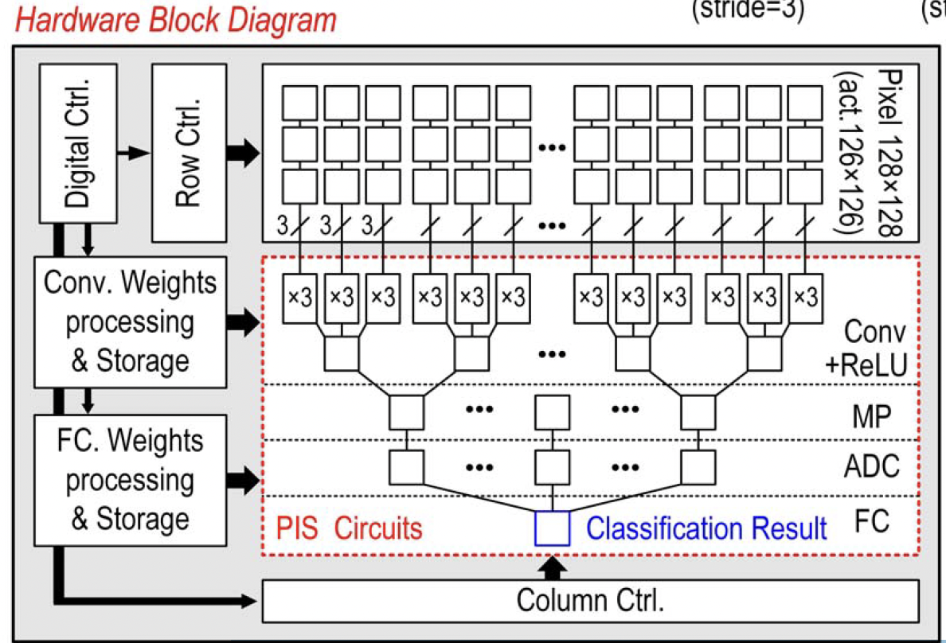
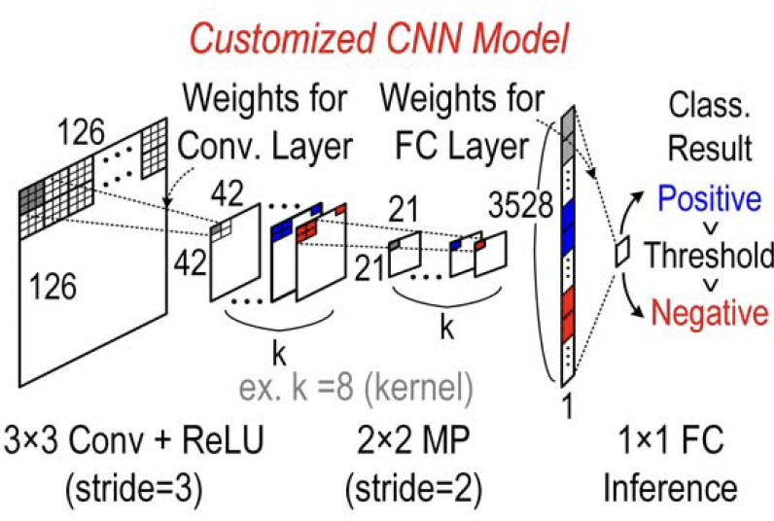
The block diagram and customized CNN model of the proposed intelligent vision sensor.
Using only 8 kernels, the network can execute a binary classification task: human face detection.

Slide 17
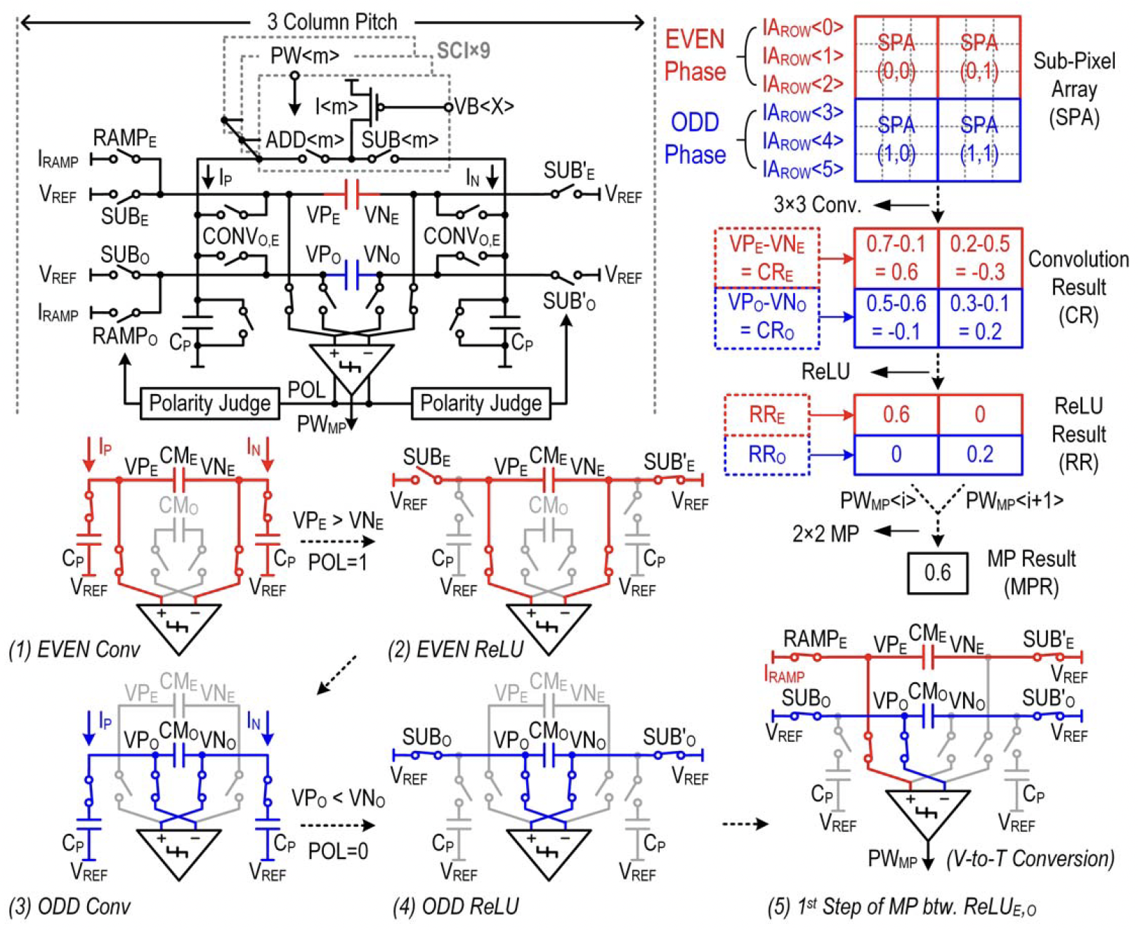
The column-parallel analog PIS circuit for Conv, ReLU and MP layers
Circuit concept:
Pulse-Width Modulation pixel and Switched Current Integration concept.

Slide 18
Assignment questions

Slide 19
What are the CNN models tested with ARCHON architucture and which model showed better accuracy with ARCHON.
What are the values of R_{AP} and R_{P} of the SOT-MRAM?

