Slide 2
Introduction to DatA Protection
Tobias Bräutigam

Slide 3
Welcome and Practicalities

Slide 4
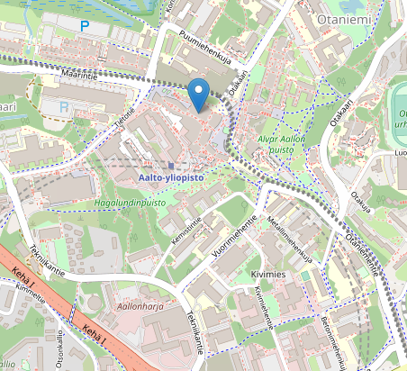
Agenda
Welcome and expectation management
Practicalities, housekeeping
Why this might be relevant
How the EU works
Fundamental rights dimension
Margin of manoevre for the Member States
Role of the Courts

Slide 5
Who am I and who are you?
Partner at Bird & Bird
Docent of information law at Helsinki & Turku
30+ university level courses
Second time at Aalto
Some Questions for you:
Which is your background: Finland – outside of Finland
What did you study or are you studying?
How much do you know about data protection? (1-10)

Slide 6
How you approach this lecture is what you get out of it.

Slide 7
What is this course about? Practicalities
What do you need to do to complete the course?

Slide 8
Learning objectives
After the course you should
Have a basic understanding of the current rules on data protection
Understand the main definitions
Understand the roles in data protection
Understand the obligations following from accountability provisions
You should also be able to understand the nature of data protection as a fundamental right and which consequences it has
No prior legal knowledge is required, and we will use legal documents as sources; this might mean that it willl take you more time to read articles etc. than usual
Spoiler Alert:
Most likely, this course is more work than others. It will demand more from you. And maybe it will open doors you did not know yet existed.

Slide 9
What you need to complete the course
Active participation
Attending the lessons
Read the mandatory reading
Solve a case study (3000-4000 words)
Notes:
Rules: You need to be there at least 4/6. If you miss more, there will be replacement assignments
Please note that I will also use material that is just discussed in class for building the case - so if you miss you need to get the information from a friend.

Slide 10
Reading assignments & discussion
You will find reading assignments on the syllabus
There is mandatory and (sometimes) optional reading
There will be usually questions on the assignments and they build the basis for the discussions/activities
How to read an article
Take part actively in the discussion. I will assign people to summarize parts and there will be group work.

Slide 11
When shall we meet again in thunder, lightening or rain?
No | When | What
1 | 04.09.2023 09.15-11.45 | Introduction & Background
2 | 11.09.2022 09.15-11.45 | Principles & Definitions
3 | 18.09.2022 09.15-11.45 | Everything is forbidden, unless it is allowed & accountability
4 | 20.09.2022 09.15-11.45 | Rights & Transparency (note: I might be travelling)
5 | 02.10.2022 09.15-11.45 | Data transfers
6 | 09.10.2022 09.15-11.45 | Enforcement & the right with a megaphone
E | 23.10.2022 | Case studies due

Slide 12
Any Questions?

Slide 13
Introduction & Background

Slide 14
Why the Topic is relevant?

Slide 15
Many reasons to pay attention
Public debate
Data as the new paradigma
Mistakes could impact your business

Slide 16
There is a lot of Data

Slide 17
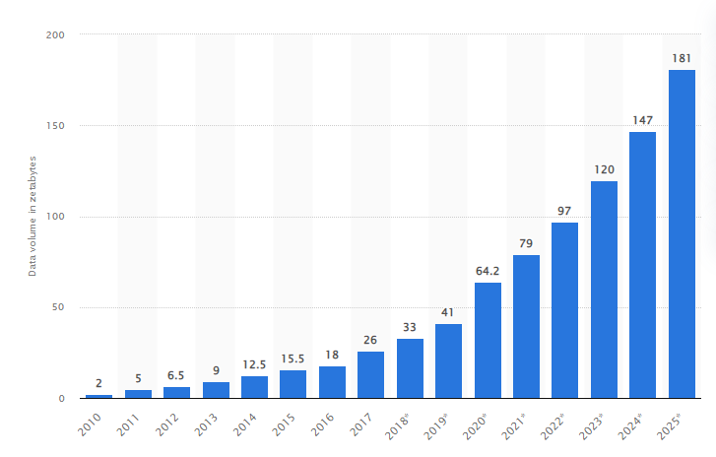
Volume of data/information created, captured, copied, and consumed worldwide from 2010 to 2025 (zetabytes)
How much is a zetabyte?
A zettabyte is 10²¹ or 1,000,000,000,000,000,000,000 bytes.
It would take 1 billion
1 terabyte hard drives to store one zettabyte.
It is a lot.
Notes:
Commission estimate:
2018: 33 Zetabytes
2025: 175 Zetabytes

Slide 18
https://youtu.be/bvDAjYWJBqc

Slide 19
History and structure

Slide 20
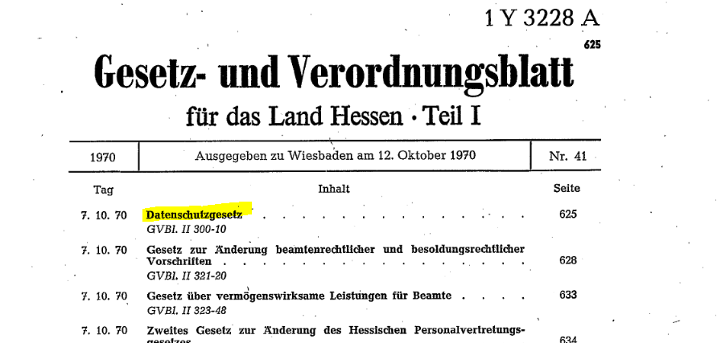

Slide 21
History: Data protection law (data protection v. privacy)
1970: Hesse (state in Germany)
1973: Sweden => Datalag
70ies: Germany, France end of the 70ies; UK Act 1984
1974: US ➔ Privacy Act (note: administration!)
1980: Economic orientated OECD Guidelines of The OECD Guidelines on the Protection of Privacy and Transborder Flows of Personal Data, adopted on 23 September 1980
1981: Convention of the Council of Europe for the Protection of Individuals with regard to Automatic Processing of Personal Data (Convention No. 108)
1998: Directive 95/46
2008: Data Protection Framework Decision 2008/977/JHA on personal data processed for police and judicial cooperation in criminal matters (FDPJ) was finally adopted with the intention of covering data processing in (former) third pillar matters.
2018: GDPR – will be applicable May 2018
2019: FinnishTietosuojalaki applicable (1.1.2019)

Slide 22
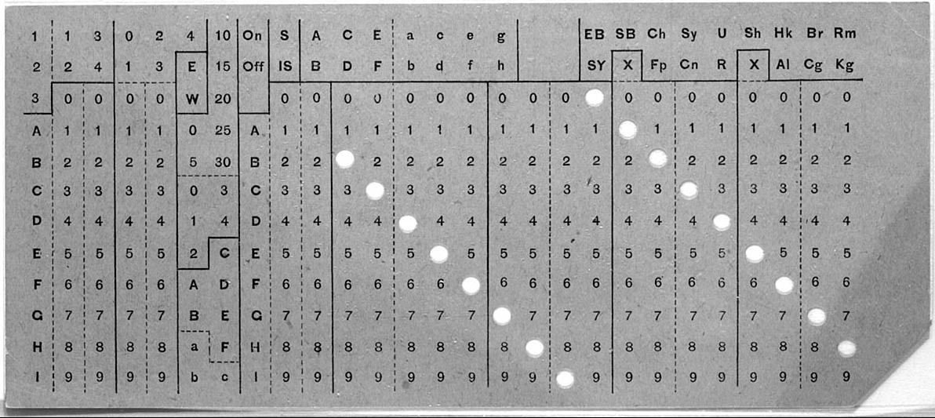
History (2) (semi-automatic) data processing
Herman Hollerith – 2nd generation immigrant
Tabulating machine company => became IBM
Machines used for 1890 census
Why punch cards?
Notes:
NY, MIT
IBM only merging with otheer

Slide 23
A simple structure of data protection problems
Collection
As communicated?
Surveillance
Use
Using as communicated?
Necessary data?
Profiling
Manipulating?
Where does it end up?
Hacking
Data breaches
Selling?
Sharing?
Data
subject

Slide 24
Sources in DP LAW

Slide 25
There are various sources in data protection law
Fundamental Rights documents
Charta of Fundamental Rights
European Convention on Human Rights
EU Law
GDPR
E-Privacy
Member States law
Data Protection Act (tietosuojalaki)
Act on the privacy in working life (työelämän tietosuojalak)
Case law
EU courts
National courts
Guidance documents
EDPB
National authorities

Slide 26
How EU Law works
Credit goes to Sam Wrigely, mistakes are my own

Slide 27
Primer on EU legal structure?
Primary law
Treaties
Charter
Secondary law
Regulations (directly applicable in Member States, no need to implement separately)
Directives (must be implemented, not directly applicable) and other acts
EU law effectively has supremacy over national law (simplification)
EU "laws" are made up of
articles (legally binding)
recitals (a non-binding preamble that often states the goals for the legislation and is used as a guide to interpretation)

Slide 28
How does the EU Commission work?
The European Commission is made up of one commissioner from each country and their staff. It has sole competence to draw up the first draft of legislation.
Legislation is then amended and voted upon by the Council of the European Union (confusingly a different body to the European Council), which is made up from government ministers from each Member State, and the European Parliament, which is made up from directly elected MEPs
Each Institution tends to come up with their own preferred version of the text, and then agree on a final version during the trialogue procedure
The legislative procedure takes a very long time and a lot of political compromise between different countries, parties and interest groups

Slide 29
Primer on EU legal structure?
Questions of legal interpretation are brought before the CJEU, often through the preliminary reference procedure.
The Court of Justice, which deals with certain special actions, questions of interpretation and appeals from the General Court. One judge from each country sits on the Court, and there are 11 advocate generals, who issue non-binding expert opinions on each case.
Only the CJEU is entitled to interpret matters of EU law.
If a Member State court is not sure how the law should be read, they normally need to send a preliminary reference to the Court of Justice (e.g. Schrems case)
Notes:
The CJEU has two branches:
The General Court, which mostly deals with complaints involving EU bodies. Two judges from each country sit on the court. Cases normally have three or five judges, but it can also be one or fifteen. We mostly aren’t concerned with this court and, when we are, it’s normally when people are appealing refusals by the Institutions to grant access to documents.
Cases can be heard by the full court, by a Grand Chamber of 15 judges, or by Chambers of three or five judges. This is the court with which we are mostly interested, since they do the legal interpretation work.

Slide 30
Fundamental Rights Dimension

Slide 31
Our fundamental rights
Convention for the Protection of Human Rights and Fundamental Freedoms (“European Convention on Human Rights”)
Article 8 – Right to respect for private and family life
Charter of Fundamental Rights of the European Union [2012] OJ C326/391
Article 7 – Right to respect for private and family life
Article 8 – Right to the protection of personal data
Article 42 – Right of access to documents

Slide 32
European Convention on Human Rights
Right to respect for private and family life
1. Everyone has the right to respect for his private and family life, his home and his correspondence.
2. There shall be no interference by a public authority with the exercise of this right except such as is in accordance with the law and is necessary in a democratic society in the interests of national security, public safety or the economic well-being of the country, for the prevention of disorder or crime, for the protection of health or morals, or for the protection of the rights and freedoms of others

Slide 33
Charta of Fundamental Rights
Article 8 Protection of personal data
1. Everyone has the right to the protection of personal data concerning him or her.
2. Such data must be processed fairly for specified purposes and on the basis of the consent of the person concerned or some other legitimate basis laid down by law. Everyone has the right of access to data which has been collected concerning him or her, and the right to have it rectified.
3. Compliance with these rules shall be subject to control by an independent authority.
Notes:
Proclaimed 2000
Into force: 2009 (Treaty of Lisbon) 1.12.

Slide 34
GDPR

Slide 35
The GDPR is the main data protection law in Europe
Very much debated, heavily lobbied
Applicable since 25 May 2018
The GDPR replaced the national laws and regulations based on the EU Data Protection Directive (46/95/EC)
The GDPR is directly applicable in each member state
The Data Protection Authorities are task with enforcing those rules

Slide 36
Overview over the GDPR (just the highlights)
Principles & Definitions
Rules that make processing lawful
Rights
Roles: controllers & processors
Data breaches & accountability
International data transfers
Rules for DPAs
Enforcement
Special rules

Slide 37
Principles-based vs rules-based regulation
Principle-based regulation: “Processing must be fair, lawful and transparent”
Rules-based regulation: “The contract between the controller and the processor must contain the following elements: X, Y, Z…”
Another element – the risk-based approach. “Processing must be governed according to how much it might harm data subjects.”
Which method does the GDPR use? What are the pros and cons of each method?

Slide 38
E-privacy directive

Slide 39
ePrivacy Regulation in a nutshell
Also known as "Cookie Law"
ePrivacy Directive effective since 2002
The European Union ePrivacy Regulation aims to:
broaden the scope of current e Privacy Directive; and
align online privacy rules across EU member states
Directive provides guidelines and expectations for electronic privacy
Unsolicited Marketing
Cookies
Confidentiality
Complements the GDPR
ePrivacy regulation will replace the current ePrivacy Directive in the near future, covering e.g. electronic communications, such as metadata

Slide 40
ePrivacy v. GDPR – what are the differences?
GDPR
ePrivacy
Complements the GDPR
Regulates electronic communications even if it concerns non-personal data
Takes precedence in cookies
Only applies to processing of personal data
Was created to protect personal data
Was created to protect person's private life

Slide 41
Other European ACTs

Slide 42
One more thing..
Open Data Directive
The Directive on open data and the reuse of public-sector information sets out minimum rules on the reuse public
Regulation on data protection in EU Institutions
The GDPR does not apply to EU institutions. Thus, the aim of this regulation is to fill this gap and regulate personal data processing inside the EU.
Law Enforcement Directive
The GDPR does not apply to situations where law-enforcement authorities act as controllers. Thus, the aim of this directive is to fill this gap and regulate personal data processing in lawenforcement situations
Database Directive
Protection for databases.
PSD2
Regulates data usage

Slide 43
National Laws

Slide 44
Member States have national laws that supplement the GDPR
"General law"
"Sector specific laws"
Employment
Health care
Banking
tietosuojalaki in Finland

Slide 45
Case Law and Guidances from Authorities

Slide 46
Case law: there is a lot!
What is personal data? Lindqvist (2003); Breyer (2016), Nowak (2017) Vyriausioji tarnybinės etikos komisija (2022)
Roles: Jehovan todistajat (2018), Wirtschaftsakademie (2018), Fashion ID (2019)
Data retention: Digital Rights Irleand (2014)
International data transfers: Schrems I (2015), Schrems II (2020)
Right to be forgotten: Google Spain (2014)
Jurisdiction: Weltimmo (2015), Google Spain (2014)
Cookies: Planet 49 (2019)

Slide 47
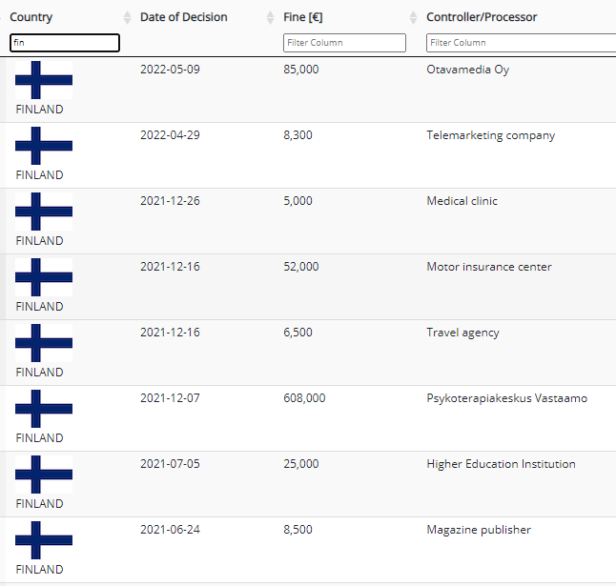
DPA case law

Slide 48
The European Data Protection Board gives non-binding guidance (but very influencial)

Slide 49
Activity

Slide 50
Questions regarding the Article "The Right to Privacy"
Form groups of 2-3 people and discuss. Start by clarifying what you have not understood.
What is the new technology discussed in the article? What would it be in our times?
"Gossip is no longer the resource of the idle and of the vicious, but has become a trade […] It both belittles and perverts " Do you agree?
The authors quote a variety of cases and also theorize about what might be the reason to protect what we now call privacy. What 5 justifications do they discuss?
Which of the options mention in Q3 do the authors land on as the root of the right to privacy?
Notes:
Instantaneous photographs and newspaper enterprise ("but since the latest advances in photographic art have rendered it possible to take picture")
D
Intellectual property ("copyright"), contract, trade secret, confidence, implied contract
Propertz

