Slide 1
Trade Policy
Svetlana ledyaeva
Notes:
Both model predicts welfare gain with free trade, but…

Slide 2
256% tariff on Chinese steel
Notes:
Existence of trade restriction: tariff/import tax, quota, production subsidy
Vietnam: value originated from China, finalized in February 2018, >200% tariff
2016

Slide 3
Questions
Why trade restrictions?
Consequences of trade restrictions?
Different restriction measures will affect trade flows in different ways.
For simplicity we restrict attention mainly to tariffs.

Slide 4
Outline
Partial equilibrium (the tariff industry) - small country - large country
General equilibrium (all industries) - small country - large country
Empirical Evidence
Notes:
Small: take international price as given
Large: can change the price

Slide 5
partial equilibrium, small country
Price
demand
supply
Standard partial-equilibrium demand and supply curve for a good
In autarky, the market clears at p_{au} and q_{au}
Suppose that under free trade the world price for this good is p_{ft}, lower than p_{au}
p_{au}
p_{ft}
Consumers demand q^{d}_{ft} while producers supply q^{s}_{ft}
The difference is imported from abroad.
import_{ft}
q^{s}_{ft}
q_{au}
q^{d}_{ft}
Quantity

Slide 6
partial equilibrium, small country
Price
Suppose the government imposes a tariff T on imports
to help domestic producers (protect them against foreign competition)
demand
supply
If the country is small, the world price will not change but the domestic price will rise to p_{ft}+T
As a result, domestic demand falls, supply rises and therefore imports fall
p_{ft}+T
T
p_{ft}
import_{tar}
q^{s}_{ft}
q^{s}_{tar}
q^{d}_{tar}
q^{d}_{ft}
Quantity

Slide 7
partial equilibrium, small country
The government policy seems to work since:
Domestic production expands and foreign competition (imports) falls
What are the welfare costs of this trade policy?
We should distinguish three types of economic agents:
Producers
Consumers
The government
Notes:
draw on white board: as CS, PS, Gov rev with trade

Slide 8
partial equilibrium, small country
Price
Producers gain:
Consumers lose:
Government gains from tariff revenue: import_{tar} × T
Net welfare loss:
demand
supply
p_{ft}+T
T
p_{ft}
q^{s}_{ft}
q^{s}_{tar}
q^{d}_{tar}
q^{d}_{ft}
Quantity
Notes:
Ask: PS, Gov rev

Slide 9
partial equilibrium, small country
Summary of welfare effects of tariffs for small country:
Producers gain (producer surplus rises)
Government gains (government revenue rises)
Consumers lose (consumer surplus falls)
The gains to producers and the government are completely paid for by the consumers: net welfare falls
The distributional effects have political economy consequences: many consumers suffer a small individual loss, but a few producers benefit from a large individual gain
Conclusion: it is attractive for producers to invest in lobby groups to impose trade restrictions, but not for the many consumers to do the same to try to avoid this
Clearly, politicians should take this into consideration when making their decisions (but it is questionable if they do).

Slide 10
partial equilibrium, large country
Price
The analysis is quite similar for a large country
Difference: tariff reduces imports, and thus total demand for the good, hence world price fall to p_{tar}
Price in the tariff-imposing country is then p_{tar}+T
demand
supply
p_{tar}+T
T
p_{ft}
p_{tar}
q^{s}_{ft}
q^{s}_{tar}
q^{d}_{tar}
q^{d}_{ft}
Quantity

Slide 11
partial equilibrium, Large country
Price
Producers gain:
Consumers lose:
Government revenue:
Net welfare loss if and net gain otherwise
demand
supply
p_{tar}+T
T
p_{ft}
p_{tar}
import_{tar}
>
q^{s}_{ft}
q^{s}_{tar}
q^{d}_{tar}
q^{d}_{ft}
Quantity

Slide 12
partial equilibrium, large country
Summary of welfare effects of tariffs for large country:
Producers gain (producer surplus rises)
Government gains (government revenue rises)
Consumers lose (consumer surplus falls)
A welfare gain is thus possible
In general, a ‘suitable’ choice of tariff will lead to a welfare gain for a large country: the ‘optimal’ tariff argument
This argument ignores general equilibrium complications and retaliation. We now turn to these issues.

Slide 13
General equilibrium, small country
Food
Consider a small labour abundant country with the ppf as drawn below
At the given world price p^{world} it produces at point Q* and trades at world prices to consume at point C*, reaching welfare U*
p^{world}
Q*
C*
U*
ppf
0
Manufactures
Notes:
We use the framework of Heckscher-Ohlin framework covered in last lecture; ask which good labor abundant country export

Slide 14
General equilibrium, small country
Food
If the country imposes a tariff t, on its import good (manufactures)
Price line for domestic producers clockwise to p^{world}(1+t)
Production moves to Q²
p^{world}
p^{world}(1+t)
Q*
Q²
C*
U*
0
Manufactures

Slide 15
General equilibrium, small country
Food
Partial equilibrium analysis already showed output in the protected sector expands
This general equilibrium analysis shows that this comes at the expense of a contraction in the other sector
p^{world}
p^{world}(1+t)
Q*
Q²
C*
U*
0
Manufactures

Slide 16
General equilibrium, small country
Food
The country can still trade with ROW at the price p^{world}
So the available income line is parallel to the initial income line through the new production point
p^{world}
p^{world}(1+t)
Q*
Q²
C*
0
Manufactures

Slide 17
General equilibrium, small country
Food
Consumers, like producers, face the distorted price p^{world}(1+t)
They consume along the new income at a point like C² when their utility curve is tangent to distorted prices. Welfare = U²
p^{world}
p^{world}(1+t)
Q*
Q²
C*
C²
U²
0
Manufactures

Slide 18
General equilibrium, small country
Food
The difference in production and consumption income (at domestic prices) represents tariff revenue
We assume that this is redistributed lump-sum to the consumers
p^{world}
p^{world}(1+t)
Q*
Q²
C*
C²
U²
0
Manufactures

Slide 19
General equilibrium, small country
Food
Note that tariffs result in a double distortion.
First, producers change production and thus reduce income at world prices.
➔ Welfare U¹ at point C¹ could be attainable
p^{world}
p^{world}(1+t)
Q*
Q²
C*
C¹
U*
U¹
0
Manufactures

Slide 20
General equilibrium, small country
Food
Second, consumers are also confronted with distorted prices (domestic prices deviate from the world prices), which lowers welfare to U² at C²
The first reduction in welfare is the production effect, the second is the consumption effect
p^{world}
p^{world}(1+t)
Q*
Q²
C*
C²
C¹
U*
U²
U¹
U²
0
Manufactures

Slide 21
general equilibrium, small country
Summary:
Our general equilibrium analysis for a small country confirms that imposing a tariff always leads to a welfare loss
The increase in output of the protected sector comes at the expense of a reduction of output in the other sector
Imposing a tariff leads to a double distortion as both producers and consumers are faced with distorted domestic prices
Notes:
Consistent with partial eqm results

Slide 22
Offer curve
Country named K which enjoys both goods Y and X.
It is better at producing good X, but wants to consume both goods.
Point C is autarky.
At point C, country K can produce (and consume) 3 Y for 5 X.
Trade➔Point B, it can trade with the other country and consume at point S. Trade is 5 Y for 7 X.
Full specialization➔Point A, trades and then consumes at point T. Trade is 1Y for 1X.

Slide 23
General equilibrium, large country
A’s import
Consider two large countries America (A) and Britain (B)
Let X be export and M be import; trade balance for A implies: p_{x}X_{A} = p_{M}M_{A} or M_{A} = pX_{A} , where p = p_{x}/p_{M}
In trade space (see figure) trade balance is achieved along a line through the origin
A can choose any point along this line; in perfect competition producers and consumers choose the best point available, say C
C
A import at price p
slope = p
A’s export
A export at price p
Notes:
Need the aid of offer curve to analyze changes in eqm price
Price of exporting good is 1/3 of price of importing good. Trade along the price line to achieve trade balance
How to determine C: ppf tangent to price, utility tangent to price (use white board graph)

Slide 24
General equilibrium, large country
An increase in relative price of export goods to p’ rotates the trade balance line counter-clockwise: relative p_{x}
A’s consumers and producers then choose a different optimal point, say D
For each relative price A offers a different (optimal) quantity of exports in exchange for imports
A’s import
D
A import at price p’
C
slope = p’
A export at price p’
A’s export

Slide 25
General equilibrium, large country
Connecting export offers in exchange for imports for all prices gives the offer curve
It summarizes all optimal production and consumption decisions in the economy
Moreover, it is possible to derive trade indifference curves (see textbook)
These are tangent to trade balance lines at optimal points (e.g. C and D) and welfare increases for A to the upper-left corner
A’s import
A’s offer curve
higher welfare for country A
D
C
A’s export
Notes:
Derive trade indifference curve on white board, print page 169

Slide 26
General equilibrium, large country
Since what A exports B must import, we put B’s exports on the vertical axis and B’s imports on the horizontal axis
The offer curve is therefore curved the other way and welfare increases for B to the lower-right corner
B’s export
B’s offer curve
B’s import

Slide 27
General equilibrium, large country
Combining this information in one figure, we then see that only at point E the exports A wants to offer in exchange for imports
Match exactly what B wants to offer in exchange for its imports (why not at origin?)
The slope of the trade balance line through point E determines the free trade equilibrium price p
A’s import
A’s offer
B’s export
E
B’s offer
free trade price = p
A’s export
B’s import

Slide 28
General equilibrium, large country
A’s import
A’s Offer curve rotate inward with tariff at any price (terms of trade), tariff restrict trade volume.
We can derive the ‘optimal’ tariff for a large country, say A
Taking B’s offer curve as a restriction, A’s welfare is not maximized at point E
Instead, it is maximized at the tangency point F
Country A could potentially have a welfare gain
A’s offer with ‘optimal’ tariff
A’s offer
B’s export
E
F
B’s offer
A’s export
B’s import
Notes:
Relative price of importing goods decreases, exporting goods increase

Slide 29
General equilibrium, large country
With simultaneous moves: A wants to move from E to F, B wants to move from E to G
The end result is a move from E to H with lower welfare for everyone
Further retaliation may worsen this outcome ➔ need international rules and policy coordination in the WTO
A’s import
A’s offer with ‘optimal’ tariff
A’s offer
B’s export
E
F
B’s offer
G
H
A’s export
B’s import

Slide 30
Summary
Tariff benefits protected producers and provides government revenue at the expense of a welfare loss for the consumers
Imposing a tariff always generates an overall welfare loss for a ‘small’ country
A ‘large’ country might benefit from an ‘optimal’ tariff
These benefits disappear with simultaneous moves and retaliation; hence, the need for international rules

Slide 31
empirical evidence
Whether a large country can gain from setting an import tariff depends on it’s power to influence international prices
This power may differ by goods/industry
Let’s first see how international prices are determined by import demand and export supply curve
Notes:
Go back to partial & general eqm graph

Slide 32
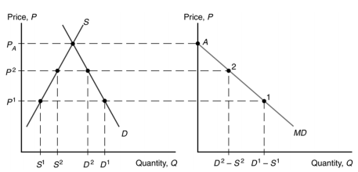
Home import demand curve

Slide 33
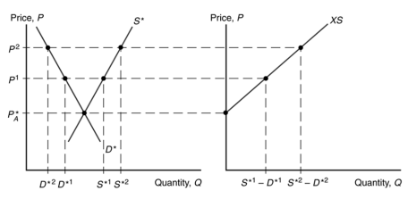
Foreign export supply curve

Slide 34
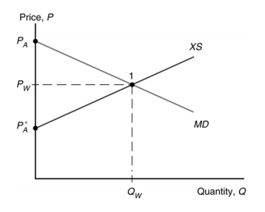
World equilibrium
E

Slide 35
empirical evidence
With import tariff, home import demand curve shifts to the left
The magnitude of decrease in price depends on foreign supply elasticity
Elastic supply ➔ smaller price change Inelastic supply ➔ bigger price change
Hence, import tariff is higher with low elasticity of foreign supply
Broda, Limao and Weinstein (AER, 2008): measure the inverse of the foreign supply elasticity, and show it’s positively correlated with import tariff - use only non-WTO countries
Notes:
Draw on white board: tariff reduce import demand; elasticity

Slide 36
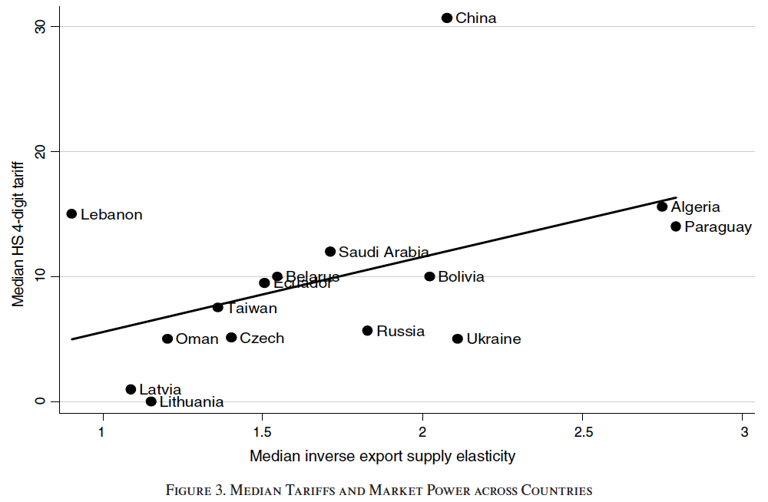
BLW (2008): country averages

Slide 37
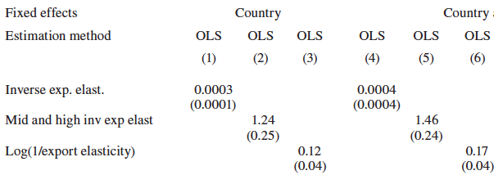
BLW (2008): within country across goods
Industry &

Slide 38
So…
Theory prediction seems to hold
Can also be tested in GATT/WTO:
See, for example, Bagwell and Staiger
(Annual Review of Economics, 2010)

Slide 39
Types of tariffs
Ad valorem tariff: a percentage of the value of the product.
Specific tariffs are computed on the physical quantity of the good being imported, a tariff of $1.22/kg on certain types of cheeses.
Mixed tariffs are expressed as either a specific or an ad valorem rate, depending on which generates the most (or sometimes least) revenue.
Compound tariffs include both ad valorem and a specific component.
Tariff rate quotas: very low for import volume until certain threshold; very high after this threshold

Slide 40
Other trade policy measures than tariff
Export subsidies
Export and import quotas
Sanitary and phytosanitary (SPS) measures
Prohibition for political reasons (Embargo)
Licence

Slide 41
WTO – World trade organization
It is an organization for trade opening.
It is a forum for governments to negotiate trade agreements.
It is a place for them to settle trade disputes.
It operates a system of trade rules.
Is a place where member governments try to sort out the trade problems they face with each other.

Slide 42
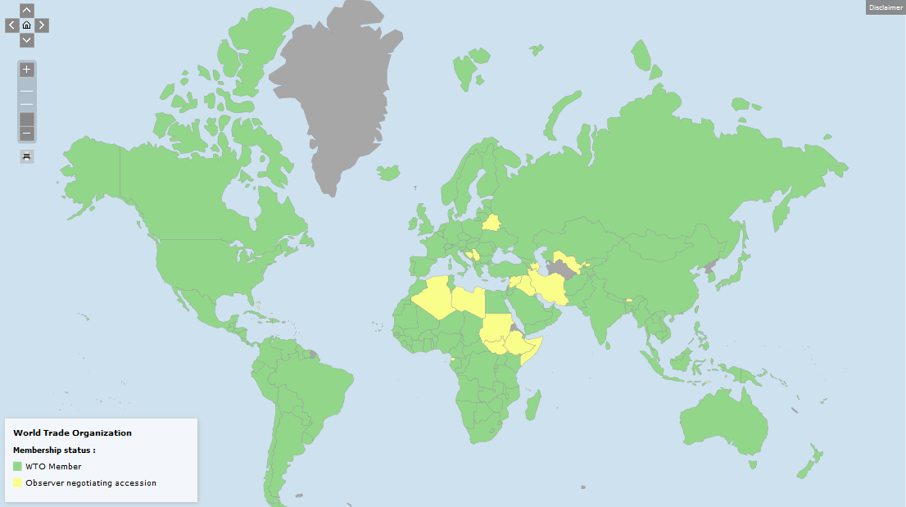

Slide 43
Only 12 countries are not WTO members/observers.
They are Eritrea, Kiribati, Marshall Islands, Micronesia, Monaco, Nauru, North Korea, Palau, San Marino, Somalia, South Sudan, Turkmenistan, and Tuvalu.

