Slide 1
Period Costume & Style
Lecture 6 / EARLY 17th CENTURY ENGLAND
LUDVIG XIV AND FRENCH COURT
8.3.2022

Slide 2
Early 17th Century England:
James I and his reign
Charles II and his reign
Inigo Jones and court masques
17th Century France:
Louis XIV

Slide 3
1603 Death of Queen Elizabeth
James VI of Scotland is James I
Stuart Dynasty
Elizabeth’s Ladies in Waiting at her funeral
in 1603

Slide 4
King James in Ceremonial robes, 1603
He wears slashed breeches, a doublet with a ruff and a simar coat under his long cape of black velvet

Slide 5
James I by Paul Somer 1603
Wearing no more peascod belly
Wide plate collar
Breeches with panes
Silk hose
Heeled shoes with a rosette tie
Short circular cape

Slide 6
Queen Anne of Denmark 1605
Daughter of Christian IV of Denmark.
When James I come to the English throne, she brings Ingo Jones to design the Coronation Ceremonies.
She has pearl drop earrings, a Medici collar and a wheel farthingale - with rosettes at the shoulders and down the front of the bodice
by John DeCritz

Slide 7
Lord Dudley 3rd Earl of the North
Lord Dudley wears a doublet with a Jerkin like a vest over it and breeches
Millstone ruff and linen cuffs with lace
The pom-poms on the shoes have become more exaggerated

Slide 8
Anne Vavasour with gloves and fan, common accessories to show wealth
Skirt support -> wheel farthingale & bum roll
Medici collar
Hems shortens, notice red petticoat
John DeCriz the elder, 1605.
Notes:
Lady in waiting for queen Elizabeth
the mistress of two aristocratic men

Slide 9
The bum roll is a padded sausage style roll that is fastened around the hips and ties center front allowing for a round full hip
This was easier to wear than the wheel farthingale and more common among middle class women

Slide 10
Wheel farthingale
Millstone ruff instead of medici collar
Wide lace cuffs are in fashion
Handkerchief of fine linen
Notice low neckline to show bosom

Slide 11
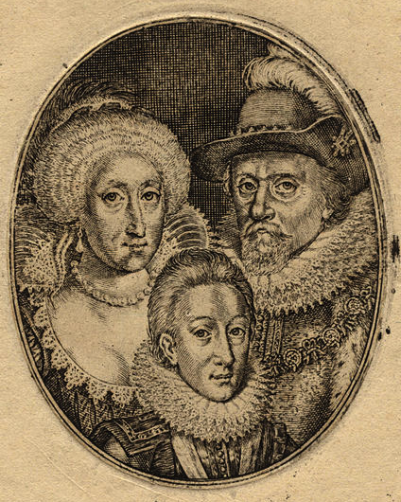
King James and Queen Henrietta Maria with their son Charles
Engraving by Simon de Passe c. 1612

Slide 12
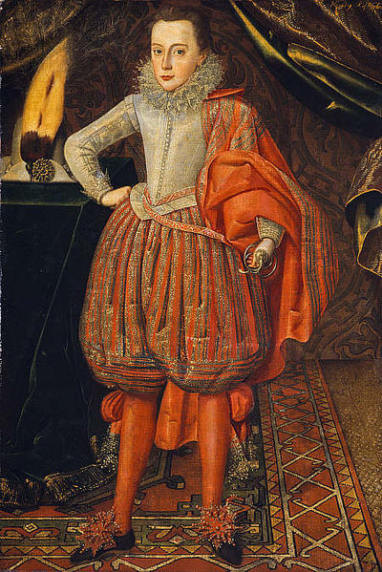
Charles I c. 1610 wears same garments as adults
Knee length breeches
Jerkin is still quite stiff but without beascod belly

Slide 13
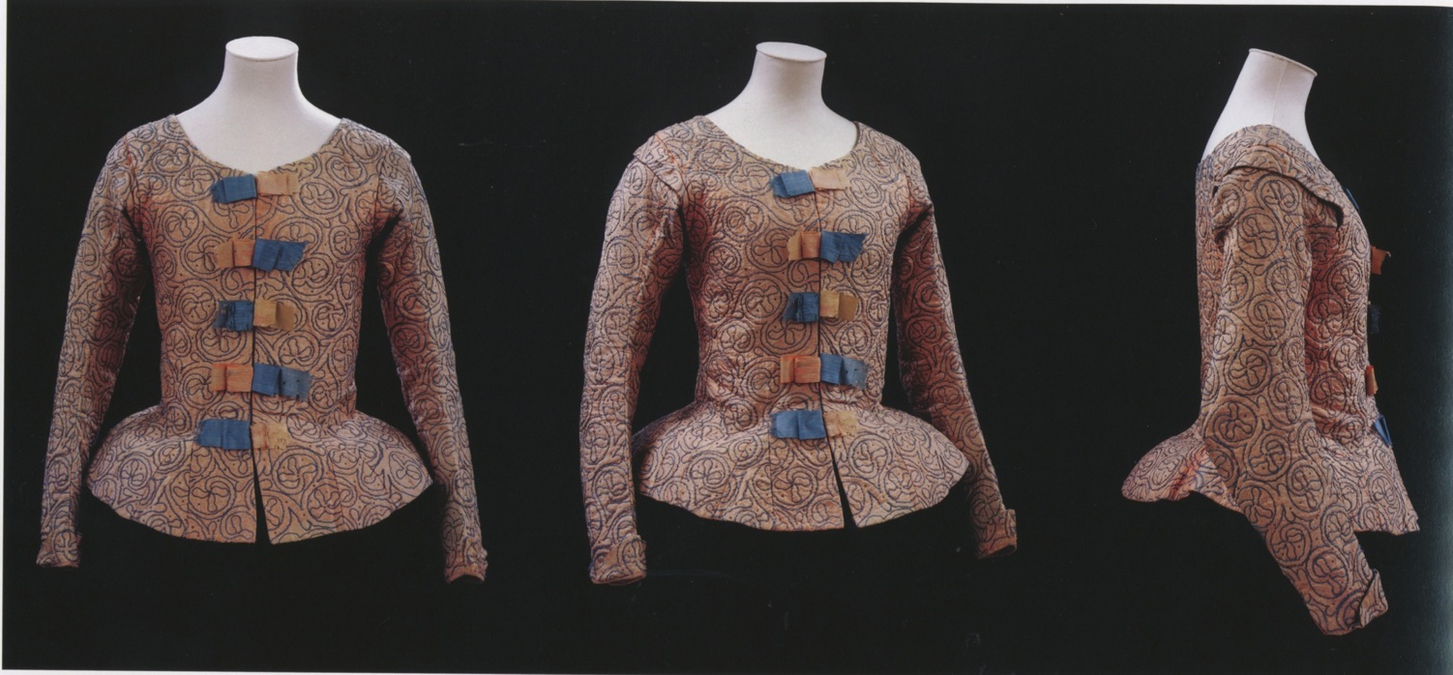
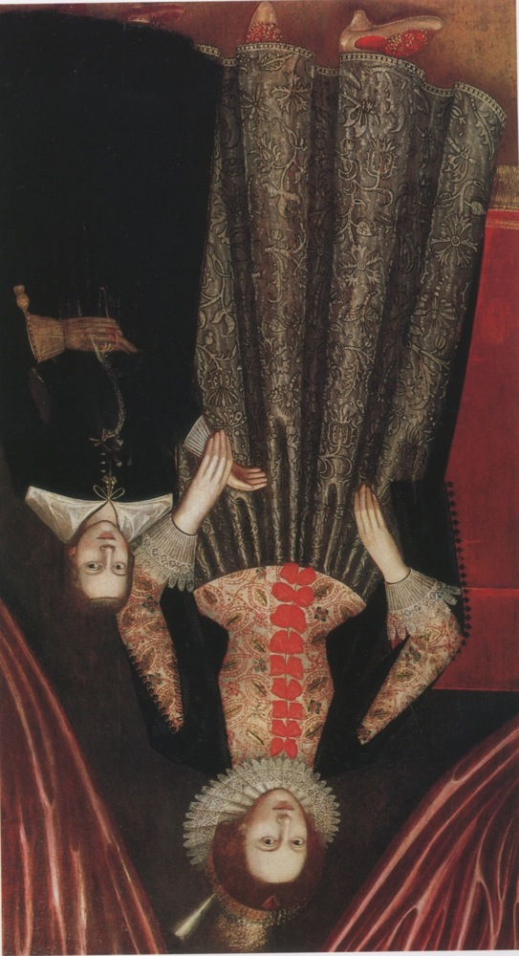
Silk bodice, 1610-20
Originally coral pink, silver spangles and blue thread
Alterations done three times: first to add circumference around the hip, then width was added to the back and third, neckline was altered
Notes:
Wheel farthingale dissapears slowly
Waistline is natural
Notice separate linen/lace cuffs
Collar is still
up and stiff

Slide 14
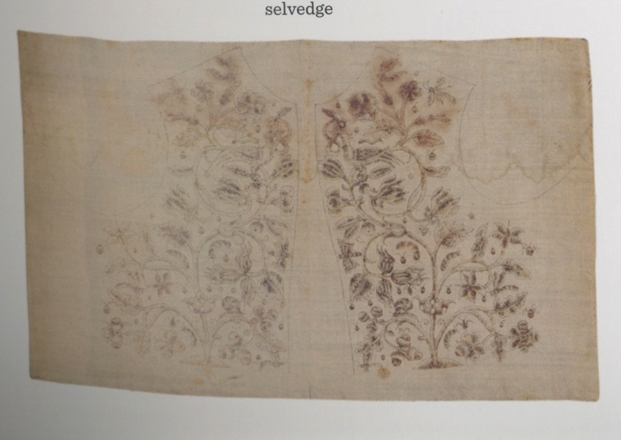
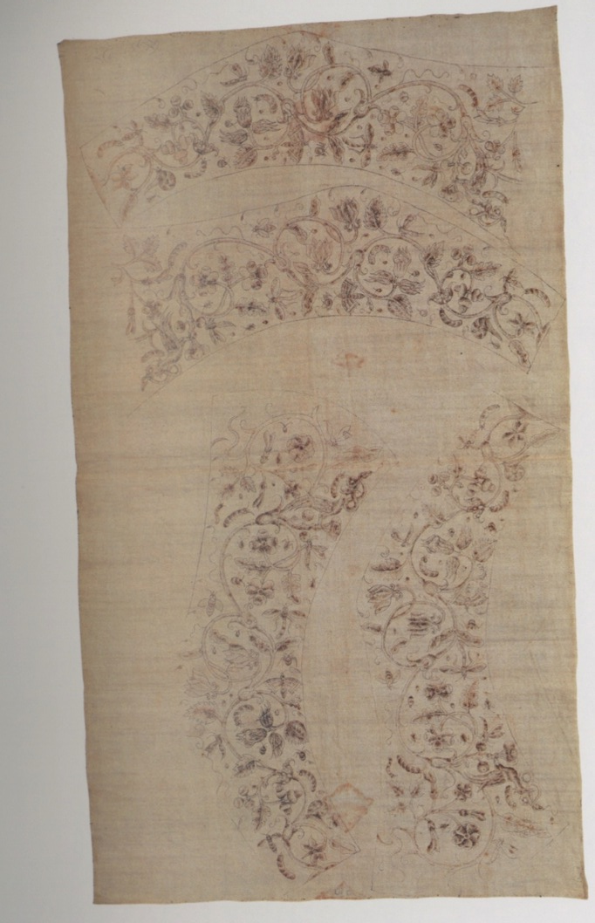
Embroidery and other decoration was done before sewing the garment pieces together

Slide 15
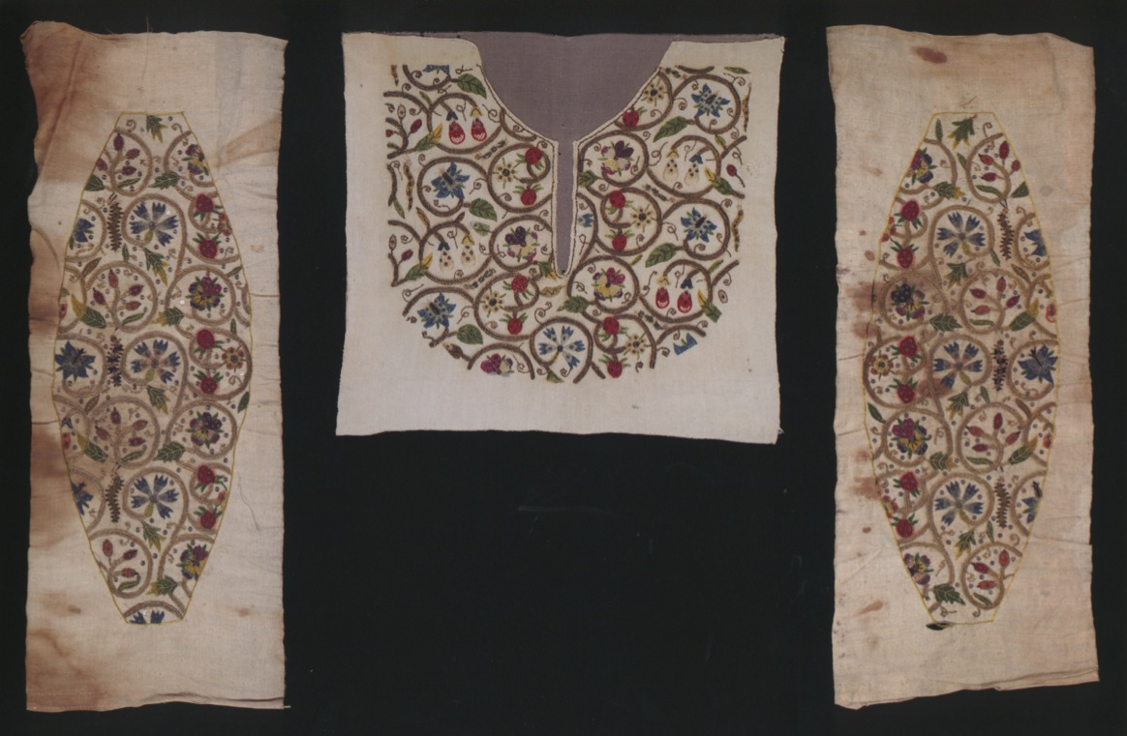
Linen sleeve panels and linen partlet with silk embroidery Used in ”cheat waistcoats”

Slide 16
Waist begins to rise around 1615
Collar turns down
Sleeves shorten
Less fullness, softer silhouette

Slide 17
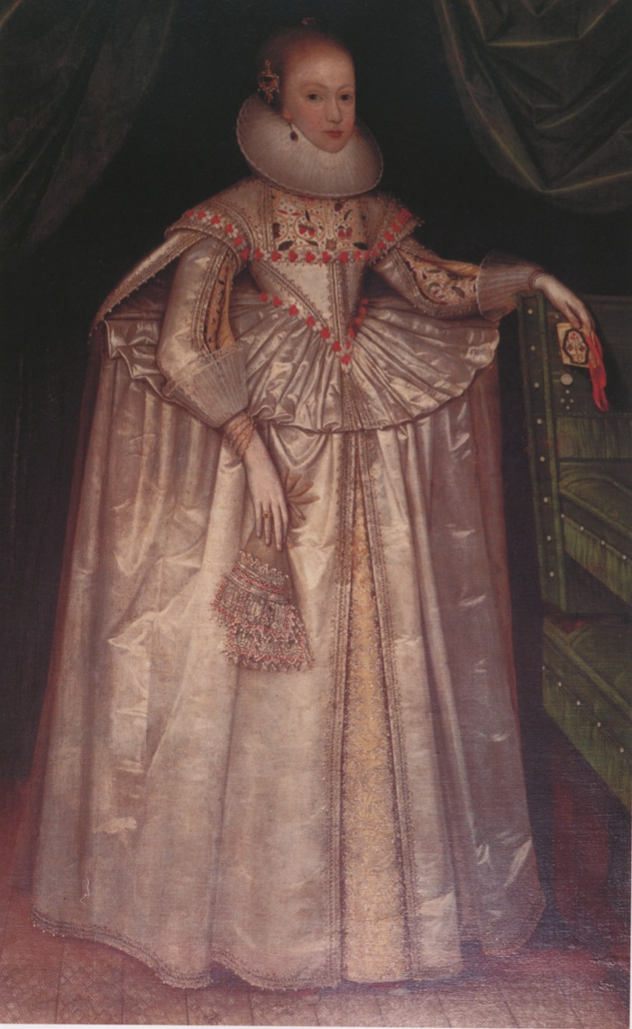
Lady Hunsdon c.1620
She has not given up of the wheel farthingale, however her waistline is fashionably high
She wears hanging sleeves, open sleeves and ”cheat waistcoat”
Falling ruff and matching cuffs

Slide 18
Margaret Layton’s bodice at the V&A in London
Linen and hand embroidered with silk, metal and linen thread

Slide 19
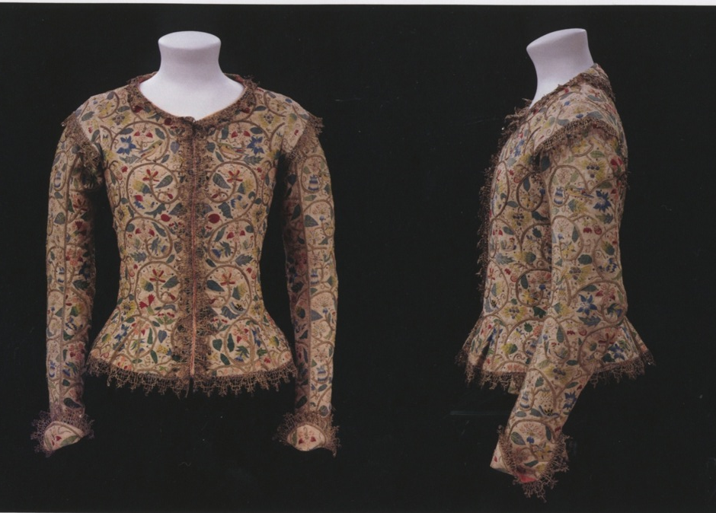
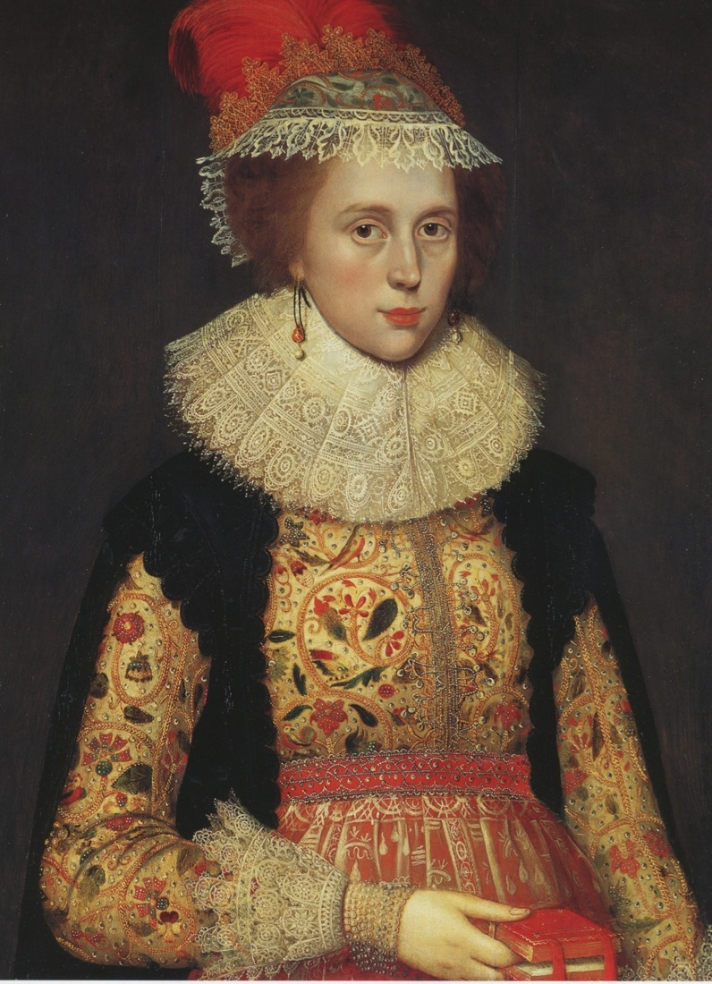
Look at the garment structure, do you see any difference with the painting?
Notes:
There are no interlinings, boning or stiffening so it was used over stays
Gores in the hem allows bigger circumference for the bum roll and fathingale

Slide 20
Portrait of Margaret Leighton, 1620
Surviving piece shows the alterations made to this garment

Slide 21
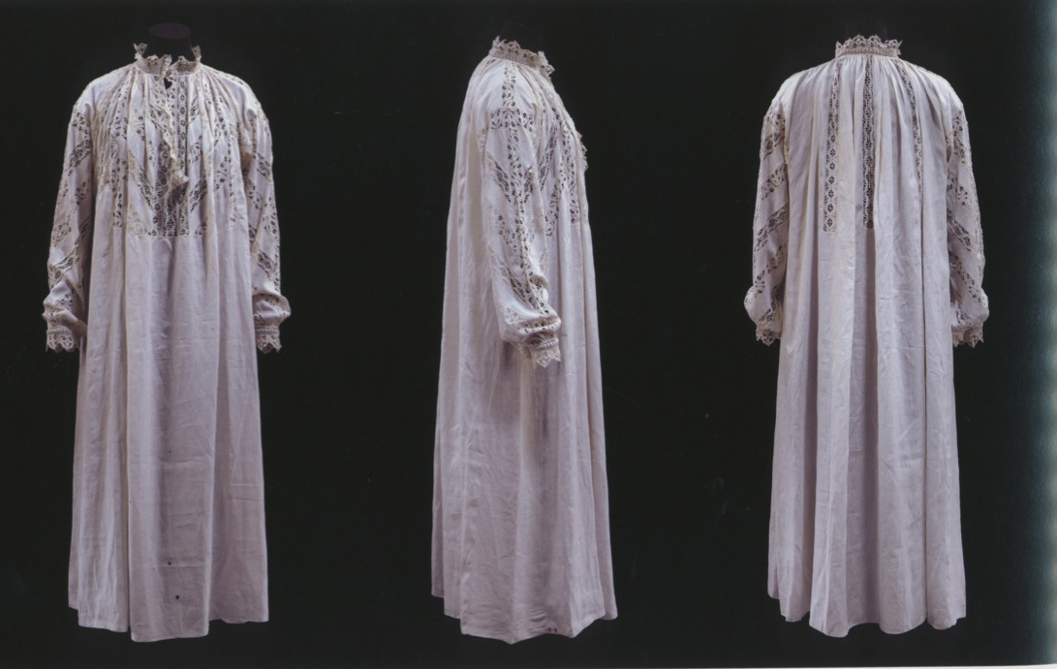
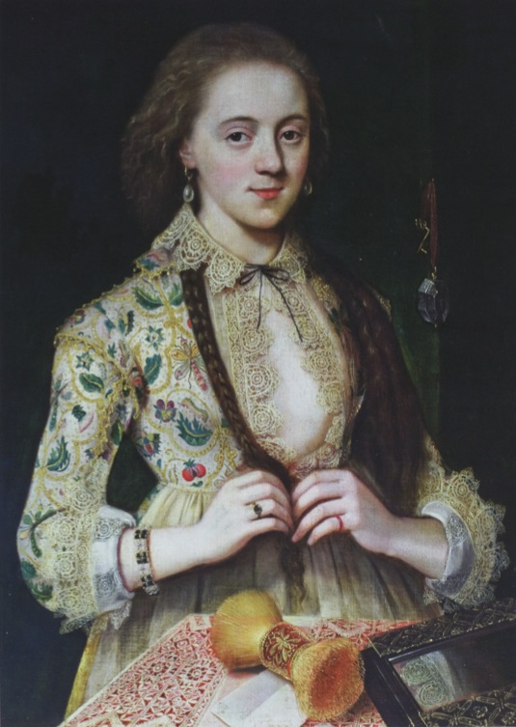
Smock is also used instead of chemise
Decoration of the smock is visible on the chest and around neck

Slide 22
William Larkin George Villiers, 1st Duke of Buckingham, 1616
Very strong supporter of King James.
When he is killed, his sons are raised by James I
Villiers wears a doublet that is more high waisted and an elaborate plate collar with his breeches.
He wears the remnants of a simar coat with hanging sleeves under his black velvet cape.
New high heeled shoes with pom pom rosettes

Slide 23
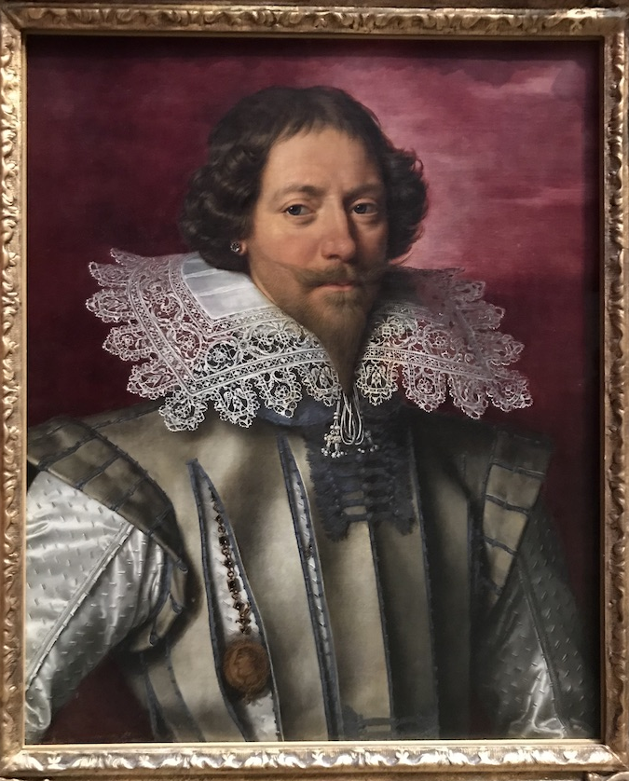
Portrait of an unknown aristocrat 1610-20
Collar made of fine lace
Medallion visible from the long slash

Slide 24
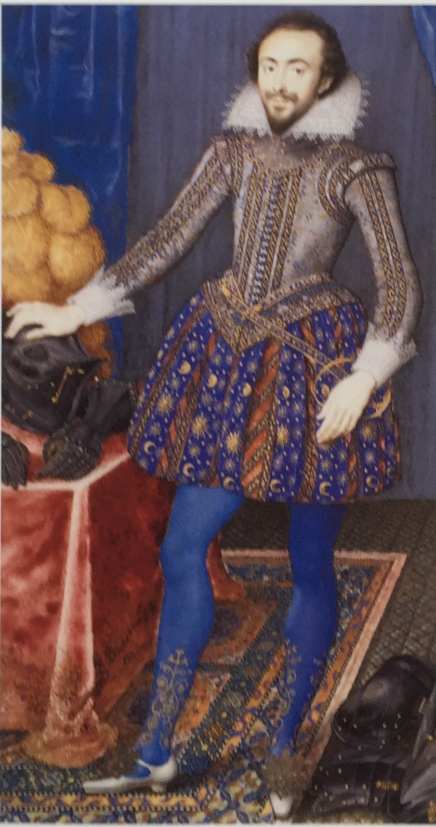
Richard Sackville, Earl of Dorset 1616
Large paned breeches, short jerkin over the doublet
Transitional plate collar is form between ruff and falling collar
Note high heeled shoes with
pom-poms and decorated socks
- Knitted and embroidered socks became highly fashionable

Slide 25
The buff jerkin
Depicts a young man in a Cavalier hat with wide brim
He wears a buff jerkin made of suede leather. It is lightweight and protective armor for daily wear
Buff jerkins are used mostly in the Low Countries, Germany and Scandinavia
She wears a plate ruff

Slide 26
An extant buff jerkin
This extant garment shows the tough leather jerkin with silver buckles down the front
Silver ribbon around the sleeves giving them a hint of a chain maille look.

Slide 27
Buff jerkin of
Gustav II Adolf, circa 1620
Livrustkammaren, Royal Armoury, Stockholm

Slide 28
Judith Leyster, The Jolly Drinker, 1629

Slide 29
The Cavalier Look
Portrait of Henry Duke of Lorraine, 1631
Falling band collar with lace edge
Longer hair and small Van Dyck pointed beard
Doublet and jerkin with slashes
Venetian breeches with ribbon appliques
Boots with turned down cuff showing the red lining

Slide 30
Charles I of England
King of England 1625 – 1649
Married Henrietta Maria of France
He has the new Cavalier look:
Van Dyck beard, moustaches
Falling band collar
Doublet longer, especially the flaps
Venetian breeches
Boots become fashionable
Long gloves

Slide 31
King Charles I of England by Van Dyck, 1635
With the constant revisiting of plague in the cities, the gentry flee to the countryside
Charles wears long hair, and a Van Dyck pointed beard.
A Cavalier wide brim hat
A satin jerkin with a falling band collar edged in lace.
A leather baldric to hold his sword
Red Venetians
Nether hose
Soft leather boots with spurs
A walking stick is the new popular accessory

Slide 32
Cavalier - Maria Louisa Tassi 1629
Medici collar is surmounted on the transitional gown.
The longer bodice is stiffened with a busk and the center panel separates out to become a stomacher.
Sleeves are lower and puffed
Sleeve panes are made of ribbon that matches the ribbon used to tie in the puffs and around the waist.

Slide 33
Extant Garments V& A, London
This ensemble has three matching pieces with ribbon trim appliqued in a pattern on all three: Doublet, Venetians and a collared cape
Boot hose with a lace edge
Boots with butterflies and spurs
A glorious falling band collar made entirely of lace

Slide 34
Queen Henrietta Maria
Painted by Anton Van Dyck in 1633 when she was 34 years old.
She wears a high waisted gown with full sleeves ending just below the elbow and elaborate cuffs
She also has a black ribbon accenting the waist with a rosette
She wears a partlet tucked in to her wide open neckline that is edge with a lace band collar

Slide 35
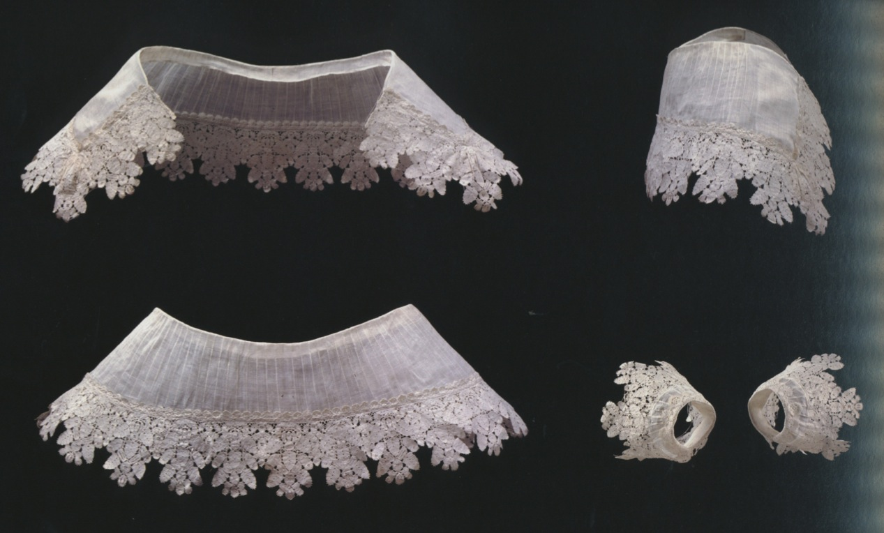
Linen and lace collar with matching cuffs

Slide 36
Van Dyck, Queen Henrietta Maria, 1640
A side profile of the Queen showing the placement of the bun.
Soft curls gracefully surround her face
Open neckline with lace
Dropped shoulder and puffed sleeves

Slide 37
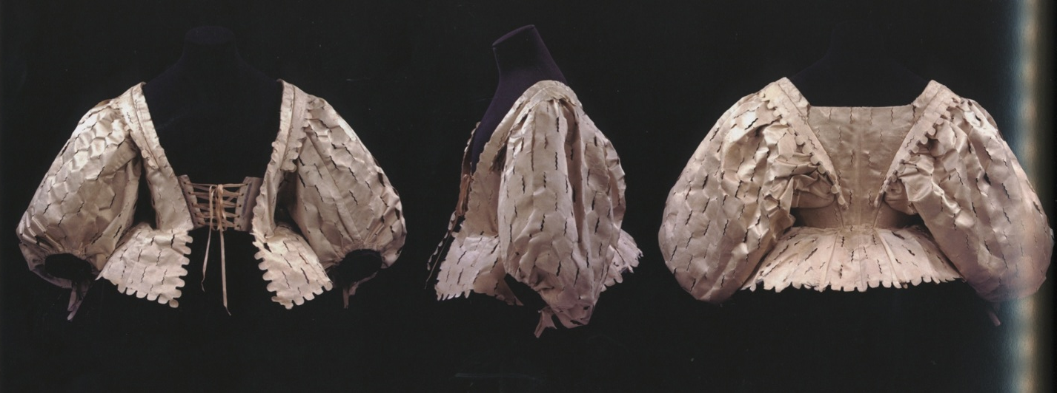
Slashed silk satin bodice 1630
Notice the sleeve setting at the back
Waist is higher than natural waistline

Slide 38
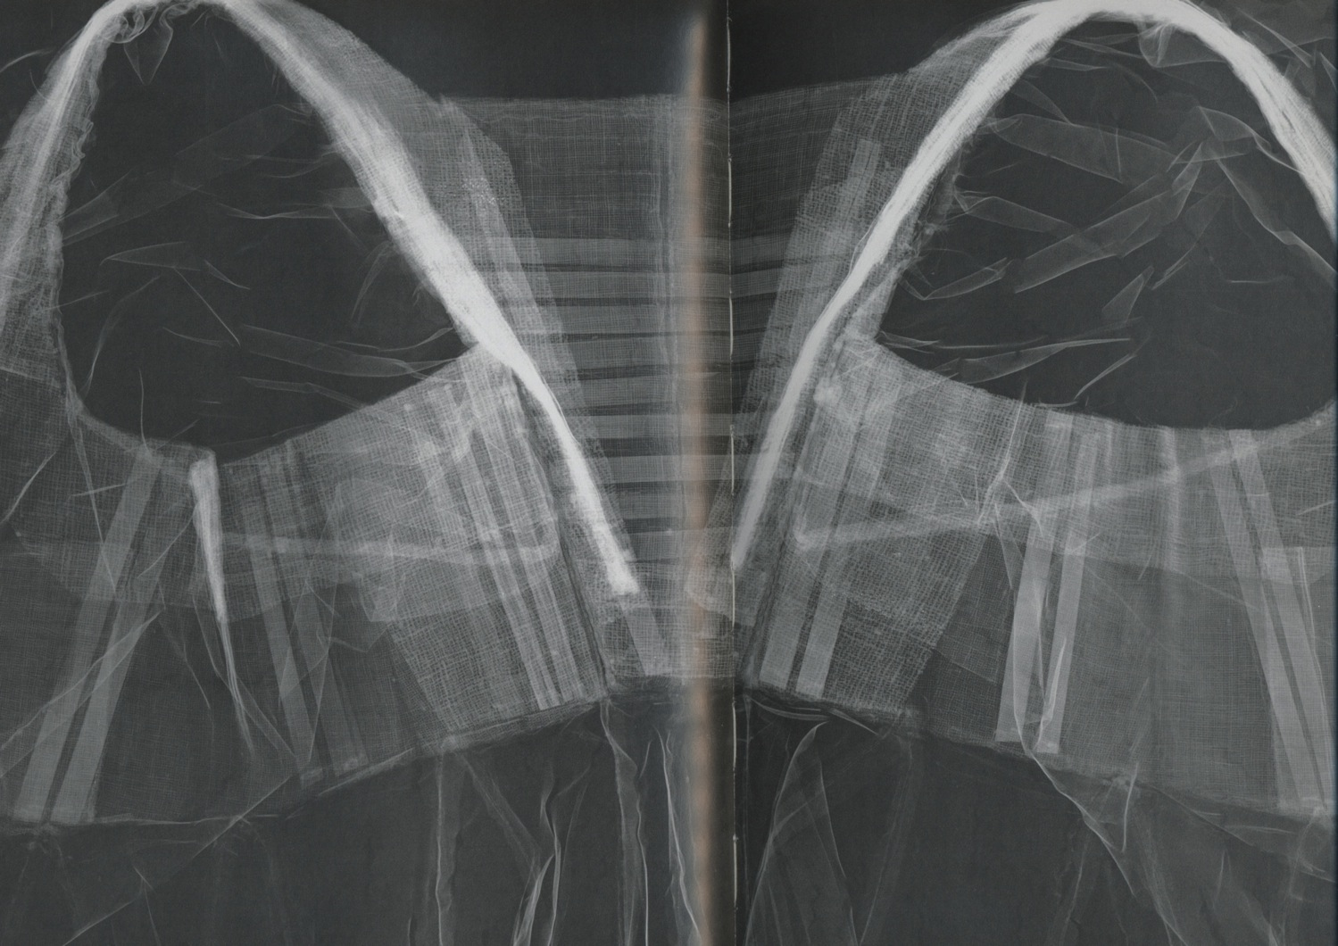

Slide 39
Court Lady from England in 1641
A side view showing the new softer, more natural round shape of these gowns. The satin was lighter weight than brocade or velvet, yet it’s stiffness allows a full shape
The train is beginning to develop
The extremely wide neckline creates a drop shoulder for the sleeve that pins the shoulders down, so the arms cannot be raised

Slide 40
Venceslaus Hollar, Habits of English Women 1640
Hollar does etchings that are printed up and distributed that show the fashions at court in England.
Here is a high waist gown of satin with an extremely wide neckline.
The shoulders are held down and then banded in lace

Slide 41
Hollar, Habits of English Women 1640
A back view of the high waist gown with its wide lace collar draping down from the neckline.
A mirror is hanging from her waist as an accessory, and she holds a fan.

Slide 42
Children of Charles I of England
In 1626 young boys are dressed in women’s attire
They also follow the adults fashion

Slide 43
Kristina at the age of 2, born 1626, daughter of Gustav II Adolf and Eleonora av Brandenburg
Bodice is structured like adults
The Royal Armoury
Livrustkammaren, Stockholm

Slide 44
Court Masque
Masque performance has a script and it ends to a grand ball dance
Leads to folk plays
This is Italian Bernardo Buontalenti’s design for a masque in Medici palace, late 16th century

Slide 45
English Court Masque
- Ben Jonson is court poet under Stuarts
1603 first Ben Jonson masque
1609 first anti-masque with grotesques
- Around 1625 Ben Jonson has artistic disagreements with Inigo Jones and Jonson leaves court
- Masques by William Davenant
- Civil war 1638, end English court theatre until Restoration

Slide 46
Inigo Jones
Travels to Italy late 16th Century
Inspired by Court Masques
Inspired by Perspective
Court Painter to Christian IV, Denmark
Queen Anne asks for him to go to England
450 Drawings for 25 Masques still exists in Chatsworth House, Derbyshire

Slide 47
First court masque, 1605

Slide 48
Court Paraders for the Coronation Ball

Slide 49
Spring and Dutch Page costume

Slide 50
An elephant wagon for James I and Queen Anne to Sit upon

Slide 51
Coronation Masque

Slide 52
Masque of Queens, 1609

Slide 53
Masque of Queens, 1609

Slide 54
Court Masquers 1613

Slide 55
Henrietta Maria as Chloris, 1631
Henrietta Marie
The daughter of Maria de Medici married Charles I in 1625

Slide 56
France
Henry of Navarre, the Protestant King is assassinated by Francois Ravaillac, a Catholic
1610 Louis XIII ascends to throne at age 9
New regency with Marie de Medicis / Louis XIII
Cardinal Richelieu gains power
1643 Louis XIV succeeds at age 4
1661 Louis XIV takes control
1682 moves court to Versailles

Slide 57
Cardinal Richelieu, 1625
1610 Louis XIII Ascends to Throne at age 9
New regency with Marie de Medicis/Louis XIII
Cardinal Richelieu gains power
1643 Louis XIV succeeds at age 4

Slide 58
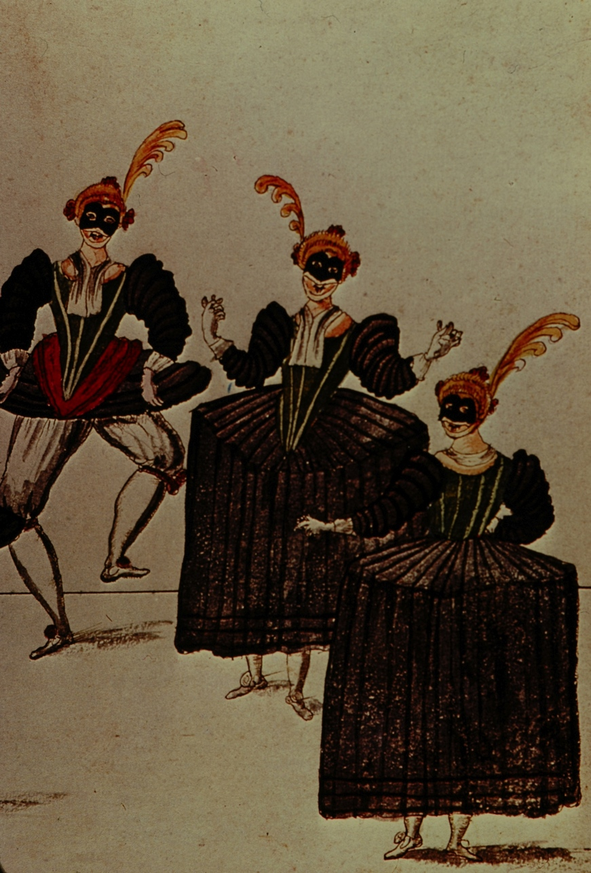
French Court Ballets
Daniel Rabel (1578 - 1637)
appointed as court designer in 1620
Louis XIII dances Court Ballets
Ballet des Fetes et Forests de St.Germain 1625
Le Ballet du Serieux et Grotesque 1627
Le Ballet des Nymphes Bocageres da la Forest Sacree 1627

Slide 59
Henri de Gissey (1621 - 1673)
Takes over after Rabel’s death -1637
Huge Spectacles began
Notes:
40 events
12 hours long at night
Louis Plays “The King”
He has become too old

Slide 60
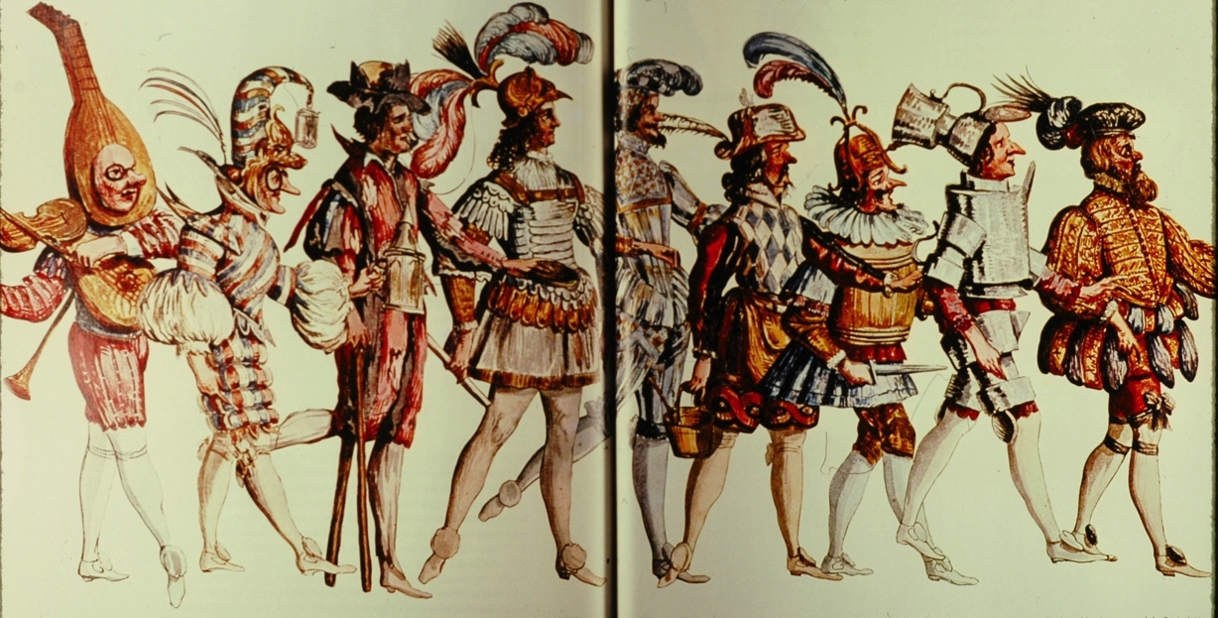
Les Fetes de Bacchus 1637
King would interact with actors
Very complete costumes
Notes:
Musician, Jester, Crippled Beggar, Bibulous King, Tipsy Courtier, Town Crier, Barrel-chested Swordsman, Reveler in Wine Mugs, and the Host

Slide 61
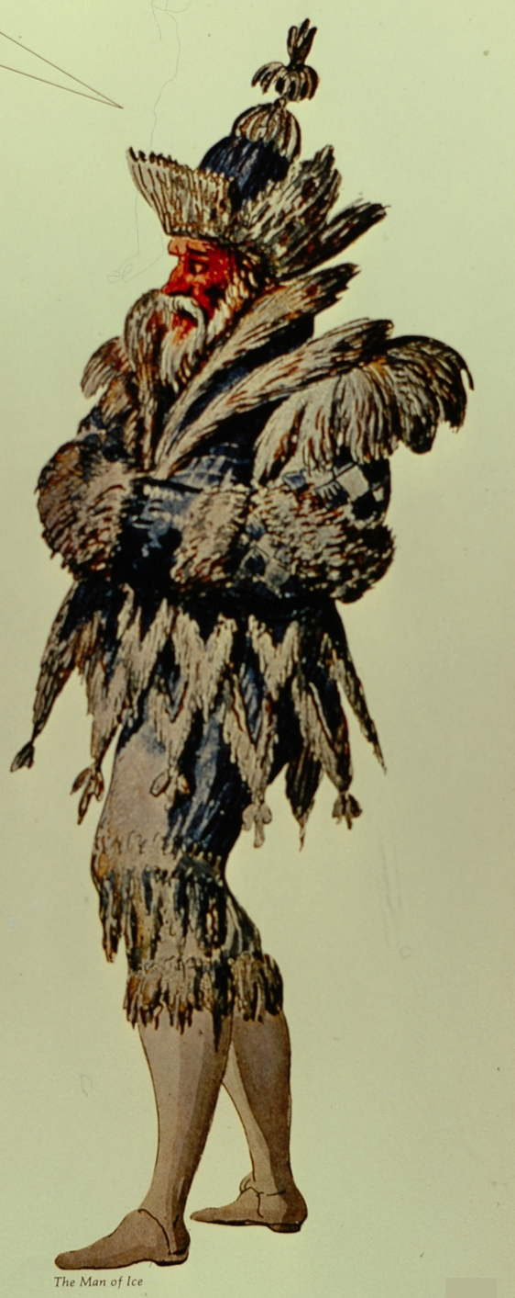
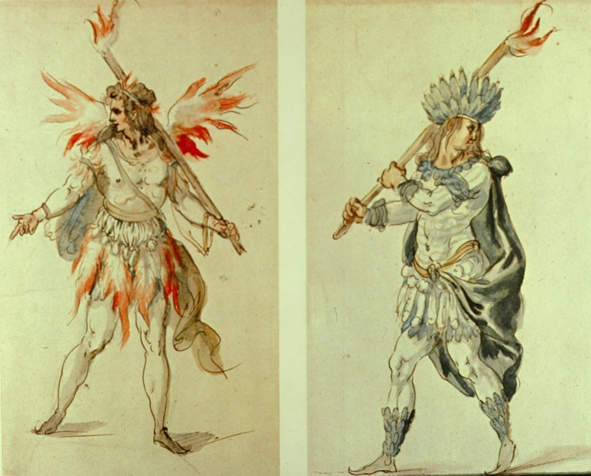
Henri de Gissey, Fire and Ice 1637
Another pagent of de Gissey with everything in extremes of hot and cold. Visit of King from the North.

Slide 62
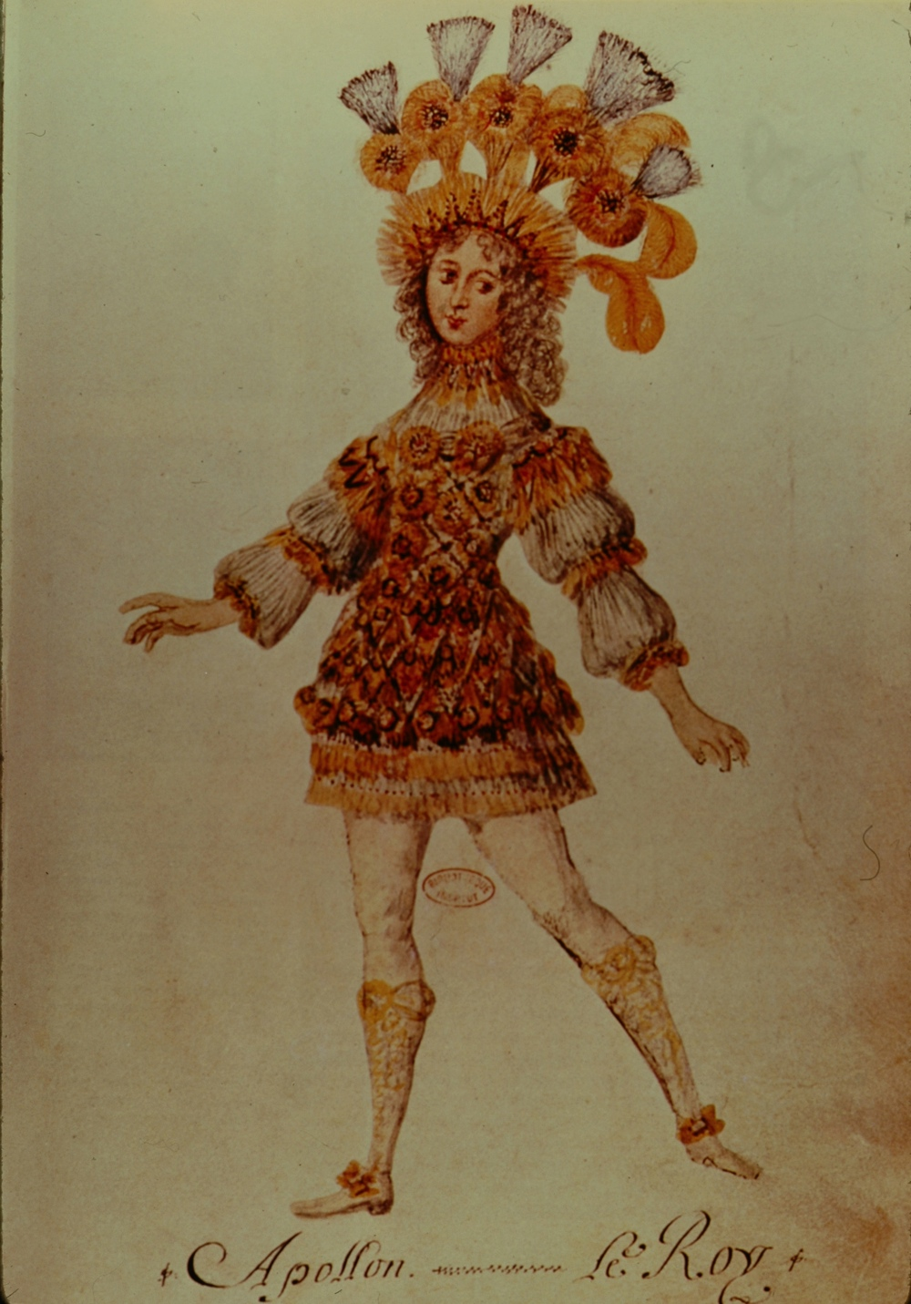
France and The Sun King
1643 Louis XIV succeeds at age 4, rules untill age 77 (1715)
Cardinal Mazarin (1642 – 1661) takes control after Richelieu (1624-1642)
Paris Parliament rises up against Mazarin
Civil War (The Fronde) 1648-1653

Slide 63
Louis XIV marries Marie-Therese in 1659 (Age 20)
Marie-Therese is the daughter of Philip IV of Spain
Marriage ends war with Spain
Philip’s wife is Anne of Austria (Louis XIII Sister)
Blond haired, blue eyed Austrian. Blond is fashionable - beginning of
powdered wigs
- Madame de la Valliere
was his first official
mistress
- They have many children,
later legitimized

Slide 64
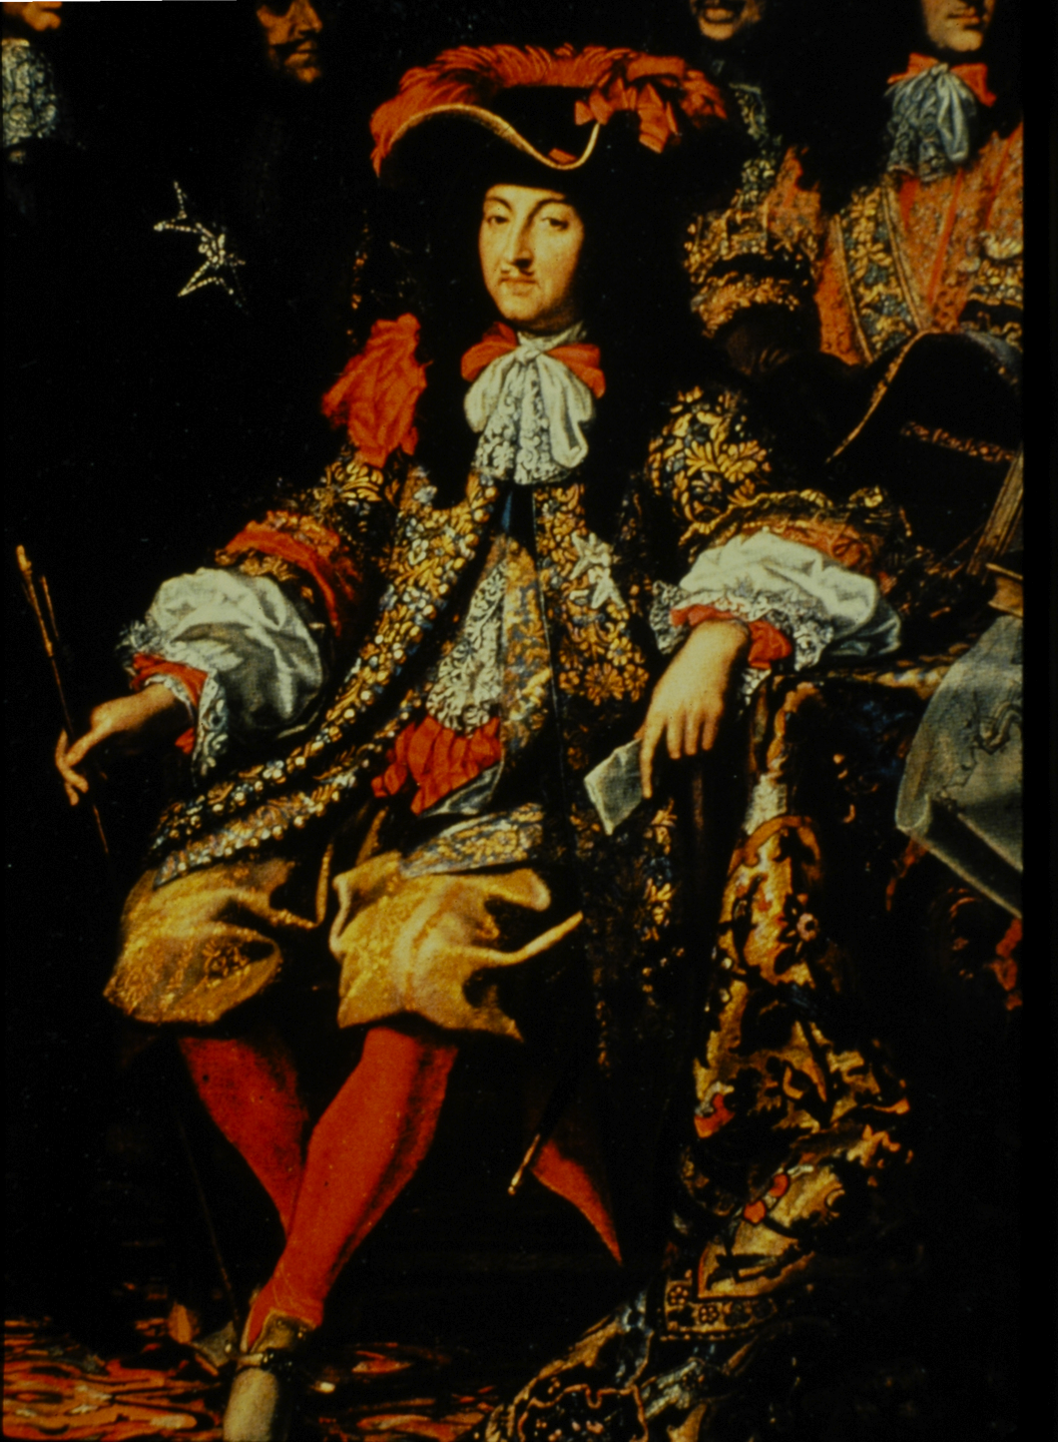
Louis XIV as patron of the arts
Writers
Jean-Baptiste Moliere
Jean Racine
Voltaire chronicles reign “Age of Louis XIV”
Fashionable long waistcoat, established by king Charles II of England in 1666

Slide 65
Louis XIV starts Academie Royal de Danse – in 1661
Trains professionals to do the court dances
Comedie - Ballet (Moliere-Lully)-1661
Designer Henri de Gissey
Le Carousel de Louis XIV – 1662
Louis takes on a new mistress in 1667, Madame de Montespan

Slide 66
1661 Louis XIV takes control (Age 22)
Establishes a dictatorship by divine right
God’s representative on earth
The beginning of 54 years of devoted work
Gets economy to work by banning all non-French Fabrics
Court etiquette, road building, theology - Courtiers purchase fabrics and clothes to show at court. Good for the economy& good for the stability of the country.
Portrait of Jean-Baptiste Colbert, Minister of Finance to Louis XIV
Wears natural long hair, small beard & moustache
Rabat collar evolved from falling band collar

Slide 67
Courtly Manners
11 civil wars in past 40 years
Louis encourages gambling, pleasing the king
Court etiquette becomes a means of governing
Portrait of Ignazio Maurgi Rosso Senator from Parma Italy.
Peruke/Peruque/Full bottomed wig
Cassock Coat
Petticoat Breeches with Ribbons
Rabat turning into a cravat
Heeled Shoes & Rosettes

Slide 68
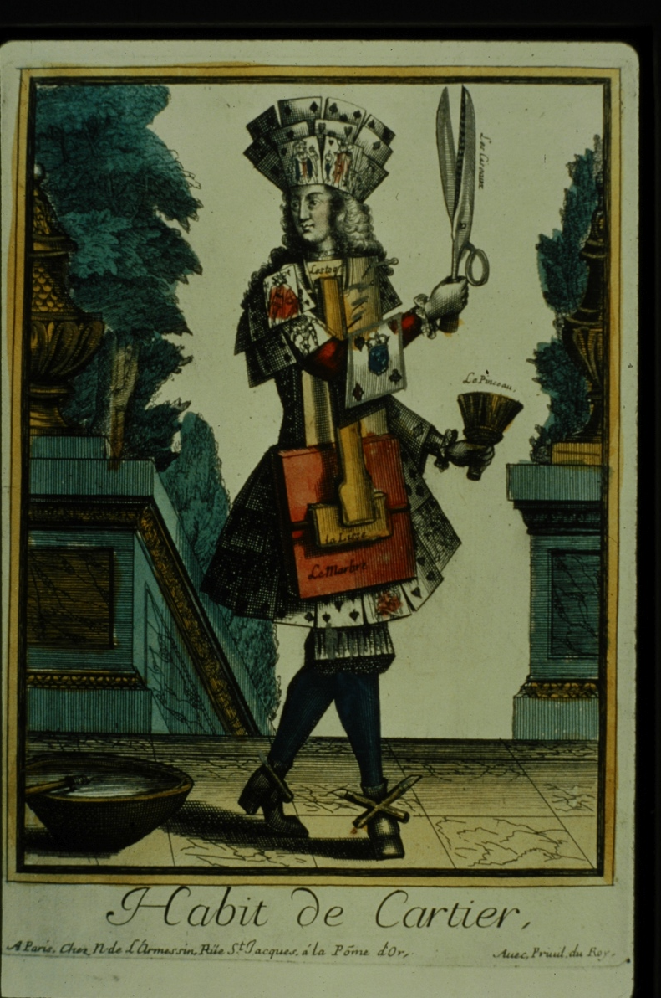
Louis encourages Fashion
A card advertising a tailor
“a couture of habits/costumes”
a costume made of cards -since the king encouraged card games and gambling to keep the nobles distracted.

Slide 69
Predominant style of women’s dress between 1660-80
Front piece of the bodice grows longer
Wide collar is called a whisk
Puffed sleeves, dropped shoulder

Slide 70
Bodice and skirt from 1660
In this example one can see clearly these two pieces
Very long stiff bodice
Oval neckline without a collar
This soft style of fashion was established by Louis XIV mistress Madame de Montespan
- Originates from her numerous pregnancies

Slide 71
Siamese ambassadors visited Louis XIV court
Their sumptous garments are said to have inspired these striped cotton fabrics called siamoises

Slide 72
French fashion plate, mantua 1685
Between 1680-1710, Women’s dress silhouette was narrow and tall
Skirt shifts to back, ruffles, puffs, trimmings
Bodice and skirt sewn together, like long coat, called mantua
Following trends of Louis XIV’s new mistress Madame Maintenon

Slide 73
Hired professional tailors made garments for upper classes throughout the century
Tailors were mostly men, although women began to move into this profession after 1675
A group of French women seamstresses applied for the right to form guild of female tailors
Notes:
Hollander: as a result: a difference in the way clothes were conceived and made for the two sexes came into existence for the first time

Slide 74
Mantua, 1690
Hand-colored fashion plates began to be produced in Paris in the late 17th century
She wears fashionable headpiece called fontange
Named after one of Louis XIV’s mistresses Madamoiselle de Fontange

Slide 75
Low Countries & Holy Roma Empire
Senior merchant of the Dutch East India company 1640
Low Countries used black colour and millstone ruff longer than others because of the connection with Holy Roman Empire and Spain

Slide 76
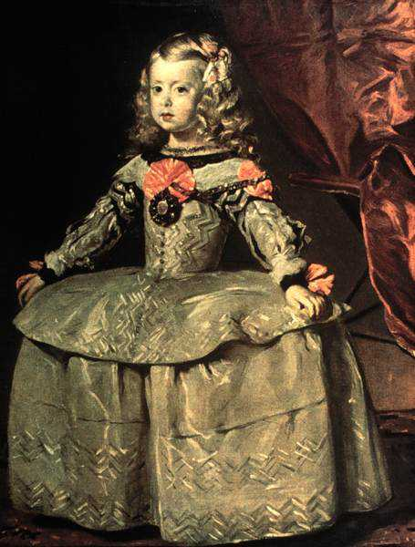
Mariana of Austria, Queen of Spain and Infanta Margarita
She is the daughter of Maria Anna of Spain. Married at 14 to Philip IV who was her uncle
She is regent in 1665 since her her husband Philip IV dies and her sickly son comes to the throne at age of 3
The Spanish court maintains the Wheel Farthingale long after others have dropped it. The top half becomes like a jacket with it’s huge peplum.

Slide 77
Charles II of Spain at age 15
He only lived to the age of 36 and was the last Hapsburg King.
Too much intermarriage among the Hapsburgs. He is the son of Philip IV and Philip’s niece.
He wears a fashionable cravat like Louis XIV and red bow made of ribbons

Slide 78
Inés de Zúniga, countess of Monterey 1660- 1670
Following the spanish court style

