Slide 1
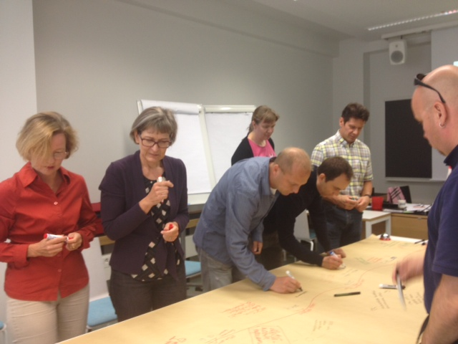
Learning and Teaching in Higher Education (5 cr)
Kirsti Keltikangas and Päivi Kinnunen
Contact session 1, 7.3.2018
Photo: Maire Syrjäkari, 2014
Notes:
Maire

Slide 2
WELCOME TO THE COURSE!
Learning and teaching in higher education (5 cr) Contact session 1: University pedagogy and learning theories
Instructors:
Kirsti Keltikangas Päivi Kinnunen
Pedagogical specialist (SCI) Pedagogical specialist (BIZ)
kirsti.keltikangas@aalto.fi paivi.kinnunen@aalto.fi

Slide 3
People in this course (21) coming from all six schools speaking these languages

Slide 4
Schedule
9.00-11.00 Welcome!
Who are we?
Introduction to the course
Pre-assignment and expectations for the course
11.00-12.00 Lunch
12.00-15.15 Researching the education of own field
Learning and learning theories
15.15-15.30 For the next session
Feedback
Notes:
9.00-10.00 Welcome!
Who are we?
Introduction to the course
10.00-11.00 Pre-assignment and expectations for the course
11.00-12.00 Lunch
12.00-14.45 Learning and Learning theories
14.45-15.15 Researching the education of own field
15.15-15.30 For the next session
Feedback

Slide 5
Aalto University Pedagogical Training (25 cr)
More Information on the upcoming courses in Inside: https://inside.aalto.fi/display/enles/The+structure+and+the+courses+of+pedagogical+training
Notes:
No certificates anymore
After the course tacher in charge will ask learning service staff to register the grade results to Oodi, where youj can see them or ask for a transcript of study record.

Slide 6
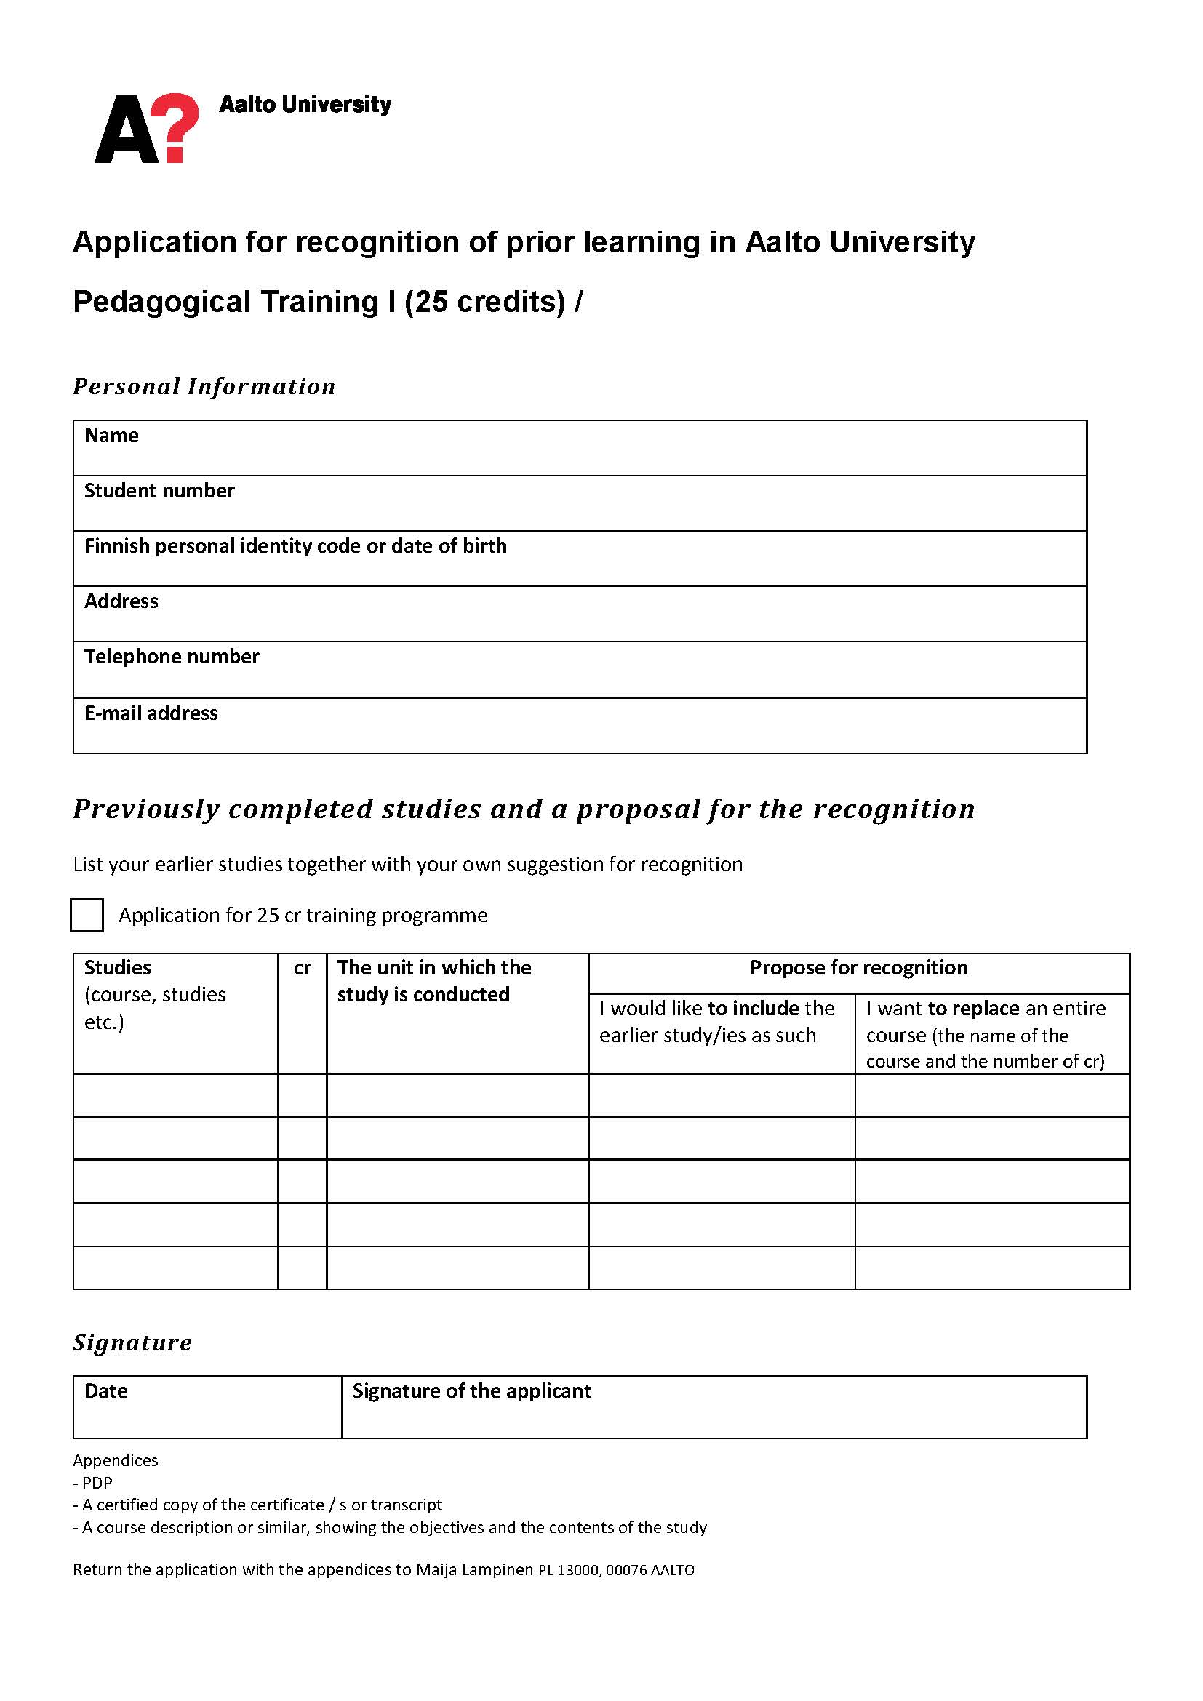
Recognition of Prior Learning (RPL)
If you wish to complete Aalto University pedagogical studies (25 cr) and you have some earlier pedagogical studies (e.g. a course)
You can include the earlier study/ies (e.g. as an elective course) or you can to replace an entire course into the entity.
Contact teachers
At least 10 cr of the pedagogical studies (25 cr) should be completed at Aalto University.
Notes:
Maire hyöty: tulee kirjattua Aallon systeemiin (osaaminen tunnistetaan ja tunnustetaan)

Slide 7
After Aalto University (25 cr) entity you
have acquainted yourself with different types of teaching and learning approaches and have formed your own approach to teaching and learning.
are familiar with different teaching methods and know how to apply them in your teaching.
are familiar with different phases of course design and you can evaluate their meaning in educational development.
have developed your expertise in supervising students and you are able to activate students in their learning processes.
are familiar with information and communication technology in teaching, also from the learner's perspective.
are familiar with the teaching and teachers in different disciplines of Aalto University.
recognize your own strengths and development needs as a teacher.
have completed a guided teaching practice.

Slide 8
:
Learning outcomes for the course
After the course, you
are able to identify, define and evaluate factors that affect your teaching
are able to recognize different theories of learning and you have become aware of how they influence teaching
have formed your own approach to teaching and learning/ teaching philosophy and you have knowledge on how to develop your teachership and teaching
you recognize factors, which affect to the quality of teaching
are able to understand your teaching in a wider context and envisage the expertise provided by your own field of teaching and the future prospects of the field.
Photo: Maire Syrjäkari, 2014
Notes:
Päivi
Oman alan asiantuntijuuden ja pedagogisen asiantuntijuuden yhdistäminen
Verkostoituminen ja kokemusten jakaminen
Tietoisuuden syventäminen omasta toiminnasta ja ajattelusta opettajana
Itselle sopivien opetusmuotojen ja -tapojen kehittäminen
Ammatillinen kehittyminen ja uralla etenemisen tukeminen

Slide 9
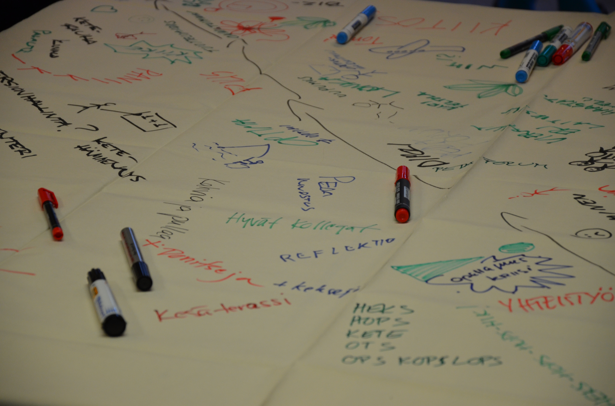
Learning outcomes After the day you
Know other participants and you have familiarized yourself with the course and working methods
are able to identify different learning theories
aware of different aspects of learning
have started to construct your own approach to teaching.
Photo: Maire Syrjäkari, 2014
Notes:
Päivi

Slide 10
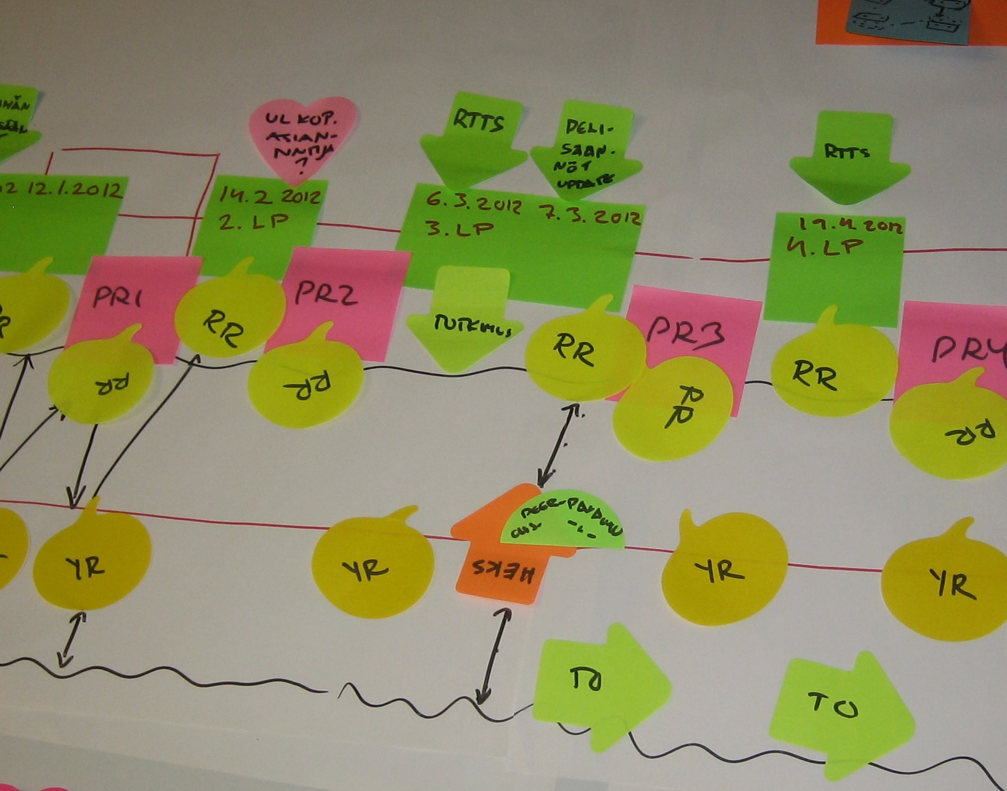
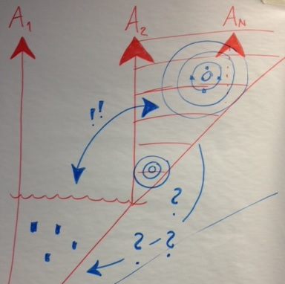
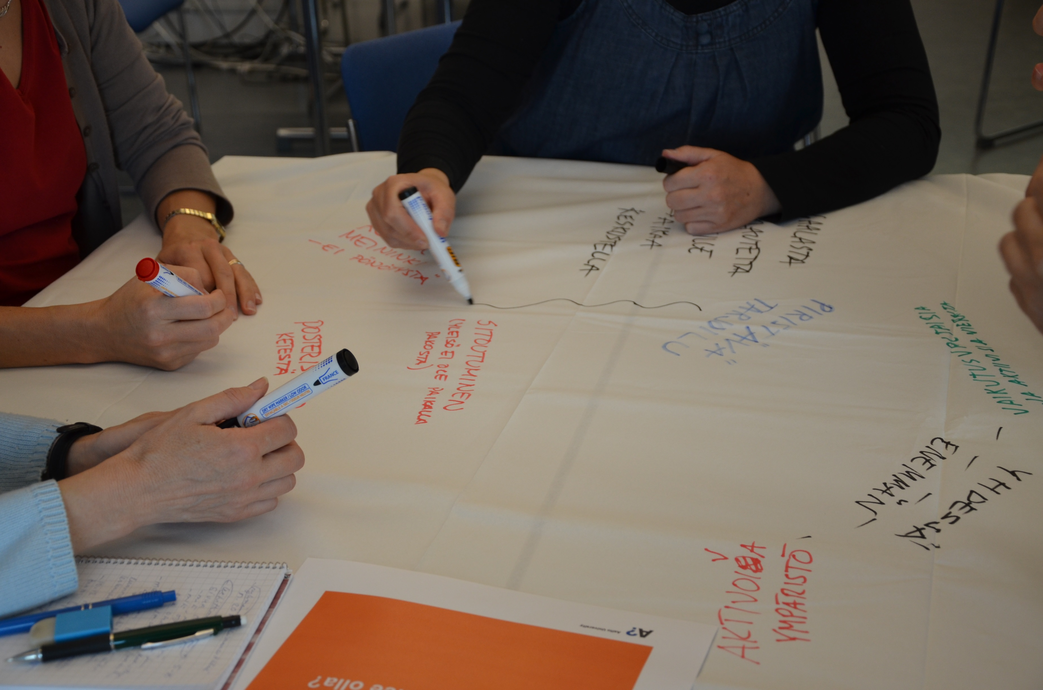
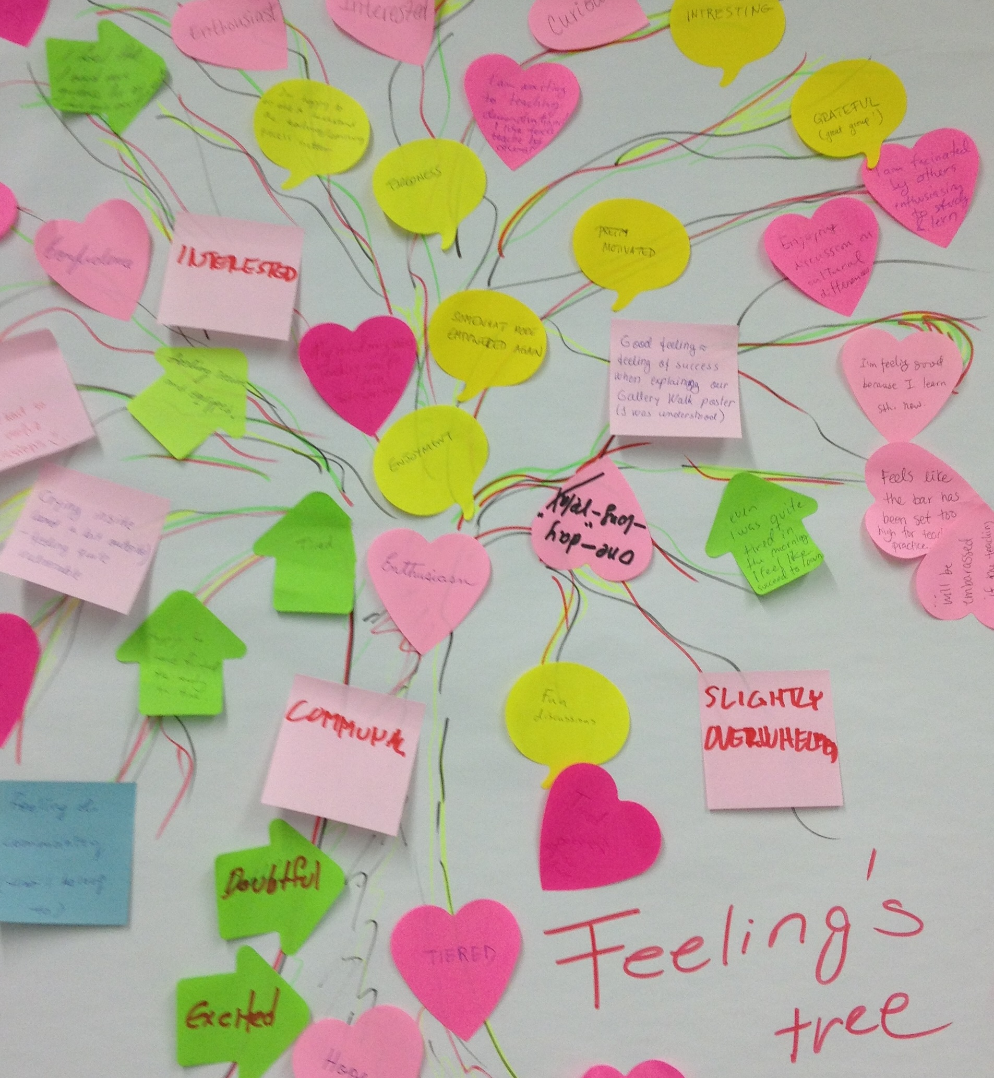
Timeline: Learning and Teaching in Higher Education (5 cr)
Pre-assignment
DL 1.3.2018
CS1: 7.3.2018
University pedagogy and learning theories
CS2: 21.3.2018
Approach to teaching and expertise
CS3: 12.4.2018
Reflection, expertise and development
CS4: 4.5.2018 Quality of teaching
Log 1 DL 12.3.
Log 2 DL 27.3.
Log 3 DL 16.4.
Log 4 DL 9.5.
Reading tasks (3) DL 20.3.
Reading tasks (2) DL 11.4.
Reading tasks (2)
DL 3.5.2018
Essay: Approach to learning and teaching
Essay: version 1.0 DL 27.3.
Essay: Peer feedback DL 11.4.
Essay: version 2.0 DL 20.4.
Essay: Facilitator feedback
DL 3.5.
Essay: Final version DL 23.5.2018
Notes:
Maire
what kind of thoughts arose
we do not have unnecessary tasks
Each activity will benefit the formation of your own approach to learning and teaching and to develop your own teachership

Slide 11
Contents
How to develop my own teachership?
How to support my students’ learning?
Learning
Learning centred culture
Quality of learning
Expertice
(students)
Learning theories
Approach to learning and teaching
Reflection
Providing & receiving feedback
Quality of teaching
Expertice
(teacher)
Picture: http://schools.cbe.ab.ca/b806/library/Imageswebpage/teacher2.gif
Notes:
Päivi
Theories of learning, approaches to teaching and learning
Evaluation and quality as a part of teaching development
Societal dimensions associated with teaching at universities
Future outlooks related to teaching in disciplines
Individual development as a teacher
Know other participants and you have familiarized yourself with the course and working methods
Are able to indentify:
different learning theories,
how learning theories are applied in teaching situations.
Tää olis kivat tapa esittää sisällöt
Feedback
Course planning as a part of curriculum work
Expertise in teaching and learning
Learning centred approach to course planning
Writing intended learning outcomes
Core content analysis
Teaching and assessment methods
ICT tools
Course work load
Assessment and feedback as a part of development of own courses
Providing & receiving constructive

Slide 12
Cocktail-party
Your name
The best in my home country is..
What are my strengths as a teacher?
Notes:
Päivi
Coctail party
Lappuun kirjoitetaan nimi, mistä tulee, mitä odottaa kurssilta
2-3 hengen ryhmissä keskustellaan ja vaihto muutaman kerran. Ohjaajat osoittavat milloin vaihdetaan.
Nimikierros
Perustelu, miksi lämppäri
15 min

Slide 13
Break
Notes:
Pikkutauko korkeintaan 10.10 saakka

Slide 14
Snow ball –method: What is learning?
Step 1: (working time 10 min)
Take a look at your pre-assignment. Tell your pair about your own approach to learning and teaching. How do you define learning? Discuss with your pair and consider together your conception of learning. Create common mindmap (or concept map) on learning by writing on sticky notes one concept per one sticky note related to your conception.
Step 2: (working time 15 min)
Two pairs combine their mind maps to create together a new common one. You can also add new things to your map.
Picture: http://people-equation.com/the-snowball-effect-when-small-workplace-offenses-grow-out-of-control/
Notes:
Päivi
12.00 -13.10
20+15+20+10= 70 min
Vaihe 1: Jaetaan pareiksi opetuskokemusjanan mukaan.3 ryhmää joissa 3 hlö ja 5 ryhmää joissa 2 hlö
Vaihe 2: Yhdistetään pareja ohjeen mukaan (1+2 ja 3+4 Ja 5+6 ja 7+8
Purku 15 min/2. pääasiat käsitekartasta. Yksi- kaksi esittelee.
Purun jälkeen teoriaan
Koko harjoitukseen 75 min.
----------------------------

Slide 15
Snow ball –method: What is learning?
Step 3: (working time 20 min)
Next, we form two new groups by combining two previous groups together. Create new common mindmap.
Step 4: (working time 5 min/group)
Group presents its common mindmap of conception of learning.
Picture: http://people-equation.com/the-snowball-effect-when-small-workplace-offenses-grow-out-of-control/
Notes:
12.00
-13.10
20+15+20+10= 70 min
Vaihe 1: Jaetaan pareiksi opetuskokemusjanan mukaan.3 ryhmää joissa 3 hlö ja 5 ryhmää joissa 2 hlö
Vaihe 2: Yhdistetään pareja ohjeen mukaan (1+2 ja 3+4 Ja 5+6 ja 7+8
Purku 15 min/2. pääasiat käsitekartasta. Yksi- kaksi esittelee.
Purun jälkeen teoriaan
Koko harjoitukseen 75 min.
----------------------------

Slide 16
Lunchbreak 11-12

Slide 17
Education research in your own field of education
Notes:
14.30-15-00
30 min max15.10

Slide 18
What is educational research in your field?
Field of science
Educational science
e.g. math education research
Pedagogy/didactics
Higher education pedagogy
Sociology
Subject matter pedagogy
Psychology
Philosophy

Slide 19
Examples of topics that have been researched in the fields of engineering education research and physics and chemistry education research
Much researched topics:
Teachers’ pedagogical actions (e.g., used teaching methods) and their effect on students’ learning outcomes.
Students’ characteristics
Goals and content of education, what is taught
Less studied topics:
Teachers, e.g., teachers’ characteristics, teachers’ perceptions on students’ learning process
Kinnunen, P., Lampiselkä, J., Meisalo, V., & Malmi, L. (2016). Research on teaching and learning in Physics and Chemistry in NorDiNa Papers. Nordic Studies in Science Education, 12(1), 3-20.
Kinnunen, P. & Malmi, L. (2013). Pedagogical focus of recent engineering education research papers. Proceedings of 41th SEFI Conference, 16-20 September 2013, Leuven, Belgium

Slide 20
Why doing educational research in your subject field is worth while?
You don’t have to rely on gut feeling on what works and what doesn’t work in teaching?
You may get information, e.g., on:
Who your students are: how do they think, what kinds of conceptions (or misconceptions) they have
How students study
What effect specific teaching method/assignment type … had on students’ learning/ persistence/drop out rate/motivation/interest on the topic.
Why this teaching method works
→ better understanding of learning process → you are better equipped to guide the learning process.

Slide 21
What to pay attention to when starting to do educational research on multidisciplinary area
You need:
Knowledge of theories used in different fields, e.g., prevailing theories of how people learn.
Understanding of (concurrent) research paradigms that have an effect on:
what is regarded interesting to study (~what kind of research questions are regarded interesting)
what kind of research methods are used and the type of results that research produces.
To find out how to present and disseminate your results. How to write a research paper in another field; what you should elaborate in the paper and what is taken for granted in the field, writing style ....
→ Interdisciplinary collaboration is useful: you most likely don’t have enough expertise in both fields.

Slide 22
Jawitz, J. & Case, J. 2009. Communicating your findings in engineering education: the value of making your theoretical perspective explicit. European Journal of Engineering Education. 34(2), 149-154. (Table from p. 151)
Examples of research paradigms in engineering education research
 | Positivism | Constructivism | Critical inquiry
Aim of the research | Establish facts and laws | Develop useful interpretations | Achieve social change
Research is guided by | Testable hypotheses | Research questions | Social problems
Role of researcher | Objective observer | Constructer of interpretations | Change agent
Example RQ | What factors influence study success in engineering education? | How do students use lectures and tutorials in their learning? | Does the institutional culture result in different groups of students feeling at home or alienated ?
For further reading:
Pears, A., Thota, N., Kinnunen, P. & Berglund, A. (2012). Harnessing Theory in the Service of Engineering Education Research. Proc. 42nd ASEE/IEEE Frontiers in Education Conference. October 3-6, 2012, Seattle, Washington, USA. 391–395.

Slide 23
From developing education towards research in education

Slide 24
Doing research
Developing teaching
What worked/didn’t work last time I gave this course? Define what you want to develop in the course
What information/skill you need to obtain in order to make the needed changes?
Make a concrete plan what changes you’ll make in a course
Put the plan in action
Collect data/evidence on what kind of effects the changes have had.
Conclude which changes you’ll keep next time
Distribute good practices
Define research question(s)
Do literature review/ what do we already know about the topic
Construct hypothesis based on the background work.
Empirical part: collect data
Analyze data
Interpret results, make conclusions
Distribute the results

Slide 25
Different options to make educational research in your field part of your professional development
Read recent educational publications in your field. E.g., math education research has a long history already so there is much to read.
Approach developing your own teaching with the same systematic mindset as you do when doing research in your field.
Attend workshops and national/international conferences on educational research in your field
Get to know other teachers/researchers in your field
Publish conference & journal papers
One of your homework is about finding & reading a research paper in your field – so you get to take the first step now ☺

Slide 26
Journals
Journal of Engineering Education
European Journal of Engineering Education
Computer Science Education
ACM Transactions of Computing Education
IEEE Transactions on Education
IEEE Transactions of Learning Technologies
Computers & Education
British Journal of Educational Technology
Journal of Chemical Education
Chemistry Education Research and Practice
Journal of Management Education
International Journal of Art & Design Education

Slide 27
Some engineering education research and computer science education conferences
Frontiers in Education (FIE)
Annual SEFI conference
American Society for Engineering Education conference (ASEE)
Research in Engineering Education Symposium (REES)
Innovation and Technology in Computer Science Education (ITiCSE)
International Computing Education Research conference (ICER)
Koli Calling – International conference in computing education
research

Slide 28
Break
Notes:
14.20-14.30

Slide 29
Learning theories
Notes:
Maire
Noin 20 min input 13.30-13.50
whether the theory and practice in line with each other, or is there something contradictory

Slide 30
Learning Theory, Theories of Learning, Conception of Learning, Approach to Learning…
Learning theory, Theories of Learning – a scientific theory explaining learning, based on research
Conception of Learning, Approach to learning - individual’s conception of learning
Terms are used differently in the literature
Lindblom-Ylänne, S. ja Nevgi., A. (toim.) 2009 Yliopisto-opettajan käsikirja.
Notes:
whether the theory and practice in line with each other, or is there something contradictory

Slide 31
Essential questions
How does a person learn?
How do we define learning?
What is a teacher’s role and task in learning process?
How teacher’s teaching activities support learning?
How student’s studying activities support learning?
What is a student’s role and task in learning process?
What kind of learning environment supports learning?
Notes:
Miten ihminen oppii?
Miten oppiminen ymmärretään?
Miten oppimista tämän tiedon valossa voi edistää?
Minkälaiset olosuhteet ja tilanteet tukevat oppimista?
Minkälaiset olosuhteet ja tilanteet estävät tai haittaavat oppimista?
Mikä on opettajan rooli tai tehtävä oppimisessa
Mikä on oppijan rooli tai tehtävä oppimisessa ?
Opetusteot ja oppimisteot
Opetusmenetelmälliset ratkaisut

Slide 32
Learning theories
Behaviorism
(1900→)
Cognitive
Psychology
(1950→)
Constructivism
(1960) 1990→
?
Notes:
There are three main paradigmas; behaviourism, cognitive psychology and constructivism
Learning theories are the products of their own age and context. They have been developed by educational research of that time.
Paradigmas have rised to answer the questions that previous one couldn´t
whether the theory and practice in line with each other, or is there something contradictory
criticism focused
According to the behaviouristic idea of learning, learning is an externally controlled change in behaviour, formation of new stimulus-reaction links. Teaching is organised in the following steps:
setting clear, concrete and measurable behavioural goals.
dividing the learning material into small sections.
defining and finding suitable reinforcements for behaviour, means for rewarding the desirable results
Cognitive psychology: after behaviourism, attention was focused on the internal phenomena of the human mind. From 1950's, targets for research included problem-solving, memory, language, selective attentiveness. Cognitive psychology is based on experimental and scientific research, and it does not consider the introspection in cognitivism the only or the most reliable source of information. A clear point in time for the emergence of cognitive psychology is difficult to define, but it received important impulses from the development of artificial intelligence and cognitive science in 1956.^{[1]} The term was accepted in wide-spread use thanks to the book by Ulrich Neisser titled Cognitive psychology that came out in 1967.
The cognitive phase was followed by constructivism.
Social constructivism: a general name for various lines of research based on the idea of social construction of information. Social constructivism looks at the social construction of reality and meanings.
As the founding work of social constructivism is usually considered the book by Peter Berger and Thomas Luckmann : The Social Construction of Reality, which was published in 1966 and translated into Finnish in 1994. According to Berger and Luckmann, reality is a shared system of meaning constructed in social interaction, not a reflection of "genuine reality". This work remains important for today's social constructivism, and for example the study of narrativity and discourses have continued developing this tradition.
Yksilön kasvua ja kokemuksen merkitystä korostavat teoriat: Theories which underline one’s growth and the meaning of experiences: Humanistic, transformative learning (Mezirow), experiential learning (Kolb).
Three main paradigms of educational research
Different theories are placed under these ”umbrellas”
These three don’t cover all the theories and the ”chronological boundaries” are not clear
Paradigms have raised to answer to the questions that previous one couldn’t
Oppimisen teoriat voidaan karkeasti esittää tällä tavalla (vrt. ennakkolukutehtävänä ollut artikkeli)
Minkä tyyppiseen oppimiseen voidaan päästä?

Slide 33
Behaviorism
(1900→ 1950…1960)
Key actor/role: teacher
Learner’s role: passive, responses to stimulus
Learning is seen as a change in external behaviour.
Stimulus
Black box (student’s mind)
Reaction
Feedback
Learning process according to behavioristic learning theory
Learning theorists: Pavlov, Skinner
Notes:
(jos aikaa, niin käydään näitä muutamaa lyhyesti läpi)
Behaviorism focuses on one particular view of learning: a change in external behaviour achieved through a large amount of repetition of desired actions.
Good habits are rewarded.
According to this approach a teacher is a domain person in a classroom. And learning takes place by repetitive practice. Student´s mind is a black box and she or he is getting some kind of stimulus and student have to respond to that.
Pavlov´s experiments formed a basis of this method (1913)
Excample of today: language studying with computer program (words, grammar, pronauncing)
A pilot can practice flying in simulator in special circumstances.
criticism focused…
According to the behaviouristic idea of learning, learning is an externally controlled change in behaviour, formation of new stimulus-reaction links. Teaching is organised in the following steps:
setting clear, concrete and measurable behavioural goals.
dividing the learning material into small sections.
defining and finding suitable reinforcements for behaviour, means for rewarding the desirable results
Behavioristinen oppimiskäsitys
Mm. John B. Watson, Ivan Pavlov, B. F. Skinner, E.L. Thorndike (1910-luvulta lähtien)
Kasvatusoptimismi, edistysusko, luonnontieteiden kehitys, empiirinen psykologia, positivistinen tieteenfilosofia
Oppimisen alkeisilmiöt, jotka ilmenevät reagointina ja havaittavina käyttäytymisen muutoksina.
Käyttäytyminen on kuvattavissa ja selitettävissä havaittavien ärsykkeiden ja reaktioiden avulla eikä sen selittäminen edellytä sisäisten prosessien mukanaoloa
Oppiminen on tottumista ympäristön säännönmukaisuuksiin, tarkoituksenmukaisten reaktioiden vahvistumista ja epätarkoituksenmukaisten reaktioiden häviämistä
Behavioristinen oppimiskäsitys
Mm. John B. Watson, Ivan Pavlov, B. F. Skinner, E.L. Thorndike (1910-luvulta lähtien)
Kasvatusoptimismi, edistysusko, luonnontieteiden kehitys, empiirinen psykologia, positivistinen tieteenfilosofia
Oppimisen alkeisilmiöt, jotka ilmenevät reagointina ja havaittavina käyttäytymisen muutoksina.
Käyttäytyminen on kuvattavissa ja selitettävissä havaittavien ärsykkeiden ja reaktioiden avulla eikä sen selittäminen edellytä sisäisten prosessien mukanaoloa
Oppiminen on tottumista ympäristön säännönmukaisuuksiin, tarkoituksenmukaisten reaktioiden vahvistumista ja epätarkoituksenmukaisten reaktioiden häviämistä

Slide 34
Cognitive Psychology
(1950→1960)
Why?
Cognitive psychology replace behaviorism as a dominant paradigm in 1950-60. They criticized the black box of human mind -> it should be opened and understood.
Student’s role: an active data processor
Learning is an internal mental process, a change in schema (mental model)
Learning theorists: Levin, Jean Piaget (1896-1980), David Ausubel (1918-2008)…
Notes:
After behaviorism attention was focused on the internal phenomenom of the human mind.
Cognitive psychology replace behaviorism as a dominant paradigm about 1950-60.
The argued that the black box of human mind should be opened and understood
Opening a black box is valuable and necessary for understanding how people learn.
The thought that mind is like computer.
Schemata is like a model in mind.
criticism focused…
Skeema, aCognitive psychology: after behaviourism, attention was focused on the internal phenomena of the human mind. From 1950's, targets for research included problem-solving, memory, language, selective attentiveness. Cognitive psychology is based on experimental and scientific research, and it does not consider the introspection in cognitivism the only or the most reliable source of information. A clear point in time for the emergence of cognitive psychology is difficult to define, but it received important impulses from the development of artificial intelligence and cognitive science in 1956.^{[1]} The term was accepted in wide-spread use thanks to the book by Ulrich Neisser titled Cognitive psychology that came out in 1967.
The cognitive phase was followed by constructivismssimilaatio, akkomodaatio, täydellisen oppimisen malli (Engeström)
keema, assimilaatio, akkomodaatio, täydellisen oppimisen malli (Engeström)

Slide 35
Constructivism
(1960) 1990→
Learner’s role: active, constructing knowledge
Learning and teaching should be designed in a way that builds on the students’ background/previous knowledge.
Teacher’s role: a facilitator who encourages students to discover principles for themselves and to construct knowledge and meanings (as an individual or as a group).
Learning is active, contextual and situational process
Learning theorists: David Ausubel (1918-2008), Lev Vygotski (1896-1934), Jean Lave, Etienne Wenger (1952-) … …
Notes:
13.50 saakka
Viittaa rakentamisen metaforaan ja ihmisen aktiiviseen tekemiseen: Oppija aktiivinen, sosiaalinen tiedonrakentaja
Taustateorioita
Kognitiivinen oppimiskäsitys/psykologia
Humanistinen/Kokemuksellinen oppimiskäsitys
Sosiaalinen/Yhteisöllinen oppiminen
Konstruktivismissa on eri suuntauksia, joita voidaan jaotella sen mukaan, mitä ne painottavat
criticism focused…
Different theories are placed under these ”umbrellas”
New information is linked to prior knowledge thus mental representations are subjective.
Knowledge is constructed based on personal experiences.
Constructivistic learning approach emphasizes on discussions, collaboration, negotiations of meanings ,deep understanding and authentic activities and contexts. Learning does not take place only in class room.
Learning is contextual and situational ´- Student is learning continuosly –
Understanding and thinking are central in learning process.
by working answering open-ended questions and solving real-world problems
Different theories are placed under these ”umbrellas”
New information is linked to prior knowledge thus mental representations are subjective.
Knowledge is constructed based on personal experiences.
Constructivistic learning approach emphasizes on discussions, collaboration, negotiations of meanings ,deep understanding and authentic activities and contexts. Learning does not take place only in class room.
Learning is contextual and situational ´- Student is learning continuosly –
Understanding and thinking are central in learning process.
by working answering open-ended questions and solving real-world problems
Social constructivism: a general name for various lines of research based on the idea of social construction of information. Social constructivism looks at the social construction of reality and meanings.
As the founding work of social constructivism is usually considered the book by Peter Berger and Thomas Luckmann : The Social Construction of Reality, which was published in 1966 and translated into Finnish in 1994. According to Berger and Luckmann, reality is a shared system of meaning constructed in social interaction, not a reflection of "genuine reality". This work remains important for today's social constructivism, and for example the study of narrativity and discourses have continued developing this tradition.
Konstruktivistinen oppimiskäsitys: Ihminen on aktiivinen ja sosiaalinen tiedon käsittelijä
Oppiminen perustuu aiempiin kokemuksiin ja tietoon
Oppija rakentaa tietoa aktiivisesti yksilönä ja muiden kanssa yhdessä
Tieto ja oppiminen on todellisuuden tulkintaa
Jokainen oppija rakentaa erilaista tietoa samanlaisista tilanteista ja materiaalista
Konstruktivistinen oppimiskäsitys: Ihminen on aktiivinen ja sosiaalinen tiedon käsittelijä
Oppiminen perustuu aiempiin kokemuksiin ja tietoon
Oppija rakentaa tietoa aktiivisesti yksilönä ja muiden kanssa yhdessä
Tieto ja oppiminen on todellisuuden tulkintaa
Jokainen oppija rakentaa erilaista tietoa samanlaisista tilanteista ja materiaalista

Slide 36
http://aokk.jamk.fi/learning/approaches/pdf/new_approaches_to_learning_and_teaching-irmeli_maunonen-eskelinen.pdf

Slide 37
Learning and teaching environment
Teaching methods
Guiding
Teaching practise
Approach to teaching
Conception of learning
Theoretical knowledge
Self-image
Values
Conception of knowledge
Conception of human
Conceptions of skills and development of skills
Experiences
Cultural and social environment
Notes:
13.30-13.50 Maire
it also relates to the physical premises

Slide 38
Discuss in groups
List teaching and learning methods you have encountered as a student and/or as a teacher.
What kind of learning theory the methods reflect?
What are your values as a teacher?
How does a teaching method(s) you like to use convey the values you have?

Slide 39
Break
Notes:
13.30 saakka

Slide 40
Assignments for the next session 21.3.2018 1. Learning log, DL 12.3.2018 2. Reading tasks, DL 20.3.2018 (2 readings) 3. Start to write your essay, first version DL 27.3.2018
Notes:
Klo 15.10
Maire

Slide 41
1. Learning logs, DL 12.3.2018
The aim of the learning logs is to focus and follow your learning and become aware of your thinking processes.
Learning log is a reflective writing concerning the topics presented in the contact sessions. It is a unique record of your thinking and learning during the course.
The learning log has to be completed within a week after the contact session. The length of the reflection is around 0,5-1 page.
Instructions and submission in MyCourses in Home Assignments
In the learning log you can think for example:
What were your thoughts after the teaching session?
What supported your learning in the teaching session?
What kind of thoughts and ideas arouse to you concerning the themes presented?
How can you apply these ideas to your own teaching?
Where would you like to focus in the future? etc.
The logs are visible only for the course instructors

Slide 42
2a. Reading tasks, DL 20.3.2018
Read and familiarize yourself with Chapter 3 Discipline-based teaching (pp. 38-55) from the book University teaching in focus: a learning-centred approach / edited by Lynne Hunt and Denise Chalmers. Abingdon, Oxon; New York: Routledge, 2013.
Browse through the following reports (see below). They will give you an idea about future work skills.
How do they differ?
How should you take into account them in your teaching/minor/major/program or should you?
Consider your own field/discipline has it changed in past 10 years? What kind of skills/knowledge/competence are needed in the future in your field?
1. Future Work Skills 2020. Institute for the Future for the University of Phoenix Research Institute. Pdf is found in MyCourses.
2. What are the 21st-century skills every student needs? World economic forum.
http://www.weforum.org/agenda/2016/03/21st-century-skills-future-jobs-students

Slide 43
2b. Education research of your own field of science; Find and read and write -task, DL 20.3.2018
Goal: Get some view of publications in your own field of education
Task: Choose one of the journals and browse papers published in 2014-2017
Select one or two different types of papers, which you find interesting
Write a short (500-1000 words) summary of the papers, in which you discuss
Goals / research questions of the paper
Motivation for the work. What is the problem addressed?
What data is collected and how it is analysed, if there is an empirical part in the work?
Are there any learning theories / models in the background?
What are the central results and conclusions?
How can the results be applied in teaching practice?
Return your writing to MyCourses –environment ->Contact Session 2, Education Research –discussion forum.
Be prepared for discussing the paper with your peers on this course.
Notes:
Päivi

Slide 44
Example key words
assessment, scoring rubrics
Feedback
reflection
constructivism
learning outcomes
constructive alignment
interactive learning
project-based learning
Problem-based learning
experiential learning
Peer discussions
peer instruction
online learning, e-learning, virtual and remote laboratories
blended learning
retention, drop out
flipped classroom
teaching with technology
inquiry-based learning
curriculum development, curriculum design
interactive environments, robotics

Slide 46
3. Start writing an essay: My approach to teaching and learning
The aim of this essay is to begin to formulate your approach to teaching and learning. When you combine theoretical knowledge with your prior experiences, reflect on your values and thoughts, you begin to develop your own approach to learning and teaching.
Utilize for example, your pre-assignment, discussions of learning concept (mindmap) and ”tree task”
The essay is written in a form of an essay.
The length is around 5-7 pages (Wordcount).
Instructions for the essays is found on MyCourses.
Deadline for the first version is 27.3.2018.
You can use your pre-assignment as a starting point for your essay.
For the next version concern the learning theories or some teaching methods or models based on the theories. How are they shown in your teaching or in your thinking? Could you use some ideas in your teaching?
Notes:
Maire

Slide 47
Closing the day: please describe the session with 2-3 words http://presemo.aalto.fi/ltihecs1 Thank you!
Notes:
15.20-15.30

