Slide 1
Session 2: Preprocessing NBE-E453001 - Special Course in Human Neuroscience V D: Imaging Brain Microstructure and Connectivity with Diffusion MRI Dr. Timo ROINE - timo.roine@aalto.fi

Slide 2
Session 2 – sample HCP dataset
Please start working with the data for your project. If you do not have own data, download a dataset from the Human Connectome Project from:
100307_3T_Diffusion_preproc.zip
password: dMRI-course
In addition, FSL and MRtrix3 are recommended tools for preprocessing and analysis.
If using HCP dataset, please register and agree to terms at: https://db.humanconnectome.org/
https://edu.flinga.fi/s/EAFM45J

Slide 3
Quiz 2
What are the main sources of distortion and other imaging artefacts in diffusion MRI data requiring preprocessing? Is there a specific order to correct for them?
In what applications is correct alignment of T1 and dMRI data extremely important? With which preprocessing steps can this be achieved in optimal manner?

Slide 4
Session 2 outline Course practicalities Discussion: preprocessing methods Quiz (10 min) Break (5 min) Practical demonstration of preprocessing Discussion and feedback Assignments before session 3

Slide 5
Intended learning outcomes
By completing the course, the student can
understand diffusion MRI acquisition and analysis methods
describe applications of these methods
explain the principles of investigating brain microstructure and structural brain connectivity with diffusion MRI
recognize issues in applying these methods in research and clinic
apply diffusion MRI methods to investigate brain microstructure and structural brain connectivity (e.g., analyze a dataset or design a project)

Slide 6
Course outline
Session 1: Physics of diffusion MRI acquisition and artefacts (24.4.)
Self-study (pre-assignment) and lectures, quiz
Homework: Learning log and essay + self-study (material given at the end of the session)
Session 2: Data preprocessing (29.4.)
Self-study, lecture, practical demonstrations, group discussion, individual reflection, quiz
Homework: Learning log + self-study
Start of the project work

Slide 7
Course outline
Session 3: Diffusion tensor imaging (14.5.)
Self-study, lecture, practical demonstrations, group discussion, individual reflection, quiz
Homework: Learning log (DL 18.5.) self-study, return first draft of project work report (DL 20.5.)
Session 4: Constrained spherical deconvolution and tractography (21.5.)
Self-study, lecture, practical demonstrations, group discussion, individual reflection, quiz
Homework: Learning log (DL 25.5.). self-study, give peer feedback on the project work report (DL 29.5.)

Slide 8
Course outline
Session 5: Connectivity networks and microstructural analyses (30.5.)
Self-study, lecture, practical demonstrations, group discussion, individual reflection, quiz
Homework: Learning log + self-study, return project work report (5.6.)
Session 6: Summary of the course, presentations of project works (6.6.)
Seminar presentations, lecture, group discussion, feedback, individual reflection

Slide 9
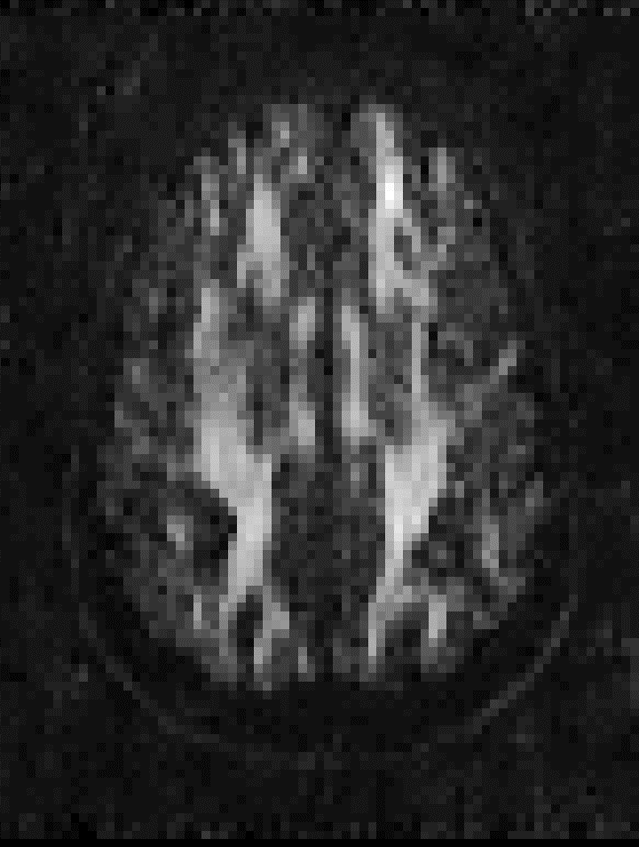
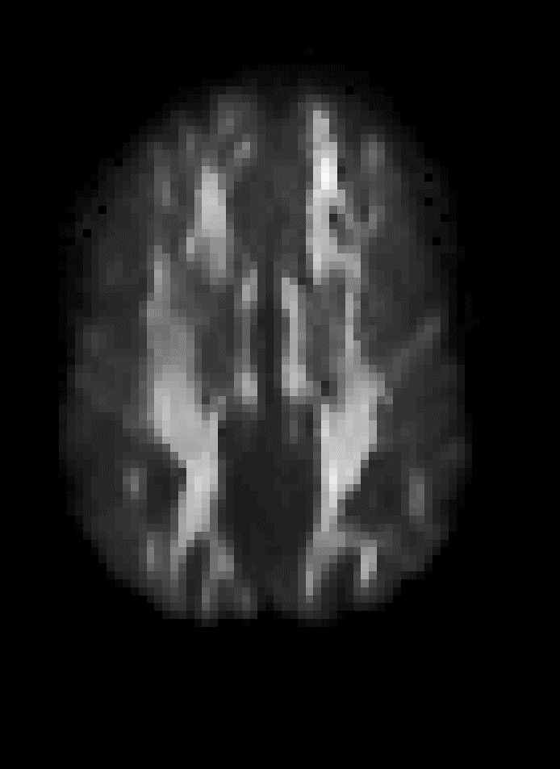
Denoising
Original DW image
Denoised with random matrix theory
Denoised with non-local means
^{Veraart et al. 2016}

Slide 10
Denoising
Original DW image
Residuals with random matrix theory
Residuals with non-local means
^{Veraart et al. 2016}

Slide 11
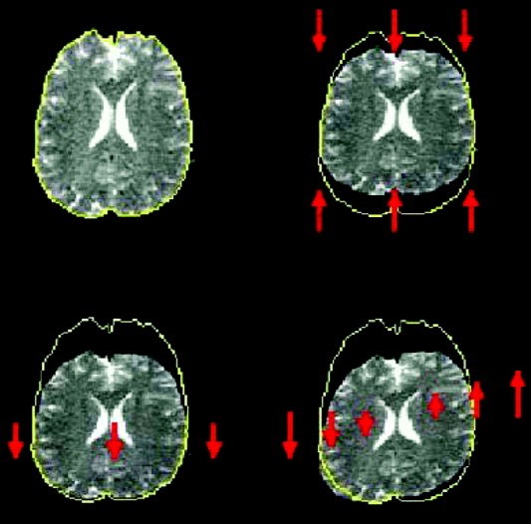
Eddy currents
^{Le Bihan et al. 2016}

Slide 12
Echo-planar imaging distortions
^{Andersson et al., 2003}

Slide 13
Echo-planar imaging distortions
^{Andersson et al., 2003}

Slide 14
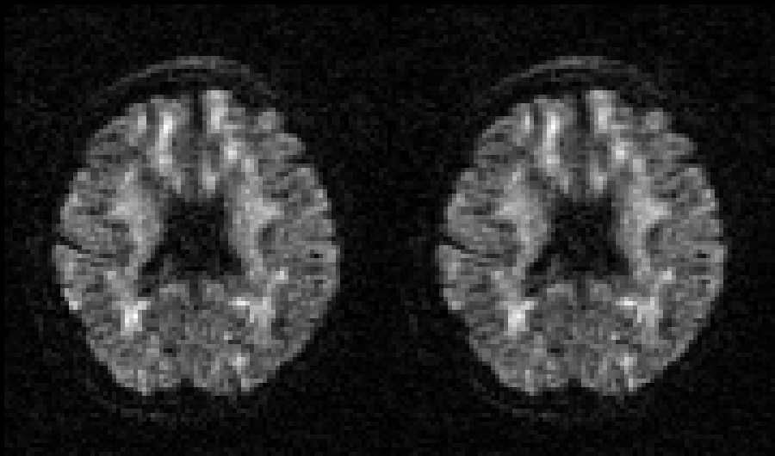
Subject motion
^{Andersson et al., 2017}

Slide 15
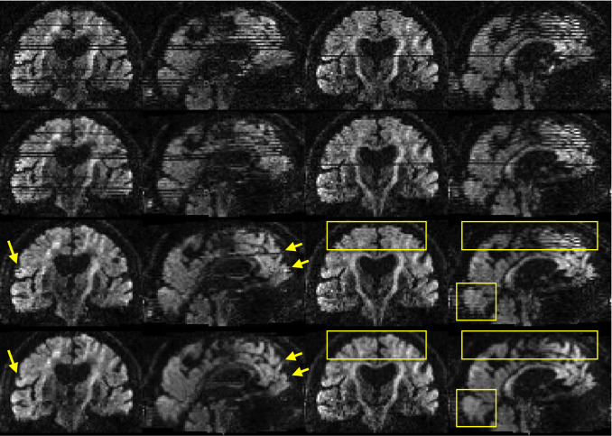
Motion artefacts
^{Andersson et al., 2017}

Slide 16
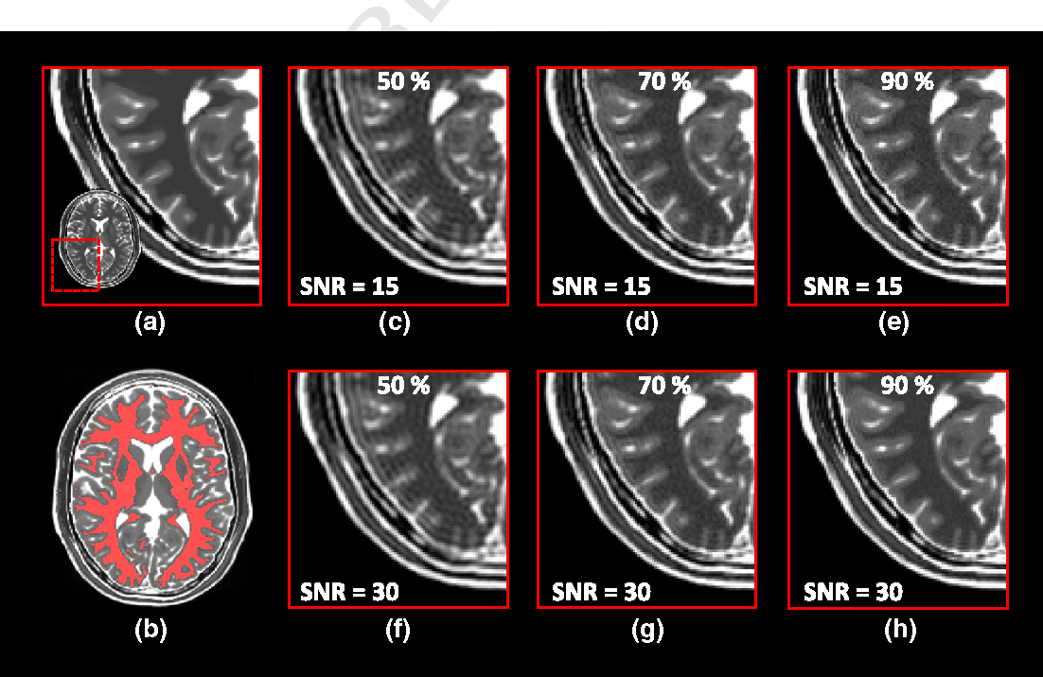
Gibbs ringing
^{Perrone et al., 2015}

Slide 17
Practical demonstration
# 1a. DICOM to MIF + NII conversion (in MRtrix3)
mrconvert dicom/c2b-sub004/ dwi.mif
mrconvert dwi.mif dwi.nii -export_grad_fsl bvecs bvals
# 1b. If you already have NII-files instead of DICOM (note that dicom header info will not be included in MIF)
# Tools such as dcm2niix give a .json file with the .nii.gz files including the information from dicom header
mrconvert -force -quiet -fslgrad "${outputdir}"/"$subject"/dwi.bvec "${outputdir}"/"$subject"/dwi.bval "${inputdir}"/"$subject"/dwi/"$subject"_run-1_dwi.nii.gz "${outputdir}"/"$subject"/dwi.mif.gz
# 2. DENOISING (Veraart et al., 2016) - should always be done before any other preprocessing
dwidenoise dwi.mif dwi_denoised.mif
# 3. REMOVE GIBBS RINGING ARTIFACT (full fourier acquisition required, with partial fourier, e.g., 6/8 this step should be skipped)
mrdegibbs dwi_denoised.mif.gz dwi_denoised_degibbs.mif.gz

Slide 18
Practical demonstration
# 4. EPI, eddy current and motion correction (in FSL)
mrconvert -strides -1,+2,+3,+4 dwi_denoised.mif.gz dwi_denoised.nii.gz
topup --imain=blips.nii.gz --datain=acqp.txt --out=field --config=b02b0.cnf --scale=1 --iout=topup_b0 --verbose
bet "${outputdir}"/"$subject"/topup_b0 "${outputdir}"/"$subject"/topup_b0_brain -m
eddy_openmp --imain=dwi_denoised.nii.gz --mask=topup_b0_brain_mask --index=index.txt --acqp=acqp.txt --bvecs=bvecs --bvals=bvals --topup=field --out=dwi_corrected --verbose
# or with MRtrix3 script dwifslpreproc, which also uses FSL, but gives less freedom in organization of files for TOPUP
mrcat b0_ap.mif b0_pa.mif b0_pair.mif -axis 3; dwifslpreproc DWI_in.mif DWI_out.mif -rpe_pair -se_epi b0_pair.mif -pe_dir ap -readout_time 0.0741199 -align_seepi
# 5. B1-bias field correction (inside the MRtrix3 script, ANTs or FSL are used)
#ANTs N4BiasFieldCorrection is optimal, but FSL works, too
dwibiascorrect ants dwi_corrected.nii.gz dwi_biascorrected.nii.gz
dwibiascorrect fsl dwi_corrected.nii.gz dwi_biascorrected.nii.gz

