Slide 1
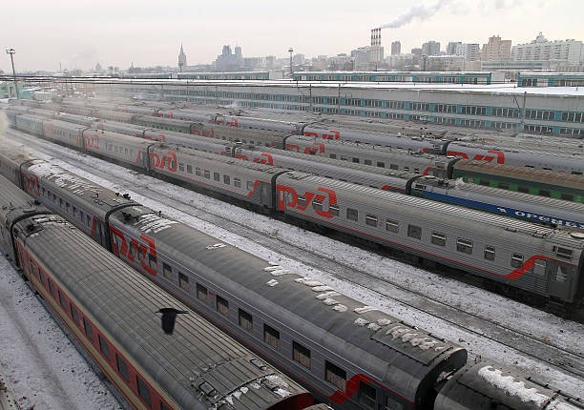
Introduction to Russian Railways
Marta Malik
2013 – present - Doctoral student, Aalto BIZ, Logistics
“Sustainable transport logistics across Russia”
2019 – Customer service, OOCL Finland
2013 – Container shipment analyst, Logistics Center of Russian Railways

Slide 2
Agenda
Background
Capacities
Volumes
Operations
Corporate Culture
Future

Slide 3
Background: Infrastructure vs. Brand
Russian railways, or “Russian Railways”
2003 – “Russian Railways” launched
1837 – construction of railways began
Further development:
Beginning 20th Century – Transsiberean Railway
1957 – 1st high-speed train able to reach 134 km/h
1965 – Moscow – Leningrad: 4h 59 min, 160 km/h max speed
But …

Slide 4
Downturn, 1990s
No new railways were built
Obsolete railway stations, local and long-distance trains
Passenger transport subsidized by freight transport
Decade of obsolescence

Slide 5
Reforms, 2003 - 2010
2003 – «Russian Railways»
Freight and passenger transport
Infrastructure construction & services
Locomotive traction services
Rolling stock provision & repair
Research and Development
100% owned by the Government of Russian Federation

Slide 6
Stages
2001–2002 – Ministry of Railways to “Russian Railways”
2003-2005 – Public corporation
Structure by activities
Increasing competition
2006-2010 – 60% of rolling stock to private market

Slide 7
Notes
“Russian Railways” – 17 years old
Russian railways – 183 years old
Preceding downturn – 10 years
Today: 10 years since reforms are complete
Visible but slow changes

Slide 8
Rail Capacity
Technical parameters | 1000 km | Rolling stock | 1000 units
Operational length of railways | 85,3 | Freight mainline locomotives (electric and diesel locomotives) | 11,8
 |  | Shunting locomotives (diesel locomotives) | 5,9
 |  | Freight cars of all types | 196,3
Length of electrified lines | 43,4 | Passenger locomotives | 3,1
 |  | Long-distance passenger cars | 21
 |  | Passenger cars of commuter trains | 14,3

Slide 9
Role in transport
Railway freight turnover – 45,3 % (pipelines considered)
Railway freight turnover, without pipelines – 80%
Passenger turnover – 26,4 %

Slide 10
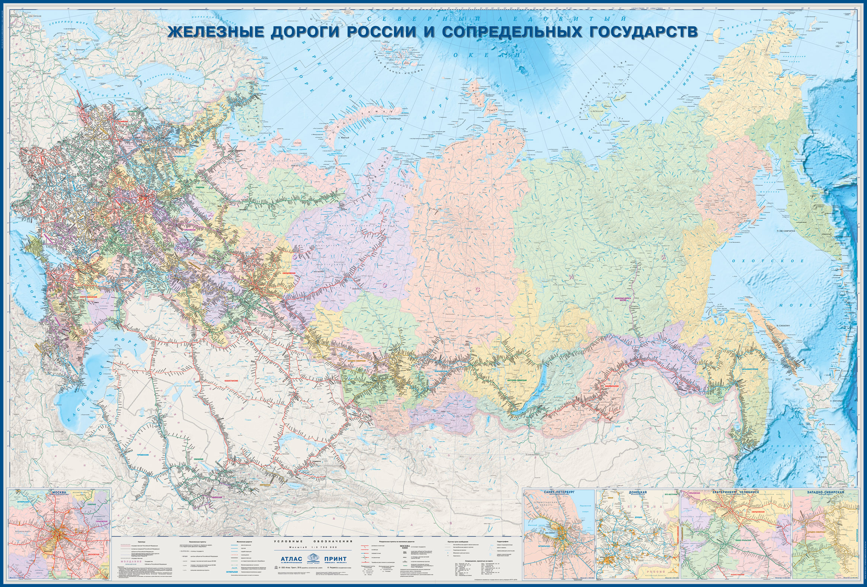

Slide 11
Room for improvement
Extensive and mostly electrified in the West
Railway infrastructure is available in 80 out of 85 subjects of Russian Federation
Total length of the rail is 120 thousand km

Slide 12
Russian Railways = Passengers + Freight

Slide 13
Freight trains
Inland
Export
Import
Transit
Notes:
They categorize freight trains in a very simple way – if is an inland, export, import, or transit train.

Slide 14
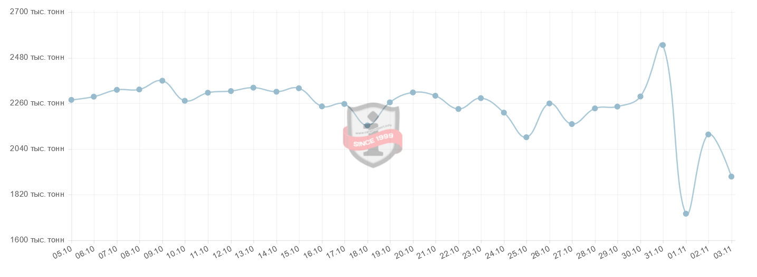
Total daily loading (inland shipment, 2020)
Thousand tons

Slide 15
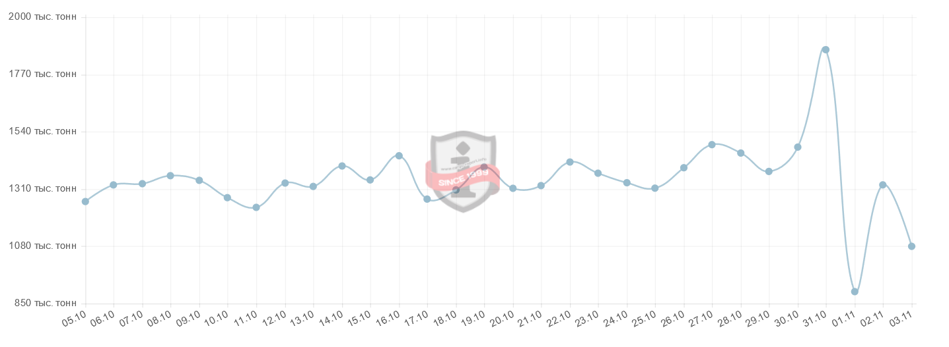
Total daily loading (export, 2020)
Thousand tons

Slide 16
Inland shipments by cargo October 2018 (September 2020)
Mineral construction materials - 18 mn tons (21 mn tons)
Oil products - 12 mn tons (10 mn tons)
Ores - 6 mn tons (9 mn tons)
Black metals - 4.5 mn tons (4.2 mn tons)

Slide 17
Export shipments by cargo October 2018 (September 2020)
Coal – 17 mn tons (17 mn tons)
2018: 25% - Cyprus, 20% - Japan, 10% - UK
2020: 26.6% - Cyprus, 25.4% - Japan, 12.6% - China, 7.7% - UK
Oil products – 7.5 mn tons (6.3 mn tons)
2018: 48% - Netherlands, 23% - Italy, 10% - China
2020: 48.9% - Netherlands, 24% - Italy, 8.7% - China
Fertilisers – 2.5 mn tons (3 mn tons)
2018: 26% - China, 22% - Switzerland, 17% - Brazil
2020: 29.7% - China, 20.7% - Brazil, 16.7 - Switzerland
Black metals – 2.5 mn tons (2.2 mn tons)
2018: 15% - Turkey, 14% - Taiwan, 13% - Italy
2020: 17.4% - Taiwan, 16.2% - Turkey, 10.6% - Mexico
Timber – 2.5 mn tons (2.3 mn tons)
2018: 58% - China, 14.5% - Finland
2020: 57.2% - China, 16.4% - Finland

Slide 18
Notes
Mineral construction materials for internal consumption
Oil products crucial in internal consumption and for export
Oil products, ores and black metals: internal consumption > export
Coal mostly goes for export

Slide 19
Russian Railways = 16 railroads
Oktyabrskaya
Moscow
Gorkovskaya
North
North-Caucasian
South-East
Privolzhskaya
Sverdlovskaya
South-Ural
West – Siberian
Kuibyshevskayaya
Krasnoyarskaya
East-Siberian
Zabaikalskaya
Far East
Kaliningrad
BAM

Slide 20
Corporate structure
Monopoly
Subsidiaries / affiliated organisations:
Railroads
Operating units
Transporting companies
Technical procurement
Infrastructure development
Repair units
Track facilities
Competition
competitive development of each segment within the railway industry
efficiency and quality of the offered services

Slide 21
Subsidiaries by activities
Logistics Service Providers
Warehousing Providers
Rolling stock services
Maritime Logistics

Slide 22
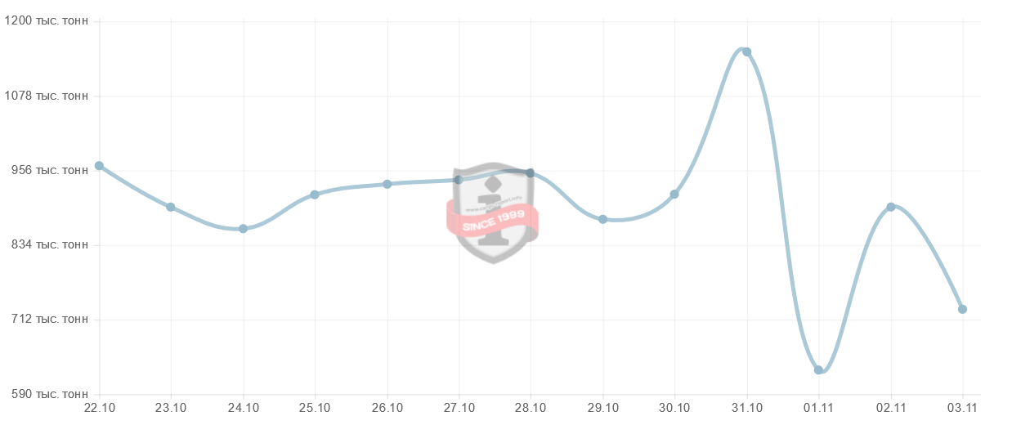
Daily loading to sea ports October - November 2020
Thousand tons

Slide 23
Loading to sea ports by basin, 2017 (2020)
Baltic Sea basin – 102 mn tons (84 mn tons)
5 ports, including St. Petersburg
Far Eastern basin – 88 mn tons (76 mn tons)
7 ports
Azov-Black Sea basin – 70 mn tons (49 mn tons)
7 ports
Arctic Sea basin – 23 mn tons (15 mn tons)
3 ports
Caspean Sea basin – 211.1 thousand tons (112.9 thousand tons)
3 ports
PS: River port – different story

Slide 24
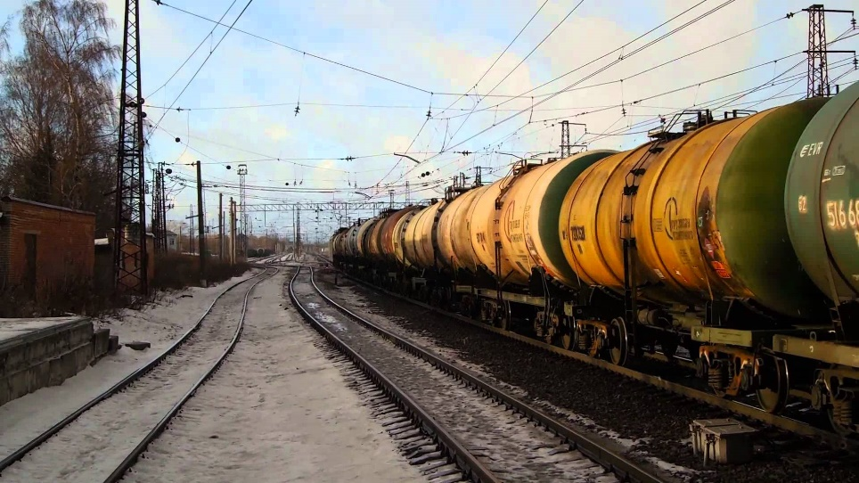
Operations
Threads schedule – movement of the train in a Cartesian coordinate system, where the X axis is the time axis, and the Y axis is the distance axis
Fixed routes / not connected to a cargo type
Railroads receive / pass the freight train
Change of locomotive brigades
Change of locomotives
Challenges for performance:
Priority to passenger trains
Waiting for locomotives/ locomotive brigades
Capacity limits (no technical documents)
Repair works on tracks, so called ‘windows’

Slide 25
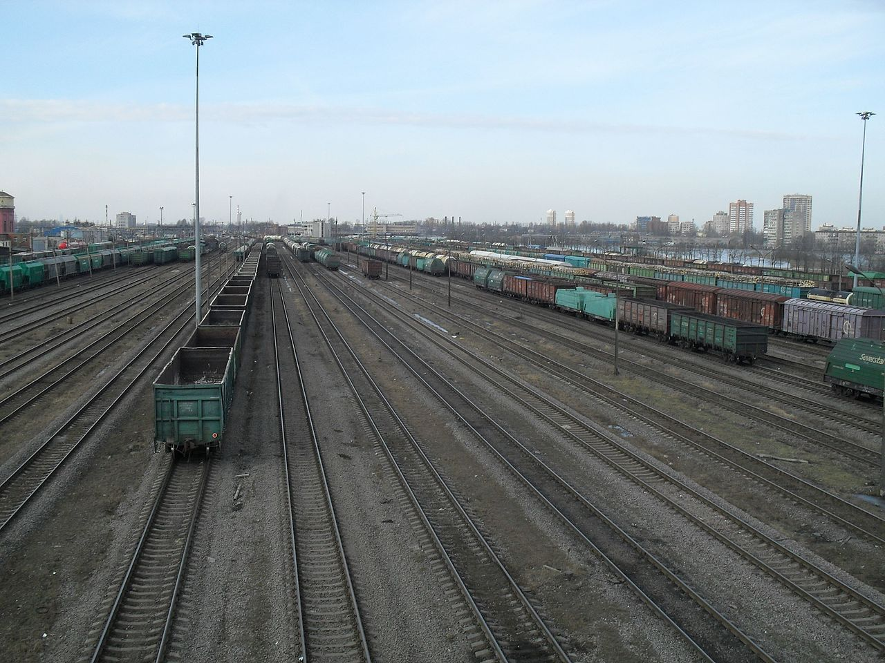
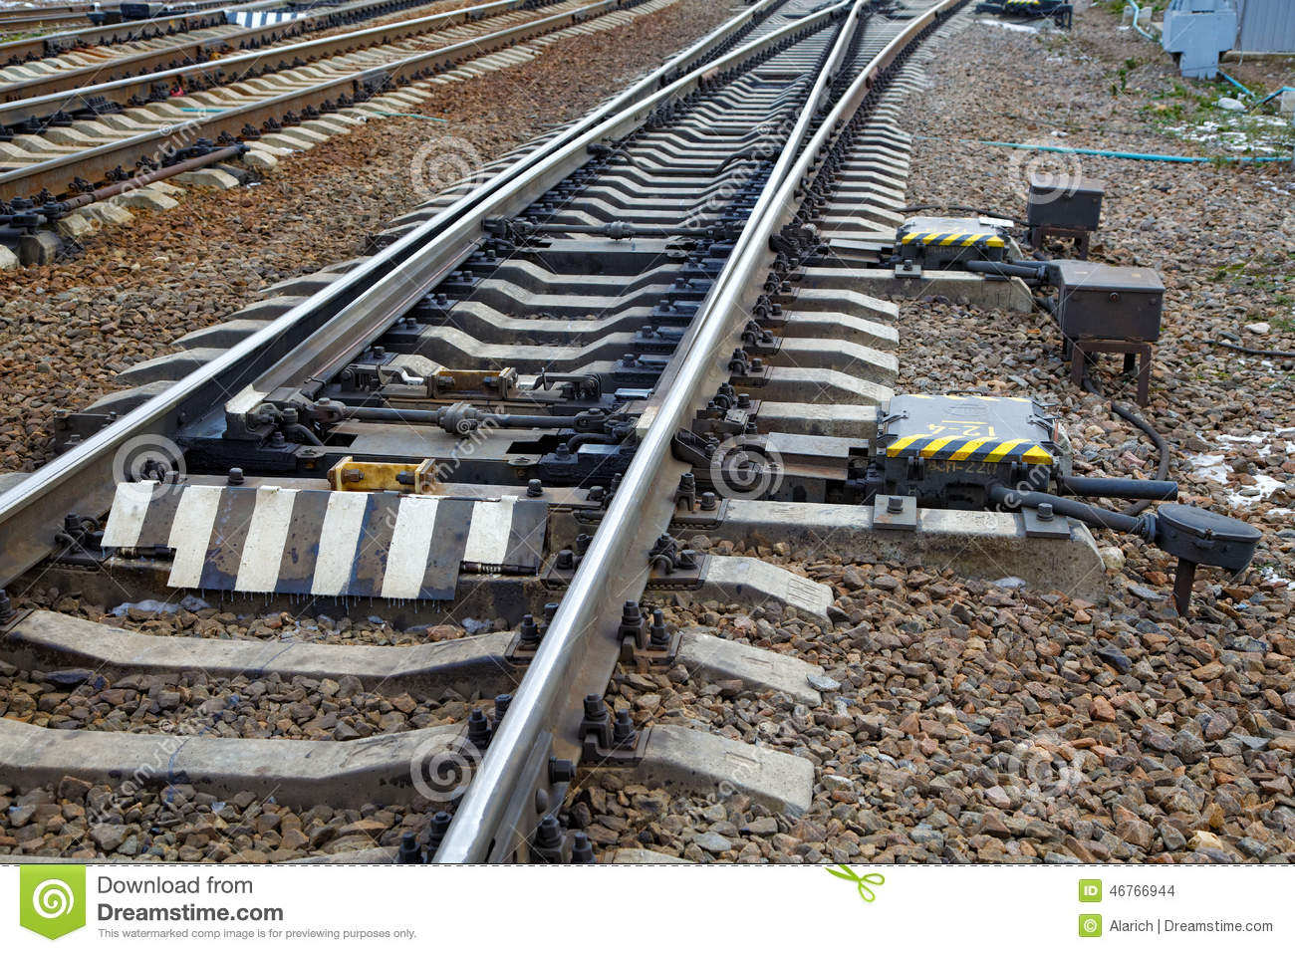
Freight stations
Freight stations of different class
Sorting freight stations (e.g. St. Petersburg Sorting)

Slide 26
KPI: Journey speed
Journey speed – an average daily speed of a freight train, that takes into account the waiting time at all the stations on the way, except for the dispatch and the final station. In other words, it shows with what speed the train proceeds from the dispatch to destination, expressed as km/ day.
Actual vs. Standard:
Avg. for each thread
Avg. for all the trains proceeding over 24 hours (18:00 – 18:00)
Avg. for each railroad
Avg. / month, or year
Oktyabrskaya RR:
13 container trains per 24 h
2-3 export / import/ transit trains
Delay over 36 hours called ‘abandoning’ the train
Earlier/ later arrival within 30 min to standard time is not considered a delay

Slide 27
Rolling stock
Tanks
Open-box wagons
Covered wagons
Hopper wagons
Refrigerators
Car carriers

Slide 28
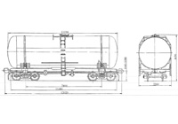
Tanks
petrol
oil products
alcohol

Slide 29
Open-box wagons
nonaggressive bulk cargo
requiring no protection from precipitation and weather
loose non-dusty, bulk, stacked, piece and other goods

Slide 30
Covered wagons
goods requiring weather protection
piece, grain and a wide range of other

Slide 31
Rolling stock – Hopper wagons
Bulk cargo, e.g. grain

Slide 32
Refrigerators
perishable goods

Slide 33
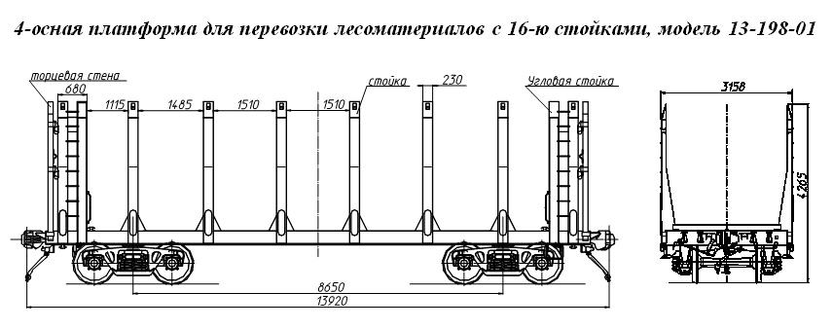
Flat wagons
timber products, wheeled machines within the internal dimensions of the wagon
not requiring weather protection

Slide 34
Car carriers
for transporting cars

Slide 35
Employment
759 028 employees (2016)
Privileges for employees
Free tickets for a long-distance train once a year
Discounts when purchasing real estate
Free of charge commuter trains (up to 300 km)
Health care services
And other

Slide 36
Corporate culture
Semi-military company
Subordination
Irregular hours
Many conflicts and tense environment
Creativity welcome for Strategy only, not operations
Deviations reported in written, signed and delivered
Men have better career opportunities
Lunch separate for managers and employees
Continuity of generations in professions

Slide 37
Role of Government
Key, number 1 stakeholder
Values - power and funds shift
Development = economy + society + environment
Triple bottom line of CSR
Government
decides what is included versus excluded within CSR domain

Slide 38
Strategic goals to 2030
Economic
Developing single efficient transport system in the country
Increasing sustainability of rail transport and the safety
Expanding geographical presence in the transport services markets,
Increasing the investment attractiveness of rail transport
Environmental
Technical re-equipment of railway infrastructure
Modernization of rolling stock and the acquisition of new rolling stock
Integrating environmental factors in management decision making.
Social
solving the problems of economic and social development of the regions, where the company is a key employer

Slide 39
Social Responsibility
‘Northern Delivery’ – a complex of measures by the Government taken to ensure delivery of vital goods to remote areas of Far North of Siberia, Far East and of European part of Russia on annual basis before the winter. The priority vital goods are food and oil products. Purchase from South of Russia is centralized. Reasons:
Absence of own agricultural produce and industry in the Far North
Remoteness of main industrial areas for thousands kilometers that makes delivery too complex and expensive for private companies even during the summer
Absence of infrastructure (railway: 80/85 subjects of RF) in most arears of Far North, where air and maritime are the only means of delivery

Slide 40
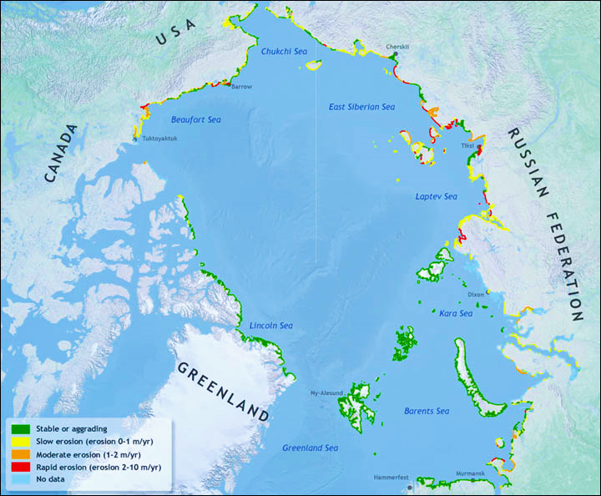
Northern Sea Route
Far North of Russia:
Northern Sea Route
Barents Sea
Kara Sea
Laptev Sea
East Siberian Sea
Exploration for natural resources

Slide 41
Key notes
Connecting all the federal okrugs
Safe transportation of freight over long distances
High potential for extending infrastructure
One of the biggest employers in Russia
Semi-military company
Integral to delivery of produce to remote areas of Russia
Integral to developing Northern Sea Route

Slide 42
Thank you!
Marta Malik
marta.malik@aalto.fi
https://www.linkedin.com/in/marta-malik/

