Slide 1
Strategy and Marketing from a Business History Perspective
Prof. Dr. Henrikki Tikkanen
Aalto University School of Business, Helsinki, Finland

Slide 2
RBV, Dynamic Capabilities Research (Teece, Pisano & Shuen, 1997; Teece, 2007)
Questions of Life and Death:
The assets, knowledge base and capabilities of the firm
Quality and number of executives, especially in the upper echelons
Corporate structure and routines
Ability to renew itself from time to time (cf. IBM, also Nokia)

Slide 3
Competitive Dynamics Research (e.g. Miller & Chen, 1994; Ferrier, 2001)
Competitive advantage is centrally explained by competitive actions (marketing, sales, supply, investments, M&A… i.e. How the business model is)
Speed of actions/reactions (e.g. Price wars)
Aggressiveness
Uniqueness
Levels of action (i.e. How many actions are conducted)
Action repertoires (and their renewal, i.e. SOME marketing)
Rhythm of actions (cf. KONE corporation as a ’serial acquisitor’ of small local service firms all around the Globe)

Slide 4
A Competitive Dynamics Approach to Strategy and Competitive Advantage: What Do Companies Actually Do in Competing?

Slide 5
Normative implications of CD Research
Four ways to win the battle (Smith et al. 2001)
Be aggressive
Use a complex repertoire of actions (but focus on the right ones!)
Be unpredictable
Delay the leader’s action

Slide 6
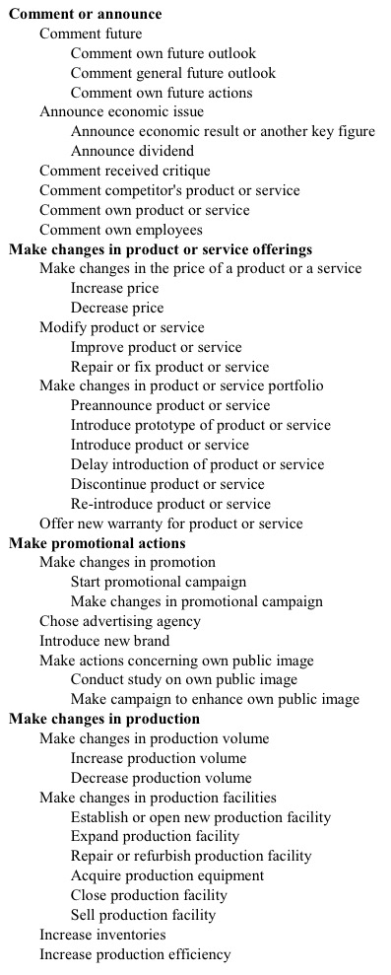
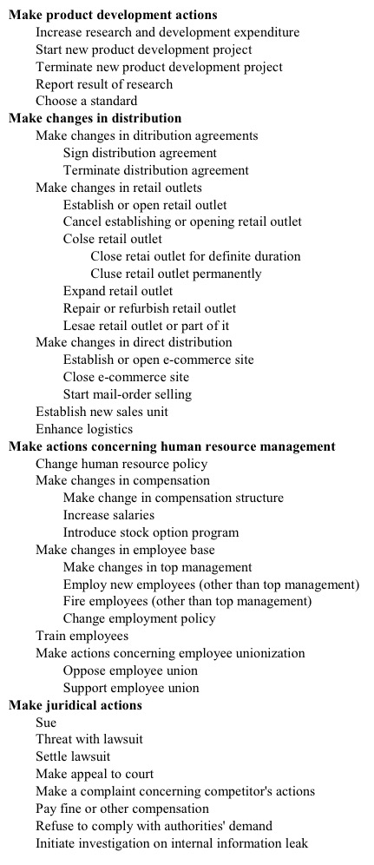
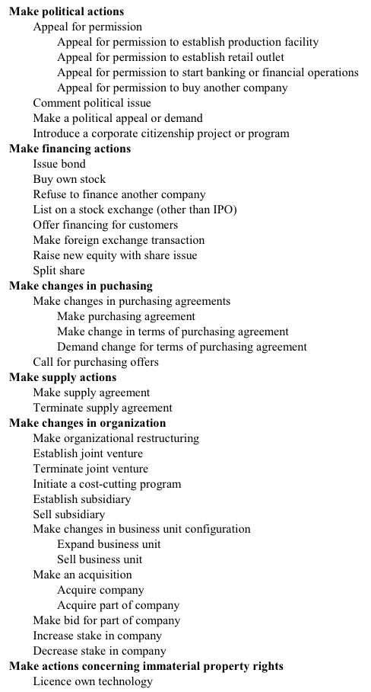
A taxonomy of competitive actions
Nokelainen, Tomi (2005). Towards a Taxonomy of Competitive Actions: Preliminary Evidence from Three Industries. Suomenlinna Workshop on Competitive Dynamics. Helsinki, Finland, 2005.

Slide 7
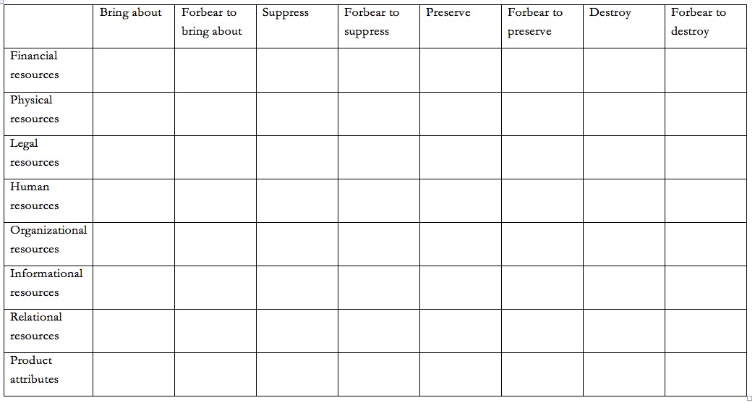
A typology of competitive actions
Nokelainen, Tomi (2008). A Typology of Competitive Actions. Doctoral Dissertation, Faculty of Business and Technology Management, Tampere University of Technology, 2008

Slide 8
Designing and implementing a successful strategy. The role of strategic consistency

Slide 9
Strategic Evolution in an Industry: Case Finnish FMCG (Grocery Retail) Industry 1945-1995

Slide 10
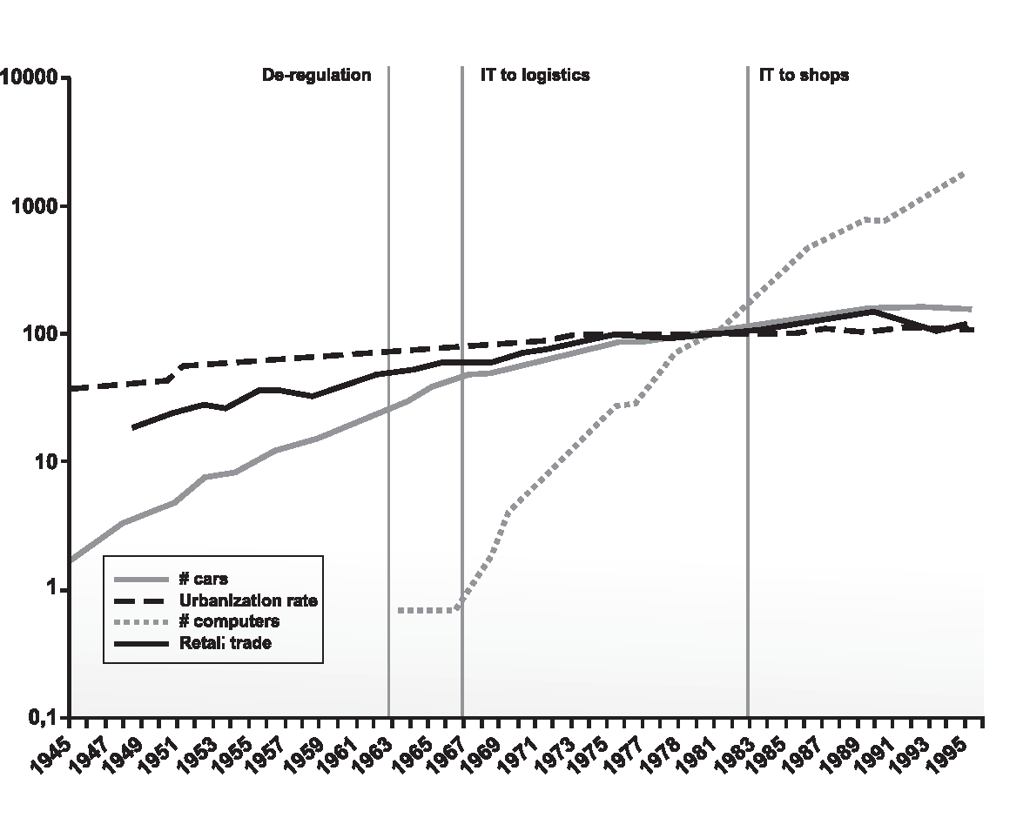
The Business Environment as a Selection Mechanism

Slide 11
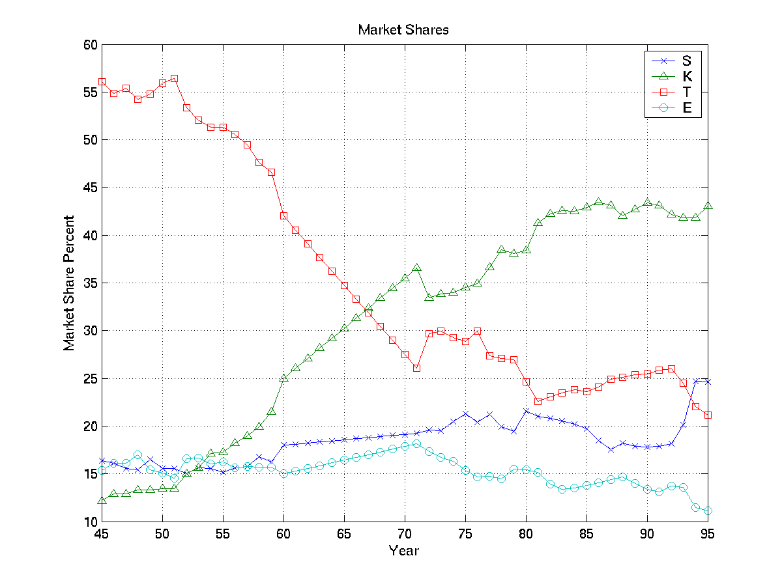
Market Shares

Slide 12
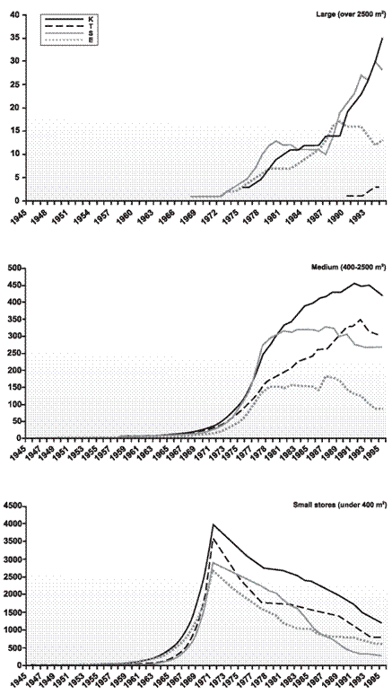
“Although we know that many of our grocery shops will not survive for long, we must support them. We must help them believe in the future even if that future might be a very short one…our own existence and results are dependent on them (i.e. small grocery shops).” (the minutes of T marketing day 26.9.1976)
“…we sure have poorly selling outlets. Dissolving them would be of utmost importance, but it is very difficult from the perspective of the management. We must find a means to keep these small local shops alive.” (Meeting of Suur-Savo shopkeepers 29th of December, 1963)

Slide 13
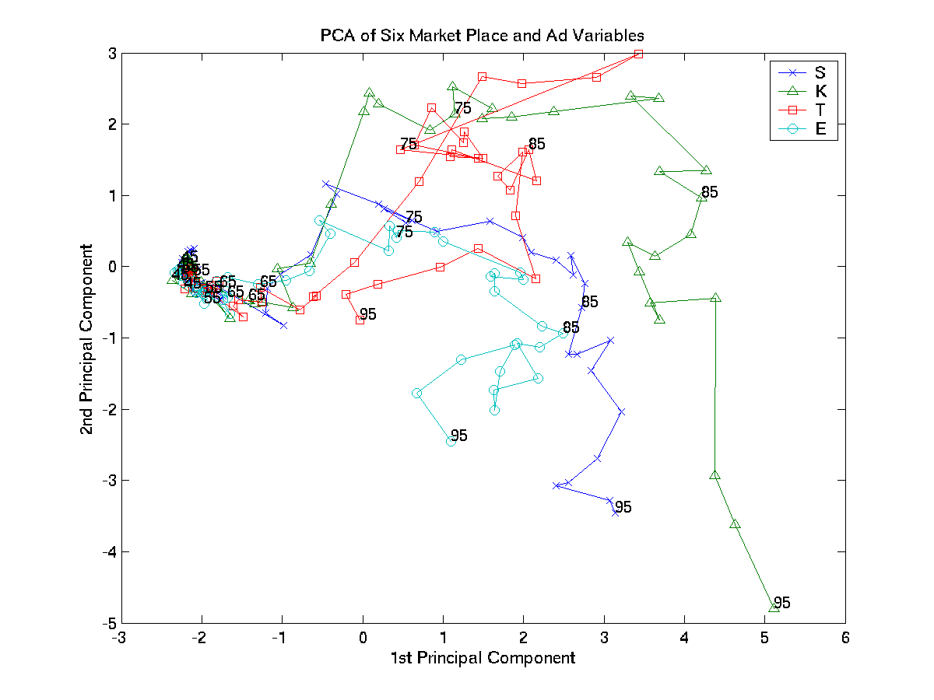
PCA of Competitive Actions

Slide 14
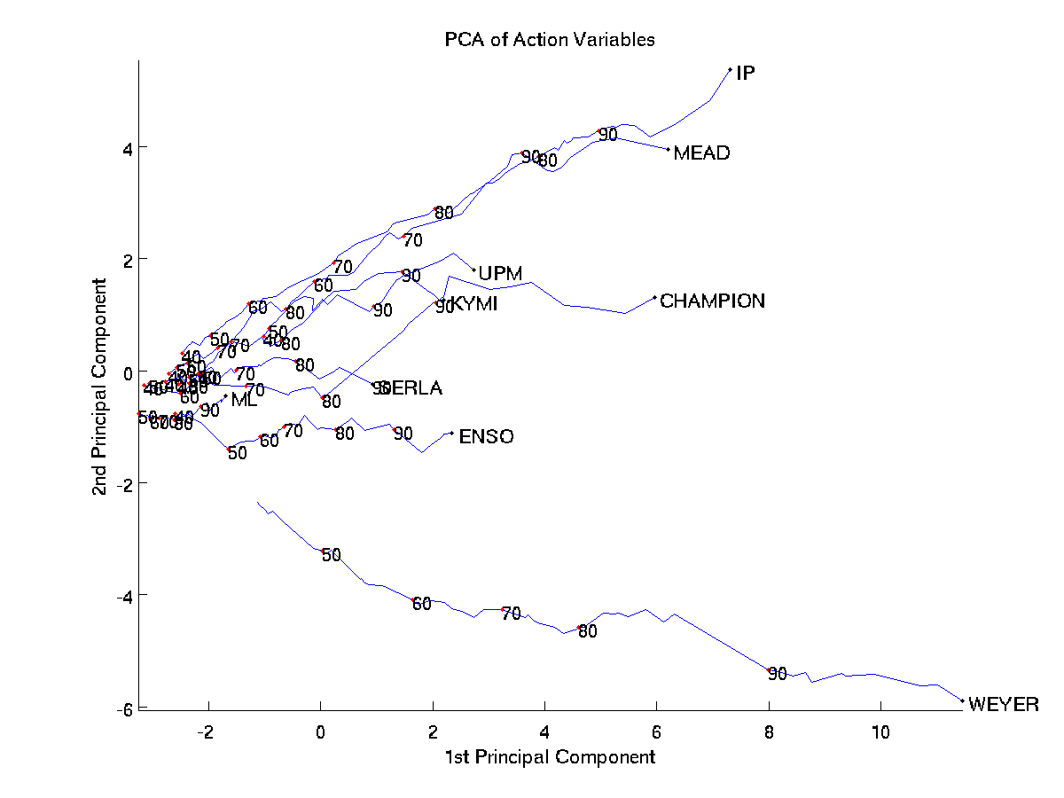
Another Example: The Global Paper Industry

Slide 15
Variation
Micro level changes in the Business Model of the Firm
Competitive Actions
Investments in technology and capabilities
Filter1
Changes in the Business Environment
Filter 3
Management cognition and understanding
Filter 2
The firm as an administrative structure and its culture, i.e. Material elements of the BM
Ideas
International benchmarks; changes in consumption patterns etc.
Retention
Best Business Models Survive and Prosper

Slide 16
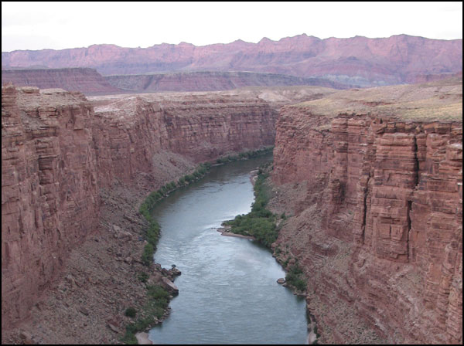
The River Metaphor: The Firm as a Product of its History
Ei pysähdy
Systeeminen
Tied to a certain path and links
Time and rhytm of decisions essential

Slide 17
Wrap-Up: Managerial Implications
It is ’easy’ to identify great social and demographical changes
Less easy to understand changing customer need and preferences
Central to know the history of the own organization (’the river’)
Filtering relevant strategic foresight throughout the organization
Merging understanding and decision-making
The central role of strategic leadership!

Slide 18
Key Lessons:
Be strategically consistent
Listen to your own organization, its network and external experts
Understand the evolutionary logic in your business (in the end, battle for survival)
Develop the Business Model that is best suited at a certain point in time to succeed in competition
The Nokia case of the next session is a good example of great successes and failures

Slide 19
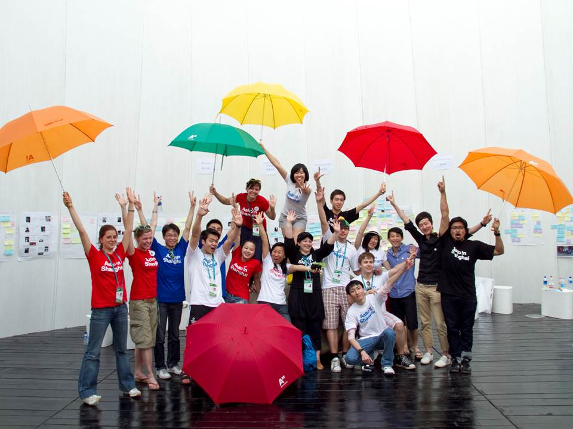
Thank you!
Kuva: Tuuli Sotamaa
Aalto-yliopisto

