Slide 1
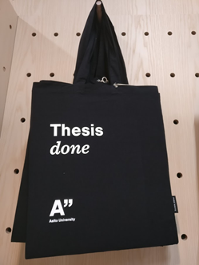
Turnitin assignment activity in MyCourses
Motto
Turnitin is a tool to support learning of scientific writing
Turnitin is at its best when used for draft versions. Used in this way Turnitin is a chance instead of threat.
Scientific writing is a skill → Practice makes perfect
Minna Vänskä, LES, Services for teachers

Slide 2
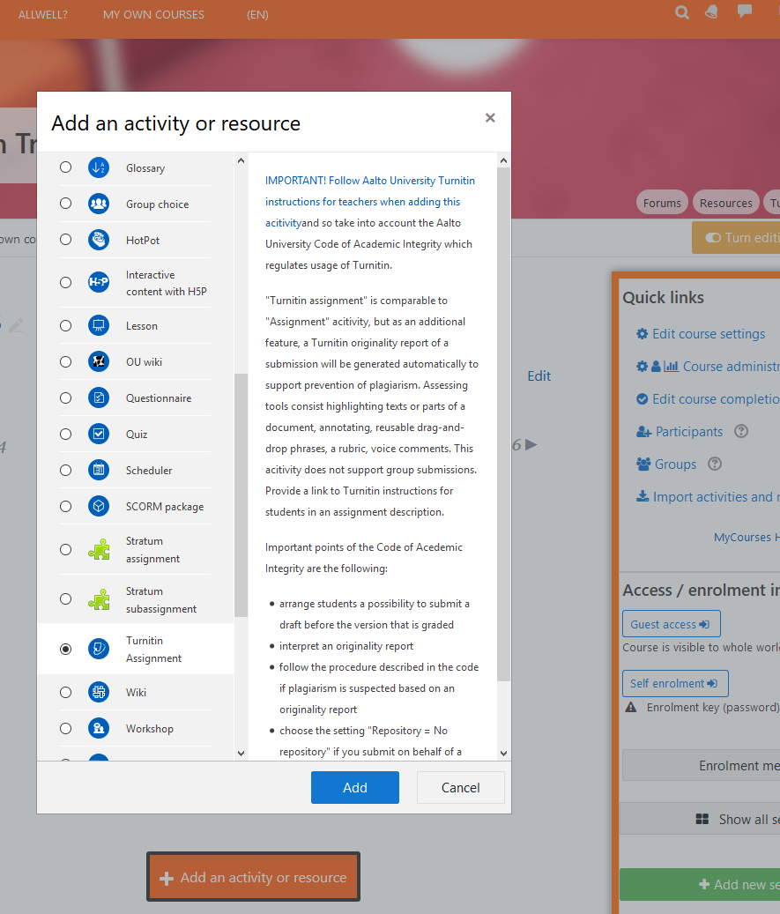
Turnitin assignment activity
1.
Turnitin assignment is one of the activity types that a teacher can add in MyCourses workspace.
The basic idea of the activity:
students submit their files (essays/lab reports/technical reports/case studies/thesis versions/any assignments that include text) in the inbox
a teacher can give feedback and/or grade to each student.
Special features of the activity:
max 5 inboxes (=parts) for different versions with due dates
Turnitin similarity report is generated automatically on each submission
feedback tools: annotating on document, reusable phrases, voice comment and rubric.
peer feedback
3.
2.
4.
→ Help students learn academic writing as a process
1.

Slide 3
Turnitin assignment activity
2.
After choosing Turnitin Assignment
3.
you get a description of the activity and a link to detailed Turnitin instructions of Aalto University.
4.
When adding the activity, take a look into a summary of Aalto University Code of Academic Integrity from Turnitin point of view:
both you and your students should know their rights and responsibilities when using Turnitin assignment activity
give your students a chance to practice academic writing: ask them to submit draft version(s) before a version that will be graded
→ get to know the settings of the activity (in English), asetukset selitettynä suomeksi (in Finnish)
3.
2.
4.
1.

Slide 4
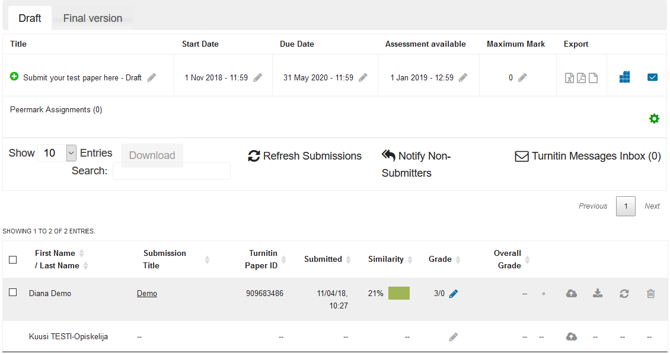
Students’ submissions are opened in MyCourses,
but feedback and grades are given in Turnitin feedback studio
1.
Open a student’s submission in MyCourses > the submission opens in a new window, Turnitin feedback studio
2.
If a submission is graded in feedback studio, the grade is seen in MyCourses inbox as well as in “Grades” view
1.
2.

Slide 5
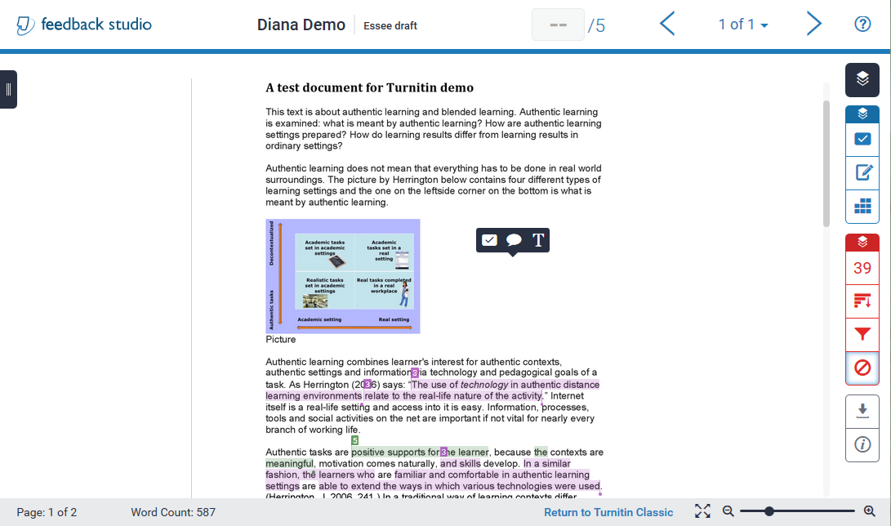
Turnitin feedback studio – teacher’s view
See detailed explanations (also in Finnish)
9. Move to a previous or a next submission
2.5. Grade
10. Instructions (Turnitin.com)
Tools:
7. Jump between pages
1. Layers (show whether they are active or hidden)
2. Show/Hide instructor feedback layer
blue= comments in view, black= comments hidden
2.1 QuickMarks
2.2 Feedback summary: voice or text comment on whole document
2.3 Rubric/Form
3. Show/hide similarity layer
red= similarities in view, black= similarities hidden
2.4. Insert a QuickMark comment/ Comment/ text comment on view on the spot you click
3.1 Match overview
3.2 All sources + exclude sources
3.3 Filters and settings
3.4 Excluded sources
4. Download (current view as pdf / digital receipt of submission / originally submitted file)
4.1 Submission information
6. Page number of the page in view & word count of the whole paper
5. Zooming a submission

Slide 6
Turnitin similarity report
always interpret similarities in their text contexts while reading and assessing an assignment
When assessing drafts
feedback on content, referencing, citations etc. can be given with help of similarity report
unintended or intended plagiarism or “bad writing style” is noticed. Also second hand sources may be revealed via similarity report (explore sources of similarities in the reference list).
students can revise and edit their texts for final versions without disciplinary consequences
When grading final versions
feedback as described above BUT possible plagiarism suspect must be handled as described in the code
Note: plagiarism suspect can not be handled by lowering the grade

Slide 7
Scientific writing – set of valuable skills in working life
Finding fresh scientific publications or other trusted and quality sources of a field
Collecting one’s “own library” with help of reference manager
Providing arguments and evidence
Crediting authors with citations and references
Etc.
→ Skills need practising
Include assignments that train scientific writing (or some phases of it) in courses already before thesis
Ensuring that such assignments are planned in the degree programme would be beneficial for students
As an advisor or supervisor you can order a personal, ready-made MyCourses workspace for thesis supervision

Slide 8
Support
turnitin@aalto.fi or mycourses@aalto.fi
ask any questions concerning Turnitin assignment activity or MyCourses
ask trainings on demand
Turnitin 2-hour-trainings for staff: information and enrollment in Workday
Teaching Hub on every Wednesday at 12-15
Harald Herlin Learning Centre, Ground floor
Turnitin instructions for teachers in English and in Finnish (or google turnitin aalto)

