Slide 1
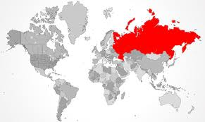
International economic relations of Russia
Svetlana Ledyaeva
Aalto University School of Business

Slide 2
Learning outcomes
International economic relations of Soviet Union
Recent developments in Russia`s foreign trade
Foreign invetsment IN and OUT of Russia
Russia and international organizations

Slide 3
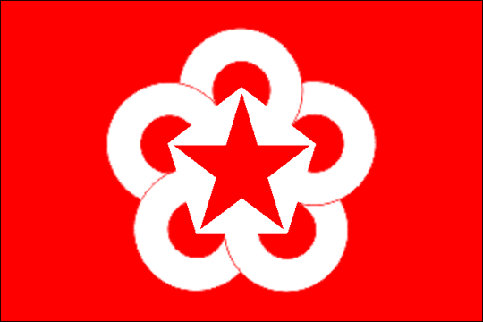
History: Soviet Union. Comecon
Comecon (1949): Council for Mutual Economic Assistance.
Comecon’s members were the Soviet Union (Leader), Bulgaria, Czechoslovakia, Hungary, Poland, Romania, Albania, Eastern Germany, Mongolia, Yugoslavia, Cuba, Vietnam.
Comecon ➔ response to the formation of the Committee of European Economic Cooperation in Western Europe in 1948. ➔ OECD (Organization for Economic Cooperation and Development)
1949-1953: Comecon’s activities ➔ mainly the registration of bilateral trade and credit agreements among member countries.
After 1953 ➔ promotion of industrial specialization among the member countries.

Slide 4
Comecon’s successes
The organization of Eastern Europe’s railroad grid and electric-power grid.
The creation of the International Bank for Economic Cooperation (1963) to finance investment projects jointly undertaken by two or more members.
The construction of the “Friendship” oil pipeline, which made oil from the Soviet Union’s Volga region available to the countries of Eastern Europe.
Aid to Third World: 85% to Cuba, Mongolia and Vietnam; 7 billion USD in 1965-1985

Slide 5
Comecon`s end
In 1991, Comecon was renamed into the Organization for International Economic Cooperation.
Each nation was deemed free to seek its own trade outlets.
Members were reduced to a weak pledge to “coordinate” policies on quotas, tariffs, international payments, and relations with other international bodies.
No information on its activities at present moment! ➔
Does not function anymore

Slide 6
International trade of Russia
***

Slide 7
History: Soviet Union trade
Trade ➔ minor role in the Soviet economy.
In 1985 exports and imports each accounted for only 4 percent of the Soviet GDP.
2013: exp/GDP=28%; imp/GDP=22.5%
2017: exp/GDP=22%; imp/GDP=14.3%
2019: exp/GDP=28.3%; imp/GDP=20.8%
2020: exp/GDP=22.4%; imp/GDP=13.6%.
The Soviet Union conducted the bulk of its foreign economic activities with communist countries, particularly those of Eastern Europe.
In 1988 Soviet trade with socialist countries amounted to 62 percent of total Soviet foreign trade.

Slide 8
History: Soviet Union trade
The manner in which the Soviet Union transacted trade varied from one trade partner to another.
HARD CURRENCY: West (except Finland) and most Third World (developing countries).
BARTER, COUNTER TRADE, INDUSTRIAL COOPERATION, BILATERAL CLEARING AGREEMENT: Finland, members of Comecon, China, Yugoslavia, and a number of Third World countries.

Slide 9
Export and import dynamics in Russia, 1996-2020, billion USD

Slide 10
Top 10 export and import partners, 2020
Country | Export from Russia, % | Country | Import to Russia, %
China | 14,58 | China | 23,7
Netherlands | 7,36 | Germany | 10,09
United Kingdom | 6,87 | USA | 5,7
Germany | 5,52 | Belarus | 5,44
Belarus | 4,74 | Italy | 4,4
Turkey | 4,73 | France | 3,49
Kazakhstan | 4,17 | Rep. of Korea | 3,09
Rep. of Korea | 3,7 | Japan | 3,07
USA | 3,25 | Turkey | 2,21
Italy | 2,99 | Kazakhstan | 2,18

Slide 11
Top 10 export and import partners, 2010
Country | Export from Russia, % | Country | Import to Russia, %
Netherlands | 13,41 | China | 17,02
Italy | 6,14 | Germany | 11,62
China | 4,98 | Ukraine | 6,12
Belarus | 4,55 | Japan | 4,48
Germany | 3,99 | Italy | 4,38
Poland | 3,58 | Belarus | 4,35
Turkey | 3,52 | USA | 4,30
Ukraine | 3,43 | France | 3,59
Japan | 3,15 | Rep. of Korea | 3,18
USA | 3,01 | Poland | 2,54

Slide 12
Export industrial breakdown, %

Slide 13
Import industrial breakdown,%

Slide 16
Russia, China and USA export by main sector, 2018, million USD

Slide 17
For which countries Russia is the most important export destination? Export to GDP, % : Summary, Average in 2010-2016
Average above 5%: Belarus, Lithuania, Estonia, Ukraine
Average between 2 and 4%: Latvia, Kazakhstan, Slovakia, Czech Republic, Finland, Hungary, Slovenia and Poland.
Average about 1%: Bulgaria, Belgium, Germany, Netherlands, Austria, Turkey, Croatia, Italy and Sweden.
Average below 1%: China, Denmark, Switzerland, France, Ireland, UK, Spain, Norway, Greece, Japan, Brazil, India, Canada, USA, Australia, Mexico

Slide 18
For which countries Russia is the most important export destination? Export to GDP, % : Summary, Average in 2015-2019
Average above 5%: Belarus (21.6%); Lithuania (8.6%).
Average between 1 and 3%: Kazakhstan (2.8%), Uzbekistan, Paraguay, Mauritania, Armenia, Poland, Kyrgystan (1.25%).
Average between 0.4 and 1%: Latvia (0.94), Vietnam, Moldova, Georgia, Netherlands, Serbia, Ecuador, Czech Republic, Austria, Slovenia, Slovakia, Belgium, Jamaica, Italy (0.43).
Finland – 0.28% now!

Slide 19
For which EU countries import from Russia is important? Import to GDP, %; Summary, Average in 2010-2016
Average above 5%: Belarus, Lithuania, Ukraine, Bulgaria, Estonia, Kazakhstan, Slovakia, Hungary, Latvia.
Average between 4 and 1%: Finland, Poland, Czechia,Turkey, Greece, Netherlands, Belgium, Croatia, Sweden, Germany, Italy, Slovenia, Spain
Average below 1%: France, Austria, China, UK, Norway, Japan, Denmark, Switzerland, India, USA, Brazil, Mexico, Ireland, Canada, Australia.

Slide 20
For which EU countries import from Russia is important? Import to GDP, %; Summary, Average in 2015-2019
Average above 10%: Belarus (33.6%), Kyrgyzstan, Mongolia, Armenia (10%).
Average between 5 and 10%: Lithuania (9.5%), Kazakhstan, Moldova, Ukraine, Estonia, Bulgaria (5.7%).
Average between 2 and 5%: Uzbekistan (5%), Georgia, Slovakia, Serbia, Slovakia, Azerbaijan, Finland, Poland, Hungary, Turkey, Bosnia, Sudan, Czech republic, Netherlands, Greece (2%).

Slide 21
Russia`s importance in foreign countries` trade

Slide 22
Trade between Russia and the EU (2015-2018 as cumulative)
EU GDP
EU28 World
EU28 World
Export to Russia, 4.3% of EU export or 0.53% in EU GDP
Russia GDP
EU GDP
Import from Russia, 7% of total import or 1% of EU GDP/10% of Russian GDP

Slide 23
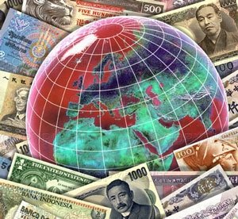
Foreign investment in Russia
***

Slide 24
History: Foreign Investment of Soviet Union
Soviet government prohibited foreign investment because it would have undermined the state's decision-making prerogatives on investment, production, and consumption.
In the late 1980s limited foreign investment has been permitted in the form of joint ventures in the Soviet Union.
In 1991 Foreign Investment Law permitted foreign investment in most sectors and in all the forms available in the Russian economy.

Slide 25
Question for points
Would you guess the core motives to invest into Russia?

Slide 26
Core motives for Foreign Direct Investment into Russia
Huge natural resources
Vast market potential
Low production costs (cheaper labor costs, e.g.)

Slide 27
When weighing risks vs opportunities to enter the Russian market, what risks should top the list?
Grayling’s first annual Foreign Investment Survey, 2013: 42 CEOs of large international companies operating in Russia.

Slide 28
Restrictions on foreign ownership
2008, the Law on the "Procedure for Foreign Investments in Companies of Strategic Significance for the Defence and Security of the State“.
--Restricts investments by foreign investors in companies that are deemed to be strategic:
Forty-two sectors including oil, natural gas, nuclear energy, natural monopolies, strategic mineral, aviation, space, fishing, media, arms production and other defence-related industries.
--Foreign investors need a permission for controlling stake in companies operating in these sectors (from a committee led by the prime minister).

Slide 29
Russia in competition for foreign investment
--Investors consider China to be Russia’s chief competitor for FDI attractiveness.
--China advantages over Russia: population size, business environment and its enduring image as a low-cost production base.
--Russia’s strength lies in its higher purchasing power and well-educated population (both declining versus China at present).
--Sergei Belyakov, Deputy Minister of Economic Development of Russia: “Russia`s other advantage is its lucrative geopolitical and geographic position. This is beneficial for deploying production facilities that focus not only on the domestic market, but also on Europe and Asia.”

Slide 34
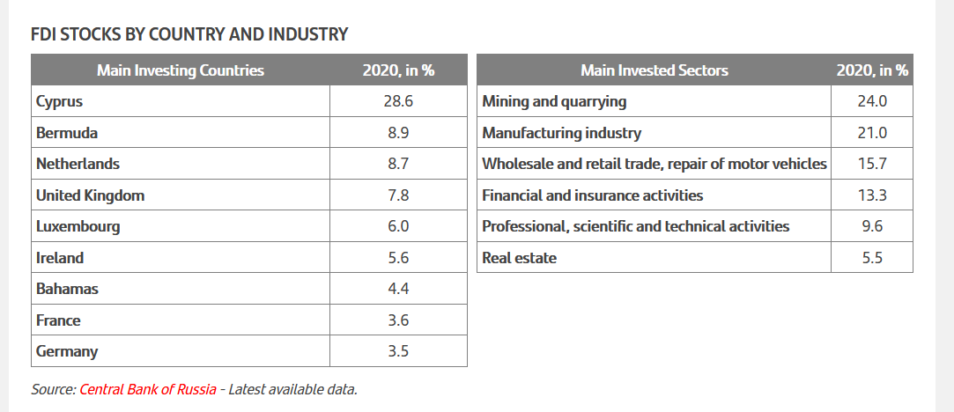
FDI stock in Russia – about 447 billion USD

Slide 35
Some calculations
Cyprus FDI stock in Russia – 125 billion USD.
Cyprus GDP in 2020 – 24 billion USD.
Germany FDI stock in Russia – 15.7 billion USD.
Germany GDP in 2020 – 3.8 TRILLION USD.
PARADOX?

Slide 36
Question for points
Any explanations for this FDI paradox?
You get 1-2 points for correct answer.

Slide 37
Offshore Financial Centers
An offshore financial center (OFC) is a jurisdiction specializing in providing corporate and commercial services, such as offshore banking licenses (international banking license) or the incorporation of offshore companies (international business companies).
OFCs also levy little or no taxes on corporate and/or personal foreign income.
Offshore jurisdictions ➔ Secrecy jurisdictions:
"A secrecy jurisdiction provides facilities that enable people or entities escape or undermine the laws, rules and regulations of other jurisdictions elsewhere, using secrecy as a prime tool."

Slide 38
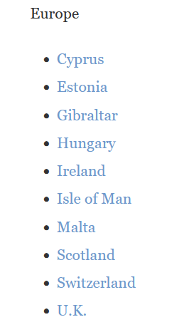
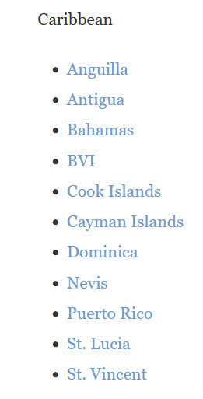
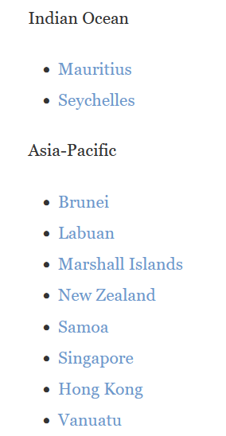
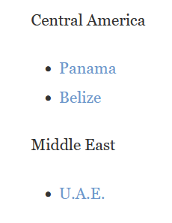
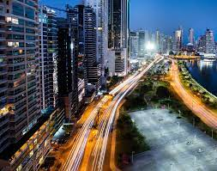
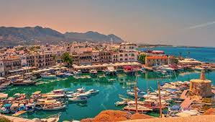
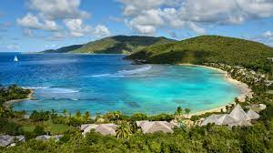
Cyprus
BVI
Seychelles
Panama

Slide 39
Capital (FDI) round-tripping
Offshore financial centres (OFC) ➔ strong position in both inward and outward FDI flows of emerging economies, such as Russia or China.
A significant share of these flows is formed by round-trip investment, where domestic investment is disguised as FDI by first investing capital to an OFC and then transferring it back to the country of origin as inward FDI.
It is estimated that most of the FDI to Russia from selected OFCs such as Cyprus could be money of Russian origin.
Reasons for round-tripping: tax-fiscal arbitrage, regulatory arbitrage and secrecy arbitrage.

Slide 40
Regional distribution of inward FDI in Russia, net inflows, cum. 2011-2018, %
Federal district | %
CENTRAL | 59,7
URALS | 16,4
FAR-EASTERN | 12,8
NORTH-WESTERN | 5,3
SIBERIAN | 2,5
VOLGA | 0,9
SOUTHERN | 0,8
NORTH CAUCASIAN | 0,1
CRIMEA | 0,0
Region | %
Moscow | 53
Tyumen Region | 13
Sakhalin Region | 11
Saint Petersburg | 5
Moscow Region | 4
Krasnoyarsk Territory | 4
Yamal-Nenets Autonomous Area | 3
Chelyabinsk Region | 2
Lipetsk Region | 2
Sverdlovsk Region | 2
Amur Region | 1
Nizhny Novgorod Region | 1
Kostroma Region | 1
Republic of Tatarstan (Tatarstan) | 1
Tomsk Region | 1

Slide 41
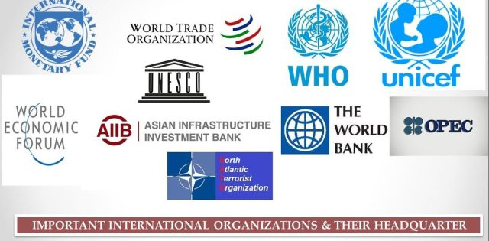
Russia and international economic organizations (IEO)

Slide 42
Russia and IMF, World Bank and WTO
Working relations between IEO started in 1992 with the country's admittance to the IMF and the World Bank.
The country's IMF quota is SDR 12,903.7million (2.71 % of the Fund's total quota; 2.59 % of votes), which does not allow Russia to influence the process of decision making in the framework of IMF.
The largest: USA - 82,994.2 million SDR; 16.52 % of votes
World Bank:
Provided more than $16 billion in loans to support structural transformation in Russia.
9 active projects on 13.06.2017 with budget of 696,1 million USD cumulatively.
Russia has become a fully-fledged WTO member in mid-summer 2012.

Slide 43
Russia and OECD, G8 and G20 groups
In 1994, the Declaration of Cooperation between OECD and Russia was signed in order to improve the political dialogue and to help Russia build up a market-oriented economy.
Since the summer of 1999, Russia has been granted the status of observer in a number of OECD working bodies.
On 30 November 2007, the OECD Council approved the roadmap to accession for the Russian Federation.
Russia has taken on important regional and global roles through its memberships in the Group of 8 and the Group of 20.
Russia has become a significant provider of crisis
response funds and development assistance (2011).
Due to Russia-Ukraine crisis Russia is dropped out from Group of 8.

Slide 44
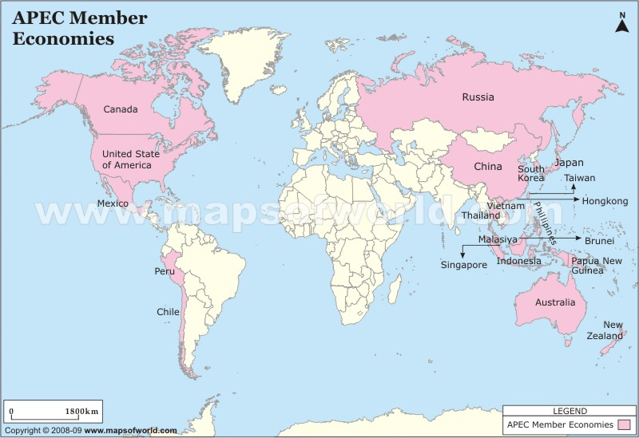
Russia and Asia-Pacific Economic Cooperation
Asia-Pacific Economic Cooperation: seeks to promote free trade and economic cooperation throughout the Asia-Pacific region. Russia is its member from 1998.

Slide 45
What is APEC

Slide 46
Russia is a member of the Commonwealth of Independent States (CIS)

Slide 47
Eurasian Economic Union

