Slide 1
Experience of the project in healthcare industry: Käveli -project on Parkinson disease
Jari Ruokolainen

Slide 2
To start with
Deleuze (1925-1995):
“To affirm reality, which is a flux of change and difference, we must overturn established identities and so become all that we can become—though we cannot know what that is in advance.”

Slide 3
The problem to be solved by the Käveli -project

Slide 4
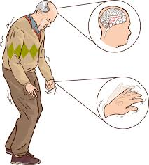
Parkinson decease as phenomenon
Motion characterization in patients is challenging:
symptom progression,
suitability of medication,
level of independence,
across time and from patient to patient
appointments at the clinic
limited understanding of the overall situation.
https://www.youtube.com/watch?v=j86omOwx0Hk
Farmacia Dona

Slide 5
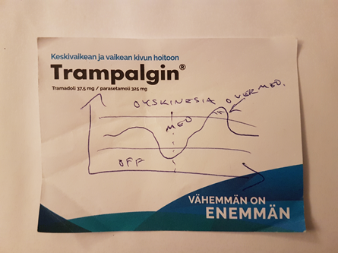
Parkinson decease as phenomenon
Longer-term measurements performed outside of the clinic could help to optimize and personalize therapies in Parkinson disease

Slide 6
Käveli -project’s set-up

Slide 7
Käveli project’s metadata
Two years projects funded by BusinessFinland, Suunto, Forciot, Orionpharma and Tampere University
Satakunta’s District Hospital was a subcontractor
The total size of the project was 250 keuros
Multidisciplinary with focus on developing algorithms
Jari Ruokolainen: project manager

Slide 8
Käveli –projects’ various perspectives
Various research disciplines involved:
Medical and health care aspects
Clinical director and physiotherapist
Can we improve the quality of the life of patients
Signal processing and machine learning
Professor, PhD candidate, research assistant
How we measure and classify the data
Ecosystem platform
Adjunct Professor
How we build ecosystem platform
Information technology
Adjunct Professor
What kind of IT architecture is needed
Adult education
Adjunct Professor
How we cultivate expertise to build expert systems

Slide 9
1. Käveli: Medical and healthcare aspects
No current publication yet

Slide 10
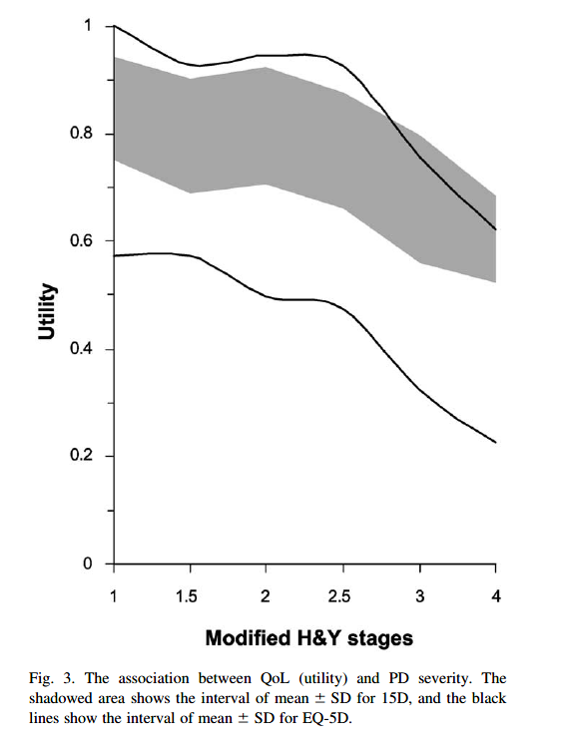
The quality of the life degenerates in the progress of the Parkinson decease
Both EQ-5D and 15D-indicators points observable decrease of the quality of life (Keränen et al.,2006)
Parkinson decease decreases the quality of the life more than 29 other deceases (Saarni et al.,2003)
Decease | EQ5D | 15D
Total | 0,835 | 0,910
Parkinson decease | 0,440 | 0,748
Depression | 0,730 | 0,841
Diabetes | 0,668 | 0,833
coronary heart decease | 0,684 | 0,821
rheumatism | 0,636 | 0,831
Keränen et al. Economic burden and quality of life impairment increase with severity of PD. Parkinsonism and Related Disorders 9 (2003) 163–168
Saarni et al. The Impact of 29 Chronic Conditions on Health-related Quality of Life: A General Population Survey in Finland Using 15D and EQ-5D. Qual Life Res (2006) Oct;15(8):1403-14

Slide 11
2. Käveli: Signal processing and machine learning aspects
Jauhiainen, M., Puustinen, J., Saeed, M., Ruokolainen, J., Holm, A., Vehkaoja, A. and Nieminen, H. (2019), Identification of Motor Symptoms Related to Parkinson's Disease Using Motion Tracking Sensors at Home (KÄVELI): Observational Case-control Study Protocol, JMIR Research Protocols, (forthcoming)

Slide 12
Käveli’s project status report
Status on 12.12.2018
84 samples → 57 patients, 27 controls
38 men, 46 women
Average age 67 years
Missing information from 13 samples
Data that has been analyzed
80 samples including 23 controls
117 gait samples from 33 comes from controls
UPDRS5-distrubution 12.12.2018, n=73

Slide 13
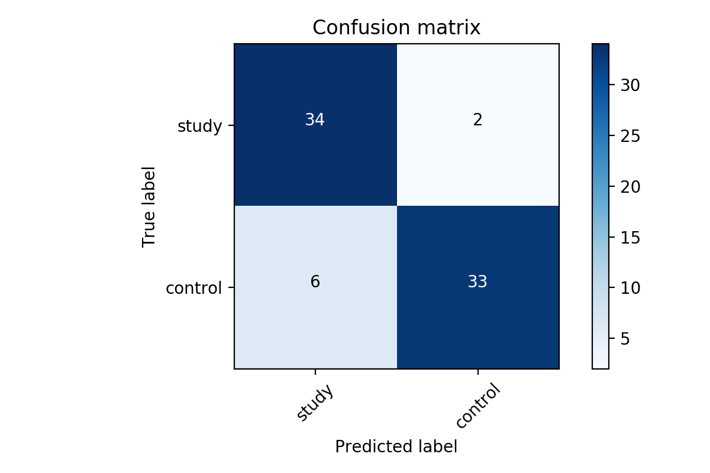
Käveli: Machine learning - Gradient-boosted decision tree
Example of the classification in which 111 pieces of 5 seconds gaits are employed for learning and 75 pieces of 5 seconds gaits for testing
Training size = 60%
Results:
Accuracy = 89.3%
Misclassification = 10.7%
True/Positive = 94.4%
True/Negative = 84.6%

Slide 14
3. Ecosystem platfrom aspects
Ruokolainen, J., Jauhiainen, M., Saeed, M., Nieminen, H., (2018), Design of the platform ecosystem – healthcare case in patients with Parkinson’s disease, IMP Conference

Slide 15
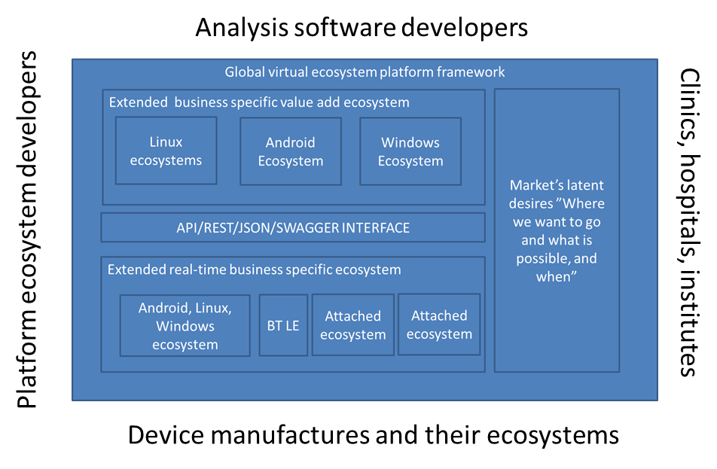
Ecosystem platform’s architecture

Slide 16
4 Käveli: Information technology aspects
Ruokolainen J, 2017. Mobile Microservice Architecture for Patients Self-Care. The Practice of Patient-Centered Care: Empowering and Engaging Patients in the Digital Era, 106, DOI: 10.3233/978-1-61499-824-2-106.

Slide 17
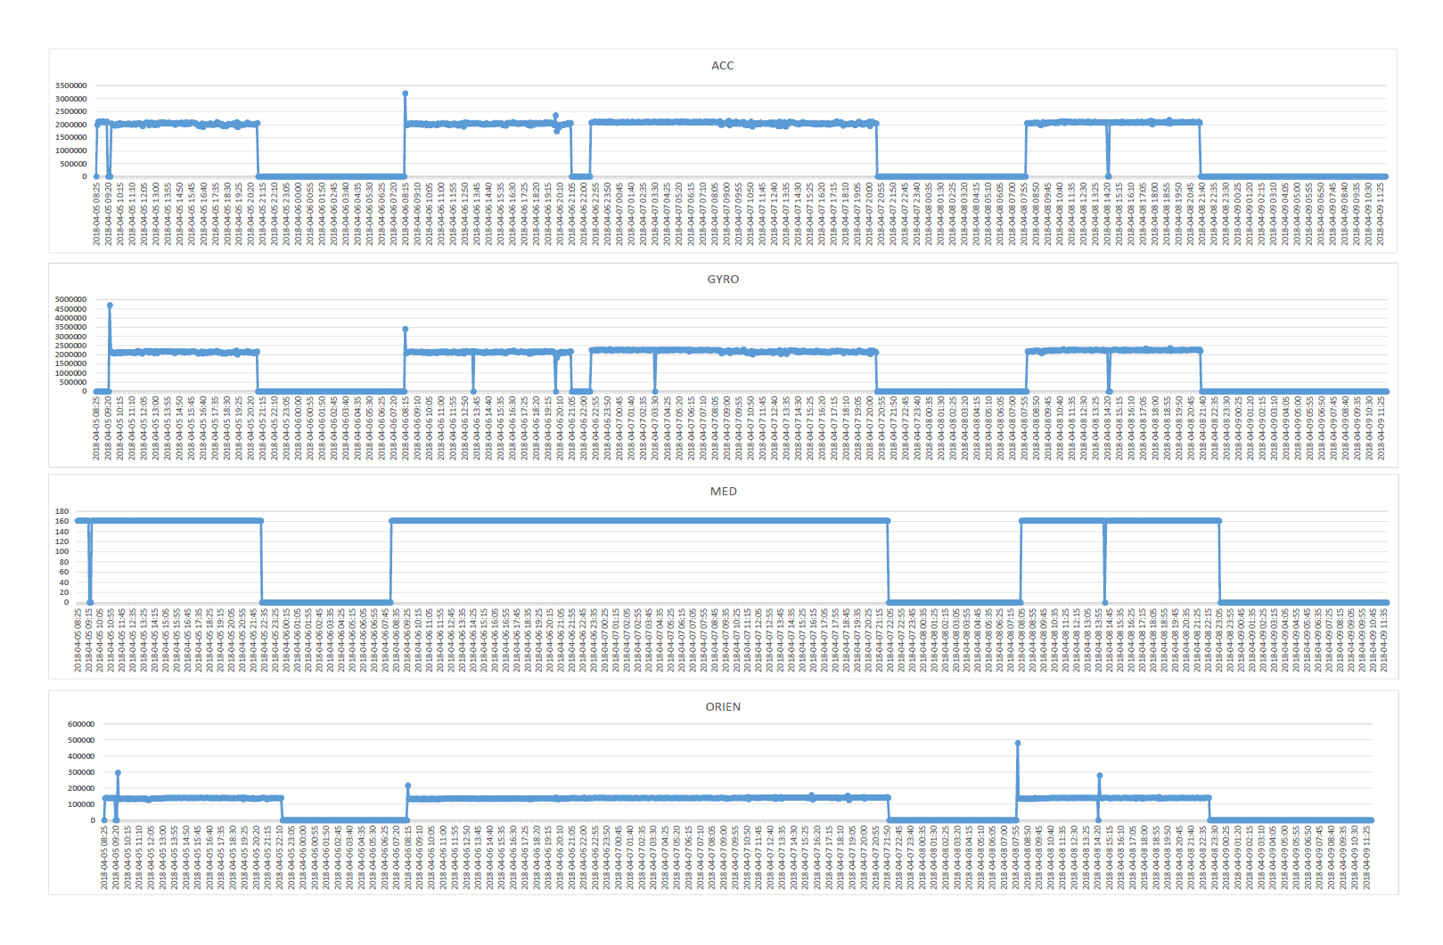
A mount of sensor data collect from a testing mobile phone in three days period from one case outside the clinic
Amount
of data
Time

Slide 18
Benefits of the solution
Value add services are easy to build e.g. UPDRS3 for Clinic
Simpifies architecture, SOA can be employed
Can be built with Get From Shelf HW components
Ecosystem platform via RESTFul API / JSON /Swaegger

Slide 19
5. Käveli: Adult eduction -building expertes
Ruokolainen, J (2019), Cultivating expertise in the creation of the machine learning system to detect Parkinson decease, Work In Progress Paper

Slide 20
Käveli –project’s activity triangular model (Engeström’s (Vygotski), 2004)

Slide 21
Theory on the expertise
The creation of expert system that is capable of recognizing individual patient status requires networked knowledge from several expert areas
The traditional asymptotic model assumes individuals’ capabilities developed through studying and training and approaches the boundaries of the individual in this expertise area.
The project practices helped to form the zones of exchange (e.g., Engeström, 2012) and transactive memories (Weger et al., 1986) between researcher

Slide 22
Conclusions
P1: In order to create an expert system on level N you need to have higher order meta expert knowledge, level N+1, in place.
P2: The main future job of an expert is to create knowledge that can be black boxed by the machine learning systems.
P3: Experts are needed to focus on gaining the knowledge to be delivered by expert systems fluently.
P4: The vision-guided experts’ exertion leads to the homogenous set of the artifacts supporting to achieving the vision and enhance the experts to work towards the joint vision.

Slide 23
Quality issues on the project
Enough formal and informal meetings including F2F meetings
Project documentation was produced by writing publications to journals and conferences with external reviewers
Careful and multiphase testing of the system prior to its delivery to customer
Setbacks
A last minute idea to collect data also from the clinic
Even the software was tested a problem occurred with a user interface
TQM as the fulfilment of customer needs and the continuous improvements in quality, making it the responsibility of every employee. (Wiele et al. 2000; talib et al., 2011).

