Slide 1
Principles of Economics
Carolyn Craven
Session 1, Monday

Slide 2
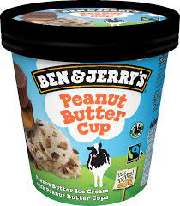
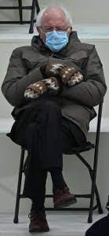
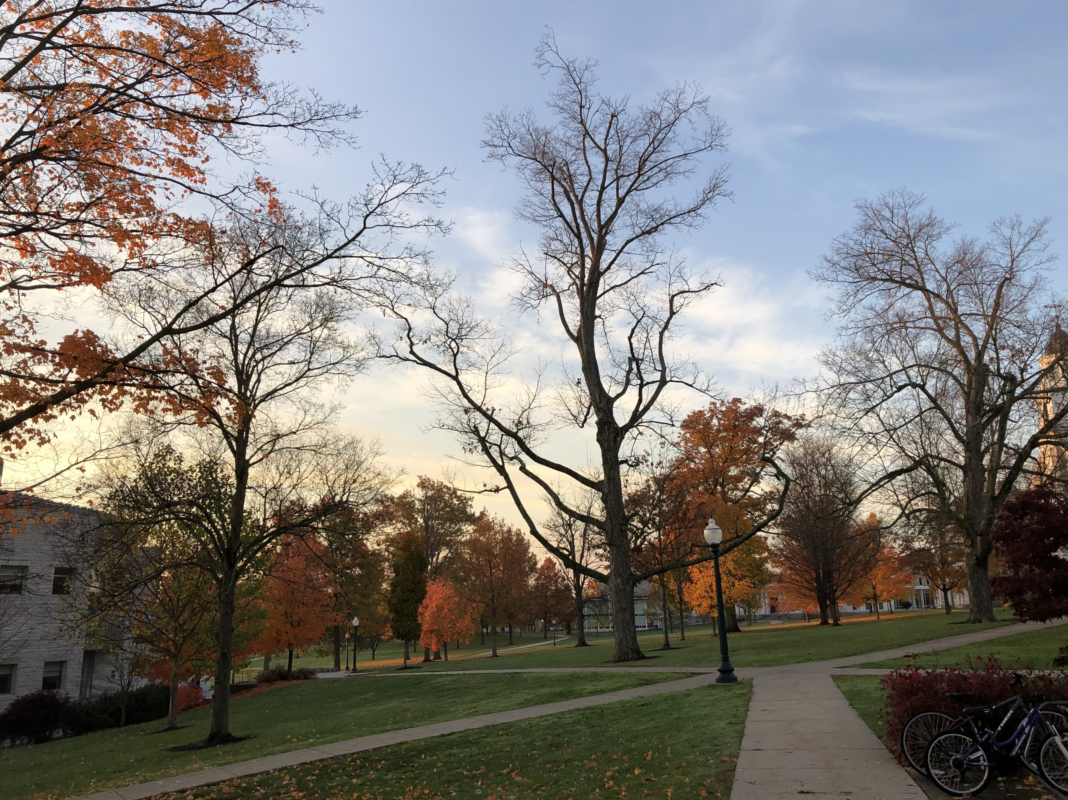
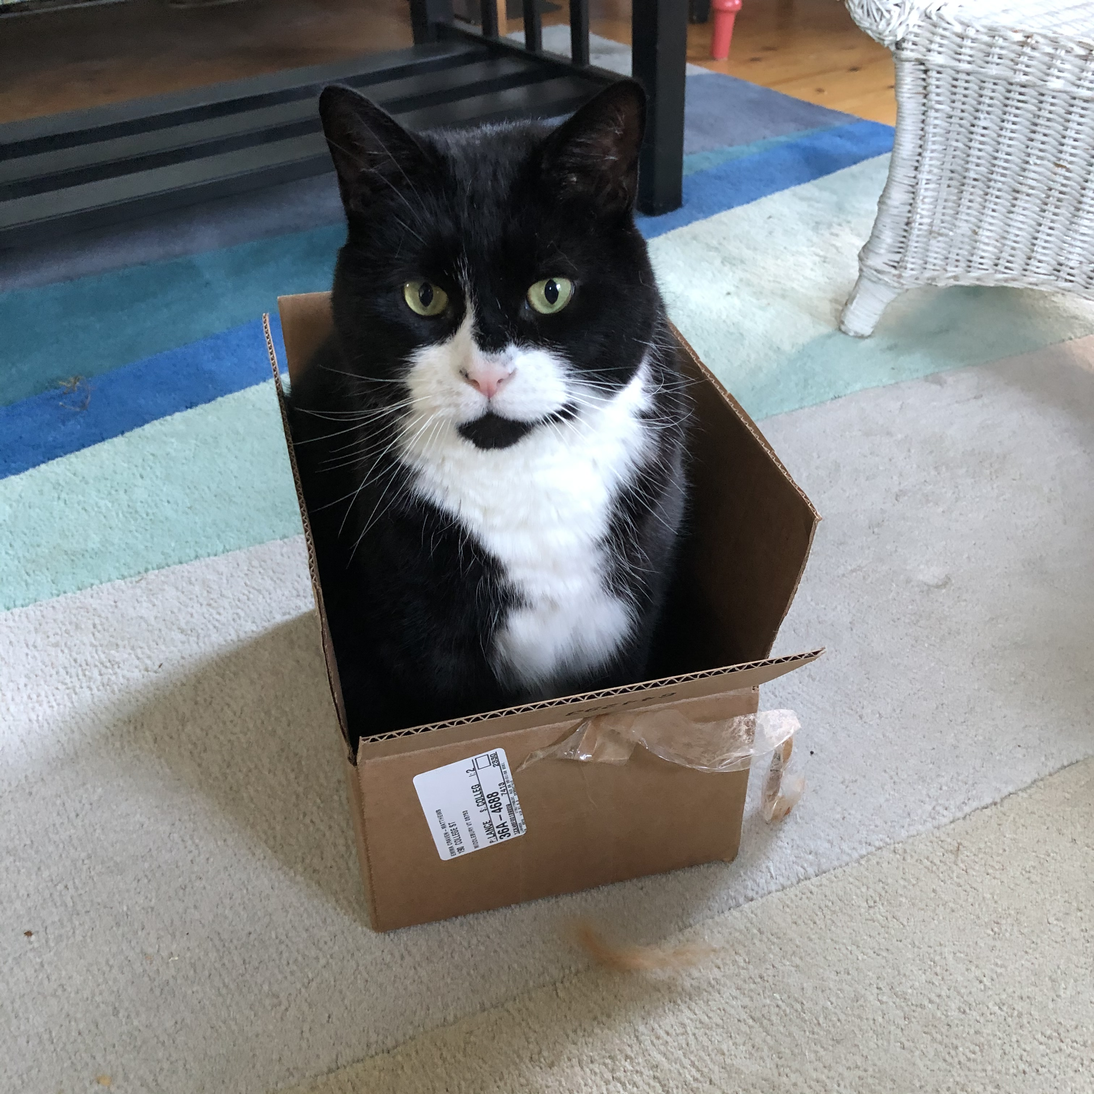
My home state: Vermont
No intro necessary
Noah Kahan
Singer-songwriter
Professor Calculus
My kitty cat
My house in snow
One of my senators,
Bernie Sanders
Fallen leaves, late October
The Middlebury College campus

Slide 3
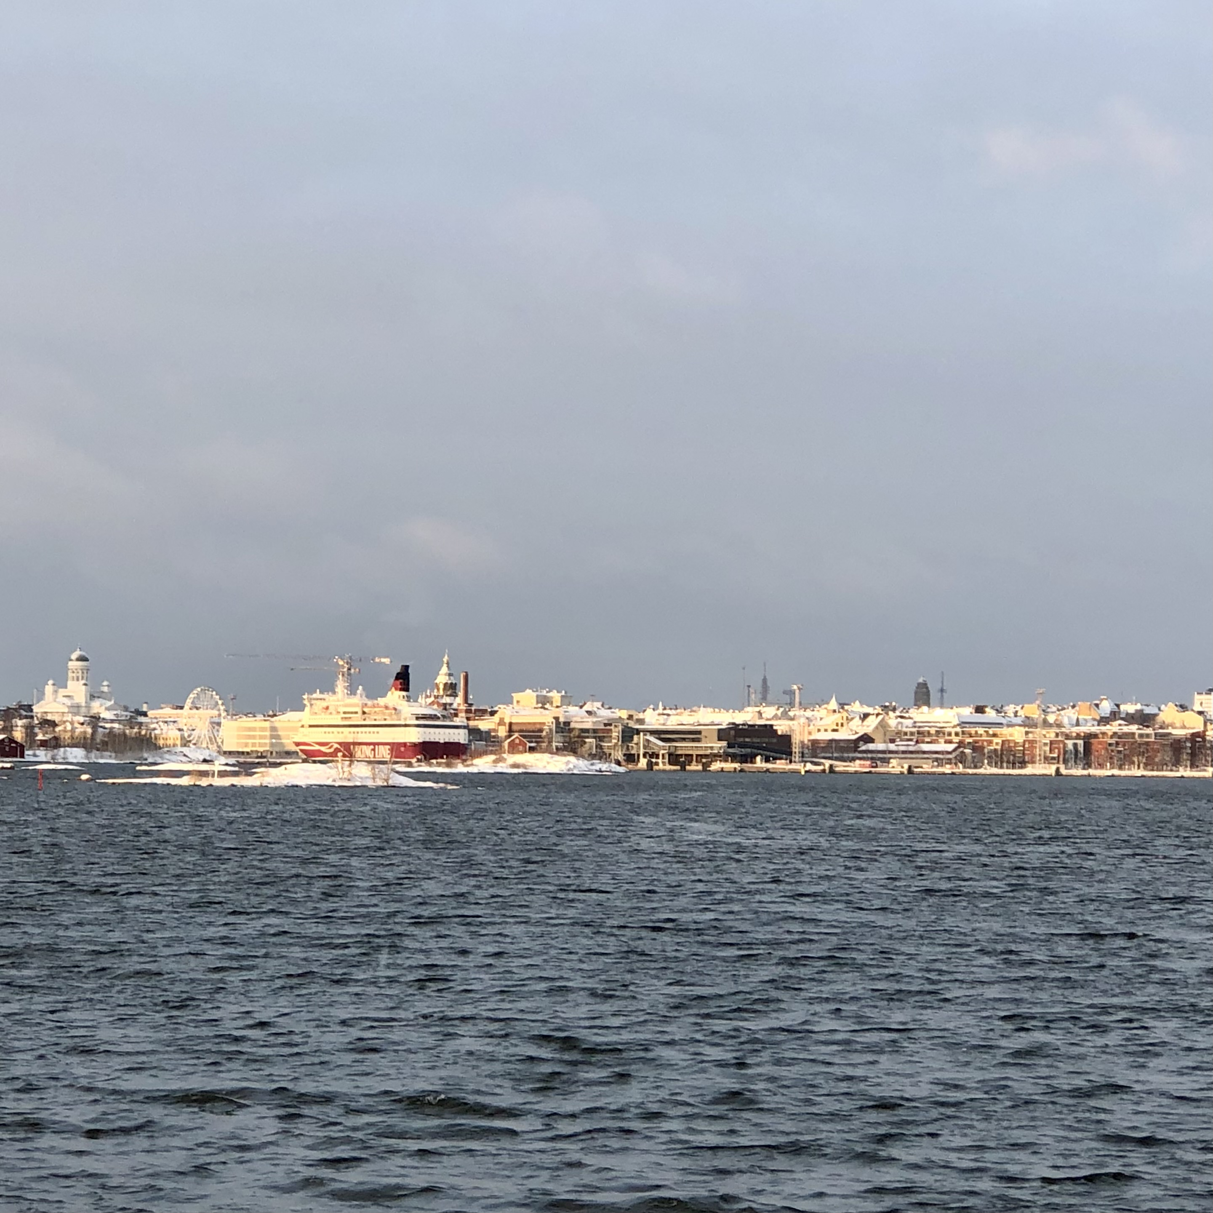
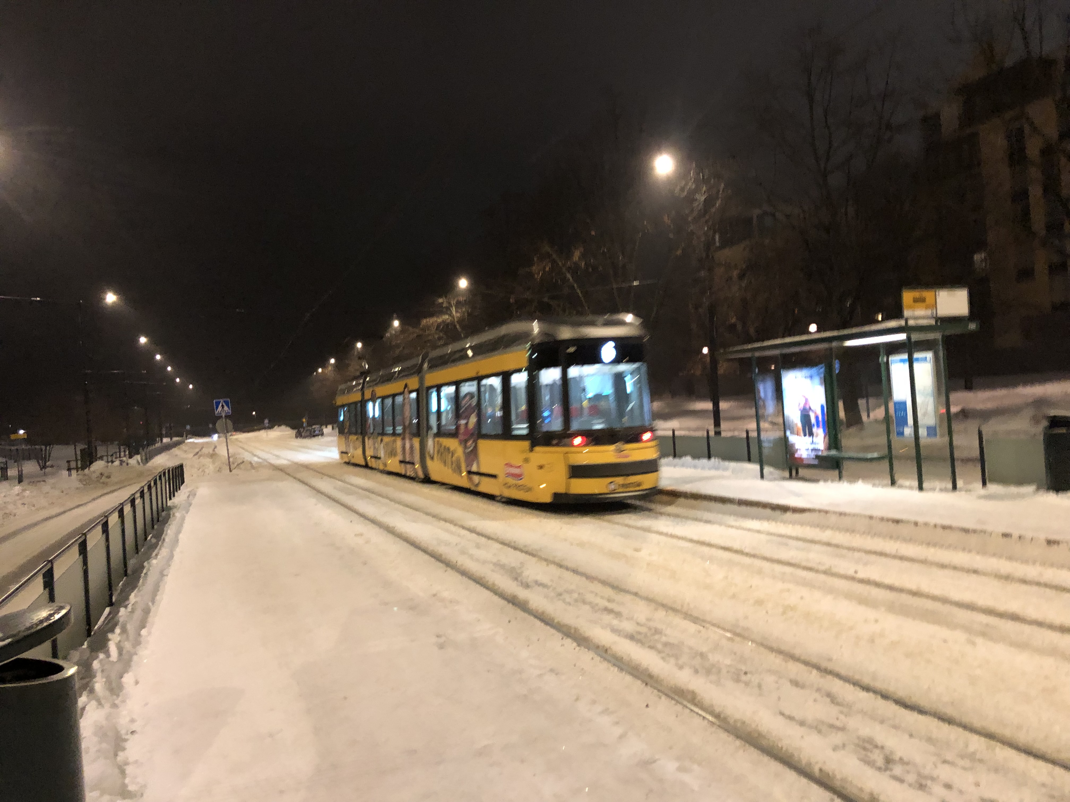
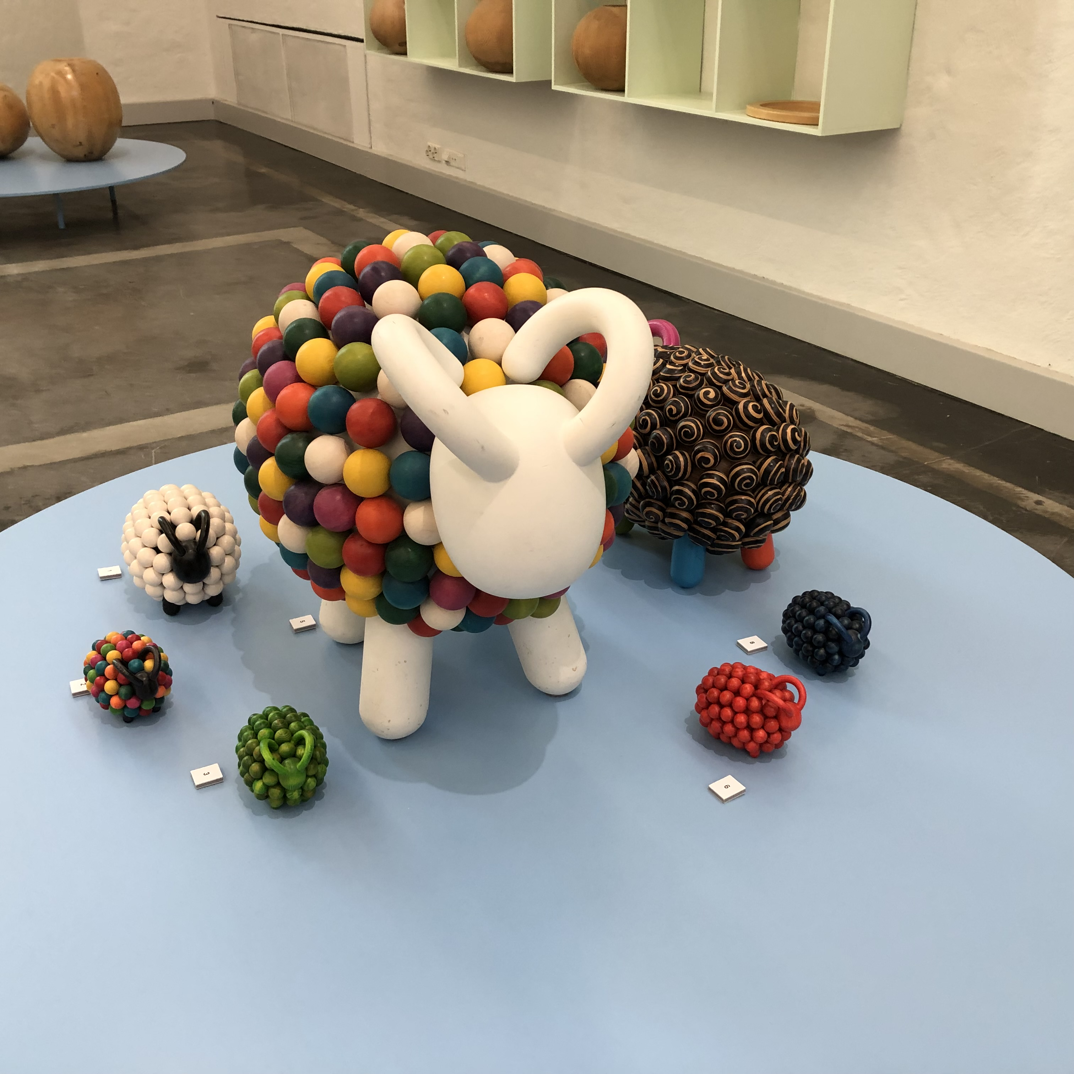
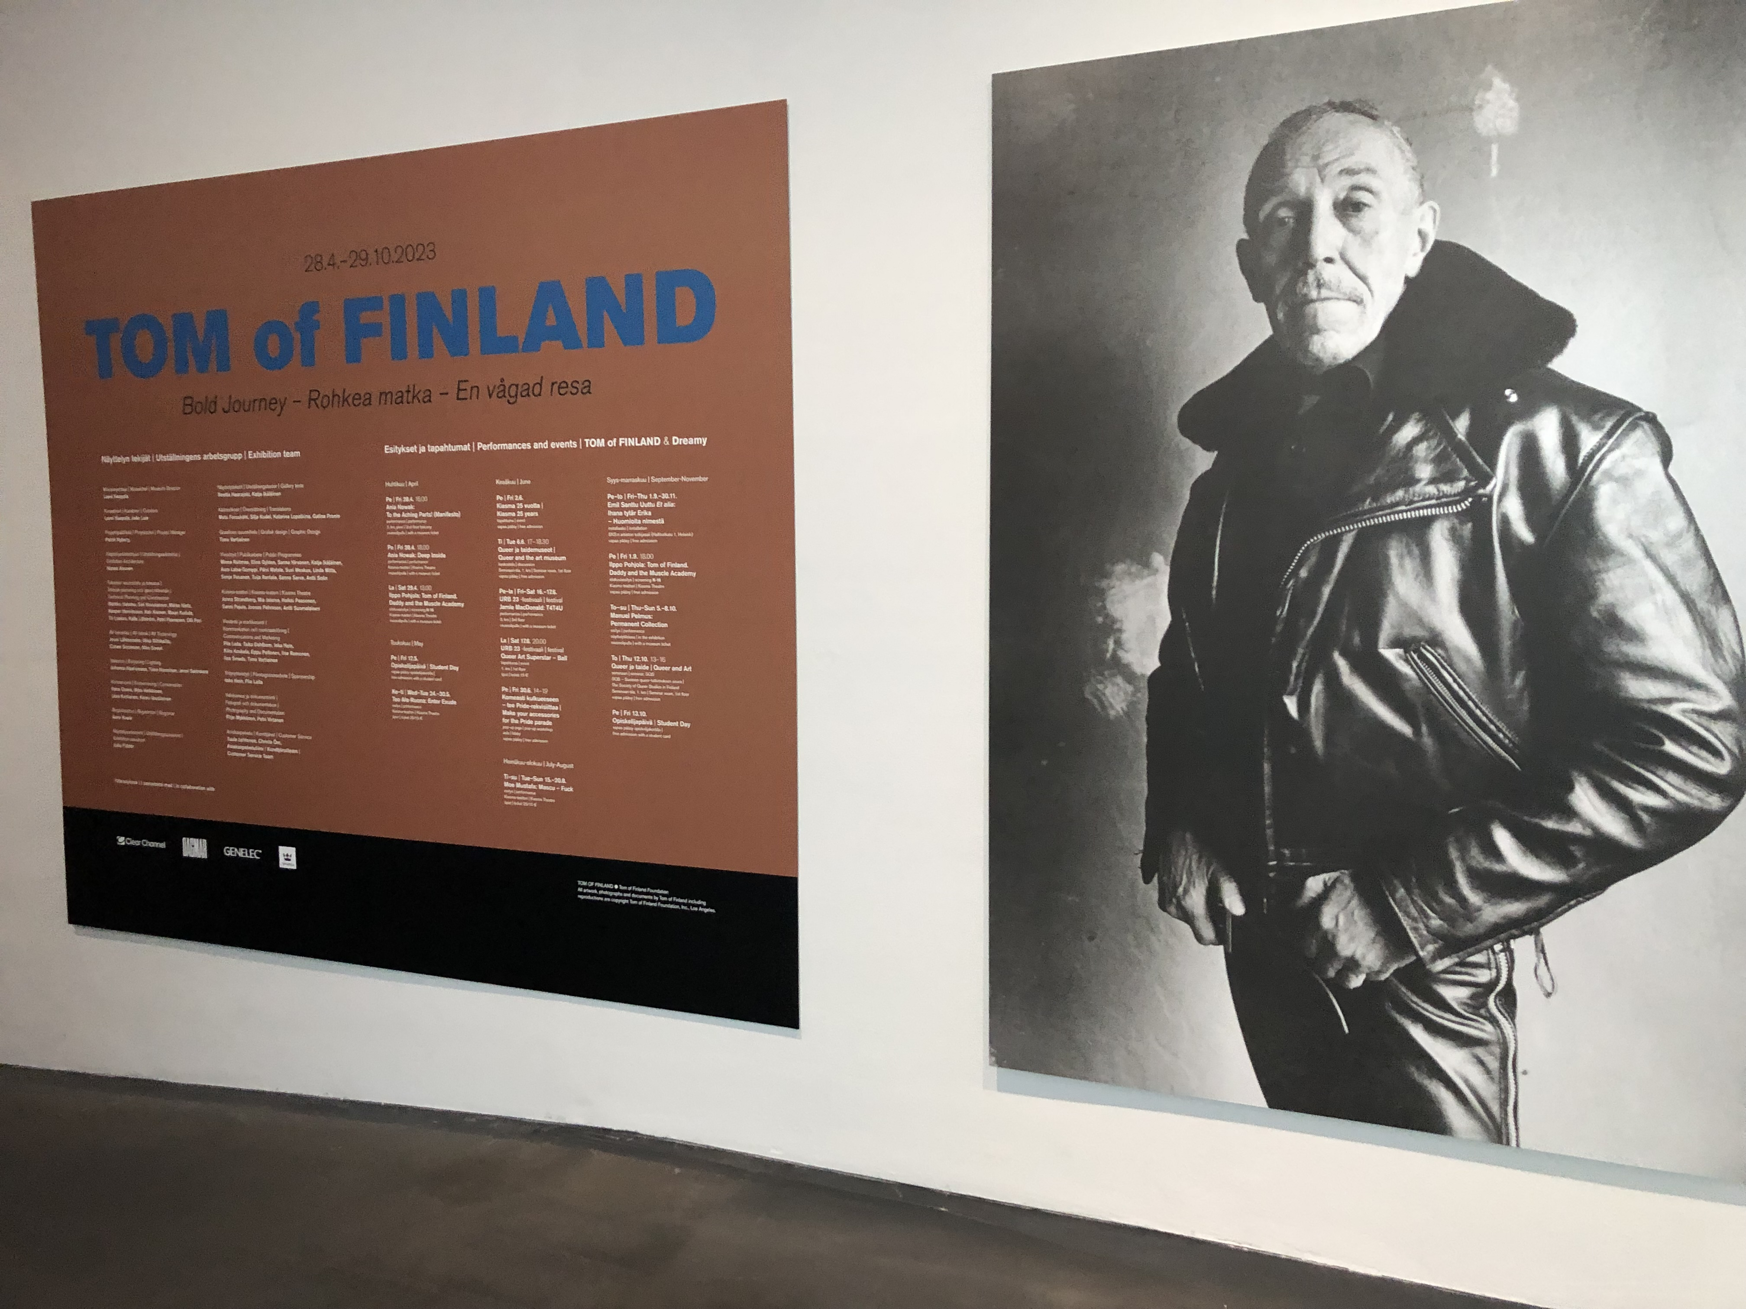
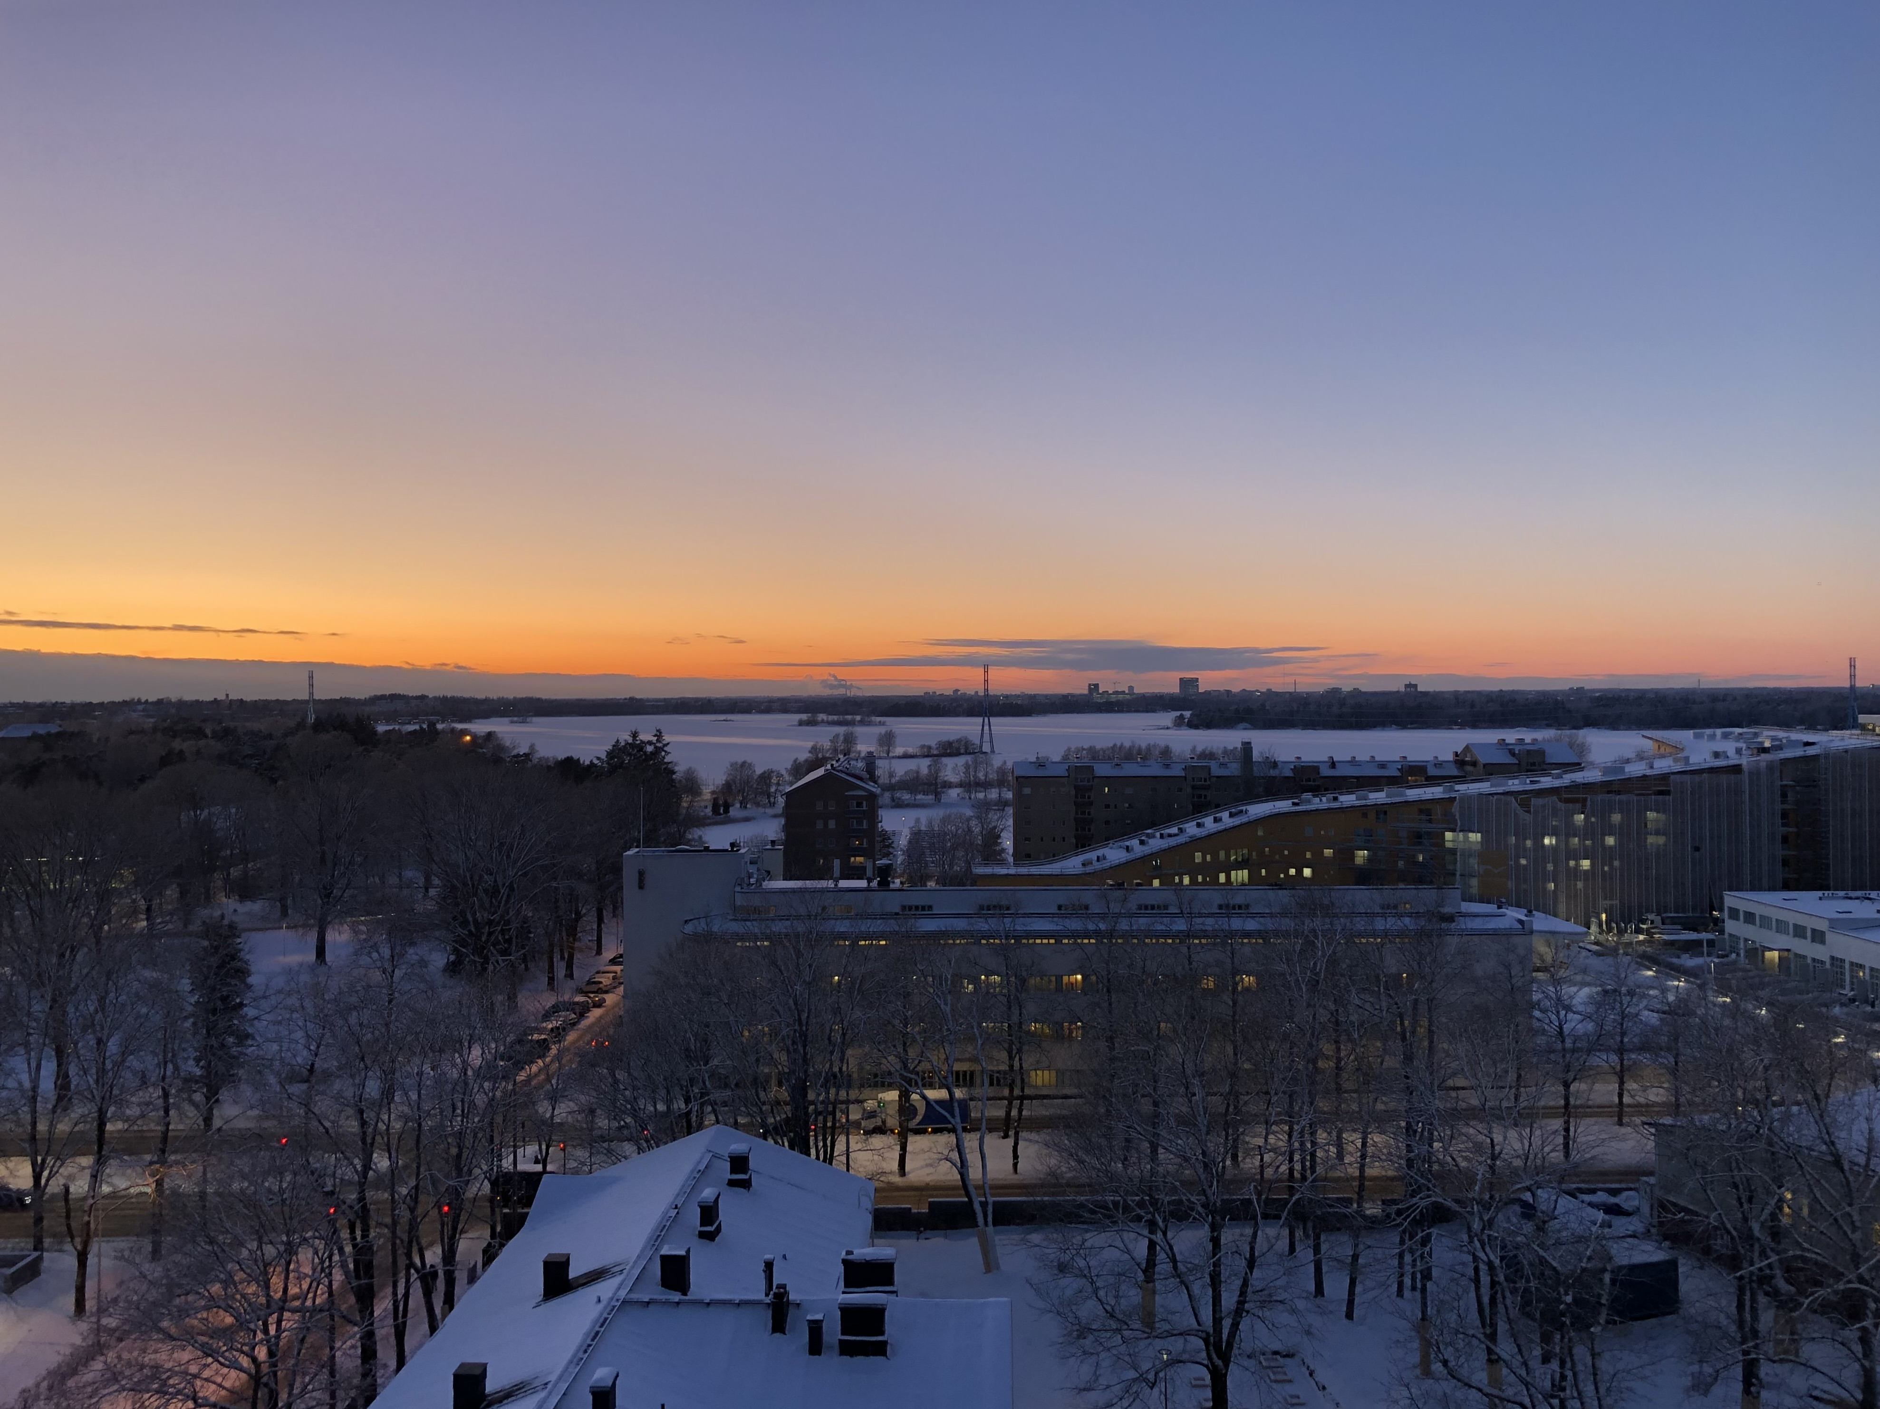
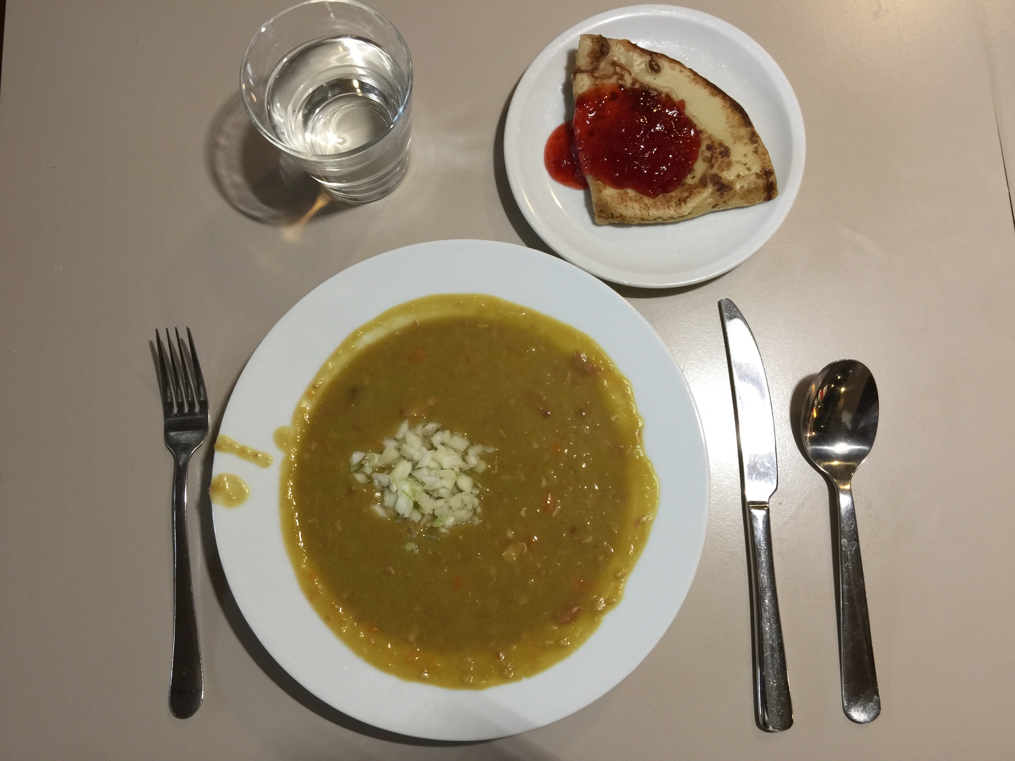
Things I like about Finland
Trams
All the water
Art and design
And other stuff too
The cold and the dark
Thursdays

Slide 4
Down to business now What are we talking about today? (a brief outline)
What is economics: competing definitions. Scarcity vs. well-being
Three institutional settings for production
What resources do societies mobilize to produce material goods and services? The meanings of capital and investment
Models. The production possibilities frontier: 2 versions
Working with linear functions and diagrams
Ceteris paribus. Relaxing ceteris paribus: “shocks”
Ricardian trade theory, using the linear PPF

Slide 5
What is economics?
“Economics is about the allocation of scarce resources.” (Mankiw & Taylor)
Where do we do with our resources?
Production: what and how
What are resources?
Who gets the production? Scarcity is the Anything valuable or useful
Distribution central problem Especially, things that
It means pervasive contribute to production
TRADEOFFS
Get something,
lose something else

Slide 6
An alternative definition
“Economics is the study of how people manage resources to enhance their well-being.” (Neva Goodwin et al Economics in Context)
Economists study human behavior…
In the context of institutions such as the family, markets, government programs…
And within the natural environment.
If we’re studying human behavior, well-being is a fairly obvious and uncontroversial end goal to attribute to humans.
But it’s not necessarily a simple concept.

Slide 7
What do you think are some important components of well-being?
Think of one that’s relevant to an individual (i.e. you)
Think of one that’s relevant to a society as a whole
we’ll compile a list

Slide 8
Our lists
Sleep
Productivity
Health
Financial stability
Education
Basic needs
Purchasing power
Happiness
Shareholder value
Social connections
Entertainment
Emotional stability
Family
Purpose
Self esteem
Self actualization
Job security
balance
Education
Health care
Sustainable environment
Social security
Freedom
Trust
Safety
Political stability
Externalities
(Lack of) corruption
Transparency
Entertainment
Equality
Laws
Quality of goods
Ethics
Property/housing
Peace

Slide 9
Suppose the goal is well-being
Economic activity is one of the means to that goal and it’s the one we focus on in this class
Not just what is produced,
But also in what institutional setting
Not just who gets it…
But also how--e.g. by paying? For free? (also an institutional structure)
Not just how resources are allocated now
But also how resources are maintained for the future

Slide 10
Three institutional settings or spheres in which production takes place
The household and community
What is produced within households? What important allocative decisions are made in households? What motivates?
The business sphere
Who are the actors? What drives activity in this sphere?
The public sector (government) + non-profit firms
How is production and distribution in this sphere different from the business sector?
For all three, consider what role money plays

Slide 11
Think of engagement you’ve had with all three
Household production you’ve done recently—a specific example
How was the product allocated (distributed)?
Have you participated in the business sphere as a SELLER? If so, what did you want from that?
An interaction with the public/non-profit sphere (aside from being a student at Aalto University)
Was a good or service exchanged? Did the exchange involve money?

Slide 12
A few more words about the resources that contribute to production
Traditionally, they are LABOR, LAND and CAPITAL
CAPITAL means a long-lasting asset that contributes to production
In one of its narrow meanings, it refers to machines, tools, infrastructure (“physical capital” or “manufactured capital” produced by humans)

Slide 13
Capital, more broadly
In addition to physical capital, “capital” can include other long-lasting entities that help produce goods and services*
Human capital: people, and their health, education and skills
Natural capital: land, water, air, minerals, flora and fauna, biodiversity, climate
Social capital: institutions, norms, social connections that also help economic activity function well
Money, other financial assets like bonds, loans; the financial system
*although that may not be their primary purpose!

Slide 14
A high level of capital is the main determinant of a high standard of living
Capital is expensive for a society or person to acquire
New machines, infrastructure (€€€, no fun involved*)
More education and training (time and €€€)
Preserving or restoring natural resources (ditto)
Building social connections, good institutions and norms
Ensuring that the financial system is resilient
In economics, adding to capital = “investment”
*Consumer goods are “fun”

Slide 15
Pause to consider “institutions”
A definition: “ways of structuring human activity”
Examples: specific, like the Finnish national health system or Nordea bank
General, systemic, like the private banking system or the higher education system
Norms/values like a 5-day workweek; honesty; trust; negative norms like discrimination or corruption
Institutions are a key underpinning of economic activity
We often don’t notice them, but huge shocks (fall of the USSR, election of Trump) can reveal their importance

Slide 16
The takeaway
Let’s have a broad, encompassing view of what constitutes economics. It’s not just market transactions like buying chocolate or selling a share of stock. It can include all sorts of human decision-making and behavior.
Let’s try to keep in mind the real goal--well-being
rather than the easily measurable outcome--€€€
And remember that invisible/unquantifiable aspects of society (institutions, norms) are important determinants of economic outcomes and of well-being.

Slide 17
A word about models
A model (in economics) is a simple, abstract representation of some process that seems important
Realistic detail is sacrificed for power and expressiveness
In economics, models typically consist of equations and/or 2-d diagrams
Models reflect the values of their builders: what’s the big question? What details are important? Which are not?

Slide 18
The Production Possibilities Frontier: a model about production
What’s its big point?
Finite resources implies scarcity
Scarcity implies tradeoffs
The PPF makes us think clearly about costs and prices

Slide 19
Finite resources
As an individual, your income is finite and, maybe equally important, so is your time. So you can’t buy every nice thing you want, and you can’t do every activity you value each day
As a nation, Finland produces about $55,000 of goods and services per person. A lot, but still limited. In some sense, goods and services are still scarce (very scarce for some people, barely scarce for others)

Slide 20
Drawing a PPF
Resources are assumed FIXED (for now) including labor time, tools and technology, the state of nature. “Ceteris paribus”*
We only show two produced goods, one for each axis on a diagram
Here, shirts and bread. Their quantities WILL VARY!
The PPF could be for a person, a village, a national economy or the world
Here, we’ll illustrate a very small economy
* “all other things the same”
In general in economics “all other things” are underlying factors that are relevant but lurking in the background of the model until a shock happens

Slide 21
Shirts
Intercept:
0 bread, max shirts
Bread (loaves)
Intercept:
0 shirts, max bread

Slide 22
Shirts
Key assumption: MORE IS BETTER
Because we like food and clothing
(and we don’t care about anything
else) Simplification!
Unattainable bundles
We can’t produce these
Intercept:
0 bread, max shirts
The frontier: the biggest bundles.
Efficient production.
All these bundles are equally efficient.
Attainable but
small bundles.
Inefficient.
Wasteful of resources,
as in a recession when labor is unemployed.
Bread
Intercept:
0 shirts, max bread

Slide 23
Scarcity and tradeoff
There’s only a tradeoff along the frontier: there, if they want more bread, they have to sew fewer shirts…
Again, because the number of people and their time is limited
Inside the frontier, there is no tradeoff: they could have more bread and more shirts
In micro we normally assume societies don’t want to operate in the interior

Slide 24
Quantifying our PPF
Suppose there are 1800 labor hours per week in this economy
A shirt takes 9 hours to make S is the quantity of shirts
A loaf of bread takes 3 hours B is the quantity of loaves
The production constraint (max production) is: 9S + 3B = 1800
Rearranging, S = (1800 – 3B)/9
S = 200 – (1/3)B number of shirts as a fn of amount of bread
Find the value of each intercept from this equation
What’s the slope of the PPF?

Slide 25
Shirts
Intercept:
0 bread,
200 shirts
Slope = -1/3
Bread (loaves)
Intercept:
0 shirts, 600 loaves

Slide 26
Digression: in Micro we’ll encounter several functions like this one: downward-sloping straight lines
To find the intercept values, the easiest method is to substitute 0 into the value of one variable and calculate the value of the other.
S = 200 – (1/3)B equation of the PPF
S = 200 – 1/3 x 0 S = 200 = Shirt intercept where B = 0
0 = 200 – (1/3)B B = 600 = Bread intercept where S = 0

Slide 27
Economic theory uses equations and diagrams to express ideas
Here, the negative slope of the PPF expresses the idea of scarcity. More of one, less of the other. A tradeoff.
The constant slope/straight line tells us that the tradeoff is constant. One loaf always requires a decline in production of 1/3 shirt.
And, the |slope| expresses the price of bread, not in money, but in shirts. It’s a relative price or a real price or an opportunity cost. One loaf costs 1/3 shirt.
The price of a shirt is the reciprocal: 3 loaves of bread.

Slide 28
Shirts
Intercept:
0 bread,
200 shirts
Magnified hugely for clarity! Slope = rise over run
-1/3 shirt
Slope = -1/3
+ 1 loaf
Bread (loaves)
Intercept:
0 shirts, 600 loaves

Slide 29
Opportunity cost
A broad conception of cost: “what is given up” to take some action
It may not involve money
In our PPF, there’s no money, just shirts and bread
In a market economy, opportunity cost usually includes a money price, but could also have non-monetary elements such as time or other valuable things
Weekend idea: travel to a ski area, ski, have fun
That costs € but also means you will miss your friend’s birthday party and be too tired to do homework Sunday—significant costs in addition to the €. All those together are the opportunity cost

Slide 30
Another important microeconomic idea is represented in the PPF: marginal analysis!
Marginal in economics means incremental, at the edge or border.
Increasing bread production by one loaf is a marginal change (starting at 200 loaves and moving to 201, e.g.)
Marginal concepts typically correspond to slopes, or to partial derivatives in calculus
Marginal analysis is a way of solving maximization problems (not in this case at the moment though)
We’ll explore it more fully later this week

Slide 31
Practice problem: the PPF
Suppose there are 300 total labor hours in a small, chilly economy.
It takes 4 hours to catch one kg of cod (a fish)
It takes 2 hours to gather one kg of lingonberries
Write the production constraint, as in the shirts/bread example. Then express lingonberry production (L) as a function of cod production.
Draw the PPF. Include intercept values. Label the slope value
What is the relative P of lingonberries? Of cod?

Slide 32
Working with diagrams in economics
There are two types of events with pictures like the PPF and ALL microeconomic and macroeconomic 2-d graphical diagrams
Event type number 1
A movement along the existing line happens when one variable changes value, and the other does too. (It typically will, since the two vars usually have a relationship!)
Ex. for the PPF: the economy starts making more shirts, less bread
The tradeoff doesn’t change and the PPF does not move. Only the choice along the PPF changes. Society wants more shirts, has to accept less bread.

Slide 33
Shirts
Movement along from A to B:
Q of shirts rises to 133
Q of bread must fall to 200
200
No “underlying factors” have
changed. Ceteris paribus holds.
B
133
A
100
Bread (loaves)
600
100 200 300

Slide 34
Event type number 2
A shift of the line/curve happens if the system is shocked and an underlying factor changes (previously held constant: ceteris paribus)
For the PPF: a change in the number of workers. Or a weather event. Or a new tool that speeds up shirt-making. Or many other possible shocks. These are “underlying” because they’re not on the diagram.

Slide 35
Shirts
A shift in the PPF due to growing population.
We have relaxed the ceteris paribus assumption.
Production possibilities have expanded.
The relative price of bread has not changed.
240
200
Slope still = -1/3
Bread (loaves)
600
720

Slide 36
Shirts
Shift in the PPF due to a new tool for shirt production. Production possibilities have again expanded, although not symmetrically. The relative price of bread has changed!
Higher or lower???
300
200
Bread (loaves)
600

Slide 37
Continuing with the cod/lingonberry problem…
Suppose the climate warms, and lingonberries love it
Write a new equation for lingonberries (L) as a function of cod (C)
The original constraint was 4 x Cod + 2 x Lingonberries = 300 hours
so the lingonberry equation was L = 150 – 2C
What is your relative price of lingonberries now?
Draw the new PPF on the same diagram.
Note: when there’s a shock, like this one, draw before-and-after on the same diagram to illustrate the change clearly

Slide 38
Using the PPF to talk about international trade
The PPF reflects the costs of producing two goods in a particular community or nation
Nations are likely to have different resource endowments: some have big labor forces (India); some have very little land (Japan); some are rich in physical capital (Germany), etc.
(Not that this is random—it’s all conditioned by historical processes)
These different compositions of resources suggest that it could be beneficial for nations to specialize in certain types of production and then trade with other nations—taking advantage of low costs for certain goods in each region

Slide 39
Finland and Germany: their PPFs. No trade yet Production must equal consumption for each
Wood products
Wood products
Germany’s
production and consumption choice
Finland’s
production & consumption choice
Vehicles
Vehicles
FINLAND
GERMANY

Slide 40
Note that Finland’s relative Pv = 2, while Germany’s relative Pv = 1
Wood products
Wood products
Slope = -2
Pv = 2 wood products (V are expensive)
Slope = -1
Pv = 1 wood product (V are cheap)
vehicles
vehicles
Finland’s PPF
Germany’s PPF

Slide 41
Theory of Comparative Advantage Ricardian Trade Theory
David Ricardo (Portuguese-British, 1772-1823) pointed out that nations have different relative prices for the same goods
In my example, wood products are cheap in F; vehicles are cheap in G
Ricardo suggested that if each nation specializes in its low-cost good, and trades with the other, both nations would gain
Even if, as in our pictures, Germany has many more resources than Finland!
footnote: Ricardo’s idea of C.A. was based on countries having different labor productivities—not on factories vs. forests.

Slide 42
How does that work? Find a relative price between Finland’s and Germany’s: for instance, P*v = 1.25 (which is P*w = .8)
Wood products
Wood products
Pv = 2
Pv = 1
Slope = -1
Slope = -2
Vehicles
Vehicles
Finland’s PPF
Germany’s PPF

Slide 43
They both profit by trading at that in-between price of P*v = 1.25 (or P*w =.8)
Why? In Finland, vehicles cost 2 units of wood. So a vehicle price of 1.25 is a good deal!
For Germany, wood products cost 1 vehicle. If P*w = .8, wood products are a good deal!
Finland benefits by importing “cheap” vehicles, and Germany benefits by importing “cheap” wood products

Slide 44
The new trade price of Pv = 1.25 is in orange To maximize total outpu, Finland produces ONLY wood and Germany ONLY vehicles
Wood products
Wood products
Slope of trade line = -1.25
Production: all wood
Slope of trade line = -1.25
Production: all vehicles
PPF slope = -1
PPF slope = -2
vehicles
vehicles
Finland’s PPF
Germany’s PPF

Slide 45
Finland can consume on the orange line, ABOVE its PPF Same for Germany: it can consume ABOVE its PPF
Wood products
Wood products
Production: all wood
Consumption: some of each
Consumption: some of each
Production: all vehicles
vehicles
vehicles
Finland’s PPF
Germany’s PPF

Slide 46
Both countries have higher consumption
The orange lines, higher than the original PPF, show the “gains from trade” that arise when nations specialize
The idea of gains from trade is an old, famous, surprising, and powerful result in economic theory
Trade theory is much more complex than this. In particular, even though total consumption rises for both countries, some groups in both countries are always worse off as a result of trade
In particular, vehicle producers in Finland and loggers in Germany

Slide 47
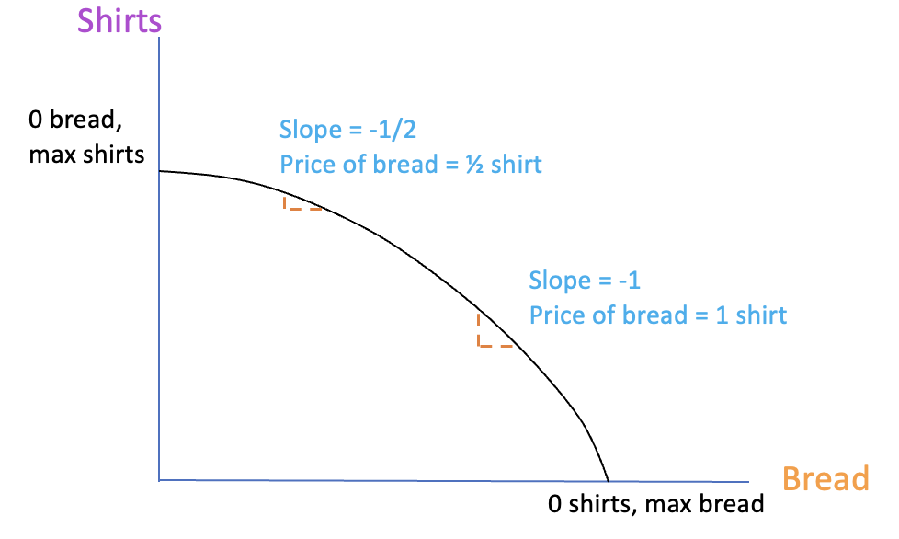
A refinement of the PPF This curved PPF has a changing price of bread as production levels change

Slide 48
Assumption behind this PPF The cost of production increases as production grows
Bread gets more expensive
as the economy makes more
bread, moving down to the right.
Why? Some resources are
well-suited to bread
production. As they get scarce,
costs rise.
Likewise, shirts get more
costly moving up the curve.

Slide 49
What’s the implication of increasing costs in the curved PPF?
If costs go up as production grows, Ricardo’s result that countries gain from total specialization does not hold
Because (for Finland) wood products eventually start getting expensive. As do vehicles in Germany.
So we expect nations to specialize somewhat (but not necessarily shutting down production of one product)

Slide 50
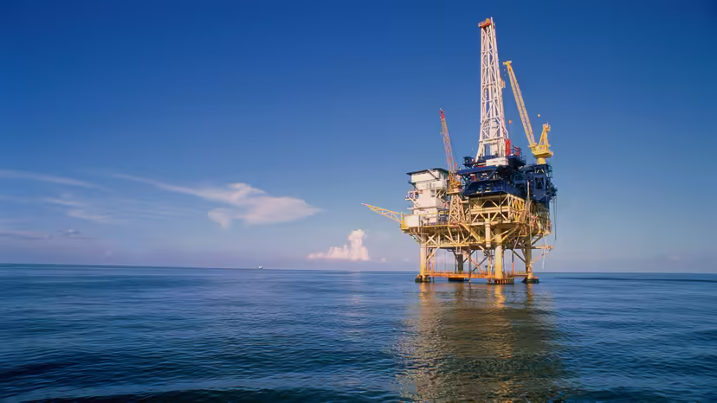
Increasing costs: an example
The U.S. produces petroleum, but usually imports it as well (although not in 2020-2022)
Some oil fields have abundant and low-cost reserves—in the Gulf of Mexico adjacent to Texas and Louisiana, and north of Alaska in the Arctic.
Others are much more expensive to access: petroleum off the coast of California and near the Northeastern states and fracked oil
Because of those high costs, the U.S. is unlikely ever to produce its “maximum” level of oil. It’s cheaper to produce some at home and import the rest.

