Slide 1
Is This a good Business?
14.8.2019, Kalle.airo@aalto.fi

Slide 2
Agenda for this Session
Introduction and Learning Goals
Warmup
The Seven Domains Model
Teamwork and Presentations to The Class
Feedback on Learning Goals

Slide 3
Visiting Educators in Class Today
Alexander Tittel & Tanja Himstedt from Karlsruhe Institute of Technology, Germany

Slide 4
Introduction

Slide 5
The course framework
Notes:
In addition, we added the fifth stage (or the third diamond) – business modelling

Slide 6
3 simultaneous tracks
Notes:
Ta dam
Simultaneously to the project development track you will have Self and team development tracks
Team dynamics track will be guided by Jari Ylitalo. You will have the kick off session for this track today in the afternoon after the lunch. Then you will have the checking points during the course – in the end of this Friday, and in the end of last week. Jari will explain you later the process
And third track – is a self development track. Johannes and I will guide you through that process. A bit later from now we will start the kick off session.
The main idea of this track is to open up for you the topic of sustainable wellbeing and purposeful life; setting up the mindset that you have to align your everyday routines with your life goals. Again, we will tell you more about this in a while.
But the believe that the combination of these 3 tracks accompanied with amazing events program will provide you with fully multidimensional learning experience!!!

Slide 7
Learning outcomes based on Bloom’s taxonomy:
1. Knowledge and 2. Comprehension:
to define the basic concepts of experience economy, design thinking, UX design, leadership, team working, experimentation, and business modelling;
3. Application:
to master iterative design process to develop own business ideas;
to develop team working skills, ability to adjust to different cultures and personalities, practice to teach the peers personal areas of expertise;
to create personal concept of sustainable wellbeing and apply wellbeing practices already during the course.
AALTO VENTURES PROGRAM
Notes:
It is the answer to the question what can you do now that you have passed this course?
Did you noticed smth new that I didn’t talk yet about? Yes, besides project development track you will have something more
Upper levels we will cover after the first three will be done.
4. Analysis:
to identify user’s needs and experiment with solution;
5. Synthesis:
To create your business concept

Slide 8
Warmup

Slide 9
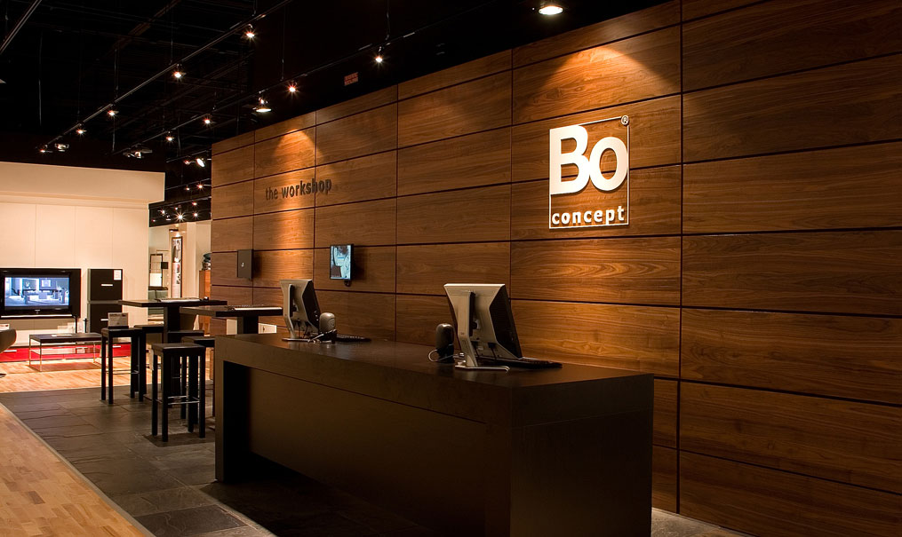
You…

Slide 10
…want to sell this…

Slide 11
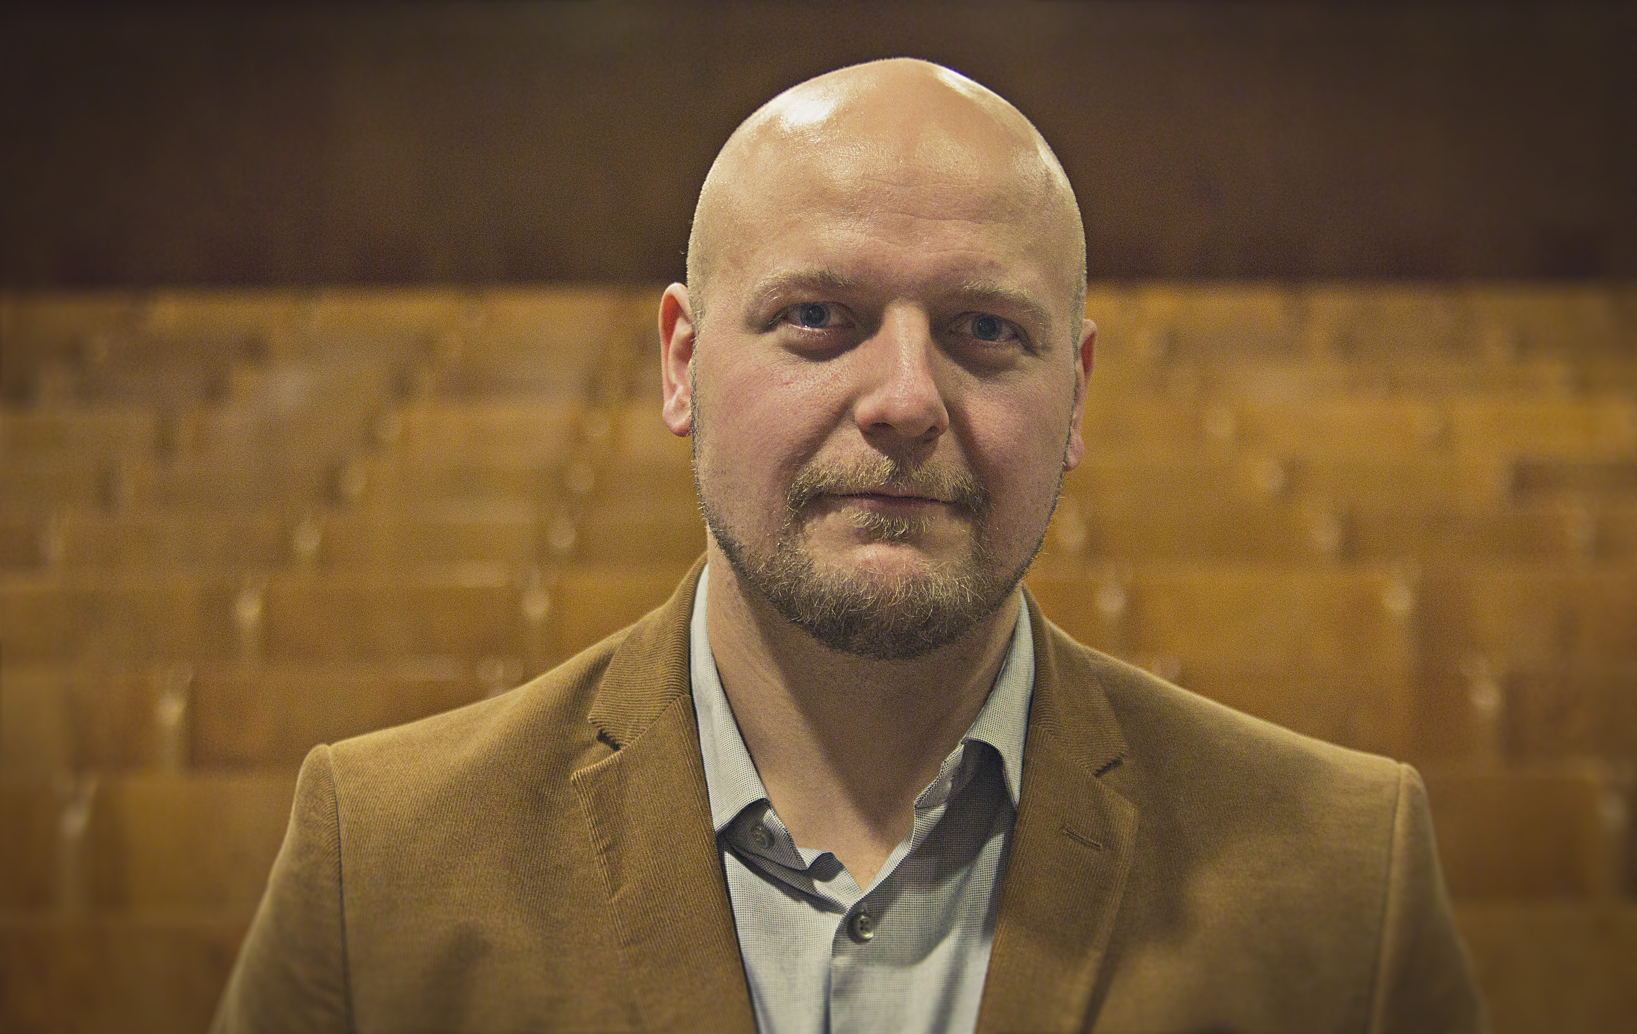
…to this guy

Slide 12
Warmup
What do you need to know about the customer?
What else could he spend the same money on?

Slide 13
More Competition than this

Slide 15
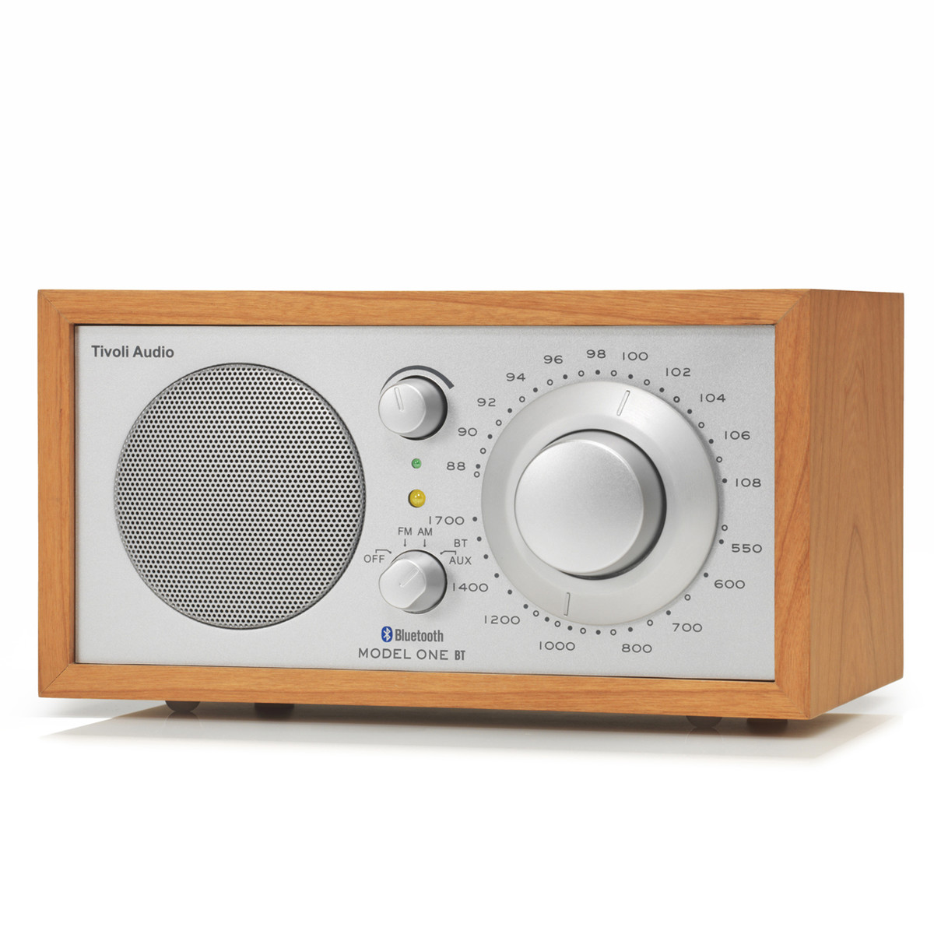

Slide 16
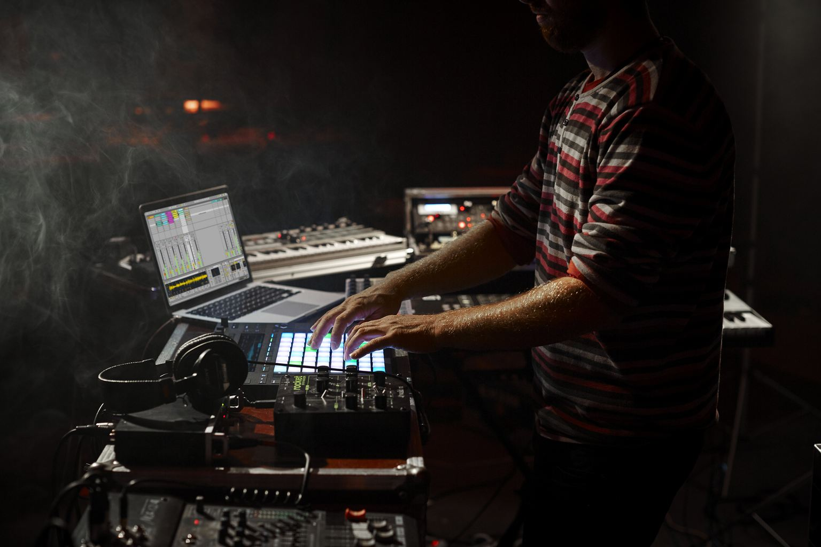
He bought this with ’the sofa money’

Slide 18
Market $≠$ Industry

Slide 19
John Mullins’
The Seven Domains Model

Slide 21
The Market Domains
Market = Buyers
(NOT Products)

Slide 23
Micro Market
Will the fish bite?
Talk with people, not statistical averages

Slide 24
Teamwork: Micro Market 1/2
Two teams work together:
10 min Teams prepare answers internally
5 min Team A explains to team B (who will ask for clarifications when needed)
5 min switch the roles of team A and B

Slide 25
Teamwork: Micro Market 2/2
Explain to another team (who will ask questions)
What experience are you selling?
Who is your target customer?
What are the benefits to your customer and why is your experience attractive to them?
Make notes for future reference

Slide 26
Macro Market
Is this a good market?

Slide 27
Macro Market
 | Units sold | Money | Customers
Market size
Actual market growth
Projected market growth
For the macro level, using credible secondhand sources such as official statistics is a good idea. Just remember list your references properly and include links whenever possible.

Slide 28
Market trends
 | Favorable | Unfavorable
Demographic
Sociocultural
Economic
Technological
Regulatory
Natural

Slide 29
Teamwork: Macro Market
What are the top 1-3 key trends in your macro market?

Slide 30
The Industry Domains
Industry = sellers
(also of substitutes)

Slide 32
You want to sell this to me

Slide 33
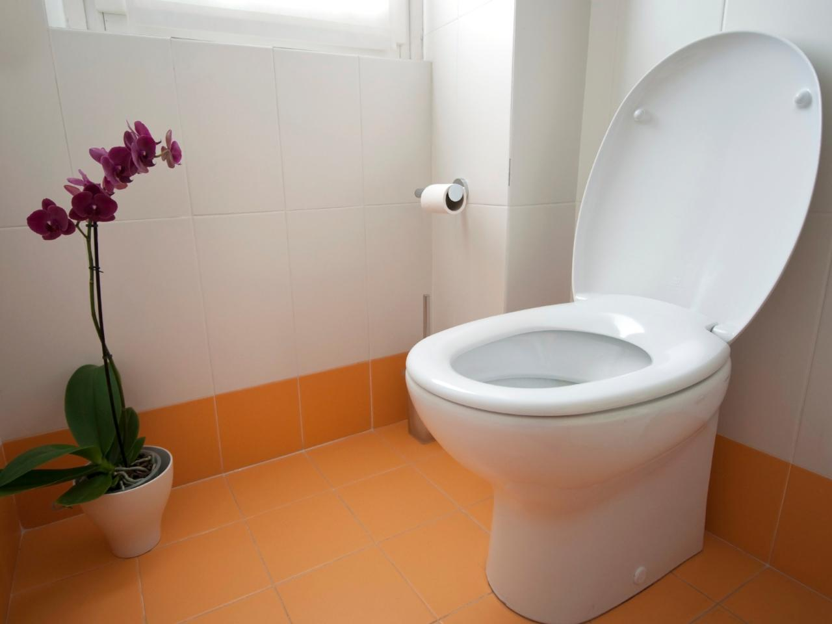

Slide 35
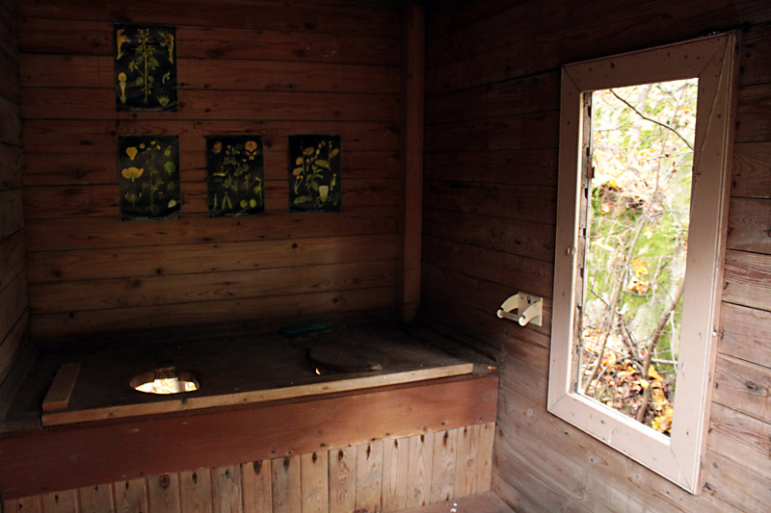

Slide 36
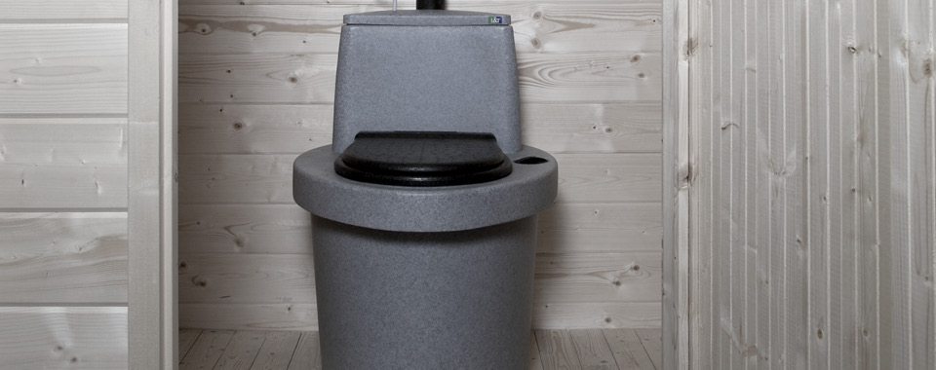

Slide 37
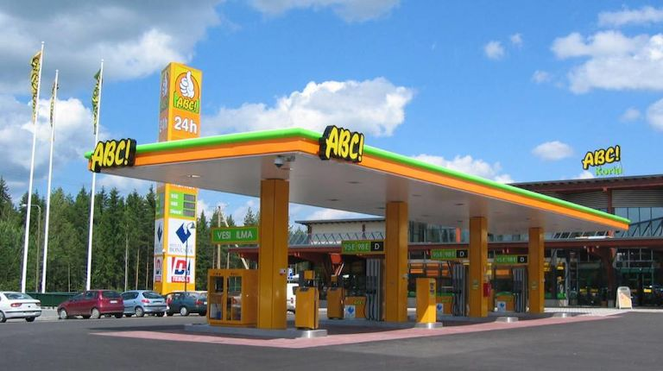

Slide 39
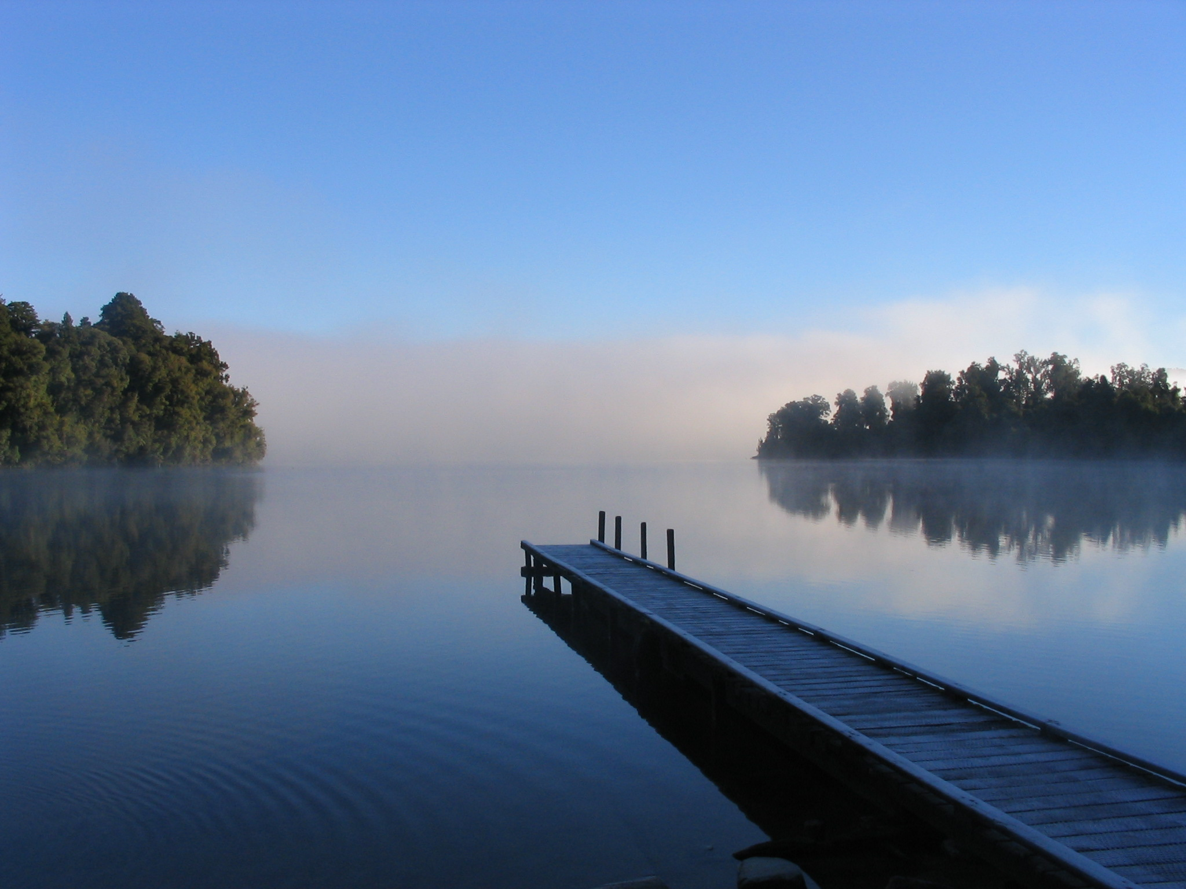

Slide 40
Micro Industry
How long will your Sustainable Advantage last?

Slide 41
Teamwork: Micro Market
What is your sustainable advantage?
How long will it last?

Slide 42
Macro Industry
Is this a good industry?

Slide 43
Porter’s 5 Forces & Value Chain
 | Our suppliers | Our company | Wholesalers | Retailers | Consumers
Supplier power
Threat of new entries
Substitutes
Customer power
Competition
Matrix idea from: http://tomtunguz.com/diagrams/

Slide 44
Short Break

Slide 45
The Team Domains

Slide 47
Team Domain 1
Business mission, personal aspirations and risk propensity

Slide 48
Teamwork: Aspirations
What are your aspirations for
The experience you are building
Your team
You as and individual
How well are those three aspirations aligned

Slide 49
Team Domain 2
Ability to Execute on The Critical Success Factors

Slide 50
Teamwork: Critical Success Factors 1/2
Two teams work together:
10 min Teams prepare answers internally
5 min Team A explains to team B (who will ask for clarifications when needed)
5 min switch the roles of team A and B

Slide 51
Teamwork: Critical Success Factors 1/2
Explain to another team (who will ask questions)
What are the critical success factors of your experience as a business?
Can you execute these factors now?
What do can you do to be able to execute these factors in the future?
(Make notes for future reference)

Slide 52
Team Domain 3
Connectedness up, down and across the value chain

Slide 53
Porter’s 5 Forces & Value Chain
 | Our suppliers | Our company | Wholesalers | Retailers | Consumers
Supplier power
Threat of new entries
Substitutes
Customer power
Competition
Matrix idea from: http://tomtunguz.com/diagrams/

Slide 54
Teamwork: Connections
What connections do you need in the value chain?
Which of the connections you have now?
Hos can you build the needed connections?

Slide 55
The Two Most Important Domains

Slide 56
You must talk to customers to find these!

Slide 57
Prepare a 1 min informal presentation
What experience are you selling?
What are the benefits to your customer and why is your experience attractive to them?
What are the critical success factors of your experience as a business?

Slide 58
Short presentations
(From your place)
1 min each

Slide 59
Feedback on Learning Goals and Q & A
1. Knowledge and 2. Comprehension:
to define the basic concepts of experience economy, design thinking, UX design, leadership, team working, experimentation, and business modelling;
3. Application:
to master iterative design process to develop own business ideas;
to develop team working skills, ability to adjust to different cultures and personalities, practice to teach the peers personal areas of expertise;
to create personal concept of sustainable wellbeing and apply wellbeing practices already during the course.
AALTO VENTURES PROGRAM

Slide 60
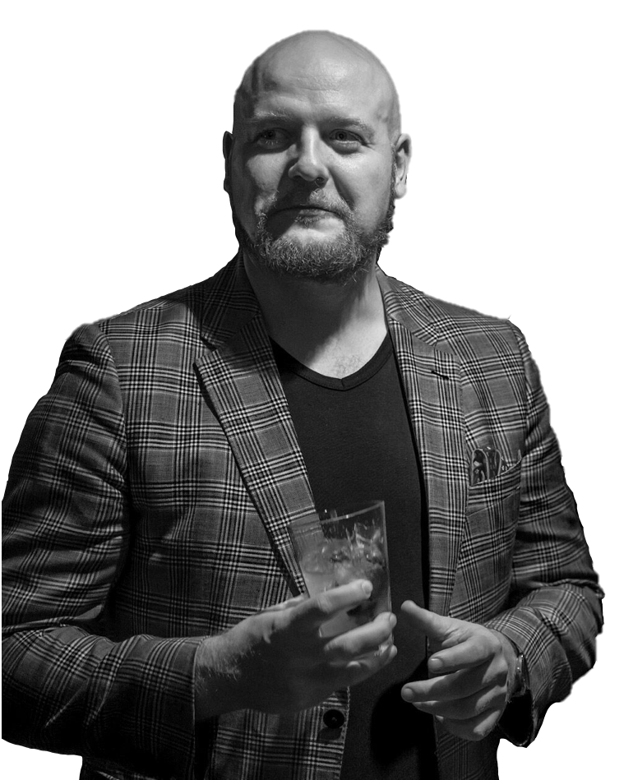
KALLE AIRO
Program director / Educator / Entrepreneur / Musician
Kalle is a culture builder who has been with Aalto Ventures Program from the very beginning, acting as both the program director and as a teacher. He is a recognized expert on innovation and entrepreneurship, having taught and supported several startups as well as having founded a couple of his own.
His “second career” is in the music industry, making melodic electronic music as a member of Gintonite. For Kalle, making music is not just a hobby, but it also helps him to look at things from a different perspective, making him a better teacher and a leader.

