Slide 1
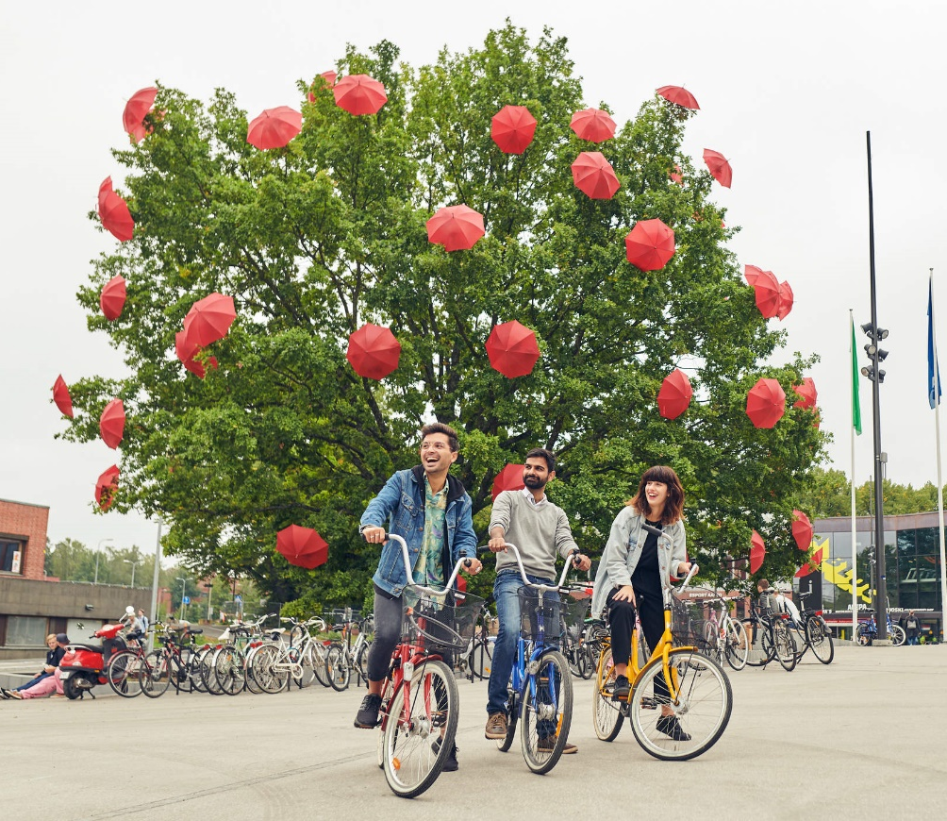
Welcome to the Master’s Programme Orientation 2021
Introduction to Master's Studies in Engineering
6-10 September 2021

Slide 2
Questions during the presentations?
We prefer written questions so you can get back to the answers later.
A separate question section opens for each presentation.
Presemo-link and access code (153695) in chat.
The link will be reposted during the afternoon.
Questions will be answered either towards the end of the presentation or later during the week. Please focus on issues related to Monday programme.

Slide 3
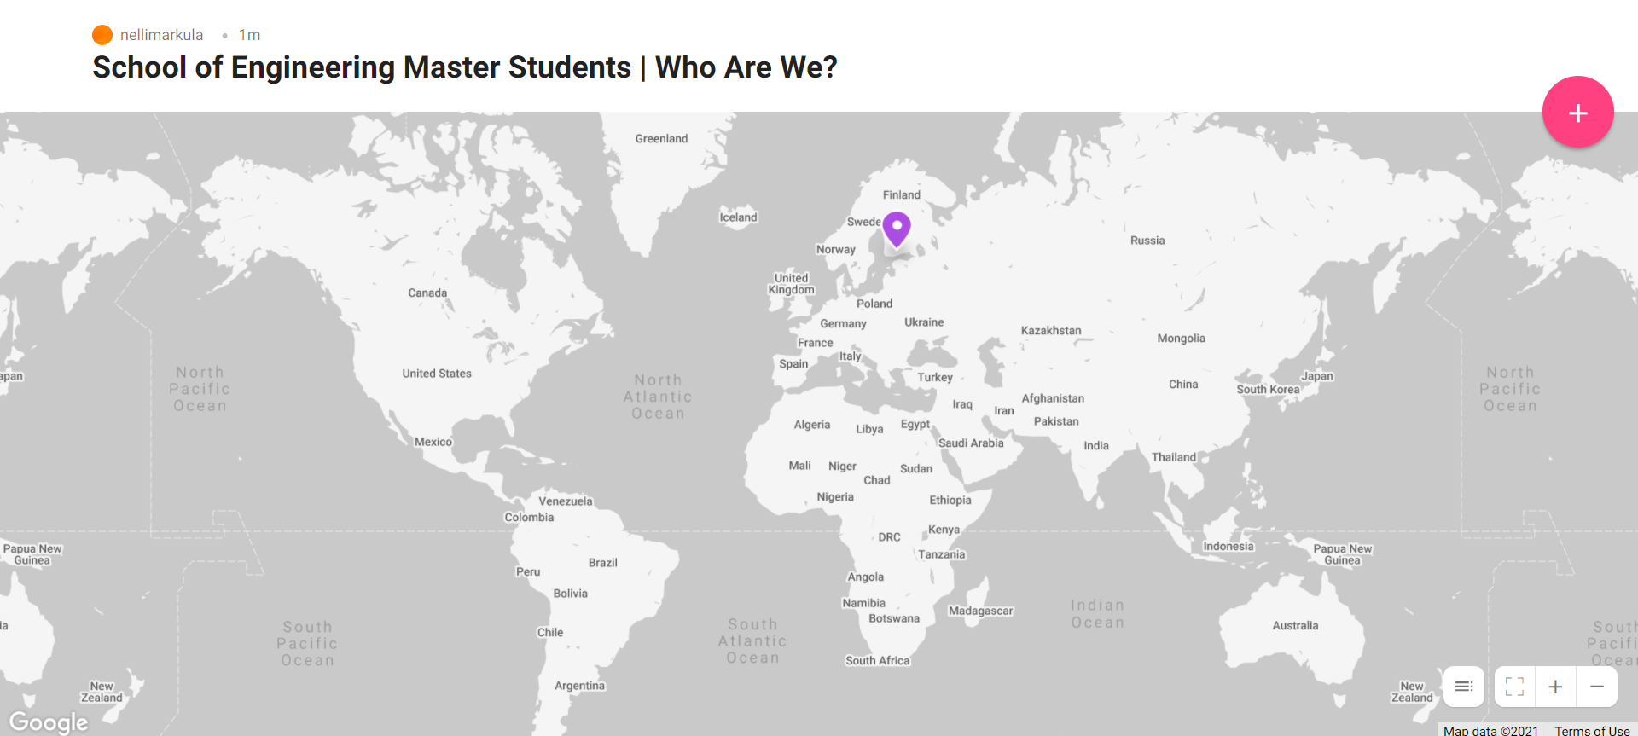
Pin yourself! Background activity for Monday afternoon

Slide 4
Interactive world map (Padlet) – link and access code in chat

Slide 5
Pin yourself on the map (THREE THINGS); preferred first name, where you come from and a photo that says something about your hometown – be it your favorite place, a beautiful scenery, or something the place is known for.
Interactive world map (Padlet) – link and access code in chat

Slide 6
To pin yourself, click here!
Interactive world map (Padlet) – link and access code in chat

Slide 7
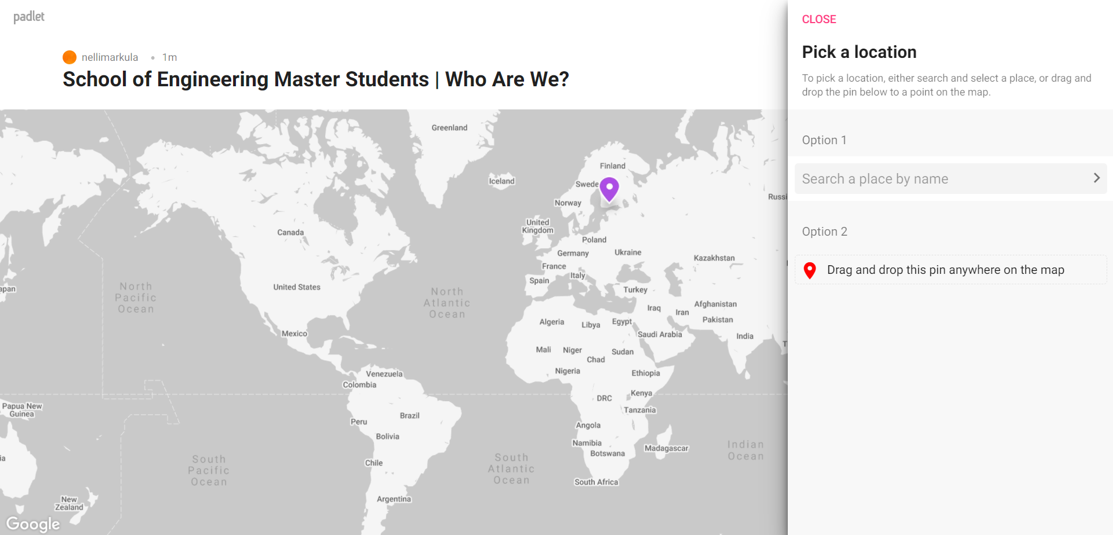
To pin yourself, click here!
Search city or country
Interactive world map (Padlet) – link and access code in chat

Slide 8
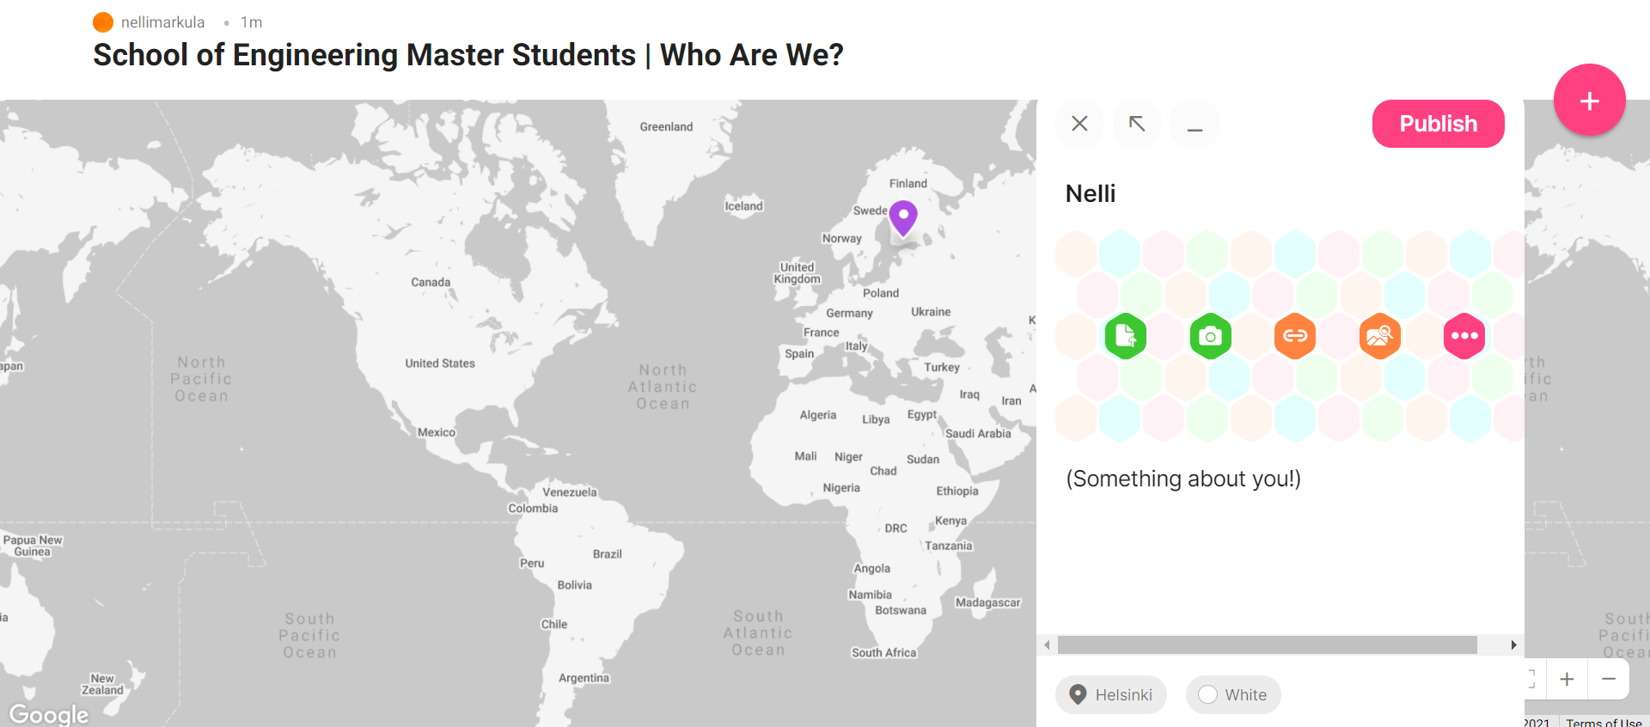
To pin yourself, click here!
Search city or country
Add preferred first name
Image search something about your hometown – a favorite place, beautiful scenery, or something the place is known for.
Interactive world map (Padlet) – link and access code in chat

Slide 9
Wait for the post to be moderated by LES staff No nonsense or exact credentials, thanks! Keep in mind first impressions.
Interactive world map (Padlet) – link and access code in chat

Slide 10
Orientation week program

Slide 11
Monday 6 September 2021 12.00-15.45
09:00-10:00 Deans welcome webinar https://aalto.zoom.us/j/69472575885
12:00 Course Introduction (Zoom/recording available later) Join Zoom Meeting
https://aalto.zoom.us/j/68737030148
Study essentials (Aino Roms, School of Engineering, Learning Service)
Internationalisation (Vilma Jokinen & Isabel Pekander, School of Engineering, Learning Service)
Enrolment for courses in SISU, MyCourses, Into. Please go to preorientation material Essential tools and IT-service
Residence permits & residence registrations (School of Engineering, Learning Service)
12:55 Pause
13:00 Scientific Writing (Susan Gamache, University teacher Aalto Language Center)
Communication in team (Yoonjoo Cho, University teacher Aalto Language Center)
14:00 Pause
14:10 Studying in hybrid: Study and group-work skills (Sanni Saarimäki, Study Psychologist, Aalto Learning Service)
15:05 Pause
15:15 Student Union AYY (Matias Saikku (ENG) ja Otto Usvajärvi (BIZ) , Aalto University Student Union)
15:30 ENG Student guilds (Emilia Luu, Markus Rauhanen, Jaan Rönkkö) welcome

Slide 12
TUESDAY 7.9.2021 Check the invitation
9:00 Program Info´s (separate schedule for programs) Meet professors in your program, curricular info
13:15 Aalto opening ceremony live broadcast https://www.aalto.fi/en/day1
14.30 Aalto Party live broadcast https://www.aalto.fi/en/day1
WEDNESDAY 8.9.2021 Check the invitation
9:00 Program Info´s (separate schedule for programs)
Meet professors in your Master´s program, curricular info
THURSDAY 9.9.2021 https://www.aalto.fi/en/events/orientation-to-student-services-and-wellbeing
10.00-12.00 Introduction to University Services (In Finnish language)
Aalto Services: Health Care, Sport, AYY, Wellbeing at Aalto
12.00 After talk with students (In Finnish language)
13.00-15.00 Introduction to University Services (In English language)
15.00-16.00 After talk with students (In English language
16.00 Esa Saarinen: Lecture (recorded in summer 2020)
FRIDAY 10.9.2021
10.00-14.00 Online SISU etc.. Clinics by ENG Learning Service planning officers

Slide 13
Next:
Study essentials (Aino Roms)

Slide 14
Internationalisation (Vilma Jokinen & Isabel Pekander, School of Engineering, Learning Service)

Slide 15
Residence Permits and Registration
Students from outside EU apply for students’ residence permit before coming to Finland
Students from EU register their residence at the MIGRI if the study period in Finland will exceed 3 months : Enter Finland service or at a service point of the Finnish Immigration Service (Maahanmuuttovirasto).
*Note that the calculation of the three-month residence always restarts from the moment when you return to Finland after travelling outside its borders.
Students from Nordic Countries register must make a notification of move and register at the nearest service location of the Digital and Population Data Services Agency (Digi- ja väestötietovirasto). https://dvv.fi/en/foreigner-registration
Apply for home municipality and personal ID-code
If you are intending to stay in Finland for more than a year, you are required also to register at https://dvv.fi/en/forms) and register your personal information in the Population Information System. You need the personal ID-code for instance for opening a mobile phone connection or a bank account.

Slide 16
INTERNATIONAL STUDENT
WHY REGISTER AT Digital and Population Data services agency (DVV)
✓ IN ORDER TO GET A FINNISH PERSONAL IDENTITY CODE
if you have not yet received it from the Finnish Immigration Service or the Tax Office
o Remember to inform the university about your personal identity code!
✓ IN ORDER TO MARK A TEMPORARY OR PERMANENT ADDRESS IN THE
FINNISH POPULATION INFORMATION SYSTEM
o That is required for example for the HSL travel card or for opening a bank
account

Slide 17
FOREIGN STUDENT
WHY REGISTER AT THE LOCAL REGISTER OFFICE
(MAISTRAATTI)?
✓ IN ORDER TO GET A FINNISH PERSONAL IDENTITY CODE
(HENKILÖTUNNUS in Finnish, PERSONBETECKNING in Swedish, earlier called SOCIAL SECURITY NUMBER )
if you have not yet received it from the Finnish Immigration Service or the Tax Office
o Remember to inform the university about your personal identity code!
✓ IN ORDER TO MARK A TEMPORARY OR PERMANENT ADDRESS IN THE
FINNISH POPULATION INFORMATION SYSTEM
o That is required for example for the HSL travel card or for opening a bank
account
TO REGISTER YOU NEED TO:
1. FILL OUT THE http://www.dvv.fi/forms AND 2. PROVIDE US THE FOLLOWING DOCUMENTS:
IF YOU ARE AN EU-CITIZEN:
The filled registration form http://www.dvv.fi/forms
Passport or official identity card
Attendance letter / study certificate from the school where you are studying (Admission letter is NOT accepted!)
If you want to be registered permanently, you also need to have a proof of EU-citizen’s right of residence from the Finnish Immigration Service http://www.migri.fi/eu_registration
IF YOU ARE A NON EU-CITIZEN:
The filled registration form http://www.dvv.fi/en/Forms/
Passport
Residence permit if you have one
Attendance letter / study certificate from the school where you are studying (Admission letter is NOT accepted!)
In order to register permanently, your residence permit must be valid for at least 12 months and your study certificate for at least 2 years. The permanent address is important if you want to get the student discount for your travel card.
Please note that we need your COMPLETE address, also the apartment number, so please check it before you visit us! The approximate processing time for the registration is 8-10 weeks. You will get an e-mail as a confirmation when your registration is ready. It will be a secure e-mail that can be opened only on one device for 30 days. You can download and save the attachment for later use

Slide 18
Working in Finland
International exchange and degree students are allowed to work in Finland with certain restrictions. The restrictions have to do with the nationality (EU/EEA or non-EU/EEA) and the nature of employment. In addition, the regulations for study-related work, compulsory training or employment having to do with thesis work tend to be more relaxed.
If you are a Nordic or EU/EEA national, you do not need any special permits for working in Finland during your studies. There are no restrictions on how many hours per week you are allowed to work, but you should take care that work does not get in the way of your study progress.
Non-EU students can work within certain limits on a student residence permit if the work is practical training included in the degree or if the amount of part-time work does not exceed 25 hours a week. You can adjust the hours on a weekly basis as long as the average is around 25 working hours per week during the academic terms. There are no limits in terms of hours on full-time work outside term times (summer and Christmas holidays specifically). For general regulations on working in Finland, see http://www.te-palvelut.fi/te/en/jobseekers/work_finland/index.html and information provided by Finnish Immigration Service http://www.migri.fi/working_in_finland

Slide 19
Finding work
Aalto University offers students Career Services. This should be the first stop for any student looking for a job. Although Career Services do not act as a part-time job recruitment agency, you might contact them for advice on possible local part-time employment opportunities, and general tips on job hunting in Finland.
The Career Service has implemented the CareerWeb system that helps employers to recruit students.
You can also contact the Employment Offices in the Helsinki region: see Ministry of Labor’s web pages (http://www.te-palvelut.fi/te/en/index.html ). Here you can also find a listing of job openings.
Career planning
Aalto University Career Services help students prepare for working life by enhancing their job hunting skills and facilitating their employment in relevant jobs. Their services range from individual career counseling and mediation of vacant jobs to organising career fairs.

Slide 20
Coronavirus vaccine in Espoo
Students can get the coronavirus vaccine in Espoo if it is their municipality of residence or place of study. International students can also get vaccinated in Espoo if they are staying in the city for more than four weeks.
First dose
If Espoo is your municipality of residence, you can book your vaccination appointment online at bookcovidvaccine.fi. If you want to book an appointment by phone, call our number 09 816 34800 (Mon–Fri 8:00–18:00) and leave a call-back request. If Espoo is not your municipality of residence, please book your appointment by phone.
You can also get the first dose of the vaccine without booking an appointment at our pop-up vaccination site or at the Iso Omena vaccination site. The walk-in vaccination site at Iso Omena is open from Monday to Friday 9:30–11:30 and 12:15–14:00. The vaccination site is located on the second floor of the shopping centre, below the Iso Omena Service Centre. The best way to find the vaccination site is to enter the shopping centre from the main entrance on the metro side of the building on Piispansilta.
Second dose
The second dose of the vaccine is given 8–12 weeks after the first dose. You can book your second vaccination appointment at the same time as you book your first appointment. Alternatively, our staff will book an appointment for you in connection with your first vaccination.
Even if you received the first dose in your municipality of residence, you can receive the second dose in Espoo. In this case, please call the appointment booking number for coronavirus vaccinations, tel. 09 816 34800, Mon–Fri 8:00–18:00. We have a call-back system. Please be prepared to tell our staff which vaccine you have received and when.
Make sure you have your Kela card or ID with you when visiting the vaccination site. There are also plans to have pop-up vaccination sites on university premises. Further information will be provided by your school. Please note! At the moment, only the first dose of the vaccine is available at our walk-in and pop-up sites. In other words, you cannot receive the second dose at these sites.

Slide 21
Orientation, safety instructions, autumn 2021
When arriving at the premises
1. use a face mask.
2. disinfect your hands with hand disinfectant in the lobby.
3. take the most direct route to the hall and avoid touching door handles.
4. keep an adequate safe distance to each other.
At the hall
1. keep an adequate safe distance to each other.
2. do not shake hands.
3. do not touch your face.
4. do not touch other people’s equipment (personal equipment).
5. do not use the same equipment at the same time (unless specifically required by the performed activity).
6. follow the instructions given in the hall.
When leaving the hall and premises
1. leave the hall taking the shortest route and alone.
2. avoid touching door handles.
3. disinfect your hands with hand disinfectant before leaving the premises.
4. remove a face mask after leaving the premises.

Slide 22
During orientation week
HSL Helsinki Region Transport travel card pop-up service point for international students on Thursday 9.9. from 11 until 16.30 in Otakaari 1 U-wing lobby (entrance M).
Starting Point service desk for students open during the orientation week 6.-10.9. Mon-Fri 12.00–16.00.
IT Service Desk Kandi (Undergraduate Centre)
Visiting address: Otakaari 1M, room U133a
Opening hours: Week 36:
Mon 6.9. open 9-11 and 12-15
Tue 7.9. open 9-11 and 12-15
Wed 8.9. open 9-11 and 12-15
Thu 9.9. open 9-11 and 12-14
Fri 10.9. closed

Slide 23
Kiitos - Thank you - Tackar!

Slide 24
Pause
Next at 1pm Scientific Writing (Susan Gamache, University teacher Aalto Language Center)
Communication in team (Yoonjoo Cho, University teacher Aalto Language Center)

Slide 25
Pause
Next at 2:10pm Studying in hybrid: Study and group-work skills (Sanni Saarimäki, Study Psychologist, Aalto LES)

Slide 26
Pause
Next at 3:15pm AYY (Matias Saikku (ENG) ja Otto Usvajärvi (BIZ))
15:30 ENG Student Guilds welcome (Emilia Luu, Markus Rauhanen, Jaan Rönkkö)

