Slide 1
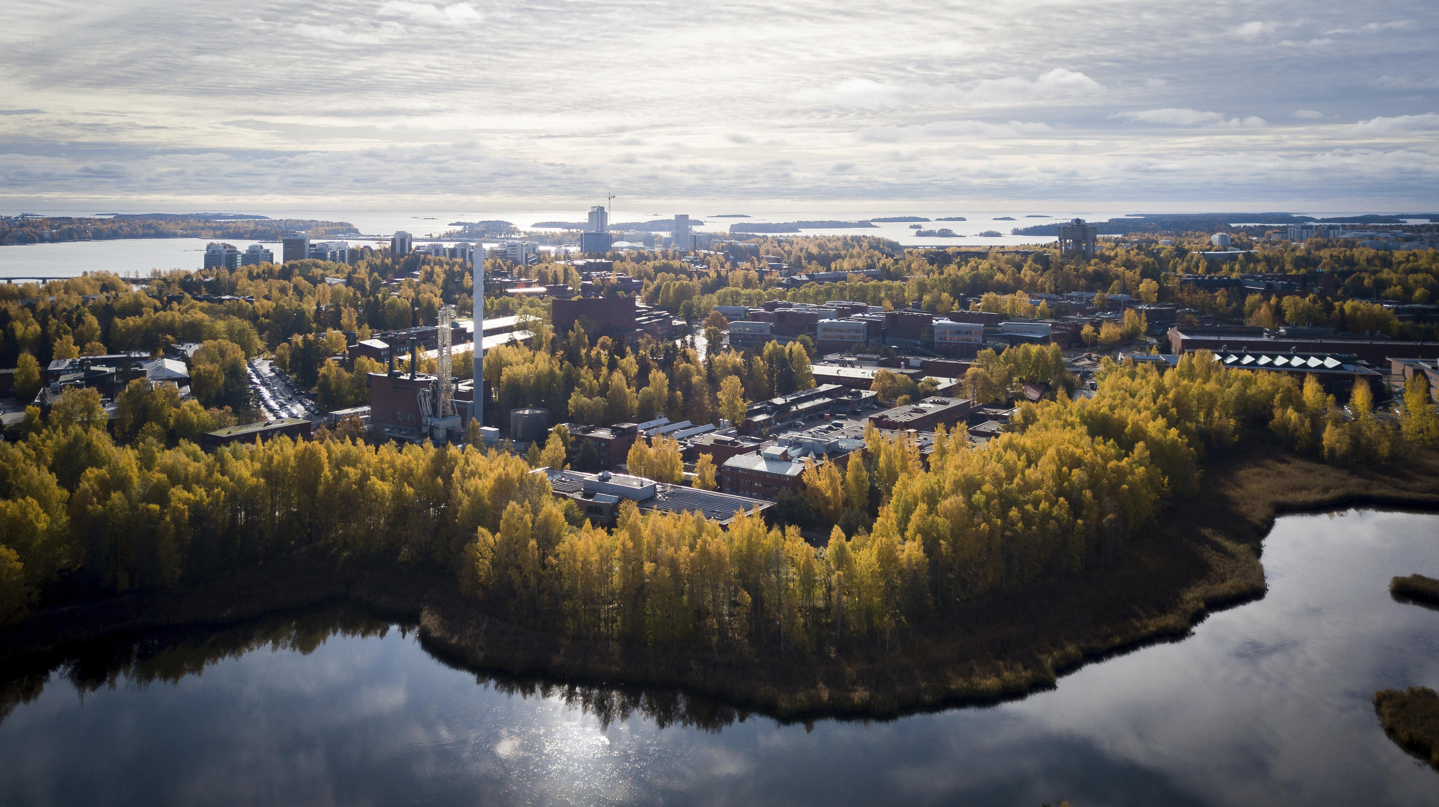

Study Essentials
New Master’s students at Aalto University School of Engineering
6 September 2021
Aino Roms

Slide 2
Preorientation reminders
Agenda
Who are we, where are we?
Recap of most important points of preorientation & introduction to further sources of information
Get to know your surroundings
Essential Tools and IT services
Your tour into INTO
How to contact us
Next steps

Slide 3

Aalto University
Get to know your surroundings

Slide 4
Reminder
Preorientation
https://mycourses.aalto.fi/course/view.php?id=30633
Get to know your surroundings
  Get to know the campus life (virtual tour)
  Aalto University and different study options
  Code of conduct

Slide 5


Merger of three leading Finnish universities
1849
Helsinki University of Technology
Aalto
University
1871
University of Art and Design Helsinki
2010
1911
Helsinki School of Economics

Slide 6
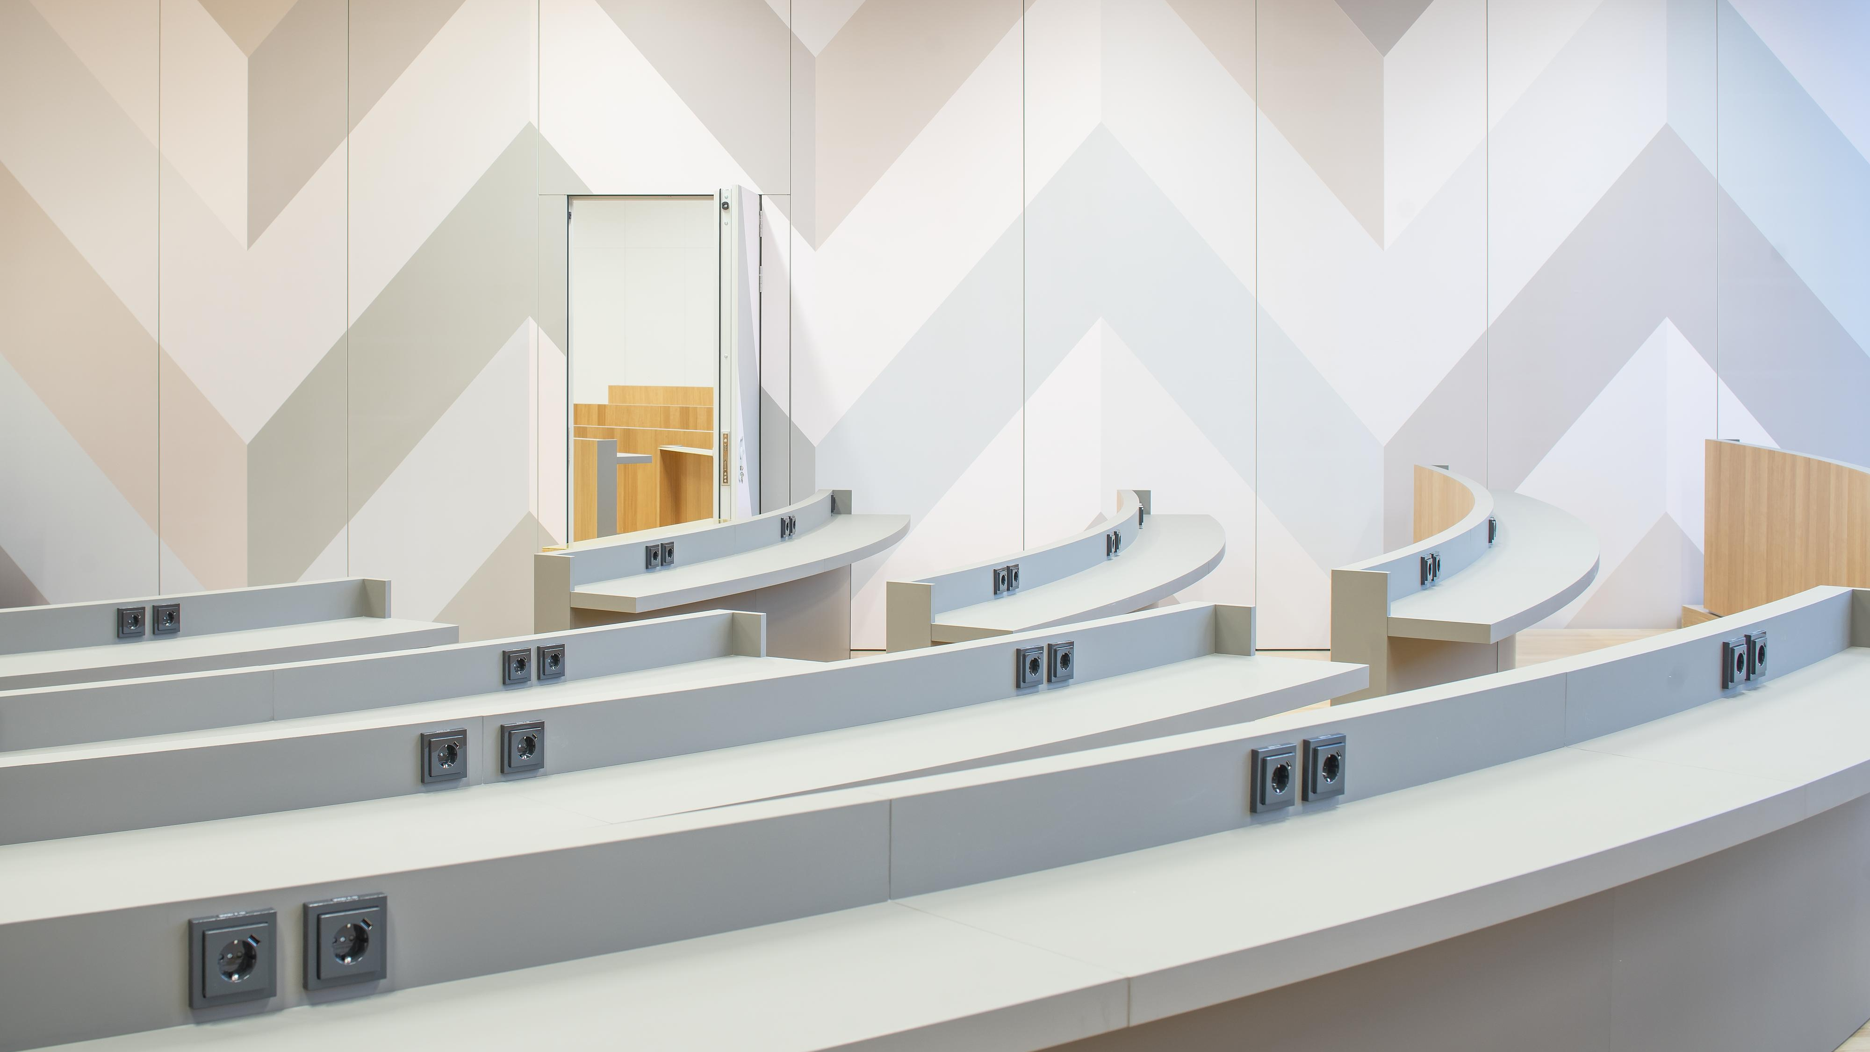
Six dynamic schools
School of Arts, Design and Architecture
architecture; art; design; media; film,
television and scenography
School of Business
accounting; economics; finance; management studies; marketing; information and service management
School of Chemical Engineering
bioproducts and biosystems; chemistry and materials science; chemical and metallurgical engineering
School of Electrical Engineering
communications and networking; electronics
and nanoengineering; electrical engineering and automation; signal processing and acoustics
School of Engineering
built environment; civil engineering;
mechanical engineering
School of Science
applied physics; computer science; industrial engineering and management; mathematics and systems analysis; neuroscience and biomedical engineering

Slide 7

Aalto University name celebrates diversity and innovative method
  The name "Aalto University" is a tribute to a courageous, overarching renaissance man, Finnish architect, designer and academic Alvar Aalto
  He distinguished himself in not only the fields of technology and economics, but also art
  The name has been chosen to reflect the concept, spirit, values and goals of the new university

Slide 8
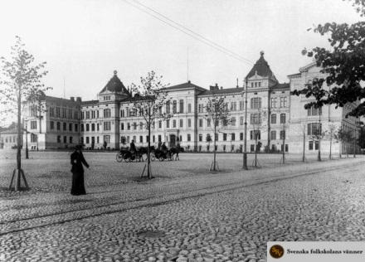
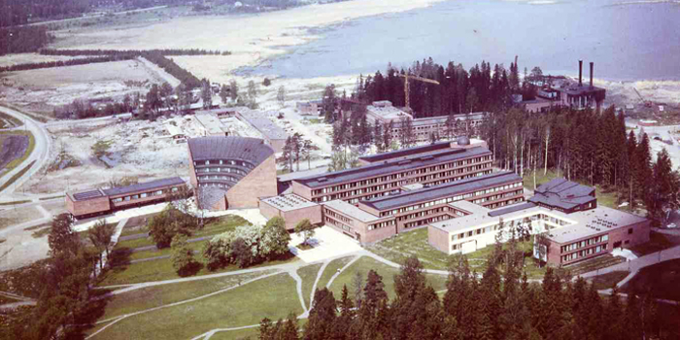
Helsinki University of Technology (TKK)
Established in 1849 in Helsinki
In 1877 a university main building was built on the Hietalahti square in Helsinki where it still stands
Planning for a new campus area in Otaniemi in Espoo began in the 1950’s
The University moved officially to Otaniemi in 1966
Otaniemi was mainly just farmland until the construction began
The Undergraduate Centre and the Library are designed by Alvar Aalto
2018: metro station and new buildings for the ARTS and BIZ schools

Slide 9
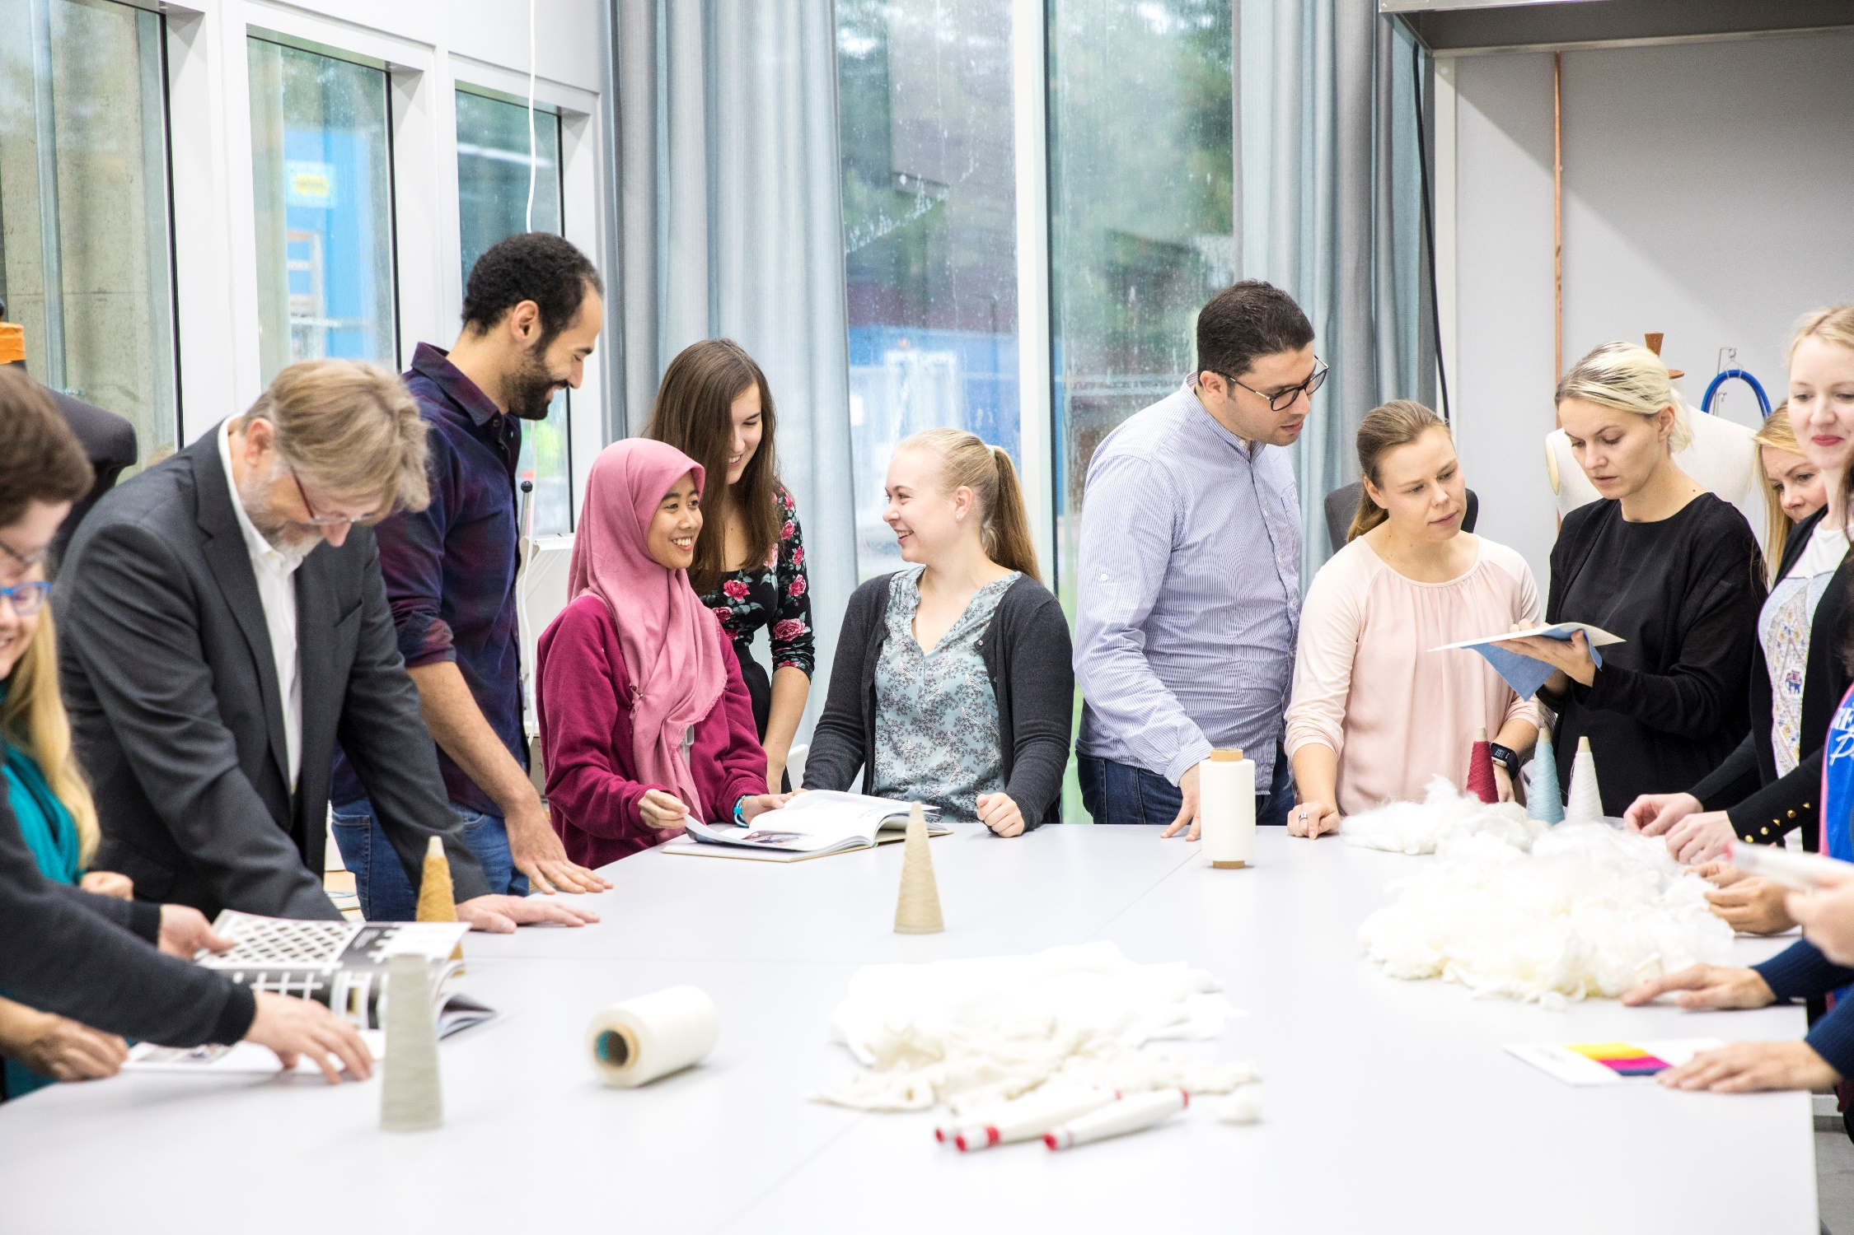
School of Engineering
Department of Built Environment (BE)
Department of Civil Engineering (CE)
Department of Mechanical Engineering (ME)
Learning Services
Notes:
We want to build a sustainable future and develop solutions for global challenges.
We do this by encouraging our students to take up the challenges of the future by offering competencies and tools for a better world.
We want our students to know and find themselves so that they’ll find their own path to change the world. In addition to the degree, we offer an international environment, an active community and new possibilities to take part in student activities.

Slide 10
Programmes offered at ENG (1/3)
Bachelor’s programmes (180 ECTS, three years)
Bachelor’s programme in Engineering (in Finnish) Mechanical and Structural Engineering (KJR) Energy and Environmental Engineering (ENY) Built Environment (RYM)
Aalto Bachelor’s programme in Science and Technology (in English) - ENG major: Computational Engineering
Notes:
Poistetaan?

Slide 11
Master’s Programmes at ENG
Go to Presemo and mark your programme!
Presemo link and access code (153695) in chat.

Slide 12
Programmes offered at ENG (2/3)
Master’s programmes (120 ECTS, two years, in English)
Advanced Energy Solutions (AAE)
Building Technology (CIV)
Creative Sustainability (CS)
Geoengineering (GEO)
Geoinformatics (GIS)
International Design Business Management (IDBM ENG)
Mechanical Engineering (MEC)
Real Estate Economics (REC)
Spatial Planning and Transportation Engineering (SPT)
Urban Studies and Planning (USP)
Water and Environmental Engineering (WAT)
Notes:
Poistetaan, jos ohjelmien esittely onnistuu Presemon kautta?

Slide 13


Programmes offered at ENG (3/3)
Joint international Master’s programmes
Nordic Master programmes
Environmental Engineering
Innovative Sustainable Energy Engineering
Maritime Engineering
Cold Climate Engineering
EIT programmes
Environomical Pathways for Sustainable Energy Systems (EIT InnoEnergy)
Energy Storage (EIT InnoEnergy)
Manufacturing (EIT Manufacturing)
Urban Mobility (EIT Urban Mobility)
Other joint programmes
European Mining Course
Notes:
Poistetaan, jos ohjelmien esittely onnistuu Presemon kautta?

Slide 14
Essential tools and IT services

Slide 15
Reminder
Preorientation
https://mycourses.aalto.fi/course/view.php?id=30633
Essential tools and IT services
  Basic IT instructions for students
  Into – Study Guide and portal
  MyCourses – Aalto’s online learning platform
  Sisu – Student information system in Aalto University

Slide 16
Your important tools
Into
Information related to your studies: contact information, instructions, academic rules and regulations
into.aalto.fi → Bookmark the page of your programme!
MyCourses
Course spaces, news and materials
mycourses.aalto.fi
Sisu
Personal study plans
sisu.aalto.fi
Course descriptions, registering for courses and exams, official electronic transcripts
Personal schedules

Slide 17

Sisu
New study information system, launched in August
Sisu HELP Wiki (check FAQ) https://wiki.aalto.fi/display/SIS
Sisu HELP chat open Mon-Thu, 12:00-15:00 until 30 Sep
Programmes’ orientation events & Study advice clinics on Friday with LES ENG

Slide 18
Your personal information
Update your records (and keep them updated) in Sisu
You can update your contact information and selections for disclosure of information by clicking the Edit button in My Profile – Personal Information
Other records must be updated by Student Services
Check at least these:
  Finnish personal ID Number (contact studies-eng@aalto.fi)
  Address
  Home municipality
  Phone number

Slide 19
Aalto email
All students have an @aalto.fi e-mail address, usually firstname.lastname@aalto.fi
You can access Aalto's email either with a browser (mail.aalto.fi) or via Microsoft Outlook on your computer (or phone).
All informational emails (instructions, decisions, newsletters etc.) will be sent to your @aalto.fi email
If you use some other email address, redirect your @aalto.fi emails
Multifactor Authentication (MFA): Download Microsoft Authenticator app (do not sign in!) and follow instructions at https://www.aalto.fi/en/services/aalto-multifactor-authentication-on-office-365-accounts
Problems? Please contact IT Services servicedesk@aalto.fi

Slide 20
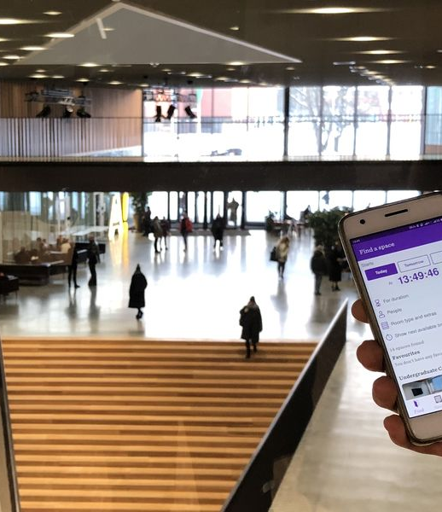
Aalto Space App
Find spaces
Navigate on campus
Reserve self-study spaces
Download in Apple App Store or Google Play, or use https://booking.aalto.fi/aaltospace/ on your browser

Slide 21
Go to into.aalto.fi → page of your programme
Your tour into INTO

Slide 22
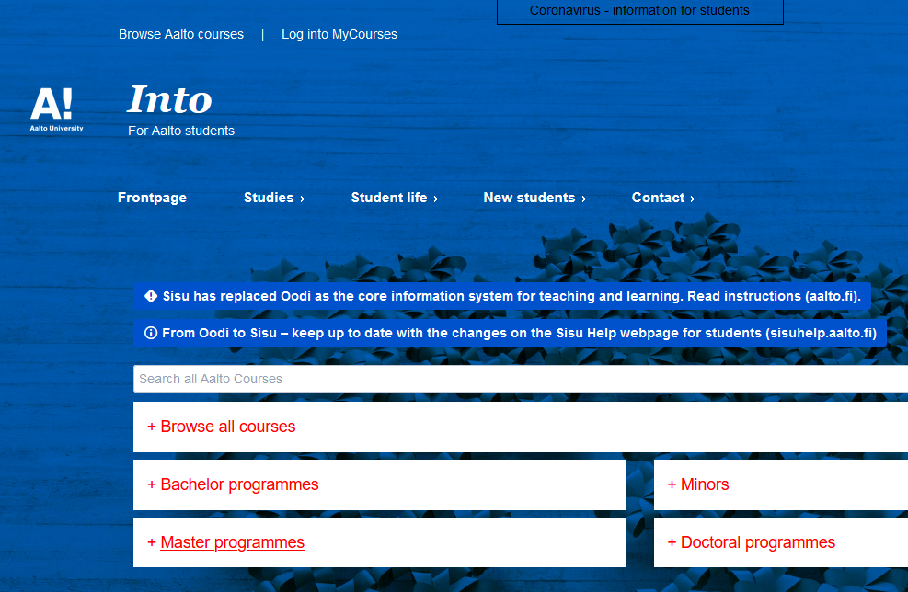
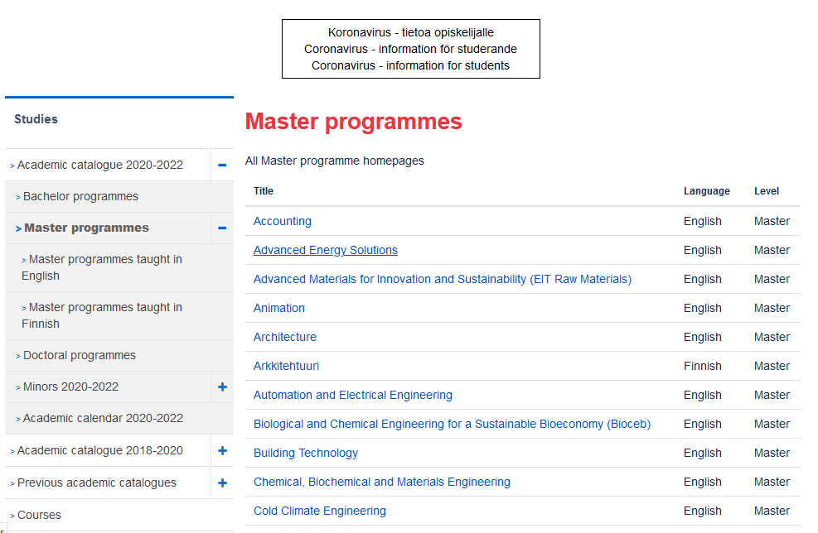
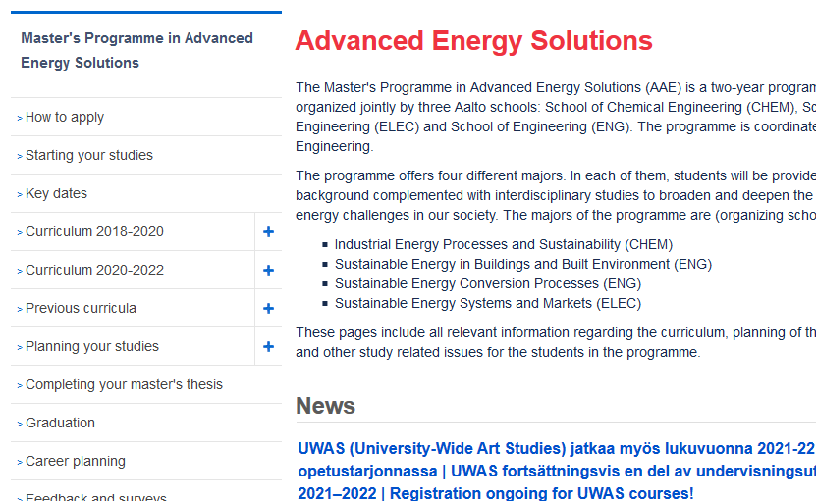
Bookmark the page of your programme!

Slide 23
Reminder
Preorientation
https://mycourses.aalto.fi/course/view.php?id=30633
Basic information on studies and courses
  Student vocabulary
  Academic freedom and responsibility
  Academic year
  Courses and other studies
  Lectures

Slide 24
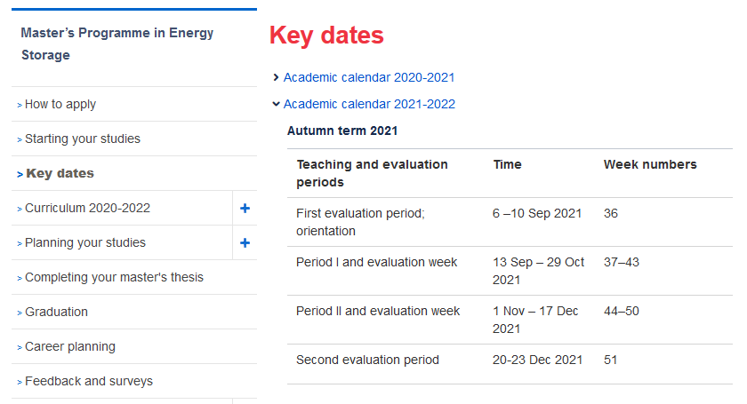
Academic year 2021-2022
(1 August 2021 – 31 July 2022)
into.aalto.fi
Autumn term 2021 (1 August – 31 December 2021)
Teaching and evaluation periods | Time
First evaluation period; orientation | 6 –10 Sep 2021
Period I and evaluation week | 13 Sep – 29 Oct 2021
Period II and evaluation week | 1 Nov – 17 Dec 2021
Second evaluation period | 20-23 Dec 2021
Notes:
Lisää screen shot Key dates

Slide 25
Academic year 2021-2022
(1 August 2021 – 31 July 2022)
“When am I free for holidays?”
Spring term 2022 (1 January – 31 July 2022)
Teaching and evaluation periods | Time
Period III and evaluation week | 10 Jan 2022 – 25 Feb 2022
Period IV and evaluation week | 28 Feb – 14 Apr 2022
Period V: multimodal period | 19 Apr – 3 Jun 2022
Check the academic calendar
PLUS
your Individual course & exam schedule (Sisu)

Slide 26
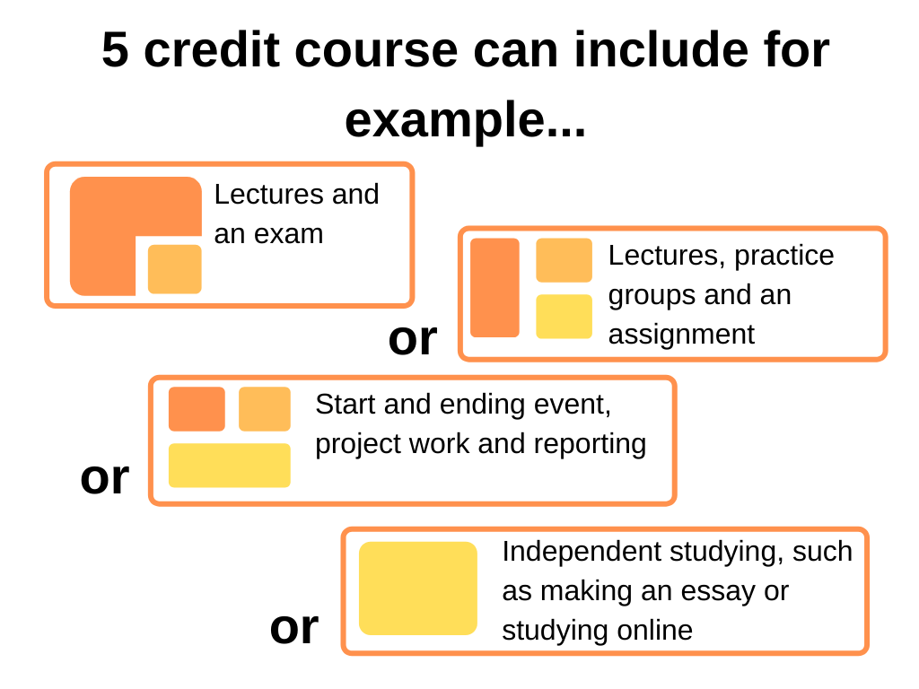
A typical course at Aalto
Not all the courses have exams
A lecture is usually 90 minutes
“Academic quarter”: Lectures start usually a quarter past and finish a quarter to
  NB! Exams always start at sharp hours!
A major part of the workload is individual or group work
Some courses have flexible extent (1-10 ECTS)

Slide 27
In addition to lectures…
Exercise sessions: calculation or programming exercises
  Can earn you extra points for the exam
Web-based teaching: exercises and tasks through an online platform, usually MyCourses
Projects: individual or group assignments
  Will constitute a part of your grade
Essays, learning diaries and other written works
The course contents are explained in detail during the first lecture – please attend!

Slide 28
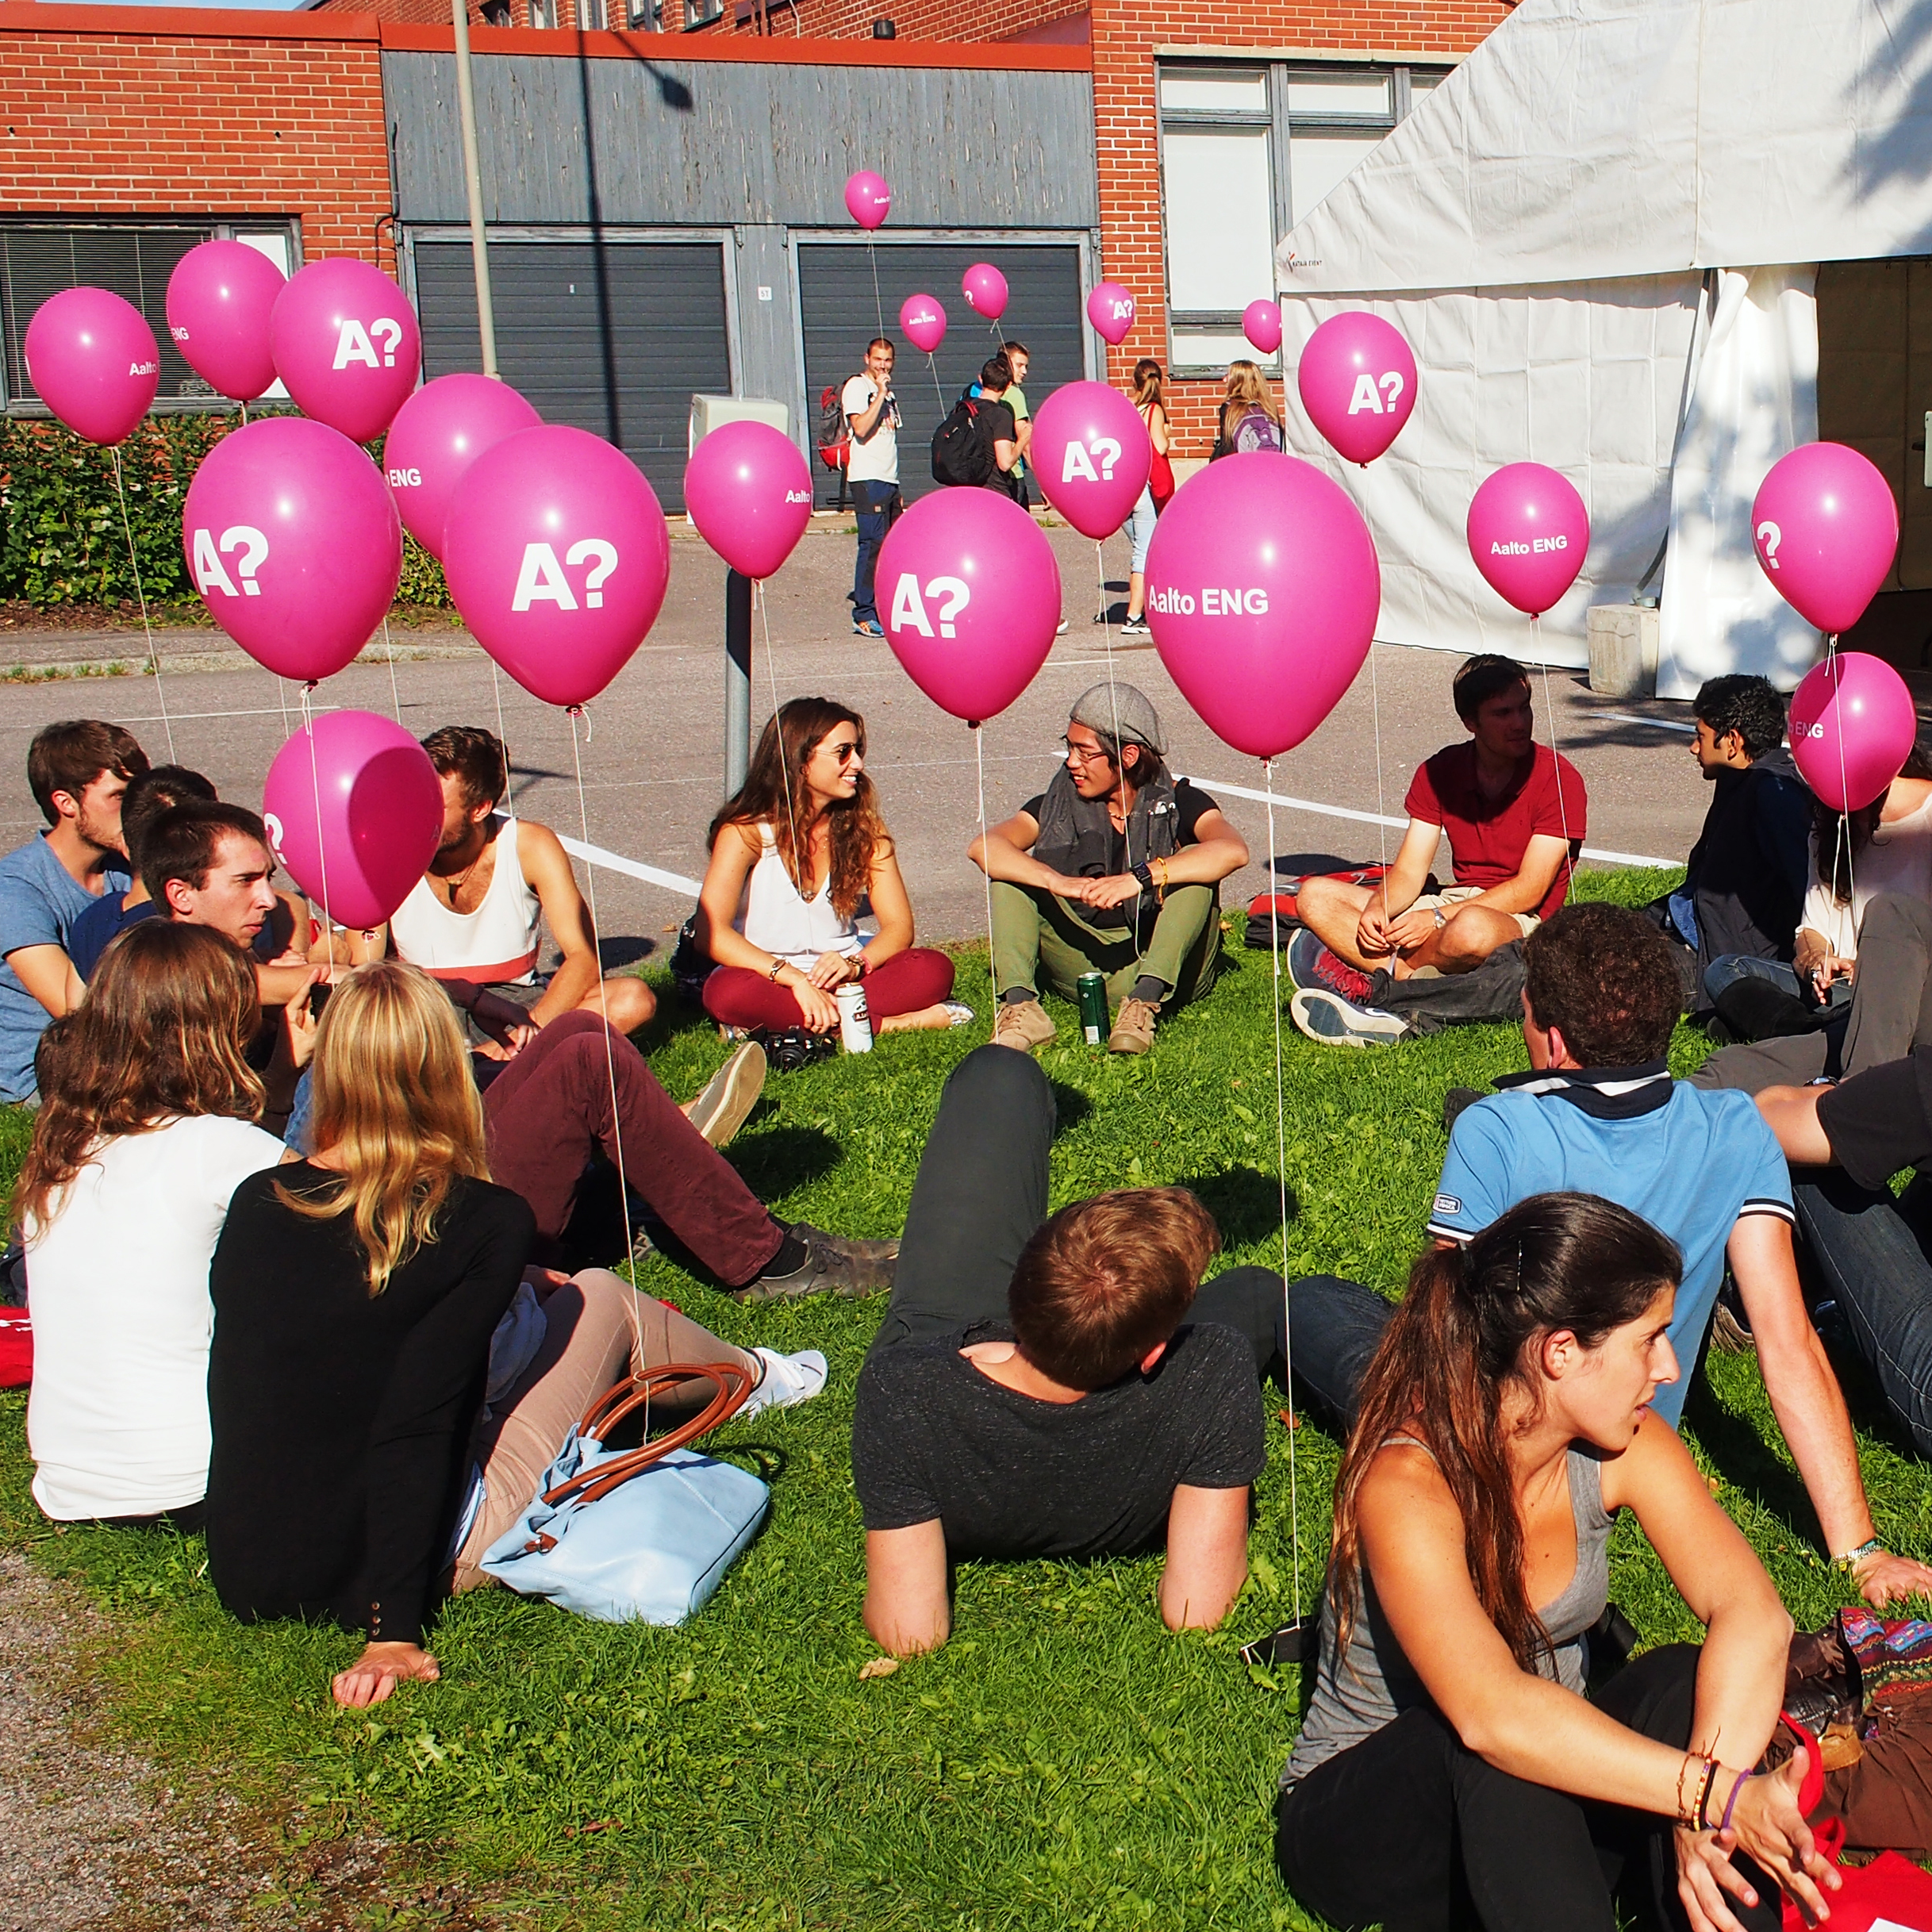
Course contents and descriptions
You can find lecture times, classrooms and course descriptions in Sisu (sisu.aalto.fi)
The more detailed information on course contents and requirements, schedules and materials,
and the latest course specific
news are available on the
MyCourses pages
(mycourses.aalto.fi)

Slide 29
Registration for courses and exams
Course registration
Some courses close registration TODAY (6 September)
Most courses are open until 20 September
Register through your Personal Study Plan (HOPS) in Sisu
Exam registration
When registering for the course you automatically register for the course exam(s) as well
If you want to re-take an exam you have to register for it separately
The first retake exams for I period courses take place after the II teaching period
You cannot attend an exam if you haven’t registered

Slide 30
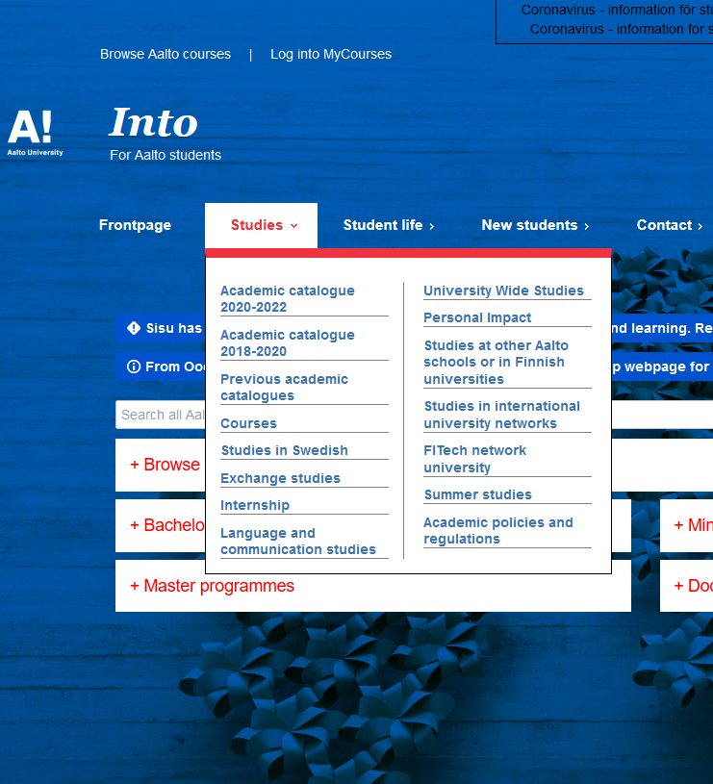
Exams
Exams take place during the evaluation week at the end of each study period
Exams last typically 3 hours
Essay questions, calculations, multiple choices etc.
Take your student card, pencil and eraser with you to the exam hall. Calculators and dictionaries → check the instructions for each exam separately.
Examination regulations in Into: https://into.aalto.fi/display/ensaannot/Aalto+University+Examination+Guidelines

Slide 31
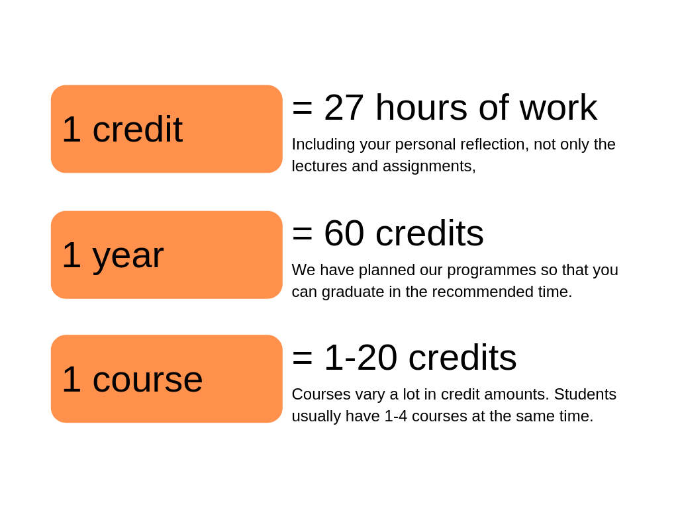
Credit system & workload

Slide 32
Grading system
Grade | Meaning | ECTS grade
5 | Excellent | A
4 | Very good | B
3 | Good | C
2 | Satisfactory | D
1 | Sufficient | E
0 | Fail | F
Courses may also be assessed as pass/fail
Failed courses will not appear on the official transcript of records
The course evaluation must be given within 4 weeks from the exam

Slide 33
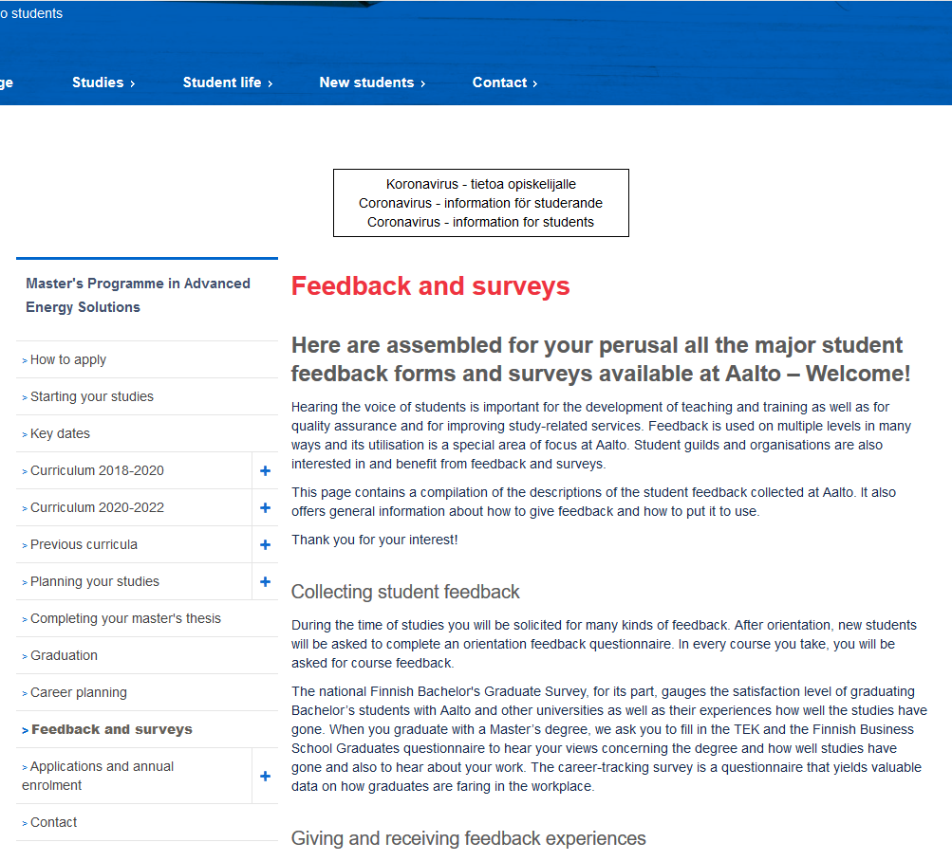
Feedback
Feedback is collected for every course
In some cases you might receive extra points for giving feedback
Time to time we also ask you to answer more general feedback questionnaires regarding the studies and also your wellbeing
It is very important that you give us feedback <3

Slide 34
Individual study arrangements
Each Aalto student has a right to reasonable individual study arrangements due to an impairment restricting his/her ability to study or other health condition.
  For example: dyslexia, sensory impairment, mathematical learning difficulties, attention deficit and hyperactivity disorder, autism spectrum disorders or mental disorders
The measures for making individual study arrangements are individual solutions to course teaching, examinations and working methods.
  For example: extended exam time, separate exam room, modified schedule, alternative ways of assessing learning outcomes
Please contact your Learning Services in your school and book an appoitment!
Additional information and contact details for individual study arrangements: https://www.aalto.fi/en/services/contact-information-for-individual-study-arrangements

Slide 35
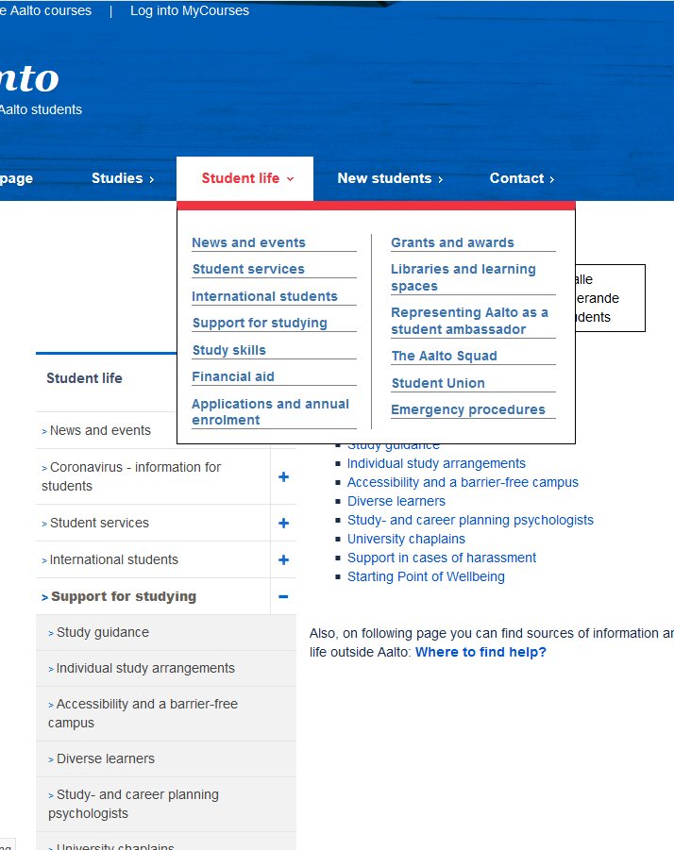
Individual study arrangements
Where to find support? (links)
https://www.aalto.fi/en/services/contact-information-for-individual-study-arrangements’
Starting Point of Wellbeing
Study and career counselling psychologists
Studentservices@aalto.fi
Covid-19, Information for students

Slide 36
Planning your studies
Degree structure
Personal Study Plan (PSP) = HOPS
Credit transfer
Practical training
Academic advising
More information in the programme specific orientation and on the programme homepages in Into

Slide 37
Learning Services, Student Services, LES, coordinators, planning officers, advisors?
How to contact us

Slide 38
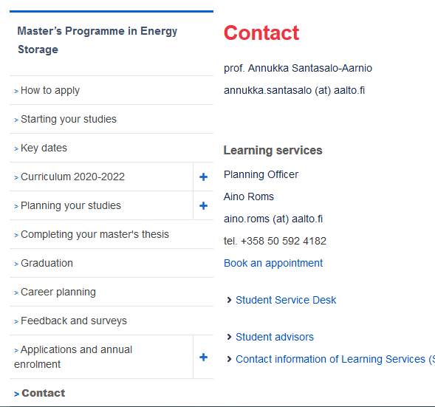
Programmes’ LES Contact information
Master’s programme | LES Contact person
Advanced Energy Solutions (AAE) | Ms Sanni Valkeapää
Building Technology (CIV) | Ms Katri Koistinen
Creative Sustainability (CS) | Ms Päivi Kauppinen
Geoengineering (GEO) | Ms Katri Koistinen
Geoinformatics (GIS) | Ms Katri Koistinen
International Design Business Management (IDBM ENG) | Ms Katri Koistinen
Mechanical Engineering (MEC) | Ms Katri Koistinen
Real Estate Economics (REC) | Ms Päivi Kauppinen
Spatial Planning and Transportation Engineering (SPT) | Ms Päivi Kauppinen
Urban Studies and Planning (USP) | Ms Päivi Kauppinen
Water and Environmental Engineering (WAT) | Ms Päivi Kauppinen
Book appointments with us at vihta.aalto.fi

Slide 39
Programmes’ LES Contact information
Joint international Master’s programmes | LES Contact person
Nordic Master programmes
Environmental Engineering | Börje Helenius
Innovative Sustainable Energy Engineering | Börje Helenius
Maritime Engineering | Börje Helenius
Cold Climate Engineering | Börje Helenius
EIT programmes
Environomical Pathways for Sustainable Energy Systems (EIT InnoEnergy) | Börje Helenius
Energy Storage (EIT InnoEnergy) | Aino Roms
Manufacturing (EIT Manufacturing) | Aino Roms
Urban Mobility (EIT Urban Mobility) | Aino Roms
Other joint programmes
European Mining Course | Aino Roms
jointmasters-eng@aalto.fi
Notes:
Nelli?

Slide 40
Certificates of student status / attendance
Transcript of records
Annual enrolment for the academic year (primarily done online via WebOodi)
Changes of name for the student register
Questions related to study rights
Always use your Aalto.fi email when you contact us and mention your student number
General Student Services
Starting Point
Otakaari 1 (Undergraduate Centre), room Y199a
Open this week 12-16; normally 12-15
studentservices@aalto.fi
+358 29 442 9280
Student Service Desk, School of Engineering
Otakaari 4 (K1 building) room K102
Closed until further notice
studies-eng@aalto.fi
+358 50 347 8230

Slide 41
Next Steps

Slide 42

Getting started with your studies
At this point you should have
  Enrolled at the University
  Been in contact with your student tutor
  Applied for a student card
  Activated your Aalto IT account
  Checked the degree structure and courses of your programme
  Got a travel card for public transportation
  Completed the Pre-orientation in MyCourses
  Registered your residence and gotten a Finnish ID code
If missing any of these, use the free hours of your orientation week to catch up!

Slide 43

Kiitos!

