Slide 1
Personal learning portfolio
Sanna Laakso 12.3.2019, version 1.2

Slide 2
Current knowledge and skills
Knowledge/skill | Source
Expert in limnology (specialized in nutrient cycles and water protection) and rural wastewater treatment | MSc HY + work at HY and VHVSY
Research | MSc HY + work at HY
Field work | MSc HY + work at HY and VHVSY
Laboratory work | MSc HY + work at HY
Social media and internet presence | Work at VHVSY + Friend’s company
Sales and customer service | Work at Glitter and VHVSY
Basics of QGIS, ArcGIS, MapInfo, R, Matlab, SWMM, SPSS, modelling, benchmarking, SWOT, LCA | MSc HY + MSc Aalto (to be)
WordPress, MailChimp | Work at VHVSY
MS Office | MSc HY + work at HY and VHVSY + independent learning

Slide 3
Skills I want to improve
Programming (R, Matlab, Python) and modelling
GIS (QGIS, ArcGIS)
CAD
Statistics
Communication skills, including English skills
Project management
Data visualization

Slide 4
knowledge I want to especially expand
Climate change
Stormwater management / Hydrology
Sustainability (in business)
Circular economy
Environmental, water and water services legislation
Basics of energy technology, industrial issues, quality assurance, risk management

Slide 5
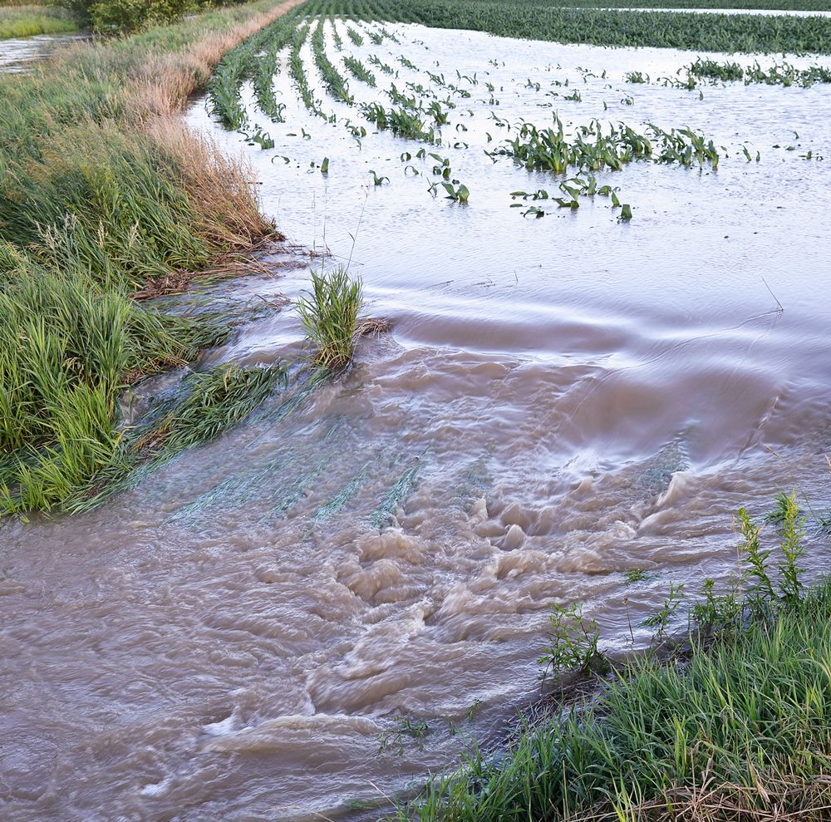
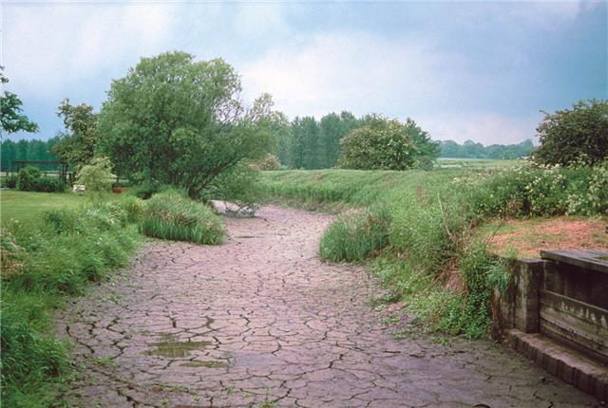
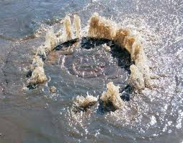
Master’s thesis
Idea about the possible topic: Climate change + Water services / Stormwater management / Hydrology / Sustainability / Risk analysis / Emerging pollutants
Preferred sectors:
private or government
http://www.groundwateruk.org
http://www.healthylakehuron.ca
https://www.welland.ca

Slide 6
Identity
What I value in a workplace
Social and environmental accountability
Meaningful mission
Cares about employees well being including offering educational possibilities and potential to grow
Good, supportive and trustful spirit
Well managed
My professional identity:
Academic attitude, critical thinking
Good problem solving skills
Creative thinking
Continuous improvement
Make things done
Skills to work in a multidisclipinary and -sectoral environment
Good team work skills (my team roles+strengths?)

Slide 7
Appendix 1. Mentor meeting with Teemu Kokkonen 31.10.2018 klo 13, Espoo
Confirmation that my selection for minor, Data science, is good
Discussion can Bachelor level courses be included in elective studies -> can
Discussion of possibility to include old, excessive studies -> will be resolved later, if still necessary

Slide 8
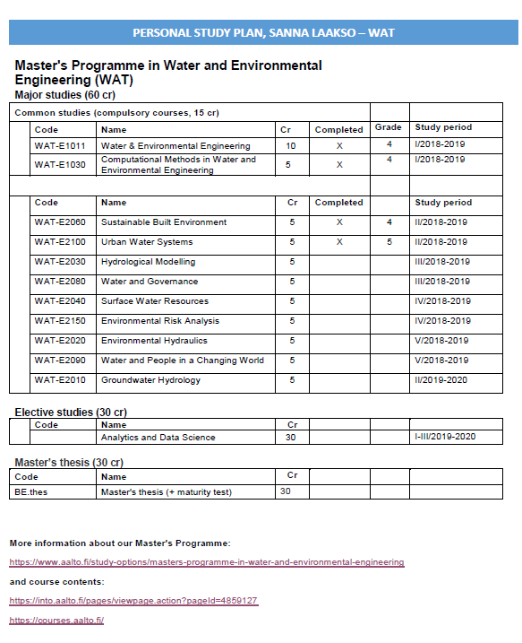
Appendix 2. Personal study plan

