Slide 1

Career Services –
We’re Here to Help!
Aila Saloranta
aila.saloranta@aalto.fi

Slide 2

Aalto CareerWeb
Job and internship adverts suitable for Aalto students
10 000+ jobs yearly
Only for Aalto students

Slide 3


Get to know employers at the recruitment events
”It was easy to get information about companies and jobs available at the recruitment events.”
Aalto Talent Expo – career fair
Thursday 31 October, 2019, Otahalli
Summer Job Day – career event
Thursday 16 January, 2020, Otakaari 1

Slide 4
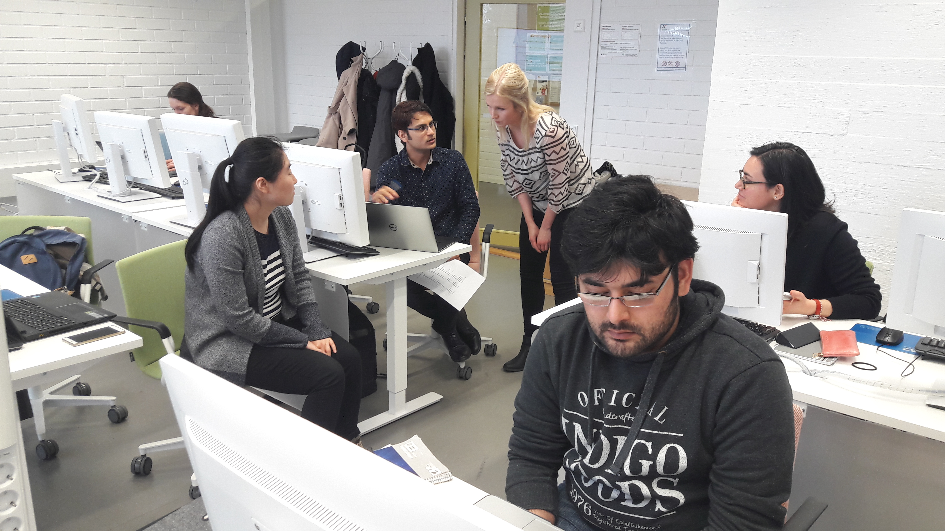
Learn job hunting skills at our trainings
”I received concrete tips to the job search process, and can now better understand the recruiter’s perspective as well.”

Slide 5

Come to the CV guidance
You receive tips to improve your CV, motivation letter or LinkedIn-profile.
Practise for the job interview, and have less stress at the real job interview.

Slide 6
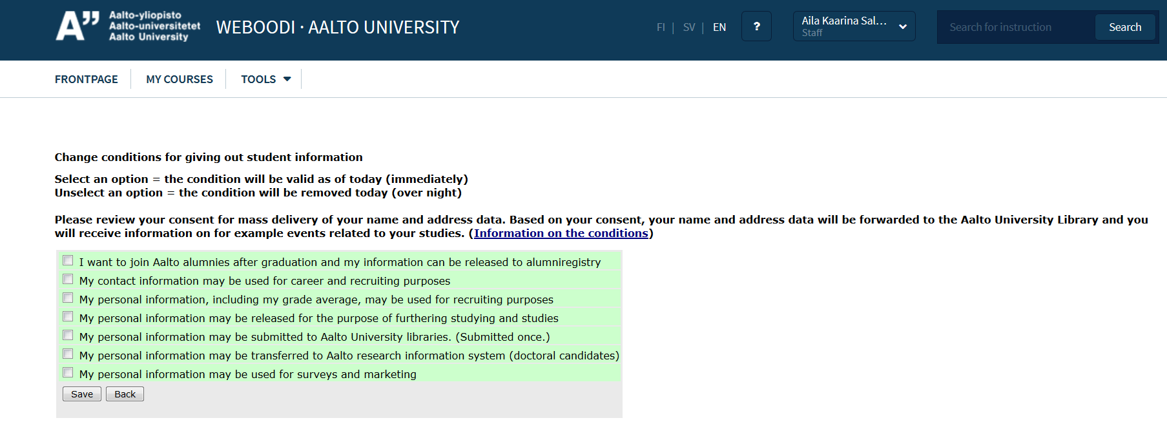
Subscribe to the Career Services’ Newsletter in WebOodi
User information
Conditions for giving out student information
Modify
Change conditions for giving out student information

Slide 7
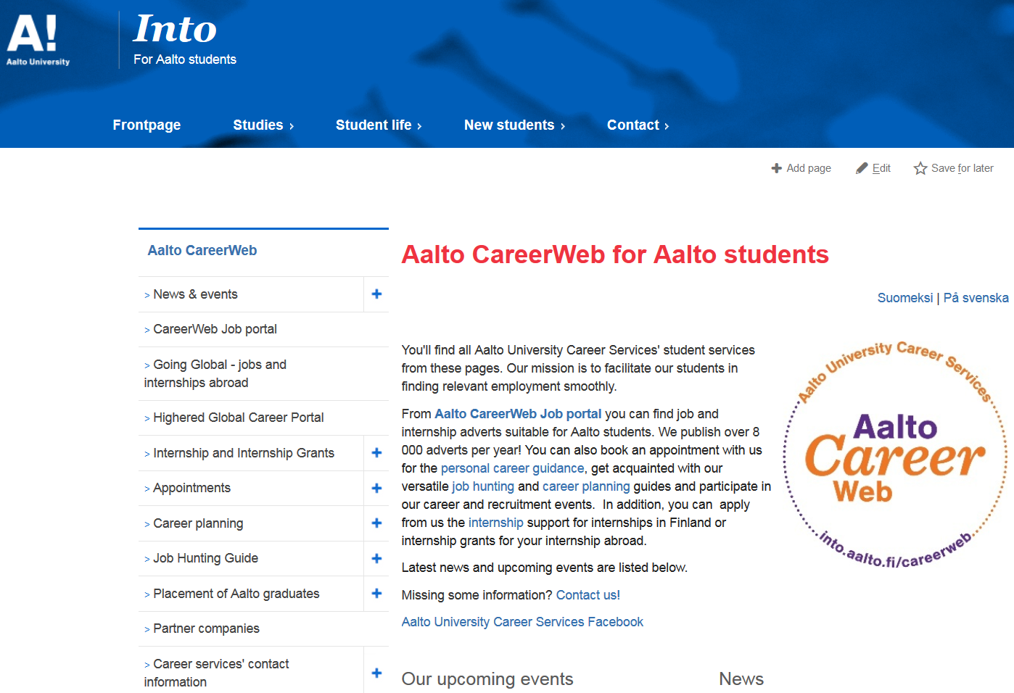
into.aalto.fi/careerweb
JOBS
PERSONAL
GUIDANCE
TRAINING
- Job hunting skills
CAREER EVENTS
- employers, alumni

Slide 8

Other Services
Internship grants
Public Sector in Finland
International
More information on CareerWeb
Personal Career Coaching
Aalto career psychologist
  seija.leppanen@aalto.fi
Student–Alumni Mentoring Programme

Slide 9

Master student’s roadmap
to a career as
a game changer

Slide 10
Career
as a game changer
Years
2
Master’s Thesis
Setting and Narrowing goals
Portfolio
LinkedIn profile
Video presentation
Learning to pitch know-how
Summer job
in your field of studies
Training / Information
1
0

Slide 13
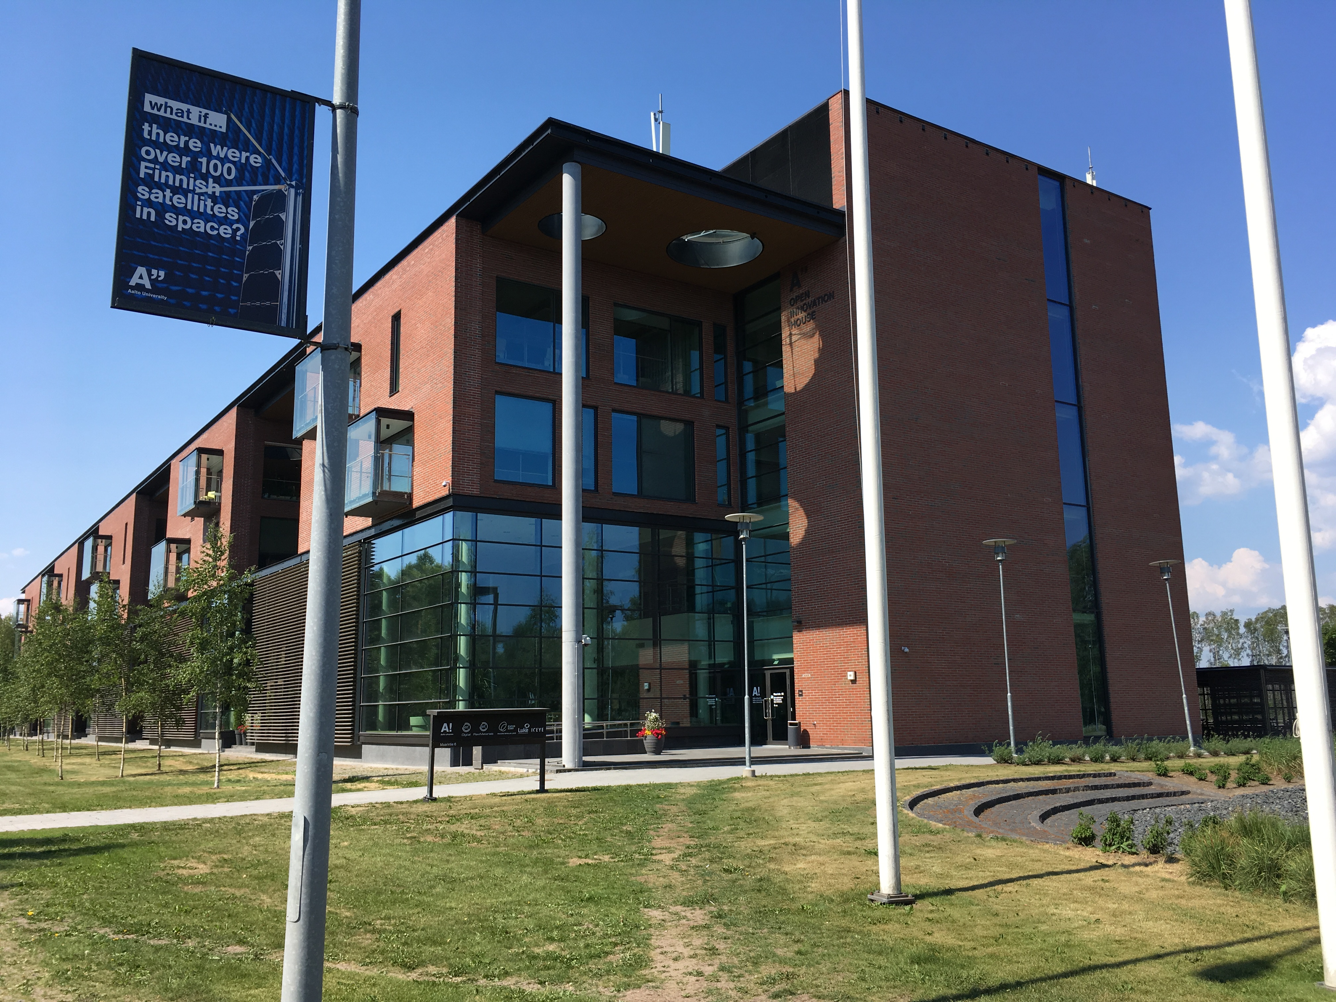
Thanks & see you later!
careerservices@aalto.fi

