Slide 1
Learning Portfolio
Jani Mäkelä

Slide 2
Start
Free-form instructions
No idea what to do → set own goals
My goals:
Can be used outside the course
Is a record for me
Completes my CV
Plan:
Select platform
Start writing
Ask for feedback and improve

Slide 3
Progress
Website (Webnode)
Eeasy to use
Writing:
Structure
Short, descriptive writing of different topics
Adding reflective text
Challenges:
Website is public → Privacy
Job application attachment → Consistency
Portfolio requirements → Deep reflection

Slide 4
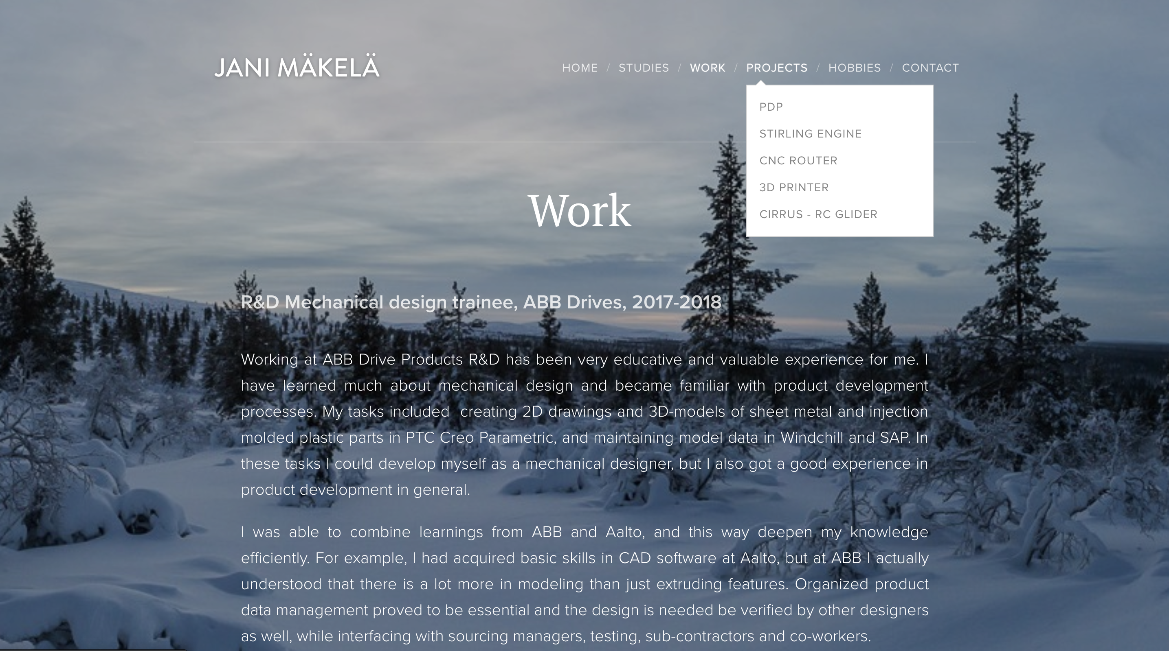
Result

Slide 5
ThanK You!
jani-makela.webnode.fi/

