Slide 1
Portfolio, PDPP and T4
Ville Kivimäki, project manager
Eeva Lilja, coordinator

Slide 2
Learning portfolios in engineering education at Aalto and the portfolio process
Welcome
Motivation and what is a learning portfolio?
Master student’s roadmap to a career as a game changer by Aila Saloranta
Portfolio examples from 2018—2019
Personal Learning Portfolio: the process and experience by MSc student Jani Mäkelä
Support for compiling your own portfolio

Slide 3
Janne Saario – Make your own path
https://youtu.be/eIvzwGQTiYo

Slide 4
Learning portfolio
The format of your learning portfolio is free
Tool to reflect your learning
Way to track your current study progress, course expectations, life goals and dreams
A good appendix to your CV
You will learn better who you are

Slide 6
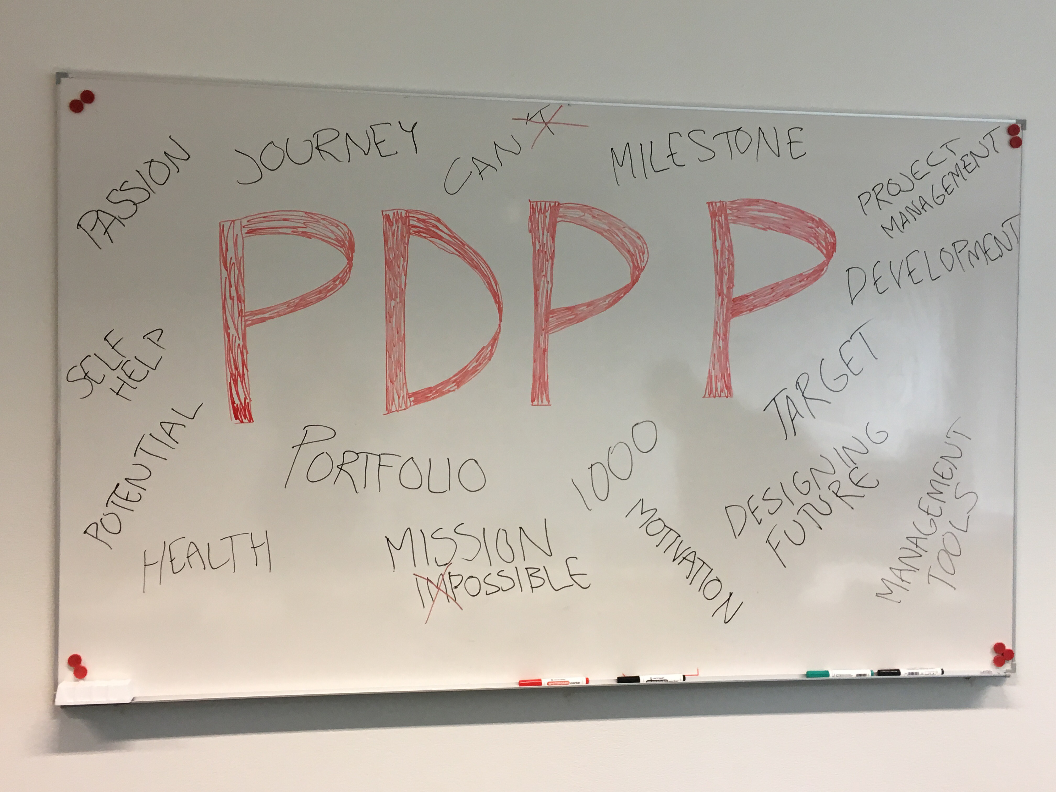
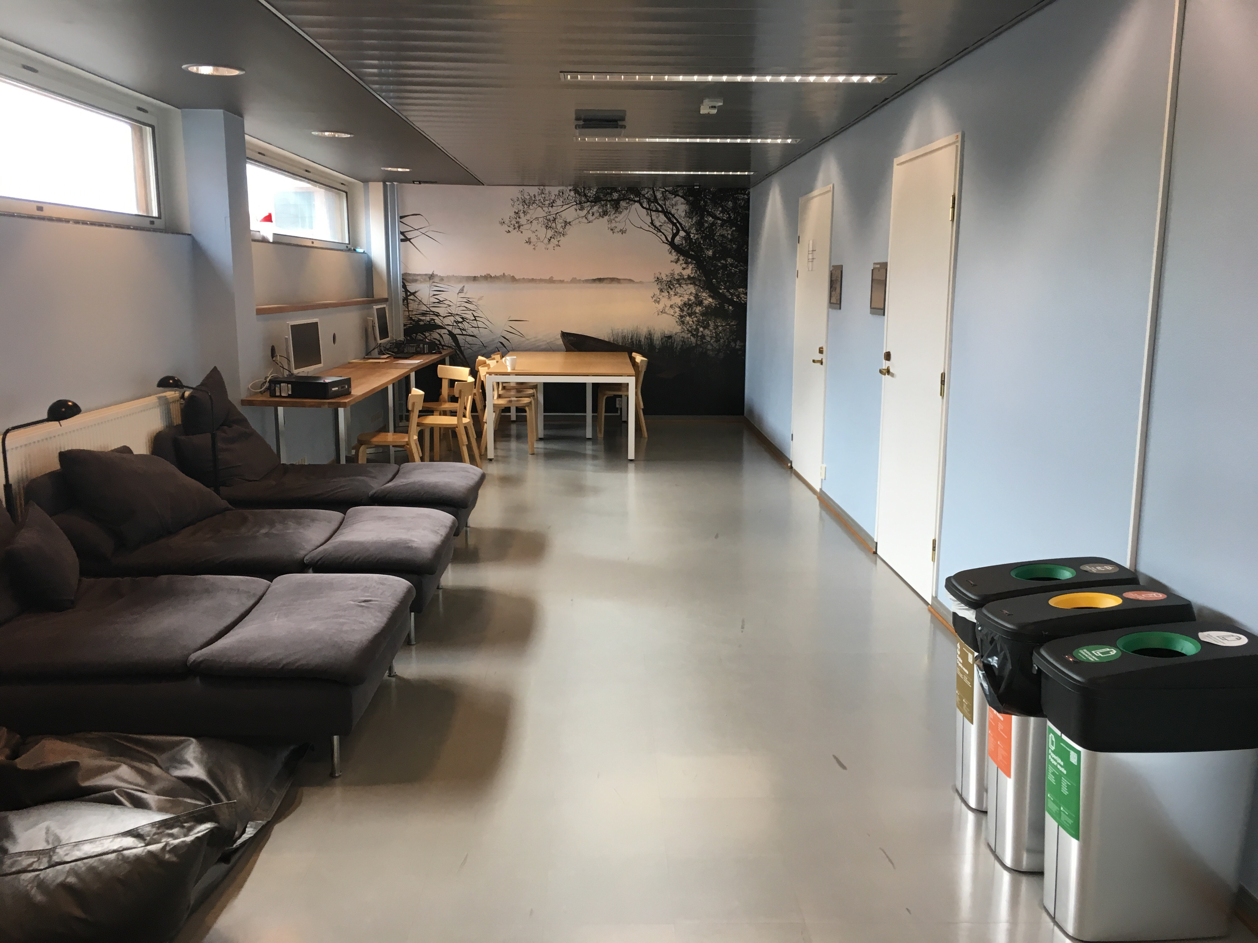

Slide 7
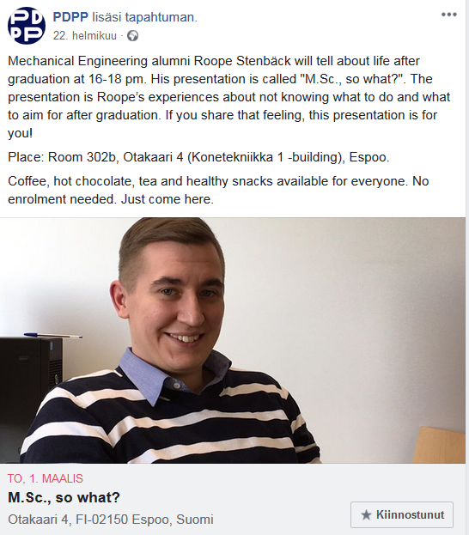
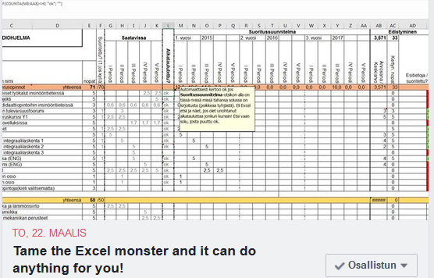

Slide 8
Hard evidence

Slide 9
T4 supports the portfolio process
Every Thursday (at 12pm-18pm) during the periods you can drop by 302b (Otakaari 4).
Ville, Eeva and visiting professionals help you to create the best portfolio possible. ☺
Also possibility to complete the course ENG-E2010 PDPP (1 credit)
Complements the portfolio process
Special events regularly (study psychologists, career services, Excel-workshops…)

Slide 10
ENG-E2010, PDPP - Personal Development Project Plan
Learning objectives: After the course the student has created a personal development project plan (PDPP), has been thinking about the goals of one’s studies, and knows how to plan and follow one’s development.
Contents: The aim of the course is to help students develop life management skills. The student finds significance and relevance for one’s studies while creating the PDPP.
Forms of work and evaluation criteria: The student has created the PDPP and participated in at least two PDPP development workshops/clinics during the autumn. The last version of the PDPP must be turned in via MyCourses.

Slide 11
You need to do a portfolio as a part of your studies…
We will help you there providing:
Explanation: what is a portfolio
Ideas on where to start
Ideas on where to go from there
Feedback
Coffee
Healthy snacks
Friends
Learning spaces

Slide 12
Fuel up your plans with us

Slide 13
3rd floor @ Otakaari 4 every Thursday 12pm – 6 pm
Starting 12th of September 2019

