Slide 1
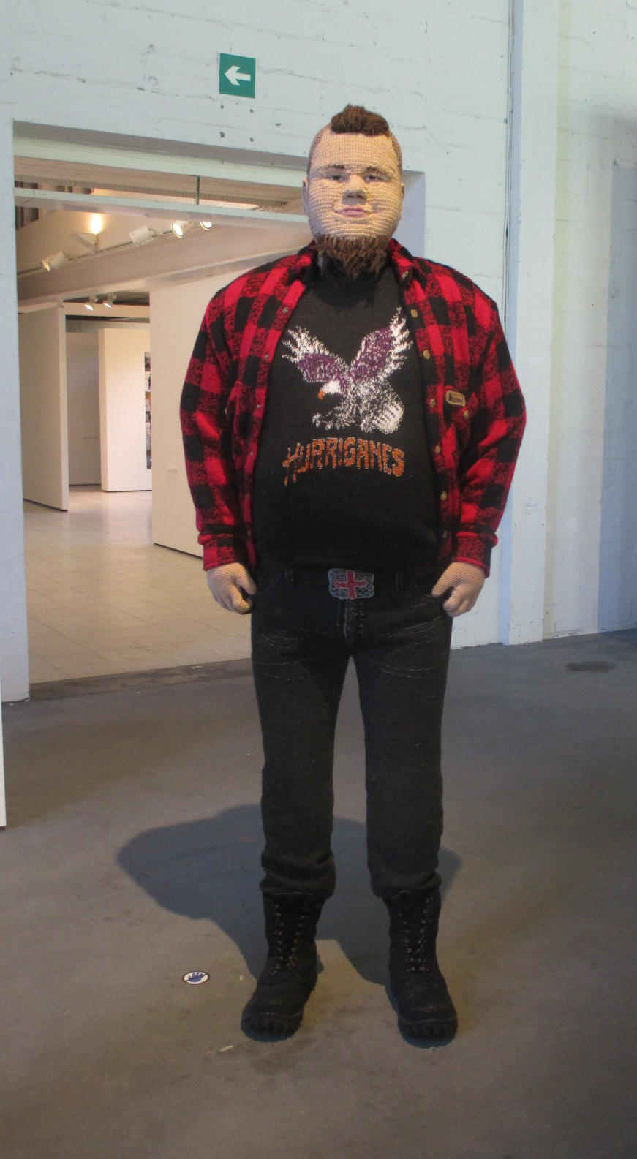
The Anatomy of self portrait
Laura Isoniemi
Visualized me
Open University
Aalto Arts 2019
Liisa Hietanen:Brother ,knitted portait

Slide 2
1.The Aanatomy of the portrait
The anatomy of the portrait can be divided to smaller units
- small elements together create the entity
The elements of portrait can be tought as
A) sights
B ) gestures
C) bodylanguage

Slide 3
A. Sight is a powerful weapon Stereotypes of portraits elements
Adult sights
The direction of the sight gives meanings and can show the position of the person

Slide 5
Different sights
Overlook Black sight
Adolescent sight Child´s sight

Slide 6
b) Gestures
The subconsciuos and conscious
gestures of a person builds up
the characters entity and credibility
Gestures can be learned and changed, some are heritated.
They can be overexaggarated, hidden and underlined ,like in comic books.
Gestures ar tools of power as well.

Slide 7
Gestures as in comic books
joy sadness ashtonished
Cunning doubtful

Slide 8
Gestures that rule the world

Slide 9
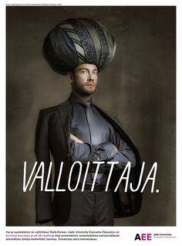
Bodylanguage and clothing; stereotypes of power

Slide 10
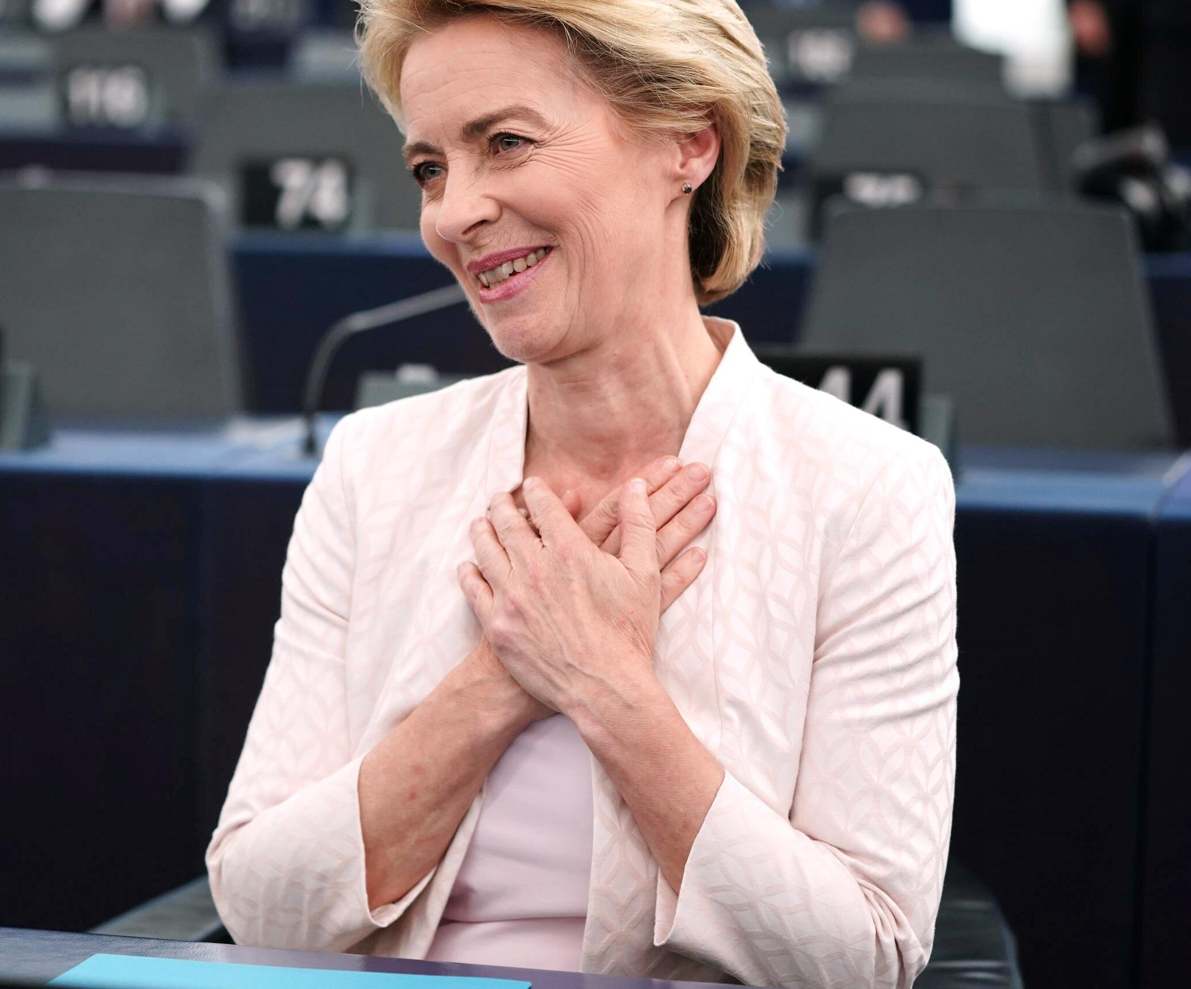
Bodylanguage of power

Slide 11
A Dialogue of two female bodylanguages from two different decades

Slide 12
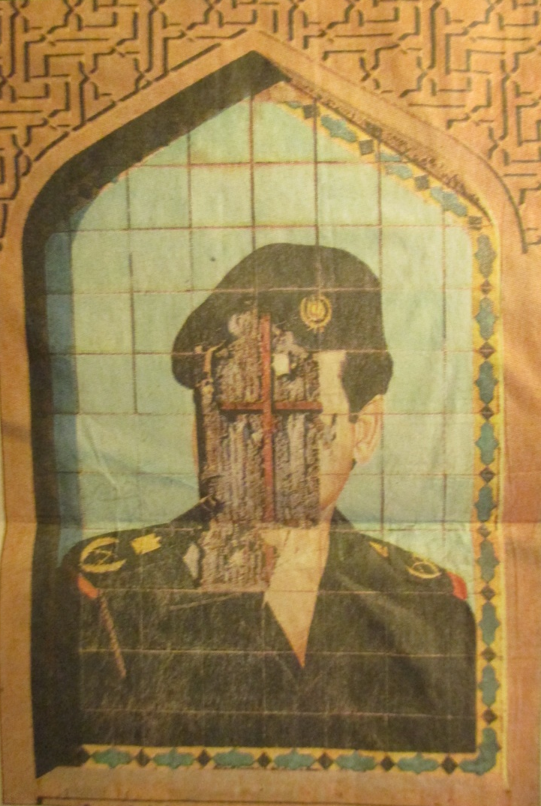
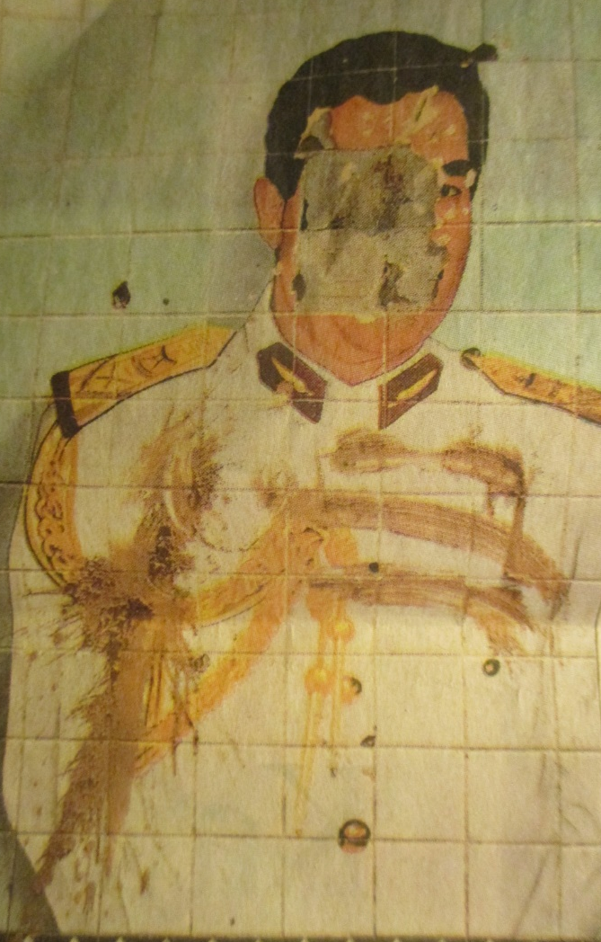
Portraits of lost power HS; Photos by Markus Jokela

Slide 13
Bodylanguage of play and joy Photos . Issye Miyake clothing

Slide 14
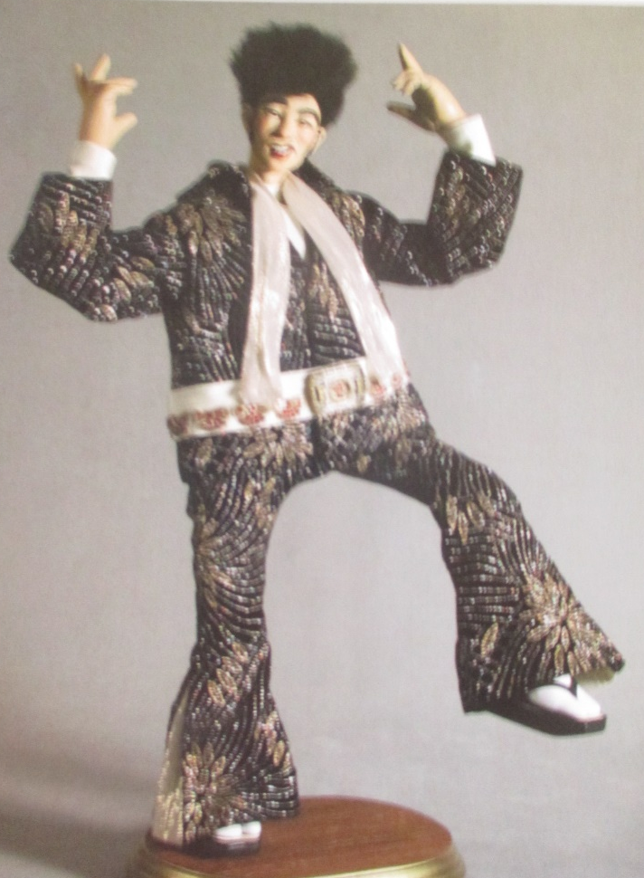
Bodylanguage of pleasure

Slide 15
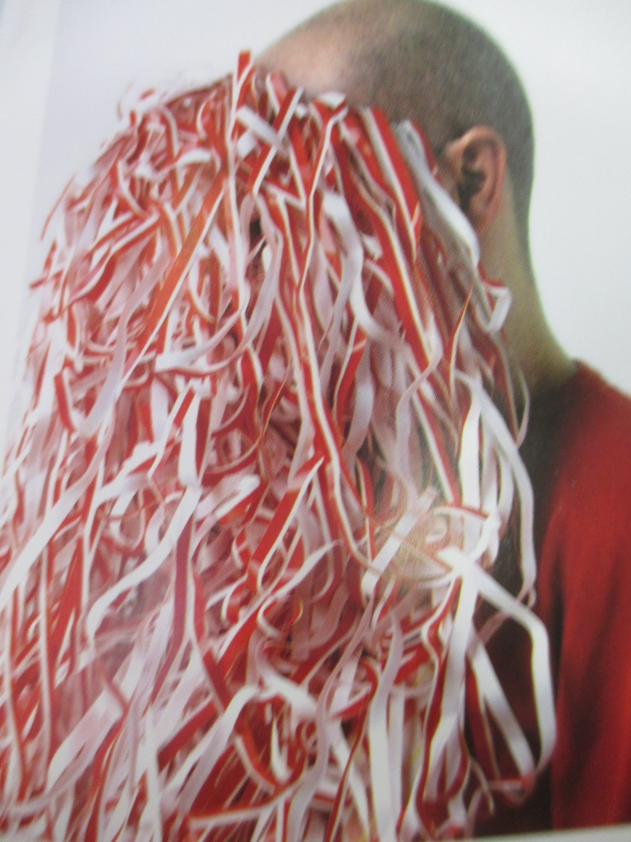
Possible me

Slide 17
Overpainted Portrait of George Harrison

Slide 18
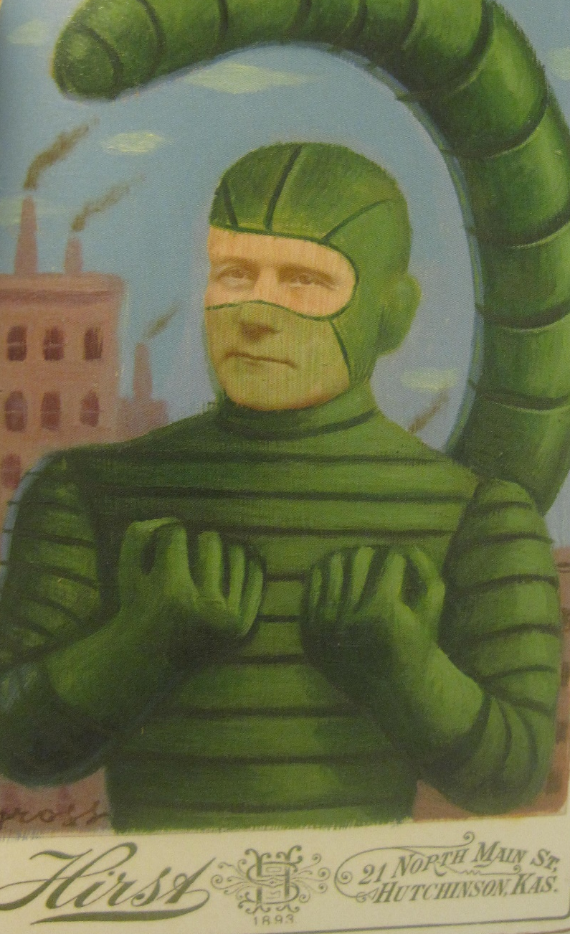
Cabinet card paintings by Alex Cross

Slide 19
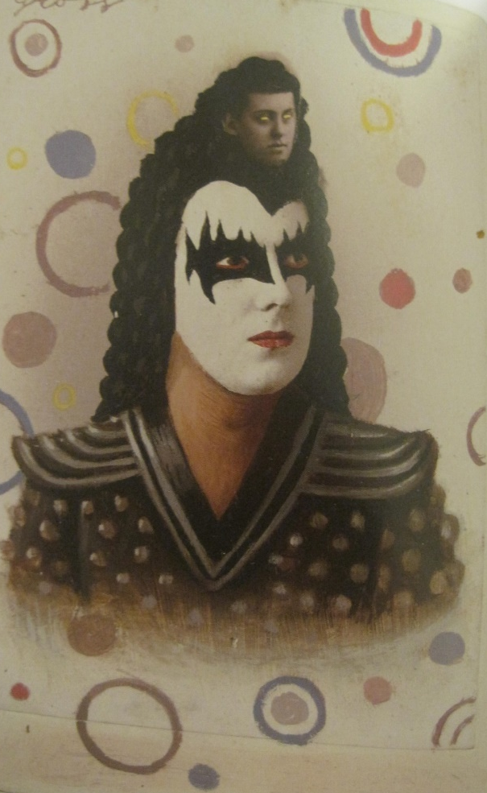
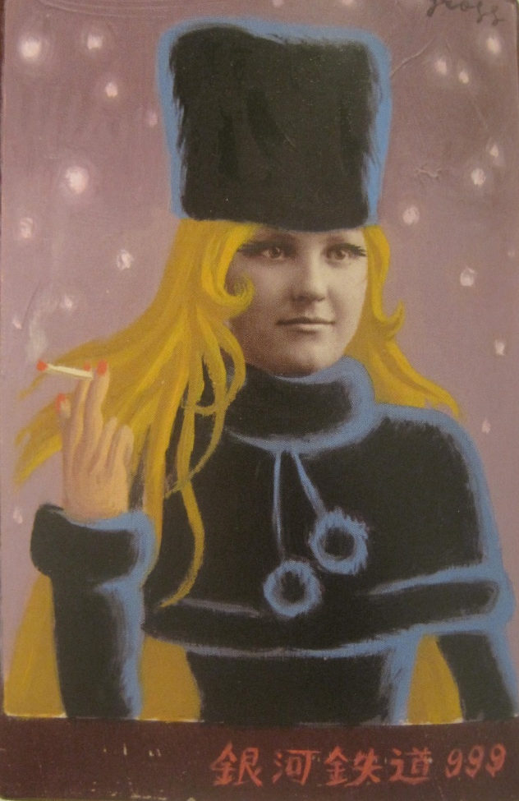

Slide 20
Empty space informing absence

