Slide 1
Business Communication Skills
61A00200
Session 2 (14 September)
Lecturer: Mark Badham

Slide 2
Today’s agenda
Effective Business Writing
Review & edit A1 Written Request in groups: Strategy Analysis & Request
Fine-tune A2a Individual Persuasive Presentation Strategy Outline
High impact Introductions & Conclusions

Slide 3
BUSINESS WRITING
Composing Techniques
FIRST: Prepare Strategy Analysis
Communicator strategy
Audience strategy
Message strategy
Channel Choice strategy
Culture strategy
TIPS:
Write 1st draft
Edit &/or ask someone to check &/or test it
Edit again

Slide 4
Composing Techniques
1. Research:
Interview/s
Company documents
Company communications (eg emails)
Surveys
4. Draft:
Organize & focus
Compose in any order
Don’t edit yet
2. Organize (Structure):
Group ideas: mindmap/idea chart
5. Edit:
For strategy 1st
For macro issues
For micro issues
For correctness (eg spelling, grammar & punctuation)
3. Focus:
Skim
Nutshell
Bottom line
Elevator pitch
Busy boss

Slide 5
Composing Techniques
1. Research: Interview
Who?
What?
Where?
When?
Why?
How?

Slide 6
Composing Techniques
3. Focus techniques:
Skim:
Imagine reader skimming…
What does reader need to know 1st, 2nd, 3rd… if he/she skims text?
Nutshell… main points only
Bottom line… one key point

Slide 7
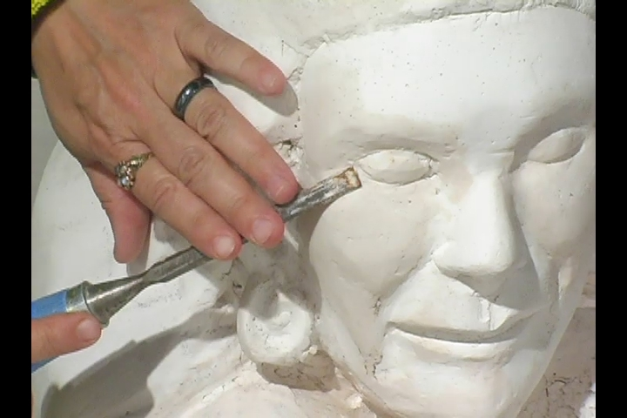
Composing Techniques
4. Draft:
Don’t start with blank page
Start with lots of text
Like sculpture, begin with ‘mess’ (in Draft stage) & methodically perfect (in Edit stage)

Slide 8
Composing Techniques
5. Edit:
For strategy 1st
Communicator strategy
Audience strategy
Message strategy
Channel Choice strategy
Culture strategy
For macro issues: Paragraphs & sections
Progression & linkages & connections
For micro issues: sentences & words
Brevity
Appropriate style (formal/informal)
For correctness (eg spelling, grammar & punctuation)

Slide 9
Composing Techniques
MACRO Writing
Headings & subheadings
Stand-alone sense
Action words
Questions
White space: indents, spacing, lists

Slide 10
Composing Techniques
MACRO Writing
Progression & linkages:
Introduction
Section heading 1
First subsection heading

Slide 11
MICRO Writing
Avoid wordiness
Shorten & vary lengths of sentences
Bold, underline, capitalize, headings, sub-headings
Style – depends on:
Relationship with audience
Communication context: indirect & impersonal in academic context vs direct & personal in business
Nature of message: good vs bad news, sensitive vs non sensitive

Slide 12
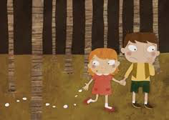
MICRO Writing
Transitions (Hansel & Gretel bread crumbs):
Addition: And, in addition, again, also, similarly, finally…
Contrast: But, however, or, nevertheless, on the other hand…
Example: For example, for instance, such as, that is…
Sequence: First, second, third… then…
Conclusion: Finally, therefore, in conclusion, as a result…
Clarification/summary: In other words, what this means is, to summarize…

Slide 13
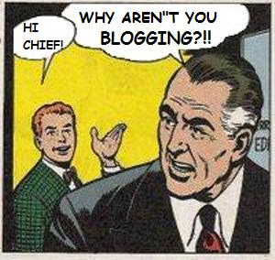
MICRO Writing
EXERCISE: Improve heading & first 1-2 sentences in this blog post
http://www.blancco.com/blog/data-erasure-as-a-service-deaas/

Slide 14
MICRO Writing
EXERCISE: Here is an improved version… Discuss the changes
Your golden opportunity in “The Cloud”: Data Erasure as a Service (DEaaS)
If you’re a cloud provider, I have some especially good news. Data Erasure as a Service (DEaaS) offers you a golden opportunity to increase revenue through an extra service to customers.
But before I get to that… “The Cloud” and the virtualized world has become quite a hot topic, hasn’t it!
In my previous blog about virtualization, I mostly wrote about Blancco solutions which integrate with different VMware environments. This time around, let’s take a broader view of the virtualized world.
Many people have been rushing to understand the new terminology surrounding “The Cloud”.

Slide 15
EXERCISE: Queensland Father of the Year sponsorship request
Task: You are asked to seek sponsorship from a 5 star hotel (eg Hyatt) for this event. Plan the contents of your sponsorship proposal…
Research: interview me… 5 Ws & 1 H
Show “QFOTY ad”
http://qldfatheroftheyear.org.au

Slide 16
EXERCISE: Queensland Father of the Year sponsorship request
Who? Target audience: companies that would benefit from association with QFOTY. Who is supporting the event? Who benefits from the event? Who is running the event?
Where? Throughout state of Queensland
What? What is QFOTY event? What are the benefits to sponsors? What are the event goals? What does the event require of the sponsoring company? What is the main message of the event?
How? How can companies sponsor the event?
Why? Why should companies sponsor the event? Why is SU Qld running the event?
When?

Slide 17
A2 Individual persuasive presentation
6-8 minute business-related persuasive presentation
Your target audience:
school: Aalto management, fellow students, potential students, exchange students, corporate partners
company where you work: top management, colleagues, company personnel, customers, suppliers, buyers, partners etc
Strategy outline using Munter Chapter 1 (10%)
- audience analysis, objective, credibility, structure
Presentation (given to an audience of 5 classmates)
Self-reflection (15 %)

Slide 18
A2 Individual persuasive presentation
Procedure
Choose a topic
Prepare strategy outline (A2a) for Session 2 (your analysis of the presentation situation)
Prepare the actual presentation including any slides you intend to use (maximum of 5)
Present: 6-8 minute presentation with peer feedback (Session 3)
Write a reflection paper (A2b) - due one week after presentation

Slide 19
A2a Strategy outline
Presentation topic
Message outcome / objective
Audience analysis
Credibility
Content and structure
Evidence: What evidence will you provide to support your position?
Audience benefits: What audience benefits will you focus on?

Slide 20
A2 Individual persuasive presentation
Exercise: In pairs, fine-tune each others’ strategy outline
Announcement: 60 second individual presentation ‘trailers’ will be held at the end of this session – prepare now
(Revised) Deadline for Strategy Outline: 5pm this Wednesday 16 September. Place in MyCourses + bring 2 copies to class in Session 3 (next week)

Slide 21
A2 Individual persuasive presentation
Feedback – common challenges to overcome

Slide 22
A1 Written request (group)
A1a Communication strategy analysis using Munter Ch 1 (10%)
A1b Email request (15 %)
Review & edit A1 Written Request in groups: Strategy Analysis & Request
Deadlines:
Draft due today
Teacher to email feedback by Wednesday 16 September
Final due 12pm Monday 21 September via MyCourses

Slide 23
A1 Written request (group)
Feedback – common challenges to overcome

Slide 24
60 second individual presentation ‘trailers’
Outline context 1st

Slide 25
High Impact Intros & Conclusions
Intros:
Create motivation: what’s in it for me?
Promise of new ideas or info
Solution to a problem they are facing
Gain credibility
Context/Overview
Arouse interest – “grabbers”
Great Grabbers!
Surprise: interesting facts, stats or controversial claims
http://www.goodnewsfinland.com/archive/point-of-view/finns-are-like-squirrels/
Quotation
Question

Slide 26
High Impact Intros & Conclusions
Conclusions
Repeat key message/s
Call for action - next steps
Link back to Intro
Finish on high note (something to clap about & get audience talking in the break)
“Feelgood” or “goodwill” endings

Slide 27
Assignments over the coming week
Deadline for final version of written request (A1): I will email feedback by Wednesday 16 September. Final due 2pm Monday 21 September via MyCourses
Deadline for Strategy Outline of A2a Individual Persuasive Presentation: 5pm this Wednesday 16 September. Place in MyCourses + bring 2 copies to class in Session 3 (next week)
Finalise your A2a Individual Persuasive Presentation – to be presented to small groups in Session 3 (next week)
Prepare for in-class test in Session 4: Read Munter chapters I, III and IV

