Slide 1
Business Communication Skills (3cr)
61A00200
Lecturer: Mark Badham

Slide 2
Today’s agenda
YOU and business communication
Course objectives, assessment, schedule
Intro to Communicating Strategically
Case analysis and class discussion

Slide 3
YOU & business communication
What kind of business writing have you done (reports etc)?
Have you given business presentations? Topics, audience ..
Your strengths as a communicator?
Skills you would like to develop? Why?

Slide 4
Learning outcomes
On completion you will be able to:
analyse audiences & define objectives to create targeted messages
write coherent, convincing, reader-friendly documents
craft clear, focused and engaging business presentations
critically assess your own and others’ communications

Slide 5
Mark Badham
Organisational communication
Media publicity
Magazine editor
Weekly TV show & monthly health program on radio
Speeches
Publications (annual reports, magazines, newsletters, brochures, books, white papers, websites, intranets),
Corporate social media sites,
Media spokesperson,
National lobbying campaigns,
Public relations company.

Slide 6
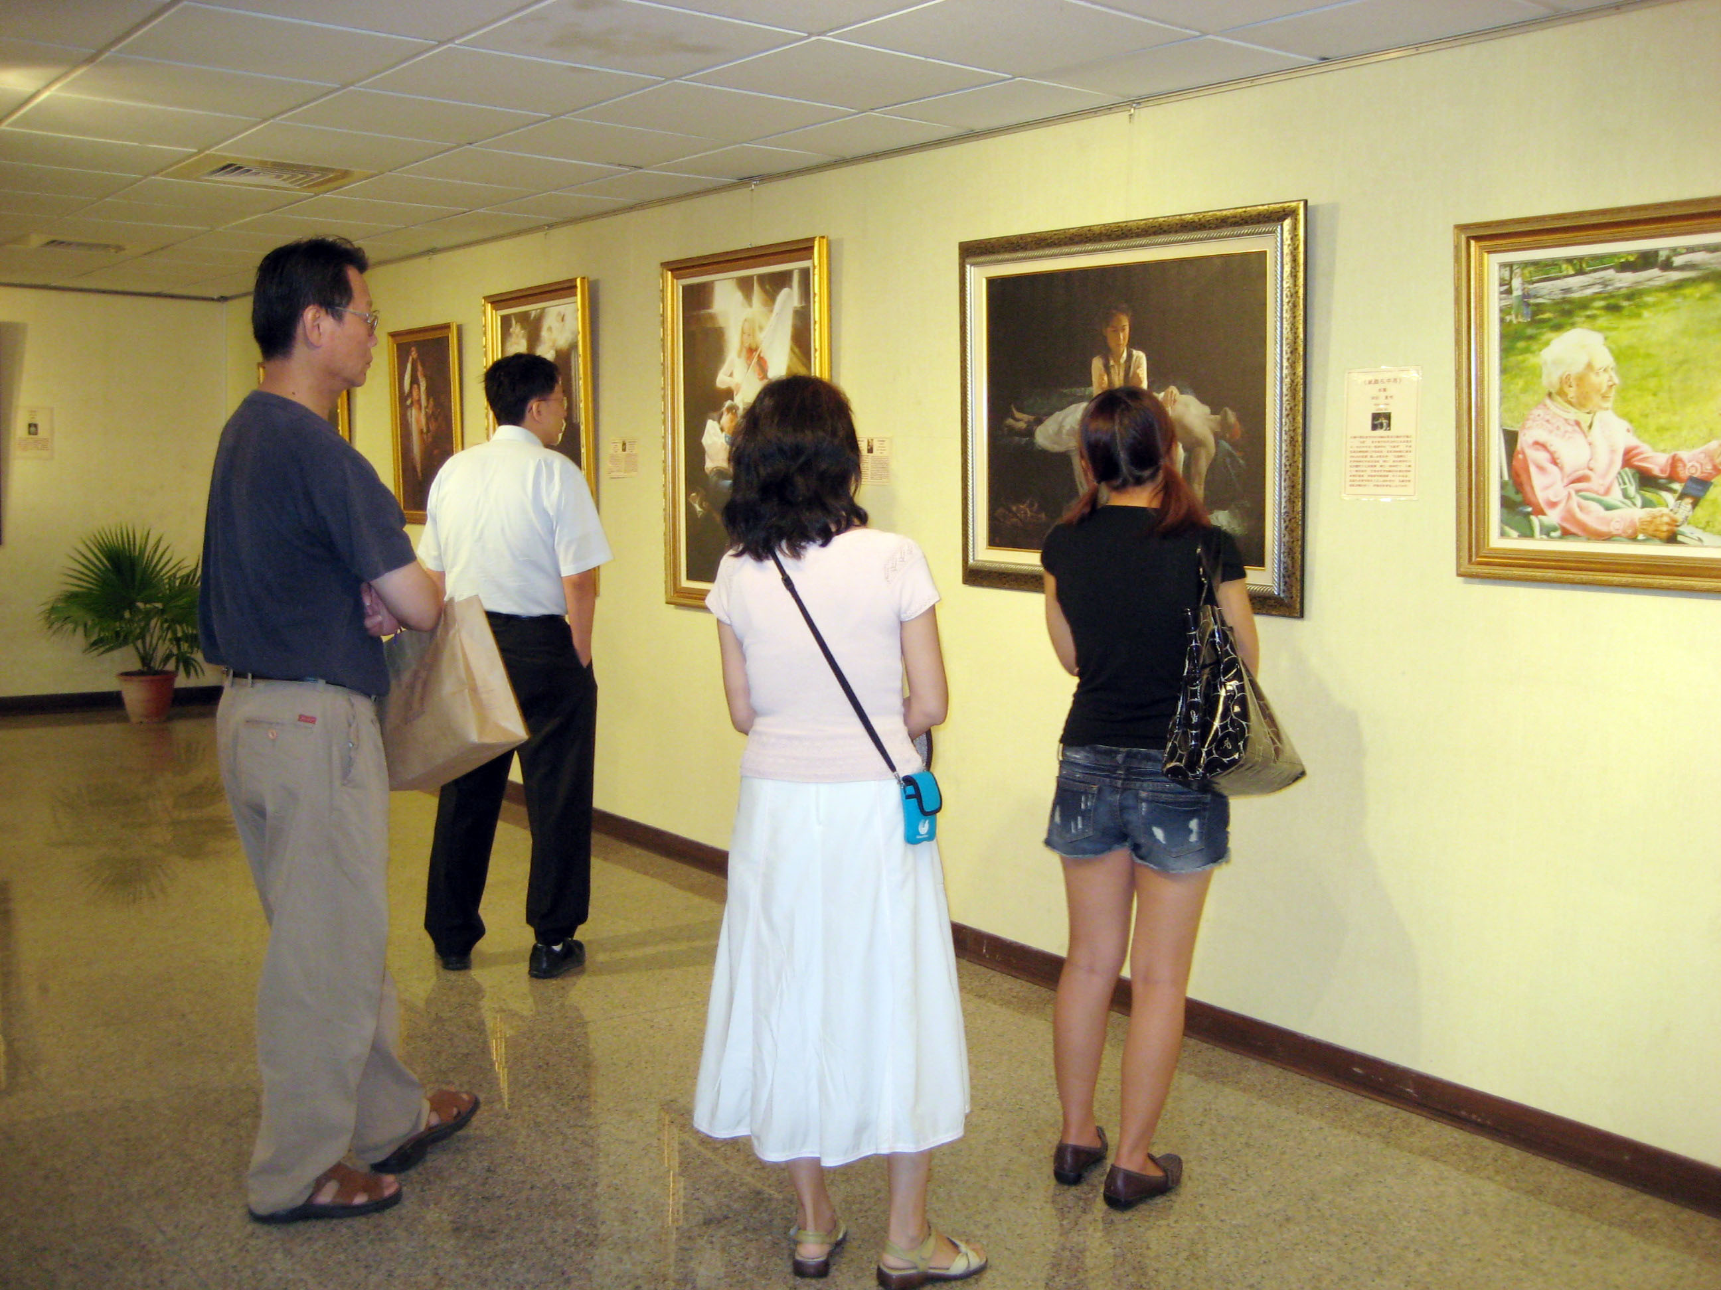
Gloria Jeans’ Coffees: Franchisee communication
Gold Coast City Council: Mayor’s public speeches
Gold Coast City Council: Taiwanese Art Exhibition sponsorship

Slide 7
How’s the workload (81 hrs/3 cr) divided up?
Class
24 hours
Assignments
35 hours
Preparation
22 hours

Slide 8
Graded deliverables
A1 Written request (group) 25
A2 Persuasive presentation (individual) 20
A3 Exam (individual) 20
A4 Persuasive team presentation (gp & ind) 25
Class Preparedness, contribution 10

Slide 9
Graded deliverables
A1 Written request (group) 25
A2 Persuasive presentation (individual) 20
A3 Exam (individual) 20
A4 Persuasive team presentation (gp & ind) 25
Class Preparedness, contribution 10
60% individual
40% group

Slide 10
A1 Written request: IKEA
Situation
Write a request to IKEA to persuade them to participate in a school project you are working on
Writer (Your group)
AaltoBiz student and a part-time cashier at Ikea.
Recipient
IKEA Finland’s environmental manager

Slide 11
A1 Written request: MEDICUS
Situation
Write a request to Medicus (pharmaceutical company) to persuade them to participate in a school project
Writer (Your group)
AaltoBiz student and a part-time worker at Medicus
Recipient
Medicus Finland’s responsibility manager

Slide 12
A1 Written request (group)
2 deliverables:
A1a Communication strategy analysis using Munter Ch 1 (10%)
- audience analysis, objective, credibility, structure
A1b Email request (15 %)

Slide 13
A2 Individual persuasive presentation
6-8 minute business-related persuasive presentation
Your target audience could be:
school: Aalto management, fellow students, potential students, exchange students, corporate partners
company where you work: top management, colleagues, company personnel, customers, suppliers, buyers, partners etc

Slide 14
A2 Individual persuasive presentation
Procedure
Choose a presentation topic
Prepare strategy outline (A2a) for week 2 (your analysis of the presentation situation)
Prepare the actual presentation including any slides you intend to use (maximum of 5)
Present: 6-8 minute presentation with peer feedback
Write a reflection paper (A2b) - due one week after presentation

Slide 15
A2 Individual persuasive presentation
3 deliverables:
Strategy outline using Munter chapter 1 (10%)
- audience analysis, objective, credibility, structure
Presentation (given to an audience of 5 classmates)
Self-reflection (15 %)

Slide 16
A2a Strategy outline
Presentation topic
Message outcome / objective: What do you want your audience to think, feel or do as a result of your message?
Audience analysis: Who is your audience? What do they know and expect? What do they feel? How can you persuade them?
Credibility: What is your initial credibility as a communicator in the situation you have chosen for your presentation? How will you endeavour to enhance your credibility?
Content and structure: How will you organise your ideas? Direct or indirect? Can you use any of the organisational patterns provided?
What evidence will you provide to support your position?
What audience benefits will you focus on?

Slide 17
Class contribution
Grade 5: Excellent contribution. Came to class thoroughly prepared having done all the required readings and preparation work. Always took an active role in class discussions and group activities. Contributions were always constructive and often insightful.
NB Full grading criteria in course outline and individual assignments

Slide 18
Strategy & Communication Strategy
What is strategy?
Why is it important to Business Communication?
How do you build Business Communication Strategies?
RACE

Slide 19
Define
objectives,
choose style
SITUATION
Analyse
audience
Assess
credibility
Communicating
strategically
DESIGN
Choose
channel
Craft
message
Notes:
Comprenhensive knowledge of company’s product. Including product features and recent innovative product. Sales and negotiating, best product mix to meet customer need. 그 이외 key competence, help to ensure the company vision and strategy. President’s management policy.
In the same boat, rowing same direction.

Slide 20
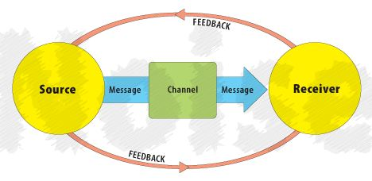
An early communication model
Shannon-Weaver Model (1949)

Slide 21
“AUDIENCE STRATEGY”
Who are they?
What do they know and expect?
What do they feel?
What will persuade them?
Analyse
audience
Munter (2012) adapted

Slide 22
Who are they?
Decision-maker
Analyse
audience
Opinion leader
Gatekeeper

Slide 23
Who are they?
What do they know and expect?
What do they feel?
What will persuade them?
Analyse
audience
Munter (2012) adapted

Slide 24
What do they know & expect?
Decision-maker - knows the topic inside out
Analyse
audience
Opinion leader – engineer, doesn’t know much about topic
Gatekeeper - poor English skills
Timing (eg length, place on agenda, when to distribute/communicate)
Visual aids (eg technology available)
Formality (eg formal/informal, dress)

Slide 25
Who are they?
What do they know and expect?
What do they feel?
What will persuade them?
Analyse
audience
Munter (2012) adapted

Slide 26
What do they feel?
Anxious about your proposal
Analyse
audience
Past bad experience with topic
Low level of interest in topic
Desired action: easy or hard? If hard…
Get straight to the point?
Short or long message?
Blancco 5

Slide 27
What will persuade them?
Tangible benefits? (Blancco products)
Analyse
audience
Job benefits?
Ego benefits?
Career benefits?
http://www.blancco.com/us/products/total-data-erasure/blancco-5/

Slide 28
What will persuade them?
Credibility through:
Common ground
Goodwill / reciprocity (Dunham gift)
Goodwill / liking (greet at door)
By association (CEO intro)
Punishment/threats (Taiwan art expo)
Analyse
audience

Slide 29
What will persuade them?
Message Structure:
Opening & Closing
Problem / Solution (Here’s the problem… help!)
2-sided approach (list all arguments)
”Ask for more” (extreme + acceptable options)
Yes, yes, yes… ah yes
Analyse
audience

Slide 30
Who are they?
What do they know and expect?
What do they feel?
What will persuade them?
Analyse
audience
Munter (2012) adapted

Slide 31
Define
objectives,
choose style
SITUATION
Analyse
audience
Assess
credibility
Communicating
strategically
DESIGN
Choose
channel
Craft
message
Notes:
Comprenhensive knowledge of company’s product. Including product features and recent innovative product. Sales and negotiating, best product mix to meet customer need. 그 이외 key competence, help to ensure the company vision and strategy. President’s management policy.
In the same boat, rowing same direction.

Slide 32
“COMMUNICATOR STRATEGY”
General: broad, overall objective
Action: accomplish a specific result
Communication (specific): ‘As a result of this message…’
Define
objectives,
choose style
Munter (2012) adapted

Slide 33
General: increase number of cars sold
Action: sell 20 cars by end of third quarter
Communication (specific): ‘As a result of this direct marketing message, 50 potential customers will come to test drive the new model next Saturday ...’
Define
objectives,
choose style

Slide 34
Communication style
Low
Join
Consult
Content
control
Sell
Tell
High
Low
Audience involvement
High

Slide 35
Define
objectives,
choose style
SITUATION
Analyse
audience
Assess
credibility
Communicating
strategically
DESIGN
Choose
channel
Craft
message
Notes:
Comprenhensive knowledge of company’s product. Including product features and recent innovative product. Sales and negotiating, best product mix to meet customer need. 그 이외 key competence, help to ensure the company vision and strategy. President’s management policy.
In the same boat, rowing same direction.

Slide 36
“COMMUNICATOR STRATEGY”
(Your) Rank
(Their) Goodwill (towards you)
(Your) Expertise
(Their) Image (of you)
(Your & their) Common ground
Kotter (1982) , Munter (2012)

Slide 37
Assess and enhance credibility
Source Emphasise
Rank title, position
Goodwill established relationship with audience
Expertise knowledge, qualifications, track record
Image attributes the audience finds attractive
Com ground shared values, ideas, and beliefs
Based on Power and Influence, Kotter (1982) and Guide to Managerial Communication, Munter (2012)

Slide 38
Define
objectives,
choose style
SITUATION
Analyse
audience
Assess
credibility
Communicating
strategically
DESIGN
Choose
channel
Craft
message
Notes:
Comprenhensive knowledge of company’s product. Including product features and recent innovative product. Sales and negotiating, best product mix to meet customer need. 그 이외 key competence, help to ensure the company vision and strategy. President’s management policy.
In the same boat, rowing same direction.

Slide 39
Print channels: memos, brochures, newsletters, reports, policy manuals, annual reports...
Electronic channels: email, Intranet, blogs, podcasts, chat rooms, video conferencing...
Choose
channel
Face-to-face channel tools: speeches, team meetings, board meetings, social events...

Slide 40
Media Richness (for engagement) Hierarchy
Rich
Physical presence (F2F)
Choose
channel
Interactive media (telephone)
Interactive media (email, sms)
Personal static media (letters, reports)
Impersonal static media (bulletins)
Lean
Adapted from Lengel and Daft (1988)

Slide 41
When to write?
Record
Precision
Mass audience
Choose
channel
When to present?
Instant feedback / interaction
Build community
Everyone gets message at same time? (Bradford)
When to combine?

Slide 42
Define
objectives,
choose style
SITUATION
Analyse
audience
Assess
credibility
Communicating
strategically
DESIGN
Choose
channel
Craft
message
Notes:
Comprenhensive knowledge of company’s product. Including product features and recent innovative product. Sales and negotiating, best product mix to meet customer need. 그 이외 key competence, help to ensure the company vision and strategy. President’s management policy.
In the same boat, rowing same direction.

Slide 43
“MESSAGE STRATEGY”
Beginnings & endings
Message organisation: Direct (get to the point) or indirect?
Message content: Achieving an appropriate mix of
Ethos (character/trustworthiness)
Pathos (emotions)
Logos (logic).
Craft
message
Aristotle in Business Communication (2007)

Slide 44
Choose message organisation
Direct
Indirect
Main idea
Explain
Explain
Main idea

Slide 45
Beginnings & Endings
The Middle:
Chunking
Repetition
Flagging signals
The unexpected gets attention
Craft
message
Storytelling

Slide 46
PWR Automation case
Why was the message unsuccessful?
What would have been a better strategy? Why?
Comment on:
Objective
Audience analysis (who, knowledge, attitude, motivation)
Style (tell, sell, consult, join)
Credibility (rank, goodwill, expertise, image, common ground)
Medium: channel choice (routine, urgency, feedback?)
Message: content and structure (direct v indirect, rhetorical mix)

Slide 47
For next week
Read Munter chapters I,III and IV
Read ‘Aristotle and persuasion’ handout
Prepare written request (A1) in groups – bring to class next week
Deadline for A2 Individual Persuasive Presentation Strategy Outline (A2a) due next Session. Bring 2 copies.

