Slide 1
S-38.3046 Value Network Design for Internet
Embedded SIM – Value Network Configuration
25th March, 2014
Group eSIM
Qin Jin
Munira Shahnaz
Erik Kosonen
Risto Sivonen

Slide 2
SIM and embedded SIM
SIM smart cards problematic for various reasons ¹⁾ (Case firm, 2014; eSIM, 2014; GSMG, 2012)
SIM as a network access application can be included on embedded Universal Integrated Circuit Card (eUICC) (GSMA, 2013a)
(Photo: Gemalto, www.gemalto.com)
Credentials
reprogrammable?
Physical?
Location of SIM?
SIM
Reprogrammable
eUICC
Surface mounted
Traditional
Soft SIM
Secure element
Non-reprogrammable?
Virtualized?
Smart card
¹⁾ SIM = Subsrciber identity module
(Figure modified from GSMG, 2012)
Current presenter:
Risto Sivonen

Slide 3
Research problem
Underlying trends
Mobile M2M traffic is increasing
Mobile M2M is driving development of embedded SIM
Case
European MNO
M2M mobile traffic with embedded SIM
5-10 years, until embedded SIM used in M2M market
Key uncertainties
Will terminal vendors behave as market changing innovators?
Will global operator alliances or M2M platform vendors that unite alliances get a large footprint compared to individual MNOs?
(eSIM, 2014)
Current presenter:
Risto Sivonen

Slide 4
Learning scenarios
Global footprint of
M2M alliances
Large
Small
Consolidating giants
Few global operator alliances for M2M market
Few large M2M platform vendors unite global operator alliances
MNOs provide services mainly to large alliances
Terminal vendors supply
Local derby
Local MNOs rule on M2M markets
Competitive local markets for M2M platform vendors
High local MNO profit due to high service level
Terminal vendors supply
Incremental
improvement
Terminal vendor
innovation
Star wars
Alliances support M2M interfaces of largest terminal vendors
Terminal compliance of M2M platform matters
MNOs provide services mainly to large alliances
Rise of oligarchy
Large terminal vendors raise heads
Terminal vendors forced to local MNO agreements
Competitive market for M2M platform vendors
MNOs serve global and local actors at home
Radical
disruption
Current presenter:
Risto Sivonen

Slide 5
SIM life-cycle differences
SIM on smart card:
Manufacture
of UICC
Select MNO
Personalize
Distribution
SIM
Activation
Usage
End of life
Personalize
(operational Profile)
eUICC:
Bssic
personali-
zation
Select / Change MNO
Usage
Manufacture
of eUICC
Distribution
End of Subscription
Pre-
issuance
Post-
issuance
(Modified from GSMA, 2013b)
Current presenter:
Risto Sivonen

Slide 6
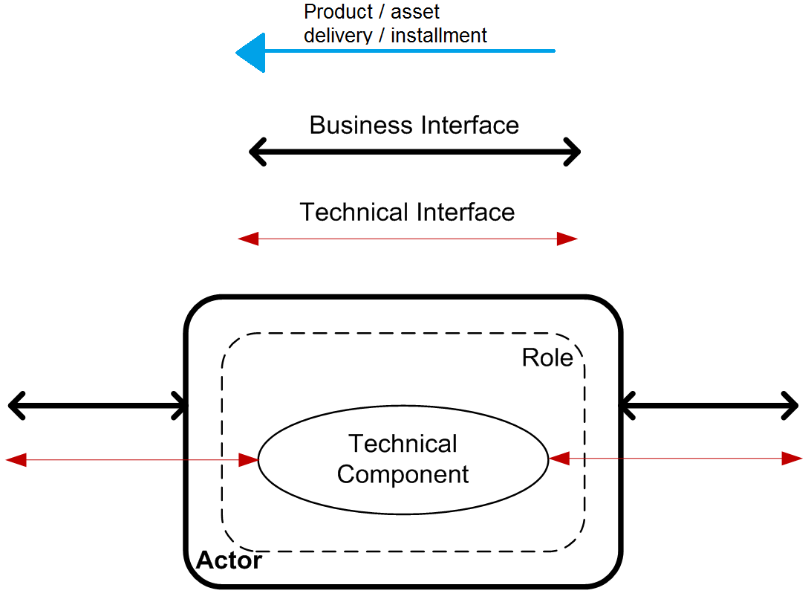
Overview of Roles & Technical components
(ETSI, 2013; GSMA, 2013a)
Current presenter:
Qin Jin
Notes:
The terms might change to GSMA specific.

Slide 7
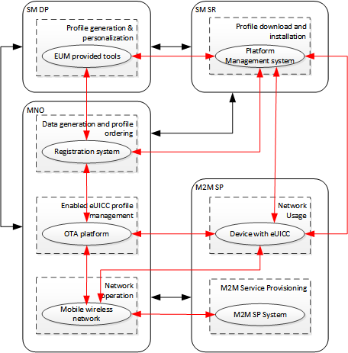
MNO driven
MNO serves M2M SP and buys subscription management from outside parties
No radical activity or threat of alliance
Footprint of
M2M alliances
Large
Small
MNO
driven
Incremental
Terminal vendor
innovation
Radical
Current presenter:
Qin Jin

Slide 8
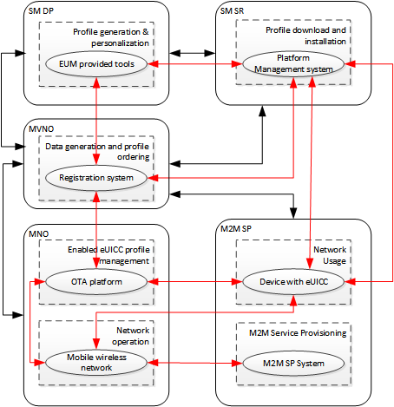
MVNO driven
MVNO (e.g., vendor or alliance) buys services from local MNO
Footprint of
M2M alliances
Large
Small
Incremental
Terminal vendor
innovation
MVNO
driven
Radical
Current presenter:
Erik Kosonen

Slide 9
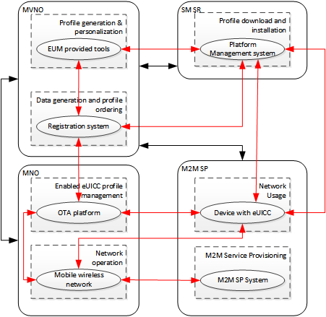
Large MVNO driven
MVNO (e.g., vendor or alliance) buys services from local MNO
Radical approach towards subscription management
Footprint of
M2M alliances
Large
Small
Incremental
MVNO
driven
Terminal vendor
innovation
Radical
Current presenter:
Erik Kosonen

Slide 10
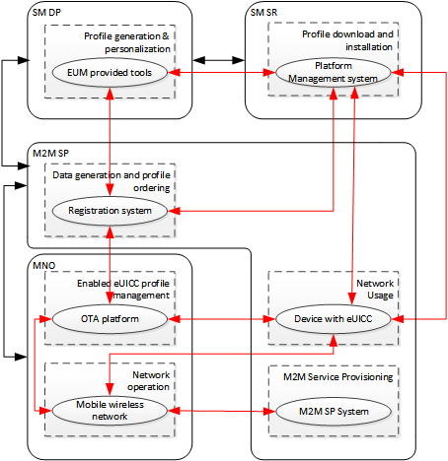
M2M SP Centric
M2M SP takes MVNO role and buys subscription management from other parties.
Footprint of
M2M alliances
Large
Small
Incremental
Terminal vendor
innovation
M2M SP
driven
Radical
Current presenter:
Munira Shahnaz

Slide 11
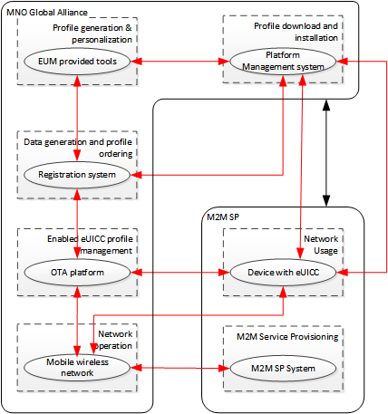
Global operator or alliance driven
Operator or alliance large enough to maintain subscription management takes over
Terminal vendor or M2M SP little chance to expand towards MVNO
Footprint of
M2M alliances
Large
Small
Global operator or alliance driven
Incremental
Terminal vendor
innovation
Radical
Current presenter:
Munira Shahnaz

Slide 12
Conclusions
Large MNO alliances and M2M platform vendors can create value from market need for mobility
Value creation high to ”global operator”
Terminal vendors can create value from need for terminal interoperability
Value creation high to terminal vendor as M2M SP and MVNO at same time
Difficult to expand to MNO business
Forced to create agreements with MNOs
Weaknesses
GSMA presents operator point of view
M2M platform vendor not fully included
Current presenter:
Risto Sivonen

Slide 13
References
CASE FIRM (2014) Interview and material provided by case firm during and after the interview.
eSIM (2014) Presentation of eSIM group on scenarios in relation to embedded SIM. Aalto University, March 2014.
ETSI (2013) Smart Cards; Embedded UICC; Requirements Specification. Release 12. ETSI Technical specification. TS 103 383 V12.0.0 (2013-02).
GSMA (2013a) Embedded SIM Remote Provisioning Architecture, Version 1.1., 17 December 2013. GSM Association, Official Document 12FAST.13.
GSMA (2013b).GSMA Embedded SIM: Accelerating growth and operational efficiency in the M2M world. GSM Association Reference Messaging Pack, 9th December 2013. Available online, http://www.gsma.com/connectedliving/wp-content/uploads/2012/03/embedded_sim_imv1v091213vFinal.pdf. Referred on 9th March, 2014.
GSMG (2012a) Reprogrammable SIMs: Technology, Evolution and Implications. Final paper. 25 September 2012. Available online, http://stakeholders.ofcom.org.uk/binaries/research/telecoms-research/reprogrammable-sims.pdf. Referred on 9th March, 2014.

Slide 14
Additional information for discussion

Slide 15
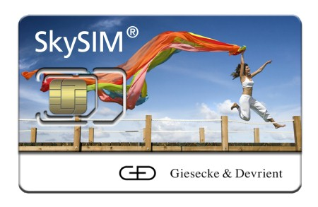
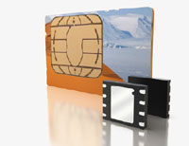
SIM and embedded SIM: Basics
LEFT: SIM is a smart card for authenticating a mobile device user for wireless networks
(Rankl and Effing, 2010)
Embedded SIM (GSMA, 2013c)
Reprogrammable over-the-air
Embedded Universal Circuit Card (eUICC) can be machine installed permanently on printed circuit boards
eUICC is smaller and compliant to greater variation of user environments
Standardization under work by GSMA and ETSI
(Photo: Giesecke & Devrient, www.gi-de.com)
Uses of SIM apart from authentication (Rankl and Effing, 2010)
Protection of program execution against manipulation
Data storage: E.g., dialing numbers, text messages, personal configuration settings for mobile devices
Generations and variations of SIM (Rankl and Effing, 2010)
SIM for GSM, USIM (UMTS) and R-UIM (CDMA 2000) for 3G
Ongoing development by 3GPP and ETSI
Different physical sizes
RIGHT: eUICC is smaller than standard SIM
(Photo: Gemalto, www.gemalto.com)
There are alternative development paths
E.g., Virtual SIM or SoftSIM does not have the secure element or global SIM’s of operator alliances (Case firm, 2014; GSMA, 2013c; Telefónica. 2013)
Current presenter:
Qin Jin

Slide 16
Types and examples of connected devices
Mobile networks
(cellular)
Short-range wireless (e.g., WiFi, ZigBee, Bluetooth)
Wired
(e.g., Ethernet, PLC, Fiber, Cat5, Coax)
(Modified from Gartner, 2012)

Slide 17
Host device
Device, i.e. terminal
Communications module
eUICC, i.e. eSIM
eUICC SW
Terminal vendor of Scenario analysis presentation broken down:
eUICC Vendor
Communications module vendor
Device/ terminal
vendor
Host device
vendor

