Slide 1
Lecture 6 videos

Slide 2
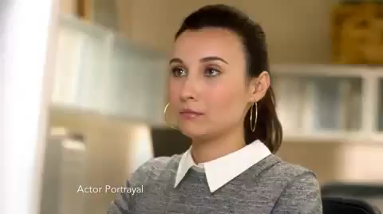
What is happening here?
Notes:
Affect – appeling to our emotions and changing attitudes, that way impact our behavior, in terms of eg. donations

Slide 3
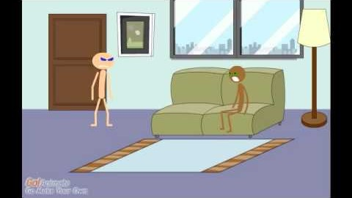
Social judgement theory
https://www.youtube.com/watch?v=dMHzXNtocEQ&ab_channel=ChristineCassimus

