Slide 1
Videos of lecture 2
In order to watch the videos, allow this PPT to become a trusted file and enable its content.
If you still can’t access the videos, use the links.

Slide 2


Slide 3
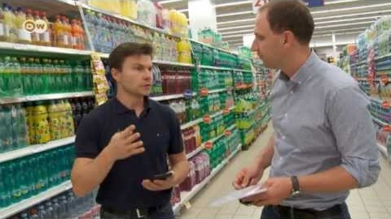
https://www.youtube.com/watch?v=Hatmm84sqm0&ab_channel=DWNews

Slide 4
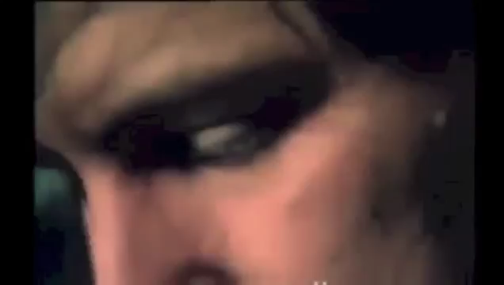

Slide 5

https://www.youtube.com/watch?v=XjmldAL9RQs&ab_channel=MangoResearch

