Slide 1
CHEM-E5140
Materials Characterization
Laboratory
General Introduction of Course
7.9.2020
Dr. Girish Chandra Tewari
Email:girish.tewari@aalto.fi

Slide 2
Material Characterization
Techniques
Probing physical and chemical properties of materials (Bulk, Surfaces and Interfaces)
Single crystals and powder(3D)
Thin films(2D)
Nanostructures(1D and 0D)
Remote Contact Session (Theoretical Background (Principle & Instrumentation))
Laboratory practice
What can I analyse?
Analysis of data
How do I get the information that I need?

Slide 3
Teaching acitivites
Major Topic1
Major Topic 2
Read
Pre-task
Class
Laboratory
Report
Feedback
Week 1
Week 2
Week 3
Week 4
Minor topic
Read
Pre-task
Class
Week 1
Week 2

Slide 4
Teaching activities – Period I
Week | Contact session | Laboratory | Pre-task
37 | General issues Introduction | - | XRD
38 | XRD | XRD | TEM
39 | TEM | - | Nanoindentation
40 | Nanoindentation | Nanoindentation | Optical Microscopy(OM)
41 | Optical Microscopy (OM) |  | SEM
42 | SEM | SEM+OM | EDS
43 | Exam week | - | -

Slide 5
Teaching activities – Period II
Week | Contact session | Laboratory | Pre-task
44 | EDS | SEM | Electronic Transport (ET)
45 | Electronic Transport(ET) | Electronic Transport(ET) | Raman
46 | Raman | Raman | XPS
47 | XPS |  | Auger + SIMS
48 | Auger + SIMS Course Summary | - | -
49 | - | Oral Exam slots (3.12) | -
50 | - | Oral exams (3.12-6.12) | -

Slide 6
How to pass the course?
5 laboratory exercises
  If you miss one -> extended report
  At least 4 laboratory participations are required to pass the course [get to the exam]
5 laboratory reports (including the pre-task), 60 %
Oral Exam, 30 %
Other tasks 10 % (Not obligatory)
Plagiarism: I do not tolerate!
Always additional work!

Slide 7
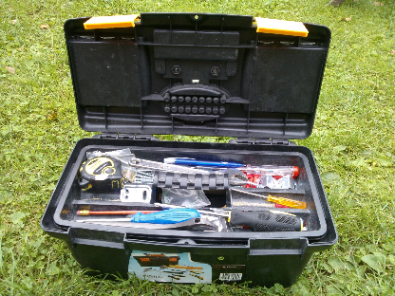
Material
All the course material will be at
MyCourses
Used also for submission and lab booking
I will add the lecture slides AFTER the lecture
As well the material we produce during lectures
Final DL for ALL submissions – 3.12 at 8 pm

Slide 8
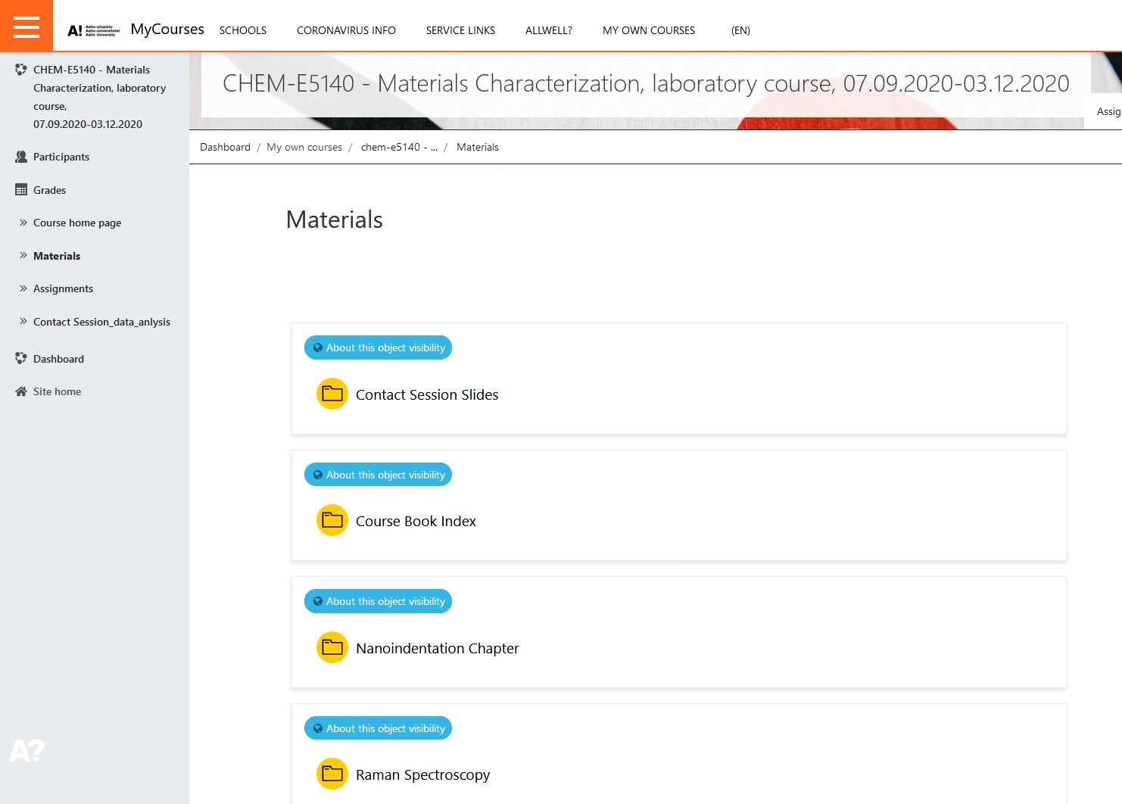
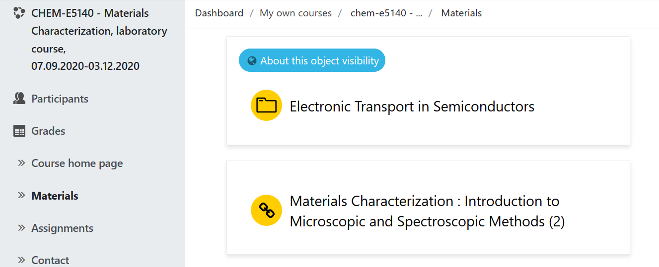
Course Book
Course book index (which pages are most relevant for the course and exam)
Free e-book for Aalto students + additional chapters for Nanoindentation, Raman spectroscopy and Electronic Transport in semiconductors

Slide 9
Flip the class room
Before major topic, study the topic from course book and prepare your pre-task
With minor topics, strongly recommended, but not obligatory! [Read rather then – not on exam]
Exam is based on the material on Course book!
At class, we do less “studying” and more doing…

Slide 10
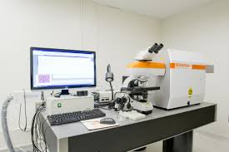
Laboratory work
XRD
Nanoindentation
SEM+OM
ET(Electronic Transport)
Raman
Select a 1 group from MyCourses – Assignments (one/each work)
Arrive in time
In a case of sudden illness try to change the time with a friend
(no additional lab times!)
Raman microscope, www.nano.pitt.edu, 19.8.2015

Slide 11
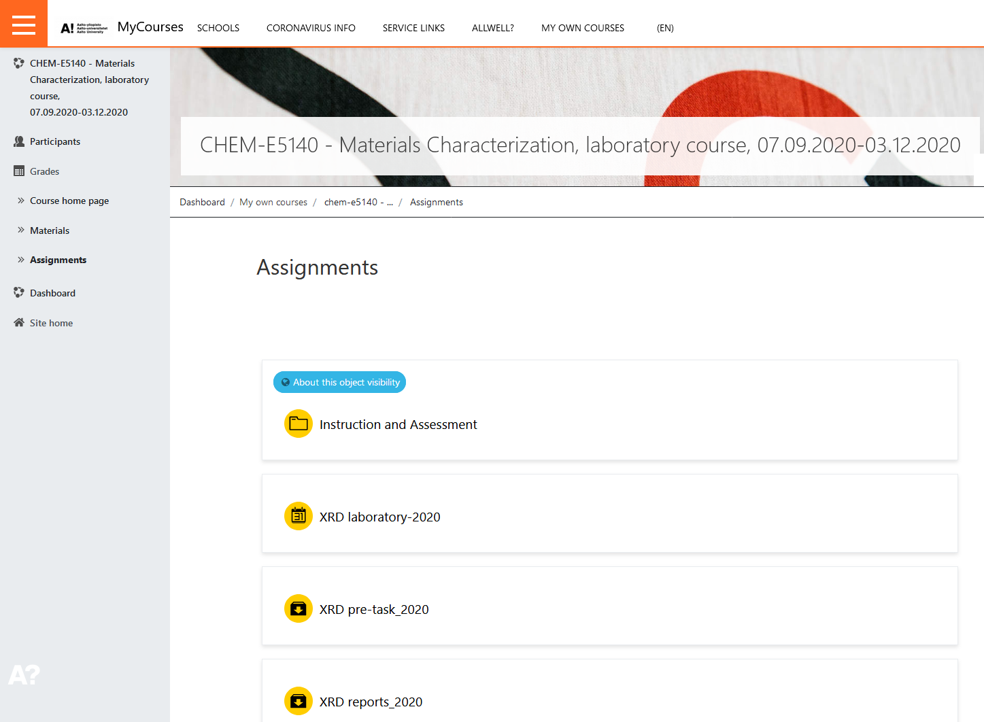
How to sign in a laboratory group
If you know you can not attend, do not book a time!

Slide 12
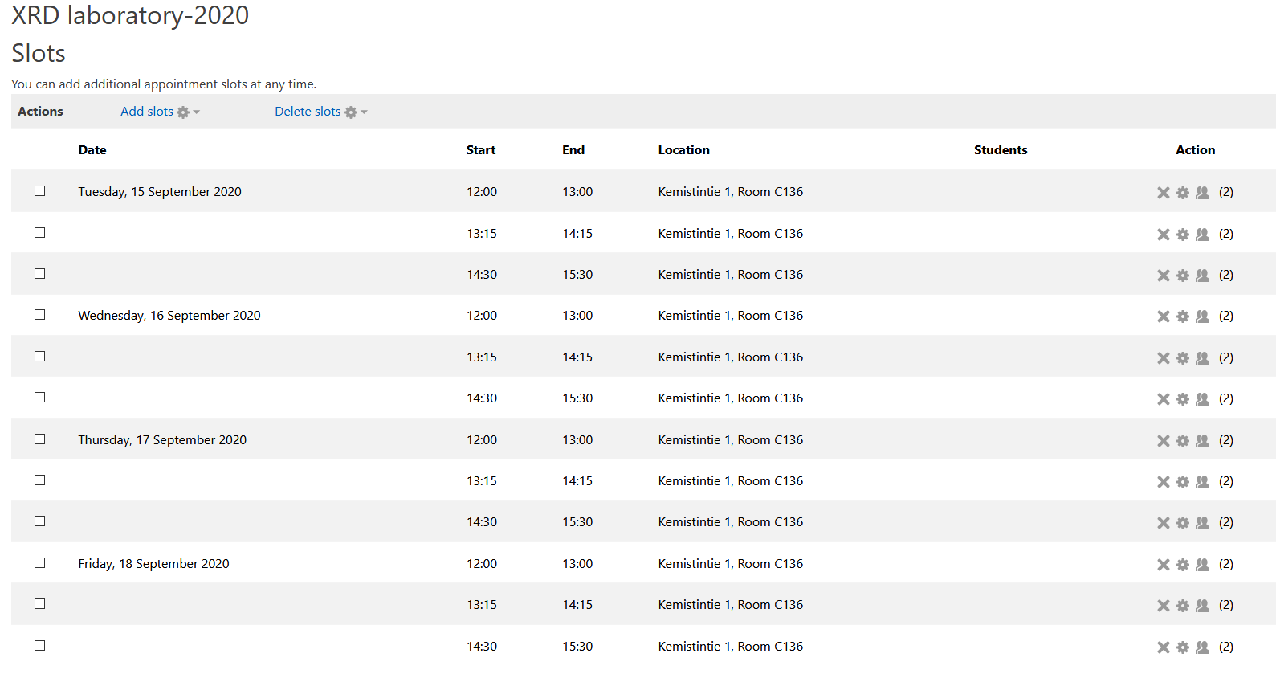
How to sign in a laboratory group
Always try to book other than the last group, to add some flexibility
If you get ill, cancel your group and book the last session!

Slide 13
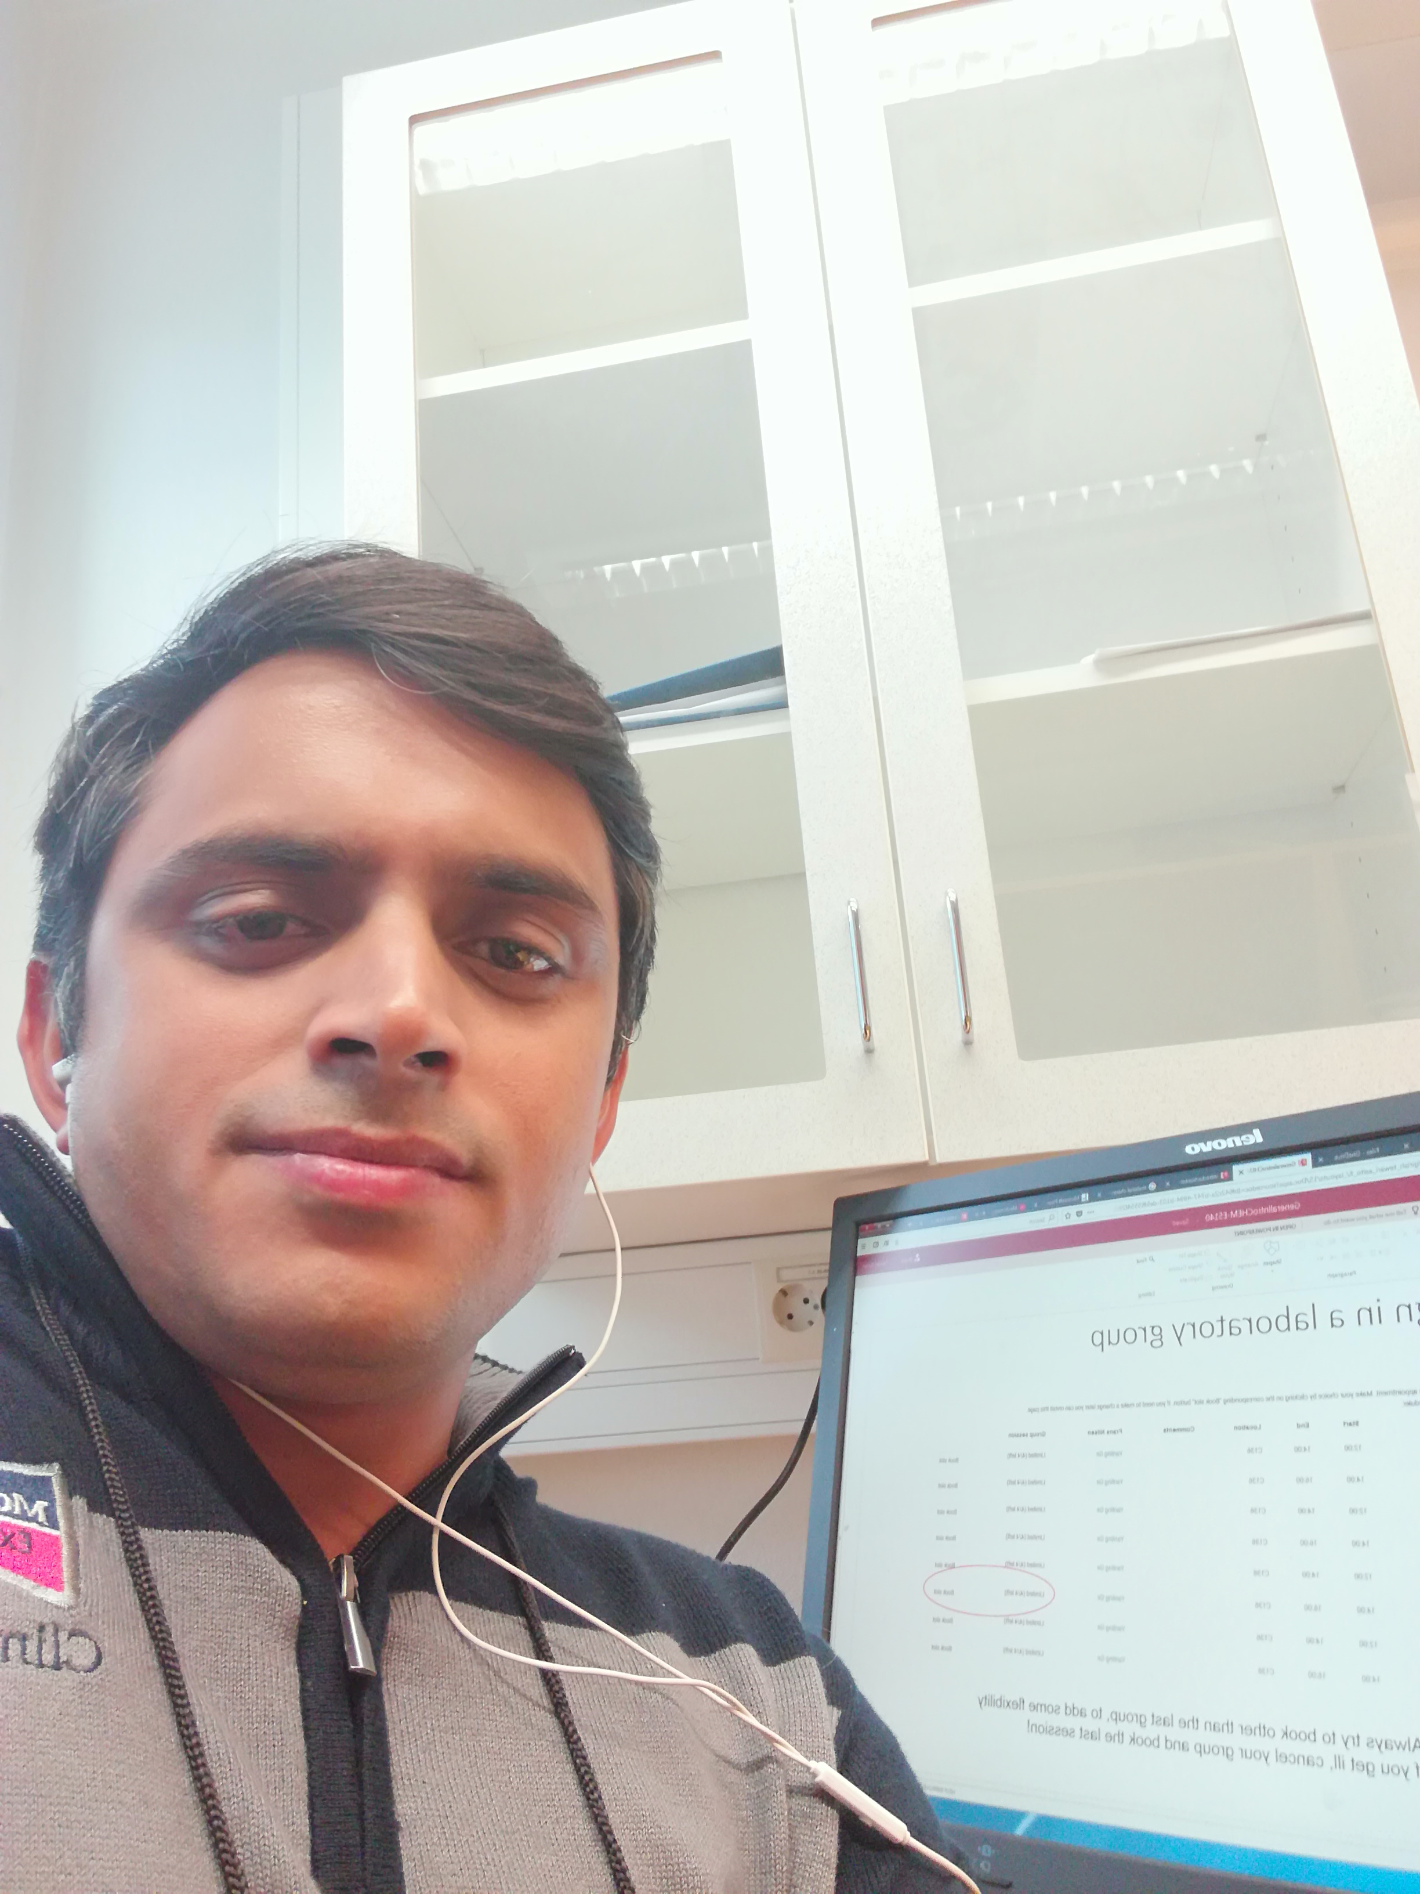
Laboratory work
XRD
Nanoindentation
SEM+OM
ET
Raman
Take pictures during the lab work and use them in your report
Take a group selfie with the equipment (confirm that you were in the lab) -> include to your report (cover page)
Selfie with the equipment

Slide 14
Laboratory instructions?
No – Why not?
This is a Master’s level, these are considered that you are working as a researcher!
Learning outcome:
How to listen in laboratory
How to prepare notes
Parameter’s might change
Learn to be Present at the lab
Not to sleep in the lab
Just 1-2 h - > Focus

Slide 15
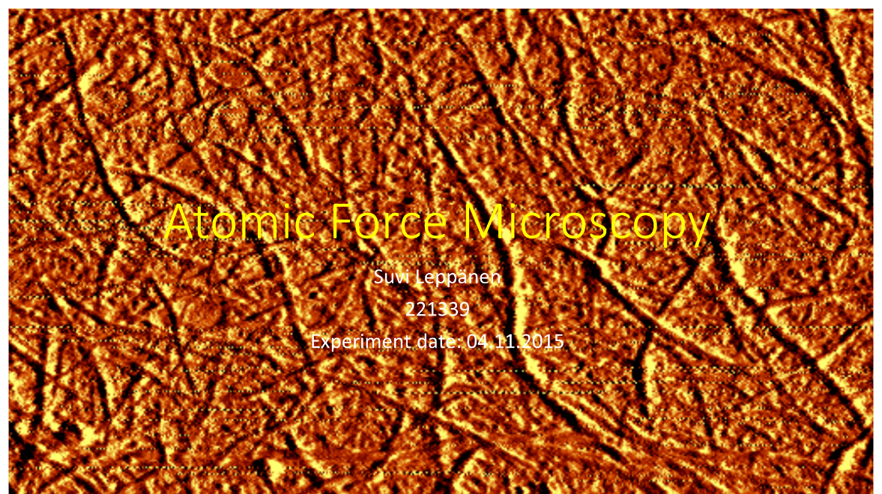
Laboratory report
Format is power point
  Why?
  Visualize your story
  Compact message
  Difficult to copy-paste

Slide 16
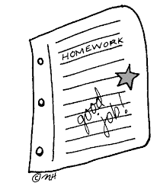
Pre-task:
How to prepare
terrapinsa005.weebly.com
Prepare 4-6 slides
  What information the method provides and how does it work?
  What kind of samples can be analysed?
  Is the method destructive for the sample?
  Your picture of the operating mechanism of the device
  (drawn with hand or by yourself with computer)

Slide 17
Pre-task (flip):
How to prepare
terrapinsa005.weebly.com
Prepare 4-6 slides
  What information the method provides and how does it work?
  What kind of samples can be analysed?
  Is the method destructive for the sample?
  Your picture of the operating mechanism of the device
  (drawn with hand or by yourself with computer)
  Bring the homework to class (we work with them)
Submit to MyCourses before the next lecture

Slide 18
Pre-task (flip):
How to prepare
terrapinsa005.weebly.com
Prepare 4-6 slides:
  What information the method provides and how does it work?
  What kind of samples can be analysed?
  Is the method destructive for the sample?
  Your picture of the operating mechanism of the device
  (drawn with hand or by yourself with computer)
  + Questions for the expert and ask them during the lecture or lab work – response to your report (required for higher grades)
Submit to MyCourses before the lecture (max size 5 MB)
Introduction for your laboratory report

Slide 19
How to hand in pre-task
Remember to submit Before the lecture

Slide 20
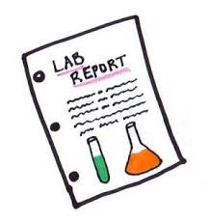
Laboratory report:
How to prepare
Introduction: your pre-task + operating image
This you already have!
www.somervillenjk12.org

Slide 21
Laboratory report:
How to prepare
Introduction: your pre-task + operating image
  Also add here the group selfie (confirmation your presence)
This you already have!
www.somervillenjk12.org

Slide 22
Laboratory report:
How to prepare
Introduction: your pre-task + operating image
Experimental: the procedure (what did you do in the lab)
  Can involve text and pictures (you take in lab)
  Here if any sample preparation done
www.somervillenjk12.org

Slide 23
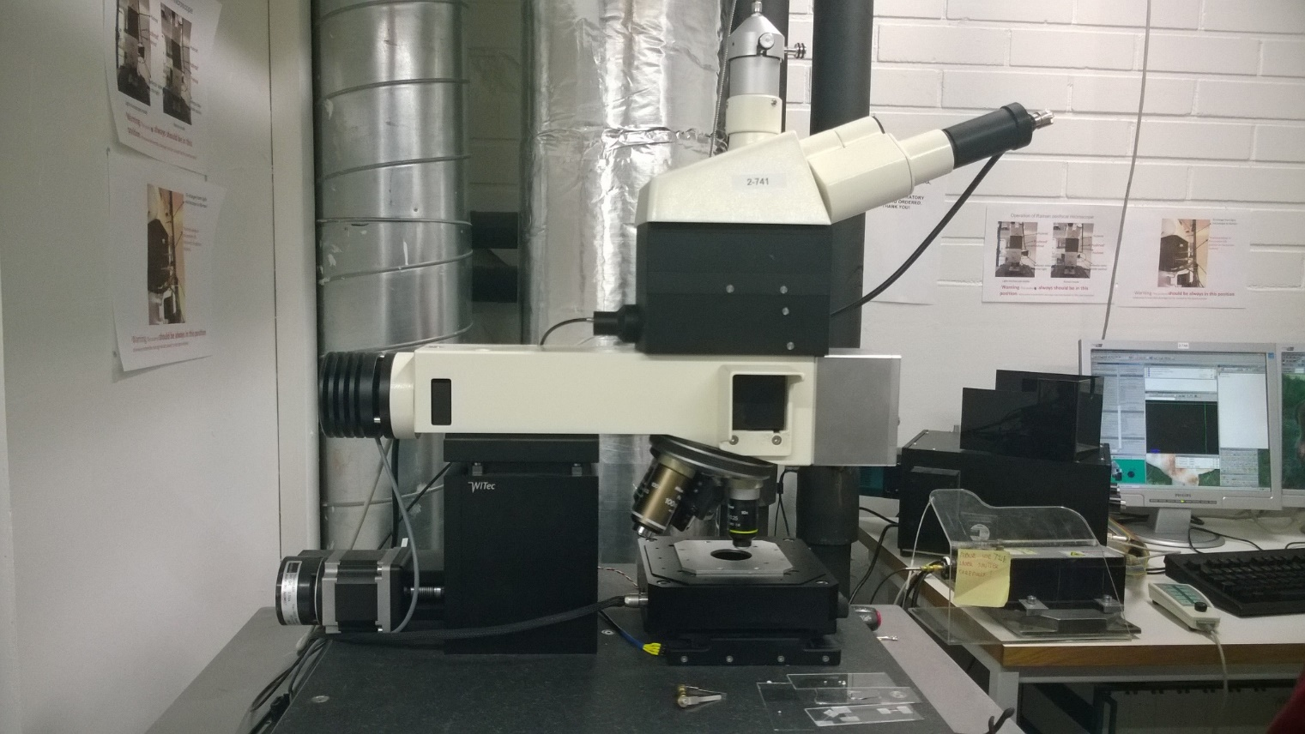
Laboratory report examples:
Experimental
detector
microscope/camera
Explain with power point! Visualizing!
sample
spectrometer
direction of the laser
laser

Slide 24
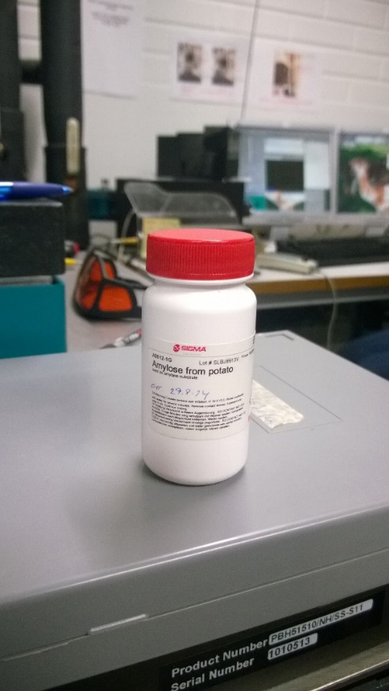
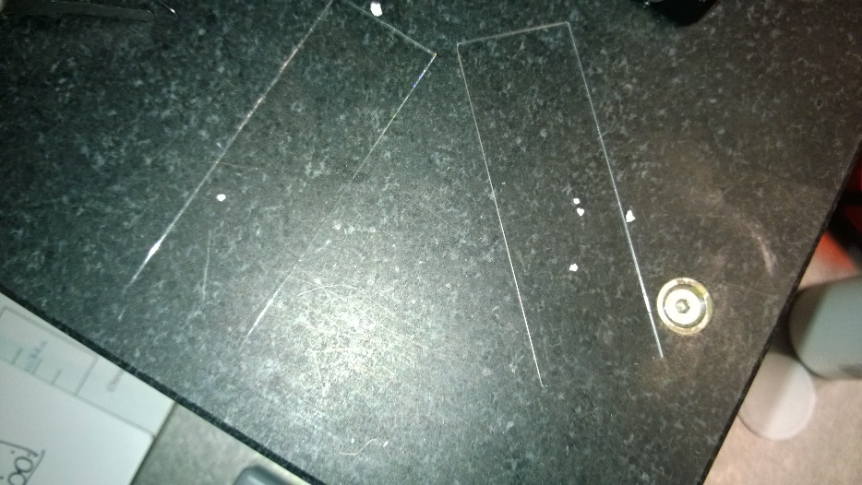
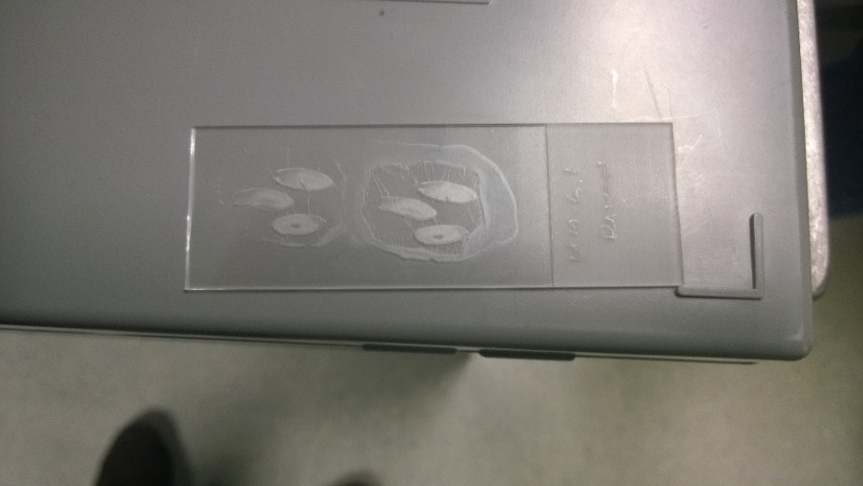
Laboratory report:
Experimental - samples
Take images of your samples, and tell in detail what they are.
Image 6: Amylose from a potato
Image 5: Bottle containing amylose from a potato
Image 7: Treated barley seeds

Slide 25
Laboratory report:
How to prepare
Introduction: your pre-task + operating image
Experimental: the procedure
Results: the result obtained
  Data presented in a clear way
  Compare the data to other researcher
    (for higher grade)
www.somervillenjk12.org

Slide 26
Laboratory report examples:
Results
Remember to present you data in a clear form (easy for the reader to understand)
You can also highlight the wanted results

Slide 27
Laboratory report:
How to prepare
Introduction: your pre-task + operating image
Experimental: the procedure
Results: the result obtained
Discussion: Analysis of the results
  You can do the data analysis with peers but
  - >Each of you will write their own report
  No need for long discussion (bullet points)
www.somervillenjk12.org

Slide 28
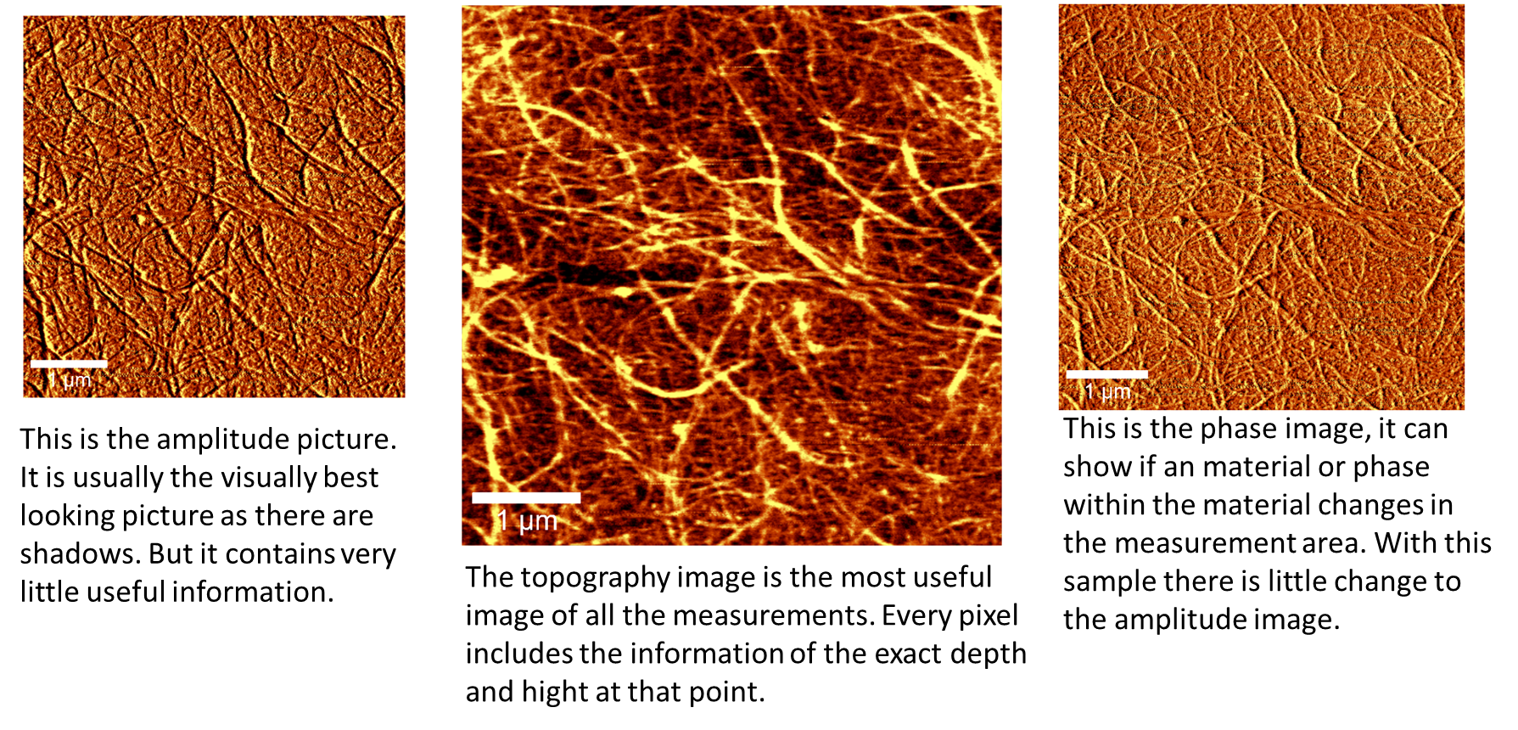
Laboratory report examples:
Analysis

Slide 29
Laboratory report:
How to prepare
Introduction: your pre-task + operating image
Experimental: the procedure
Results: the result obtained
Discussion: Analysis of the results
Conclusions:
  1 slide for technical conclusions
  1 slide for reflection
www.somervillenjk12.org

Slide 30
Laboratory report:
How to prepare
Introduction: your pre-task + operating image
Experimental: the procedure
Results: the result obtained
Discussion: Analysis of the results
Conclusions
References: add here all references used
www.somervillenjk12.org

Slide 31
Proper Reference
Example:
A. Santasalo-Aarnio, A. Lokkiluoto, J. Virtanen, M.M. Gasik, “Performance of electrocatalytic gold coating on bipolar plates for SO2 depolarized electrolyser.” J. Power Sources 306 (2016) 1-7.
Journal paper:
1. Authors
2. Title of the paper
3. Journal name
4. Volume – Year – Page numbers
5. Possible DOI (if very new)
-> No Science direct/Research gate links (the links might not exist when I’m looking at them)
- > Reference style is free (as long as having the 4 component)

Slide 32
Proper Reference
Web pages:
1. Author/s (if not known. Annon.)
2. Title of the page/section
3. Link
4. When visited (date)
Annon. “Nanoparticle - Definition.” https://en.wikipedia.org/wiki/Nanoparticle, visited 11.9.2017.

Slide 33
Learning Outcomes of the
Laboratory and Reports
Be present at laboratory situation
Keep excellent record on procedures/parameters
Explain the phenomena behind the experimental method
Present the obtained data in a clear, reader friendly form
Relate it to other measured references
Prepare good experimental conclusions
Learn to reflect on own laboratory skills
Growth path for professionalism

Slide 34
MyCourses Report Submisson
Points
Submit report
The submitted file can only be 10 MB!
Return after 7 days – DL at 8 pm

Slide 35
Laboratory report:
Assessment
Introduction: 3 p.
Experimental: 3 p.
Results: 3 p.
Conclusions and reflection: 3 p.
Total 12 p.
Submission late pretask (-1 p.) and/or report (-1 p.)!
www.somervillenjk12.org

Slide 36
Laboratory report:
Assessment matrix (MyCourses)
 | 0 p. | 1 p. | 2 p. | p.
Pre-task | No clear individual contribution The students does not understand the method | - Light description of the method And/or Parts lacking - Question lacking or not reported | Proper description of the method The student shows clear understanding of the method | The student has understood thoroughly the method and it’s constrains
Experimental | Image of equipment List of activities | Image and parts of the equipment explained Light description of the activities during the labwork | Identify the purpose of parts of the equipment Detailed description of activities in lab | Identify the purpose of parts of the equipment Understanding the reasons behind the activities

Slide 37
Laboratory report:
Assessment matrix (MyCourses)
 | 0 p. | 1 p. | 2 p. | p.
Intro/Pretask | No clear individual contribution The students does not understand the method Parts lacking | - Light description of the method And/or Parts lacking - No question or not asked/reported | Description of the method The student has understood the method At least one questions to experts asked/reported | The student has understood thoroughly the method and it’s constrains Various questions asked/reported
Experimental | Image of equipment List of activities | Image and parts of the equipment explained Light description of the activities during the labwork | Identify the purpose of parts of the equipment Detailed description of activities in lab | Identify the purpose of parts of the equipment Understanding the reasons behind the activities

Slide 38
Laboratory report:
Assessment matrix (MyCourses)
 | 0 p. | 1 p. | 2 p. | p.
Results | Figure/spectra presented No or very light comments on data No data comparison | Data modified (if required) Light comments on data No data comparison | Data modified (if required) Proper analysis of data Some data comparison with additional reference | Data modified to facilitate the interpretation Detailed analysis of data Deep data comparison with additional reference
Conclusion + Reflection + Reference | What can be seen in the results No reflection Only one reference (course book) | -Obvious conclusions of the data -Some reflection -1-2 references | - Conclusions with connection to theory - Relevant reflection > 2 references | - Detailed conclusions with connection to theory - Deep reflection - Various scientific journals as reference

Slide 39
Laboratory report:
Assessment matrix (MyCourses)
 | 0 p. | 1 p. | 2 p. | p.
Results | Figure/spectra presented No or light comments on data No data comparison | Data not modified (if required) Light comments on data No data comparison | Data modified (if required) Proper analysis of data Some data comparison with additional reference | Data modified to facilitate the interpretation Detailed analysis of data Deep data comparison with additional references
Conclusion + Reflection + Reference | - What can be seen in the results - No reflection - Minimum references (course book) | Obvious conclusions of the data -Some reflection -Few references | - Conclusions with connection to theory - Relevant reflection - Various properly prepared references | Detailed conclusions with connection to theory - Deep reflection - Various reference

Slide 40
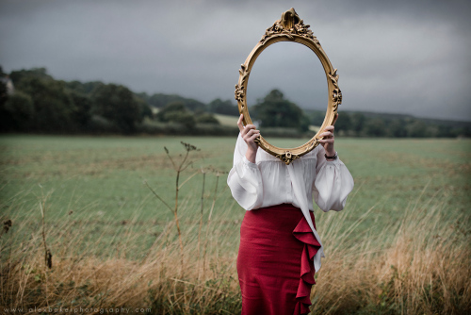
What is reflection?
You already have a degree – you already know something of the techniques
With reflection you connect the past and present knowledge – build a bridge between them:
  What did you know before of this topic
  How is this related on something else you already knew
  What was new to you?
  We practice this here at each class!
studiojoslizen.wordpress.com

Slide 41
Course assessment
Laboratory report
    Laboratory report (5 x 12p.) 60
    60 p.
Contact sessions and exam
    Oral exam 30
    - A method (max. 10 p.)
    - Interpretation of a case ( max. 20 p.)
    Course feedback (webpropol) 4
    Analysis of the data: case study (volunteer) 6
    40 p.
Minimum 60 p. to pass the course
Grade table provided after all oral exams completed

Slide 42
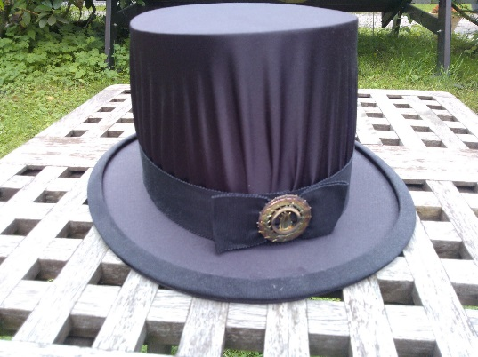
Oral Exam
First task
You can book a time when
- Participated for 4 laboratories!
Describe a method
  All the methods learned at the course are in my doctoral hat – you will take one and answer to questions:
  What information the method provides and how does it work? (0-3 p.)
  What kind of samples can be analysed? (0-3 p.)
  What could a possible result look and how is it analysed?
  (0-4 p.)

Slide 43
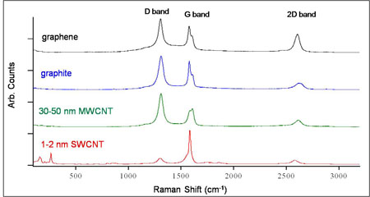
Oral Exam
Second task
A case:
  Real case (from a published paper):A material has been created
  What methods would you use to characterize this sample? (0/5/10 p.)
  You are given the data (2-3 image/spectra) from the paper
  2. What does the data tell you?
  (0/5/10 p.)
http://www.ceriumlabs.com/104/Q2_2010_Newsletter.htm, 19.8.2015

Slide 44

Contact sessions
    At the beginning of session of Major topic
    start the with pre-task
    10 min go through your pre-tasks in groups
    Wrapped up so that one group will present the main points
Need to be early
www.vroomgirls.com
At sessions we have the top expert of different techniques explaining to you how to analyse the data!
Opportunity of a lifetime!

Slide 45
Case: Data Analysis
Team of 2 persons - Volunteer task (6 p.)
Select a friend
Agree on one topic and time from (book only for one of you)
MyCourses – Contact sessions
Please select one as soon as possible
Find a journal paper where this method has been used as ONE of the characterization methods:
Do not select a paper with only this method
Read their data analysis and discuss with your peer

Slide 46
Case: Data Analysis
Prepare a power point presentation:
  What is the studied sample?
  What different methods were used –> What information did each of the method provide?
  Data of the selected method, what interpretations can be made?
  Was the characterization sufficient, would some more information be needed?
  Critically evaluate, if you keep the study reliable
  Assessment: 0-6 p. Depending on the depth of analysis

Slide 47
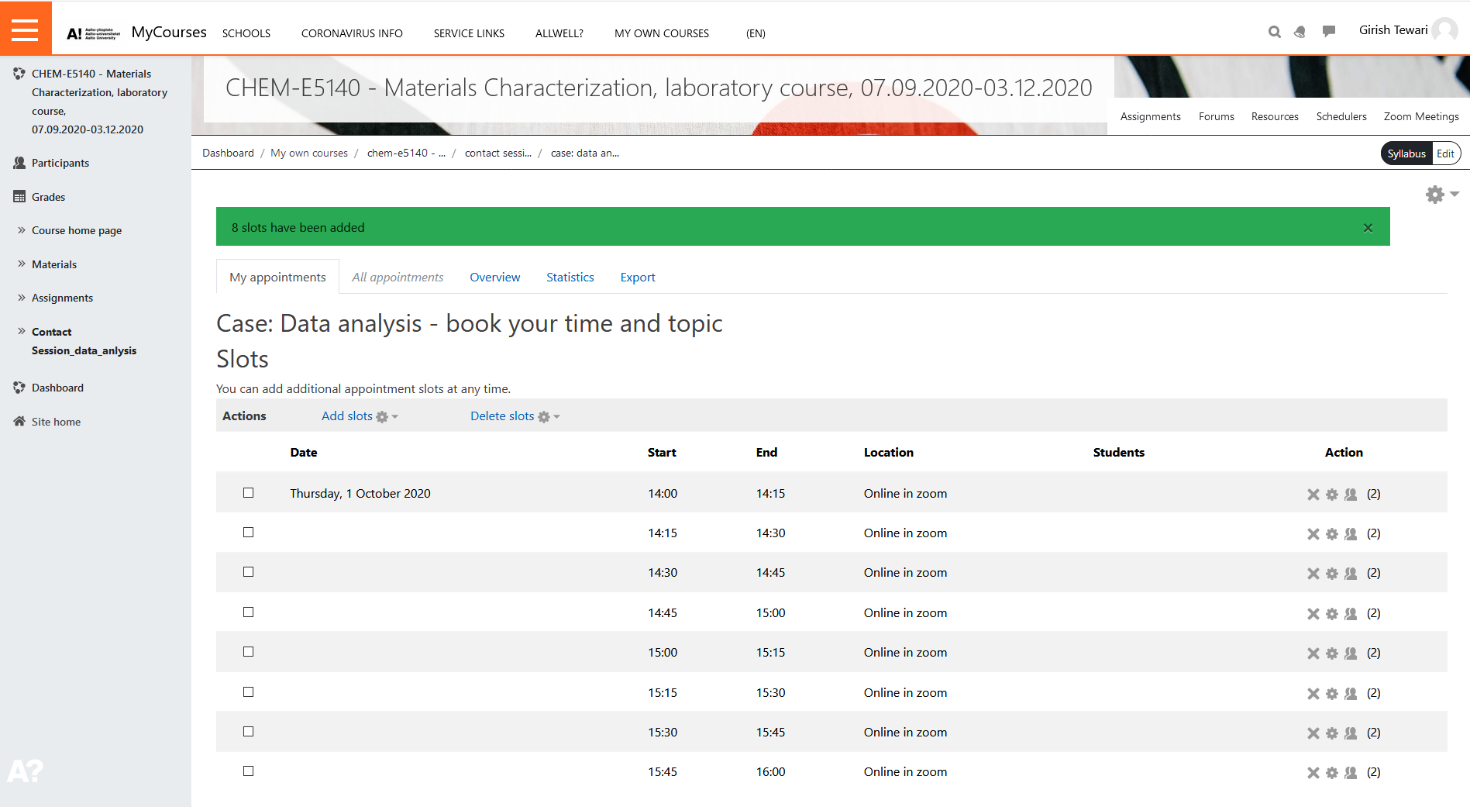
Case: Data analysis
Book your time
Both team members will book the same slot (2 places)
See the TOPIC – under Comments

Slide 48
What if you just don’t have time to finish the course
Pretask + Laboratory + Report
Accepted combination of these three
-> can be utilized at later years!
-> If one of these items is missing, you need to redo the whole lab

Slide 49
Materials Characterization
Let’s start

