Slide 1
Product Analysis
Notes:
Tämä versio on päivitetty ja oikeaksi todettu 2.9.2013

Slide 2
Agenda
13:15 Introduction, Teppo
Teachers
Course idea
Course content
Evaluation
Teams and Team building
13:05 Integrated English and communication, Matthew
14:15 Who would buy it? Meri

Slide 3
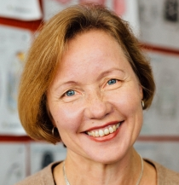
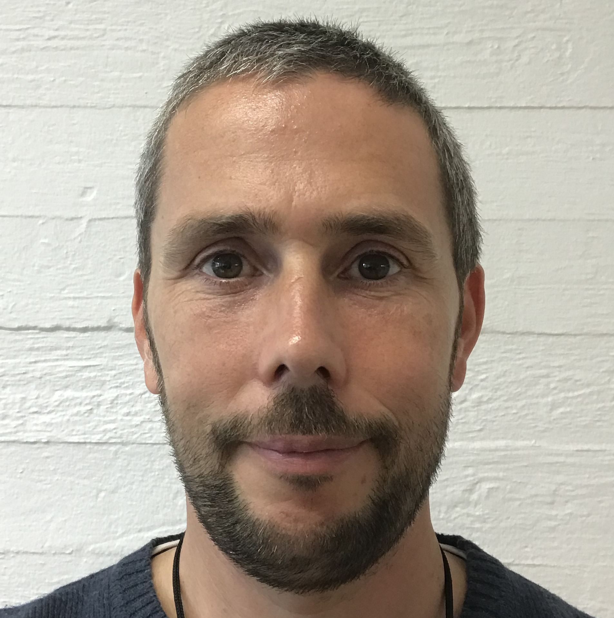
Aaltonaut Team Course teachers
Elina Kähkönen
Aaltonaut Program Head
Jaana Suviniity
Pedagogy expert
Meri Kuikka
Business
Kevin Otto Engineering
Matthew Billington English and communication
Teppo Vienamo Responsible teacher, Design

Slide 5
Learning goals
identify basic technology, design and business related aspects of a product
work effectively in a team setting
communicate the results of product analysis
+ Communication course goals (Matthew)

Slide 6
Schedule Friday 1:15-16 DF Studio
10.1. Introduction / Client
17.1. User perspective
24.1. Safety
31.1. Product composition
7.2. Functionalities
14.2. Manufacturing technologies
21.2. No program (Evaluation week)
28.2. Writing workshop, I like I wish
6.3. Materials
13.3. Cost, price, value
20.3. Innovation
27.3. Preparation for presentation
3.4. Final presentations, Suggestion for improvement
10.4. National holiday (Good Friday)
Company excursion to

Slide 7
Course outcomes
Subtasks / sessions
Product analysis report
New product idea proposal
Presentation of 5-8 min + oral exam
Free form

Slide 8
Evaluation
Team grade
Final presentation and Report 1/2
Sessions outcomes 1/2
Individual grade
Participation & activeness (6 < abs.= definitely fail)
Peer and self evaluation: +/- 1
teamwork, participation & activeness.

Slide 9
Practicalities
Schedule, presentations, returns, other course info: MyCourses AAN-C2006 - Product analysis
Physical stuff to be stored in a box in the Public storage room by the Lobby
Active participation is expected. In a case of absence, contact Teppo

Slide 10
Teams
Team 1 | Team 2 | Team 3
Weckström | Aikio | Barretto
Vehviläinen | Engström | Sameer Saral
Fatima | Lee | Cai
Kohosalmi | Törhönen | Paasilahti
 | Huovinen

Slide 11
Main learning objective: | 5 | 3 | 1
Product analysis | Product analysis is thorough and balanced handling all aspects from lectures. Sub assignments are done well |  | Most sub assignments and analyses are delivered but are lacking quality and cohesion
Team work | Does one’s own share and helps others, keeps project going on and values others ideas and work and builds also on that | Mostly present and does her/his own share of the work | Works for the project passively, does not create ideas or support others work or aggressively dominates project not giving value to others work or is a lot absent from team meetings

Slide 12
Products
Blender
Electric toothbrush
Blood pressure meter

