Slide 1
Creating a customer persona
Product Analysis 11.1.2020

Slide 2
What is a customer persona?
A customer persona is a semi-fictional representation of your typical customer (or a typical customer in one of your segmented customer groups, if you have a few) that you create based on a combination of market research and data about your current customers.

Slide 3
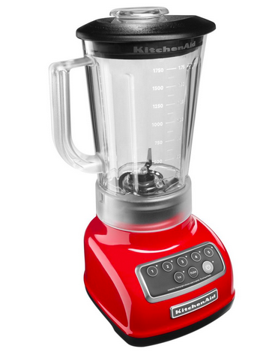
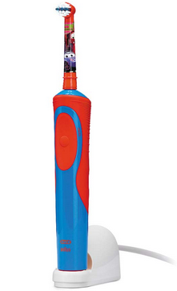
Who would use this product?

Slide 4
Who would use this product?

Slide 5
Examples of personas

Slide 9
Guess who?
Man, aged 70+
Divorced, remarried
Has adult children
Wealthy
Spends a lot of time in London
Like travel, dogs, sports cars, vintage wine

Slide 10
Let’s start building personas for your products

Slide 11
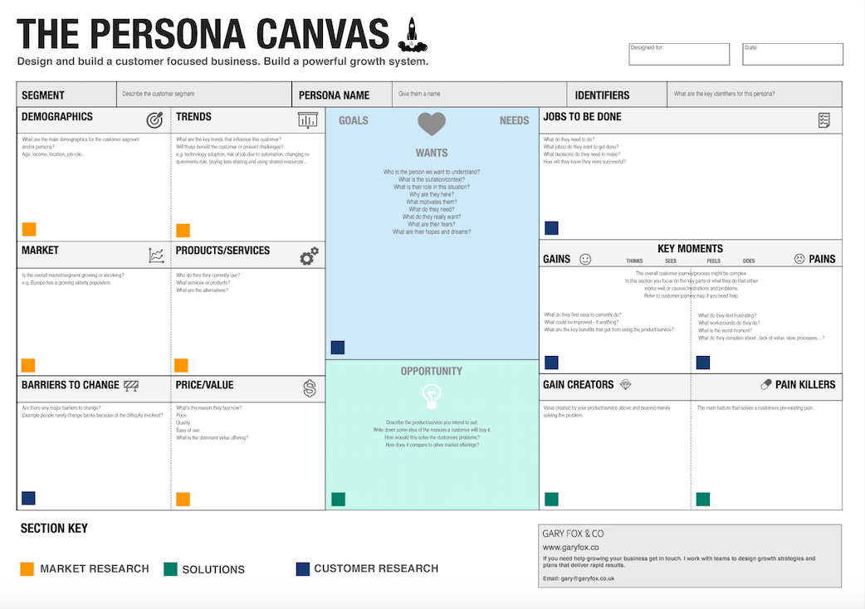
Together with your team, fill out a persona canvas for your product

Slide 12
Present your persona to the class

Slide 13
Benefits of using personas in product design
A better understanding of customers
Shorter design cycles, improved product quality
User’s goals and needs become a common point of focus for the team
The team can concentrate on designing foa a manageable set of personas, knowing that they represent the needs of many users
They are relatively quick to develop, and can replace the need to survey the whole user community and spend months gathering requirements

Slide 14
Benefits of using personas in product design
They help avoid the trap of building what (individual) users ak for rather than what they will actually use
Design and marketing efforts can be prioritized based on personas
Disagreements over design decisions can be sorted out by referring back to the personas
Designs can be constantly evaluated against the personas, reducing the frequency of large and expensive usability tests

Slide 15
Homework assignment
As a team, interview real users of a product similar to yours, and build a persona based on them. Each team member should conduct one interview.
Were the assumptions you made in your earlier persona correct?
For the next class, prepare a 5 minute presentation in which you outline what you learned based on a real user interview. Compare and contrast your assumptions vs. real user data.

