Slide 1
Doing Research
Dissertation process overview and DR themes
Case on typical considerations: Sampsa’s dissertation overview
Settling of reading groups and preparing for the reading exams

Slide 2
Agenda
Very short overview of research related understanding
To get you started exploring the substantive area where you work
Making explicit some implicit ideas many of you have about research
Combatting “design research is so different”. It really is not.
90% of Aalto design dissertations do not even include design in a major role.
That you have a design degree doesn’t make your work magically design research
That 10% of design /art inclusive research is not that unique either: there is a whole range of disciplines that do research by means of constructing things, processes or services … or even reflecting on their own professional practice.
…this is why the background readings did not have a single word on design.

Slide 3
DOING RESEARCH themes
Overview of (phd) research processes and some key choices
Scoping of research (in doing it and in reporting it)
Understanding research contexts and audiences a.ka. Research design and literature reviews & positioning ones work
What is data and what’s the use of having it (it really is not about opinions and ideas or essays)
Techniques and methods (how you do you know what you claim to know)
Using and building concepts and theories
Gathering and analyzing qualitative data
Practice based design research and artistic research
Sampling for, during and in reporting research
Practical issues: calendar, books, work rhythms, feedback, organizing, trade-offs and getting it done

Slide 4
Uses of Innovation

Slide 5
Starting points
RQ: How is use constructed in different phases of innovation?
Background: longitudinal studies of innovation, work and organizational research
Theory and field: Science and technology studies (S&TS), activity theory
Methodology: historiography, ethnograpic observation, in-depth interviews

Slide 6
Close some things early to leave room to explore in others
Something old, something new, something borrowed: 60/20/20

Slide 7
How did it end up?
Interaction between a startup and its user partners in a ten year timespan
5 years 5 months
77 interviews, 107 field memos, 10 binders of documents (+another case + licenticate on third case
Read 40 books, 200 articles
Yielded (during and later) 21 publications out of which 10int peer rev articles

Slide 8
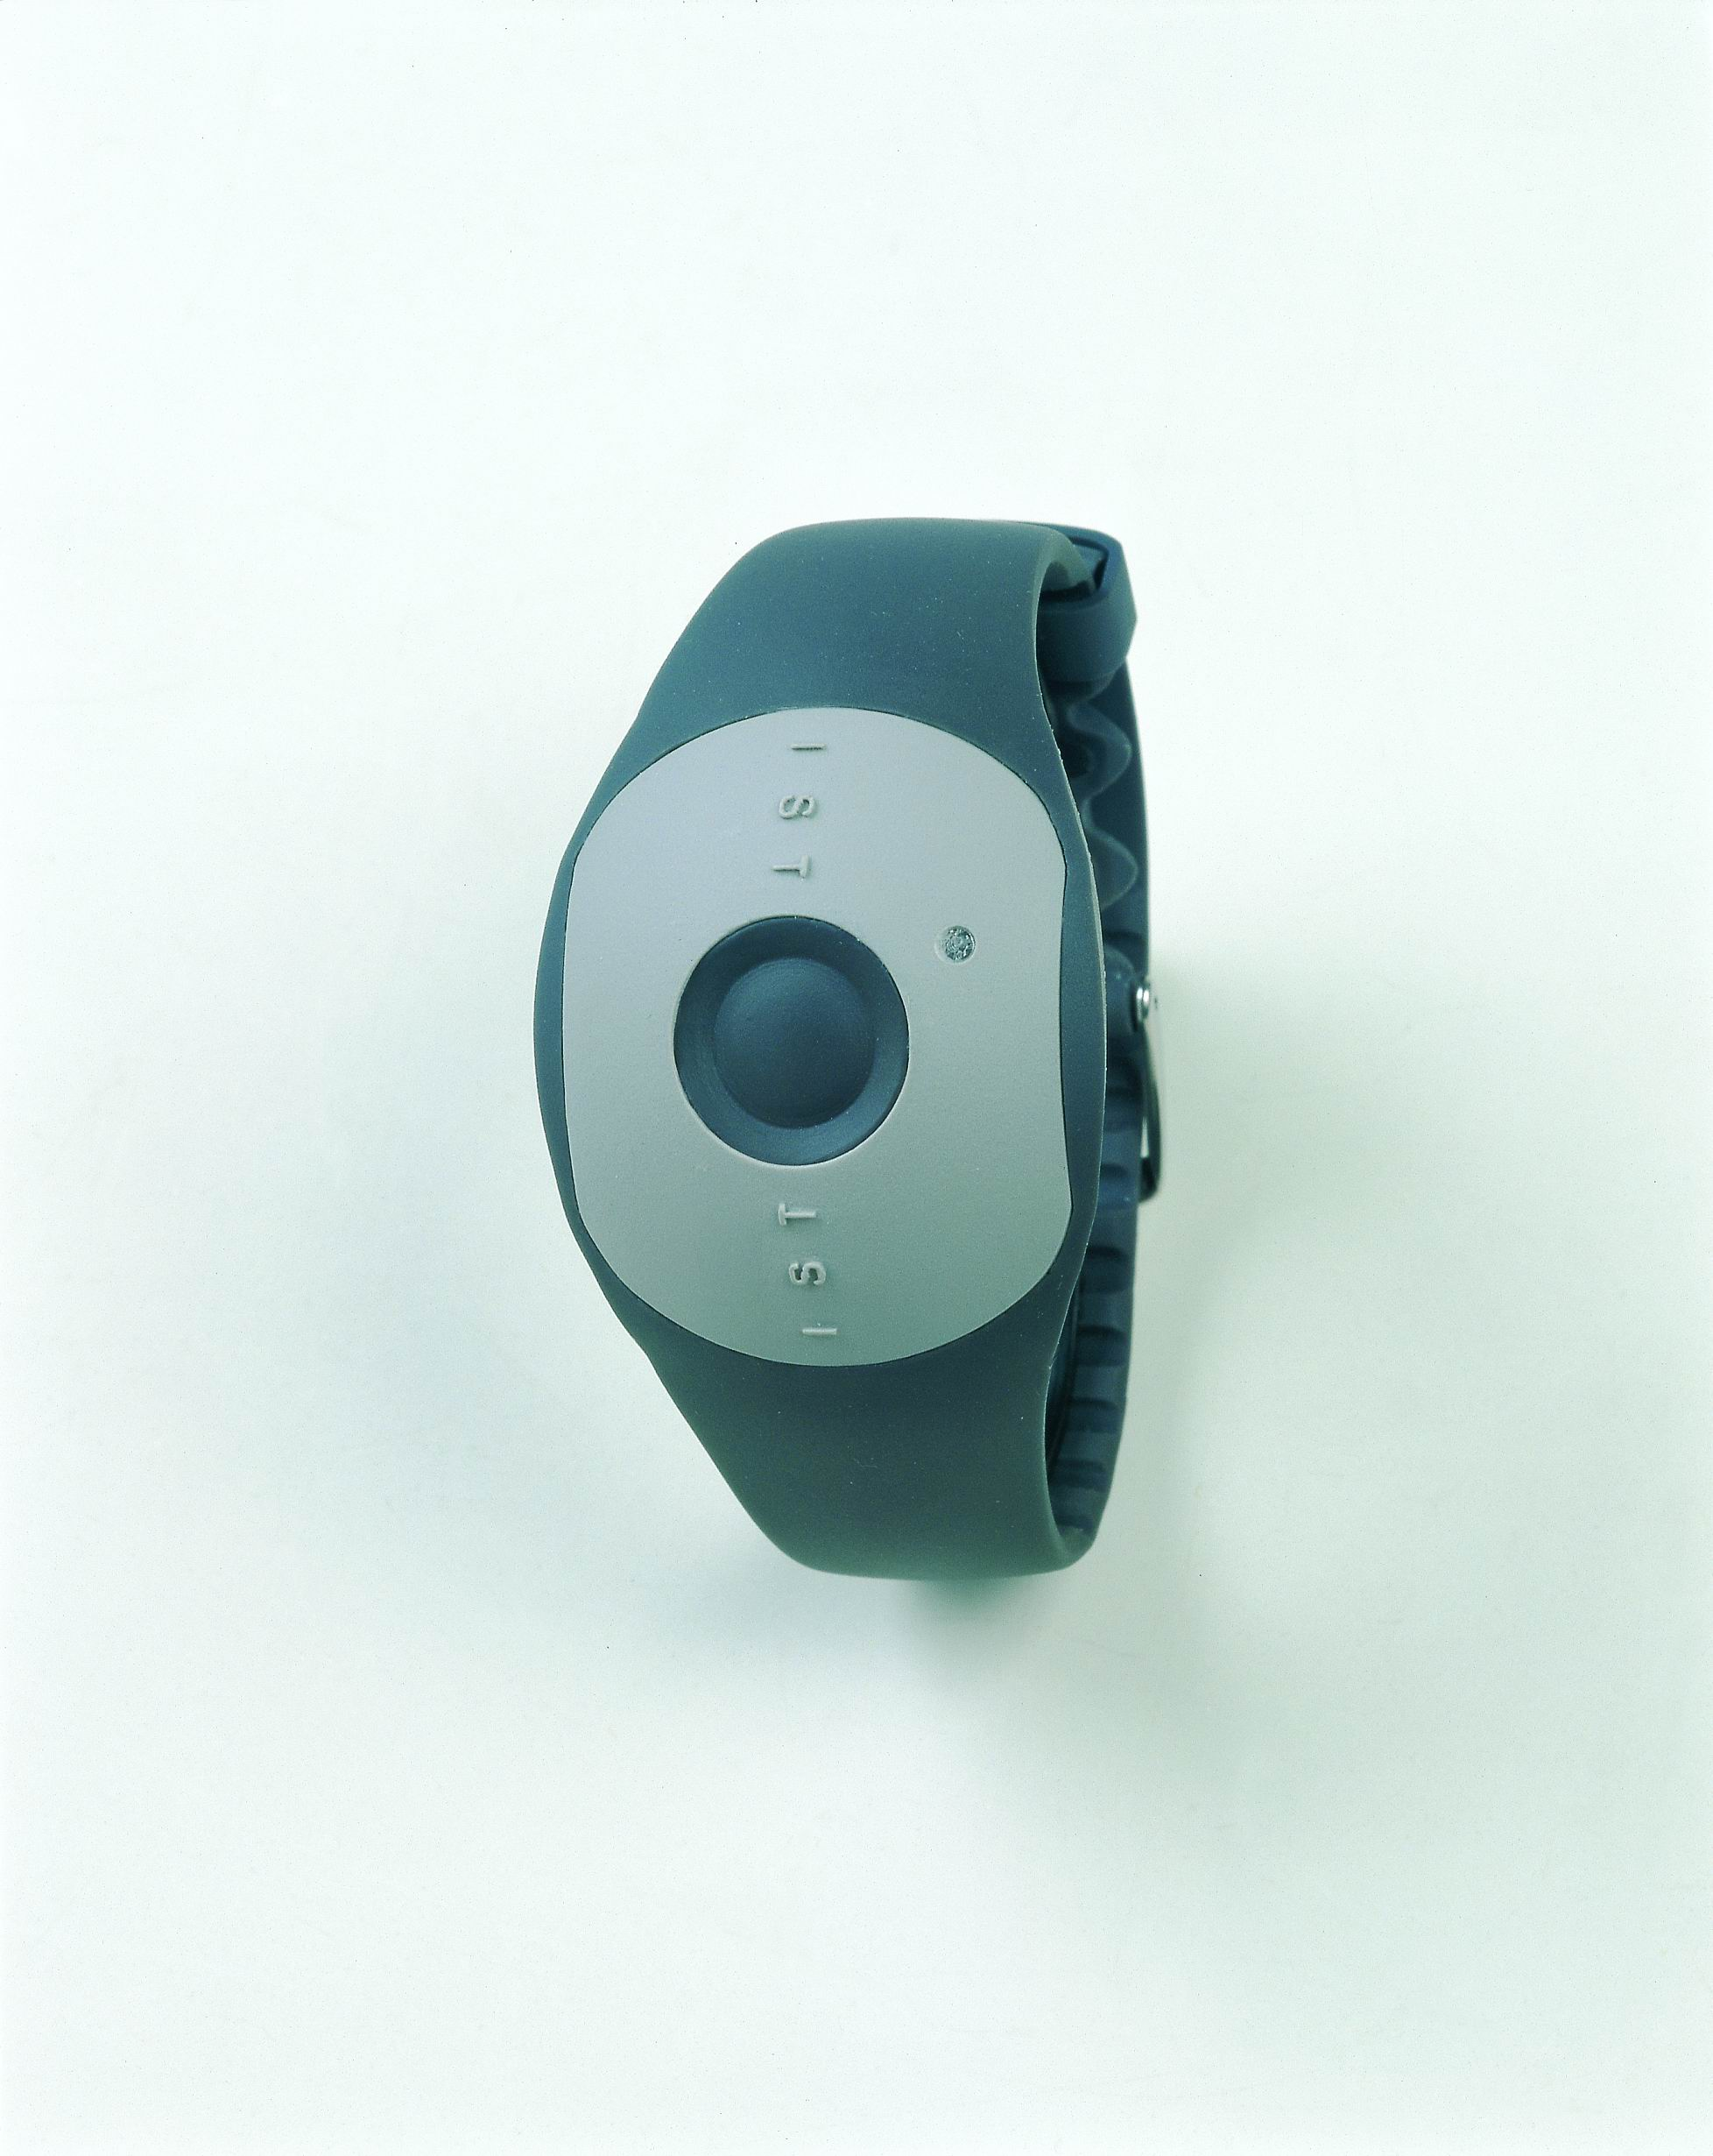
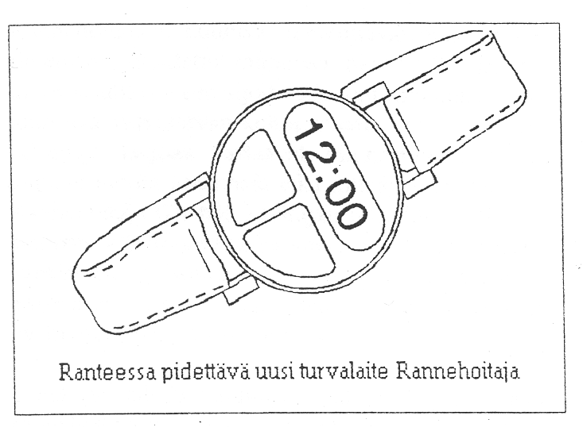
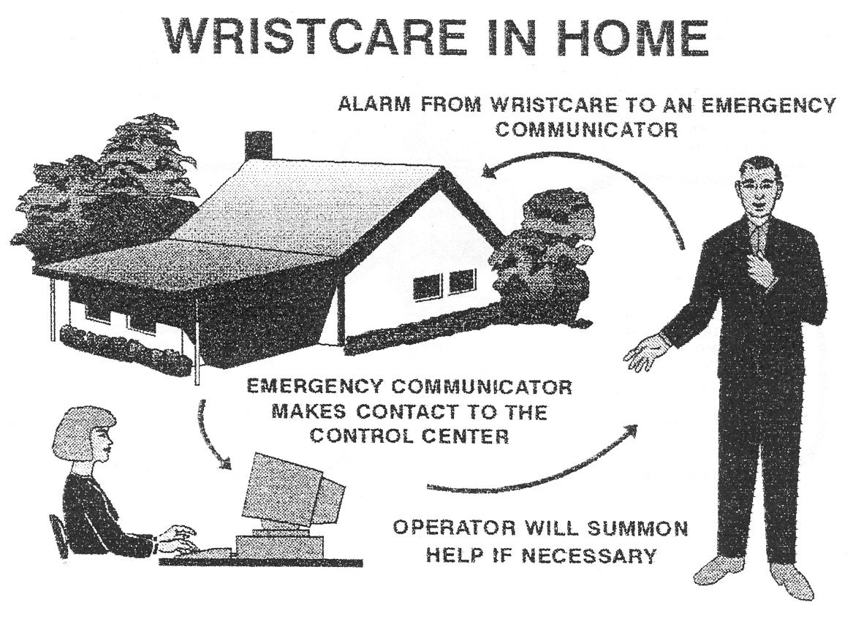
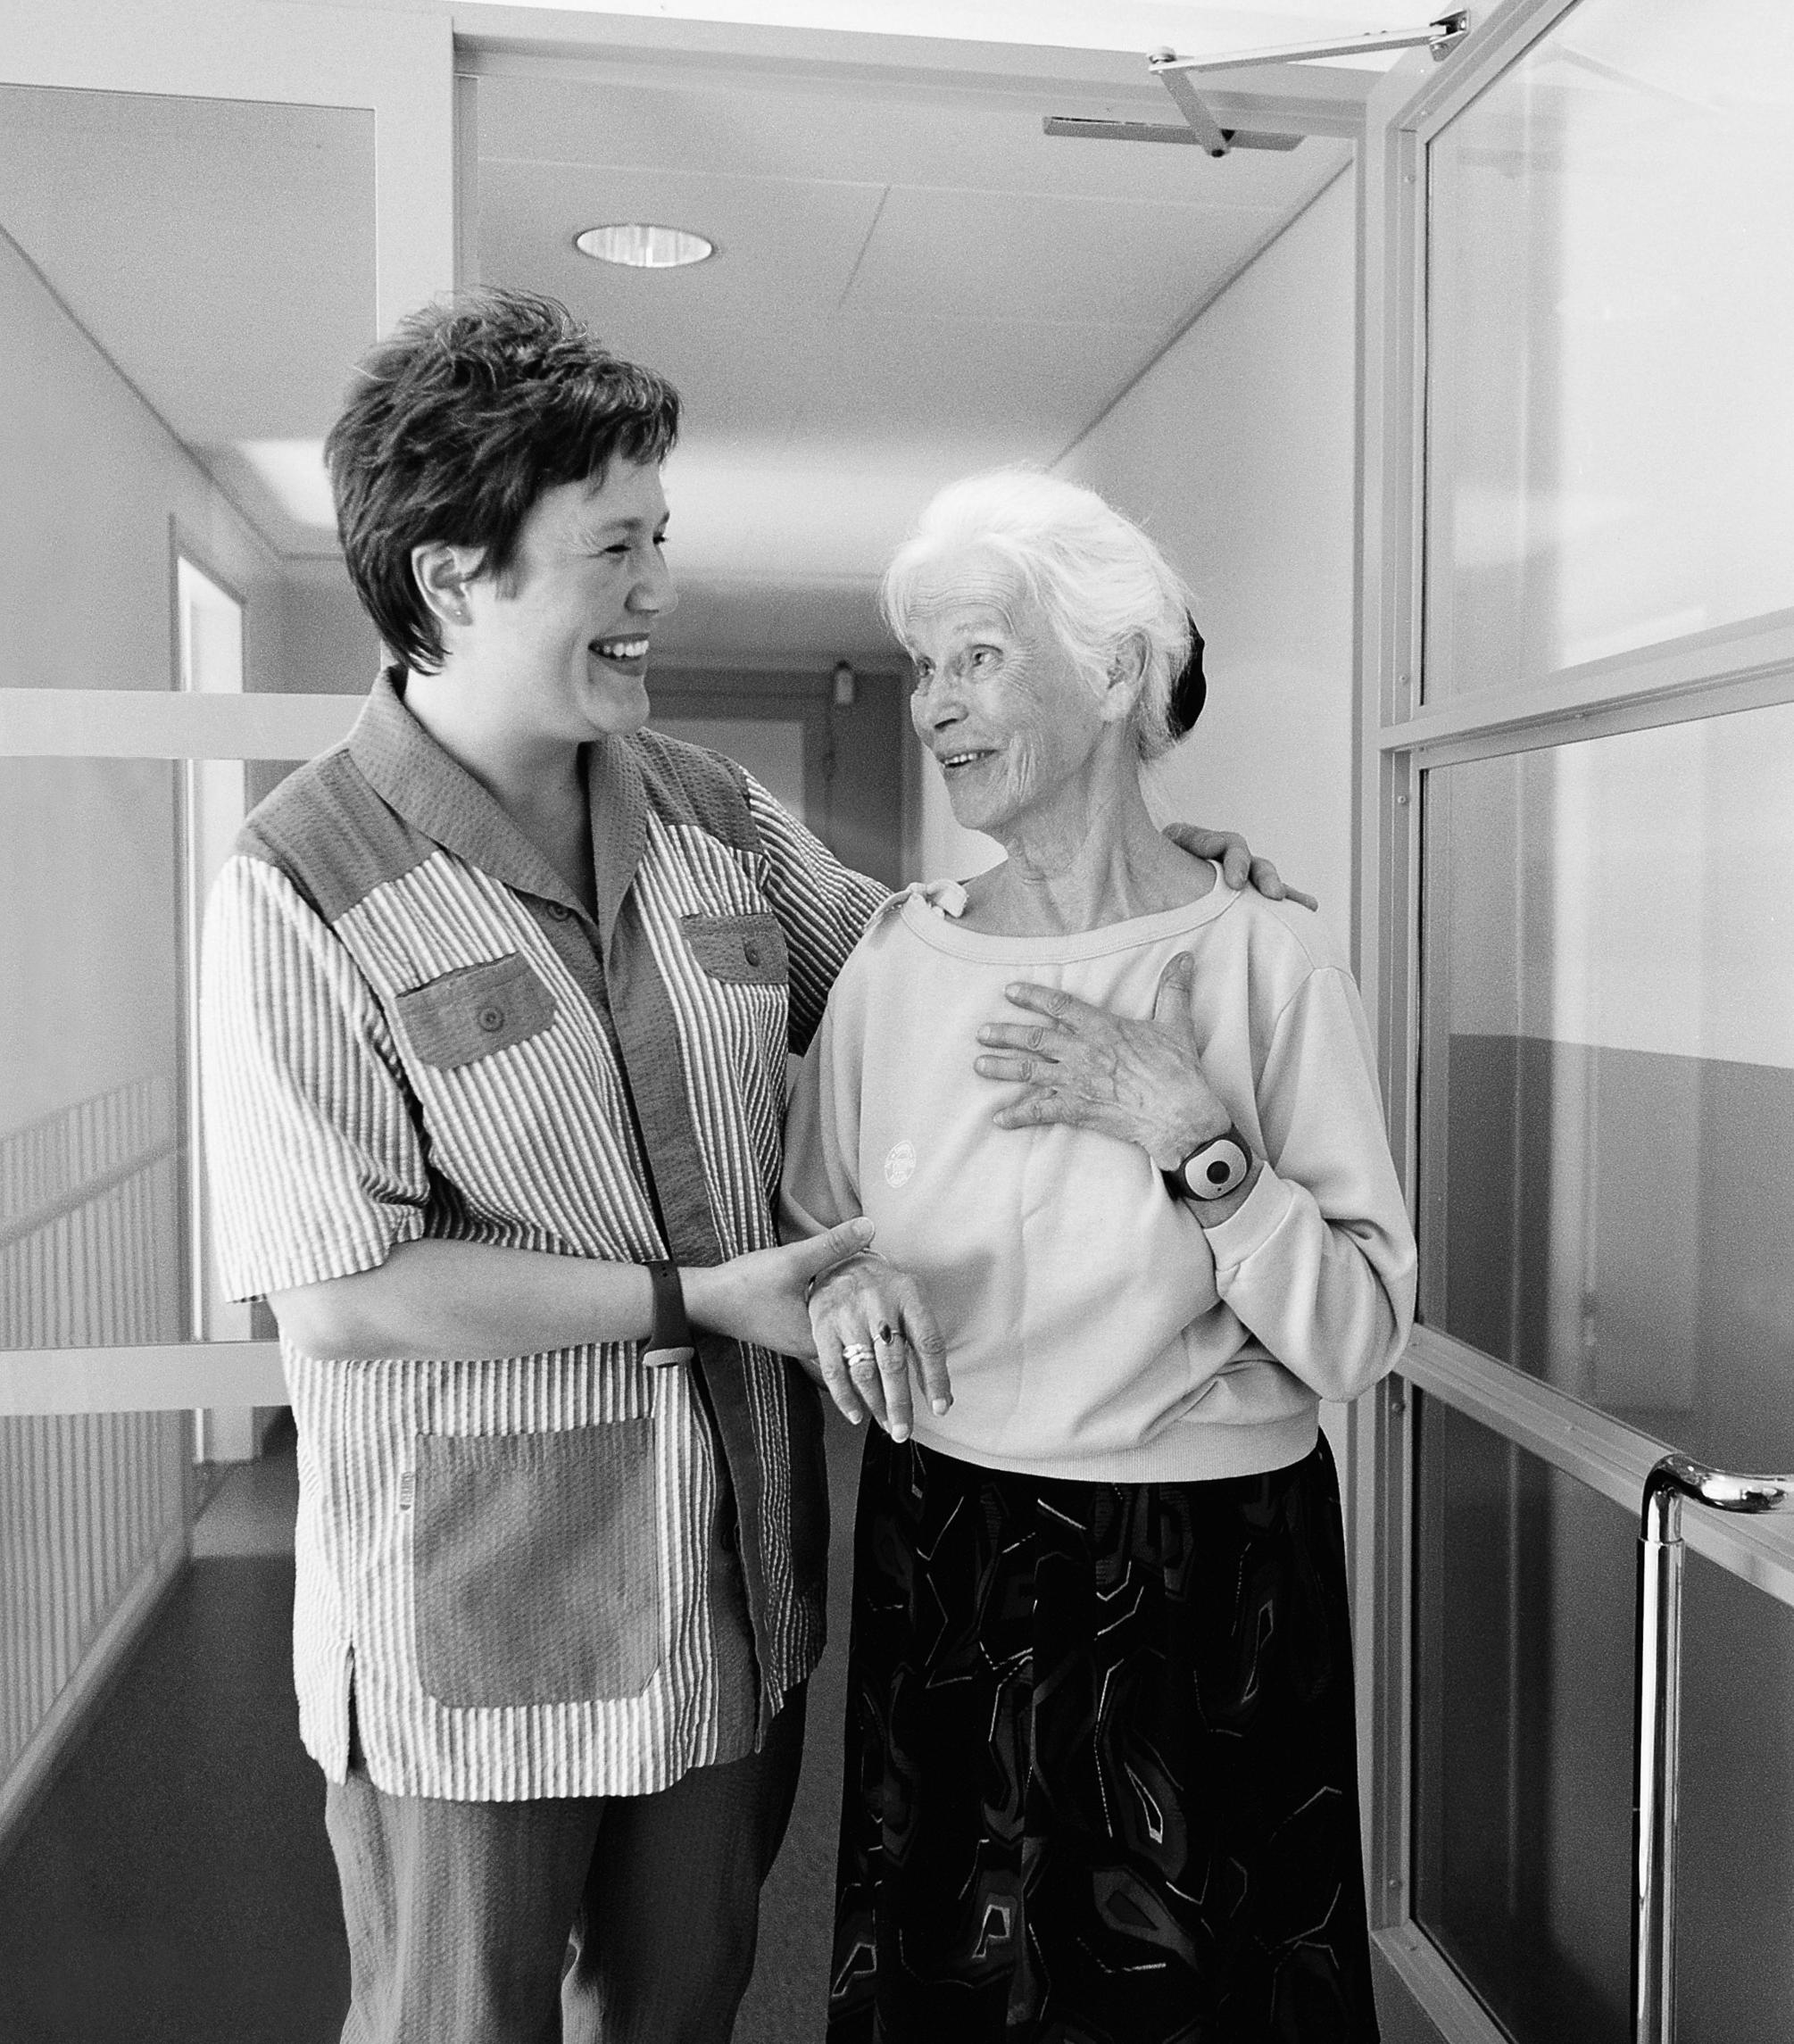
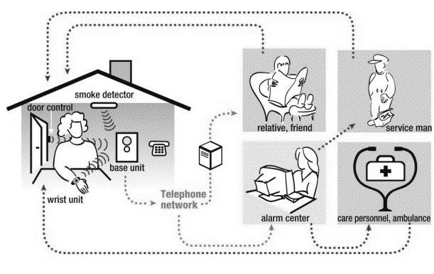

Slide 9
Choices 1: set up
Topic closed – part of broader research program, condition to my funding
8months mapping phase
Which projects the most interesting?
How interested the site and how reliable?
How do we get to study?
How freely can we publish and own the data?
→ Datex vs. IST + ProWellness

Slide 10
Can it be researched? How?
There are many many things I would like to know and promote
Very few yield research because they are either known to the core or
THEY SIMPLY CANNOT BE PLAUSIBLY RESEARCHED

Slide 11
Choices 2: orientation
Theory or empirics first?
How much do you/your supervisor know about the theory?
What is your own background competence?
How well do we know that what is assumed… can be researched
Other commitments?
Doctoral studies
Intensive data gathering vs. spread widely
Strict schedule? Strict belief in the initial topic?
Own choice: all at once. Cannot recommend to ones with family, or generally, albeit there are clear advantages to 50-60 hour weeks
Can be phased re what is interesting
Long time in the field site to for things to happen
Analysis can be started early provided there is good data
You cumulate empirics and can focus readings so that the readings really help with the empirics

Slide 12
ASSESS HOW YOU WANT TO DO IT
Million interesting things around grad students
Is this the one time you can enjoy this?
Is this the only time you have to get a phd?
(=decline from all that is not directly contributing to your phd project)
Is having phd enough or do you need a portfolio for e.g. post doc?

Slide 13
Hanging out vs. focused work
Keep it pumpkin size
&
60% you do should be your ph.d, that is 25 hours every week

Slide 14
Choices 3 : what to follow
Key informants
Key events?
Which organizations?
Own solution: interview and ethnogrpahy started in the start up right away and deepened, included user organizations after a year.
Different intensities of follow up

Slide 15
Data does not kill you
Analysis does: think carefully how you think you do it

Slide 16
Choices 4: gradual or one time analysis
Its easier to grasp the whole vs. cumulating the data
Parts tell what is still needed
Interesting/ certain/contextualizing first ?
Each analysis to a ready text or to a point?
Own: overviews of early parts and iteration on them, interaction to a point then left, usage analyses directly to text – probably quite good decisions

Slide 17
Choices 5: iterating aim and research question
Sign of good research: you learn something
How does one choose and reason change of direction?
Own solution: gradual shift from formal user research methods to examining designing of use in the whole span and scope of innovation, from description to more conceptual aims.
Design interaction and other case for later, still 6 articles + monograf

Slide 18
3rd year death valley
1st year: all is interesting, all is exploring, all pat you in the back
2nd year: you have got something, maybe, so you soldier on
3rd year: you have material, but is it really good, what is it good for…
You don’t quite see how your work relates to literature, and when you do, you are told its wrong…
Funding runs out, uncertainty increases, you realize there is job market…

Slide 19
‘till it (has to) make[s] sense
Then you suddenly realize why you were doing this
Why at least some parts in the thesis relate to each other and how
You see a structure you can maybe work out
And you enter … the last two years

Slide 20
Writing
…which takes longer than you think
…which you have to do again
…more times the weaker you begin
…on which the qualtity of the end result hinges much
…when one has to hold on to ones own vision
…listen to others’ advice and kill your darlings
…which goes out of your hands at the end…
…which follows the timing rule of 1x3x3

