Slide 1
Building experimental research designs: the pre-study
Doing research
31.10.2012

Slide 2
Something of interest: pre-research
Ones own practice
Trying a variation in ones practice
Changes caused by new materials or techniques
“something interesting (and new) happens”
It does not find (full) explanation in extant research or even practitioners’ knowledge
One has a sense that this could be somehow researched

Slide 3
Anchoring to literature: is there any news to this, what is it?
The point of experimental research is typically to amass evidence for or against a debated issue
If new exploratory knowledge is also sought: see what is out there, talk to people, identify relevant fields, read enough to see what is old news and what is news
If an established debate, then read the battle lines and think what would count as relevant evidence (most don’t) and how one could potentially produce it (mostly you cannot: if it was really easy and interesting it would have been done)

Slide 4
Prestudy 1: what could be particularly interesting
What are the moments (or aspects) in the phenomenon that are particularly interesting? Why?
How to get to study them – try out variations and possibilities!
Try out obvious and wild experiment set-ups: you can argue that one way of conducting produced xy and another xYz so we chose to…

Slide 5
Prestudy 2: getting to research design
The idea is NOT just do something that gives inspiration and call it a prestudy
A research design that is close enough to potential ways to research the issue.
Can be an extreme case
Can be a “proof-of-concept” that the item could in some circumstances be studied further
Can focus on the most tricky part to “approximate” how one could study it properly
Should rehearse the whole study set-up to see if the study could work… to avoid having iterate when doing it.

Slide 6
Prestudy 3: That the study should work - variables
Effect of fertilizer on plant growth
In a study measuring the influence of different quantities of fertilizer on plant growth,
The independent variable would be the amount of fertilizer used.
= the cause which you wish to test or measure, “the input”
The dependent variables would be the growth in height and/or mass of the plant.
=the outcome changes due to changes in the independent variable(s)
The controlled variables would be the type of plant, the type of fertilizer, the amount of sunlight the plant gets, the size of the pots, etc.
= those issues that can affect the dependent variable and mask what is the effect of independent variable “false positives” & “false negatives”, katalyst reactions etc.
Confounding variables are variables you cannot control that can affect the dependent variables

Slide 7
Prestudy 4: that the study should work – running it
How you measure your dependent variable or otherwise gain data of it
E.g. How you roll open leafs to measure them or just measure total plant height?
E.g. when you ask questions during clay molding, at what frequency
E.g. do you take video, do you interview, what to ask, what to focus on
What control variables you keep constant, which ones you cannot control
The assignments, the instructions, the materials, the setting, the timeframe …
What help and information you provide before, during and after working with people
The unit of analysis must be manageable, yet ecologically valid
Any research set up should be such that you get data on comparable units of analysis: your observational unit lets you tell about your sampling unit… that lets you tell of your population
… and if you have to change the set-up in your (quasi) experiments, it becomes harder or impossible to compare the results / events at the experiment

Slide 8
Prestudy reporting
Connect to extant research
Flag the phenomenon and novel aspects – not results
Flag possibilities for researching it – not claims to settle disputes as yet
Do not side with a position (close your interpretation before you’ve researched the case), but make hypotheses and operationalizations how you can settle the issue
Raise questions, propose research avenues, propose research designs (that you intend to pursue or would help the research you pursue)

Slide 9
And some terminology you should be aware of
Within the realm of experimental research, there are three major types of design:
TRUE-EXPERIMENTAL
QUASI-EXPERIMENTAL
PRE-EXPERIMENTAL

Slide 10
TRUE-EXPERIMENTAL DESIGNS
must employ the following:
Random selection of subjects
Use of control groups
Random assignments to control and experimental groups
Random assignment of groups to control and experimental conditions
There is some variation in true-experimental designs, but that variation comes in the time(s) that the X (treatment, information, assignment) is given to the experimental group, or in the observation or measurement (pre-test, post-test, mid-test) area.
Advantages of the true-experimental design include:
Greater internal validity
Causal claims can be investigated
Disadvantages:
Less external validity (not like real world conditions)
Not very practical

Slide 11
QUASI-EXPERIMENTAL DESIGNS
are usually constructions that already exist in the real world. Those designs that fall into the quasi-experimental category fall short in some way of the criteria for the true experimental group. A quasi-experimental design will have some sort of control and experimental group, but these groups probably weren't randomly selected. Random selection is usually where true-experimental and quasi-experimental designs differ.
Some advantages of the quasi-experimental design include:
Greater external validity (more like real world conditions)
Much more feasible given time and logistical constraints
Disadvantages:
Not as many variables controlled (less causal claims)

Slide 12
PRE-EXPERIMENTAL DESIGNS
are lacking in several areas of the true-experimental criteria. Not only do they lack random selection in most cases, but they usually just employ a single group. This group receives the X ("treatment”, instruction or assignment) there is no control group. Pilot studies, one-shot case studies, and most research using only one group, fall into this category.
The advantages are:
Very practical
Set the stage for further research
Disadvantages:
Lower validity

Slide 13
Construction (aka building or designing) as part of research

Slide 14
Construction (aka building or designing) as part of research
Many issues in design are such that they do not “occur naturally” but we have to construct them to study them.
So doing a design can be used as essential part of research
… Right…
But designing as such is not research even as it includes research-like elements
cf. practicing medicine, practicing law, practicing engineering, practicing coding, practicing design
No difference to practicing and nobody (else ever) calls their practicing as research. A patent misunderstanding to conflate the two.

Slide 15
Some minimal requirements for research through design
Whatever is researched through design/art has to be sufficiently documented in parts that are relevant to research
No difference to other ways to research, where the instruments and methods and data have to be traceable
There has to be a research relevant point to designing; some general knowledge interest must be advanced by it, not just the interest in designing

Slide 16
Common knowledge interests warranting design
Conceptual elaboration

Slide 17
Conceptual elaboration
Some formidable research proposes certain kind of artifacts or social relations or actions would be desirable / undesirable / impossible
Lets build a design to clarify
can such a thing be built in a first place (ie is it materially possible or, for instance, so contradictory it will not hold as an artifact)
does the process of designing it teach us about the characteristics and interrelations pertaining to the conceptual problem and its materialization?
if it can be built, how will its target audience view it? How will they act on it? What effects it has?
Remember: “so what” is a good question; you should elaborate something important for some audience

Slide 18
Conceptual elaboration, issues to remember
Under- and overdetermination problems familiar from scientific modelling (eg Knuuttila, 2004; Morgan, 2002).
Most concepts can be instantiated by multiple kind of designs; do you build many to see the differences within the design space?
Few concepts fully guide the construction so multiple other elements enter in construction: how do you keep track of their influence re conceptual aim
“Design quality” as judging criteria may be at serious odds with materially elaborating a concept research-wise eg as “material hypothesis”; designs are balanced, often rich in detail, research instruments are as unambigous as one can make them.
“Designerly way” of seeking to design the concept can equally be at odds with systematically exploring what it takes to realize a conceptual prototype: more systematizity may be needed to both cover as well as document the possibilities in the design space

Slide 19
“Testing a theory with materialized thing”
“What designs are Y (eg. Esthetically) most X (eg pleasing ) to group Z (eg mountain climbers)”
In order to study this, you need to vary them in regard to ONE max TWO aspects, and preferably in controlled manner. (first one, then two)
Otherwise the constructions involve so many variables you have no clue what people are reacting to.
So you build “the same thing” in four variations
…Right…
If it is so variable: imagine the length of the spoon handle for mountain climbers (who need a spoon but minimize on size)
15cm, 10cm, 5cm, 1cm
So you learn only about fixed spoon size – handle relation
You need to first know what is THE important parameter you want get at.

Slide 20
Common knowledge interests warranting design
Proof of existence: technology

Slide 21
Common in IT, IS, Engineering
You build a new kind machine/object/design/art that has never been built.
You established that it has never been built
You establish it is a worthy goal to build it (note: also/mostly research wise)
You build it
You show that you built it, elaborate the characteristics of what you built
You tell the audience it is now built and what this could potentially do
If you want you can validate it further…

Slide 22
Common knowledge interests warranting design
Proof of existence: way of designing

Slide 23
New ways of designing
Attack some core assumption about design in design research and/or its prevalent practice
If generative algorithms can design better than humans in domain X
If extending the timeframe of design engagement is practically possible and benefical (and how)
If design professionals are not needed for X… or at all
Beware: how do you establish “better” or “as good as”
Often really a matter of opinions (remember toothbrush syndrome)
BUT elegant earlier parallel: Pierre Brasseau 1964
Can x pass among relevant audience
Would it be valued higher (eg. Auction, critique)

Slide 24
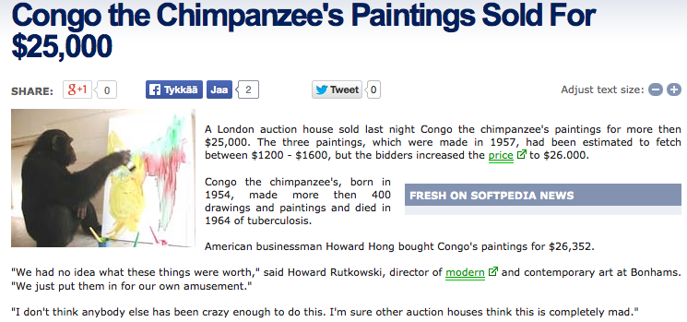
But human action is recursive, so by 2005 the value of cultural-historical phenomenon…

Slide 25
New frameworks/methods
you establish a new way of organizing and/or conducting design
you use it for a few processes
document that and how it was applied
note that the projects got done
the method has proof of existence
… however…
for the method/framework to be meaningful you would need to argue why
Having an alternative to existing methods is important as such
That your method is somehow better to alternative methods
Look back to experimental research and quasi-experiments
You are once more back with problems with experiments on complex problems

Slide 26
Study of complex process change
Áka the promise and curse of action research

Slide 27
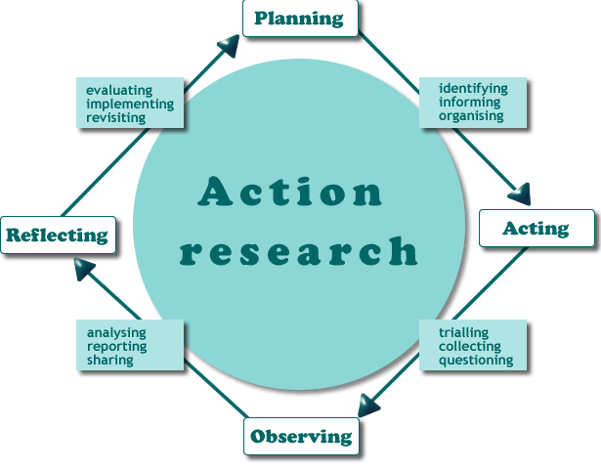

Slide 28
Action research
If you want truly to understand something, try to change it. (Kurt Lewin, 1935)
Action research typically seeks to change some felt problem in a social entity (organization, community, network)
Can take multiple forms: via organizational change, via new methods of doing the practice, via new technology
Action researcher the key change agent
Includes mplementation of the change initiative (in all its messiness and contingency) and its systematic follow on, and further changes prerequisite aka multiple rounds
HIGH requirements to document the starting condition, the nature change initiative, its course, its (often multifarious) outcomes, participant responces … and researcher interpretation of it all.
Typically narrative description phase by phase (narrative the only form that can capture the causal and quasi-causal complexity involved)
Does not escape “what is the case a case of and how exactly is it a case of that” it pays to think clearly why the change initiative is done in a particular setting and how.

Slide 29
Interventionist resarch
The researcher as interventionist, not the core change agent
Developmental work research → change laboratory
Same meticulous documentation : the process itself is not research but needs to be documented and analyzed
… and researcher-interventionist dual role equally warranting special attention.

Slide 30
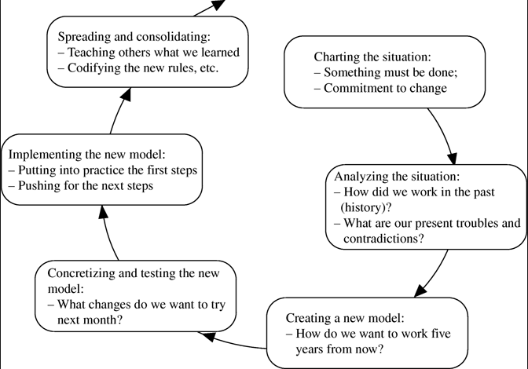

Slide 31
