Slide 1
Sampling as part of research design and scoping
Sampsa Hyysalo, doing research 10th oct 2012

Slide 2
Two extremes, extremely useless
Only representative samples can be generalized”
Qualitative research does not seek statistical representativeness”

Slide 3
Statistical inconveniences Gobo 2007
Total enumeration of X in Y is too time consuming”
Representative sampling X in y, still requires we know how y relates to Y, that is, we need to know Y”
Random sampling requires we know y – Y”
Representative sample vs. a sample
Most human phenomena are not random
Representativeness of ALL used variables
Sample size growth on increase of variables
Sampling unit (design firm) not observational unit (CEO interviewed)
Non-respondents are not random but self-select
Most quantitative research does not rest on anywhere near representative samples

Slide 4
Sampling in qualitative research design
Sampling is conceived as a way of setting up a collection of deliberatel selected cases, materials or events for constructing a corpus of empirical examples for studying the phenomenon of interest in the most instructive way…taking sampling in qualitative research seriously is a way of managing diversity (Flick, 2008, 27)

Slide 5
Tight and loose research designs
Tight research designs rest on narrow and restricted questions and prestructured informant/material selection process. Best in fields that are well studied and have well established constructs… work well for inexperienced researchers
Loose research designs have less defined concepts and less fixed methodological procedures. Approriate in fields where theoretical constructs and concepts are not very developed … require plenty of experience on qualitative research.
Miles & Huberman 1994

Slide 6
How small a sample can do?
How much significant variation there is? “
More variation, more cases needed
Constructing navajo grammar from one respondent: grammars are very orderly
Call centre customer relationship management:
Private, public, non-profit call centres
vs.
Prestudy on activities in literature, interviews and observations: Councelling, marketing, Interviewing and advertizing.
Low variation in others but high variation in councelling activities
Studying one or several of these can be then quite exactly generalized

Slide 7
Purposive sampling (Patton, 2002)
Purposive Sampling
Extreme cases
Maximal variation
Intensity (high, different..)
Emblematic case sampling
Typical cases (for close inquiry)
Excellence (or failure)
Emerging
Critical cases (relations studied are especially clear)
Sensitive/important case
…Convenience
Miles & Huberman 1994, 28:
Homogeneous sample
Theory-based sample (elaborating a construct empirically)
Nominated sampling (snowball, pyramiding)

Slide 8
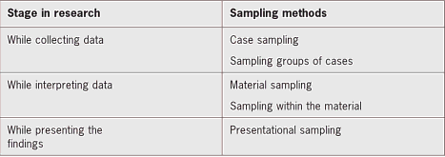

Slide 9
Gradual sampling, theoretical sampling (Glaser & Strauss, 1967, discovery of grounded theory)

Slide 10
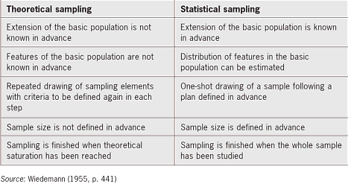

Slide 11
(Gobo, 2008, 452-453)
Do not confuse the representativeness of the case to the representativeness of its characteristics observed by the researcher”
A sample is compound of such characteristics and not just the case (e.g. firm)
Observe extensively the relationships between variables, not only assess the number of people who feature one characteristic

Slide 12
Considerations for design research
Enumeration is a bad idea unless you study something very rare (a case of one or two) or otherwise enumerable
Think how small a sample you can research your case with : more energy into researching it properly
If settled on a case, then what is this case a case of ?
Layered research design often a good idea:
describe the context in less detail
Use samples to focus

Slide 13
Recommended readings
U. Flick: An introduction to Qualitative Research. 4th edition. Sage 2007.
G. Gobo: "Sampling, representativeness and generaliability", in Seale, Gobo, Gubrium, Silverman (eds) Qualitative Research Practice, 2004, s. 405–424. http://ggobors.ariel.ctu.unimi.it/repository/ggobors/sage2004.pdf

