Slide 1
Scoping a research project
Doing Research 18.1.2012
Sampsa Hyysalo

Slide 2
Recap, or, Back to hamster kidneys
Good scope of phd research can be carved in many ways, e.g.
3 . . . 15 ... 200 sliced hamster kidneys
3 hamsters, 3 rats, 3 guinea pigs
One hamster over time (if alive)
20 different mammals’ kidneys
Overview of rodent kidney studies
Meta-analysis of mammal kidney structure
Blend of some of these
Conventions of what counts as research within the field(s) → it just may be that n>20 animals to count as reliable
The state of research: what can be taken for granted / built on / contested

Slide 3
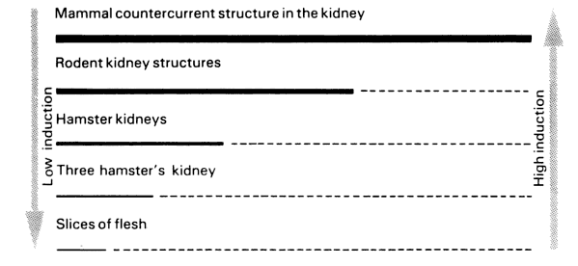
Latour 1987, 51 on hamsters

Slide 4
Recap2 positioning: scope of research is always relative to previous research
Practice perspective
Accountability policies reinforcing collaboration
Integrative structures which connect rather than separate people – horizontally and vertically
Systems for following through ideas
Commonalities
De-centralized structure
Creating customer knowledge
Participative leadership
Strategic priority for innovation
Sufficient resources for innovation
Shared strategic vision
Understanding of current capabilities
Encouraging cross-functional collaboration and teams
Meetings around problems or ideas
Flexible pro-
cesses
Front-end
Innovative Behavior
Formal process for idea management
Articulated roles and responsibilities
Clear decision-making criteria
Efficient decision-making processes
A formal front-end team
Ideation techniques
Performance orientation
Recognition of innovation efforts
Challenging work tasks and sufficient pressure
Risk-taking ability
Linking individuals to problems
Good project management
Innovative organizational culture

Slide 5
Recap3: positioning is also about research assumptions in fields
What counts as evidence? As data? As analysis?
What is accepted / preferred as research
Theory/method/data compatibility
What mandatory points there may be, e.g. “build something” in engineering

Slide 6
Scale: Show … and tell
Telling : allows you to cover the blanks and choose the level of description
“I felt the design method was useful”
“in comparing our method to findings from method A, method b and practice of C we also used, we can note that…”
“we did experiments with three student groups and they supported our claim”
“we did experiments x, y, z and they revealed… “
The experiment x is described in detail fig 1 and its main results in fig 2
“the link 1 to video of experiment X, link 2 to data transcription, link 3 on analysis protocol provide basis on which we now display frame by frame a 10 frame sequence of moments x1, x23, x27 and how interaction unfolded”
Showing : convincing, hard to deny

Slide 7
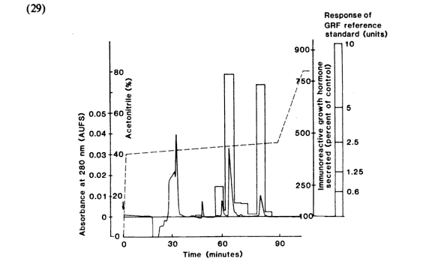

Slide 8
Conventions
Formal criteria: generally down, taik up
Conventions: 200-500pp, >7 chapters; >3 papers+ intro; 5 years for ok phd student
Clear independent contribution
Doesn’t talk rubbish about research and researchability
Hirable as post-doc to do it on ones own
No longer: knows the full canon in the field

Slide 9
“Doable problems”: Fujimura 1996 crafting science
Most “true” research questions are overwhelming for any one funding or lifetime
Greater research questions and hypotheses are sliced to phd size problems.
Phd is comprized of an issue sliced into 3-5 sub-issues
Subissues are realized in several planned and done and reported steps
=> Each contribution is relevant only in company of others!
=> together the claims are very hard to refute

Slide 10
Question hierarchy
What is the “big” question that interest you?
Its ok to grow, but not lose interest
What are the questions that are relevant in the fields you position yourself ?
Your big question is rarely answerable or interesting—otherwise 7M people had answered
To what questions can you have data for ?
Can you be “where its at” and capture it
What can be researched ?
Have got you an idea how to turn the data into findings?

Slide 11
Timeframe issues
Is what you study relevant when you publish (parts of) it
Can the string of novelties-back-then be framed as interesting on the whole –how long?

Slide 12
Close some things early to explore in others: you need 3-4 years of accumulation
Something old, something new, something borrowed: 60/20/20
After first 6 months you should seek to close at least two of the following in your plan
Approximate topic
Rough research questions
Empirical site / empirical project(s)
Data documented
Analysis methods (and skills needed)
Background theory
Otherwise you start from 0 again and again
When you close you start cumulating; discarding a direction should not be done lightly
Keep in mind expanding, embedding, adjoining, comparison strategies; only forsake work that is not phd level, turns undoable or really not your interest.

Slide 13
Robustness: build for 4+2-2+1
If you aim at 4 articles, ideate a string of 6
Troubles with any two sub-studies can be discarded
You can run with the “first four” if review times block you
If you have more on the way, you have fuel for post-doc either as done or ideated pieces
You are likely realize some of the article ideas were not so good
…and end up doing one extra piece that was more easy, interesting and/or urgent

