Slide 1
Surfaces and Films CHEM-E5150
Introduction
Jari Koskinen

Slide 2
Surface
Surfaces of material ⤳ Properties of material:
Physical
Chemical
Mechanical
Optical
Bio compatibility
Etc.
https://news.mit.edu/2015/looking-for-catalysts-with-perovskites-0730

Slide 3
Surface
Surfaces of material ⤳ Properties of material:
Physical
Chemical
Mechanical
Optical
Bio compatibility
Etc.
How to benefit the good surface properties
We grow films!
https://news.mit.edu/2015/looking-for-catalysts-with-perovskites-0730
https://vaccoat.com/blog/pulsed-dc-magnetron-sputtering/

Slide 4
Why is surface different?
Atoms in bulk and surface
Surface atoms have less neighbours (lower coordination number) than bulk atoms
high energy
different electronic structure (surface electronic states, dangling bonds)
possibly different (reconstructed) structure
capability to bind (adsorb) gases
http://butane.chem.uiuc.edu/pshapley/enlist/labs/surfaceten/surface.html

Slide 5
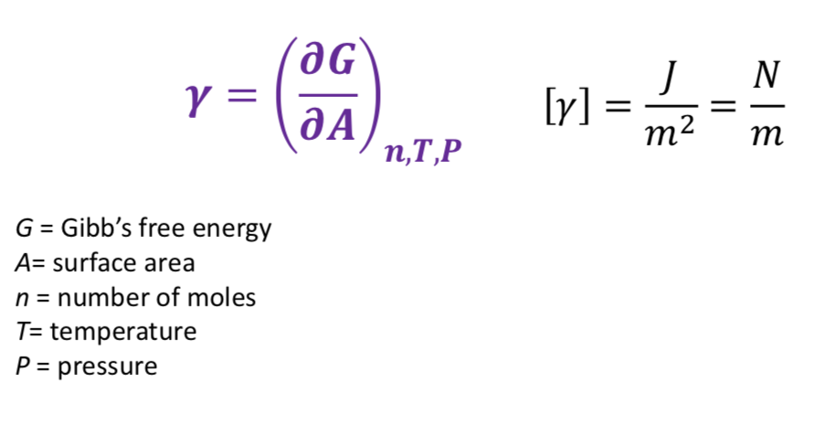
Surface energy

Slide 6
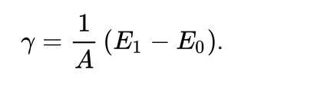
.
.
Creating new surface – breaking atomic bonds – increase of surface energy
.

Slide 7
Minimizing surface energy
Liquids tend to form droplets
Solids relax stess

Slide 8
Surface relaxationa and construction
reconstruction
https://en.wikipedia.org/wiki/Surface_reconstruction

Slide 9
Defects on surface
Point defect on surface
Electron microscopy of antisites (a, Mo substitutes for S) and vacancies (b, missing S atoms) in a monolayer of molybdenum disulfide. Scale bar: 1 nm.^{[1]}
https://en.wikipedia.org/wiki/Crystallographic_defect

Slide 10
Functional groups on
graphene surface

Slide 11
Catalytic surfaces
https://www.bartleby.com/questions-and-answers/1-figure-14.23-heterogeneous-hydrogen-catalysis.-mechanism-for-reaction-of-ethylene-with-hydrogen-on/40a398b8-9d10-4955-9f52-953b6ed96a51

Slide 12
What are surfaces like?

Slide 13
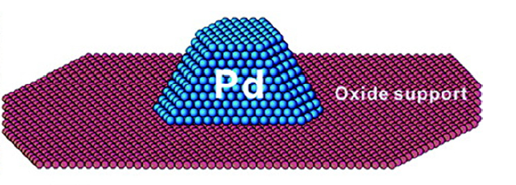
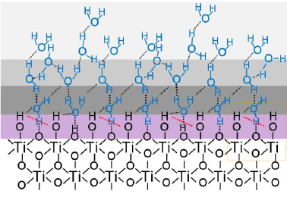
Are your surfaces this ideal ?
Or a bit dirty ?

Slide 14
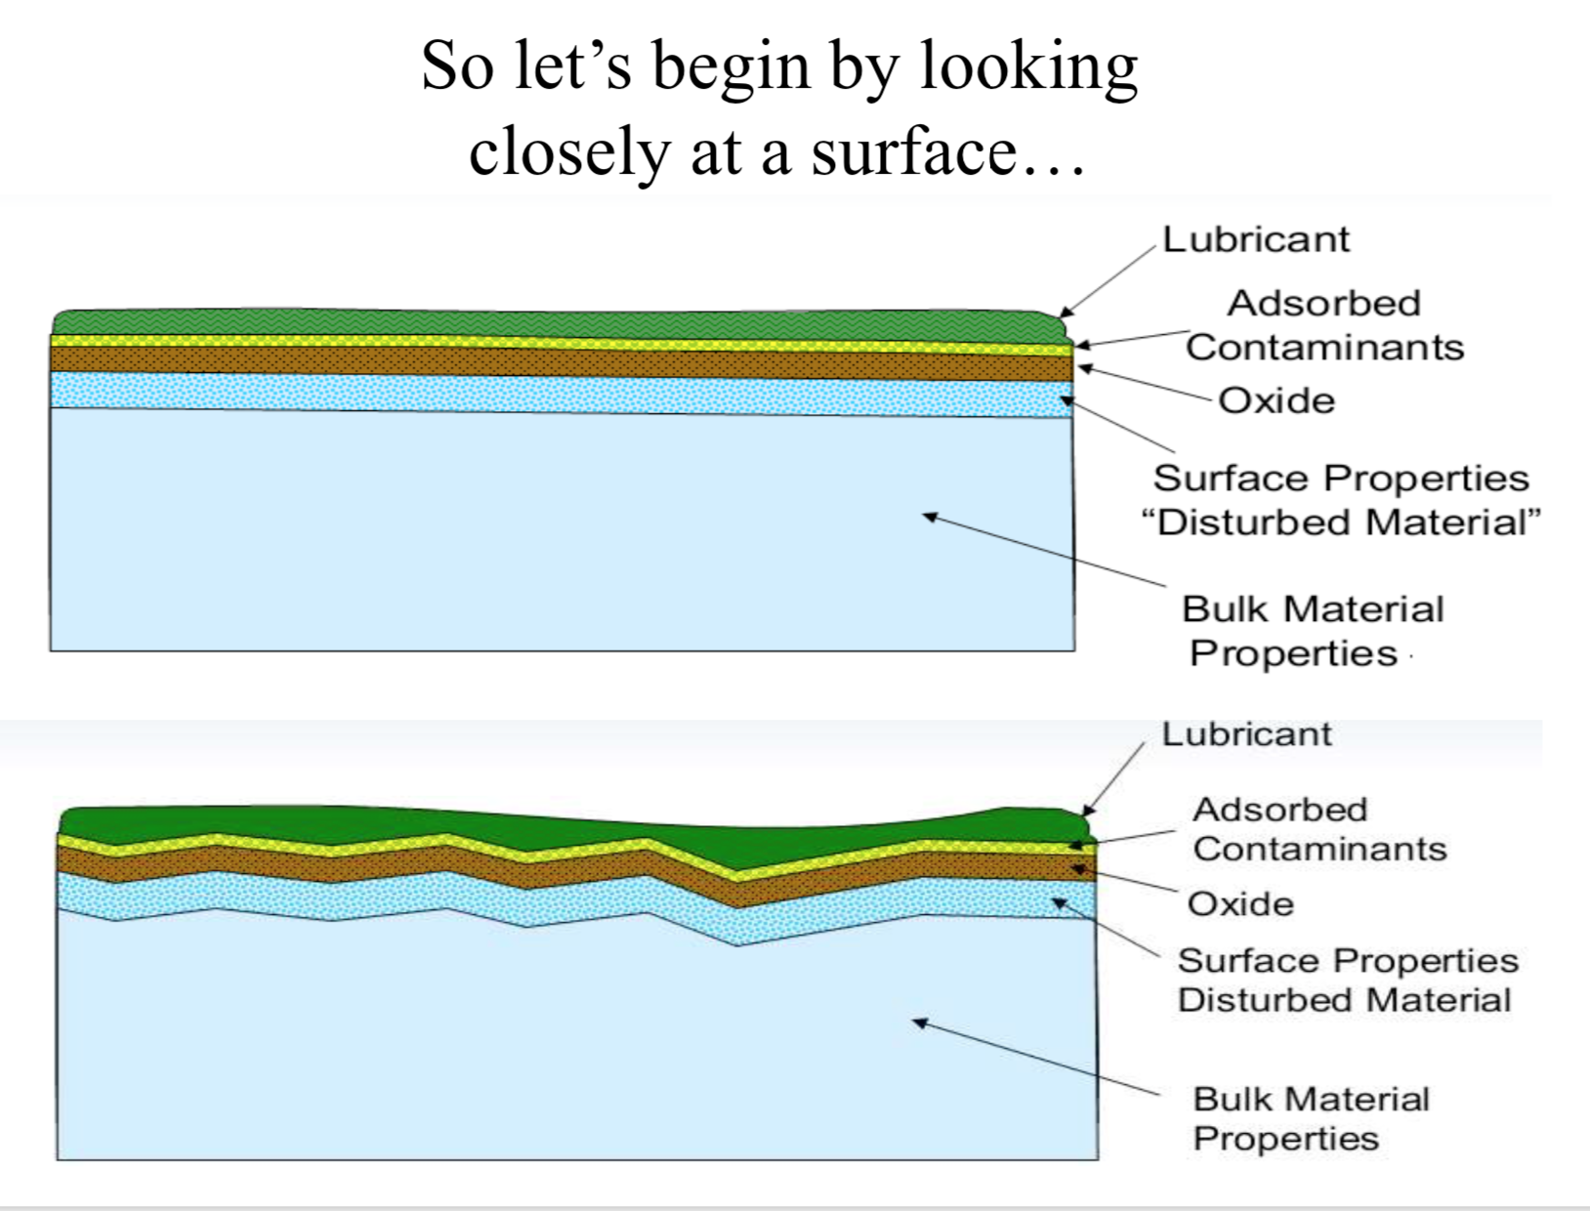
A. Sabiha Khathun
M.TECH (Machine Design)

Slide 15
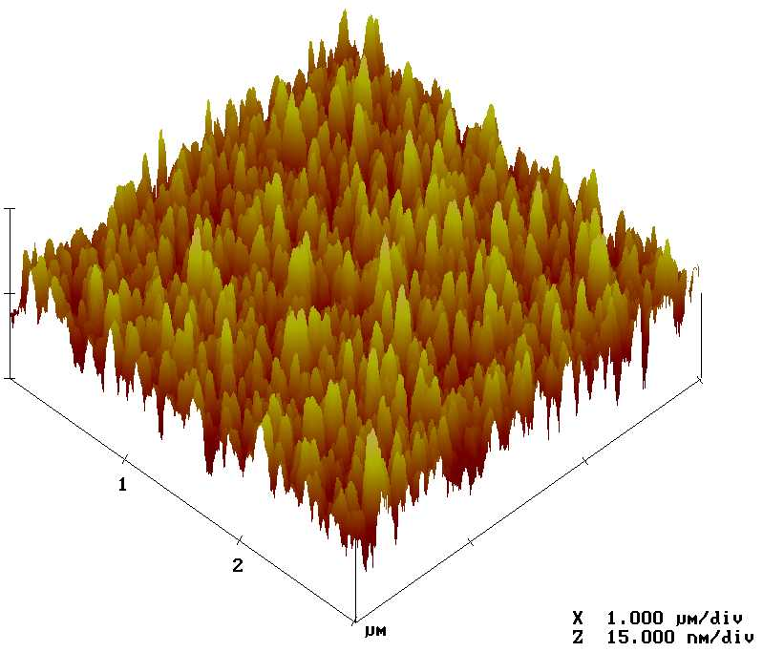
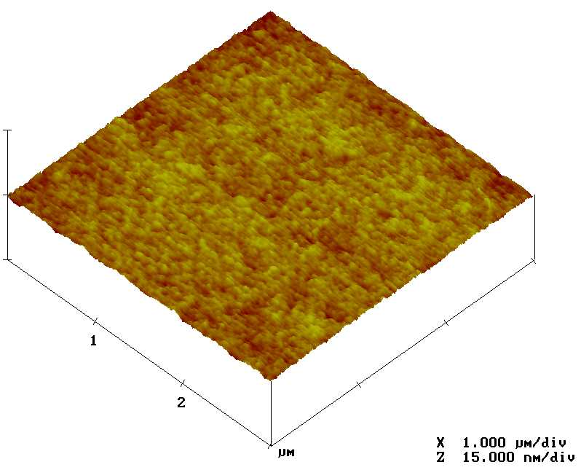
Is your PECVD oxide rough ?
RMS roughness 3.3 nm
RMS roughness 0.2 nm

Slide 16
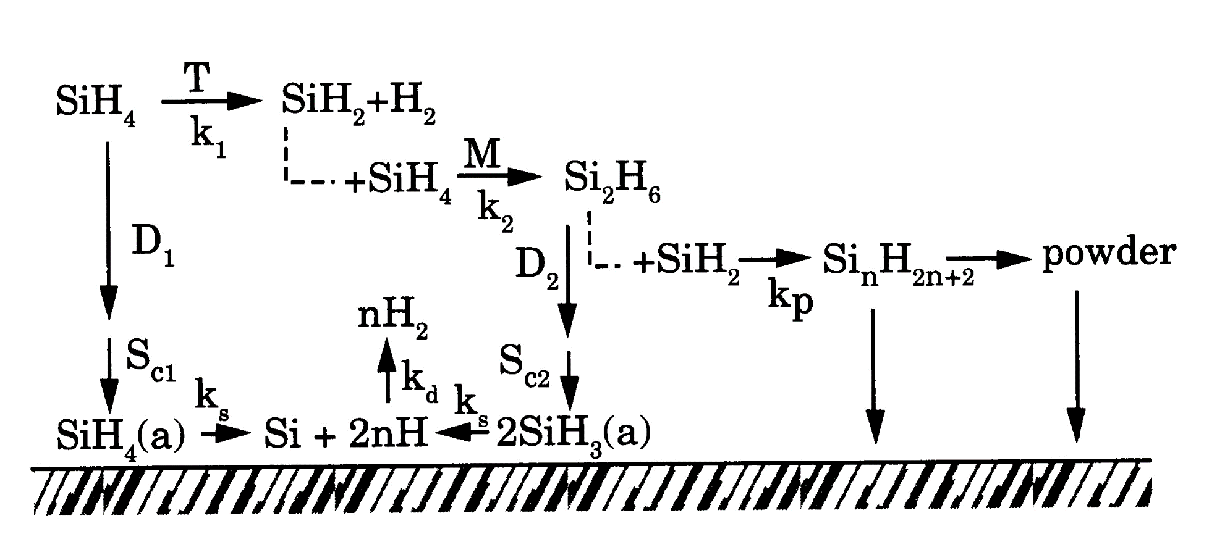
Film deposition reactions
In theory: SiH₄ (g) ➔ Si (s) + 2 H₂ (g)
In practice:

Slide 17
Functional surfaces

Slide 18
Gecko inspired dry adhesive
Gecko mimic structures… …might allow you to climb vertical walls!

Slide 19
Self cleaning superhydrophobic surfaces
Lotus leaf uses rain water to keep itself clean.
Solar panels can use the same effect.

Slide 20
Practical course details

