Slide 1
Surfaces and Films CHEM-E5150
Surface modification and coating
Jari Koskinen

Slide 2
Coatings and films terminology
Film or coating is material which is restricted in one dimension
Substrate is solid material supporting the film
Distance from surface/Thickness
Surface atoms, thin film - Atomic level:
2 – 5 atom layers on the surface (≈ 0.2 – 0.5 nm)
over 10 atomic layers (≈ 1 nm) is bulk
Thin films technically
1nm – 10 µm
Needed layer thickness, which is needed to:
protect substrate
Wanted functionality of the coating
Coatings, thick films > 10 µm
Mikko Ritala Thin Films

Slide 3
Motivations - why thin films?
Interaction of solid material with surrounding often through surface
Modification of surface ➡ material properties
Market of thin films and coatings
volume about 25 G€ in UK 2005
about 1% of GNP
common in all areas of industry
electronics
transport
energy
building

Slide 4
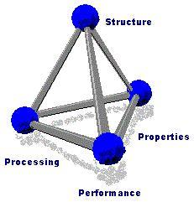
Materials Science tetra
Properties
Composition
Processing
Microstructure

Slide 5
Materials Science and Thin Films tetra
Properties
Protection
Transport
Stability
Functionallty
Composition
Depth distribution
Precipitation
Adsorption
Processing
Thin film growth Post processing
Microstructure
Microstructure
Crystallinity/amorphous
Defects
interfaces

Slide 6
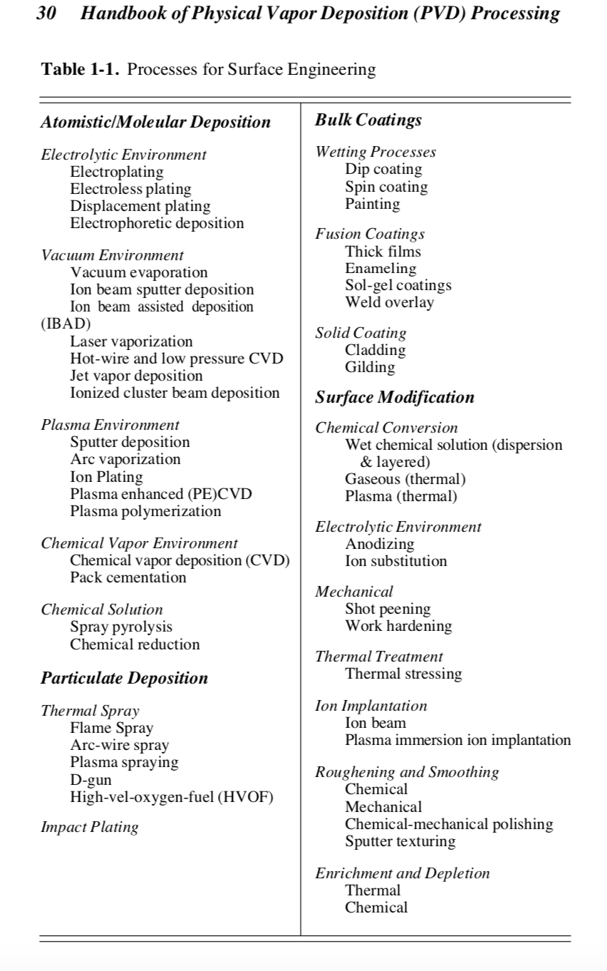
Processing for surface engineering
Handbook of Physical Vapor Deposition (PVD) Processing – Mattox 2nd edition 2010

Slide 7
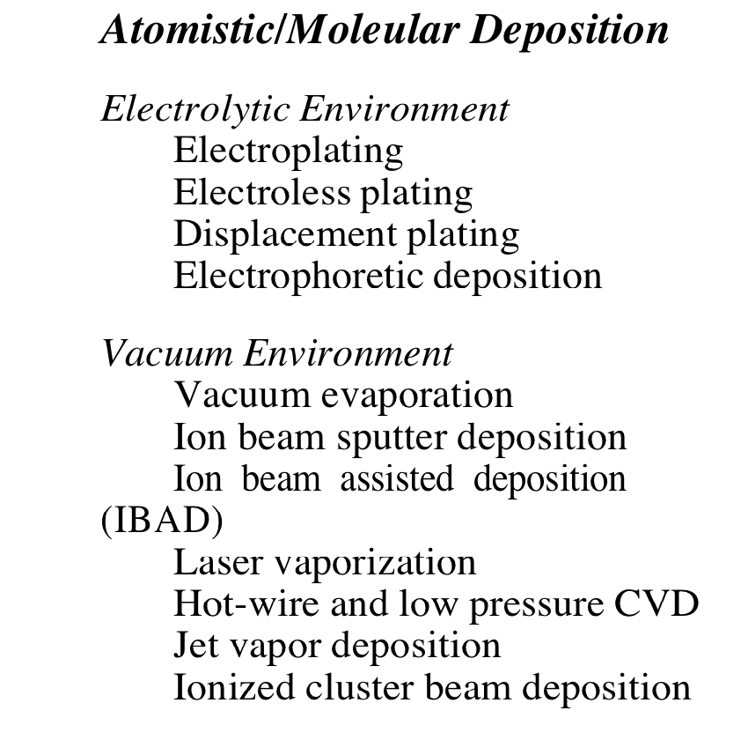
Handbook of Physical Vapor Deposition (PVD) Processing – Mattox 2nd edition 2010

Slide 8
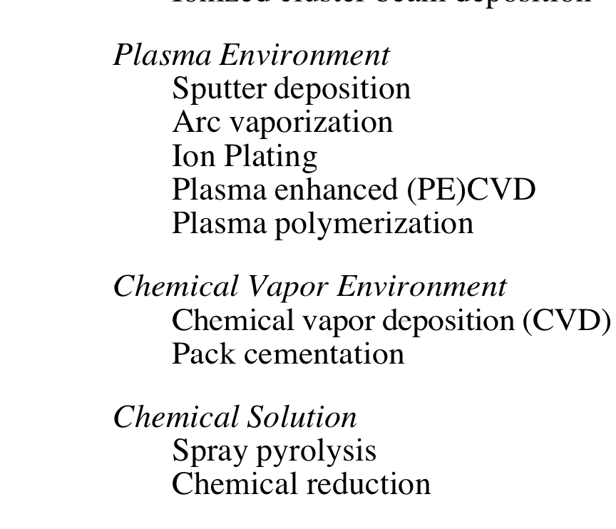
Handbook of Physical Vapor Deposition (PVD) Processing – Mattox 2nd edition 2010

Slide 9
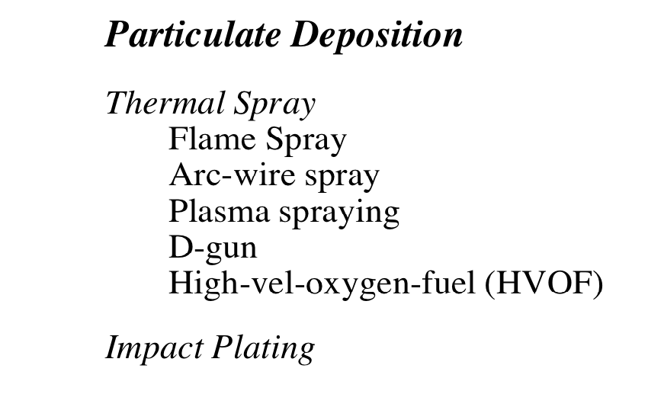
Handbook of Physical Vapor Deposition (PVD) Processing – Mattox 2nd edition 2010

Slide 10
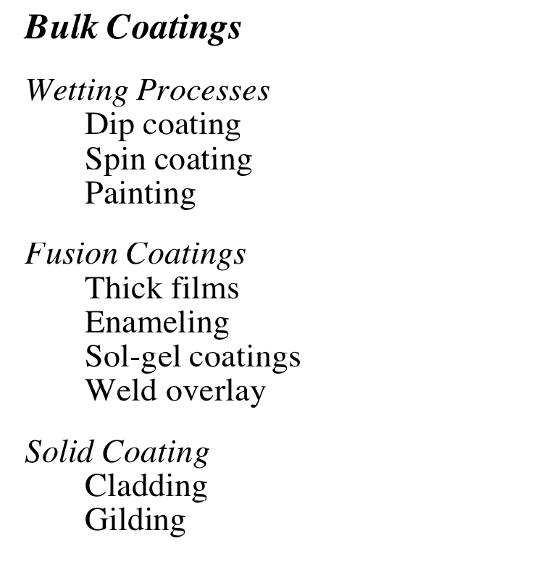
Handbook of Physical Vapor Deposition (PVD) Processing – Mattox 2nd edition 2010

Slide 11
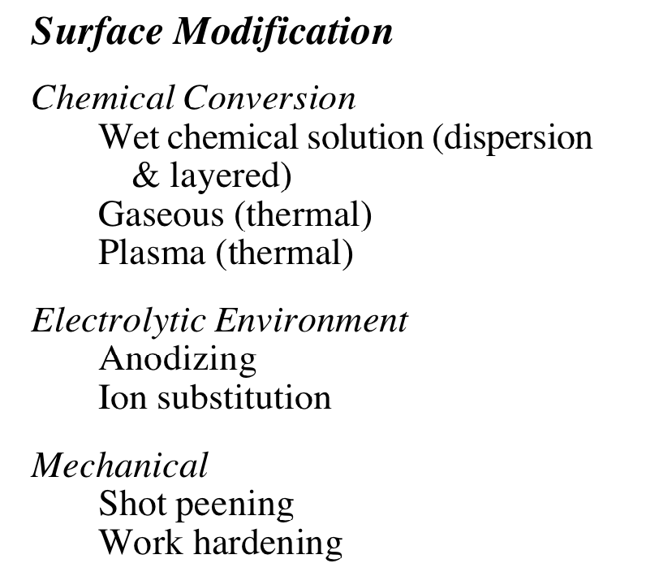
Handbook of Physical Vapor Deposition (PVD) Processing – Mattox 2nd edition 2010

Slide 12
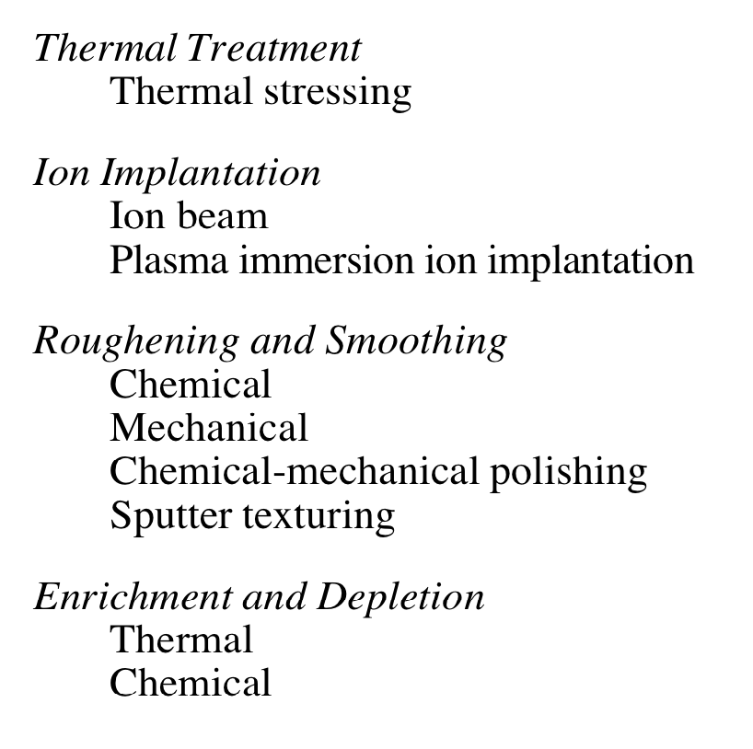
Processing for surface engineering
Handbook of Physical Vapor Deposition (PVD) Processing – Mattox 2nd edition 2010

Slide 13
Coating methods in the next slides
Physical Vapor Deposition including evaporation and sputtering.
Chemical Vapor Deposition and Plasma-Assisted Chemical Vapor Deposition
Electro deposition and Electroless Deposition.
Plasma Spraying

Slide 14
Coating methods in the next slides
Physical Vapor Deposition including evaporation and sputtering.
Chemical Vapor Deposition and Plasma-Assisted Chemical Vapor Deposition
Electro deposition and Electroless Deposition.
Plasma Spraying

Slide 15
PVD_Vacuum evaporation
http://tuttle.merc.iastate.edu/ee432/topics/thin_films/evaporation.pdf

Slide 16
PVD_Vacuum evaporation
http://tuttle.merc.iastate.edu/ee432/topics/thin_films/evaporation.pdf

Slide 17
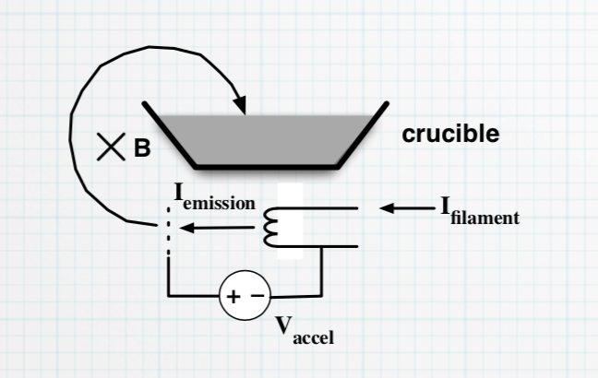
PVD_Vacuum evaporation Vapous source
Resistive heating
Electron beam heating
http://tuttle.merc.iastate.edu/ee432/topics/thin_films/evaporation.pdf

Slide 18
Physical Vapor Deposition PVD. Sputtering

Slide 19
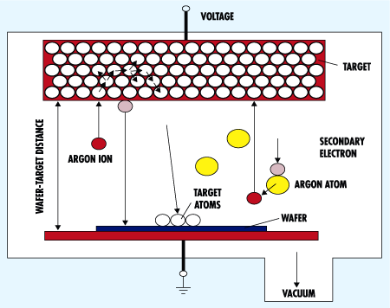
Plasma is needed to make the gas conductive, and generated ions can then be accelerated to strike the target.
Higher pressures than evaporation: 1-100 mTorr.
Better at depositing alloys and compounds than evaporation.
The plasma contains ≈ equal numbers of positive argon ions and electrons as well as neutral argon atoms. Typically only <0.01% atoms are ionized!
NE 343: Microfabrication and thin film technology
Instructor: Bo Cui, ECE, University of Waterloo; http://ece.uwaterloo.ca/~bcui/
Textbook: Silicon VLSI Technology by Plummer, Deal and Griffin

Slide 20
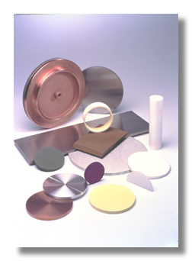
Sputtering process
Sputtering process can be run in DC or RF mode (insulator must be run in RF mode)
Major process parameters:
Operation pressure (∼1-100mTorr)
Power (few 100W)
For DC sputtering, voltage -2 to -5kV.
Additional substrate bias voltage.
Substrate temperature (20-700ºC)
In addition to IC industry, a wide range of industrial products use sputtering: LCD, computer hard drives, hard coatings for tools, metals on plastics.
It is more widely used for industry than evaporator, partly because that, for evaporation:
There are very few things (rate and substrate temperature) one can do to tailor film property.
The step coverage is poor.
It is not suitable for compound or alloy deposition.
Considerable materials are deposited on chamber walls and wasted.
NE 343: Microfabrication and thin film technology
Instructor: Bo Cui, ECE, University of Waterloo; http://ece.uwaterloo.ca/~bcui/
Textbook: Silicon VLSI Technology by Plummer, Deal and Griffin
Targets for sputter deposition.

Slide 21
Advantages/disadvantages
Advantages:
Able to deposit a wide variety of metals, insulators, alloys and composites.
Replication of target composition in the deposited films.
Capable of in-situ cleaning prior to film deposition by reversing the potential on the electrodes .
Better film quality and step coverage than evaporation.
This is partly because adatoms are more energetic, and film is ‘densified’ by in-situ ion bombardment, and it is easier to heat up to high T than evaporation that is in vacuum.
More reproducible deposition control – same deposition rate for same process parameters (not true for evaporation), so easy film thickness control via time.
Can use large area targets for uniform thickness over large substrates.
Sufficient target material for many depositions.
No x-ray damage.
Disadvantages:
Substrate damage due to ion bombardment or UV generated by plasma.
Higher pressures 1 –100 mtorr ( < 10⁻⁵ torr in evaporation), more contaminations unless using ultra clean gasses and ultra clean targets.
Deposition rate of some materials quite low.
Some materials (e.g., organics) degrade due to ionic bombardment.
Most of the energy incident on the target becomes heat, which must be removed.
NE 343: Microfabrication and thin film technology
Instructor: Bo Cui, ECE, University of Waterloo; http://ece.uwaterloo.ca/~bcui/
Textbook: Silicon VLSI Technology by Plummer, Deal and Griffin

Slide 22
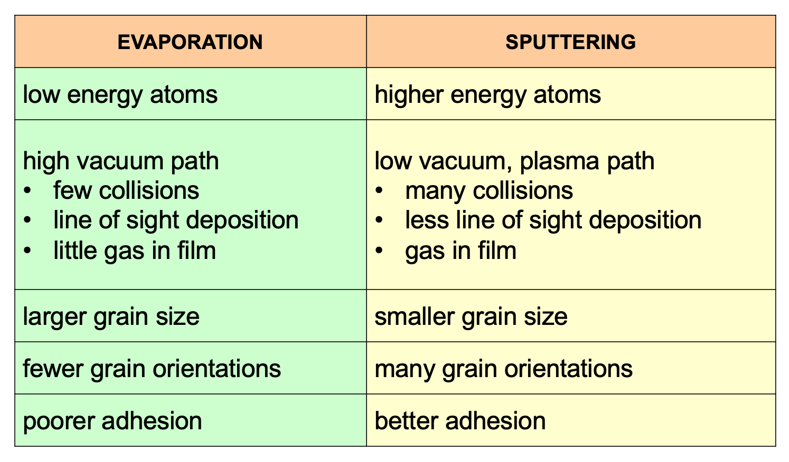
Comparison Sputtering/evaporation
NE 343: Microfabrication and thin film technology
Instructor: Bo Cui, ECE, University of Waterloo; http://ece.uwaterloo.ca/~bcui/ Textbook: Silicon VLSI Technology by Plummer, Deal and Griffin

Slide 23
Coating methods in the next slides
Physical Vapor Deposition including evaporation and sputtering.
Chemical Vapor Deposition and Plasma-Assisted Chemical Vapor Deposition
Electro deposition and Electroless Deposition.
Plasma Spraying

Slide 24
CVD
www.ttu.ee › mtx9010 › Korgtehnoloogia_Deposition_methods

Slide 25
www.ttu.ee › mtx9010 › Korgtehnoloogia_Deposition_methods

Slide 26
Coating methods in the next slides
Physical Vapor Deposition including evaporation and sputtering.
Chemical Vapor Deposition and Plasma-Assisted Chemical Vapor Deposition
Electro deposition and Electroless Deposition.
Plasma Spraying

Slide 27
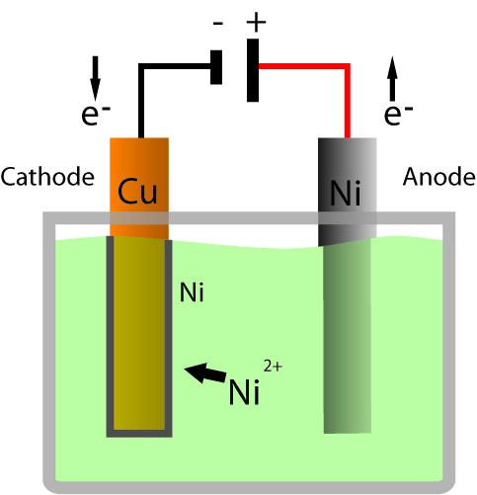
Electro plating
Copper Cathode is reduced
(accepts electrons)
Nickel Anode is oxidized
(gives us electrons)
Nick Raymond
Ni²⁺ ions within solution become attracted to Copper cathode
www.santarosa.edu › PROJECTS › Electroplating Powerpoint

Slide 28
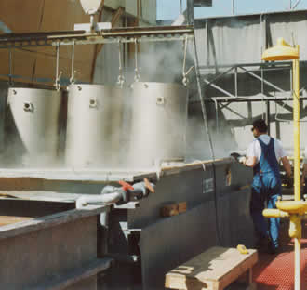
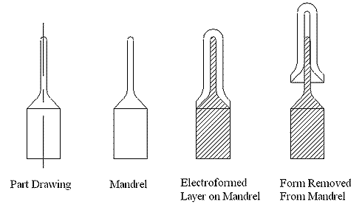
Electroless Plating and Electroforming
Electroless Plating
Chemical Reaction
More Expensive $$
Uniform Thickness
Electroforming
Metal-fabrication
Metal electrodeposited on a mandrel
https://www.vecofrance.fr/en/solutions-techniques
Electroplating, Electroless Plating, and Electroforming - UNM ...
www.me.unm.edu › ME260_FALL2005 › Presentation_11_30_05

Slide 29
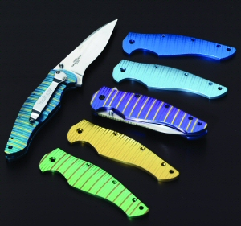
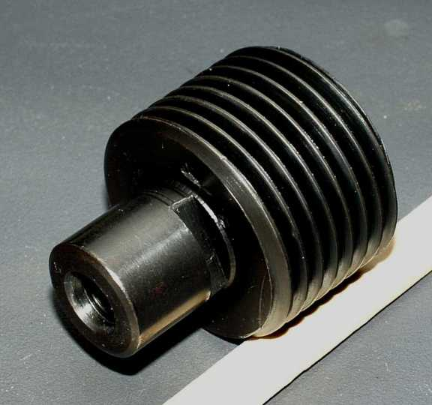
Conversion Coatings
Anodizing-
The workpiece is the anode in an electrolytic cell
Coloring-
Alters color of metals, alloys, and ceramics
Conversion of surfaces into chemical compounds: oxides, chromates, and phosphates
Electroplating, Electroless Plating, and Electroforming - UNM ...
www.me.unm.edu › ME260_FALL2005 › Presentation_11_30_05

Slide 30
Coating methods in the next slides
Physical Vapor Deposition including evaporation and sputtering.
Chemical Vapor Deposition and Plasma-Assisted Chemical Vapor Deposition
Electro deposition and Electroless Deposition.
Plasma Spraying

Slide 31
Thermal spray – coating growth from molten particles
Electroplating, Electroless Plating, and Electroforming - UNM ...
www.me.unm.edu › ME260_FALL2005 › Presentation_11_30_05

Slide 32
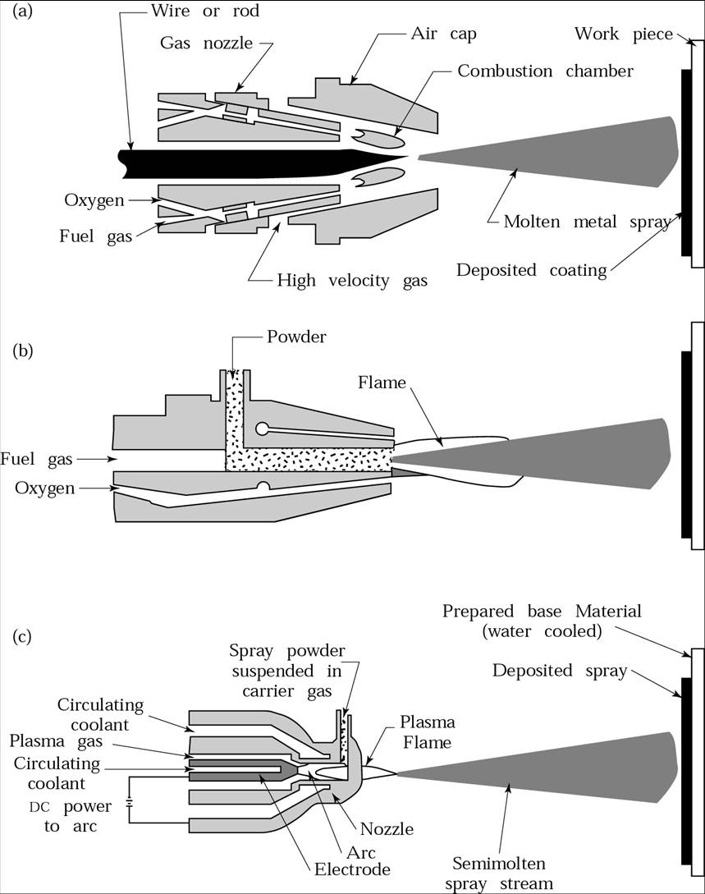
Thermal Spray
Combustion Spraying
Thermal Wire Spray
Thermal Metal-Powder Spray
Plasma Spray

Slide 33
Thermal spray coating of ball valve
https://www.valve-balls.com/valve-balls/metal-seated-balls.html

Slide 34
Surface modification
Laser treatment
Ion implantation

Slide 35
Ion implantation
https://www.hzdr.de/db/Cms?pOid=24316&pNid=0

Slide 36
Ion implanter
http://blog.bodycote.com/2017/08/02/what-is-ion-implantation/ion-implantation/

Slide 37
Ion implantation
Low process temperature
Benefits from
controlled alloying (electrical properties)
Defects and intersitials (mechanical hardening)
No (or minute) dimensional changes
Expensive

Slide 38
Laser Treatments
Heating
Melting
Vaporization
Peening
http://www.raymax.com.au/a/157.html

Slide 39
Laser gladding
https://www.laserline.com/en-int/laser-cladding/
http://www.raymax.com.au/a/157.html

