Slide 1
Surface chemistry
Sami Franssila,
With material from Mikko Ritala,
University of Helsinki

Slide 2
Surface energy
Seong et al: Dominant mechanisms of the sintering of copper nano-powders, 2016

Slide 3
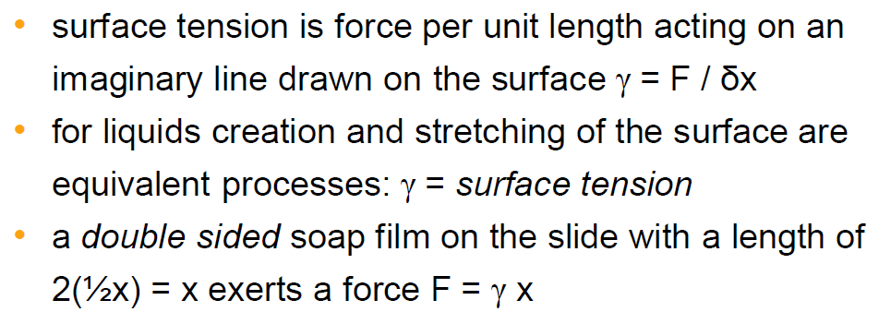
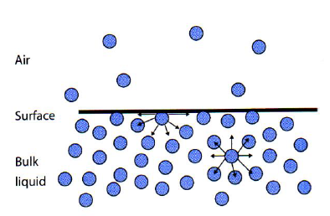
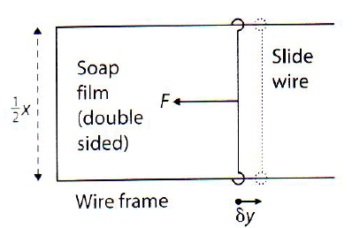
Surface tension

Slide 4
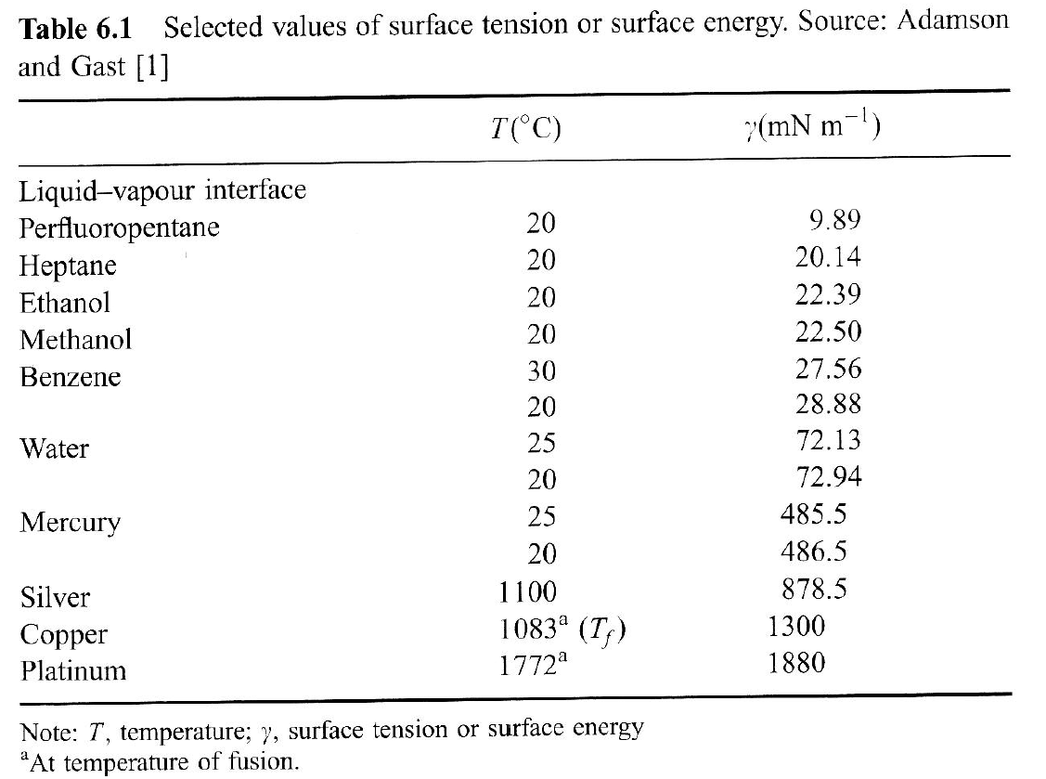

Slide 5
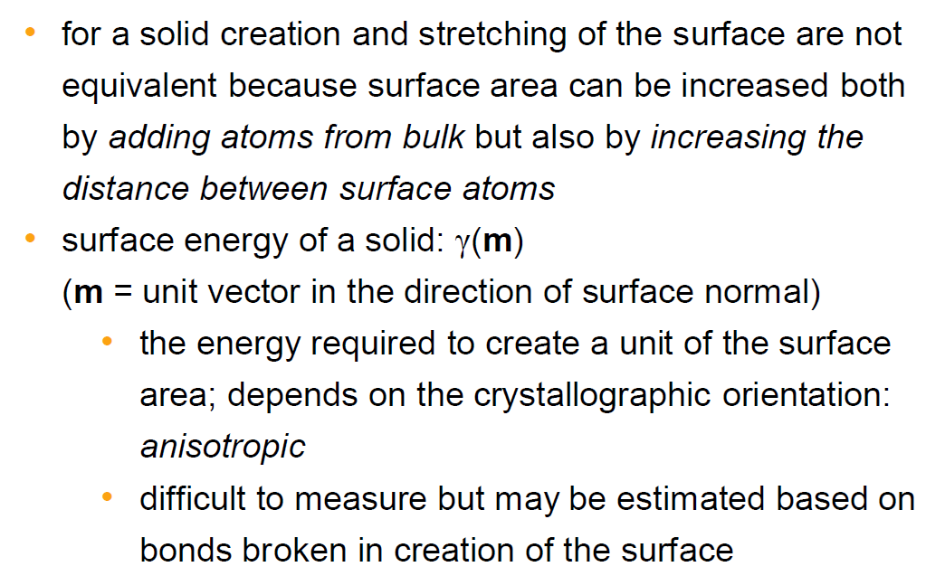
Surface energy of solids

Slide 6
Estimating surface energy

Slide 7
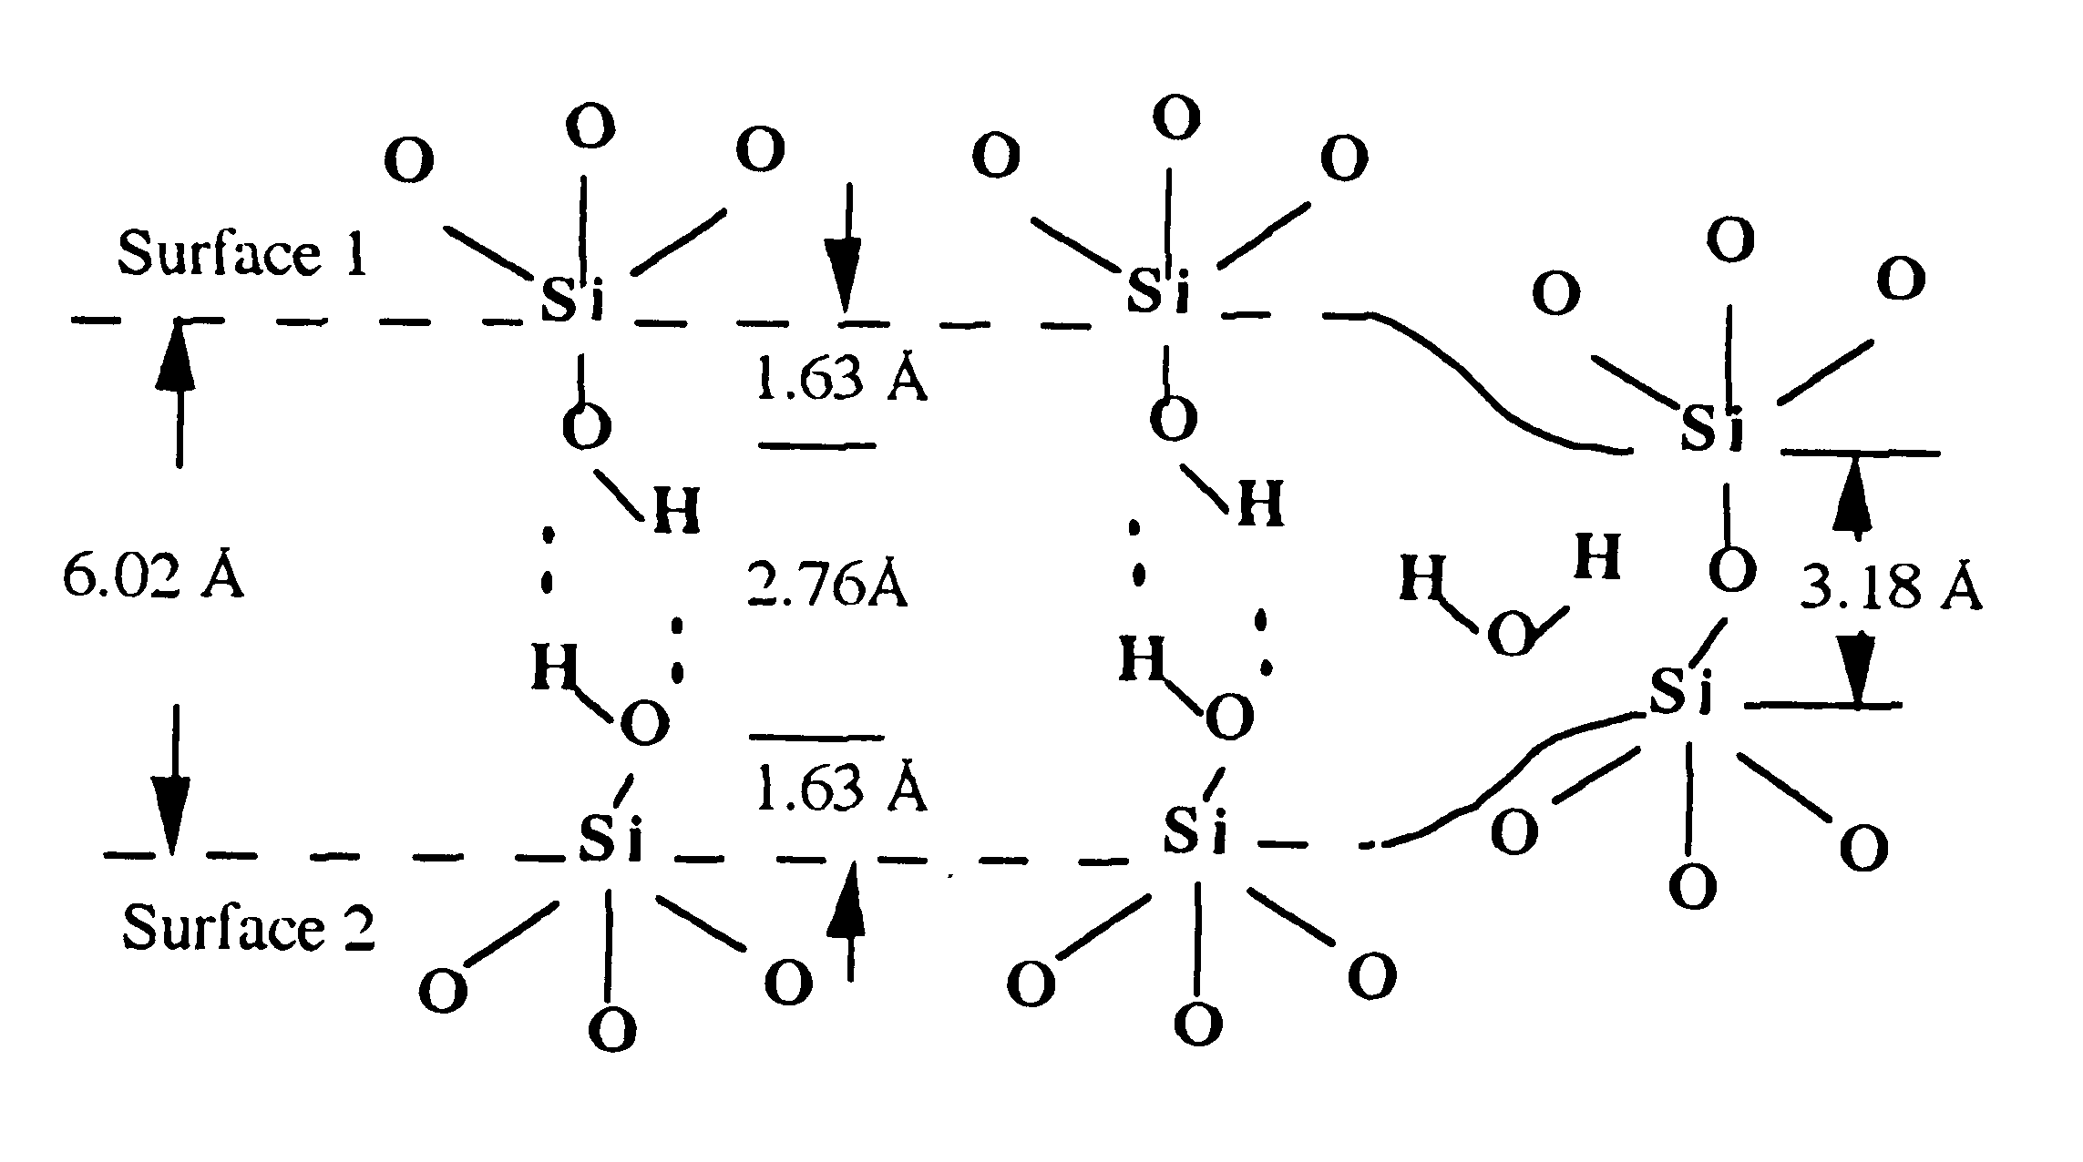
Silicon surface energy
Silicon atom surface density, ca. 10¹⁵ cm⁻², and hydrogen bond energies, 25-40 kJ/mol, which translate to ca. 200-350 mJ/m².
Tong, Q.-Y. & U. Gösele: Semiconductor Wafer Bonding, John Wiley & Sons, 1999
Surface energies calculated from Si – O bond energies (4.5 eV/bond or 430 kJ/mol) translate to ca. 3000 mJ/m².

Slide 8
Surface energy of metals

Slide 9
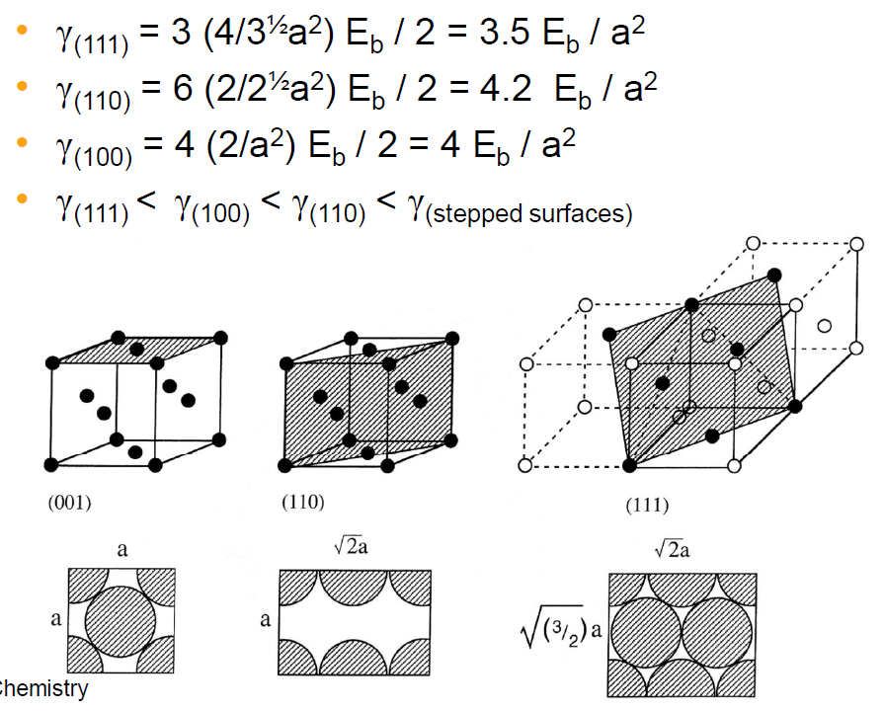
Surface energy of metals (2)
Rule of thumb:
-stabilty comes from high surface atom density and high coordination number.

Slide 10
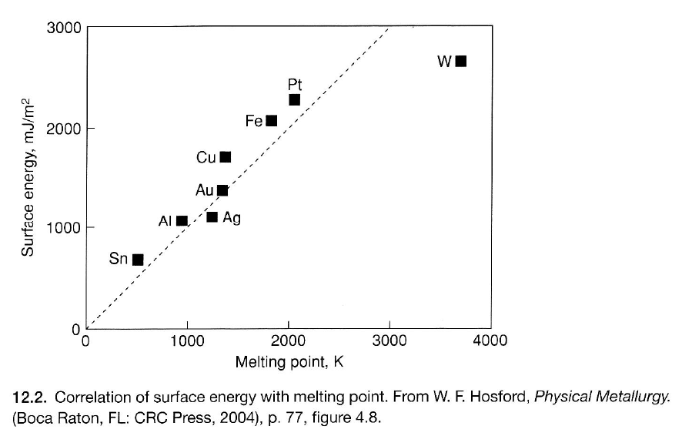
Surface energy vs. melting point
Bond strength determines both.

Slide 11
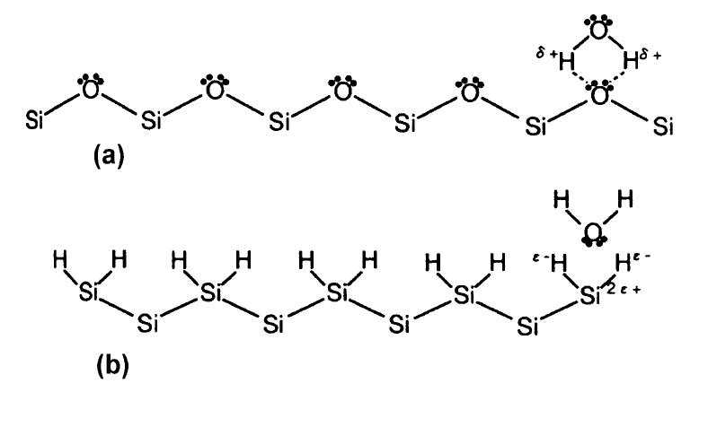
Silicon surface termination
a) Negatively charged oxygen attracts positively charged H+
b) Negatively charge H+ repels negatively charged oxygen
Hattori, T. (ed.): Ultraclean surface processing of silicon wafers,

Slide 12
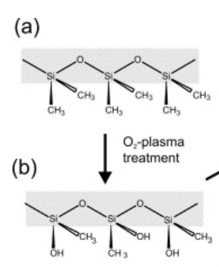
Modifying surface chemistry
Methyl-terminated, -CH₃
Hydrophobic
Oxygen plasma treatment turns some methyl groups to hydroxyl OH-, groups
➔ hydrophilic

Slide 13
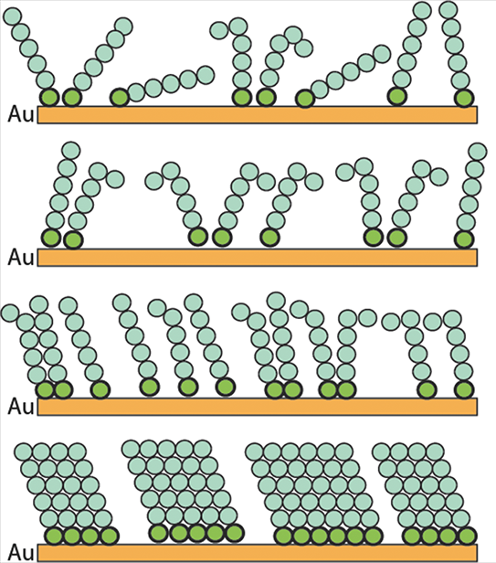
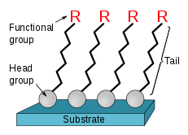
SAMs (Self-assembled monolayers)
time
Either in liquid phase or gas phase deposition.

Slide 14
Silane-SAM

Slide 15
Self-cleaning mirrors/windows

Slide 16
Adsorption

Slide 17
Atoms hitting the surface may:
1. Bounce back
-elastic scattering without energy loss
-inelastic scattering with energy loss
2. Stay on surface
-by weak interaction: physisorption
-by strong interaction: chemisorption
3. Act on surface:
-surface diffusion
-surface reactions
-desorption

Slide 18
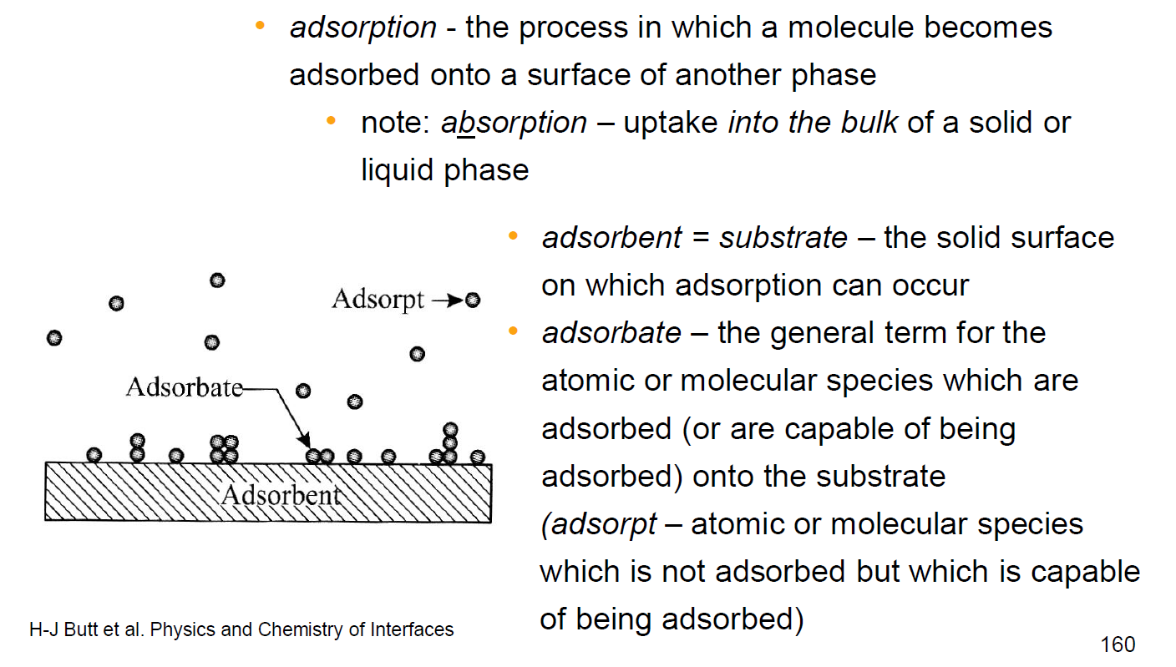
Adsorption concepts

Slide 19
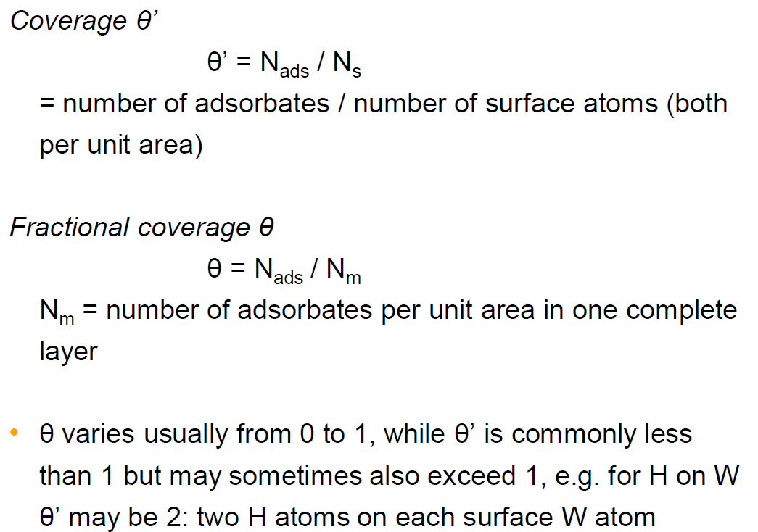
Coverage Θ

Slide 20
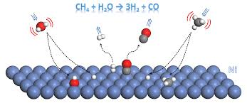
Adsorbate fate on surface
-move around by surface diffusion
-fragment
-react with substrate
-react with co-adsorbed specie
-react with gas phase specie
-desorb
Products may be volatile and desorb; or form film on surface
http://staff.ustc.edu.cn/~bjiangch/research.html

Slide 21
Reactive adsorption

Slide 22
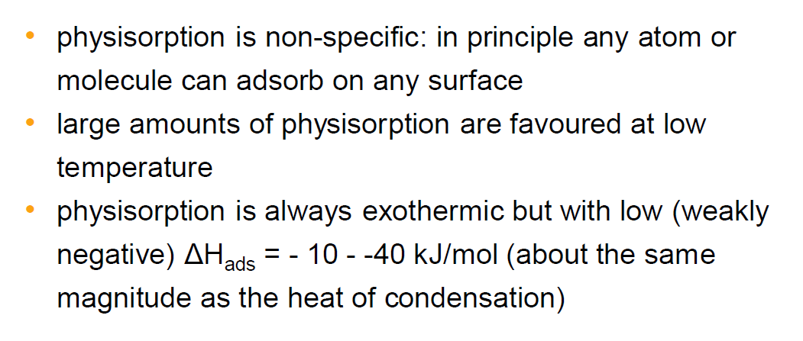
Physisorption

Slide 23
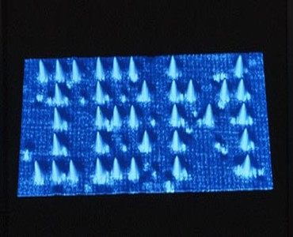
Xenon atoms physisorbed
Each xenon atom appears as a 1.6-A-high bump on the surface,
“…use of the STM at low temperatures (4 K) to position individual xenon atoms on a single-crystal nickel surface with atomic precision.
The tip of an STM always exerts a finite force on an adsorbate atom. This force contains both Van der Waals and electrostatic contributions. By adjusting the position and the voltage of the tip we may tune both the magnitude and direction of this force. This, taken together with the fact that it generally requires less force to move an atom along a surface than to pull it away from the surface, makes it possible to set these parameters such that the STM tip can pull an atom across a surface while the atom remains bound to the surface.”
The xenon atoms are spaced on a rectangular grid which is four nickel unit cells long horizontally and five unit cells long vertically, corresponding to 14 x 12.5 A.
Eigler & Schweitzer, Nature 1990

Slide 24
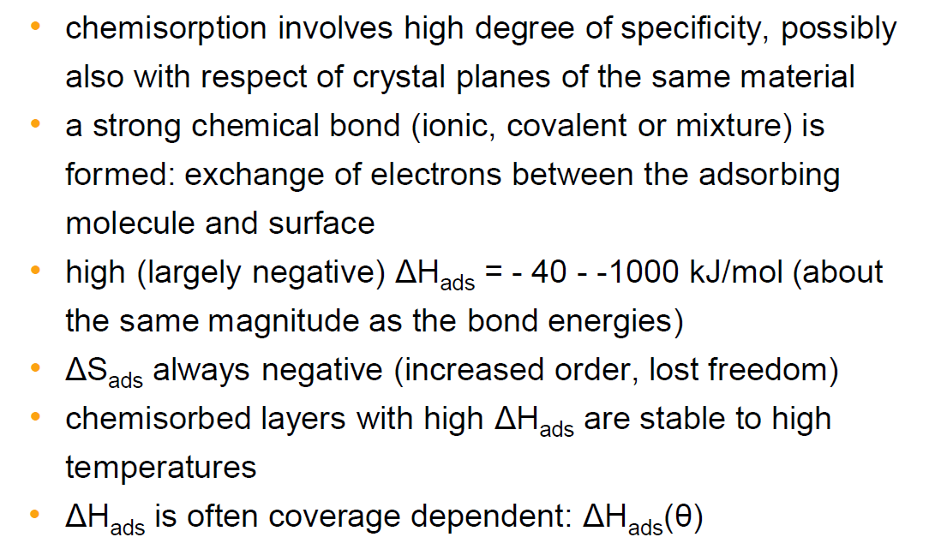
Chemisorption

Slide 25
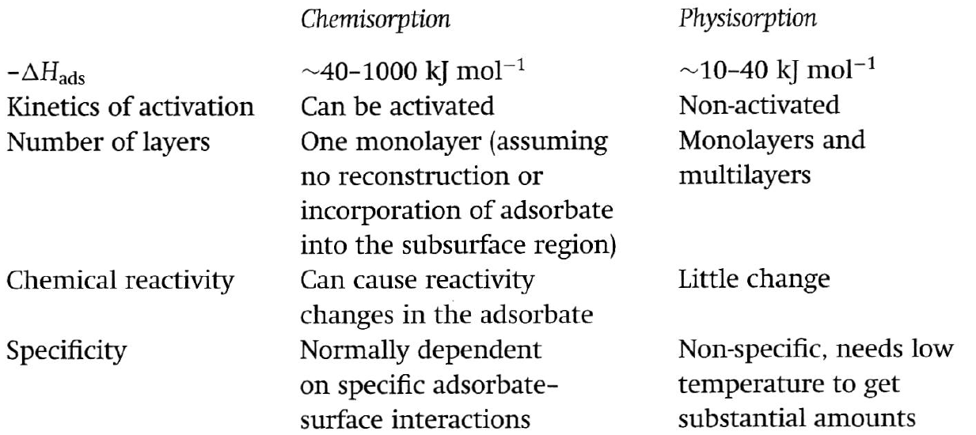
Chemisorption vs. physisorption

Slide 26
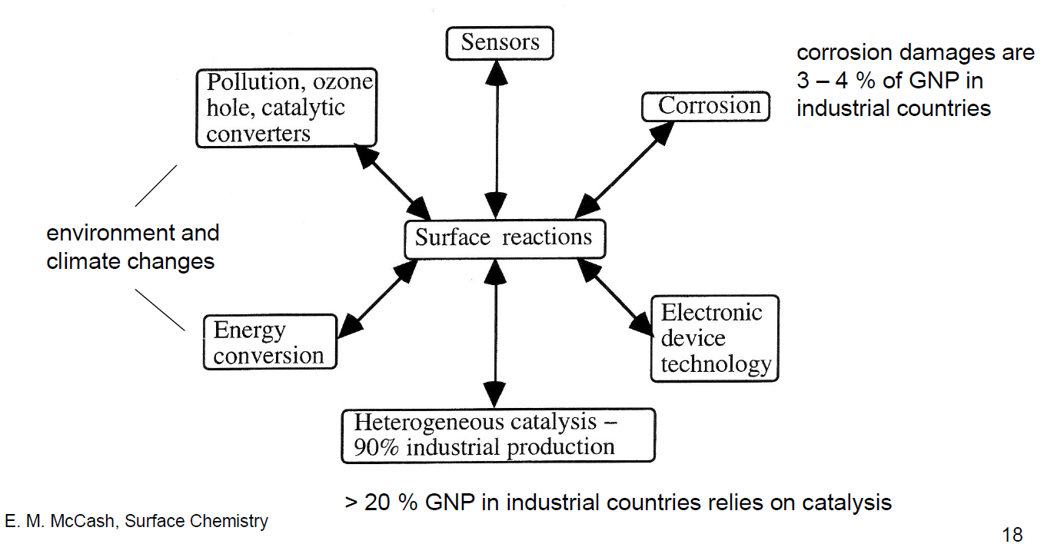
Important surface reactions

Slide 27
Catalysis

Slide 28
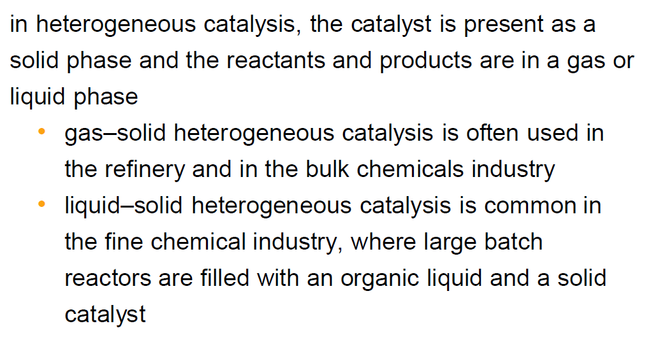
Heterogenous catalysis

Slide 29
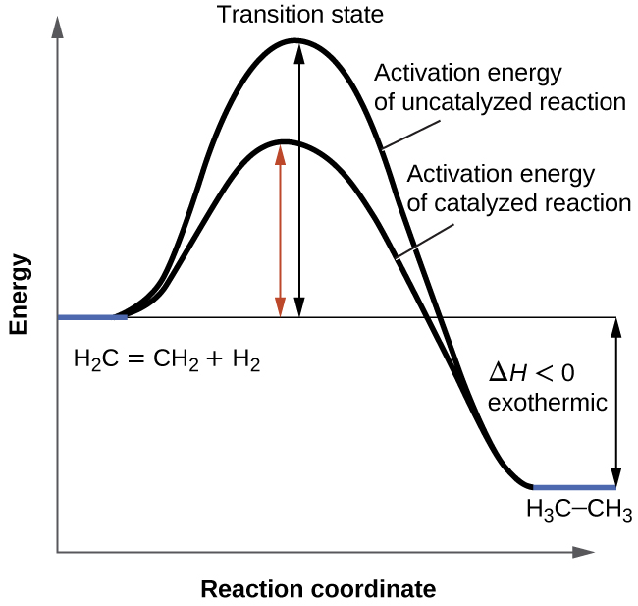
Reaction co-ordinates
It might be that homogeneous uncatalyzed reaction is replaced by heterogeneous catalyzed reaction.
https://cnx.org/contents/RTmuIxzM@3.4:bZvv2PMU@4/Catalysis

Slide 30
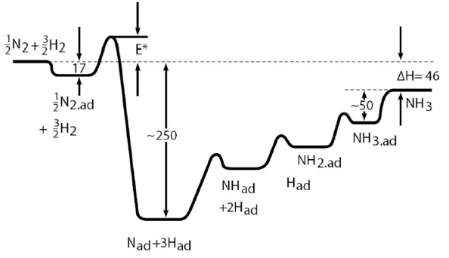
Nobel prize 2007: Gerhard Ertl

Slide 31
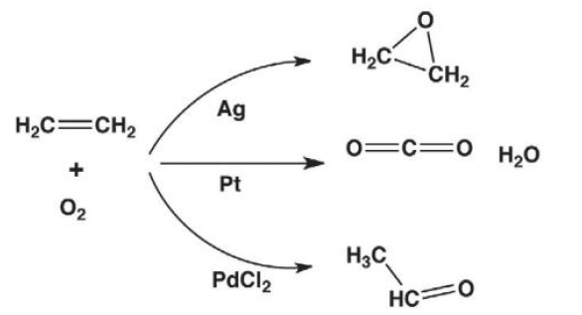
Devil is in the details
Different catalysts

Slide 32
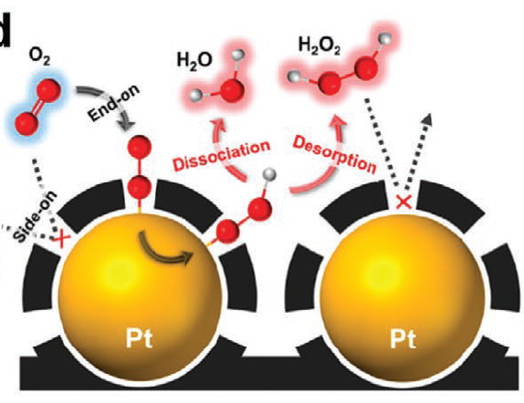
Pt/C nanoparticle catalyst
For instance, holes in carbon coating may expose a single Pt-atom; or several ➔ orientation of entering molecule different ➔ different end result
Jiang et al: Adv. Funct. Mater. 2020, 30, 2003321

Slide 33
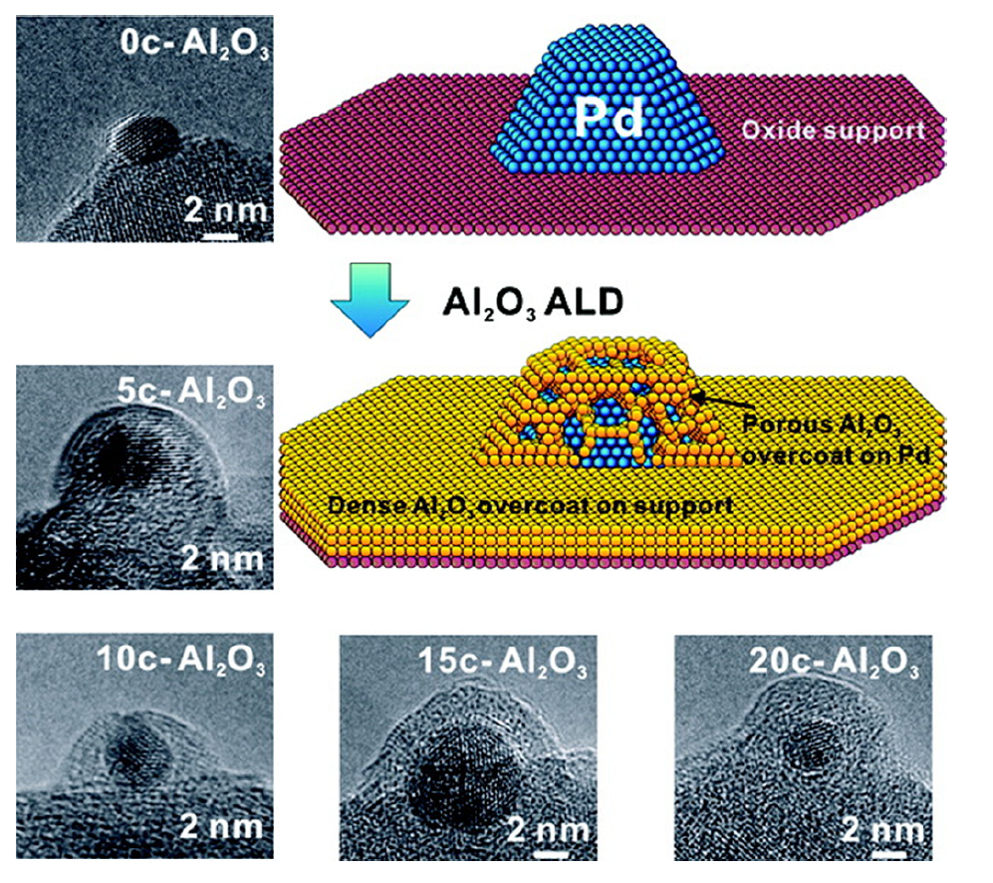
ALD-coated Pt-catalyst
ALD films <1 nm are discontinuous ➔ gas molecules have access to noble metal catalyst.
But reaction product molecules are too big to enter.
Cao et al.: Catalysts design and synthesis via selective ALD, JVST A 2018

Slide 34
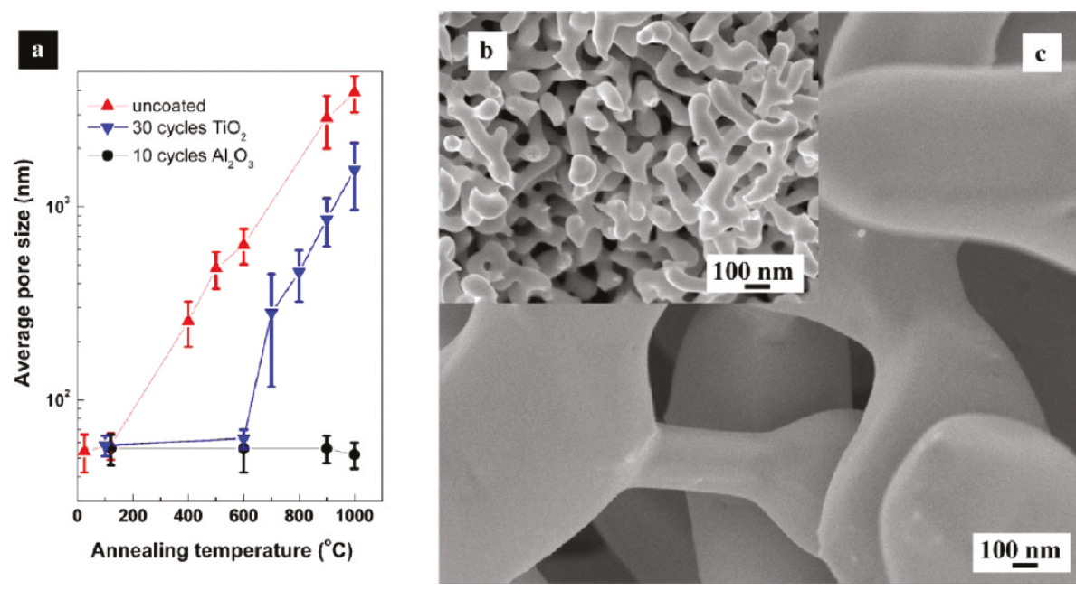
Stabilization by coating
b and c –samples both
600ºC anneal
Nanoporous gold wants to minimize area, but ALD films prevent this.
In b) nanoscale structures protected by ALD film remain;
In c) unprotected nanoscale structures have coalesced into larger microstructures
Biener et al: ALD Functionalized Nanoporous Gold: Thermal Stability, Mechanical Properties, and Catalytic Activity, Nanoletters 2011

Slide 35
Facet selective deposition
The facet selectivity was realized through the intrinsic differences in binding energies of Ce precursor fragments chemisorbed on Pt surfaces.
Fe₃O₄ on Pt, and TiO₂ on Au, there is a strong tendency to first nucleate on the egde/low coordinated sites.
Cao et al.: Catalysts design and synthesis via selective ALD, JVST A 2018

Slide 36
Crystal plane dependent etching
Some crystal planes etch much faster than others.
In silicon, (100) planes etch 100X faster than (111) planes.
(111)
(111)
54.7º
(100)

Slide 37
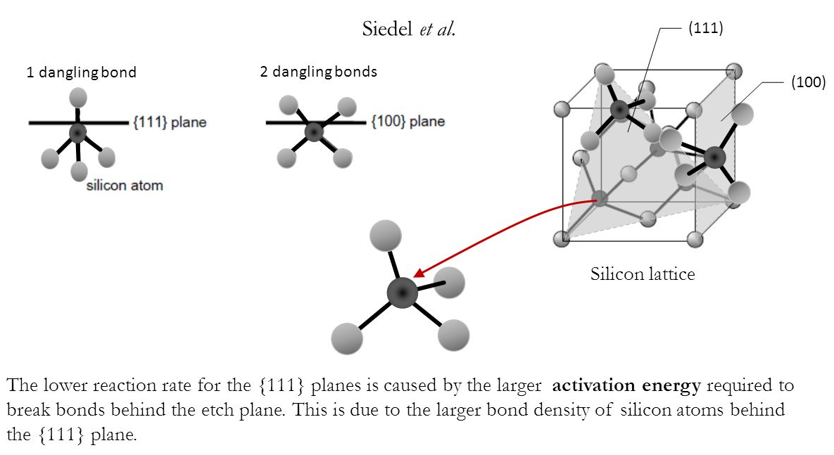
Bond density at surface

Slide 38
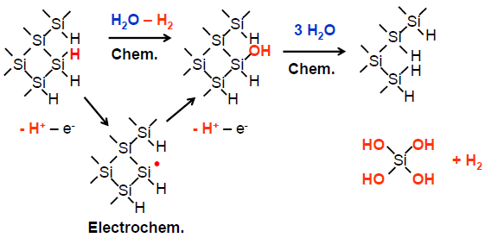
One layer at a time
4 bonds in bulk
2 bonds at surface
https://pmc.polytechnique.fr/spip.php?article580&lang=fr

Slide 39
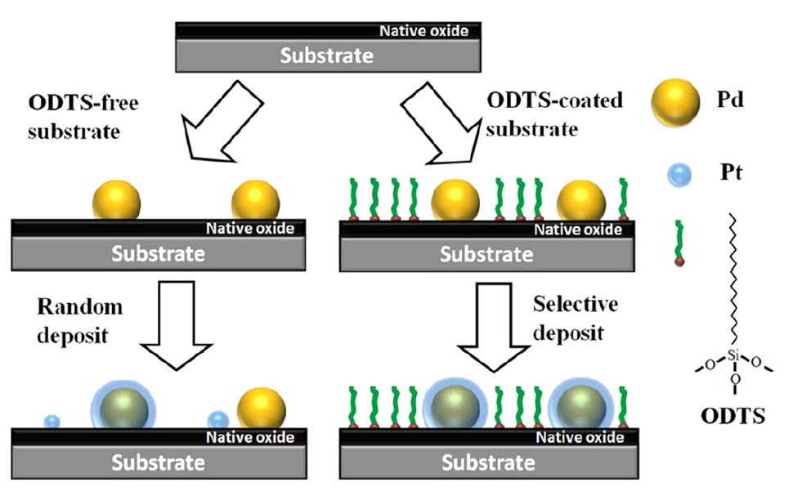
Patterning of catalyst
Cao et al.: Catalysts design and synthesis via selective ALD, JVST A 2018

Slide 40
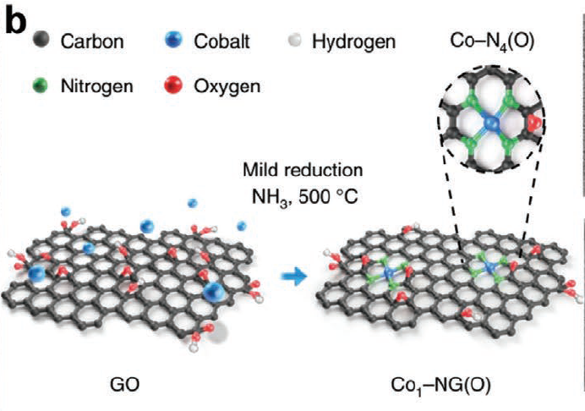
Graphene oxide catalyst
“Co–N₄ moieties are surrounded by the
desired configuration of electron-rich oxygen atoms from graphene
oxide substrates.”
Jiang et al: Adv. Funct. Mater. 2020, 30, 2003321

Slide 41
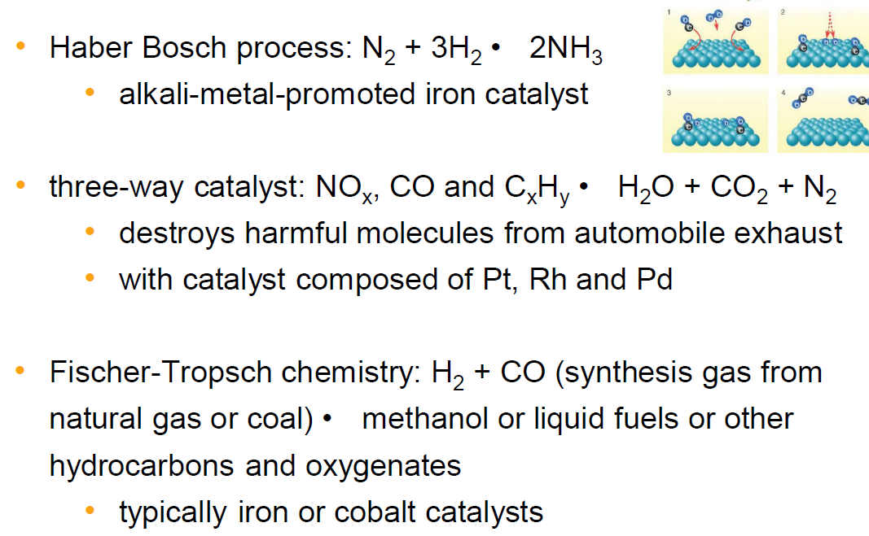
Industrial catalytic processes

Slide 42
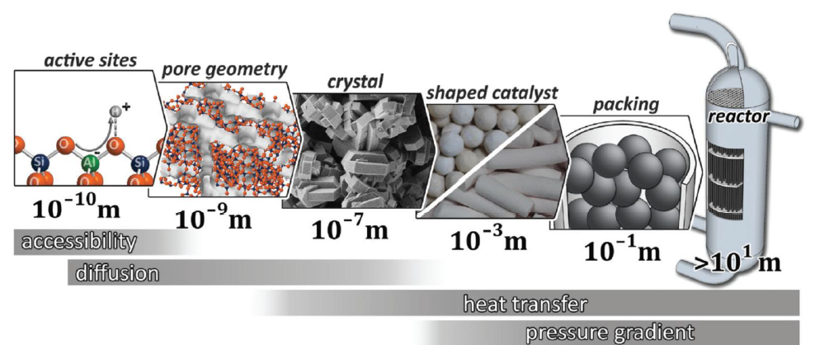
Size scales of catalysis
Chemistry & physics & computational science
Chemical engineering
Materials science
Materials science

Slide 43
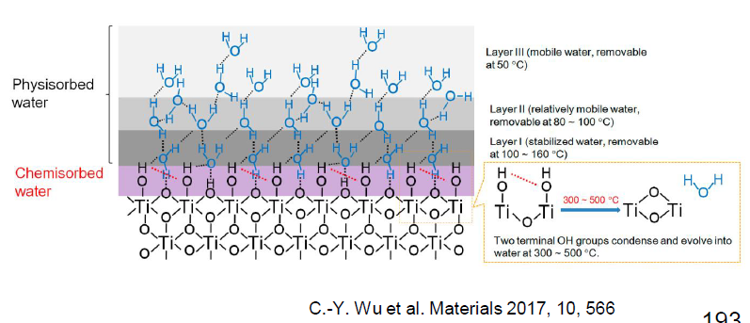
Real surfaces…

Slide 44
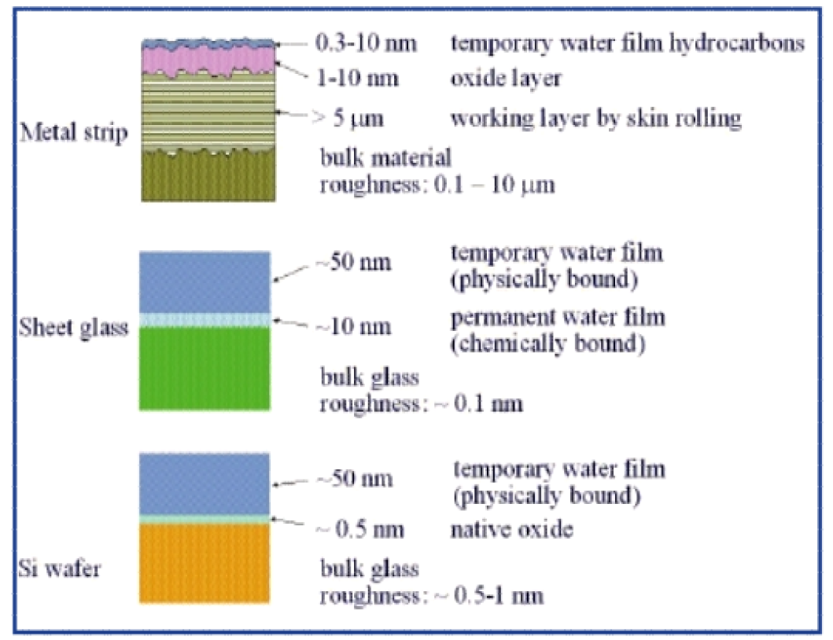
More real surfaces
Belkind & Gershman; Vacuum Technology and Coatng 2008

Slide 45
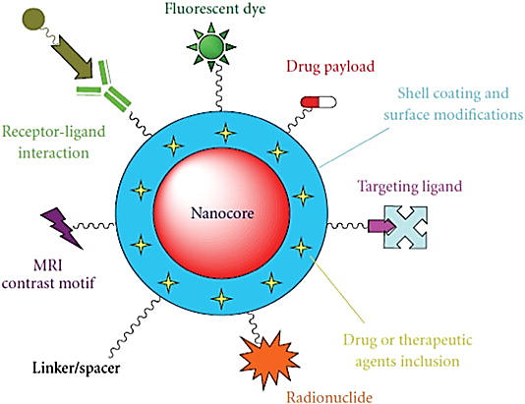
Surface functionalization
Chatterjee et al: Core/shell nanoparticles in biomedical applications, 2014

