Slide 1
Surfaces and Films CHEM E5150 Lecture 2A
J Koskinen

Slide 2
Items:
Ideal surfaces
Surface energy
Surface structure
Restructuring
Real surfaces
Contaminants
Functional groups
Deformation
Mechanical properties
Roughness topography
Defects
Electronic properties
DoS
Optical

Slide 3
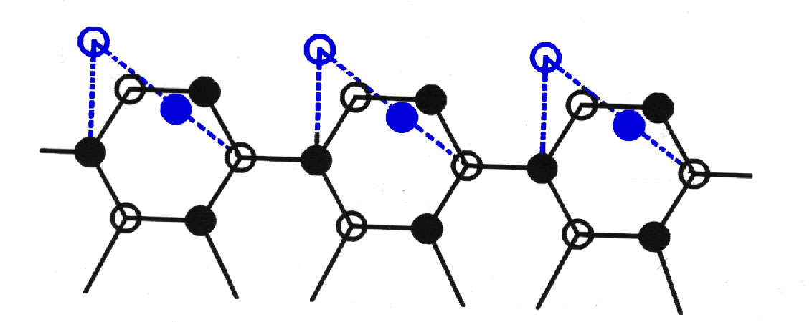
What is surface? In ideal cases:
Surfaces are defined by ‘relaxed’ atoms (i.e. not constrained in 3D as their internal counterparts are). Dangling bonds from these surface atoms are free to react.
Relaxation of surface atoms leads to reconstruction (rearrangement of atoms near the surface).
Relaxation and reconstruction are strongly influenced by the bonding type in the bulk material (i.e. metallic, covalent, ionic, and vander waals)
(110) Surface of GaAs. Surface atoms (blue) are ‘relaxed’ (i.e. not constrained in 3D).
https://player.slideplayer.com/21/6278052/data/images/img0.jpg

Slide 4
Miller Index
Wikipedia

Slide 5
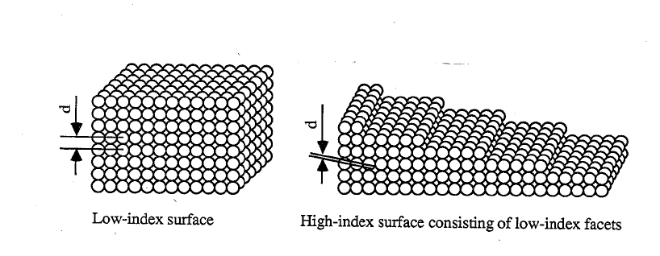
Surface energy
γ surface tension = dW work needed to form surface dA
In thermodynamic equilibrium:

Slide 6
Surface atoms and defects
Science 18 Apr 1997: Vol. 276, Issue 5311, pp. 377-383 DOI: 10.1126/science.276.5311.377

Slide 8
Relaxation and Reconstruction
Surfaces are not formed at zero temperature : Heat leads to atomic re-arrangement.
Atoms at a surface have a lower co-ordination than those in the bulk – the origin of surface tension (strictly surface stress in a solid)

Slide 9
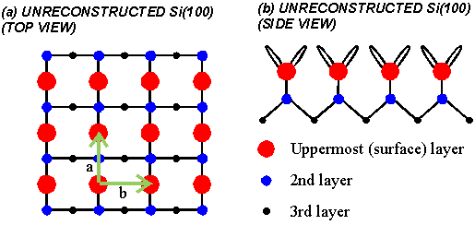
Example Si (100)

Slide 10
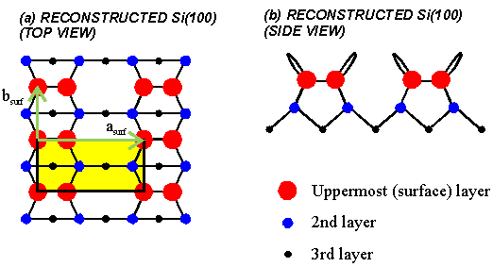
Example Si (100)

Slide 11
An STM image of the Si(100)-2x1 reconstruction

Slide 13
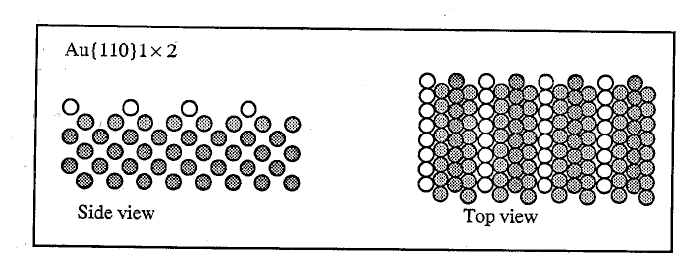
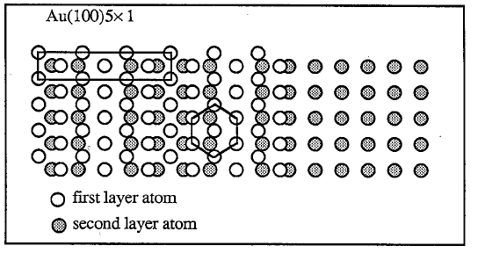
Au surface reconstruction

Slide 14
Modelling of surface electron density
Surface electron density on CeCoIn₅.
Science Advances 22 Sep 2017: Vol. 3, no. 9, eaao0362 DOI: 10.1126/sciadv.aao0362

Slide 15
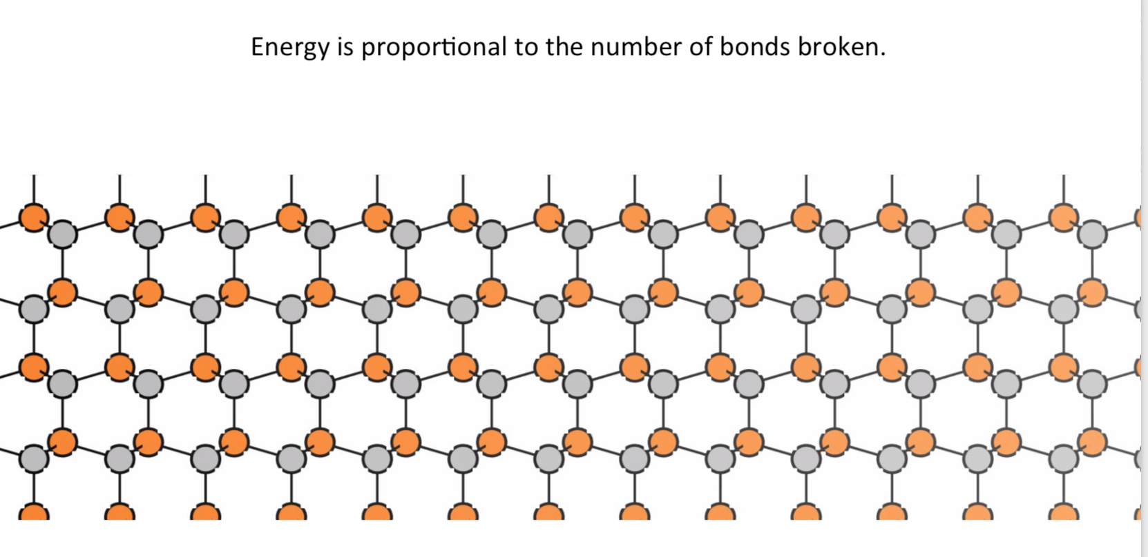
Surface energy

Slide 16
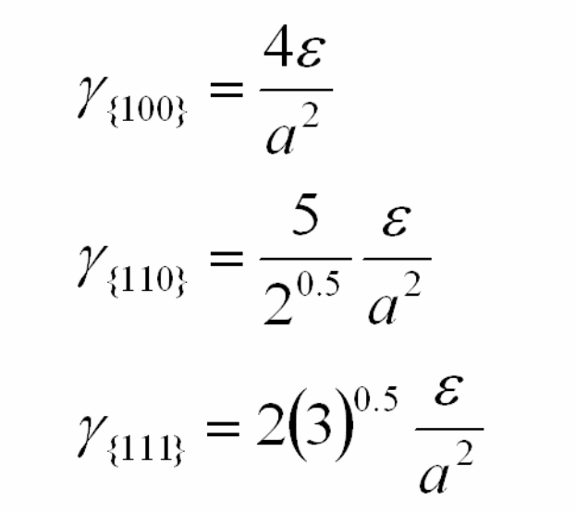
Surface energy - milled index
= 4.0
= 3.54
= 3.46

Slide 17
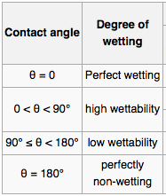
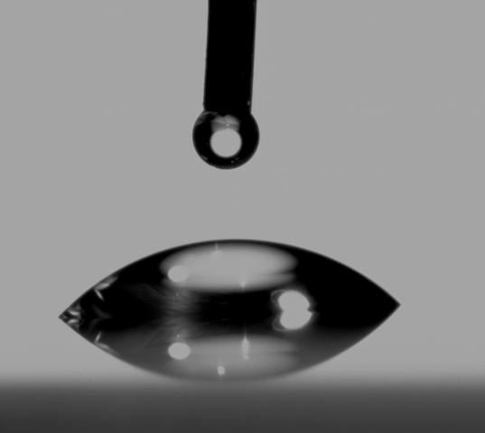
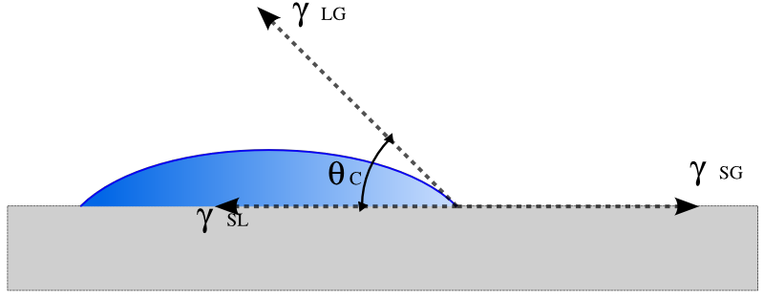
Contact angle
Young equation
S solid
L liquid
G gas
Spreading parameter S
Complete wetting when S ≈ 0
non-wetting when S ≈ -2 Υ_{LG}
Notes:
A direct measure of surface energy can be found by wettability or contact angle.
Youngs eq where each gama is interfacial energy. Gamma SG is interfacial energy between solid and gas.
High energy substrates are much easy to wet than low energy ones.
Also wetting increases if solid surface energy is higher than liquid surface energy.
Direct correlation to cleaning, solvents and how dry a surface stays.

Slide 18
Surface Electronic States
<
<

Slide 19
10.3390/nano10020362

Slide 20
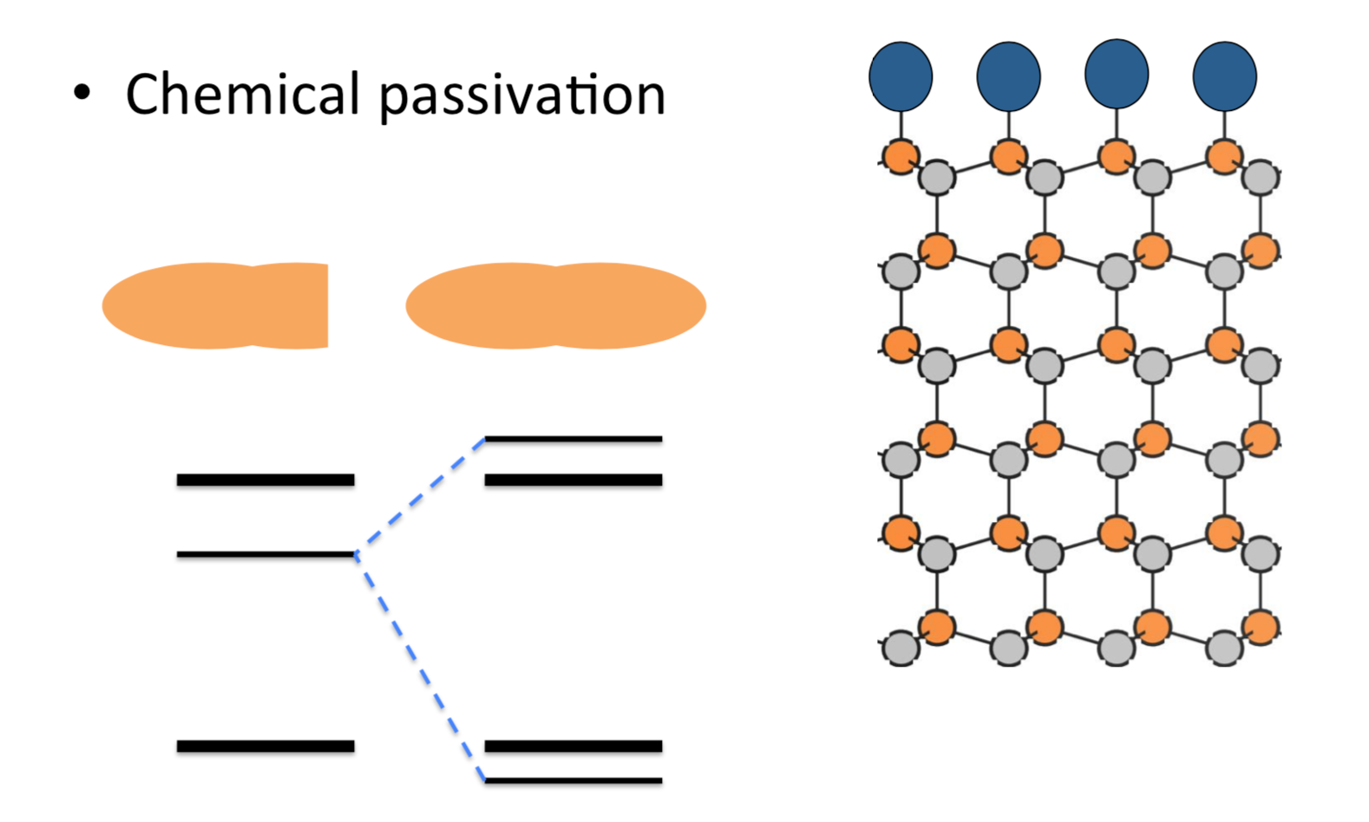
Surface passivation
Dr. Keith T. Butler Department of Chemistry k.t.butler@bath.ac.uk

Slide 21
Clean surface (0001) of MoS₂
DOI: 10.1021/acsami.5b01778 ACS Appl. Mater. Interfaces 2015, 7, 11921−11929

Slide 22
Clean surface (0001) of MoS₂with defects
defects
DOI: 10.1021/acsami.5b01778 ACS Appl. Mater. Interfaces 2015, 7, 11921−11929

Slide 23
Clean surface (0001) of MoS₂ with defects

Slide 24
Clean surface (0001) of MoS₂ with its impurities
Inductively Coupled Plasma Mass Spectrometer

Slide 25
Surface contamination
5 major contaminant classes (in CMOS processes)
Particles
Metallic ions
Chemicals
Bacteria
Airborne molecular contaminats

Slide 26
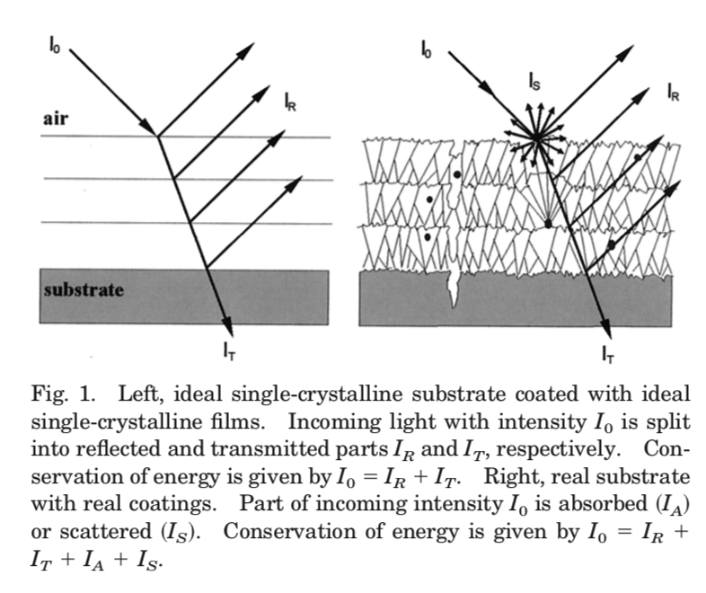
Optical properties of real thin films
1 June 2002 / Vol. 41, No. 16 / APPLIED OPTICS

Slide 27
Transparent – semi transparent
Photovoltage
Controlled emission
Decoration

Slide 28
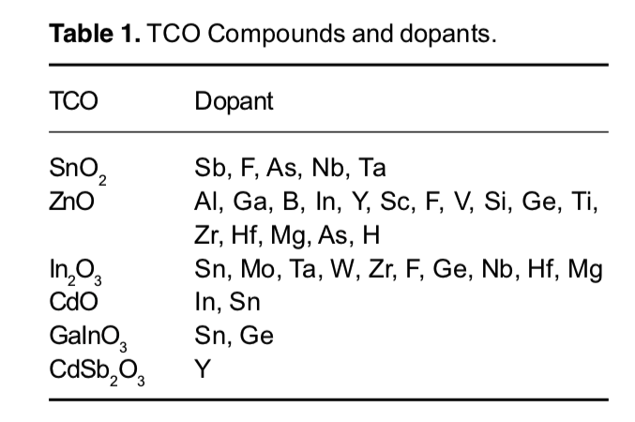
TCO (transparent conductive oxides ) films
ITO Indium Sn oxide
IMO Indium Mo oxide
ITiO Indium Ti oxide
FTO Tin oxide + fluorine
Resistivity ~10⁻⁴ Ωcm or less
Charge carries due to oxygen vacancies
and dopand impurities
https://doi.org/10.1016/j.tsf.2009.09.044
https://doi.org/10.1515/rams-2018-0006

Slide 29
Transparent conductive layer

Slide 30
Color map L* a* b*
The CIELAB color space (International Commission on Illumination - CIE in 1976)

Slide 31
Arc deposited Ti-Mg-N Effect of composition
Mg/Ti ratio 0 → 0.53
- colors golden → copper → violet → metallic gray
- conductivity 98 → 457 µΩcm

Slide 32
Bulk Plasmons
Introduction to Surface Physic, N. Tabet

Slide 33
Surface plasmos
https://doi.org/10.1039/C5NR00578G
Introduction to Surface Physic, N. Tabet

