Slide 1
Surfaces and Films
CHEM E5150
Lecture 2B
J Koskinen

Slide 2
Items
Low pressure – vacuum
Thin film growth from incoming molecules
Surface characterization

Slide 3
Items
Low pressure – vacuum
Thin film growth from incoming molecules
Surface characterization

Slide 4
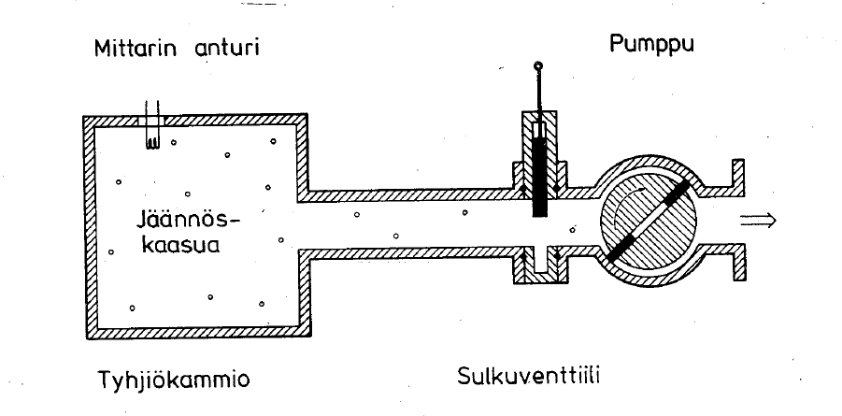
Vacuum system
VACUUM GAUGE
PUMP
RESUDUAL GAS
VACUUM CHAMBER
FLANCE

Slide 5
Idea gas collision
Video
https://simplexitysolutions.blogspot.com/2015/
09/interpretation-of-pressure-on-kinetic.html

Slide 6
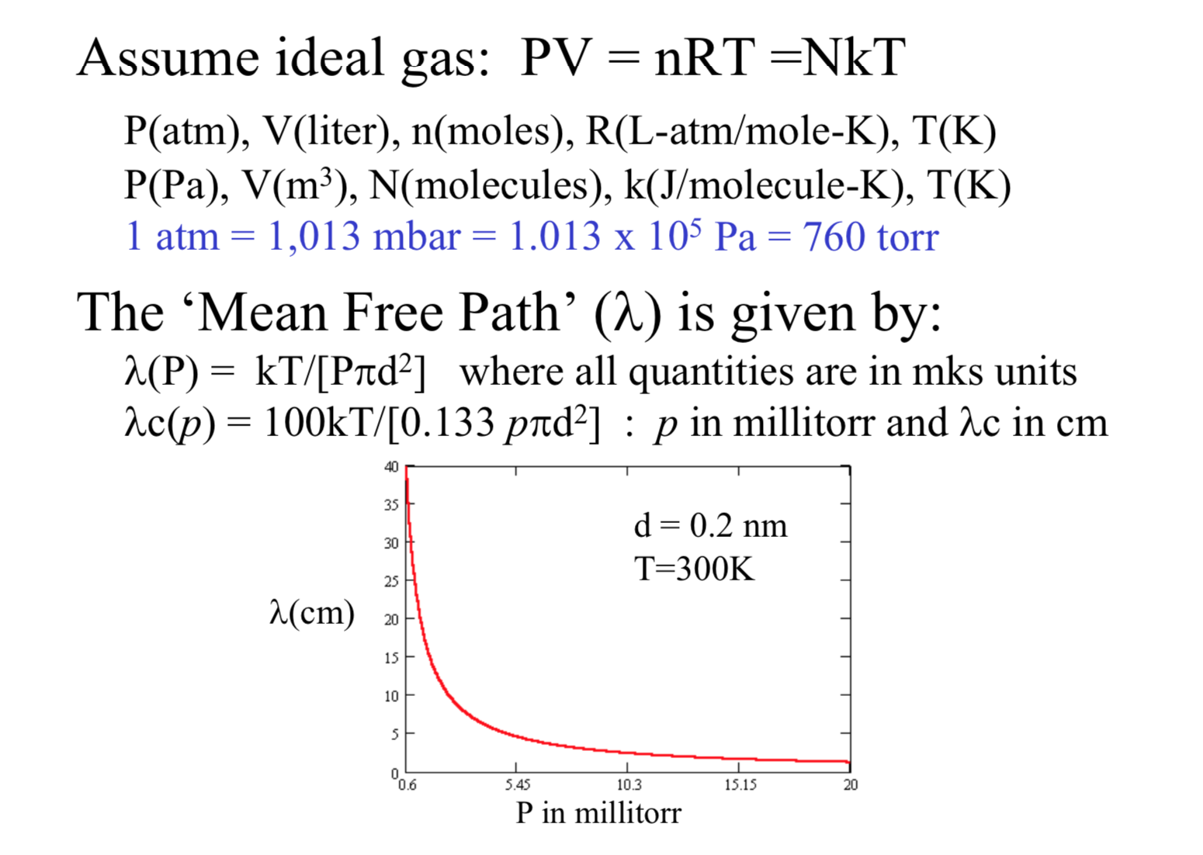
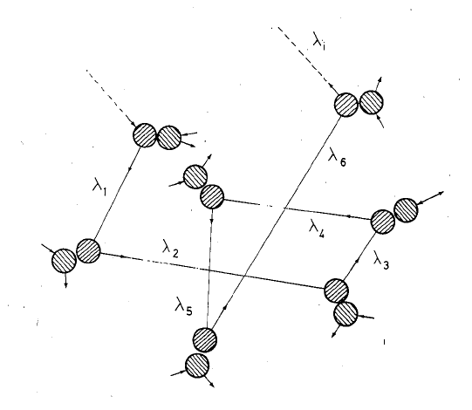
Vacuum – low pressure
Prof. K.W. Hipps
www.wsu.edu/~hipps/M571.htm

Slide 7
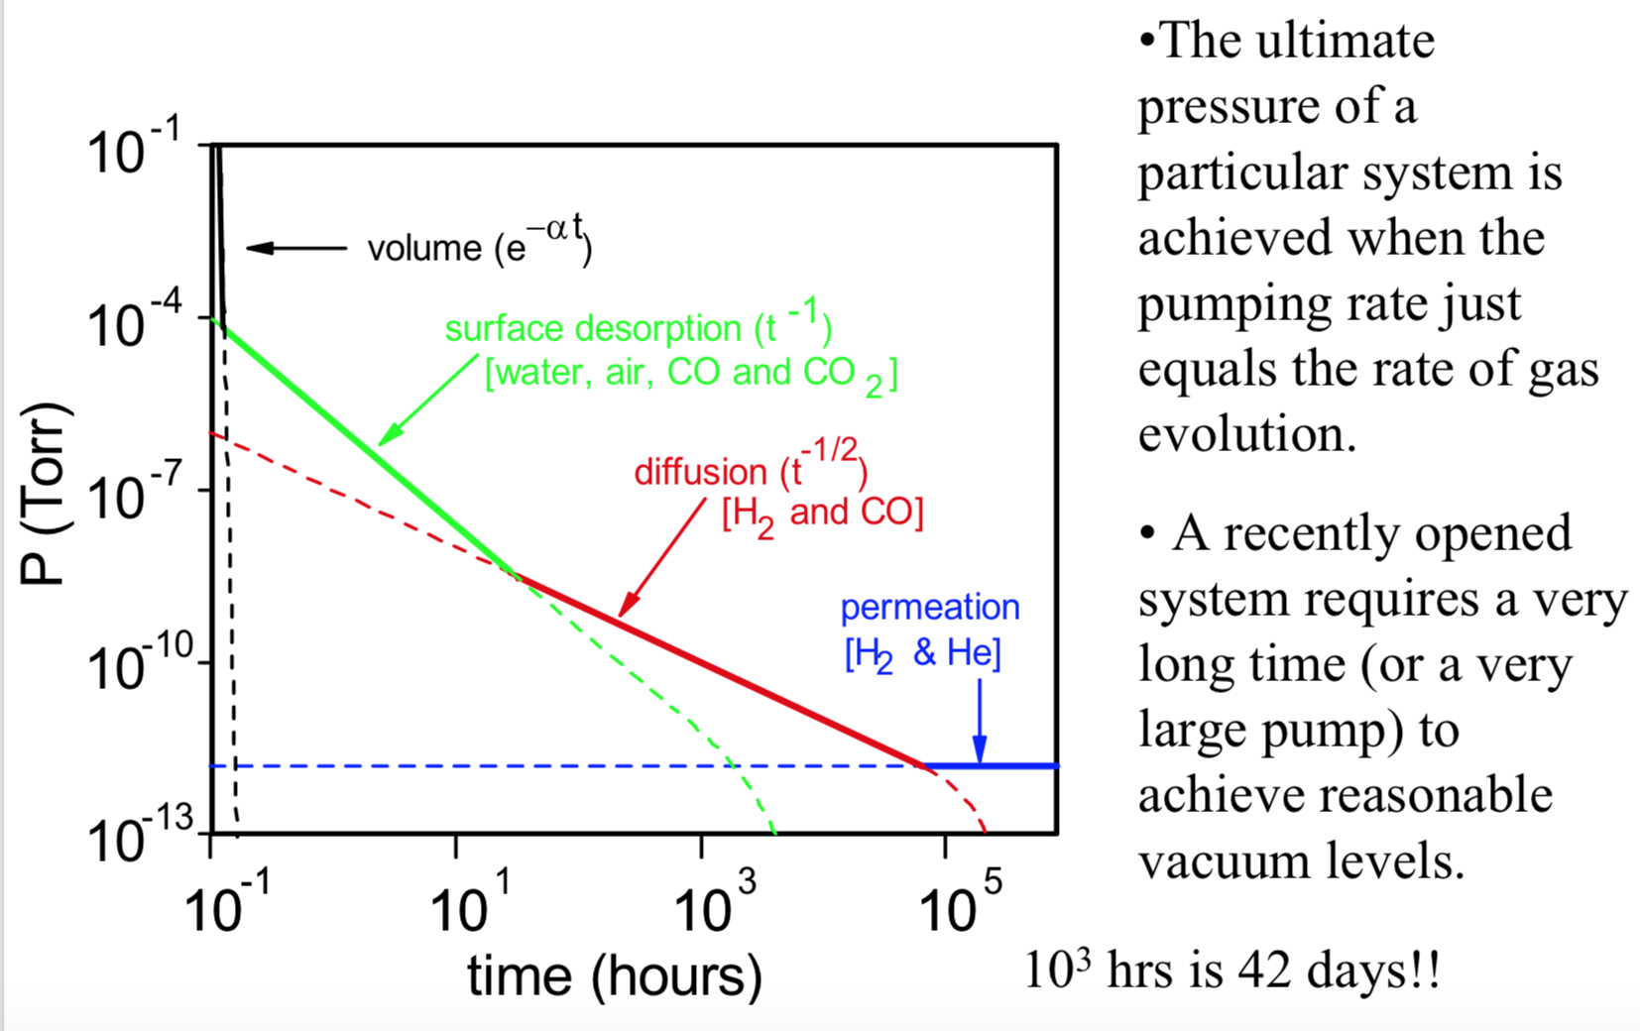
Pump-down Pressure vs Time
Typical Unbaked Stainless Steel Chamber
Prof. K.W. Hipps
www.wsu.edu/~hipps/M571.htm

Slide 8
Viscose flow
Viscous flow: λ << D
Water in a pipe. The intermolecular interactions are much more important than the interactions with the container.
P ≥ 50 milliTorr = 7 Pa = 5x10⁻² Torr
Prof. K.W. Hipps
www.wsu.edu/~hipps/M571.htm

Slide 9

Knudsen flow
Viscous flow: λ ≈ D
Intermediate state. About as many intermolecular collisions as collisons with the wall
Prof. K.W. Hipps
www.wsu.edu/~hipps/M571.htm

Slide 10
Ballistic flow
Viscous flow: λ ≫ D
Bullets bouncing off walls. Negligible intermolecular interactions. Primary interactions are with the container
P ≤ 0.5 milliTorr = 0.07 Pa = 5x10⁻⁴ Torr
Prof. K.W. Hipps
www.wsu.edu/~hipps/M571.htm

Slide 11
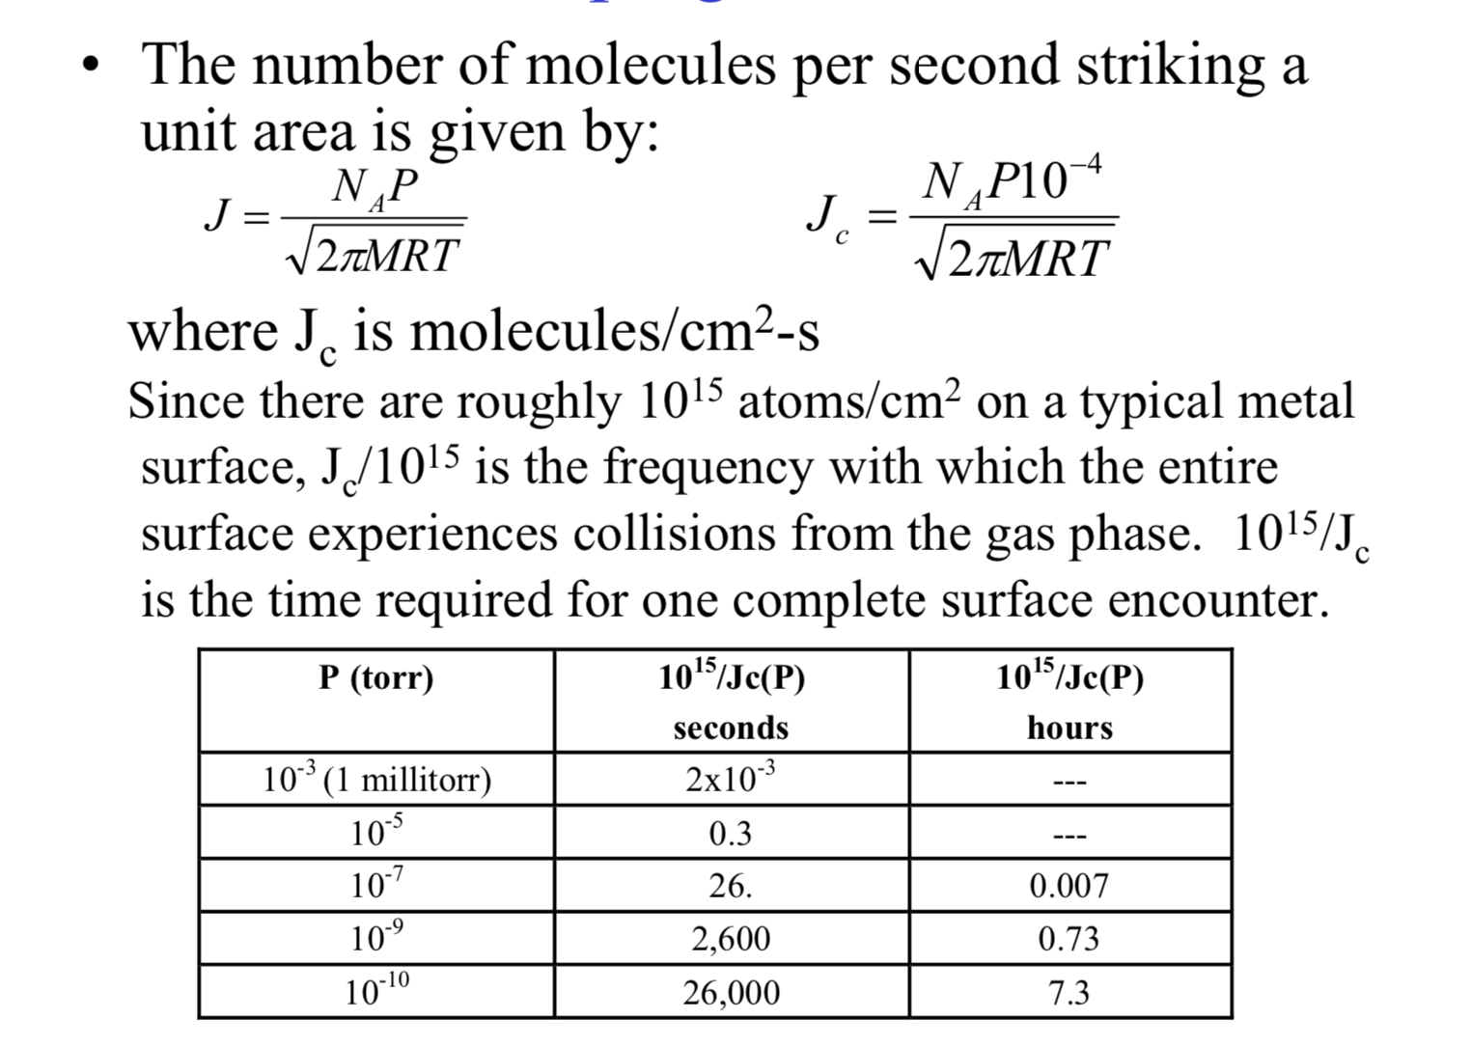
Impingement Rate
Prof. K.W. Hipps
www.wsu.edu/~hipps/M571.htm

Slide 12
Items
Low pressure – vacuum
Thin film growth from incoming molecules
Surface characterization

Slide 13
Adsorption of atoms on surface
http://soft-matter.seas.harvard.edu/index.php/File:Fig6.gif

Slide 14
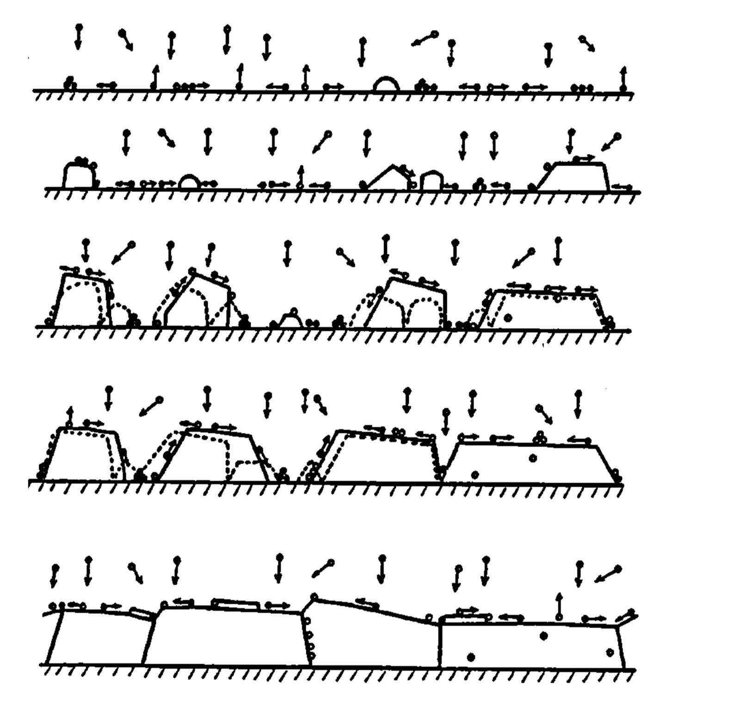
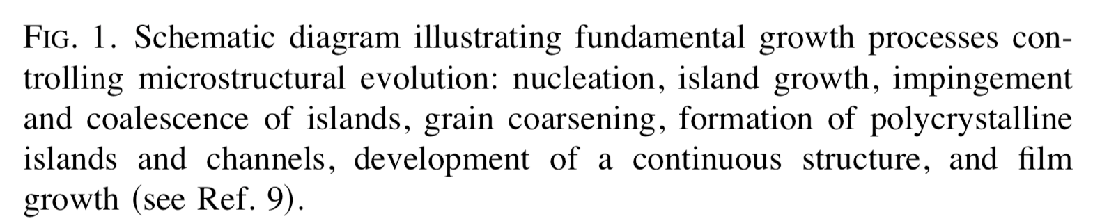
Thin films growth
J. Vac. Sci. Technol. A 21„5..., SepÕOct 2003

Slide 15
Nucleation

Slide 16
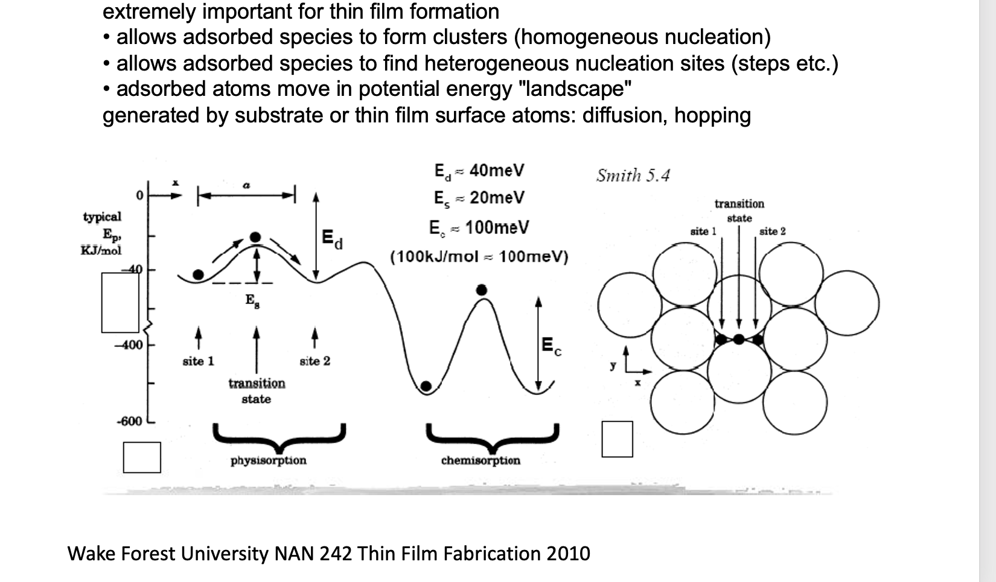
Surface diffusion
M. Ohring, Materials Science of thin films, 2002

Slide 17
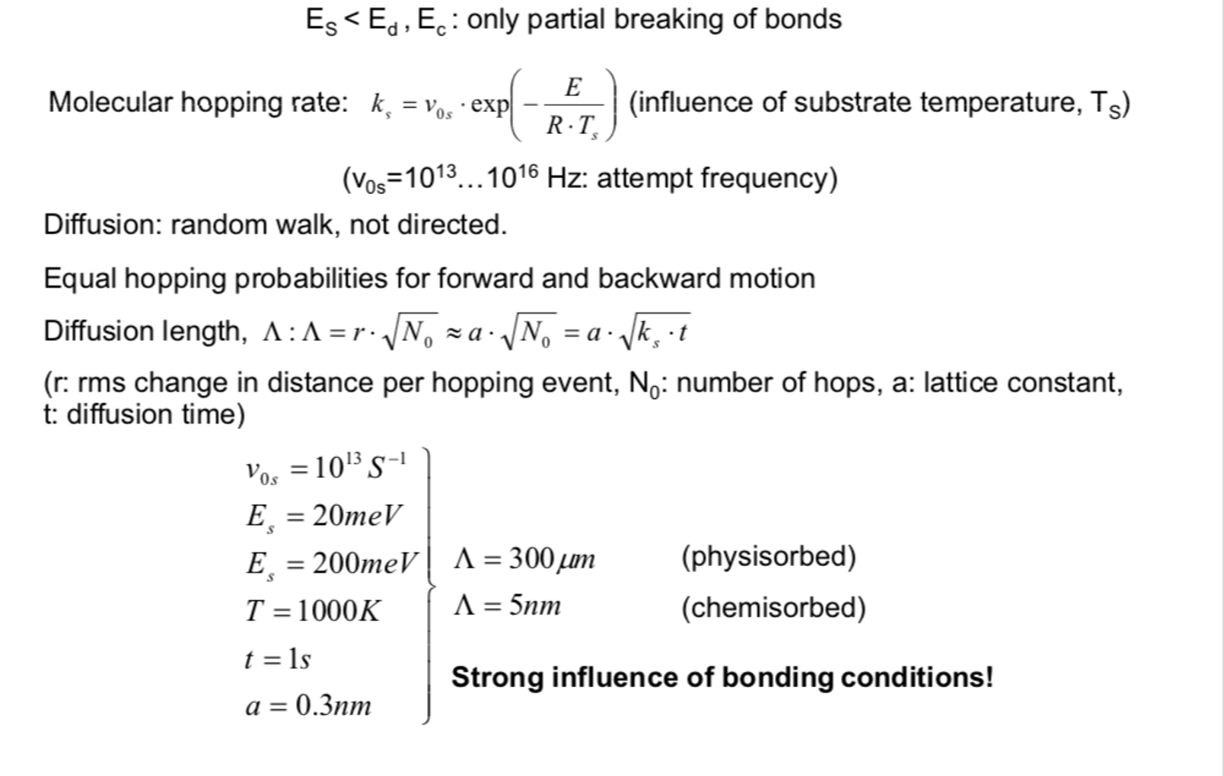
Surface diffusion

Slide 18
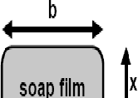

Nucleation – minimizing surface energy
ΔW = 2 ⋅ γ ⋅ ΔA = 2 ⋅ γ ⋅ Δx ⋅ b
F ₌ ΔW
b Δx ⋅ b
= 2 ⋅ γ
Force acts tangentially
Tends to decrease surface area
Fundamental to thin film growth:
Surface energy can be minimized by surface diffusion
γ ⋅ A → min
Chemical composition
crystallographic orientation atomic reconstruction
Surface topgraphy
M. Ohring, Materials Science of thin films, 2002

Slide 19
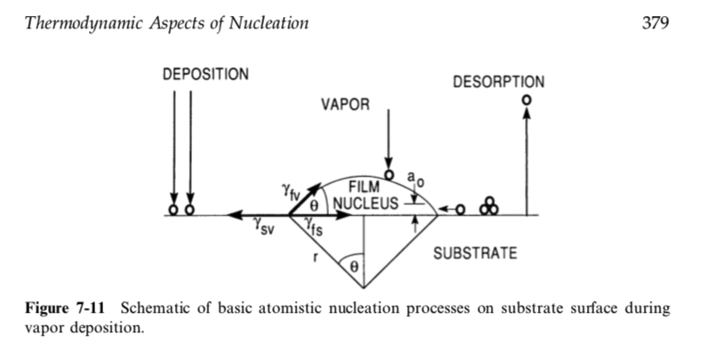

Nucleation of a growing film
M. Ohring, Materials Science of thin films, 2002

Slide 20
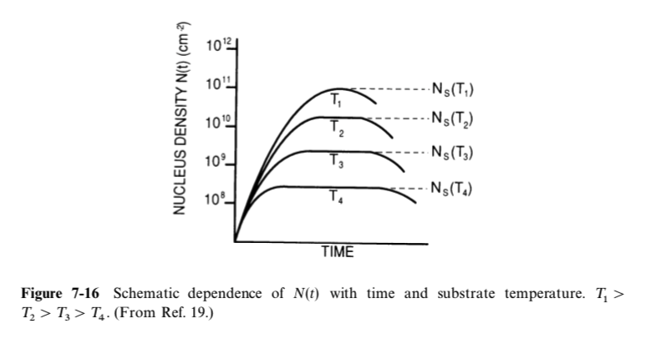
Density of nuclei
M. Ohring, Materials Science of thin films, 2002

Slide 21
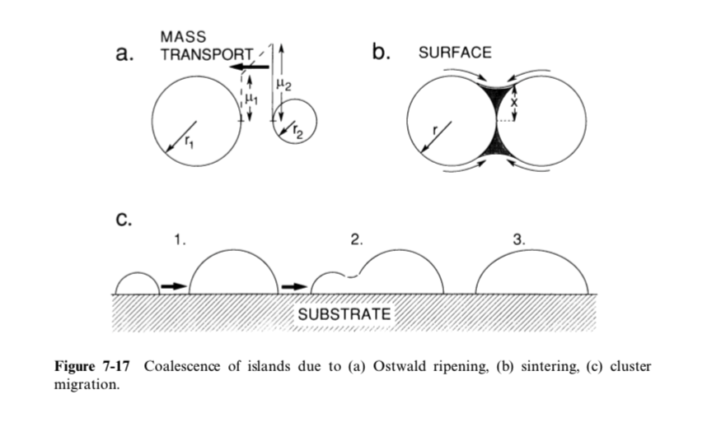
Coalescence - ripening
M. Ohring, Materials Science of thin films, 2002

Slide 22
Items
Low pressure – vacuum
Thin film growth from incoming molecules
Surface characterization

Slide 23
Thin films characterization
Why vacuum for cahracterization of thins film and surfaces?
  Only in high vacuum surfaces are clean
  Many characterization methods are scatter physics:
    Particle in or particle out ( high mean free path λ needed)

Slide 24

Scattering experiment
particles ➔in vacuum !!
elastic scattering
  mass, density
  diffraction
inelastic scattering
  information on material
    DOS
    bonding
    identification of elements
    …
OUT
photon
IN
electron
molecule
ion, atom, neutron

Slide 25
XPS -ESCA
Chemical bonding
Composition
wikipedia

Slide 26
Auger electron spectroscopy
Surface composition
Chemical bond

Slide 27
LEED Low Energy Electron Diffraction
Crystalline structure

Slide 28
Seconday ion mass specroscopy

Slide 29
Seconday ion mass specroscopy
Vacuum roughly 10⁻⁶ mbar
Ions: Ar⁺, O₂⁺, Cs⁺ (M 133) 1 – 30 keV
sensitivity 10¹² – 10¹⁶ atoms/cm³
beam focus down to 1 µm
mapping of elements
Depth profiling by sputter etching
seconday ion yield depends on chemical composition of sample
  reference samples with known composition necessary for quantitative analysis
Sputtering - > mixing of composition
  depth resolution decreases when sputtering deeper

Slide 30
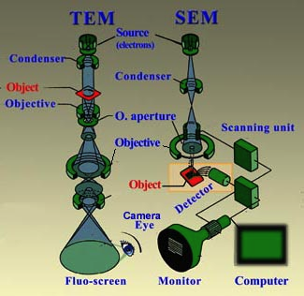
Electron microscopy
Topography
Defects
Impuriteis
Thickness
Atomic structure
Defects

Slide 31
SEM - EDS Energy Dispersive Spectroscopy

Slide 32
TEM EELS Electron Loss Spectroscopy
Chemical bonding
Combined with atomic resolution

Slide 33
Ion beam scatter (Rutherford Back Scattering RBS)
Sample thin film
Surface composition

Slide 34
Grazing angle x-ray spectroscopy

Slide 35
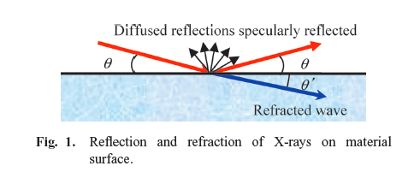
X-Ray Reflectivity XRR
Thin Film
  thickness
  density
  roughness
  rougness of interface
Miho Yasaka, The Rigaku Journal, 26(2), 2010

Slide 36
Thickness of film – contact profilometry
https://australiasurfacemetrologylab.org/new-page

Slide 37
Optical non-contact profilometry
https://www.laserfocusworld.com/test-measurement

Slide 38
Residual stress of thin films
R

