Slide 1
Surface preparation
sami.franssila@aalto.fi

Slide 2
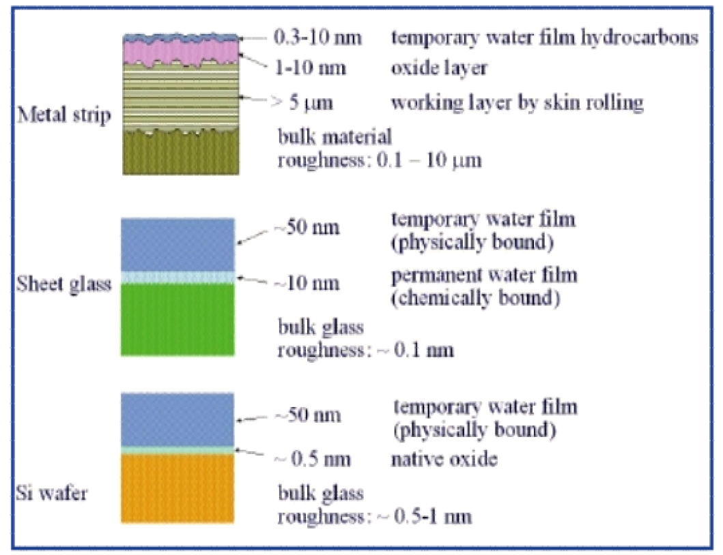
Non-ideal surfaces
Belkind & Gershman; Vacuum Technology and Coatng 2008

Slide 3
Sources of contamination
Gas phase, e.g. water vapor, ammonia, hydro- carbons.
Airborne particles: pollen, smog, viruses,…
Liquid phase, e.g. dissolved oxygen, dissolved metal ions, waterborne particles, residues of cleaning solvents
Solid phase, e.g. packages and boxes, tweezers, spatulas, conveyor belts, robot hands, chucks and holders,…

Slide 4
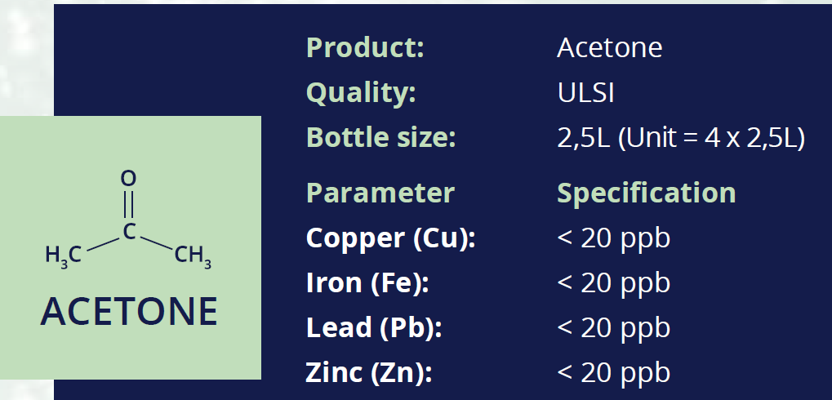
Liquid phase contamination
Water purity (18 MΩ-cm; reverse osmosis)
Cleaning chemicals !!! Never fully pure.
MicroChemical GmbH

Slide 5
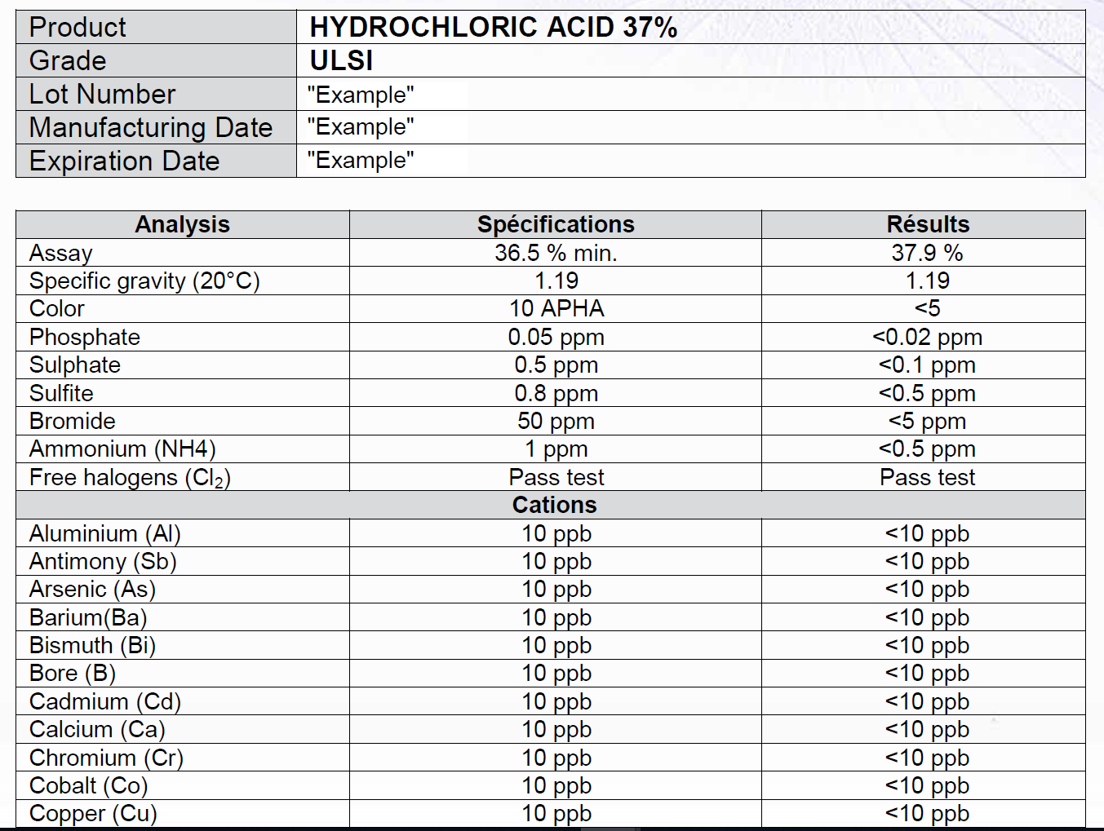
MicroChemical GmbH

Slide 6
0.1 ppm sulphate
If we have 2.5 liters of HCl, how many sulphate groups are there ?
2.5 liters is ca. 2.5 kg, or 70 moles ≈ 4*10²⁵ molecules.
0.1 ppm means 10⁻⁷ ➔ 4*10¹⁸ molecules.
If we clean a batch of 25 silicon wafers, 100 mm diameter, total surface area is 4000 cm².
If all sulphate from liquid would be deposited on the wafers, that would equal 10¹⁵ molecules/cm².
Silicon surface atom density is (5*10²² cm⁻³)^{2/3} =10¹⁵cm⁻².

Slide 7
Solid phase contamination
Objects are stored in boxes, or containers.
Objects are handled by tweezers, hands…
Objects are placed on chucks/holders for processing.
Process chambers are made of solid materials, and the more energetic the process, the more likely it is to kick chamber wall atoms around.

Slide 8
Avoiding solid contamination
Use inert and hard materials like stainless steel and molybdenum.
Polish surfaces to minimize sites for foreign atom attachment.
Clean tweezers/chucks/chambers/boxes (by wet or dry cleaning, or if really dirty, by mechanical cleaning like sand blasting).

Slide 9
Surface preparation goals
Removes contamination
Leaves surface in known condition
Eliminates previous step peculiarities
Eliminates waiting time effects

Slide 10
Surface preparation operations
Cleaning (removal of adherent stuff)
Etching (removal of surface layers)
Activation (surface bond modification)
Passivation (surface bond inactivation)
Deposition (coating the surface)

Slide 11
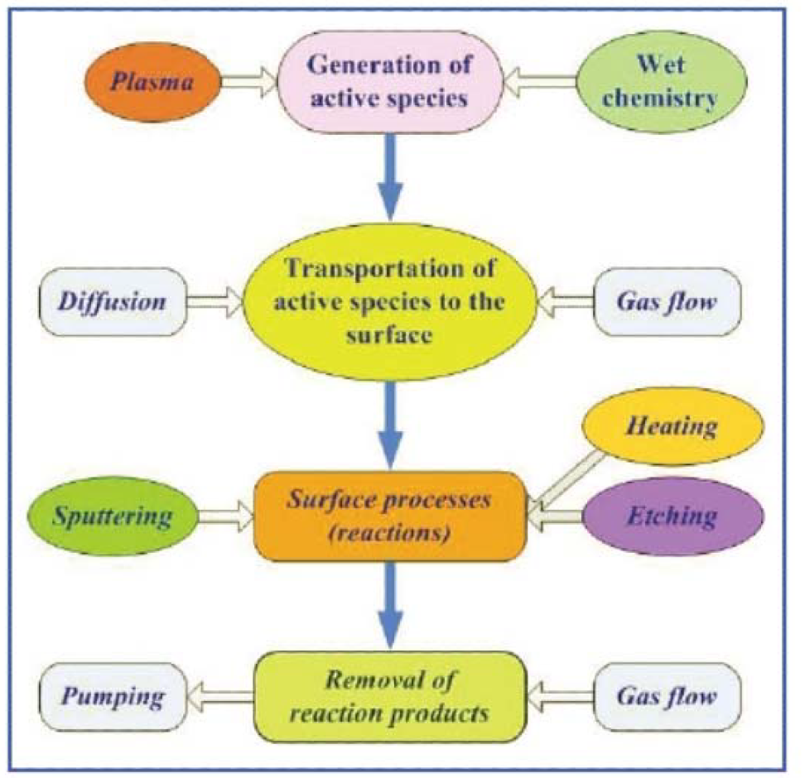
Process steps in cleaning
Belkind & Gershman; Vacuum Technology and Coatng 2008

Slide 12
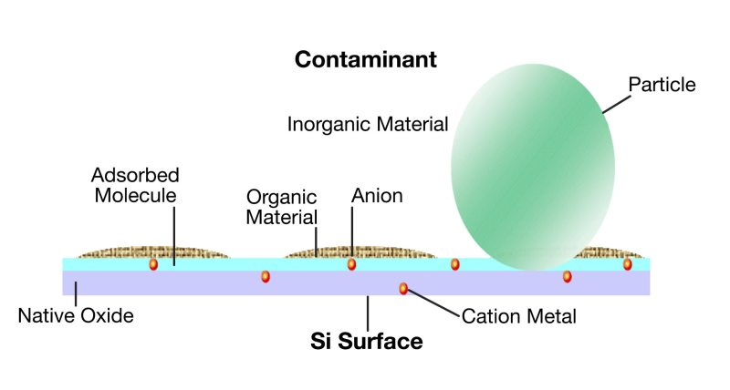
Cleaning
removal of particles
removal of native films
removal of polymeric films
removal of metals and ions
removal of adsorbed water
https://www.mksinst.com/n/wafer-surface-cleaning

Slide 13
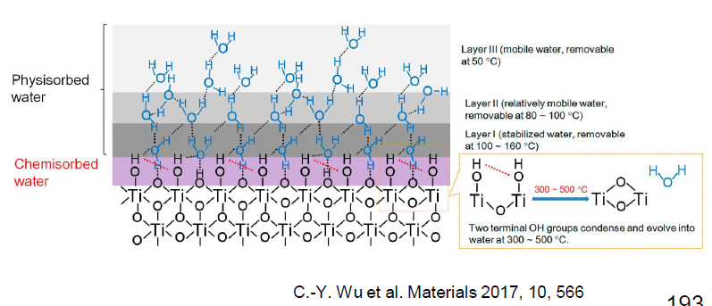
Surface water
Different kinds of water !
Strongly bonded inner layer (chemisorption, covalent bonds)
Weakly bonded outer layers (physisorption, H-bonds)

Slide 14
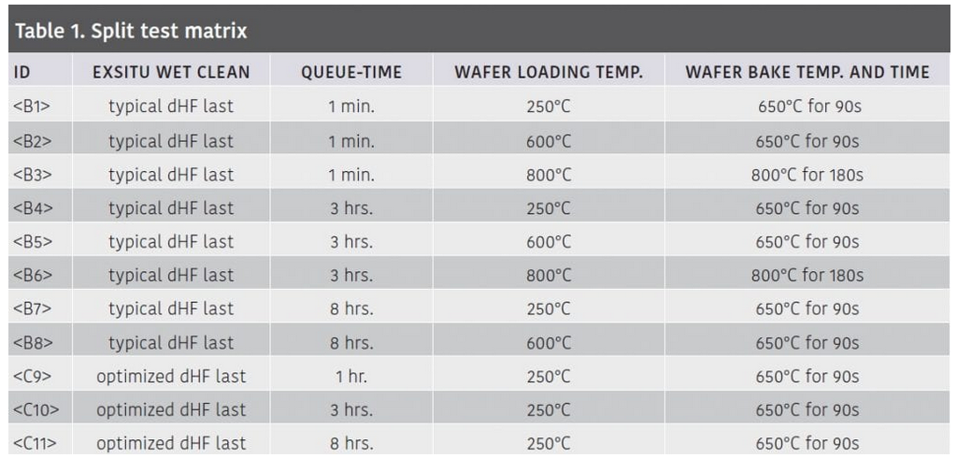
Water removal bake
Water boils at 100ºC, in bulk.
But chemisorbed H₂O molecules are tightly bound.
Pagliaro: Surface Preparation for Low Temperature CVD Si Epitaxy Processing, https://www.semiconductor-digest.com/2020/02/03/surface-preparation-for-low-temperature-cvd-si-epitaxy-processing/

Slide 15
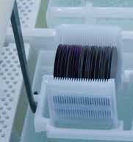
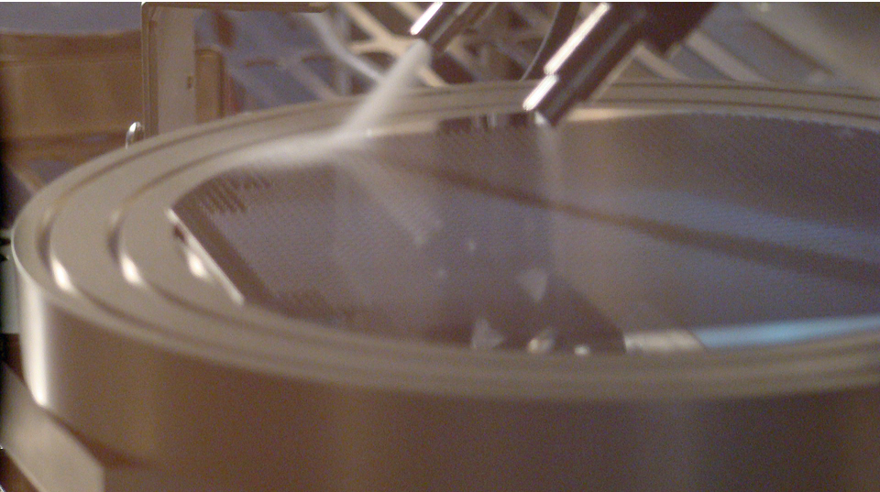
Wet cleaning
Aqueous solutions
Acidic solutions
Alkaline solutions
Solvent treatments
immersion
spray/jet

Slide 16
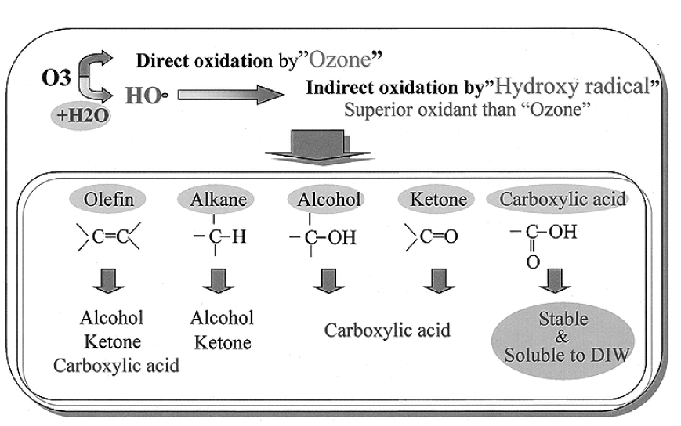
Ozone-spiked water
Ozone, O₃, is very reactive
Ozonated DI-water with 1-100 ppm ozone
Ozone breaks down organic molecules to smaller fragments ➔ water soluble
Ozone addition to acidic cleans is also beneficial.
Abe et al: IEEE TRANSACTIONS ON SEMICONDUCTOR MANUFACTURING, VOL. 16, NO. 3, AUGUST 2003 401

Slide 17
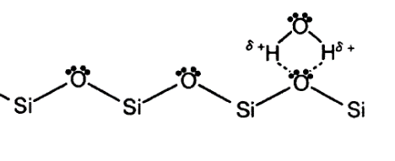
Ammonia-peroxide (APM)
NH₄OH:H₂O₂:H₂O (1:1:5)
a.k.a. APM, RCA-1 and SC-1 (standard clean)
operated at 80ºC
removes particles (by undercutting them)
removes organic materials by oxidation
leaves surface hydrophilic (OH-terminated)

Slide 18
APM reactions
Ammonia peroxide solution works by oxidizing the silicon surface, and subsequently etching the oxide away.
Eq. 12.1 2 H₂O₂ ==> 2 HO₂⁻ + 2H⁺ peroxide disproportionation
Eq. 12.2 Si + 2 HO₂⁻ ==> SiO₂ + 2 OH⁻ silicon oxidation
--------------------------------------
Eq. 12.3 Si + 2 H₂O₂ ==> SiO₂ + 2 H₂O total reaction for oxidation
Eq. 12.4 SiO₂ + OH⁻ ==> HSiO₃⁻ (aq) oxide etching
Silicon etch rate in ammonia-peroxide is ca. 0.5 nm/min and typical 10 minute clean thus results in ca. 5 nm silicon etching.

Slide 19
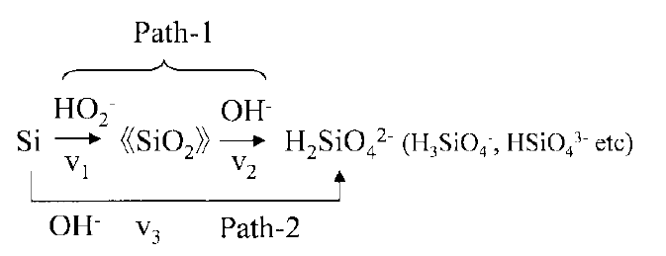
Detail mechanism of APM
= oxidation + oxide etching
= direct etching of silicon
α is the ratio of the etching reaction of path-1 to total etching reaction.

Slide 20
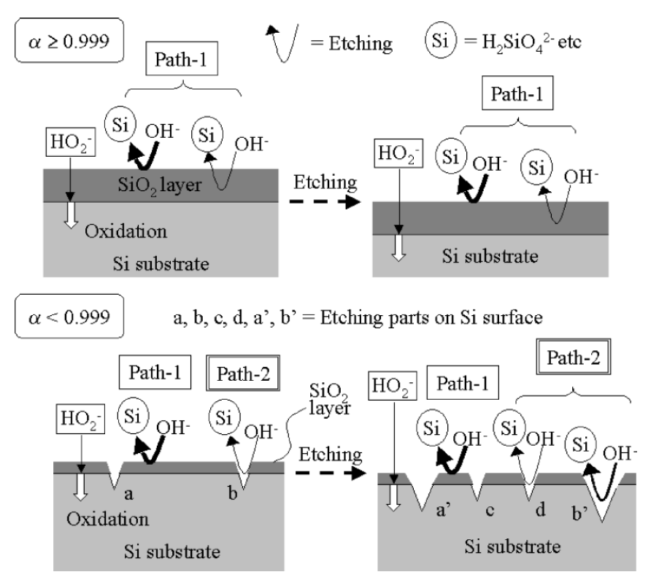
Competing etching reactions
etching reaction of a Si substrate proceeds along two paths (path-1, path-2) in APM.
In path-1, the Si surface is oxidized by OH₂⁻
then the SiO₂ layer is etched by OH-.
In path-2, the Si surface is directly etched by OH-.
Path-1 is favorable for APM cleaning because path-2 causes some problems, such as too fast etching, an increase in surface microroughness, and a decrease in particle removal efficiency.
Yamamoto et al: IEEE TRANSACTIONS ON SEMICONDUCTOR MANUFACTURING, VOL. 12, NO. 3, 1999

Slide 21
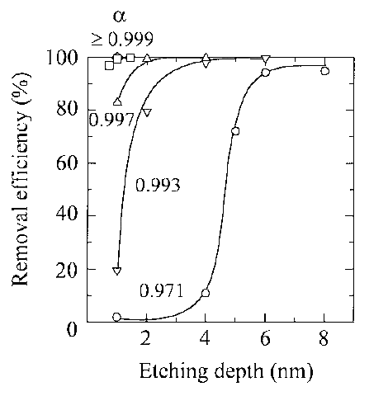
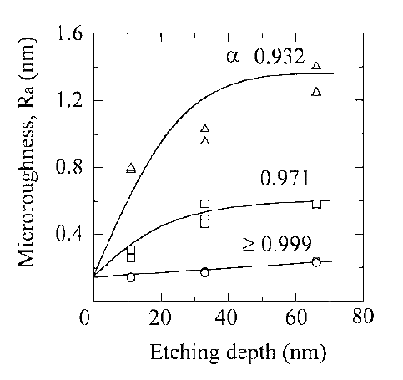
Particle removal by etching
Ammonia-peroxide mixture, etching rate: 1.1 nm/min.
Yamamoto et al: IEEE TRANSACTIONS ON SEMICONDUCTOR MANUFACTURING, VOL. 12, NO. 3, 1999

Slide 22
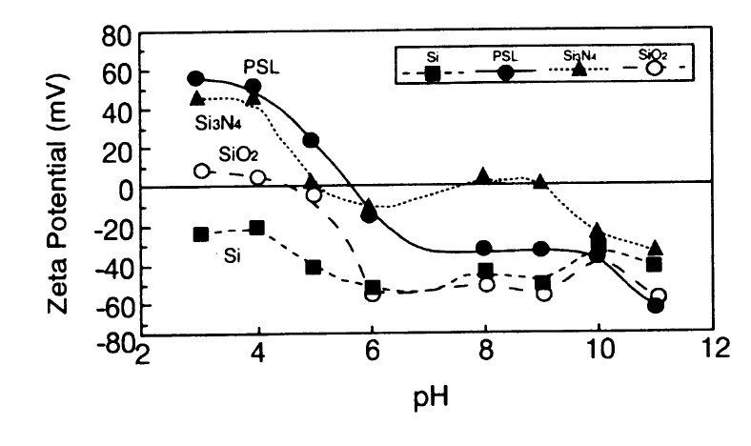
Zeta-potential (surface charge)
If the surface and the particles have opposite charges, they will repel each other ➔ no particle deposition.
Hattori, T. (ed.): Ultraclean surface processing of silicon wafers,

Slide 23
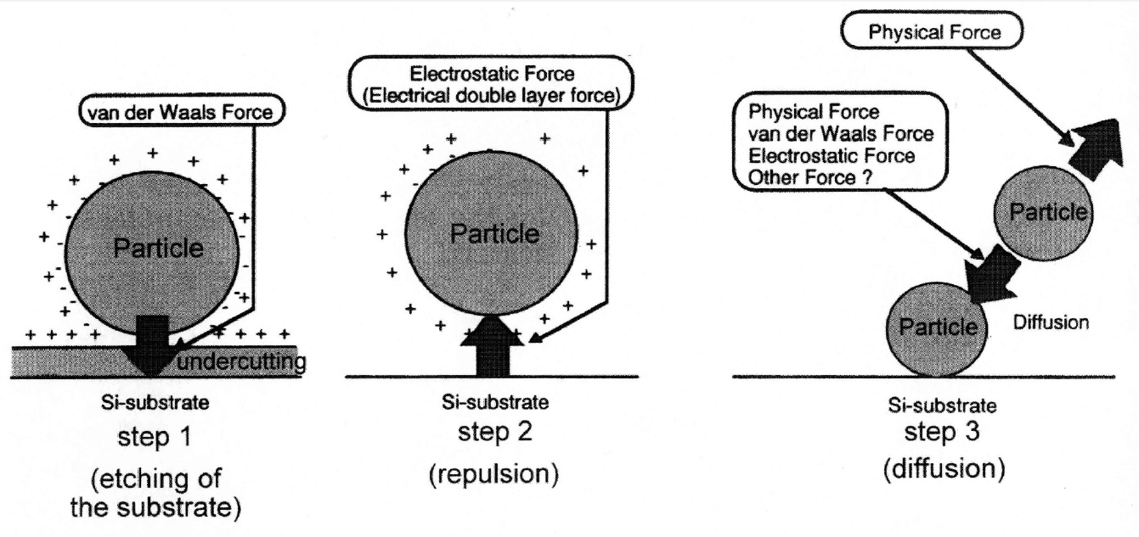
Undercut etching
Hattori, T. (ed.): Ultraclean surface processing of silicon wafers,

Slide 24
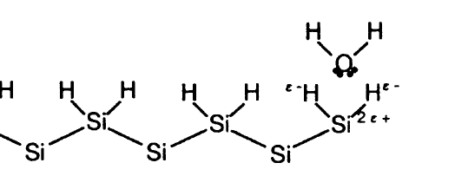
Hydrogen chloride-peroxide
HCl:H₂O₂:H₂O (1:1:6)
a.k.a. RCA-2 and SC-2
operated at 80ºC
removes metal contamination
leaves surface hydrophilic (H & F-terminated)
Hattori, T. (ed.): Ultraclean surface processing of silicon wafers,

Slide 25
Sulphuric acid
H₂SO₄ is a strong oxidant
Organics removal by oxidation
Metals dissolved
Oxidation is enhanced by addition of peroxide H₂O₂
120ºC operating temperature
May leave sulphur residue
Chemical waste

Slide 26
HF, hydrofluoric acid
removes SiO₂
comes in many concentrations and formulations:
  DHF (dilute HF), HF:H₂O (1:100-1:1000) (room temp)
  BHF (buffered HF, HF:NH₄F 6:1 volume ratio (at 35ºC)
  strong HF (49%) (room temperature)
leaves surface hydrophobic
does not give a burning sensation immediately
delayed attack on bone after diffusing through the skin
special gel treatment ! Check this gel before using HF.

Slide 27
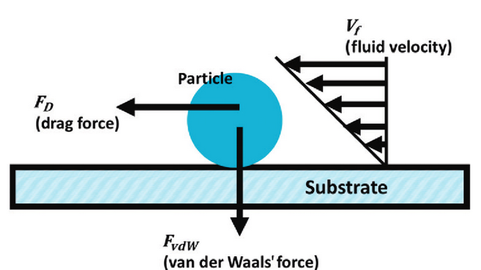
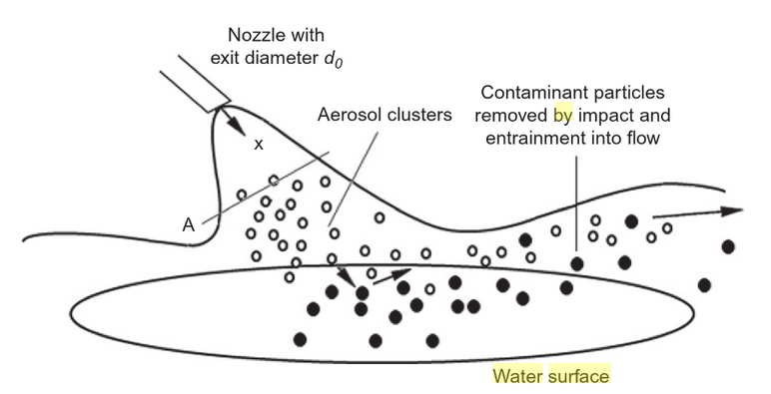
Jet cleaning/aerosol cleaning
Provides mechanical extra energy.
Kohli & Mittal: Developments in Surface Contamination and Cleaning, Volume 10

Slide 28
Dry cleaning
Vapors anhydrous HF
Gases O₃, H₂, HCl
Ions Ar+
Atoms Si
Photons UV (with Cl₂ or O₃)
Plasmas CF₄
Aerosols CO₂
Thermal bake

Slide 29
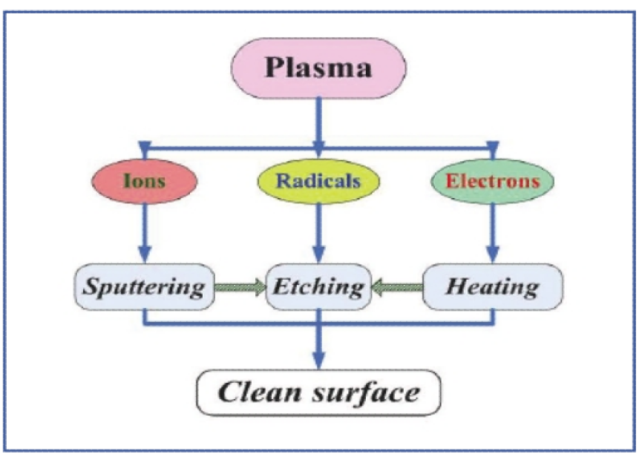
Plasma cleaning mechanisms

Slide 30
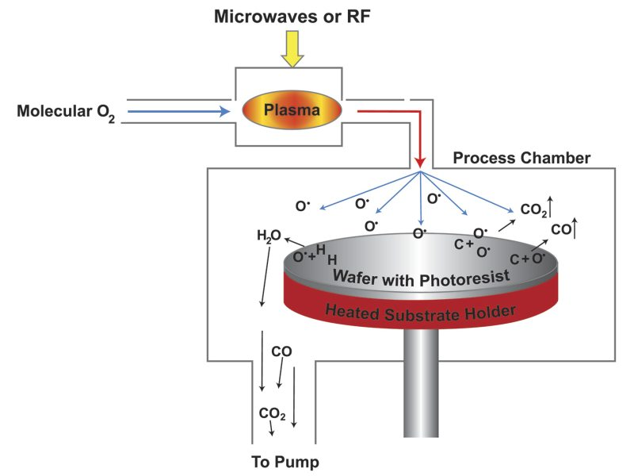
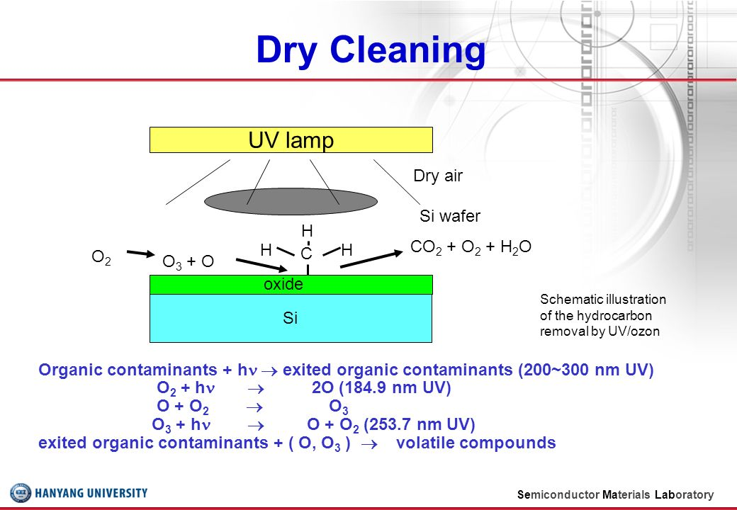
Ozone dry cleaning
UV-ozone cleaning:
Combined effect of UV-induced bond breakage and chemical action by ozone
Downstream plasma cleaner:
ozone diffuses; no UV-exposure
Surfaces will be oxidized in the process (a few nanometers)
https://www.mksinst.com/c/wafer-and-chamber-cleaning

Slide 31
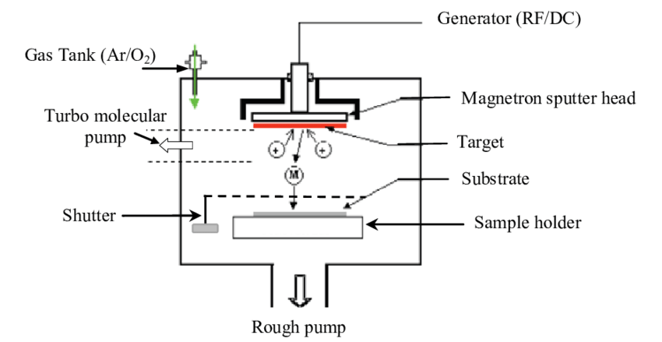
In-situ cleaning in sputtering
Sputter clean the target, while substrate is covered by shutter
Apply bias to substrate, and argon ions will bombard the substrate, and hit off surface specie
Adel et al: Modeling of magnetic properties of iron thin films deposited by RF magnetron sputtering using Preisach model, 2016

Slide 32
Plasma: sales talk
✓ Cleans even in the smallest cracks and gaps
✓ Cleans all component surfaces in one work step, including the interior of hollow bodies
✓ Residue-free removal of breakdown products by vacuum extraction
✓ No damage to solvent-sensitive surfaces by chemical cleaning agents
✓ Removal also of molecularly fine residues
✓ Fit for immediate further processing. No venting or removal of solvents
✓ No storage and disposal of hazardous, polluting and harmful cleaning agents
✓ Very low process costs
https://www.plasma.com/en/cleaning-with-plasma/

Slide 33
Etching
Etch away any unwanted film/material
Remove uppermost layers of material itself to reveal hopefully intact material
Etch and undercut particles ➔ particle removal

Slide 34
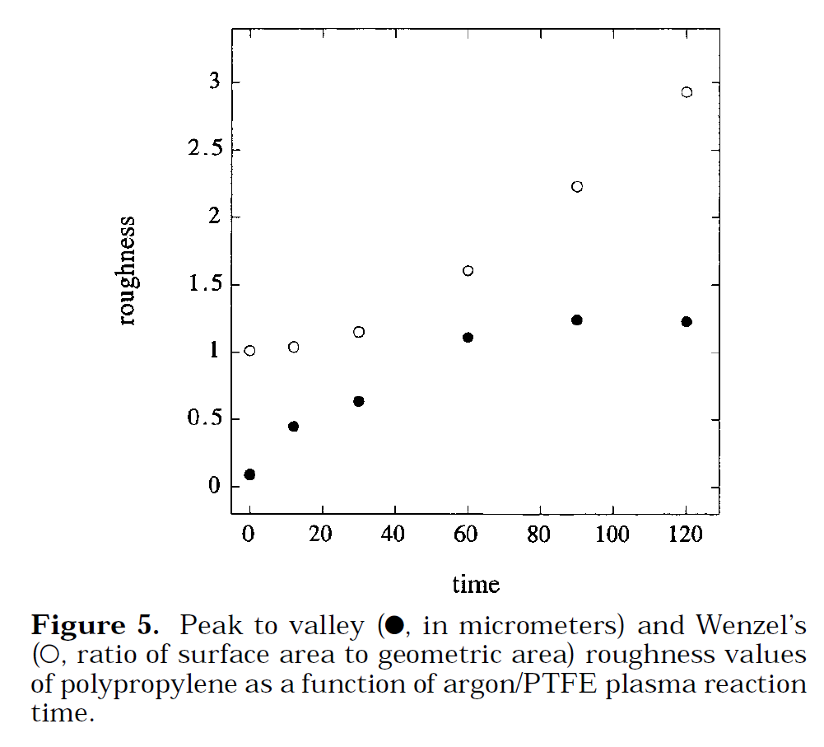
Etching easily roughens surface
Polypropylene was simultaneously roughened and fluorinated by etching in argon + PTFE plasma.
Surface is roughened due to the differential rates of crystalline and amorphous regimes.
Reaction time can be used to control the nature of the surface roughness.
Youngblood & McCarthy: Macromolecules 1999, 32, 6800-6806

Slide 35
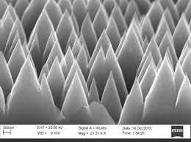
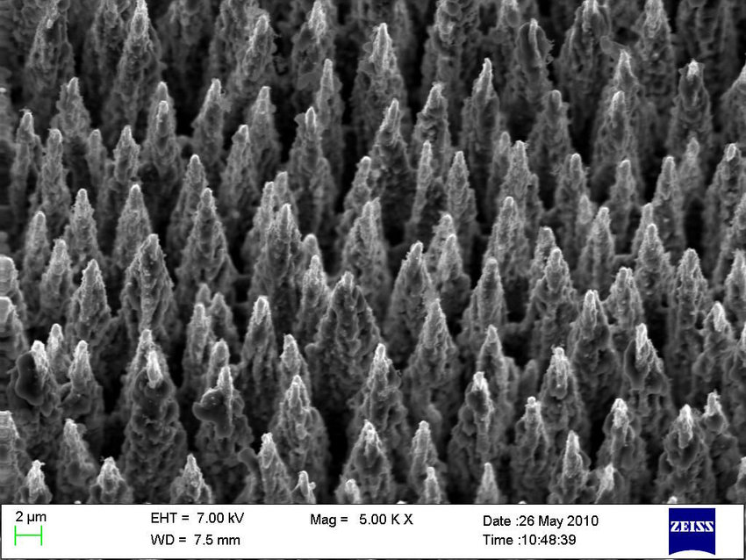
Rough on purpose
You might want to increase surface area ➔ keep etching…
Trap light by forward scattering in solar cells and photodetectors.
More area for sensing molecules to attach to.
Improved adhesion by increasing mechanical locking.
Gimple et al: Study on contact materials for sulfur hyperdoped Black Silicon, 2011

Slide 36
Activation
Provide surface with bonds that are useful in the next step
Chemical treatment, e.g. NaOH ➔ hydroxyl-terminated surface
Physical treatment, e.g. UV, ion bombardment ➔ broken, active bonds
Biological treatment, e.g. single strand DNA attached, to bind to complementary strand

Slide 37
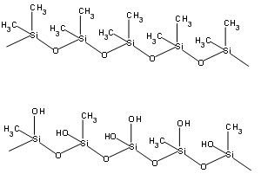
PDMS in O₂ plasma
Native PDMS surface with methyl groups (CH₃).
Oxygen plasma treated hydrophilic PDMS surface with hydroxyl and methyl groups.
OH- groups good for bonding with glass/oxides.

Slide 38
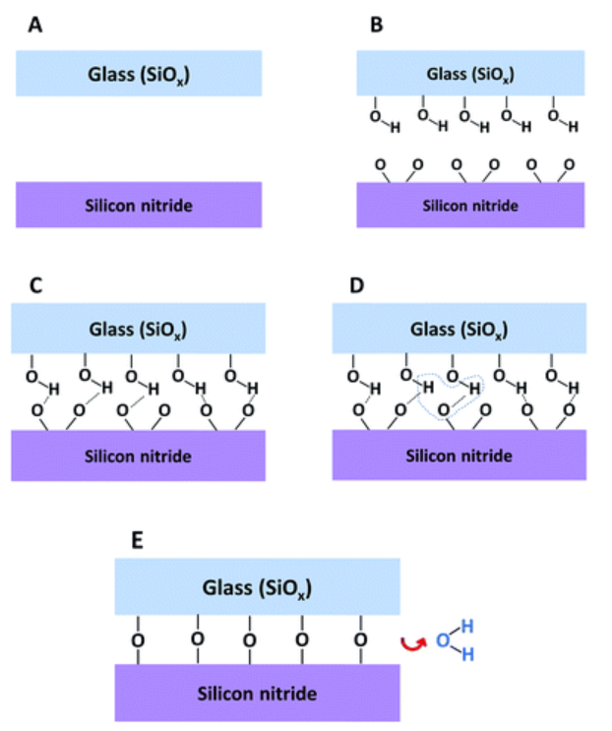
Activation can lower bonding temperature
Reactive bonds from activation enable bonding at lower temperature.
One or both wafers may need to be activated.
At least we need to start from known condition.
Pasternak et al: RSC Adv., 2018, 8, 2161-2172

Slide 39
Deposition
Adding material on surface
Molecular layers with desired physical properties, e.g. HMDS renders surface mildly hydrophobic ➔ better interaction with hydrophobic material
Self-assembled monolayers, SAMs
Oxidation to create native oxide film
Deposition of real thin films (PVD, CVD, ALD)

Slide 40
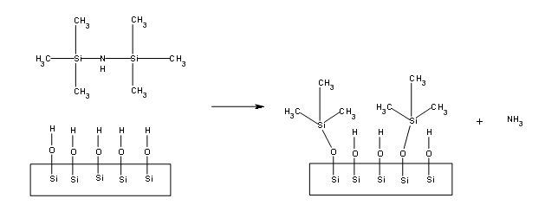
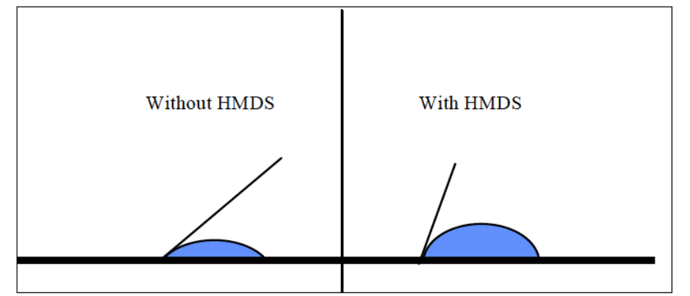
HMDS hydrophobization
Hexamethyl disilazane (HMDS) vapor phase coating renders silicon surface slightly hydrophobic, CA ca. 70º. Hydrophobic polymer in next step will adhere to it better than to oxidized surface with CA ca. 20º.

Slide 41
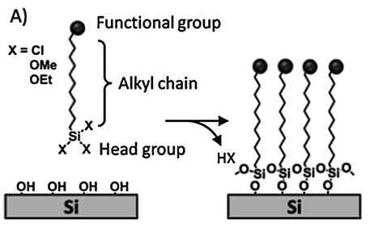
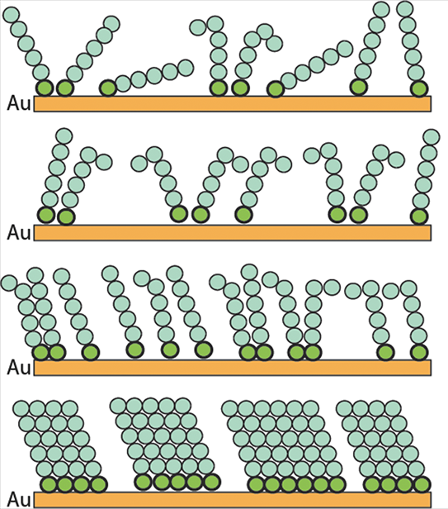
SAMs: self-assembled monolayers
In liquid or vapor phase.
Slow reaction, hours typically.
Shorter chain ➔ easy assembly
Longer chain ➔ more difficult assembly, but functional group further from surface and effect greater.
A single reaction.
Covalent bond.
Self-terminating.
time

Slide 42
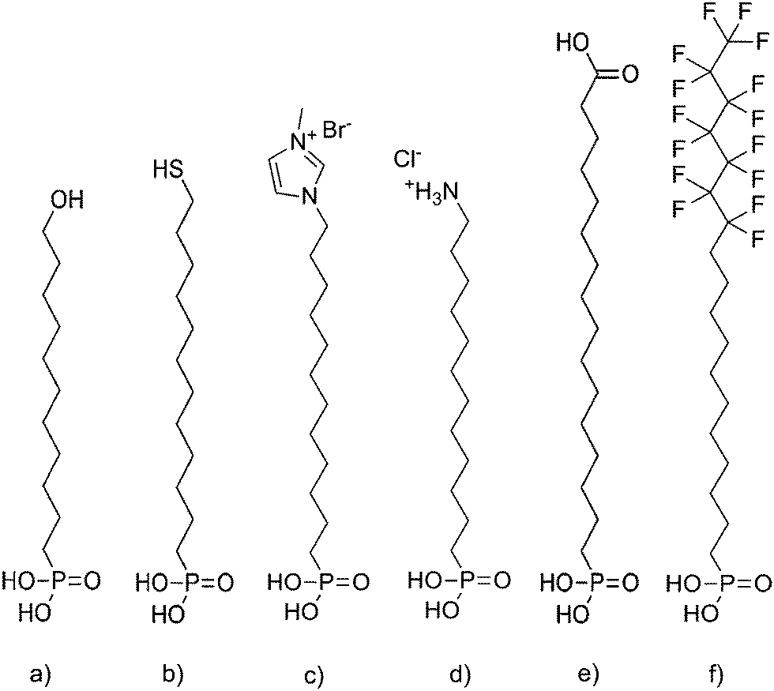
SAM functionalities
Other functionalities
Hydrophobic fluorinated surface
Hydrophilic, with polar hydroxyl-groups (OH)

Slide 43
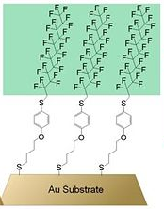
Perfluorinated surface
Fluorinated surface the most hydrophobic.
Linker molecule affects distance of functional group from surface, and coating perfection.
Au-S bond (thiol-bond) is very strong (otherwise gold does not readily react; that is why noble metals are called noble)

Slide 44
How to make a surface charged
Aminoalkanethiols
Example 1: Self-assembled monolayers (SAM) on gold
  Thiol –SH makes a covalent bond to Au
  Amino –NH₂ becomes positively charged –NH₃⁺ under acidic conditions
Au
Au
Example 2: Silane chemistry on silica, glass, Si-wafer

Slide 45
Native oxides
Native oxides, e.g. SiO₂, TiO₂, CuO form in room air, self-limited to ~ a few nm
Thin oxides of slightly better quality can be made by e.g. acid treatment, boiling HNO₃ + Si ➔ SiO₂ film 2-3 nm
Oxygen plasma and ozone obviously can be used, too

Slide 46
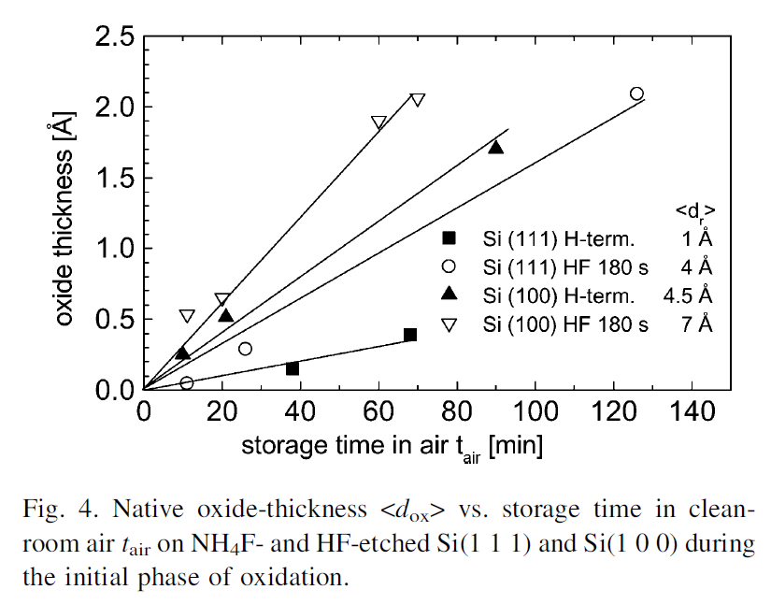
Native oxides are thin !
W. Henrion et al. / Applied Surface Science 202 (2002) 199–205

Slide 47
Passivation
Surface specie chosen to be inactive
Just the outermost atoms sometimes enough
Sometimes native oxide works
Sometimes monomolecular layer enough
But you may need to coat the surface for real

Slide 48
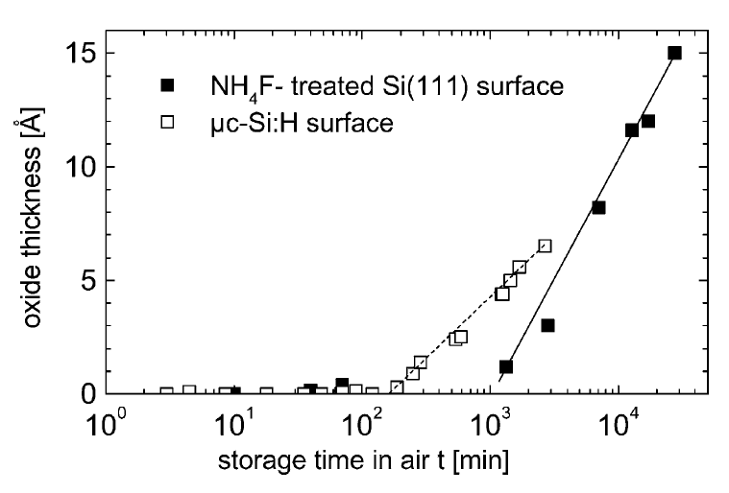
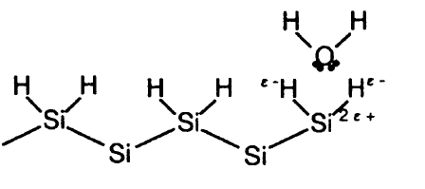
Passivation delays native oxide
”To prepare
atomically flat H-terminated surfaces the samples
were reoxidized in deionized water of 18 Mohm-cm resistivity
at 80ºC for 60 min. Afterwards the wafers were placed into NH₄F solution for 6.5 min. To minimize dissolved oxygen, the NH₄F solution was bubbled by
nitrogen and the preparation was carried out under dry
N₂-atmosphere.”
W. Henrion et al. / Applied Surface Science 202 (2002) 199–205

Slide 49
Aluminum plasma etching
Done in vacuum
2 Al + 3Cl₂ ➔ 2 AlCl₃ (moderately volatile product)
After etching, in room air, residues of AlCl₃ react with atmospheric water vapor:
AlCl₃ + xH₂O ➔ Al + yHCl + zH₂O
But: 2Al + 6HCl ➔ 2 AlCl₃ + 3 H₂
This is wet etching reaction of aluminum

Slide 50
Aluminum plasma etching
Solution 1:
After etching in vacuum, we passivate the surface before atmospheric exposure
Oxygen plasma ➔ Al₂O₃ formed
Then take wafer out of the reactor
Solution 2:
Immediately after taking away from vacuum, wash vigorously in water to remove all AlCl₃

Slide 51
Rinsing and drying are essential
Polyallylamine (PA) film was prepared as follows:
glass slide was rinsed three times with DI water,
soaked in 70% ethanol for 15 min,
rinsed three times with DI water.
Subsequently,
the glass was immersed in 6 M nitric acid for 20 min,
then thoroughly rinsed in DI water.
the glass was then exposed to oxygen plasma,
treated with pure GOPTS at 37 °C for 60 min,
then with 15% PA in water (pH = 11) and left to react at 75 °C for 36 h in a closed container.
Subsequently, the films were
rinsed with DI water (10 times) to remove unattached polymer
dried with nitrogen
This is an antiviral coating.
ACS Appl. Mater. Interfaces 2020, 12, 31, 34723–34727

Slide 52
COVID-19 resistant surface
The Cu₂O/PU coating was fabricated as follows.
A very thin layer of PU was applied to a glass slide using a sponge and then left to dry for approximately 8 min to allow partial curing of the polymer.
Cu₂O (10%) in ethanol suspension was sonicated for 3 min, and then, 1 mL was applied to the PU film and left to partially dry for about 5 min at room temperature.
The film was then heated in an oven at 120 °C for 2 h to finish the cure, forcefully blown with compressed nitrogen gas, washed thoroughly with DI water, and dried with a stream of nitrogen gas.
Each piece was then cleaned with argon plasma to remove excess polyurethane.
After plasma cleaning, the film was wetted by water, but the advancing water contact angle was recovered after 1 day.
ACS Appl. Mater. Interfaces 2020, 12, 31, 34723–34727

