Slide 1
Polishing and bonding
sami.franssila@aalto.fi

Slide 2
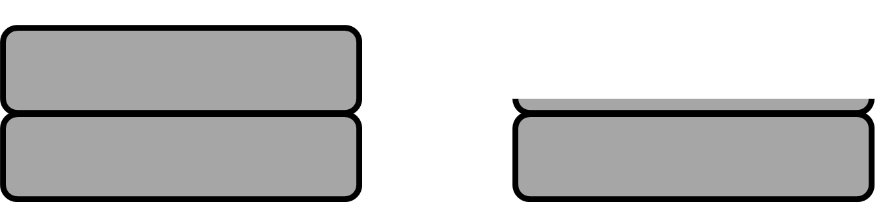
Grinding vs. polishing
500 µm
10 µm
Both use abrasive particles, but:
Grinding removes 10 µm/min in large chunks because large particles
Grinding results in very rough surface because very large chunks
Grinding leaves mechanical damage due to large chunks being torn off
Polishing uses nanoparticles to achieve smooth surfaces
Polishing removes 0.1 µm/min because small particles, small forces
Mechanism of removal is chemical and mechanical (CMP !)

Slide 3
Log scale
J. Am. Ceram. Soc., 83 [6] 1476–84 (2000)

Slide 4
Polishing needed after grinding !
Surface roughness after grinding with µm-particles is micrometers.
Planarization
Damascene
SiO₂
Al
Cu
CMP
Surface roughness after polishing with nanometer particles is nanometers.

Slide 5
CMP: chemical-mechanical polishing
Ceramic particles in acidic (or alkaline) solution abrade surface.
Acid(base) etches surface.
Soft polishing pad presses particles against surface.
Polishing rate e.g. 100-1000 nm/min.

Slide 6
Applications of polishing
Smoothing
Planarization
Damascene
SiO₂
Al
Cu

Slide 7
Applications of polishing
Smoothing
Planarization
Damascene
SiO₂
Al
Cu

Slide 8
Applications of polishing
Smoothing
Planarization
Damascene
SiO₂
Al
Cu

Slide 9
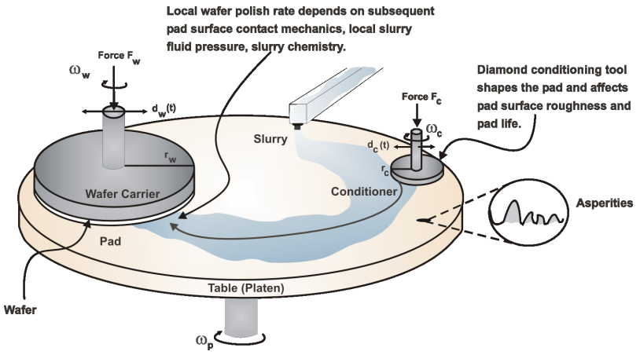
Rotary CMP tool
60-90s per wafer

Slide 10
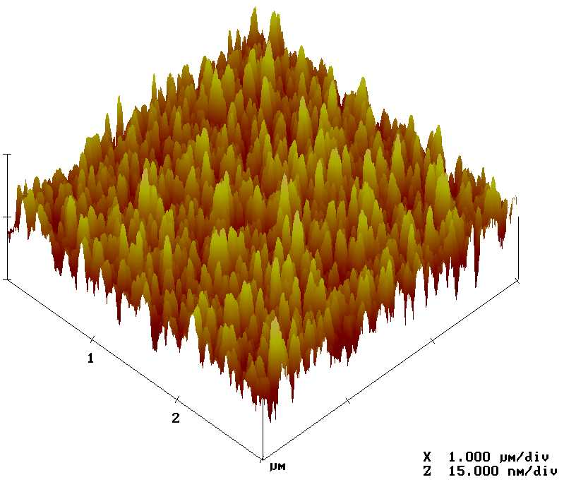
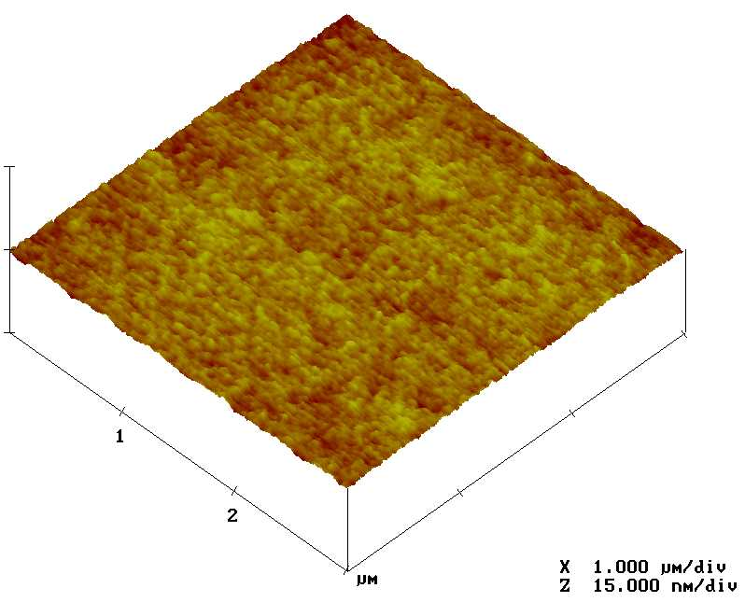
CVD oxide roughness
AFM scans of PECVD oxide: a) as deposited film peak-to-valley height is 26 nm, with RMS roughness of 3.3 nm; b) after CMP peak-to-valley is 2 nm and RMS roughness is 0.2 nm. Figure courtesy Kimmo Henttinen, VTT.

Slide 11
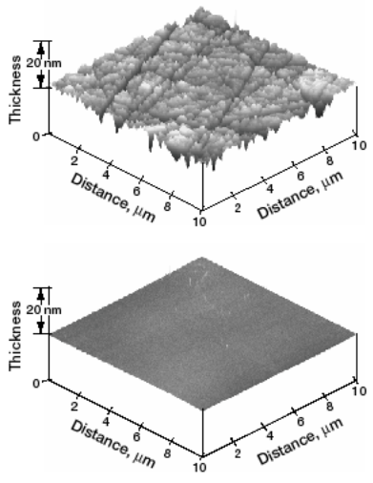
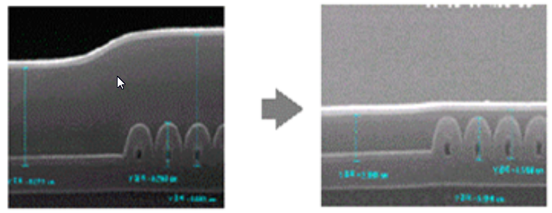
Results of CMP
CMP of SiO₂
SiC wafer before and after CMP
Planarization
Polishing

Slide 12
Polish selectivity & polish stop
Polish selectivity:
Polishing rate of material 1/polishing rate of material 2
e.g. Copper 400 nm/min Oxide 40 nm/min ➔ 10:1
e.g. Copper 400 nm/min TaN 10 nm/min ➔ 40:1
Polish stop: if selectivity is very high, we call it polish stop (even though some underlying material is removed)

Slide 13
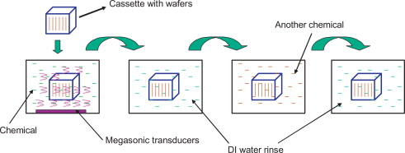
Cleaning after polishing
Zillions of particles.
Multiple step cleaning required.
First rinsing water has to be discarded, too many particles.
Keswani et al:Developments in Surface Contamination and Cleaning Wet and Dry Cleaning Methods 2015, Pages 145-183

Slide 14
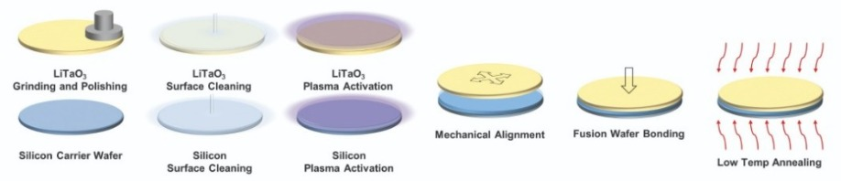
Bonding
Joining two pieces
Permanently or temporarily
https://siliconsemiconductor.net/article/108622/Wafer_Bonding_Enables_Future_RF_Filter_Manufacturing/feature

Slide 15
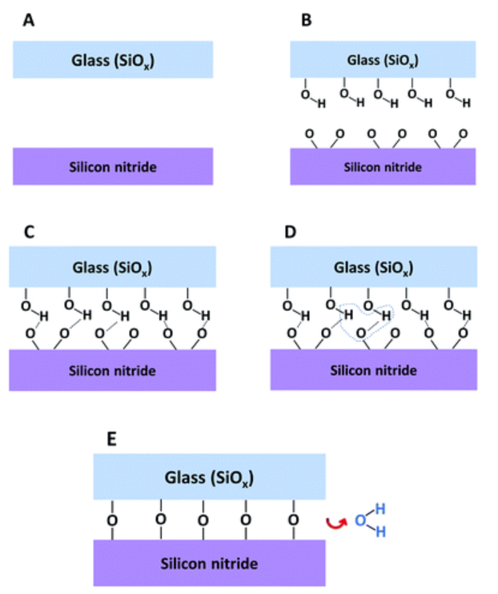
Activation can lower bonding temperature
Reactive bonds from activation enable bonding at lower temperature (if flatness and smoothness are good enough).
One or both wafers may need to be activated.
At least we need to start from known condition.
Pasternak et al: RSC Adv., 2018, 8, 2161-2172

Slide 16
SOI: silicon-on-insulator
Cleaning ➔ particle removal and hydroxyl bonds
RT joining and high temperature anneal
Top wafer grinding and polishing to desired thickness

Slide 17
Bonding considerations
Bond properties
  What are the chemical bonds that will form ?
  Do they exist naturally or formed by treatment?
  Bond strength ?
  Permanent vs. temporary ?

Slide 18
Bonding: materials
  Chemical compatibility (e.g. interdiffusion)
  Temperature tolerance
    Bond formation temperature
    Operational temperature of final product
  CTE (coefficient of thermal expansion) mismatch between materials
  Surface quality (roughness; waviness)
  Surface particles

Slide 19
Flatness vs. smoothness
1- 5 µm
1 mm-1 cm
50 µm
5 nm
atomic/nanoscale
macroscopic

Slide 20
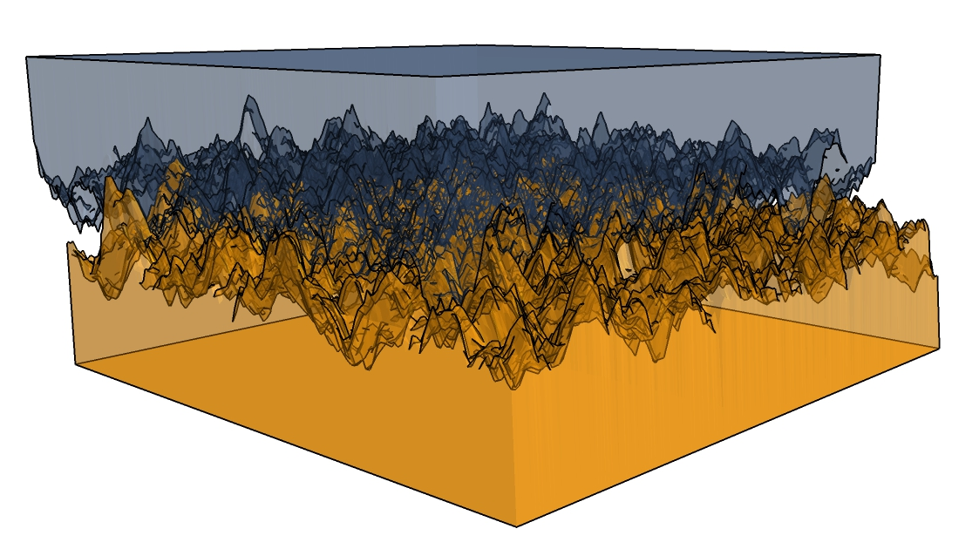
Mechanics of joining
Even polished surfaces have roughness R_{peak-to-valley} 3-10 nm ➔ not perfect contact
Heat to 1000ºC ➔ viscous flow
➔ Intimate contact

Slide 21
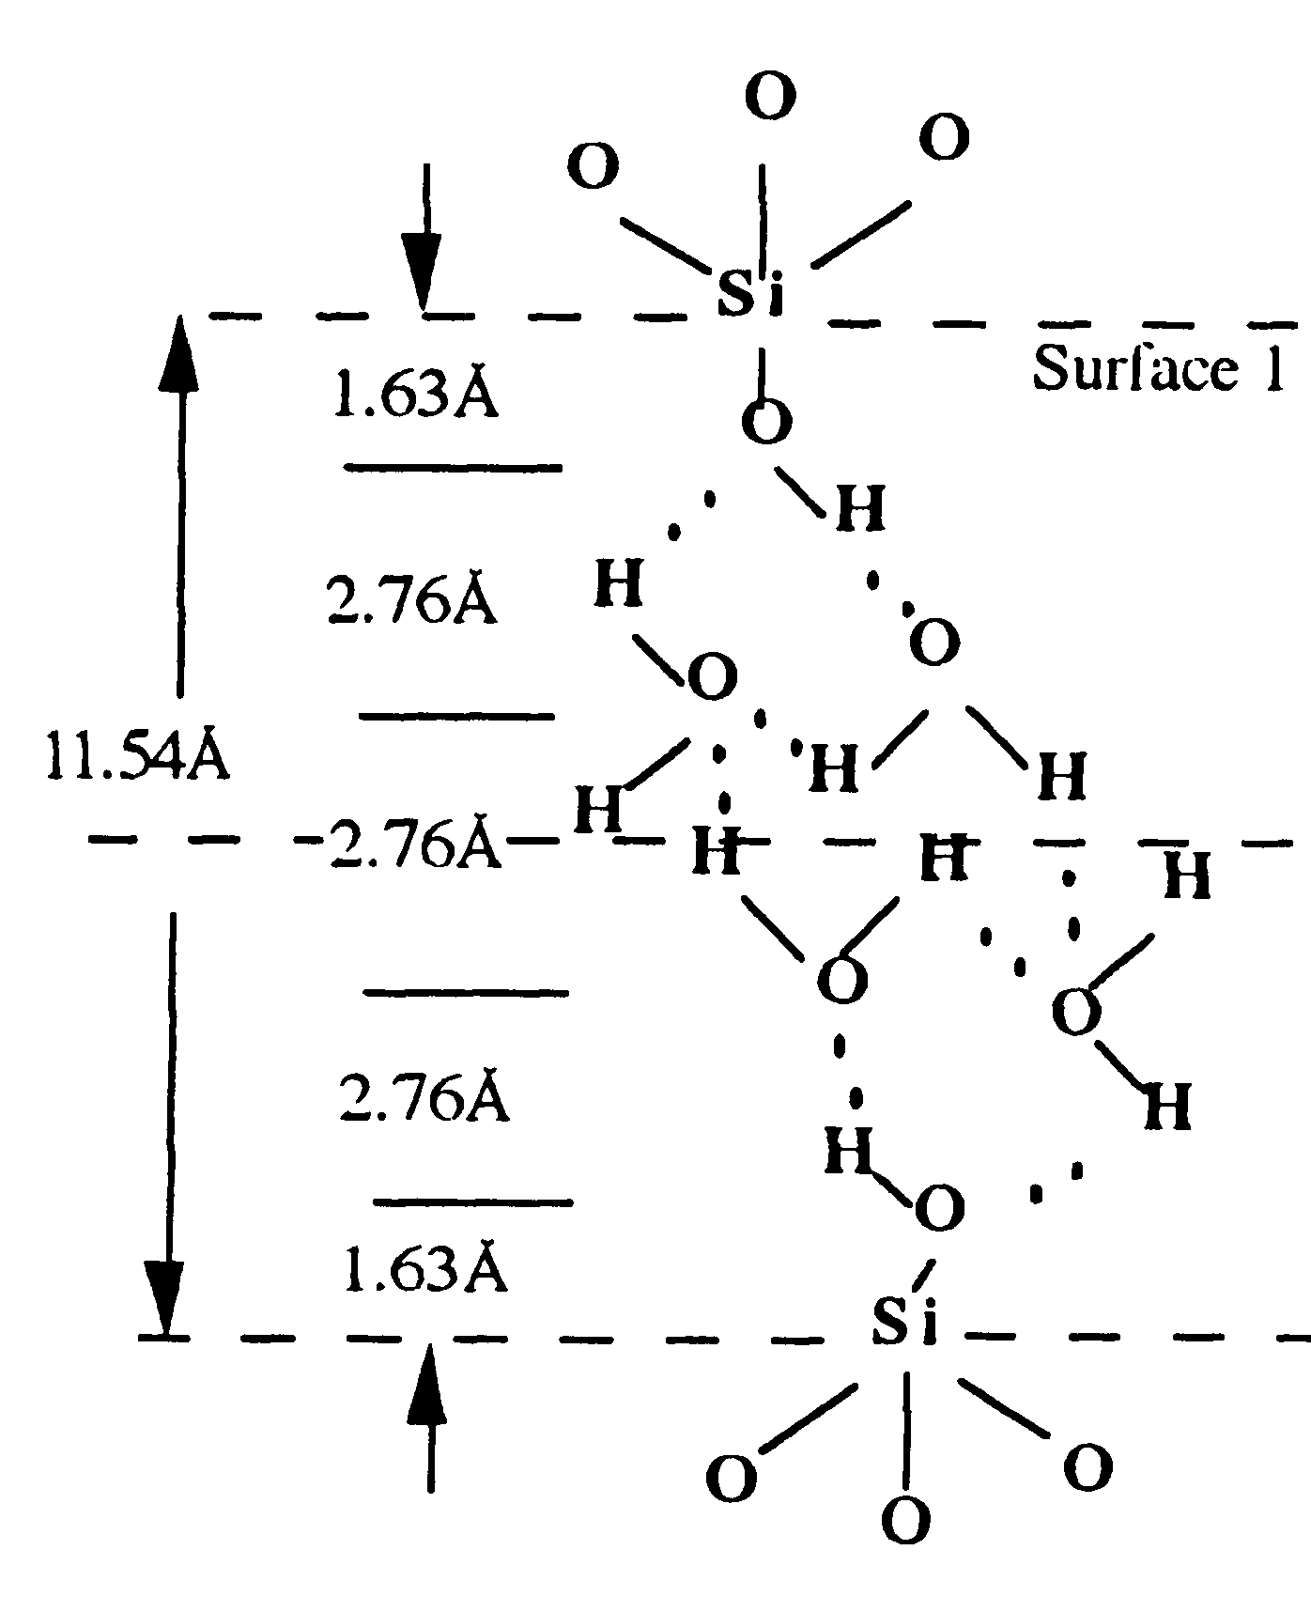
Surface water & hydrogen bonds
At room temperature, bonding happens via physisorbed water, i.e. hydrogen bonds.
Tong & Gösele: Semiconductor wafer bonding

Slide 22
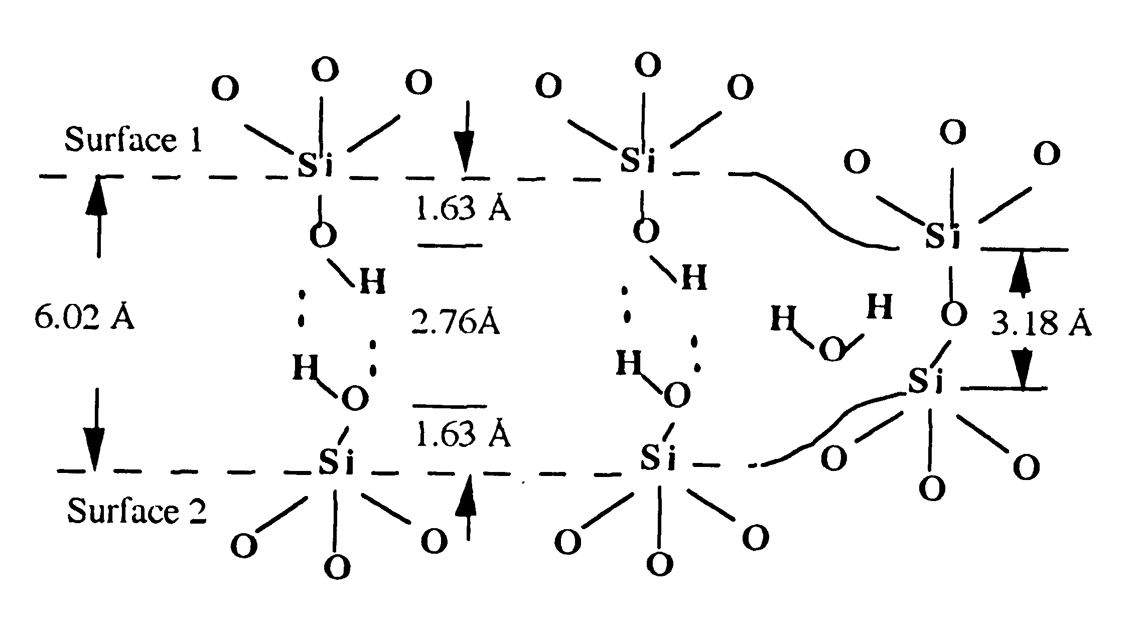
Heating to remove water
250ºC removes physisorbed water, but chemisorbed water still remains.
Surface energy 250 mJ/m² pretty close to theoretical value.

Slide 23
High temperature➔ Si-O-Si bonds
Si-O-Si bond 400 kJ/mol.
Measured surface energy
3000 mJ/m²
Theoretically:
10¹⁵cm⁻² * 400 kJ/mol ➔ 3500 mJ/m²

Slide 24
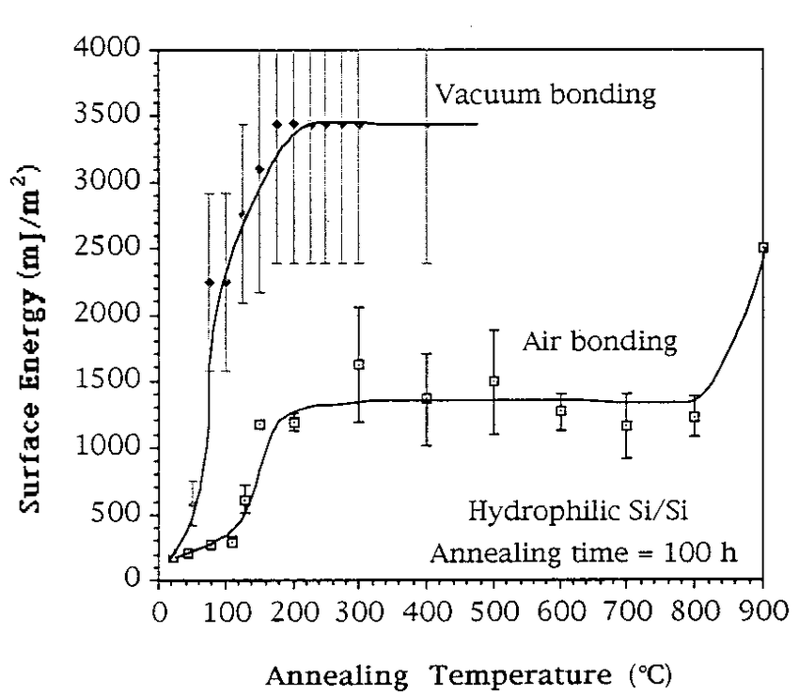
Bond strength = f(T)
Gösele et al: JVST A 17(4):1145-1152 · July 1999

Slide 25
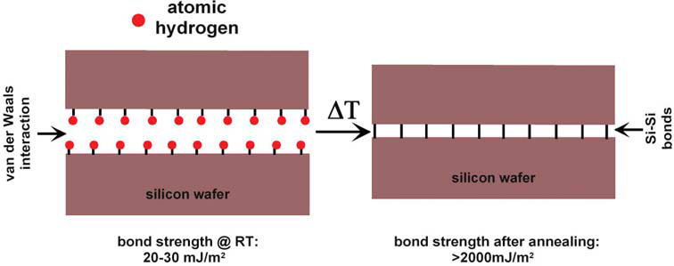
Hydrophobic Si-Si bonding
Silicon native oxide removed in HF ➔ H-termination
H-terminated surface adsorbs hydrocarbon contamination ➔ quick !
Initially, hydrogen bonds are very weak ➔ more sensitive to defects
Bonding and annealing will result in direct Si-Si covalent bond
H₂ has no place to go ➔ H₂ bubbles form at interface
(Christiansen et al. 2006)

Slide 26
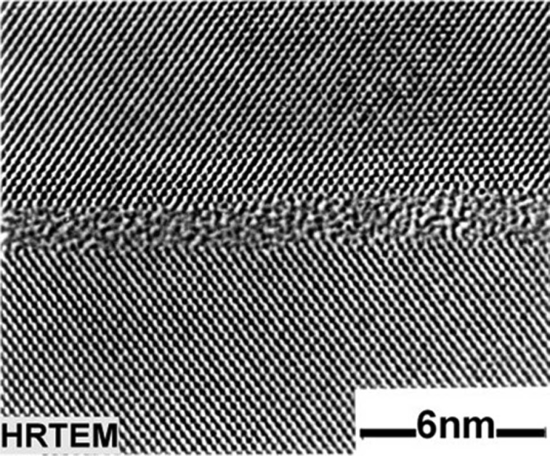
Bond interface
HRTEM showing thin amorphous oxide between two single crystal silicon layers

Slide 27
Practical bonding process steps
-particle removal
-surface chemistry modification
-(optional) vacuum pumping
-(optional) wafer alignment
-room temperature joining
-application of force/heat/voltage
-(optional) wafer thinning

Slide 28
Bonding methods
direct bonding = fusion bonding
(Si/Si; glass/glass; SiO₂/Si )
anodic bonding (AB)
Si/glass, glass/Si/glass
thermo-compression bonding (TCB)
Eutectic/TLP bonding
Si/glass frit bonding
adhesive bonding
limited by “glue” properties
No intermediate layer
Metallic intermediate layer
Insulating intermediate layer

Slide 29
Fusion/direct/thermal bonding
Identical materials bonded
No CTE problems
Bonds naturally available
Apply heat/pressure to enhance bonding
Si-Si
Glass-glass
Polymer-polymer

Slide 30
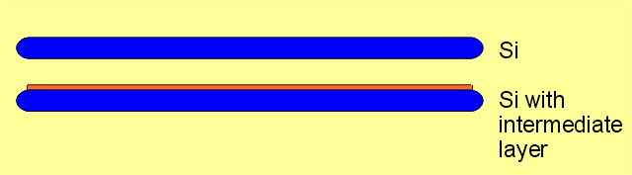
Thermo-Compression Bonding
≈ apply enough heat & pressure
Double Sided Heating:
Contact Force:
Bonding Atmosphere:
up to 550°C
100 - 40000N
1E-5 - 3000mbar

Slide 31
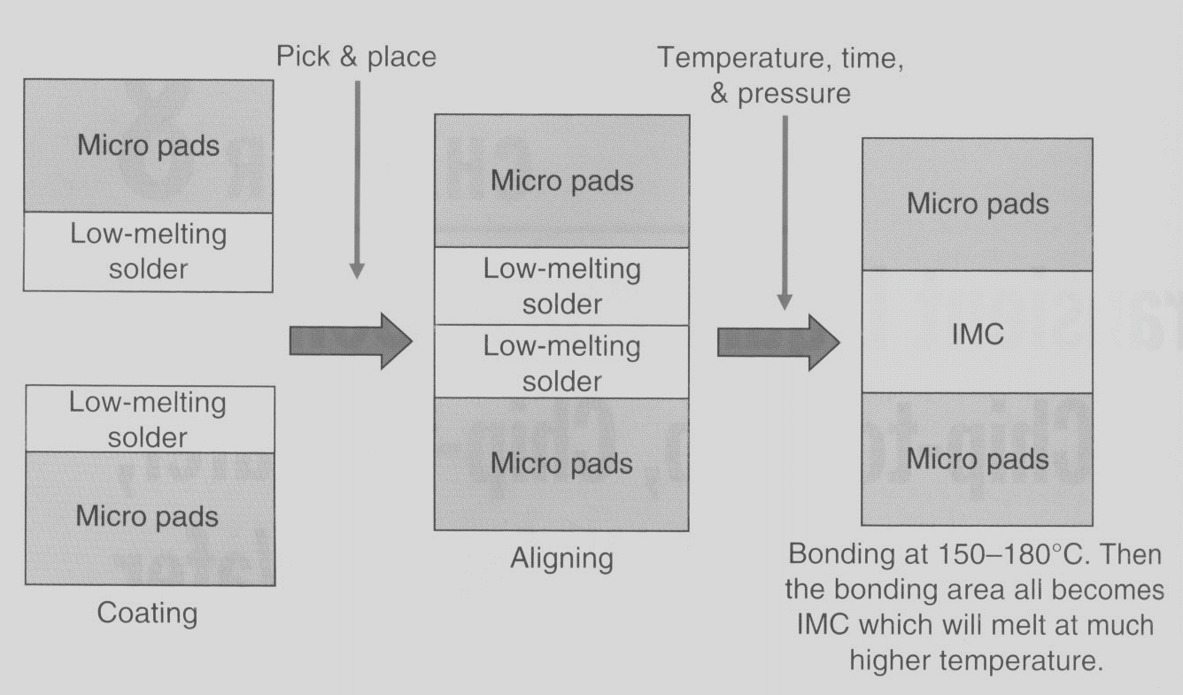
TLP: Transient Liquid Phase
≈SLID: Solid-Liquid Interdiffusion
John H. Lau: Through-silicon vias

Slide 32
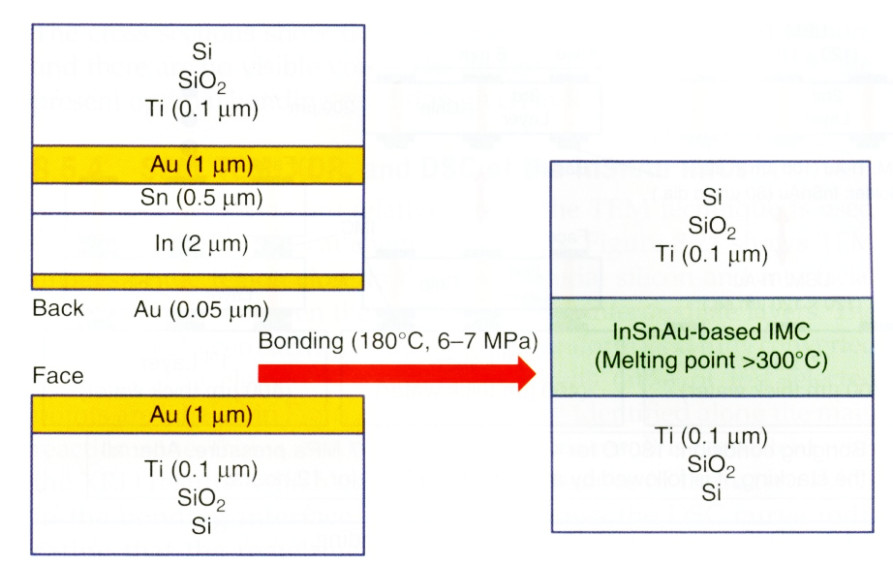
TLP/SLID, example
Why gold ?
John H. Lau: Through-silicon vias

Slide 33
Adhesive bonding ≈ gluing
surface cleaning
spin coating of polymer
initial curing (solvent removal bake)
evacuate vacuum (optional)
join the wafers
final curing with pressure and/or heat

Slide 34
Adhesive bonding benefits
temperatures around 100ºC (>T_{g})
tolerant to (some) particle contamination
structured wafers can be bonded
low cost, simple process

Slide 35
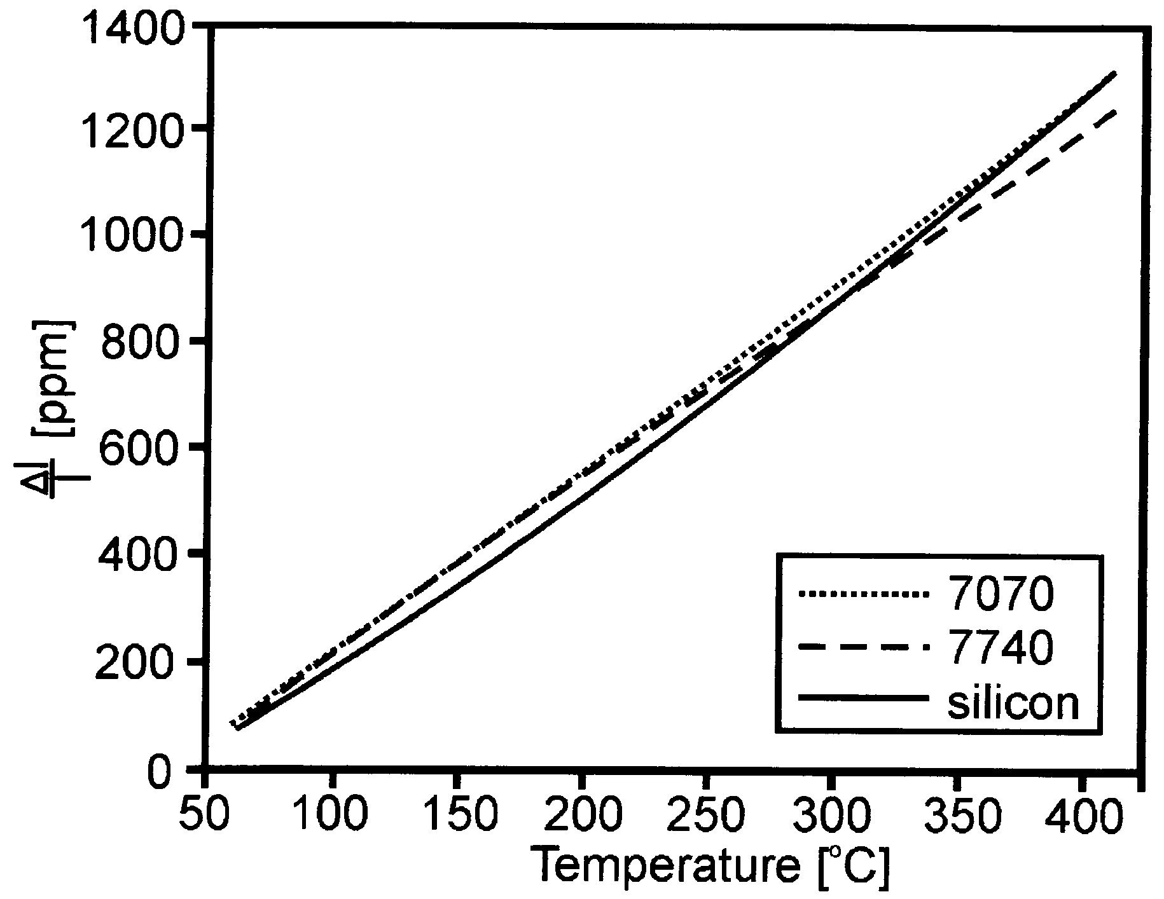
Anodic bonding
= Field-assisted thermal bonding
Glass/silicon bonded
Glass/metal bonded
Coefficients of thermal expansion of silicon and glass must be matching, otherwise cracking upon cooling
➔ only certain glasses suitable for anodic bonding: Pyrex, Borofloat
Pyrex 7070 and 7740 thermal expansion match with silicon

Slide 36
Anodic bonding
Relies on mobile Na⁺ and oxygen ions in glass.
Temperature raises ion mobility in glass.
Voltage attracts oxygen ions to interface.
Si + 2 O₂⁻ ➔ SiO₂ + 4 e⁻ reaction at glass-silicon interface.
Double Sided Heating:
Contact Force:
High Voltage Supply:
Bonding Atmosphere:
up to 550°C
1 - 1000N
0 - 2000V / 0 - 50mA
1E-5 - 3000mbar

Slide 37
Polymer thermal bonding
Raise temperature above Tg
➔softening
intimate contact
Hold long enough
cool down below T_{g}
Bond interface indistinguishable from bulk materials (because same bonds !)

Slide 38
Polymer bonding (2)
Softening by solvent surface treatment
Intimate contact
Hold long enough
Bonding of different polymers, too!
In theory a room temperature process
In practise difficult to control the thickness of the softened layer

Slide 39
Problems with particles
t
2h
R
Voids created by particles are Silicon can conform only to
very large compared to particles very small particles, < 100 nm
themselves because silicon is
rigid material

Slide 40
Flatness & microstructures
2h
t
2h
2R
2R
Only flat wafers can be bonded (=no long wavelength undulation)
Shallow channels will be bonded if they are too wide
Note: flatness is macroscopic measure; smoothness is local/atomic measure

