Slide 1
Surfaces and Films Session 5A: Ion solid interaction, film growth in PVD
Jari Koskinen
Aalto University

Slide 2
Sputtering

Slide 3
5 kV Ar-ion hitting Ni (001) surface MD simulation Kai Nordlund http://www.acclab.helsinki.fi/~knordlun/anims.html

Slide 4
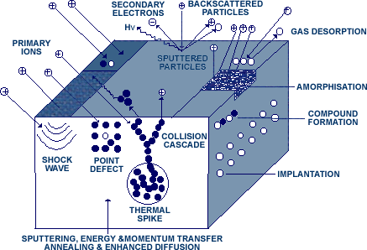
Energetic ion and surface interactions
collision cascade 10 ⁻¹⁴ – 10 ⁻¹³ s
thermal spike 10 ⁻¹³ – 10 ⁻¹² s
Fast diffusion
fast cooling
relaxation
Kts. simulaatio

Slide 5
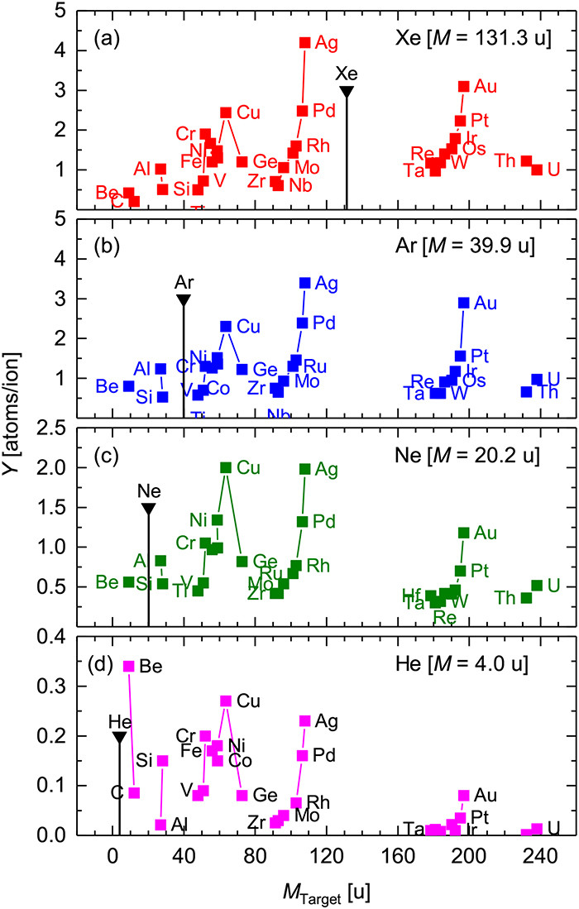
Sputtering yield Y
Y = (outgoing sputtered atoms)_{ave}/(incoming ions)
FIG. 7. Sputtering yield Y versus target particle mass M Target for sputtering with Xe ions [panel (a), Ref. 60], Ar ions [panel (b), Ref. 64], Ne ions [panel (c), Ref. 64], or He ions [panel (d), Ref. 60]. E Ion = 600 eV and α = 0 °. The vertical lines mark the primary ion mass M Ion. Please note the different scales. Modified after Ref. 20.
Published in: Carsten Bundesmann; Horst Neumann; Journal of Applied Physics 124, 231102 (2018)
DOI: 10.1063/1.5054046
Copyright © 2018 Author(s)

Slide 6
Sputtering yield of elements
Y
Thomas M. Christensen
UCCS 2000

Slide 7
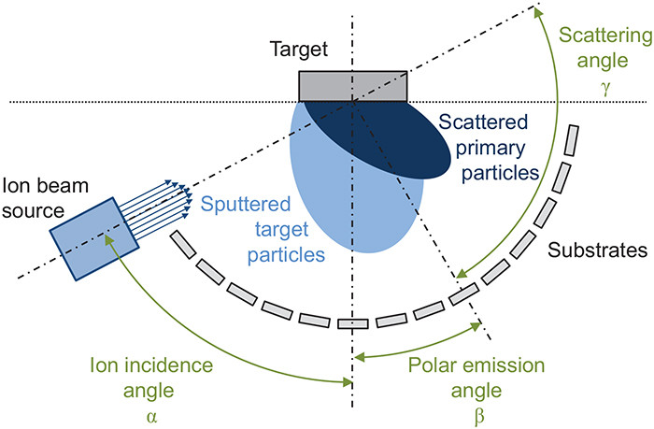
FIG. 14. Schematic drawing of an IBSD setup. Reproduced with permission from Bundesmann et al., Thin Solid Films 589, 487 (2015). Copyright 2015 Elsevier.
Published in: Carsten Bundesmann; Horst Neumann; Journal of Applied Physics 124, 231102 (2018)
DOI: 10.1063/1.5054046
Copyright © 2018 Author(s)

Slide 8
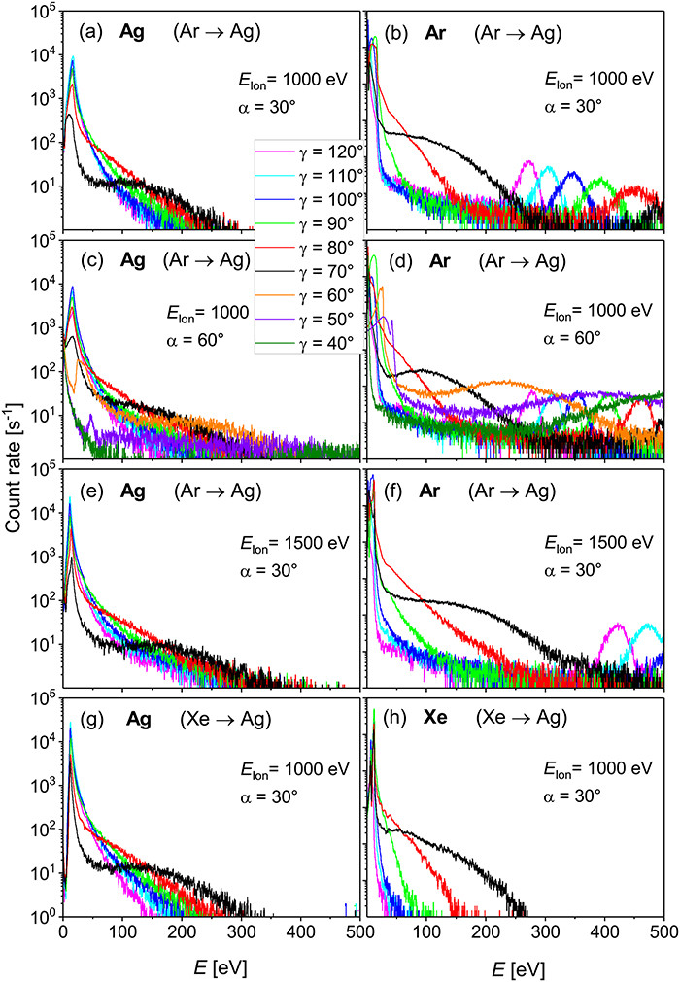
Kinetic energy of sputtered ion
FIG. 18. Measured energy distributions of sputtered target ions [panels (a), (c), (e), and (g)] and scattered primary ions [panels (b), (d), (f), and (h)] in dependence on the scattering angle γ for the bombardment of an Ag target with Ar ions [panels (a)–(f)] or Xe ions [panels (g) and (h)]. The data are shown for different sets of process parameters ( E Ion, α). The same line color represents the same scattering angle γ (but not necessarily the same scattering angle β). Reproduced with permission from Bundesmann et al., Contrib. Plasma Phys. 55, 737 (2015). Copyright 2015 Wiley-VCH.
Published in: Carsten Bundesmann; Horst Neumann; Journal of Applied Physics 124, 231102 (2018)
DOI: 10.1063/1.5054046
Copyright © 2018 Author(s)

Slide 9
Examples of calculated angular distributions according to Eq. (9) [panel (a)] or Eq. (10) [panel (b)]. The parameters are given below each panel

Slide 10
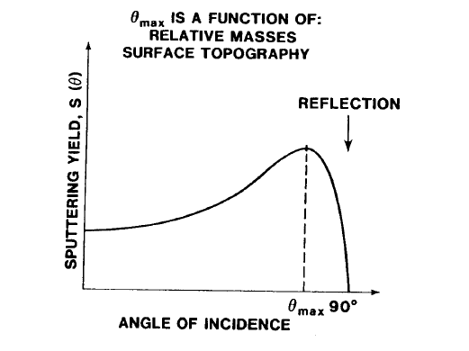
Sputter yield angle dependence
Y
Ɵ

Slide 11
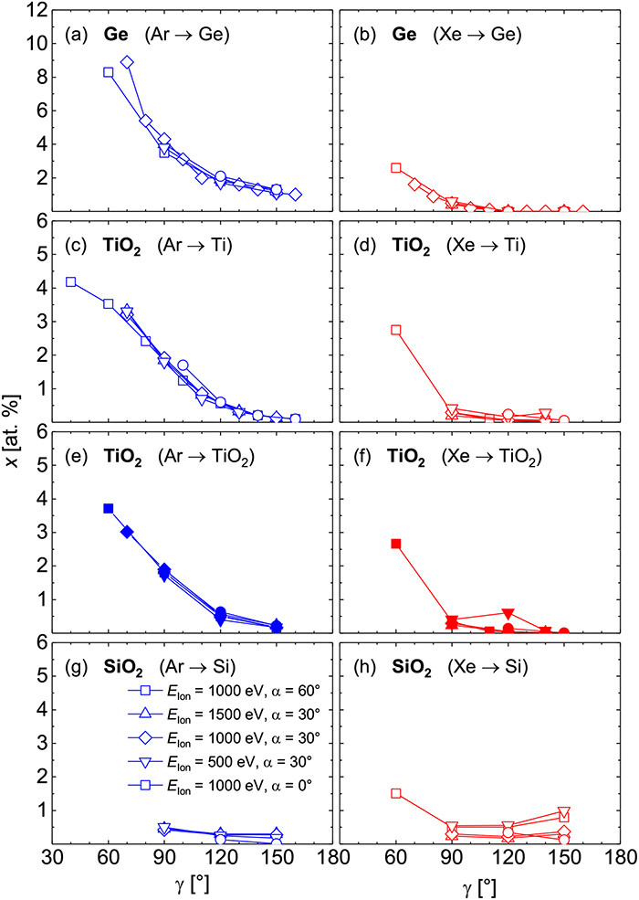
Fraction of Ar sputter ions remain in film (and target)
FIG. 21. Atomic fraction x of process gas particles versus scattering angle γ inside Ge thin films [panels (a) and (b)], TiO 2 thin films [panels (c)–(f)], and SiO 2 thin films [panels (g) and (h)] grown by (reactive) IBSD using Ar ions (blue symbols) or Xe ions (red symbols) and a metallic target (open symbols) or a ceramic target (closed symbols). Symbols of the same shape represent the same set of process parameters ( E Ion, α). Please note the different scales. Reproduced with permission from Bundesmann et al., Thin Solid Films 589, 487 (2015). Copyright 2015 Elsevier (Ge films); Bundesmann et al., Appl. Surf. Sci. 421, 331 (2017). Copyright 2017 Elsevier (TiO 2 films and Ti target); Bundesmann et al., Eur. Phys. J. B 90, 187 (2017). Copyright 2017 Springer (TiO 2 films and TiO 2 target); Mateev et al., Eur. Phys. J. B 91, 45 (2018). Copyright 2018 Springer (SiO 2 films).
Published in: Carsten Bundesmann; Horst Neumann; Journal of Applied Physics 124, 231102 (2018)
DOI: 10.1063/1.5054046
Copyright © 2018 Author(s)

Slide 12
Film growth mechanisms

Slide 13
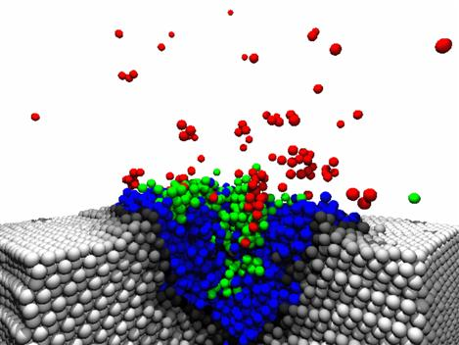
PVD (Physical Vapour Deposition)
Material from solid or gas
Plasma
Energetic ions hit surface
Ions and neutrals grow the film
www.iap.tuwien.ac.at/www/opt/images/parasol.jpg

Slide 14
Carbon thin films growth MD simulation 50 eV

Slide 15
PVD growth process
Ion energy E_{i} 10 - 1000 eV
Surface temperature -190°C - 500°C (normally < 200°C)
incidence angle
Ion density
Gas pressure
Substrate surface
Chemistry
Impurities
Topography

Slide 16
Coating structure and plasma parameters

Slide 17
Coating structure and plasma parameters
hot
slow
temperature
ions
fast
cold

Slide 18
Coating structure and plasma parameters
slow
hot
temperature
ions
cold
fast

Slide 19
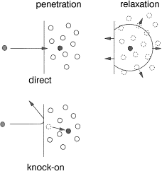
Subplantation

Slide 20
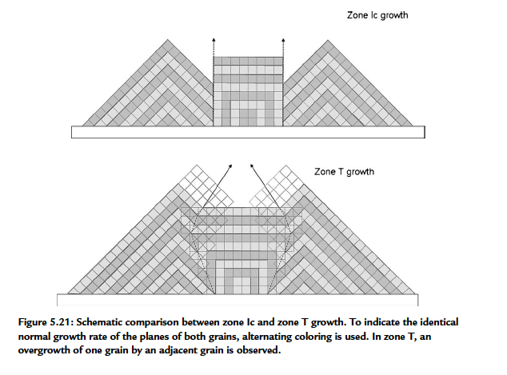
Competition of growing crystals
Handbook of Deposition Technologies for Films and Coatings - Science, Applications and Technology (3rd Edition)
Edited by: Martin, Peter M. © 2010 William Andrew Publishing

Slide 21
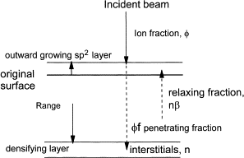
Subplantation, in amorphous carbon films
Schematic diagram of densification by subplantation. A fraction of the incident ions penetrate the film and densify it, the remainder end up on the surface to give thickness growth.

Slide 22
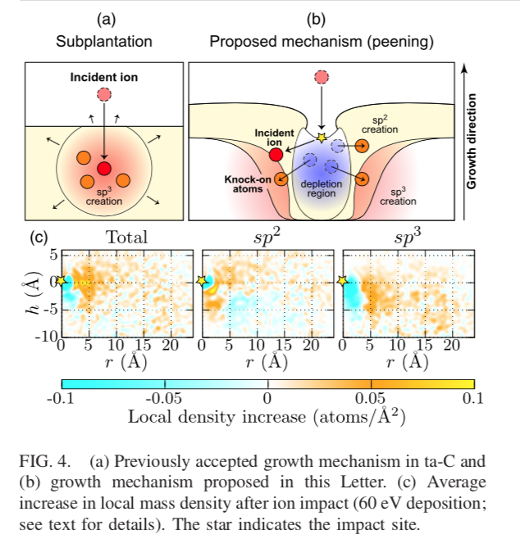
Subplantation -> Ion peening
Miguel A. Caro, Volker L. Deringer,
Jari Koskinen, Tomi Laurila, Gábor Csányi,
PHYSICAL REVIEW LETTERS 120, 166101 (2018)

Slide 23
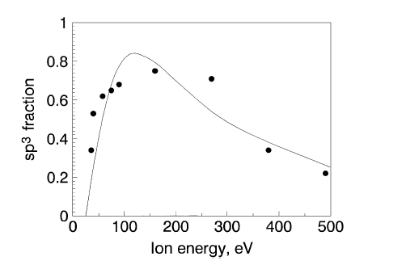
Subplantation and experiments -Carbon

Slide 24
Ta-C film growth molecular dynamic simulation,
Miguel Caro https://zenodo.org/record/1133425
In coming
100 eV carbon ions
Dr. Miguel Caro simulations
Growing film

Slide 25
Ion bombardment Effects to thin film properties:

Slide 26
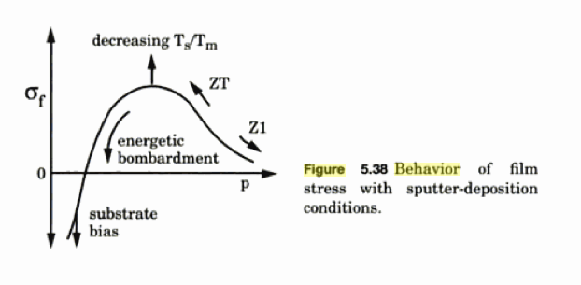
Stress Control
Gas pressure /temperature
Tensile stress due to collapsing of voids
Higher temperature annealing of structure – low stress
Compressive stress – subplantation
tensile
compressive
High > 10eV
Low < 1eV
Ion energy

Slide 27
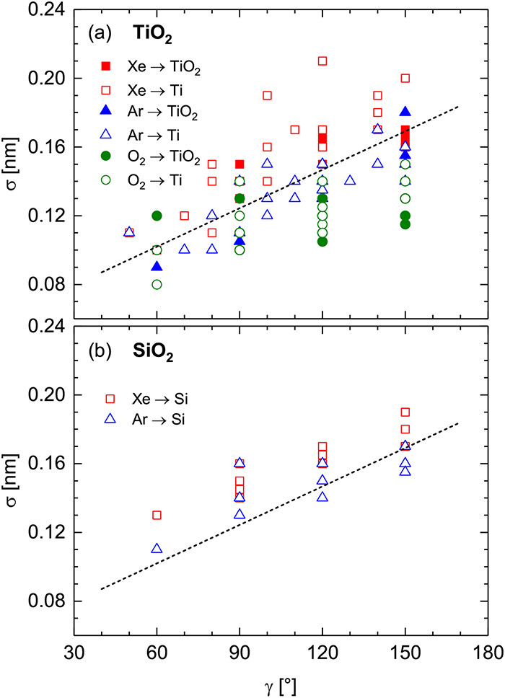
Surface roughness
FIG. 22. Surface roughness σ versus scattering angle γ of TiO 2 thin films [panel (a)] and SiO 2 thin films [panel (b)] grown by reactive IBSD using process gas Xe (red symbols), Ar (blue symbols), or O 2 (green symbols) and a metallic target (open symbols) or a ceramic target (closed symbols). The dashed lines serve as a guide to the eye. Reproduced with permission from Bundesmann et al., Eur. Phys. J. B 90, 187 (2017). Copyright 2017 Springer (TiO 2 films, Ar and Xe ions, and TiO 2 target); Bundesmann et al., Appl. Surf. Sci. 421, 331 (2017). Copyright 2017 Elsevier (TiO 2 films, Ar and Xe ions, and Ti target); Pietzonka et al., Eur. Phys. J. B 91, 252 (2018). Copyright 2018 Springer (TiO 2 films, O 2 ions, and Ti and TiO 2 target); Mateev et al., Eur. Phys. J. B 91, 45 (2018). Copyright 2018 Springer (SiO 2 films).
Published in: Carsten Bundesmann; Horst Neumann; Journal of Applied Physics 124, 231102 (2018)
DOI: 10.1063/1.5054046
Copyright © 2018 Author(s)

Slide 28
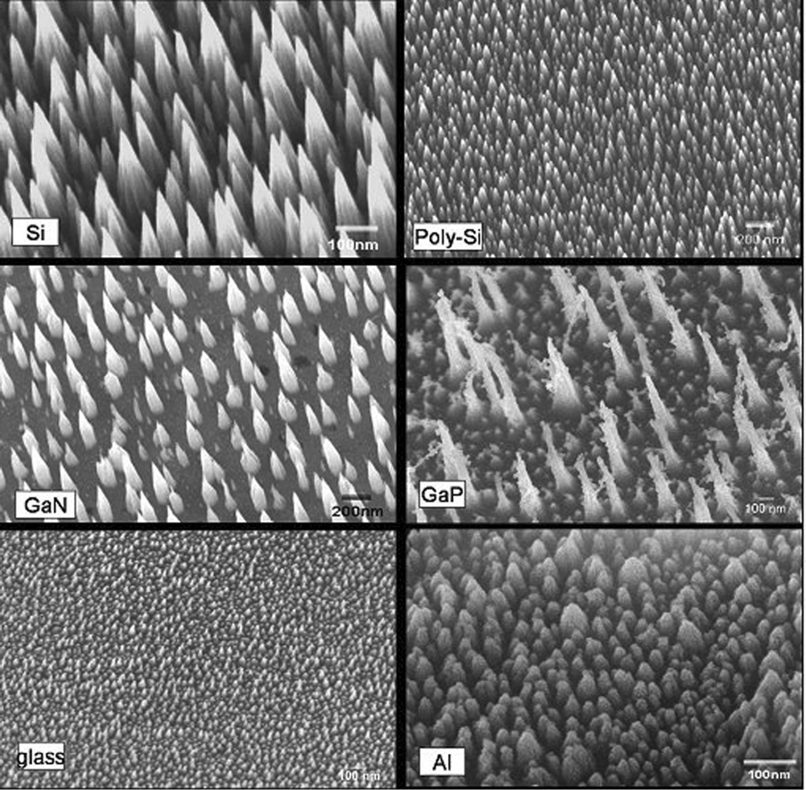
Ion beam nano roughening
Enhanced adhesion

Slide 29
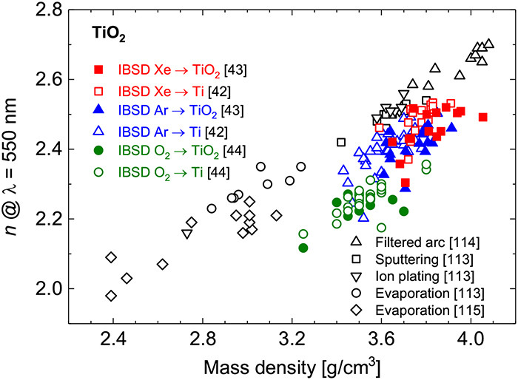
Index of refraction
FIG. 24. Index of refraction n at λ = 550 nm versus mass density of TiO 2 thin films grown by various PVD techniques.^{42–44,113–115} Reproduced with permission from Bundesmann et al., Appl. Surf. Sci. 421, 331 (2017). Copyright 2017 Elsevier.
Published in: Carsten Bundesmann; Horst Neumann; Journal of Applied Physics 124, 231102 (2018)
DOI: 10.1063/1.5054046
Copyright © 2018 Author(s)

Slide 30
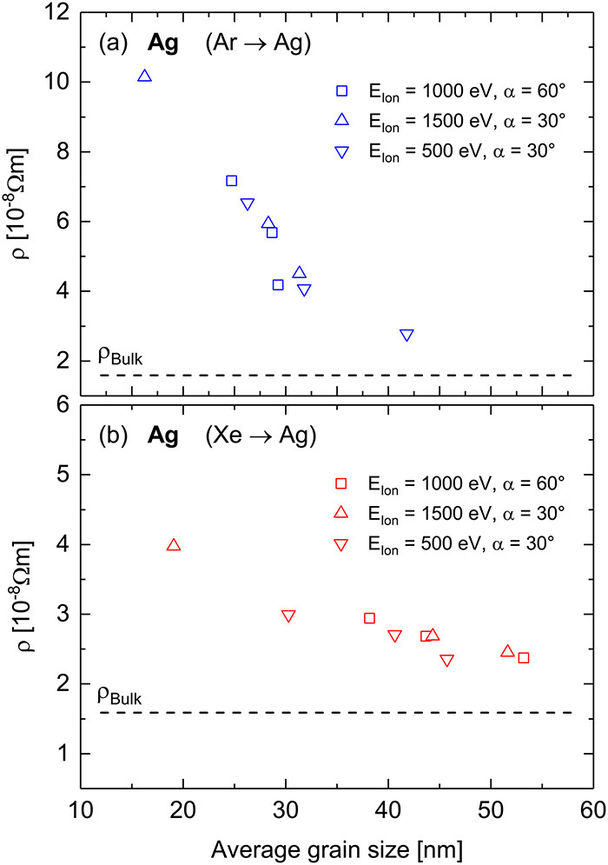
Electrical resistivity
FIG. 20. Electrical resistivity ρ versus average grain size of Ag thin films grown by IBSD using Ar ions [panel (a)] or Xe ions [panel (b)]. Please note the different scales. The data are shown for different sets of process parameters ( E Ion, α). The horizontal dashed lines indicate the electrical resistivity of Ag bulk. Reproduced with permission from Bundesmann et al., Thin Solid Films 551, 46 (2014). Copyright 2014 Elsevier.
Published in: Carsten Bundesmann; Horst Neumann; Journal of Applied Physics 124, 231102 (2018)
DOI: 10.1063/1.5054046
Copyright © 2018 Author(s)

