Slide 1
Thin film deposition on polymers and deposition of polymer thin films
sami.franssila@aalto.fi

Slide 2
Sputter deposition of polymers
Need RF-sputter,
so that there is
no charging of the target
Deposition rates ~0.6 nm/s
(slightly lower than metals)
Hynek Biederman: Organic films prepared by polymer sputtering, JVST A 2000

Slide 3
Self-sputtering of PTFE (CF₂)_{n}
Organic films that can be best described as fluorocarbon plasma polymers (Teflon-like) were prepared in the so called self-sputtering mode.
In this case argon was used to initiate the discharge that continued to be maintained by the volatile fragments when the argon supply was shut off.
RF sputtering of PTFE was also performed in argon.
Because sputtered fluorocarbon films were found deficient in fluorine, RF sputtering of PTFE in
a CF₄–Ar mixture was used and shown to give stoichiometric films.
Hynek Biederman: Organic films prepared by polymer sputtering, JVST A 2000

Slide 4
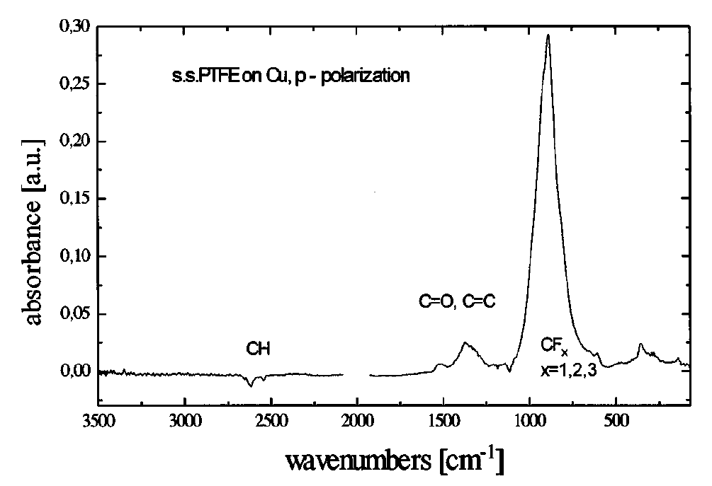
FTIR-analysis of PTFE film
Biederman: J. Vac. Sci. Technol. A 18.4., Jul/Aug 2000, p. 1642

Slide 5
XPS-analysis of PTFE-film
Biederman: J. Vac. Sci. Technol. A 18.4., Jul/Aug 2000, p. 1642

Slide 6
Film structure
These F-rich fluorocarbon plasma polymer films were stable at 450°C for 4 h.
Even after 24 h at 450°C no crystalline structures were observed by x-ray diffraction, i.e., the films appeared to be amorphous.
Biederman: J. Vac. Sci. Technol. A 18.4., Jul/Aug 2000, p. 1642

Slide 7
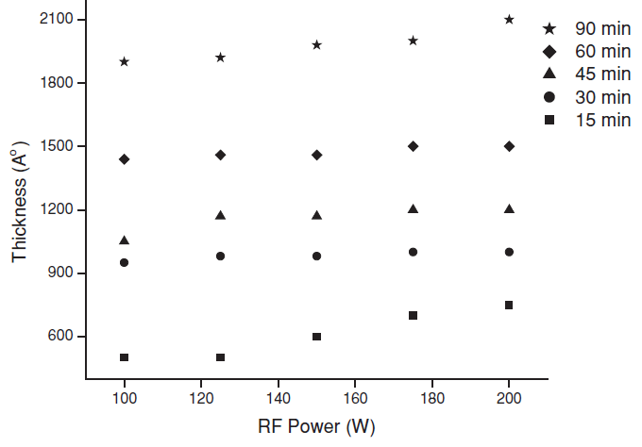
Another PTFE sputter process
Thickness @ 30 min ≈ 1000 Å
Thickness @ 90 min ≈ 2000 Å
If linear deposition rate ➔ should be 3000 Å !
“Negligible increase in thickness beyond a certain time duration
may be because of the possible equilibrium established
between deposition and etching of the film.”
Bodas & Gangal: J. Micromech. Microeng. 15 (2005) 1102–1113

Slide 8
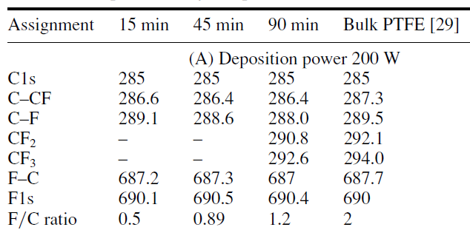
XPS analysis of PTFE film
Bodas & Gangal: J. Micromech. Microeng. 15 (2005) 1102–1113

Slide 9
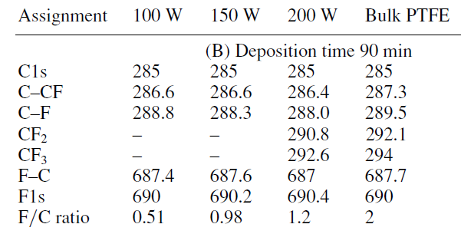
XPS vs. sputtering power
Bodas & Gangal: J. Micromech. Microeng. 15 (2005) 1102–1113

Slide 10
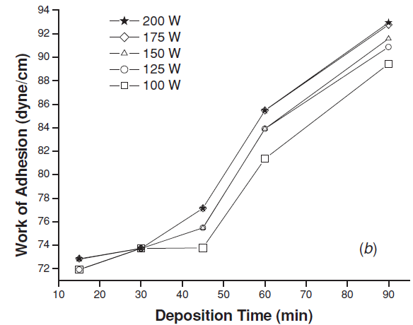
Sputtered Teflon as etch mask
Not attacked by hot KOH
Has good adhesion to Si
Rate Si: rate PTFE =
1 µm/min:0.0006 µm/min = 1700:1
Bodas & Gangal: J. Micromech. Microeng. 15 (2005) 1102–1113

Slide 11
Film effects on substrate
Sputtering (and PECVD and other energetic deposition process) will implant atoms into substrate.
Penetration of sputtered film atoms can be 50 nm in polymers.
This improves adhesion, which is important since polymers do not readily form bonds with deposited metals or ceramics.

Slide 12
Interphase layer on polycarbonate
Plasma effects generally:
cleaning
etching
cross linking
functionalization
plasma pretreatment (cross linked polymer)
mixed polymer-nitride material

Slide 13
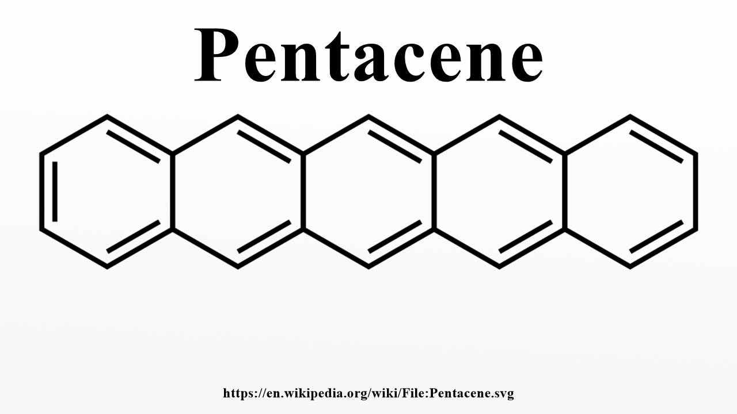
(C14H22)
Active channel material in polymer electronics

Slide 14
Evaporator for pentacene

Slide 15
Knudsen cell for pentacene
Knudsen cell is an isothermal enclosure
with a small
orifice (whereas thermal evaporator has open crucible).
Vapor emerges in a thermal equilibrium process.

Slide 16
Pentacene TFT process
Deposit polyimide
Lithography
Gold evaporation
Lithography
Gold evaporation & lift-off
Lift-off
Lithography
Pentacene evaporation
Lift-off
PECVD oxide

Slide 17
Flexible TFT: parylene passivation, silicon substrate detachment
Feili et al: J. Micromech. Microeng. 16 (2006) 1555–1561

Slide 18
Evaporation good for lift-off
Goettling et al: JOURNAL OF DISPLAY TECHNOLOGY, VOL. 4, NO. 3, SEPTEMBER 2008

Slide 19
Parylene CVD

Slide 20
Jia et al.: Laboratory pentacene and parylene evaporation systems

Slide 21
Parylene CVD: rate up when temperature down ! Not Arrhenius!
Jia et al.: Laboratory pentacene and parylene evaporation systems

Slide 22
Rate limiting step
This apparent negative activation energy is the signature that surface adsorption of a reactive species is the rate-limiting step.
In the adsorption-limited regime, increased substrate temperature reduces adsorption onto the surface, leading to lower deposition rates, but often thickness uniformity is improved.

Slide 23
Sticking coefficient
Reactive sticking coefficient (g), is defined as the probability of a precursor species adsorbing/reacting each time it strikes the surface.
As g increases, species increasingly stick to the surface on impact, leading to a faster deposition at the trench opening and poor step coverage.
Conversely, low values of g lead to multiple collisions before sticking, allowing for deposition deep inside high aspect ratio features.

Slide 24
Parylene step coverage: excellent
Monomer first physisorbs and chemisorbs only after overcoming an energy barrier.
For the chemisorbed monomer, sticking coefficient was 2.0*10⁻⁵ at 60ºC and increased to 1.4*10⁻³ at -60ºC.

Slide 25
CVD polymer step coverage
300nm deep trench conformally coated with poly(p-xylylene)
(parylene)
iCVD poly(tetrafluoroethylene) (PTFE)

Slide 26
Polymer surface activation
Organic substrates can be chemically activated using a plasma glow discharge.
This activation generates free-radical species on the substrate that can initiate polymerization when contacted with gas-phase polymer precursors.
Alternatively, inorganic substrates can be chemically activated using a piranha solution or oxygen plasma pretreatment to create a high density of surface hydroxyl groups.

Slide 27
PECVD
In PECVD, plasma excitation of the vapor phase creates the radical species.[11]
However, the degree to which organic functionality is preserved often improves by decreasing the plasma power through strategies such as
pulsing the plasma excitation[12–20] or
performing the deposition downstream of the active plasma region
Alf & Gleason article
Adv. Mater. 2010, 22, 1993–2027

Slide 28
Too long and/or high energy pulses destroy polymer functionality
Alf & Gleason article
Adv. Mater. 2010, 22, 1993–2027

Slide 29
Hydrogels by PECVD
Hydrogel poly(2-hydroxyethyl methacrylate) (PHEMA) was deposited by pulsed PECVD
while preserving the functionality and biocompatibility of the film.
Approximately 80% retention of the surface hydroxyl groups, resulting in a sessile drop contact angle of 17º
at a deposition rate of 13.4nm/min
Alf & Gleason article
Adv. Mater. 2010, 22, 1993–2027

Slide 30
Dangling bonds
if these species are not fully reacted during CVD growth, the resultant polymer film contains so-called dangling bond defects.
Once exposed to the air, these defects can further react with oxygen and water, altering the film properties from their as-deposited state.
Alf & Gleason article
Adv. Mater. 2010, 22, 1993–2027

Slide 31
iCVD (initiator CVD)
Alf & Gleason article
Adv. Mater. 2010, 22, 1993–2027

Slide 32
iCVD reactor
Alf & Gleason article
Adv. Mater. 2010, 22, 1993–2027

Slide 33
Alf & Gleason article
Adv. Mater. 2010, 22, 1993–2027

Slide 34
Alf & Gleason article
Adv. Mater. 2010, 22, 1993–2027

Slide 35
PAN nanotubes
Anodic Aluminum Oxide (AAO) template
Alf & Gleason article
Adv. Mater. 2010, 22, 1993–2027

Slide 36
Rate limiting step iCVD
Filament temperature strongly influences deposition rate.
At low filament temperatures, the radical
formation from the initiator is the rate-limiting step.
At higher filament temperatures, there is a weaker dependence between decomposition rate and filament temperature, suggesting that mass transport of the radical species to the surface becomes the rate-limiting mechanism.
Alf & Gleason article
Adv. Mater. 2010, 22, 1993–2027

Slide 37
Organic thin films: wet deposition techniques
  Dip coating
  Langmuir-Blodgett films
  layer-by-layer assembly
  spin coating

Slide 38
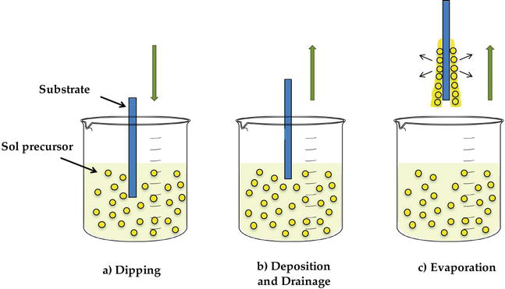
Dip coating
Dippings of the substrates (glass, silica wafer etc) into liquid that contains organic molcules or sol-precursors
  One dipping: one layer
  More dippings: more layers
Two-dimensional nanometer thickness films
Ana Isabel Gómez Varela et al:
Sol-Gel Glass Coating Synthesis for Different Applications: Active Gradient-Index Materials, Microlens Arrays and Biocompatible Channels, Intech Open 2017

Slide 39
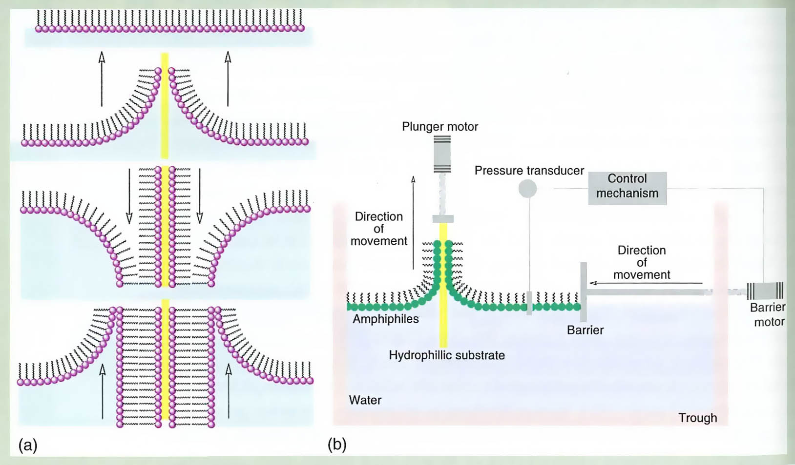
Langmuir-Blodgett: advanced dip coating
Amphiphilic molecules organize at water-air interface.
Pressure control.
Motorized lowering and raising.
Hall: The New Chemistry

Slide 40
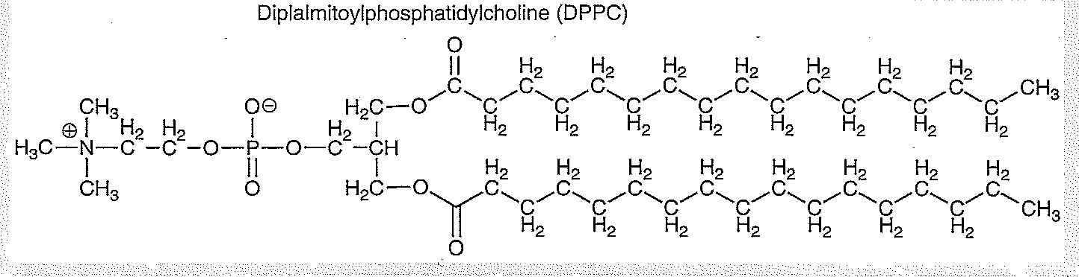
LB films (2)
To form the film on the water surface, the molecules need to be surface active, i.e. they have both hydrophobic and hydropilic parts
For example hydrophobic polymers to have hydrophilic side chains etc.
Hydrophobic backbone
Hydrophilic sidechains
d
Kontturi et al

Slide 41
Langmuir-Blodgett through
Langmuir-Blodgett technique is based on formation of ”floating” film on water, its compaction by ”squeezing” to make densified 2-dimensional solid-like film on water surface, and its transfer on a substrate
d
Kontturi et al

Slide 42
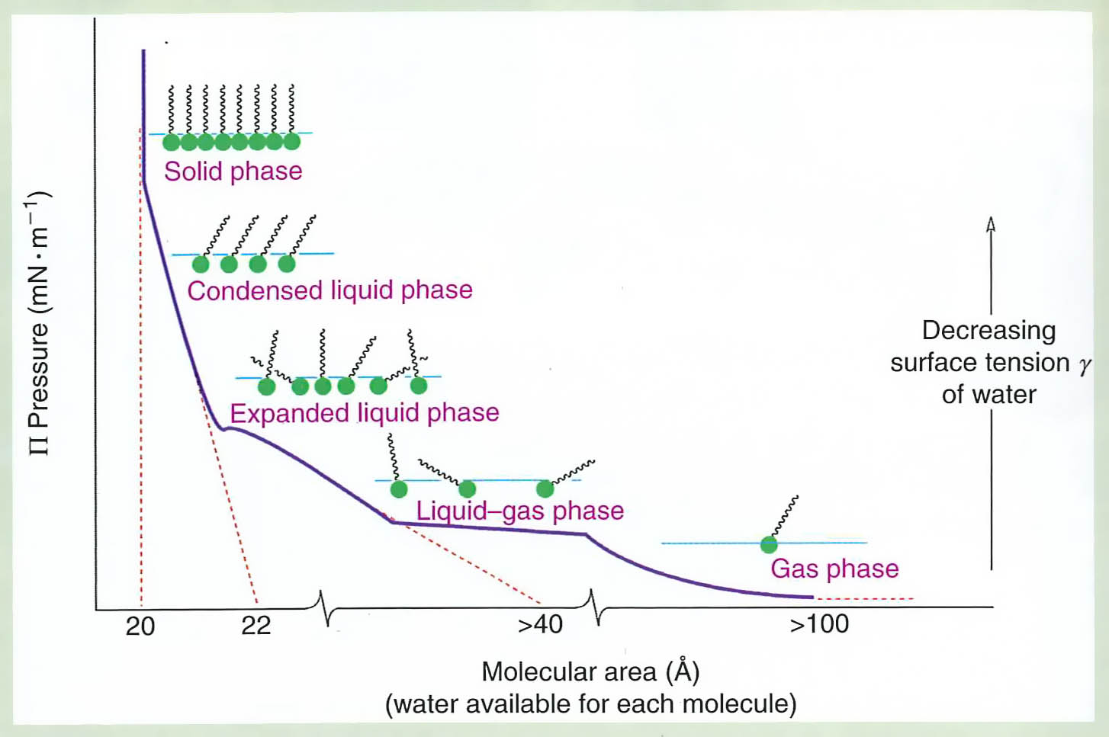
LB: Pressurization curve
Multiple layers
Hall: The New Chemistry

Slide 43
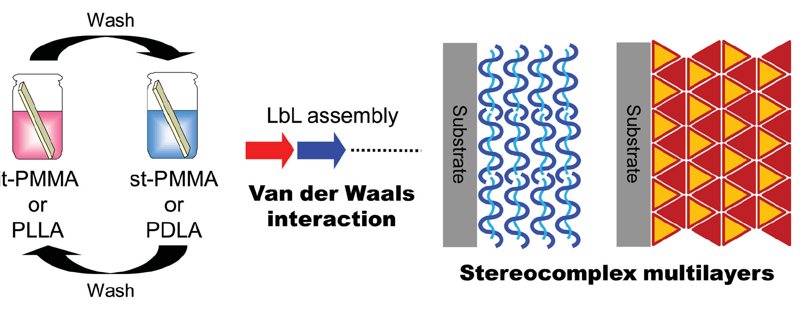
Polyelectrolytes/Layer-by-layer
These films are random, while LB films are highly organized.
Matsusaki et al: Adv. Mater. 2012,
DOI: 10.1002/adma.201103698

Slide 44
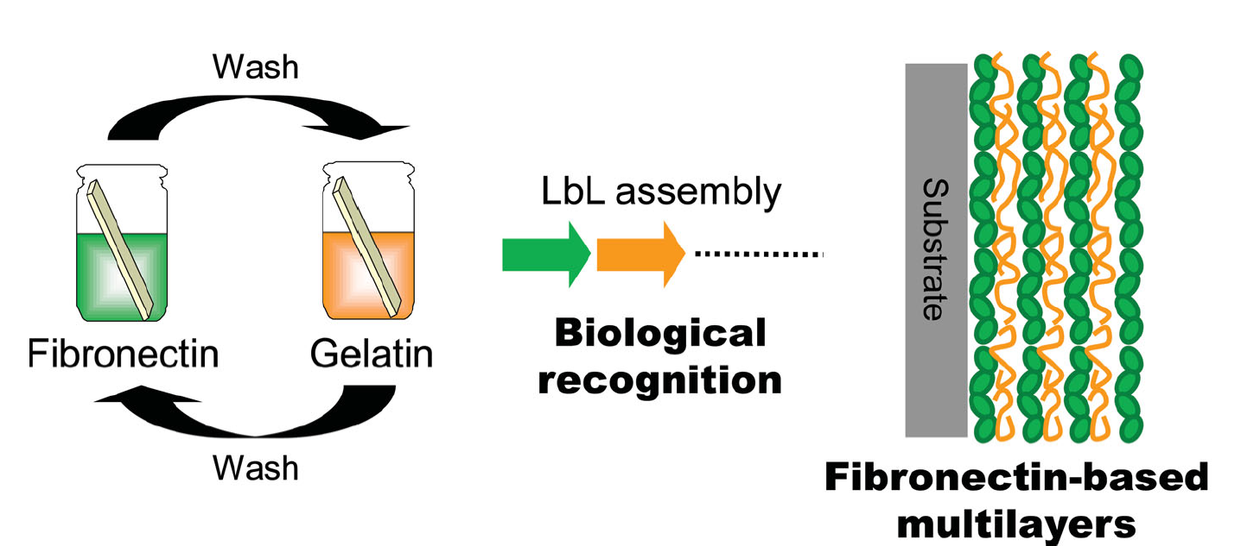
Polyelectrolytes (LbL 2)
Matsusaki et al: Adv. Mater. 2012,
DOI: 10.1002/adma.201103698

Slide 45
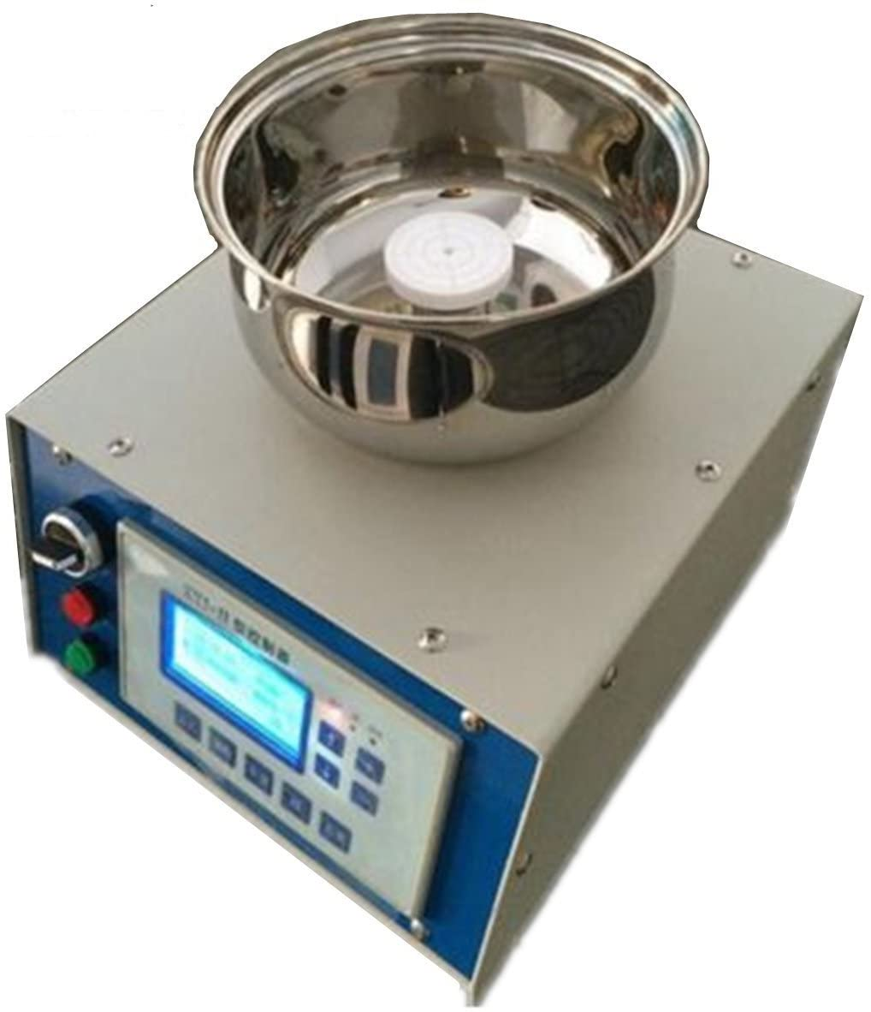
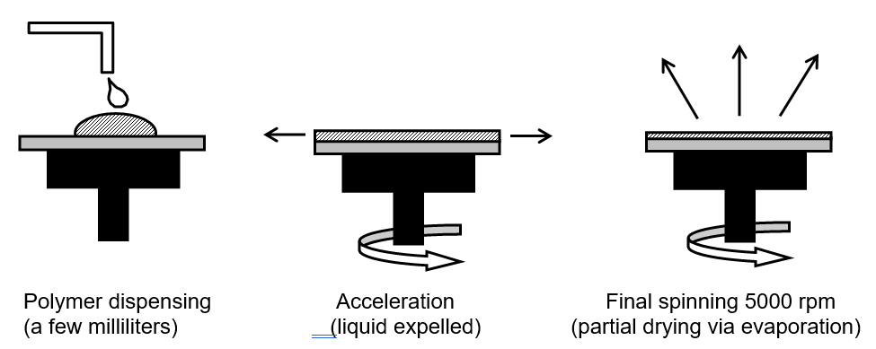
Spin coating
Film thickness is largely a balance between the force applied to shear the fluid towards the edge of the substrate and the drying rate which affects the solids content and thus viscosity.
As the film dries, the viscosity increases until the radial force of the spin process can no longer appreciably move the liquid over the surface.
Franssila: Introduction to Microfabrication

Slide 46
Thickness in spin coating
The two main factors affecting film thickness are:
viscosity η (which depends on solid content and solvent)
spinning speed ω (faster ➔ thinner)
Spin speed can be used to tailor thickness over one decade, e.g. 0.5-5 µm, but beyond that a new formulation with different viscosity must be used.
Viscosity is dependent on solid content (which can vary from 20-80%) and temperature.
Solvent evaporation rate depends on ambient environment, and a closed spinner bowl with saturated solvent vapor and adjustable exhaust from spinner bowl can both be used to control evaporation.

Slide 47
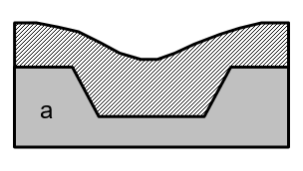
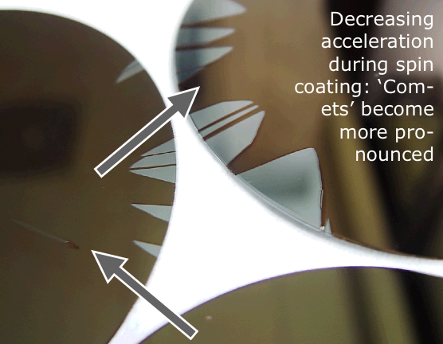
Spin coating pros and cons
-short coating time (< 1 min)
-reliable
-cheap
-uniform film thickness in case of Newtonian liquids
(=viscosity remains constant with shear rate)
-Various film thicknesses possible (0.1 µm to 500 µm)
-always requires baking step afterwards
Topography on surface ➔ non-uniform film thickness because liquid-like resist partly conforms and partly tries to flatten out.
Particles can become “sources” of defects: liquid does not spread evenly behind an obstacle.

