Slide 1
Multilayers and interfaces
sami.franssila@aalto.fi

Slide 2
Why multilayers ?
More functionality and performance
Single layer ARC vs. λ/4 filter
Grain size and orientation are affected by underlayer
More reliability
If aluminum broken because of electromigration, but TiN conducts still
Adhesion layers & barriers
SiO_{x}/SiN_{x} passivation: films complement each other
More process robustness
Etch stop layer, no timed etching needed
TiN on Al reduces reflectivity and eases lithography

Slide 3
Why not multilayers ?
More complex deposition equipment needed
e.g. Multiple targets, multiple chambers
Deposition thruput compromised
esp. if thickness or nature of films very different
Each new interface is a potential problem

Slide 4
This lecture deals with phenomena during processing
surface
thin film 2
interface 2
thin film 1
thin film 1
interface 1
substrate

Slide 5
Magnetic multilayers
5 nm Ta
5 nm NiFe
1 nm CoFe
2.6 nm Cu
2.5 nm CoFe
0.8 nm Ru
2 nm CoFe
15 nm PtMn
5 nm Ta
Surface roughness must not increase with each successive layer !! Otherwise deposition of extremely thin films becomes impossible.
substrate

Slide 6
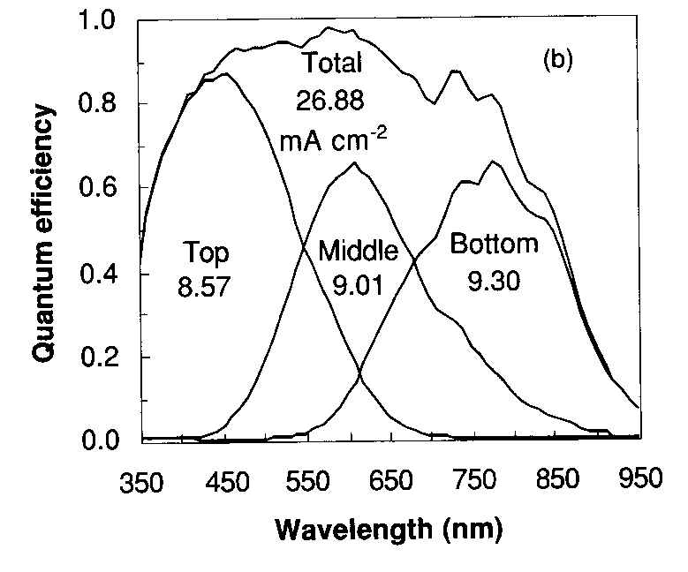
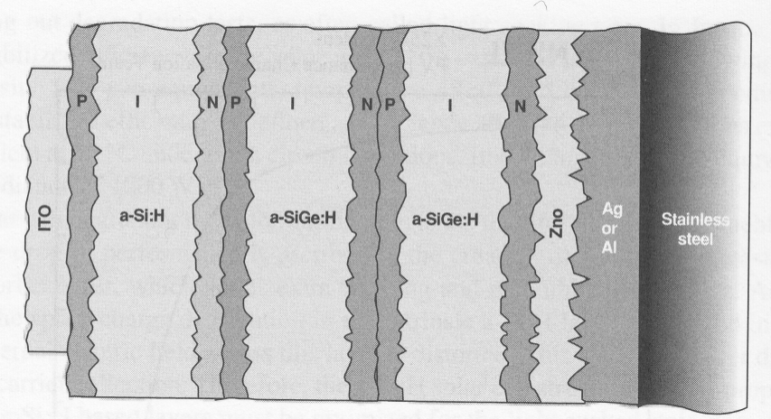
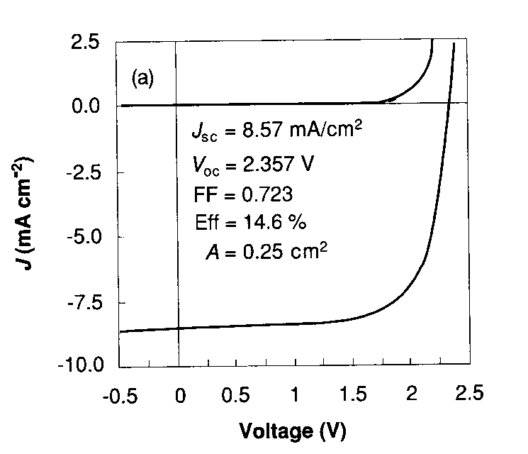
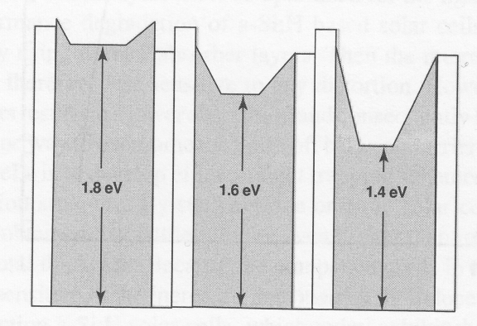
Multiple junction solar cell
Si:Ge ratio modifies bandgap
Poortmans: Thin Film Solar Cells, p. 214

Slide 7
Substrate surface
Adsorbed water
Carbon & other impurities
Particles
Roughness
Crystal structure
Crystalline defects
Dangling bonds
substrate

Slide 8
Surface reactions
Native oxide formation e.g.
Si, Ti, Cu, Cr
But CrO is conductive, others insulators.
Nitridation:
difficult, needs either
  -ammonia exposure
  -high temperature
TiN formation is an exception
thin film
substrate

Slide 9
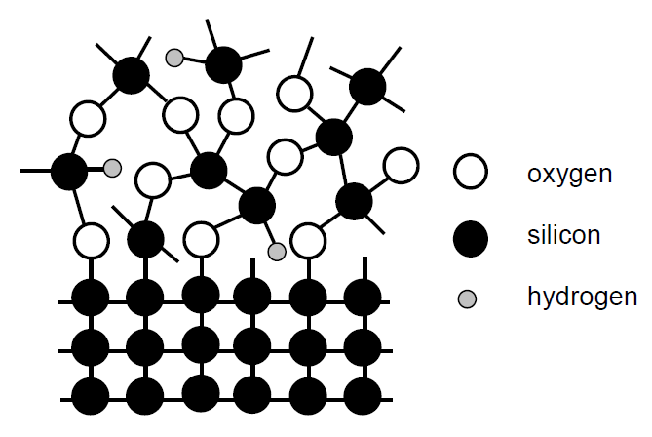
Ambient gases into film
Oxygen:
stoichiometry finetuning: Ta₂O₅
Water:
-into pores
-into PSG (hygroscopic film)
Nitrogen:
Grain boundary stuffing, TiW:N, W:N
Hydrogen (N₂:H₂ in practice)
Dangling bond passivation
thin film
substrate

Slide 10
PSG
CVD oxides have unfortunately many names:
USG = undoped silica glass (=CVD SiOx, x ≈2)
PSG = phosphorous doped silica glass (=CVD oxide, which had P2O5 flow during deposition ➔ phosphorous incorporated into film)
PSG typical: 5 wt% phosphorous
excellent gettering agent for Na+ ions
hygroscopic if too much P
Note: in metals and oxides: 1-5% dopant/alloying element
in semiconducotrs parts per million (10⁻⁶) dopant

Slide 11
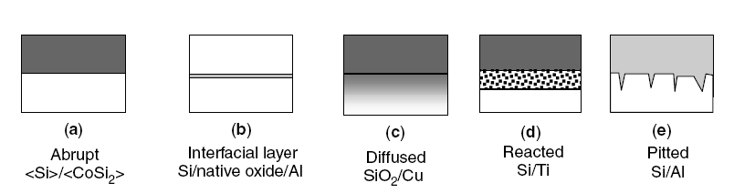
Interfaces
Stability of interface in subsequent processing and during use ?
Barrier layers: extra films to stabilize interfaces

Slide 12
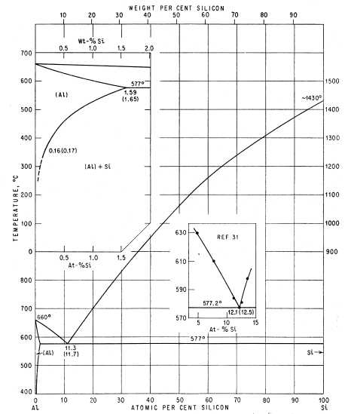
Al-Si phase diagram
A little silicon is soluble in aluminum at 400ºC, ca. 0.3 at%
➔ Al to Si interface is unstable at 400ºC

Slide 13
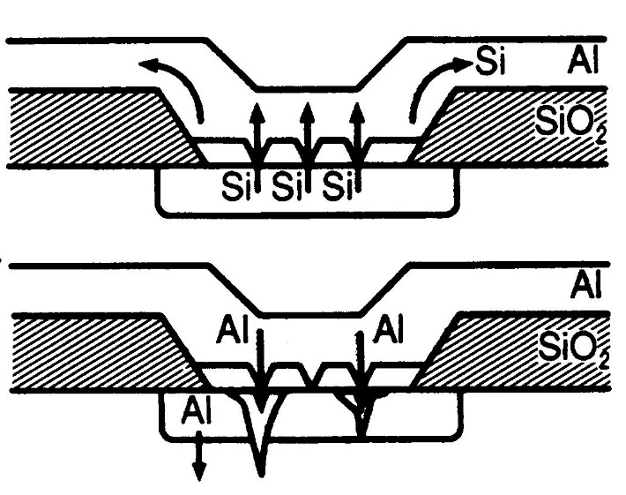
Junction pitting
Silicon dissolves into aluminum
Aluminum diffuses into silicon via the vacancies left by removed silicon
If aluminum diffusion deep, it will extend to pn-junction
➔ No pn-junction anymore
p
n
junction
Ohring

Slide 14
Interface stability: ΔG
Change in Gibbs free energy is given by:
ΔG positive = stable pair; ΔG negative = films react
For reaction titanium reaction with silicon dioxide:
Ti + SiO₂ ➔ TiO₂ + Si
ΔG = G_{TiO2} - G_{SiO2} = (160 – 165) Kcal = -5 Kcal, indicative that the reaction can take place.
For Co + SiO₂ ➔ CoSi₂ + Si ΔG> 0, no reaction.

Slide 15
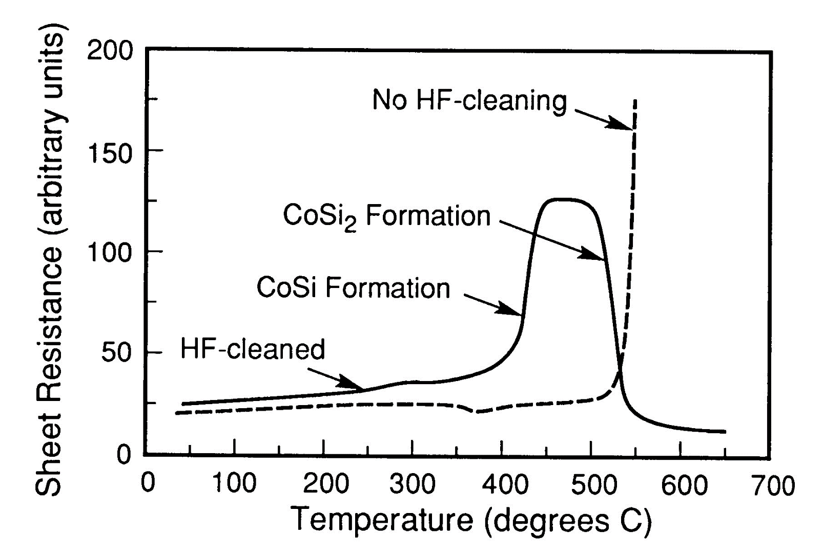
Reaction Co+Si
Co + Si ➔ CoSi
CoSi + Si ➔ CoSi₂ at higher temperature
SiO₂ native oxide delays reaction
At high enough temperature the native oxide breaks down, and Co+Si reaction can take place.
Murarka

Slide 16
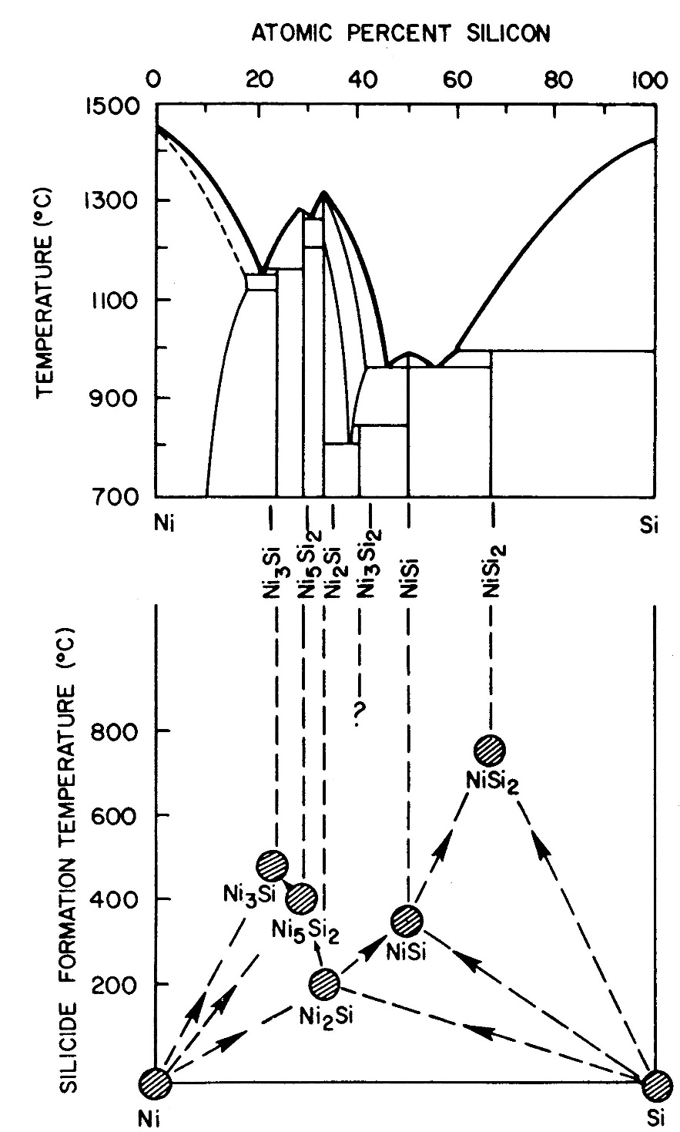
Nickel silicide formation
It is not always the case that the silicide that will form is the technologically interesting one !
NiSi is the desired low resistivity material;
NiSi₂ is the stable phase that tends to form.
Ohring

Slide 17
From substrate into film
Steel substrates are a source of metals
Glass substrates are sources of sodium
Polymer substrates are permeable to water vapor and oxygen
➔ Need barrier(s)
thin film
substrate
thin film
barrier
substrate

Slide 18
Barriers
thin film
Atom barrier: blocks atom movements.
Ion barrier: blocks ions.
Total barrier: no atoms, no electrons pass thru.
substrate
Barrier can simultaneously act as smoothing layer. This is important if e.g. stainless steel is used.
Spin-on glasses !

Slide 19
Examples of barriers
Diffusion barrier: <Si>/TiW/Al in IC metallization
Improved diffusion barrier, stuffing: <Si>/TiW:N/Al
Dielectric barrier: SiO₂/SiN_{x}/Cu
Ion barrier: glass/Al₂O₃/ZnS in electroluminescent displays

Slide 20
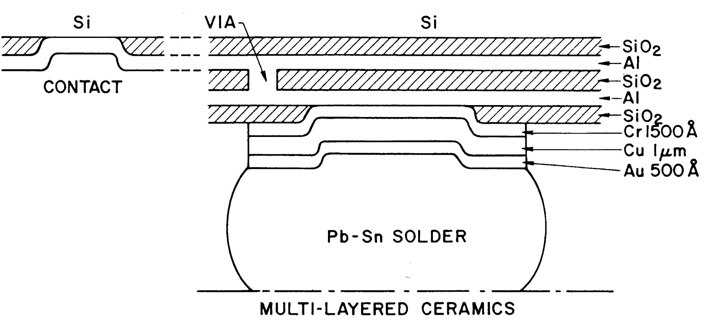
Solder joint
Integrated circuit side
Circuit board side
Pb-Sn will react with aluminum, therefore a barrier (Cr/Cu/Au) is needed.
The alternative strategy of lower temperature does not work because solder has to flow.
Ohring

Slide 21
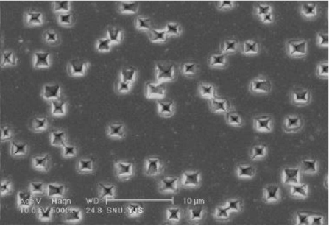
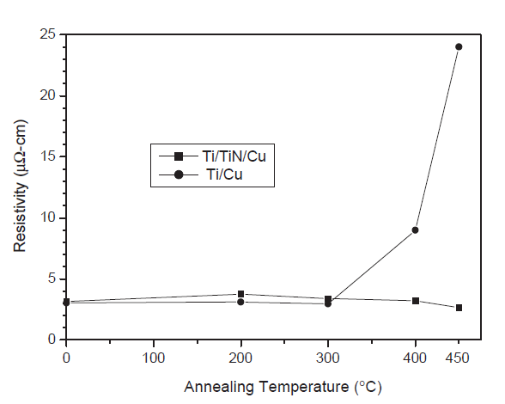
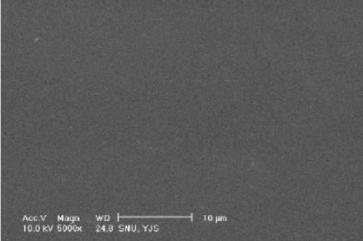
Stability of metallization
Ti barrier
Ti/TiN barrier

Slide 22
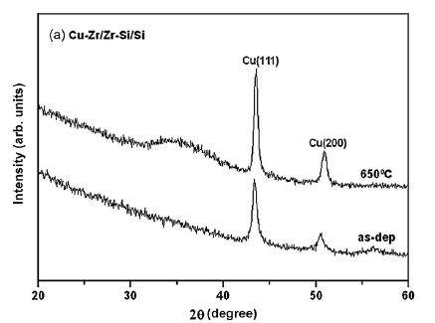
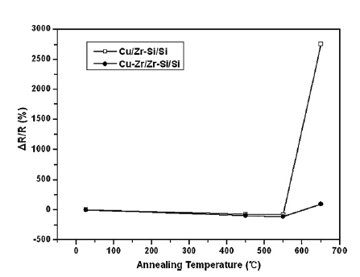
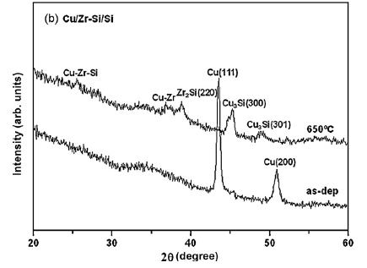
Alloying effect
Zirconium at grain boundaries acts as an extra barrier, preventing formation of high resistivity Cu₃Si

Slide 23
Copper for IC metallization
Barrier:
t < 10 nm thick
ρ < 500 µΩ-cm
Cl conc. < 2%
unif. < 2%
step coverage >90%
rate > 3 nm/min
Copper seed
t > 2 nm
unif. < 2%
step coverage ~100%
rate > 10 nm/min
growth and adhesion on etch stopper
Low-k:
CMP compatible
T_{depo} < 400ºC
adhesion on etch stopper
General:
low variation
low particle generation
large process window
Etch stopper:
growth and adhesion
on dielectric
growth and adhesion
on barrier

Slide 24
Inert annealing changes in film
thin film
Crystallization
Grain growth
Bond formation: e.g. Si-N bonds formed in PECVD nitride
substrate

Slide 25
Annealing: bond formation
2nd ramp down

Slide 26
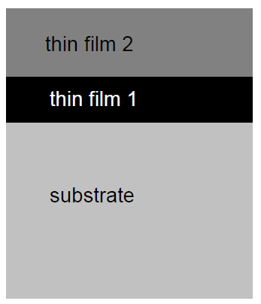
Film poisoning during 2nd deposition
If film 1 is porous or incompletely reacted, it can release atoms and poison film 2.
e.g. film 1 is spin-on-glass, and oxygen or water vapor from it penetrate into aluminum, leading to increased resistivity (and in extreme case, Al₂O₃ formation).

Slide 27
Film-to-film modification
During annealing atoms from one film move to the other.
e.g. Film-2 is phosporous-doped oxide, and film-1 is polysilicon, then polysilicon will be doped n-type by phosphorous.
e.g. Film-2 is PECVD nitride, film-1 is a-Si or poly, then during annealing hydrogen from nitride will passivate dangling bonds in silicon.

Slide 28
Substrate oxidation
thin film
If thin film precursor is oxygen or water vapor, silicon is easily oxidized, e.g. ALD ZrO₂ with O₂ pulses.
substrate
SiO₂ ca. 2 nm

Slide 29
Annealing: chemical reactions
Surface reaction:
Titanium nitride formation
2Ti + N₂ ➔ 2 TiN
N₂
Ti
Interface reaction:
Titanium silicide formation
Si + 2 Ti ➔ TiSi₂
<Si>
heat
Solution: anneal in argon

Slide 30
Annealing: chemical reactions
CuSi_{x}
Cu + Si ➔ CuSi_{x}
CuSi_{x} is a high resistivity material
CuO_{x}
Annealing atmosphere:
Even tiny oxygen contamination will lead to copper surface oxidation.

Slide 31
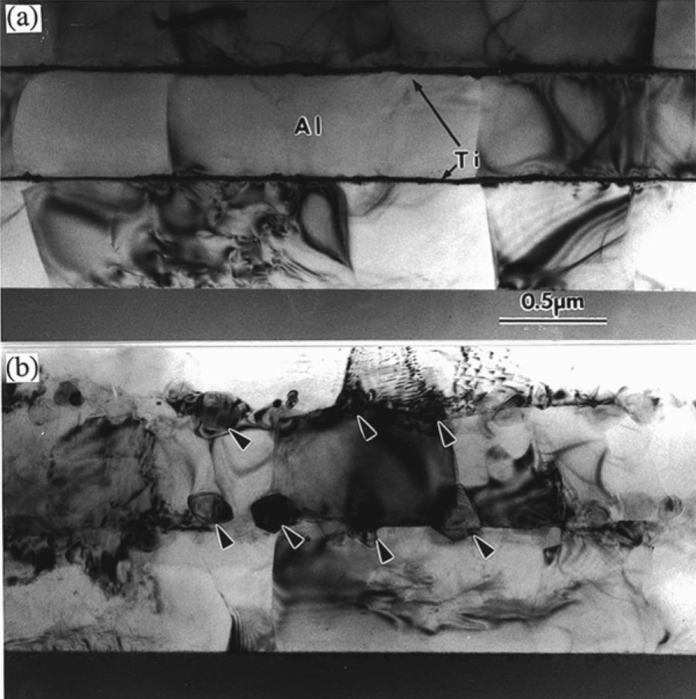
Precipitates
Pure Al yield strength 95 MPa
Al-1%Ti yield strength 175 MPa
Al₃Ti precipitates formed during 550ºC anneal.
Al₃Ti has an elastic modulus of 210 GPa, is much stiffer than pure Al (60 GPa).
Stiff precipitates block dislocation movement
through a soft matrix and thereby increase the yield strength.
One can improve the strength of an Al membrane while only slightly diminishing
its conductivity.
10 nm Ti/500 nm Al,
Annealed 550ºC, 1 h in N₂
Arrows indicate Al₃Ti precipitates
Lee, Appl. Phys. Lett., Vol. 76, p. 3415

Slide 32
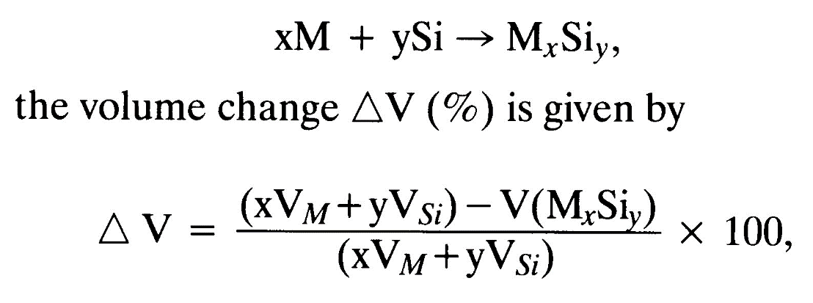
Volume changes
In silicide formation, negative volume change ➔ tensile stress
In thermal oxidation, positive volume change ➔ compressive stress

Slide 33
Annealing multilayers
Top surface reaction
-e.g. oxidation
Film-film reaction
-e.g. Ti + 3Al ➔ TiAl₃
Film-substrate reaction
-e.g. Ti + 2Si ➔ TiSi₂

Slide 34
Texture inheritance
Film 2 will register the crystal structure of film 1.
Choosing film 1 to be either amorphous (like SiO₂) or polycrystalline (like TiW), will result in different film2 texture and properties.
Molybdenum as film2:
Mo thickness Film 1 Film 2 resistivity
300 nm SiO₂ 12 µOhm-cm
300 nm TiW 9 µOhm-cm

Slide 35
Texture inheritance (2)
Protective coating, DLC, 5 nm
Ta/Ru film will induce suitable crystallinity in the magnetic data storage layer CoCrPt:SiO₂
Terminology: CoCrPt:SiO₂ means that CoCrPt films contains small SiO₂ crystals.
CoCrPt:SiO₂ recording layer 15 nm nmnm
Ta/Ru intermediate layer, 8/60 nm
NiFe soft magnetic underlayer, 80 nm
Ti (or Ta) adhesion layer, 10 nm
Disk substrate (glass or Al-Mg)

Slide 36
Symmetric 3-layer
Poly will be doped by PSG (phosphorous doped silica glass) symmetrically.
PSG
Poly
PSG
<Si>
Au/<Si>/Au mirror planarity assured by a symmetric metallization.
<Si>
<Si>

Slide 37
Acoustic λ/4 multilayers
Al (300 nm)
Mo (50 nm)
ZnO (2300 nm)
Au (200 nm)
Ni (50 nm)
SiO₂ (1580 nm)
W (1350 nm)
TiW (30 nm)
SiO₂ (1580 nm)
W (1350 nm)
TiW (30 nm)
glass wafer

Slide 38
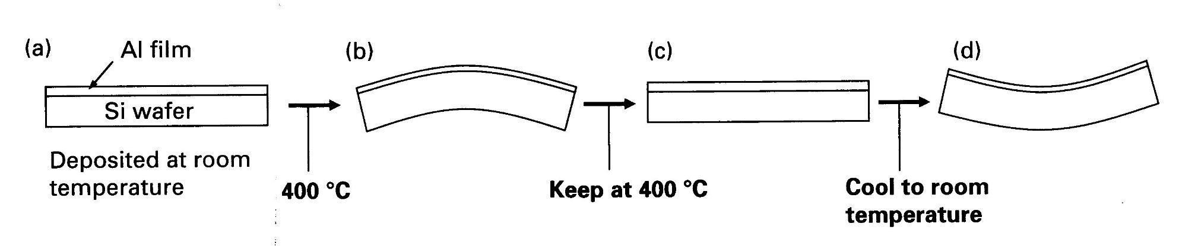
Stress evolution
Much more extensive relaxation takes place in the Al thin films than in bulk.
Thin film grain size, typically ~1 µm vs. ~ 100 µm for bulk, would enable much more extensive grain boundary sliding and hence greater stress relaxation.
Hoo-Jeong Lee,a) Guido Cornella, and John C. Bravman: Appl. Phys. Lett., Vol. 76, p. 3415
King Tu, p. 131

Slide 39
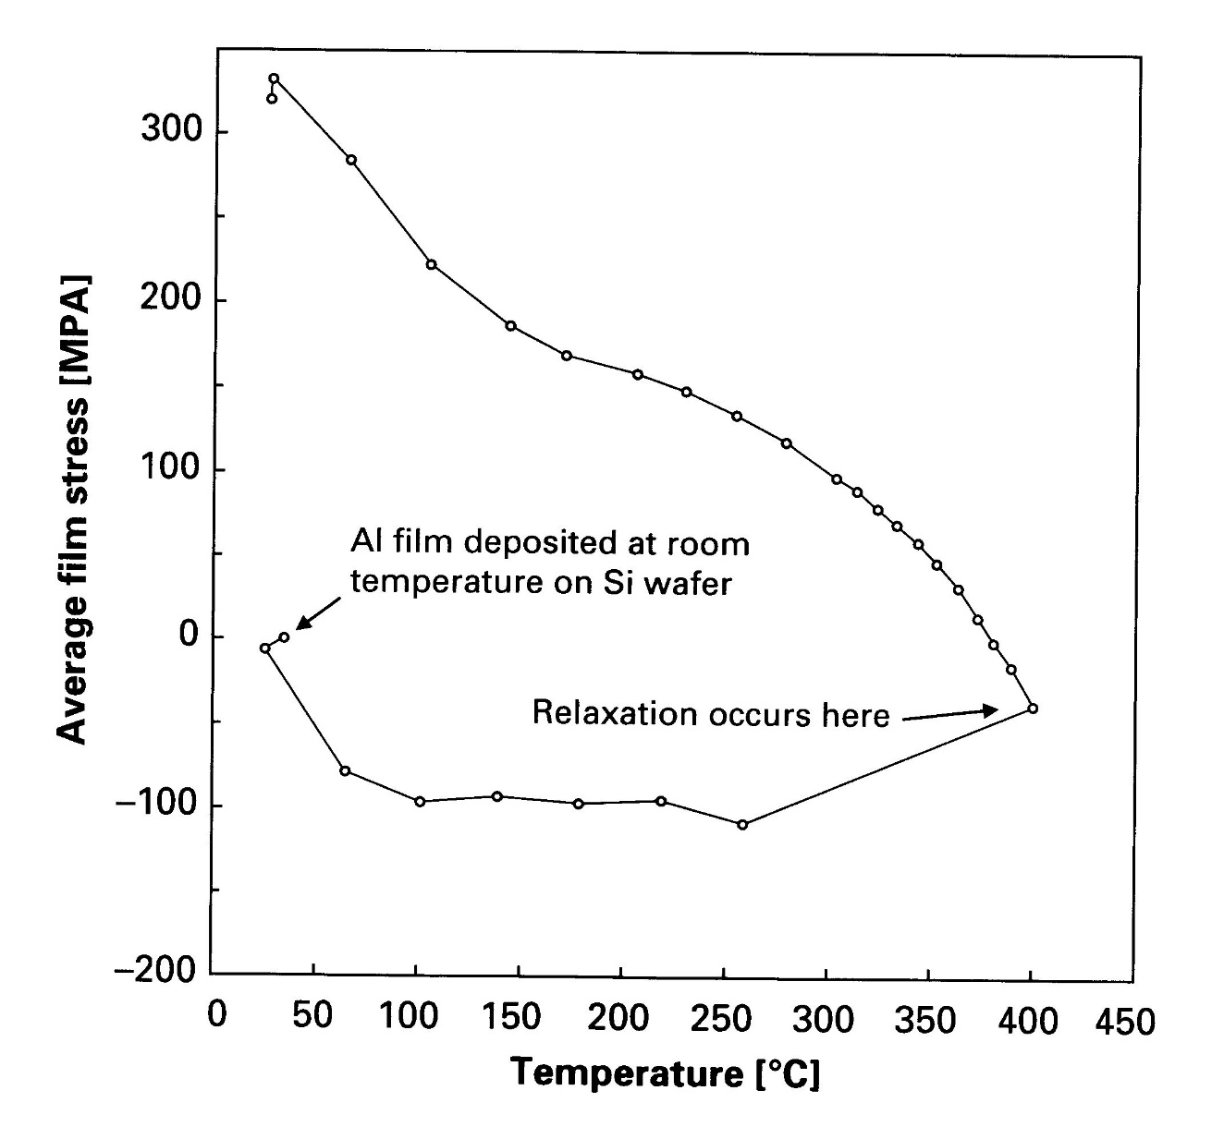
Stress relaxation (1)
King Tu, p. 133

Slide 40
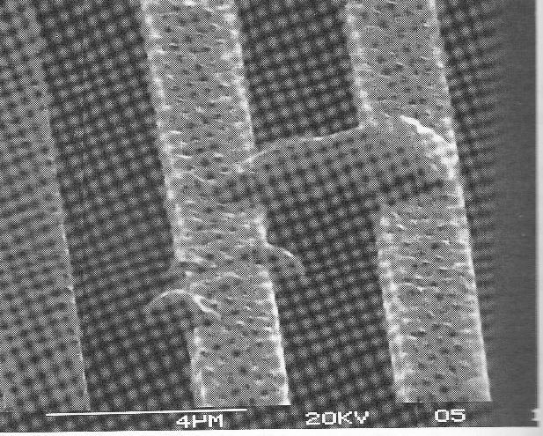
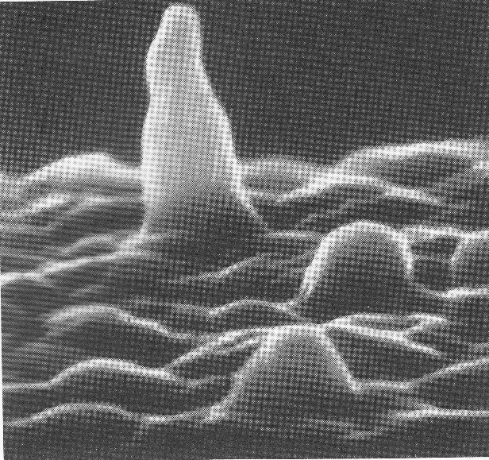
Hillock generation
Compressive stress is relieved by hillock growth.
If surface is free (as in high vacuum), the surface acts as a sink for vacancies and extra atoms are uniformly distributed over the surface.
Oxide covered surface breaks randomly and hillocks are formed.
Hillocks are same size as microlithographic structures and film thicknesses.
➔ Hillocks can short two neighboring lines or two films.

Slide 41
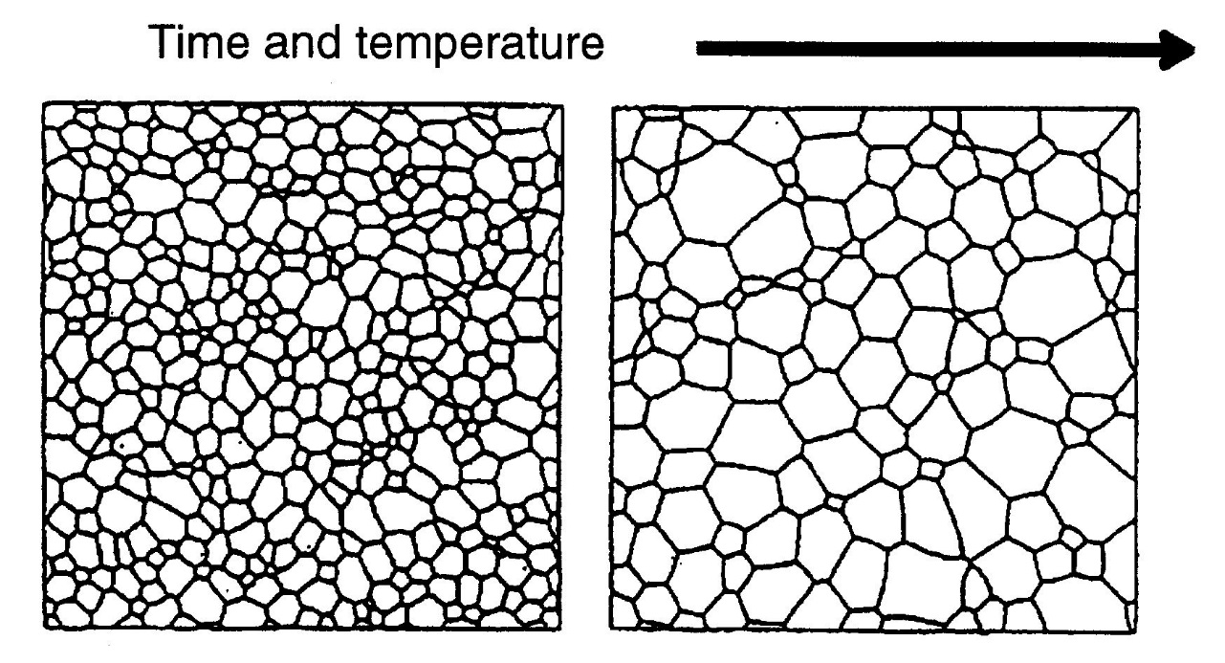
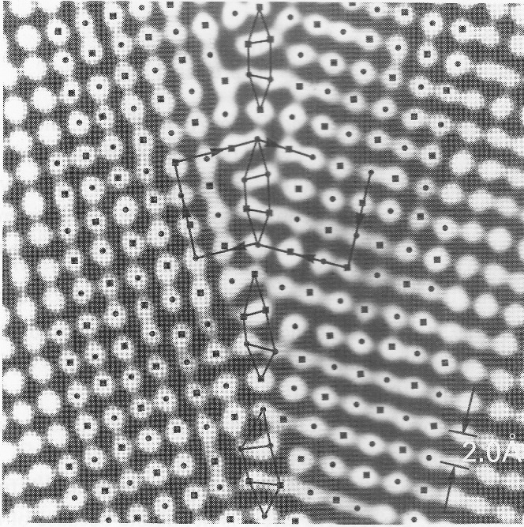
Grain growth
Grain boundaries important because they:
  -act as nucleation sites for growth of new phases
  -act as sites of enhanced reaction rates
  -act as fast diffusion paths
  -act as precipitation sites
King Tu, p. 193

Slide 42
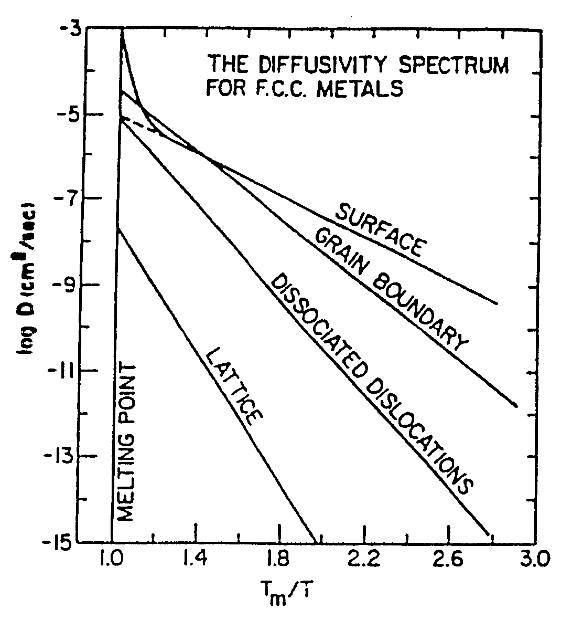
Grain boundary vs. bulk diffusion
Grain boundaries and dislocations are paths of rapid diffusion (below 0.65 T_{m}).
Impurities and dopants are easily trapped and precipitated at defects and grain boundaries ➔ fast diffusion paths blocked ➔ improved resistance against processes that rely on them.
Murarka p. 93

Slide 43
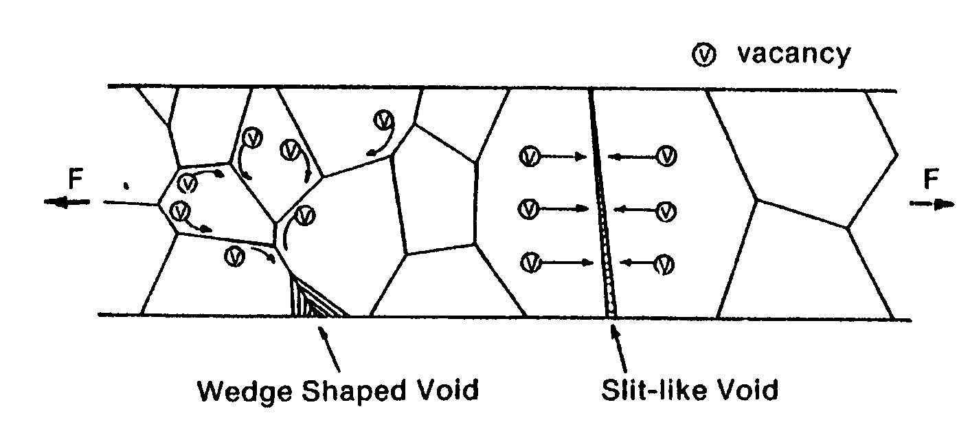
Stress voiding
In order to relieve stress, vacancies diffuse.
Grain boundary diffusion vs. bulk diffusion
Murarka p. 84

Slide 44
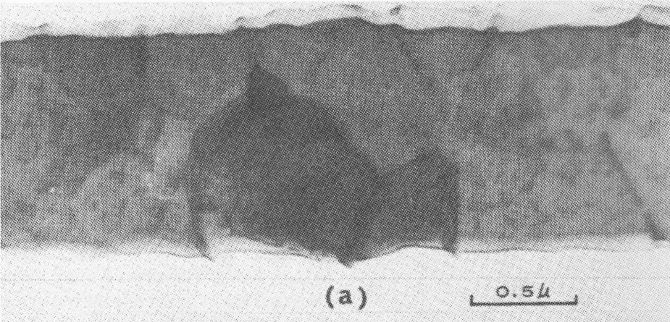
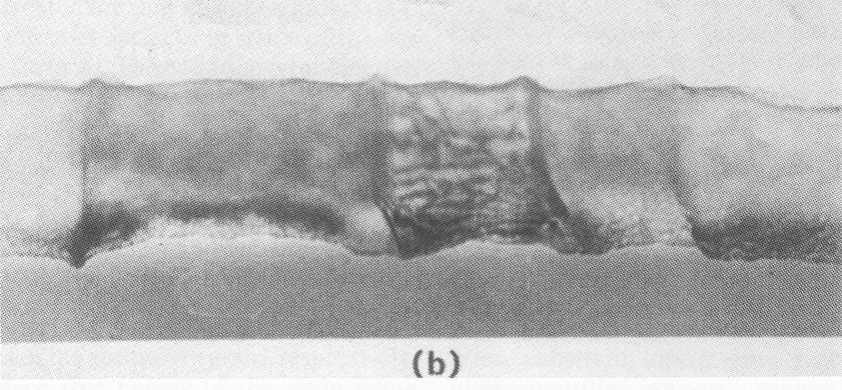
Bamboo structure
3-grain boundaries, active processes during anneal
No 3-grain boundaries ➔ fewer processes at GBs
Murarka p. 99

Slide 45
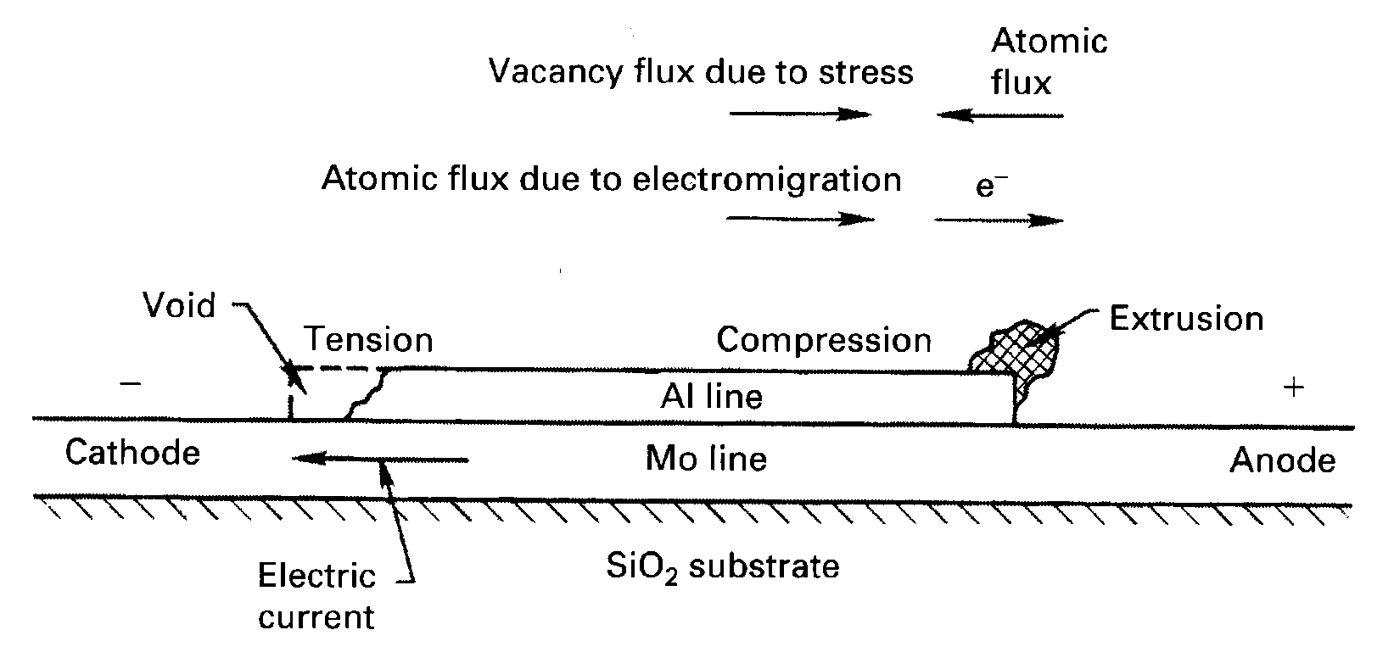
Electromigration
Electron collisions move atoms. Voids formed.
Happens when current density is high.
King Tu, p. 240

Slide 46
Mean time to failure (MTF) due to electromigration
where A is a constant dependent on wire geometry and metal microstructure, J is the current density and E_{a} the activation energy. The factor n is not known very accurately, but n=1.7 is used for aluminum. For aluminum thin films E_{a} is of the order of 0.5-0.8 eV, whereas for bulk aluminum it is 1.4-1.5 eV. As a general trend the higher the activation energy, the better the electromigration resistance .

Slide 47
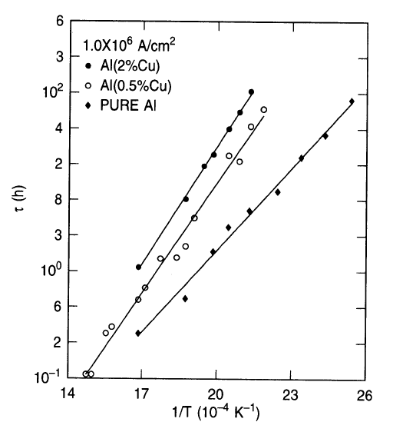
Alloying to prevent EM
500 K = 227ºC
Mean time to failure of 2.5 µm wide lines
pure Al,
Al (0.5 wt % Cu)
Al (2 wt% Cu)
at different temperatures with
1 MA/cm² current density
Hu, C.-K. et al: Electromigration of Al(Cu) two-level structures: effect of Cu kinetics of damage formation, J.Appl.Phys. 74 (1993), p. 969

Slide 48
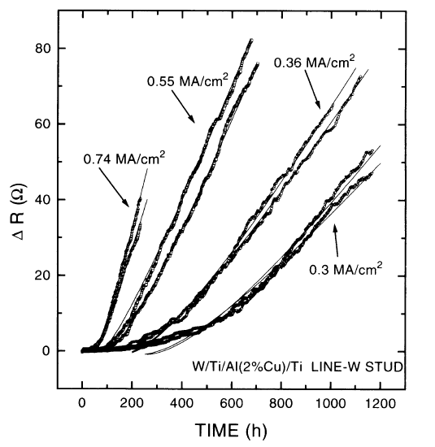
Incubation time
Incubation time before resistance increase sets in (measured at 255°C)
Hu, C.-K. et al: Electromigration and stress-induced voiding in fine Al- and Al-alloy thin- film lines, IBM J.Res.Dev. 39 (1995), p. 465

Slide 49
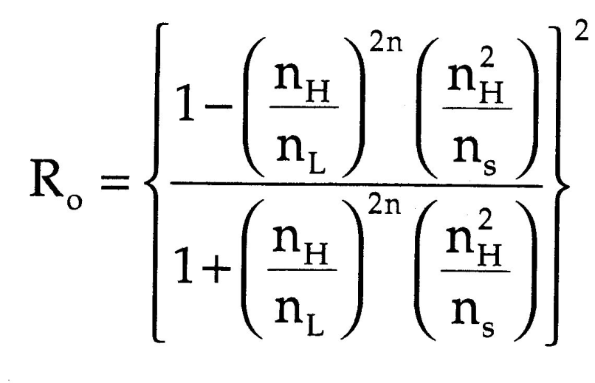
Dielectric mirrors, enhanced metal mirrors
SH(LH)^{n} =
substrate, high refractive index film,
low+high film stack of n-layer pairs
n_{H}t_{H} = λ/4 condition for thicknesses
Film H
Film L
Film H
Film L
Film H
Substrate
Martin p. 303

Slide 50
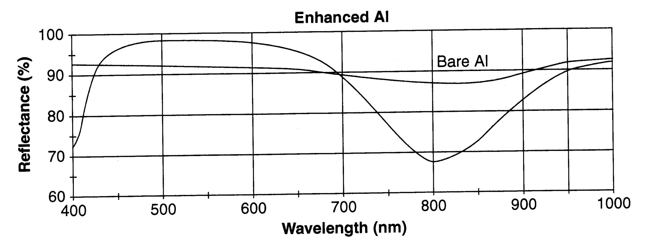
Enhanced aluminum mirror
SM(LH)² design
Glass/Aluminum/SiO₂/Ta₂O₅/SiO₂/Ta₂O₅
510 nm centre wavelength
Martin p. 301

