Slide 1
Epitaxy, superlattices, nanolaminates

Slide 2
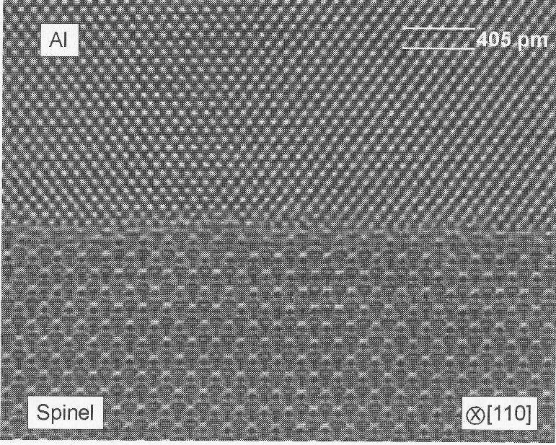
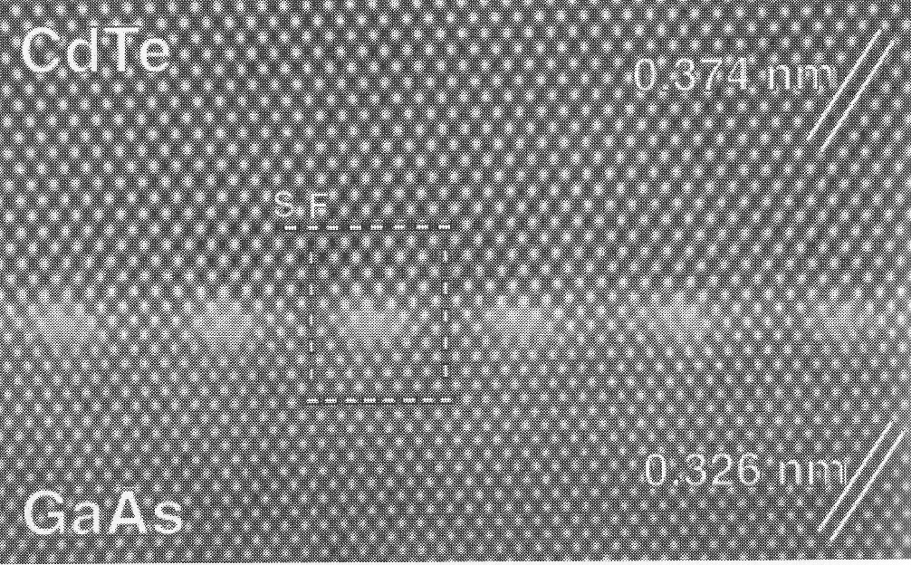
Epitaxy: single crystalline film on single crystalline substrate
CdTe on GaAs.
Stacking faults are arranged at regular intervals at the interface and epilayer is perfect
Aluminum on spinel

Slide 3
Homoepitaxy: crystalline film A on top a crystalline wafer A
Single crystal wafer
Epitaxial layer of the same material deposited on top

Slide 4
Why indeed ?
Epilayer doping concentration different from starting wafer.
Epilayer dopant type different from substrate (n/p –type)
No radial doping profile (as in CZ-crystal pulling)
No vertical doping variation (as along CZ-crystal)
No oxygen (10-15 ppma in CZ-silicon)
No carbon (which comes from SiC and C in CZ)

Slide 5
Epi requirements
Clean surface
Matching lattices
Small enough CTE difference

Slide 6
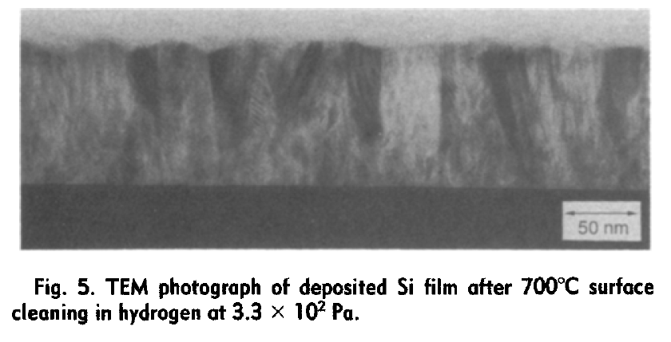
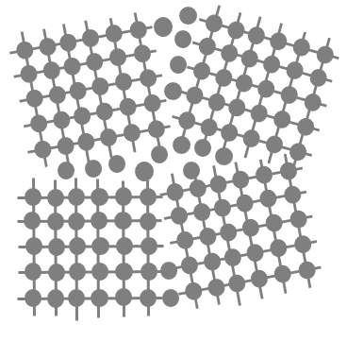
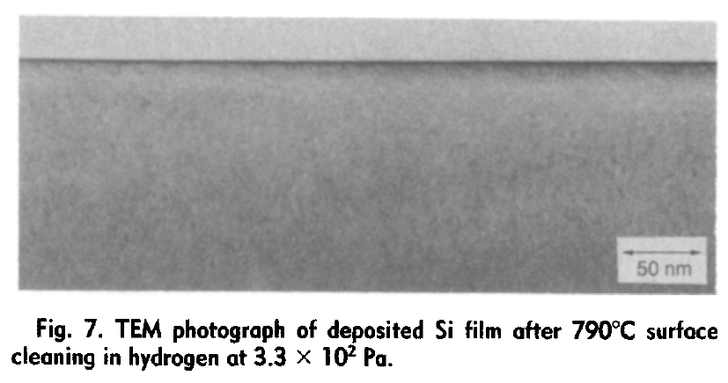
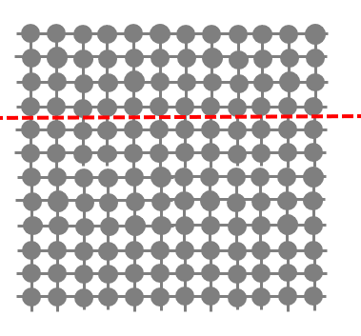
Polycrystalline vs. epitaxial
Crystallites easily seen
Perfectly crystalline film with no grains visible
Yamazaki et al: J. Electrochem. Soc., Vol. 139, No. 4, April 1992

Slide 7
Epitaxy failure
Lattice constant difference
Lattices do not match
Interfacial contamination
May work if lattice constants integer multiples !

Slide 8
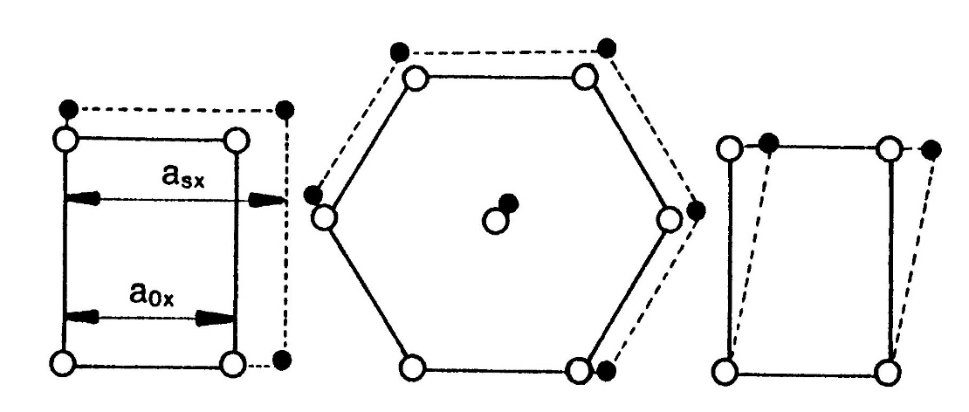
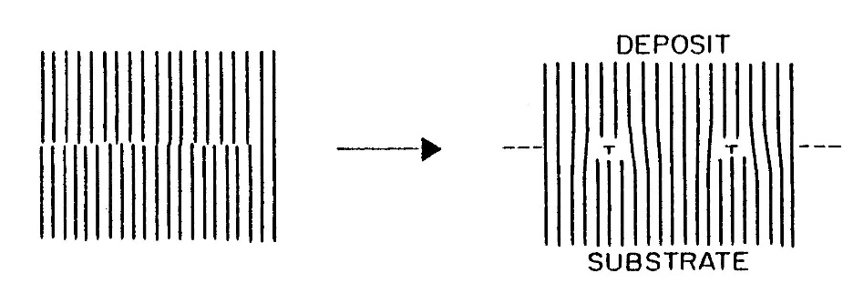
Lattice mismatch
In homoepitaxy film and substrate lattices are almost identical (because dopants change lattice constants slightly)
In heteroepitaxy lattice mismatch has to be small enough:
η = (a_{f} – a_{s})/a_{s} where a is lattice constant
Higher the mismatch η , the larger the film-substrate potential W must be

Slide 9
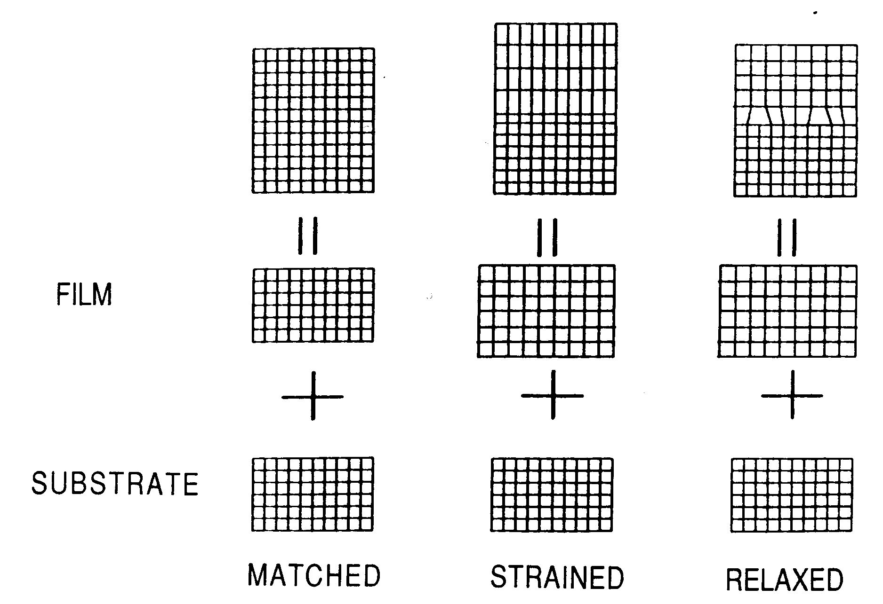
Strained & relaxed
Strained epi-layer
Misfit dislocations generated at interface

Slide 10
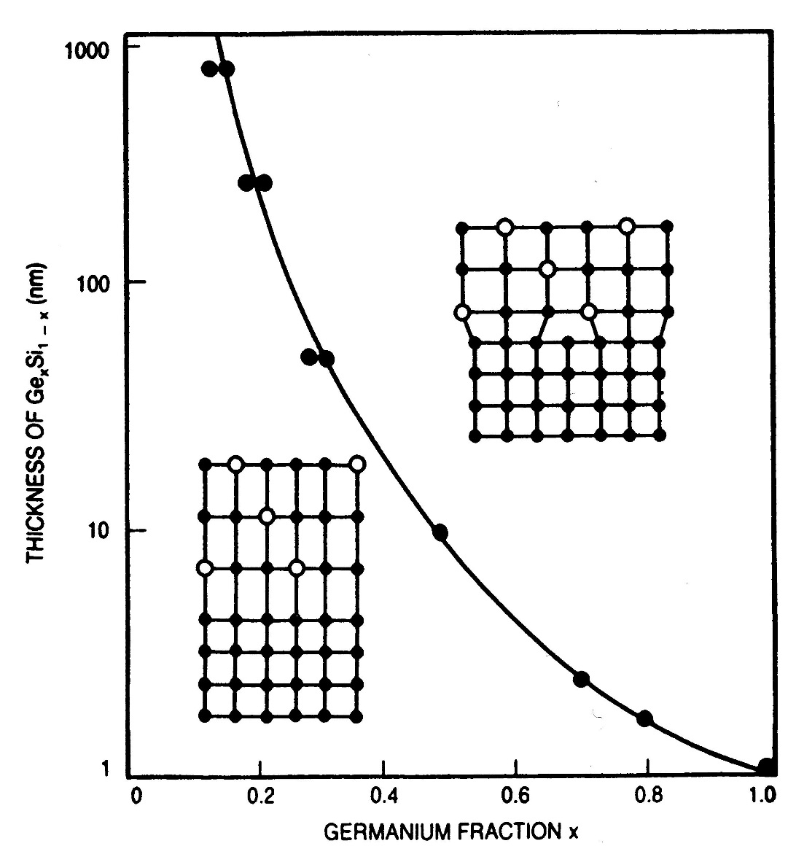
Strained & relaxed (2)
Relaxed, with defects confined to interface (but it does not always work that way)
Strained,
but with limited epi layer thickness

Slide 11
CVD epitaxy of silicon
SiH₄ (g) ==> Si (s) + 2 H₂ (g) T = 1100ºC
SiH₂Cl₂ (g) ==> Si (s) + 2 HCl (g) T = 1150ºC
SiCl₄ (g) + 2 H₂ (g) <==> Si (s) + 4 HCl (g) T = 1200ºC

Slide 12
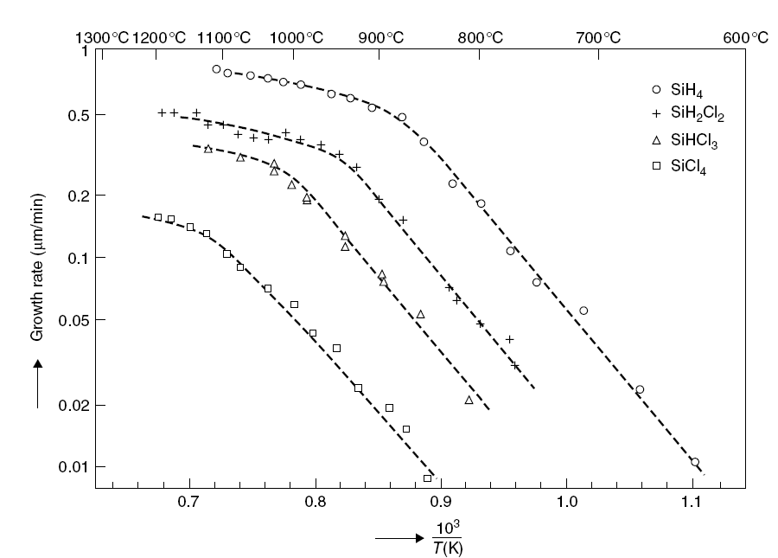
Rate
mass transport limited
surface reaction limited.

Slide 13
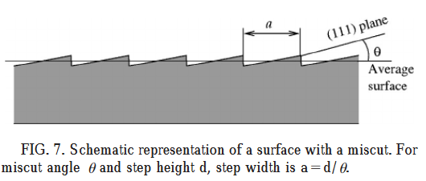
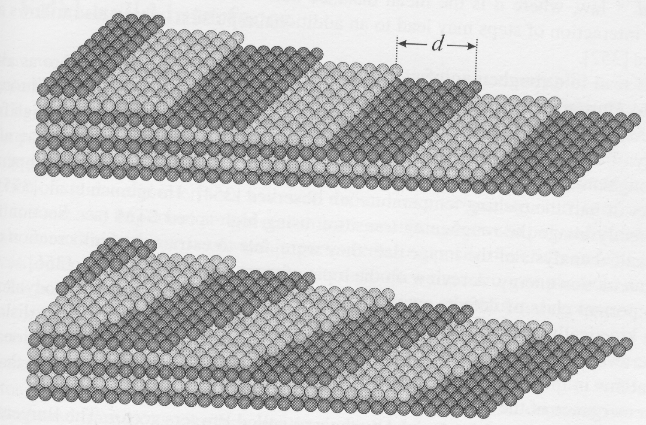
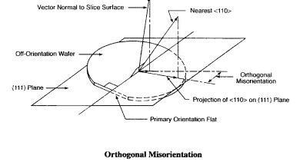
Miscut & off-orientation
Miscut relative to wafer surface
Penanen et al: Phys Rev B DOI: 10.1103/PhysRevB.62.9621
Off-orientation relative to wafer flat.
https://www.virginiasemi.com/?cont_uid=49

Slide 14
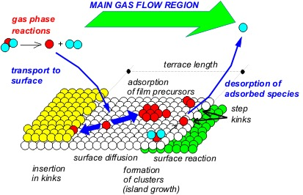
CVD epitaxy
dissociation
diffusion to
main flow
diffusion to surface
desorption of reaction products

Slide 15
Major factors affecting film structure
Deposition rate
Vacuum level
Substrate temperature
Surface structure and chemistry

Slide 16
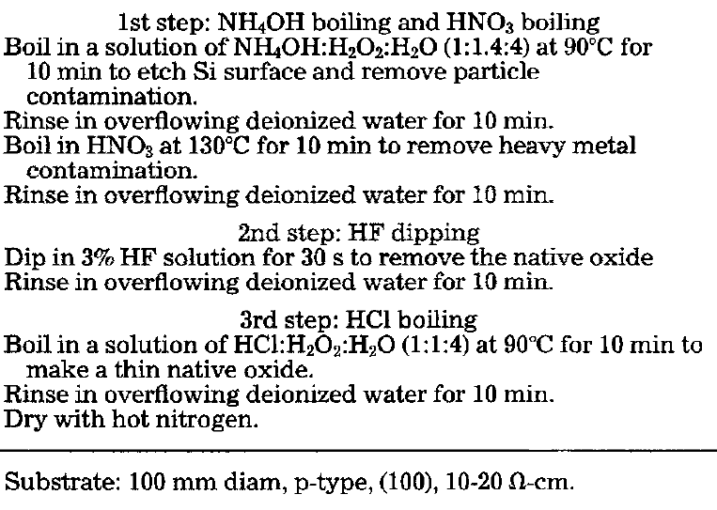
Ex-situ wet cleaning before depo
Yamazaki et al: J. Electrochem. Soc., Vol. 139, No. 4, April 1992

Slide 17
In-situ H₂ cleaning in CVD reactor
In-situ cleaning:
SiO₂ (s) + H₂ (g) <==> SiO (g) + H₂O (g)
Deposition:
SiH₂Cl₂ (g)
➔ Si (s) + 2 HCl (g)
Yamazaki et al: J. Electrochem. Soc., Vol. 139, No. 4, April 1992

Slide 18
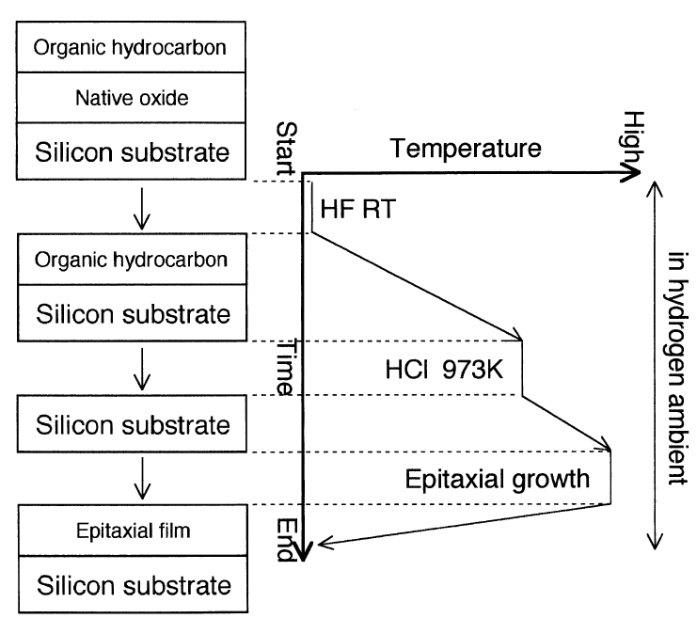
In-situ HCl cleaning
HF wet cleaning removes native oxide, by diffusing thru discontinuous organic film.
HCl etches organic material away.
Only then can epitaxial film deposition begin.
Habuka et al: Journal of Crystal Growth 186 (1998) 104Ð112

Slide 19
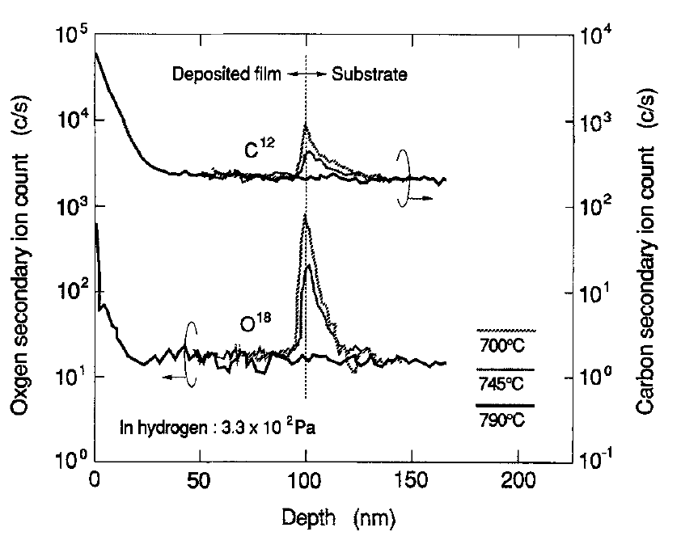
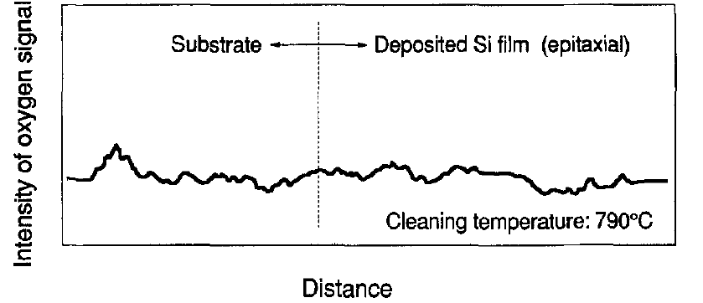
Interfacial contamination
SIMS analysis
Yamazaki et al: J. Electrochem. Soc., Vol. 139, No. 4, April 1992

Slide 20
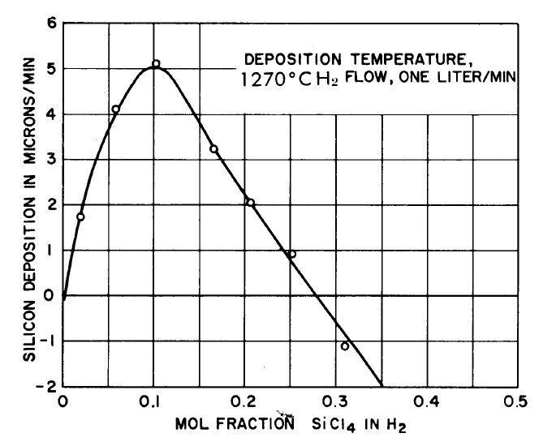
Growth vs. etching
SiH₂Cl₂ (g) <==> Si (s) + 2 HCl (g),
SiCl₄ (g) + Si (s) <==> 2 SiCl₂ (g)
Deposition regime
Etching regime

Slide 21
Epi vs. poly
High growth rate results in polycrystalline material: the arriving atoms do not have enough time to find energetically favourable positions before the next layer of atoms arrive.

Slide 22
Doping in epitaxy
Arsenic is a big atom ➔ lattice under compressive stress
Boron is a small atoms ➔ lattice under tensile stress
Too high doping leads to relaxation.
SiH₄ (g) ➔ Si (s) + 2 H₂ (g)
2PH₃ (g) ➔ 2P (s) + 3H₂ (g)
B₂H₆ (g) ➔ 2 B (s) + 3 H₂ (g)

Slide 23
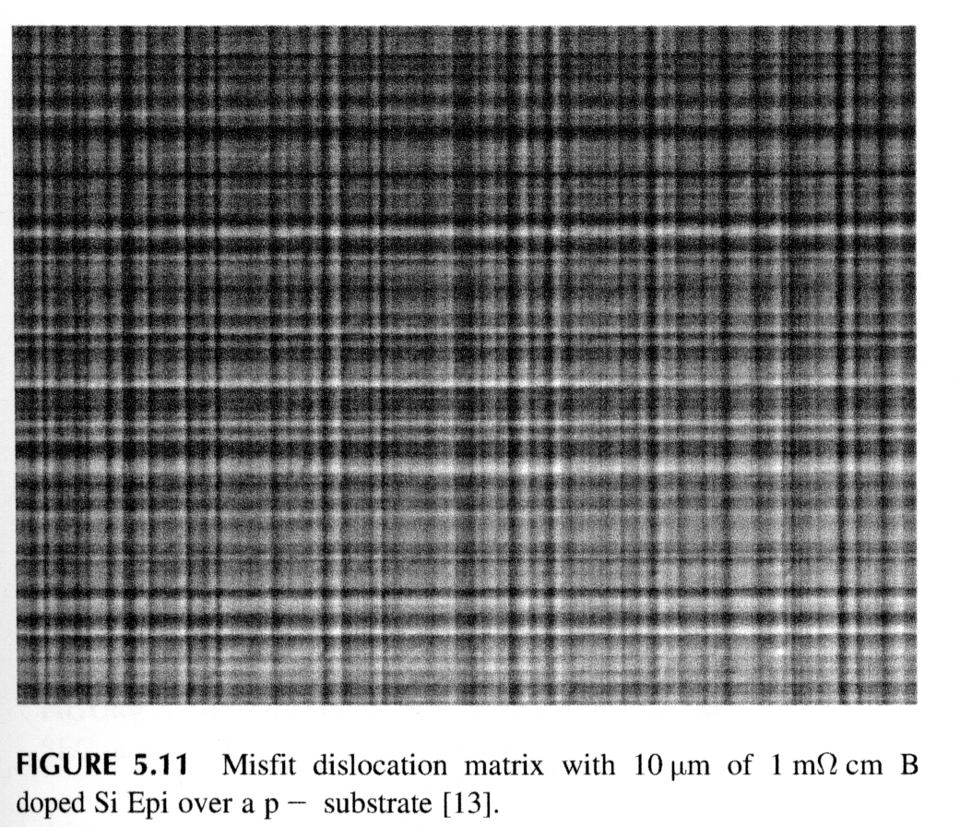
Hig boron concentration ➔ stress & dislocations
1 mΩ-cm resistivity corresponds to
1*10²⁰ cm⁻³

Slide 24
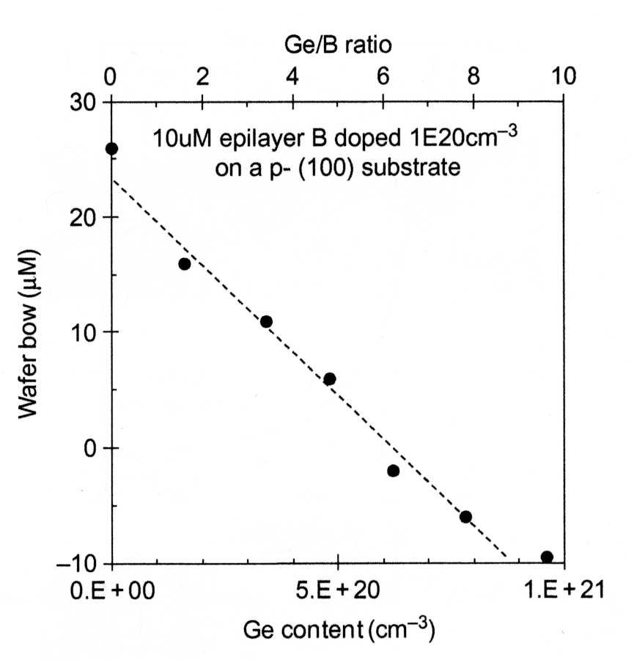
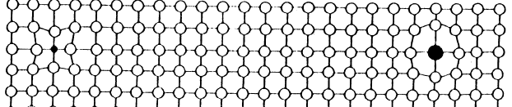
Germanium-compensation
Wafer bow,
µm
Lattice distortion
10 µm
Big arsenic and germanium
Small boron
Germanium compensates for volume changes and stresses due to small boron atoms.
Why Ge and not As?

Slide 25

Germanium atom distance ?
6*10²⁰ cm⁻³ Ge
5*10²² cm⁻³ Si
Ca. 1% Ge
$$N= \sqrt[3]{100} \sim 4.5$$
~5*5*5 silicon atoms for each Ge atom.

Slide 26
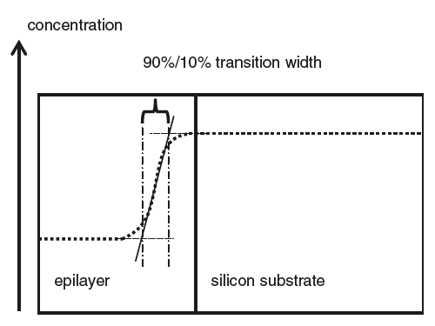
Transition width
Because epitaxy is a high temperature process, diffusion is bound to happen.
If substrate doping higher ➔ dopants will diffuse into epi-layer
But if epilayer is more highly doped, dopants will diffuse into substrate.

Slide 27
Layer thickness and interface abruptness
Si
15 nm
10 nm
10 nm
10 nm
50 nm
10 nm
500 µm
n- epilayer, 45 µm
Si₉₀Ge₁₀
n+ epilayer, 6 µm
epi-layers
p+ wafer, 300 µm
Si₈₅Ge₁₅
Si wafer 500 µm
a
b
Thin heteroepitaxial Si_{1-x}Ge_{x} layers for high speed bipolar transistors. The hatched layers are graded epi layers with constantly changing germanium content.
Thick homoepitaxial silicon layers for IGBT power transistor;

Slide 28
Characterization
    Visual inspection on all wafers.
    Resistivity measurement from a test wafer using either a 4-point probe (n/P and p/N -structures) or CV (p/P and n/N). Destructive methods!
    Thickness measurement optically with an FTIR from a p/P⁺ or n/N⁺ -structure. Nondestructive!
    Transition width using SRP.
    Automated inspection for particles, surface defects of all
    SSP wafers.
    Other measurements as required.

Slide 29
Selective epitaxy
SEG:
Selective Epitaxial Growth
ELO:
Epitaxial Lateral Overgrowth
What happens at the seam ?
ox
SEG
Si
ox
ELO
Si
ox

Slide 30
Epi applications: electronics
1-2 µm P-type epi
P⁻ substrate
CMOS:
p-type epi on a P- substrate.
Produces COP-free surface.
Thickness and resistivity uniformity specifications not critical.
Power devices:
Highly doped substrate reduces resistive losses, but devices need to be made in lightly doped material.

Slide 31
Epi applications: MEMS
n- epi
p++ epi
p-Si
p-Si
Membrane thickness control in MEMS: electrochemical etch stop
P++ etch stop: when boron concentration exceeds 5*10¹⁹ cm⁻³, KOH etching slows down

Slide 32
Heteroepitaxy: crystalline film A on top a crystalline wafer B
Multiple layers of single crystal AlAs and GaAs grown on top of single crystal GaAs wafer

Slide 33
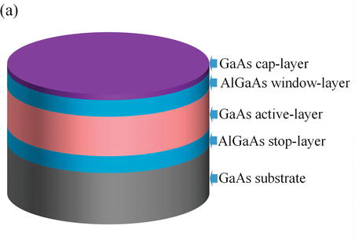
Multilayer hetero-epitaxy
If we can grow A on B, we can grow B on A.
Borschel, C. et al: Structure and defects of epitaxial Si (111) layers on Y₂O₃ (111)/Si(111) support systems, J. Vac. Sci. Technol. B 27 (2009) pp. 305-309
Zhang & Jiao: Energy Bandgap Engineering of Transmission-Mode AlGaAs/GaAs Photocathode 2018

Slide 34
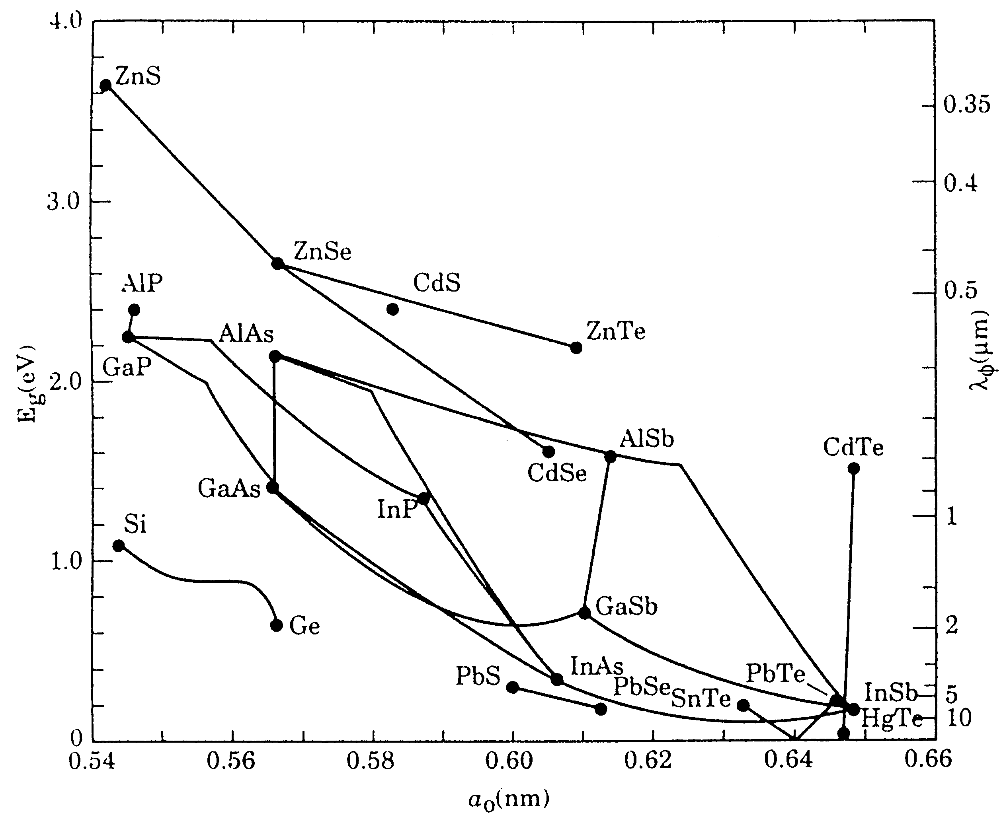
Lattice match requirement
Lattice match difference:
= (a _{subs} – a _{film})/a _{subs}
GaAs/AlAs 0.2% ➔ small and easy
Si/Ge, 4.17 % ➔ difficult (but not impossible)
Lattice constant

Slide 35
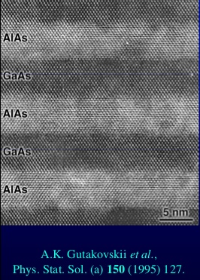
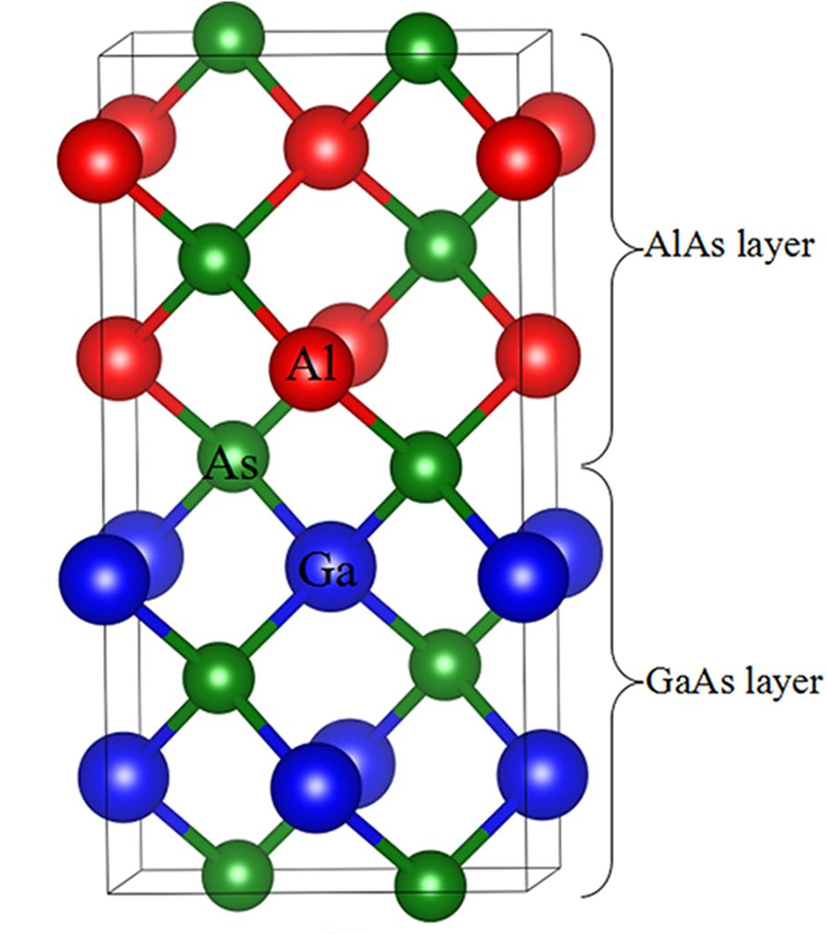
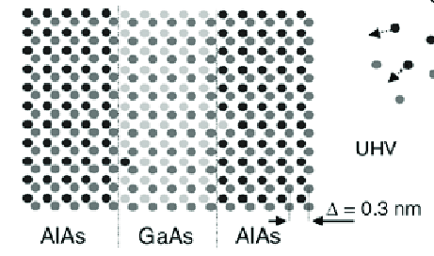
Hetero-epitaxy GaAs/AlAs
Al_{x}Ga_{1-x}As can be grown in any ratio, since lattice matching.
https://www.nature.com/articles/s41598-018-20155-0

Slide 36
Thermal expansion
Si 2.6 ppm/ºC
Ge ‎5.9 ppm/°C
GaAs 6.8 ppm/ºC
AlAs 5.2 ppm/ºC
InP 4.6 ppm/°C

Slide 37
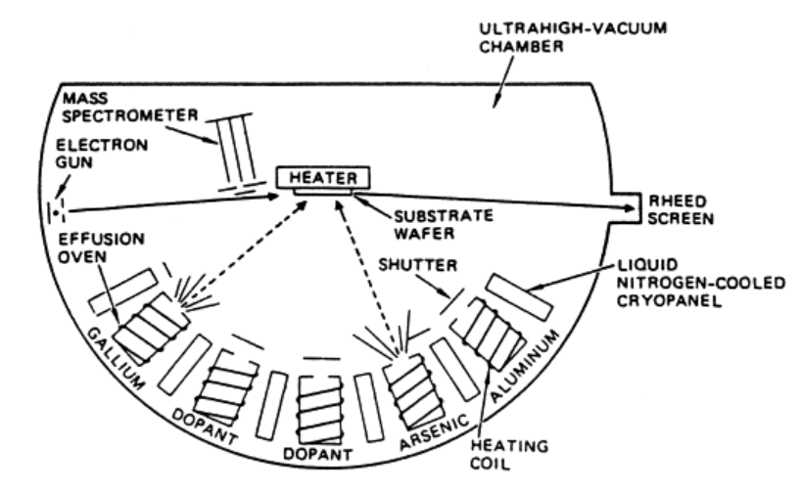
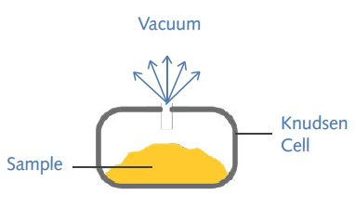
MBE: Molecular Beam Epitaxy
Effusion cell = Knudsen cell = thermal equilibrium source ➔ stable flux of vapor
MBE = advanced evaporator
Lynn F. Schneemeyer, in Encyclopedia of Physical Science and Technology (Third Edition), 2003

Slide 38
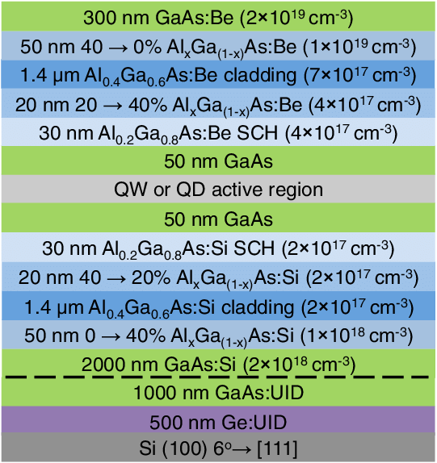
GaAs quantum dot (QD) laser
Be doping
Grading of Al & Ga concentrations
Miscut substrate
Liu et al: Quantum dot lasers for silicon photonics, 2015

Slide 39
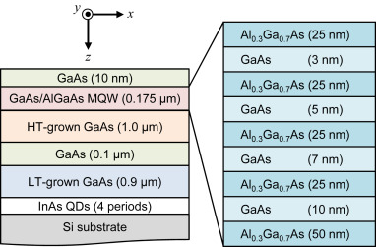
Superlattice and quantum well
(SQW/MQW, single/multiple)
Lee et al: Current Applied Physics Volume 17, Issue 3, March 2017, Pages 398-402

Slide 40
Epitaxy considerations
Thermal mismatch:
CTE differences cause strains
Diffusion:
high T produces surface diffusion which helps epitaxy, but too high T produces diffusion of film atoms into substrate
Usable temperature range e.g. 0.35T – 0.4T
Defects in substrate:
Misfit dislocations can propagate into film
Impurities (from the gas phase):
Can act as faux nucleation sites, prevent surface diffusion, generate defects, cause oxidation (oxygen, water vapor)
Surface impurites (not removed by cleaning):
Native oxides completely prevent epi, and must be in situ removed

Slide 41
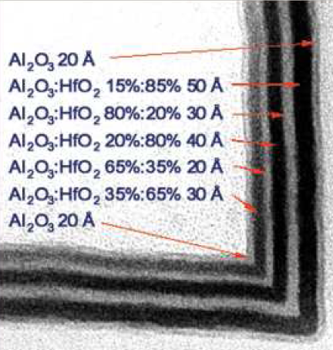
New materials: nanolaminates
Adriana Szeghalmi,Stephan Senz, Mario Bretschneider, Ulrich Gösele, and Mato Knez, APL 2009

Slide 42
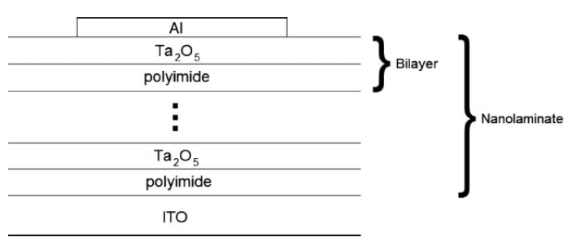
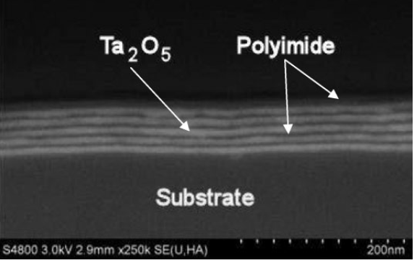
Inorganic-organic NL
5x(10 nm PI/10nm Ta₂O₅)/Si.
Salmi, Ritala, DOI: 10.1002/cvde.200906770

Slide 43
Nanolaminate vs. superlattice
Similar layer thicknesses
Similar deposition equipment
But: amorphous or polycrystalline films

Slide 44
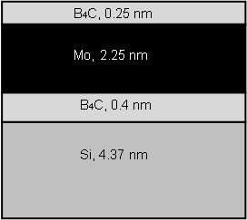
Sputtered NL
This structure repeated 50 times
Bajt, S.: Improved reflectance and stability of Mo-Si multilayers, Opt. Eng. 41(2002), pp.1797–1804.

Slide 45
NL by ALD
Flexible polymer substrate ➔ folding space mirror for X-ray telescope
S.M.George et al: Thin Solid Films 515 (2007) 7177–7180

Slide 46
X-ray mirror
S.M.George et al: Thin Solid Films 515 (2007) 7177–7180

Slide 47
Al₂O₃/Ta₂O₅
Szeghalmi & Knez: APPLIED PHYSICS LETTERS 94, 133111 2009

Slide 48
Ionic conductivity
The 4:1 cycle ratio (10.4 mol% Y dopant) resulted in the highest conductivity of all films, which was 2 orders of magnitude greater than bulk YSZ (8 mol% Y dopant).
Johnson et al: Materials Today Volume 17, Number 5 June 2014

Slide 49
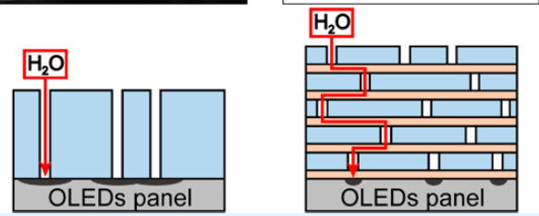
NLs as vapor barriers
Multilayer structures are unlikely to have defect in the same position in every layer ➔ improved leak tightness.
Yoon & Sung: DOI: 10.1021/acsami.6b15404

Slide 50
Barrier properties of NL
Water vapor transmission rate reduced by 4 orders of magnitude for same thickness.
Peter F. Carcia, Robert S. McLean, Zhigang G. Li, Michael H. Reilly, and Will J. Marshall
Citation: Journal of Vacuum Science & Technology A 30, 041515 (2012); doi: 10.1116/1.4729447

