Slide 1
Surfaces and Films CHEM-E5150
Wear and Friction
Jari Koskinen

Slide 2
Relevance of wear and friction
Wear is major cause of material wastage and mechanical performance - durability
Friction is major cause of energy dissipation
About 1/3 of global energy conssumptio is needed to work against friction
Lubrication to control wear and friction
Art of surfaces and films

Slide 3
Friction

Slide 4
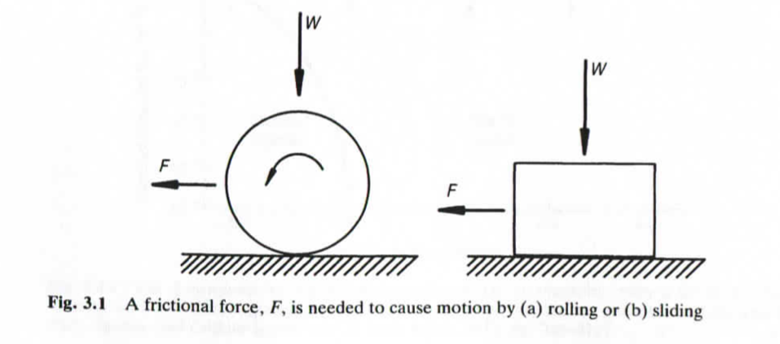
Co-efficient of Friction
F_{tangental}/F_{normal} = µ
µ_{static}
µ_{kinetic} < µ_{static}
µ = µ_{adhesion} + µ_{deformation}
F_{normal}
F_{normal}
F_{tan}
F_{tan}

Slide 5
Traditional laws of friction
The elementary property of sliding (kinetic) friction were discovered by experiment in the 15th to 18th centuries and were expressed as three empirical laws:
Amontons' First Law: The force of friction is directly proportional to the applied load.
Amontons' Second Law: The force of friction is independent of the apparent area of contact.
Coulomb's Law of Friction: Kinetic friction is independent of the sliding velocity.

Slide 6
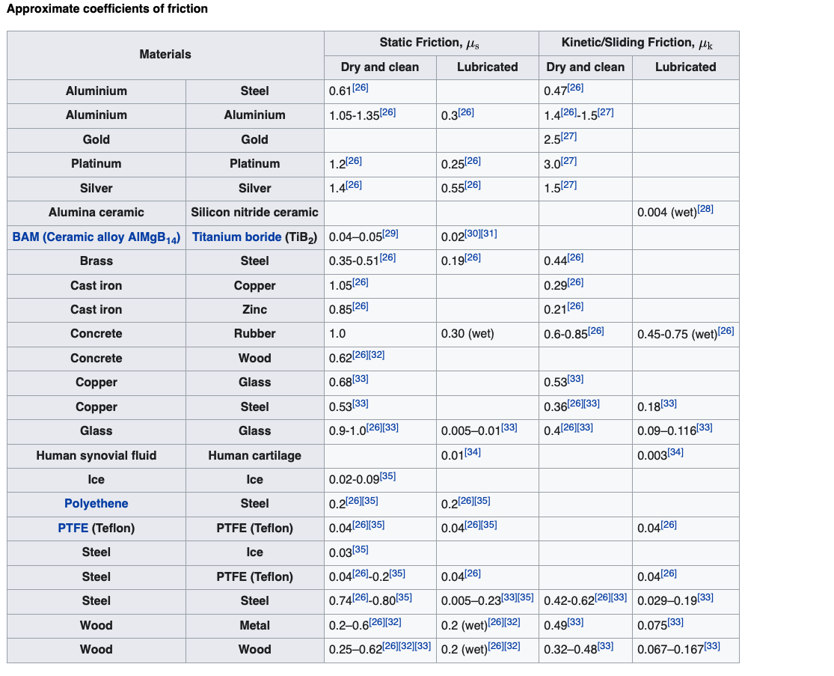
Approximate coefficients of friction
Wiki

Slide 7
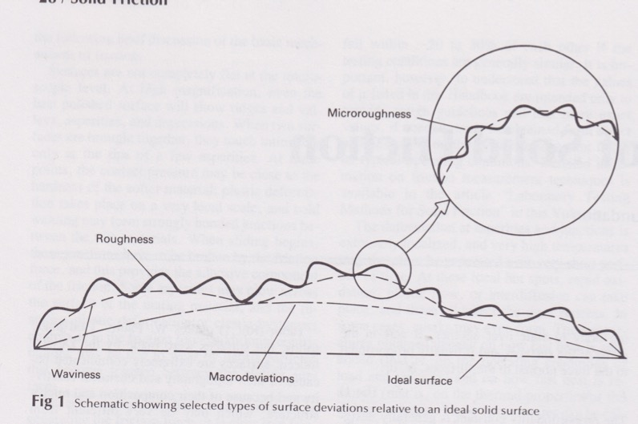
Real surface topography

Slide 8
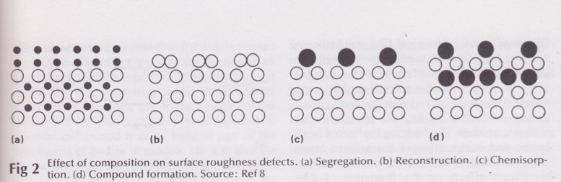
Atomic surface “roughness”

Slide 9
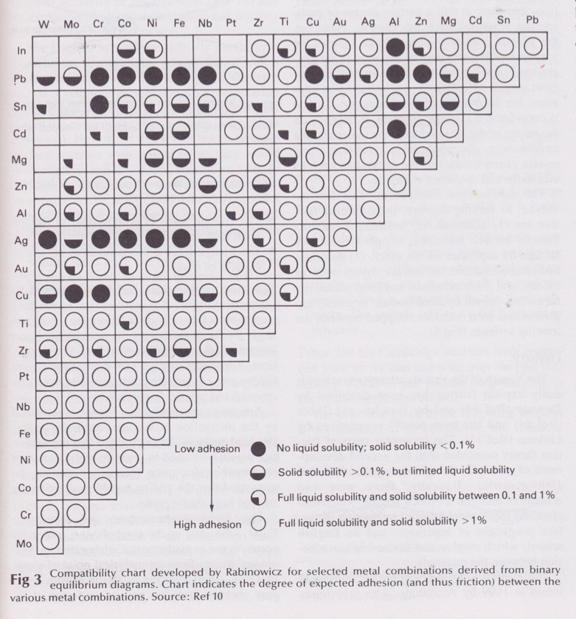
Metal-Metal adhesion vs. solubility

Slide 10
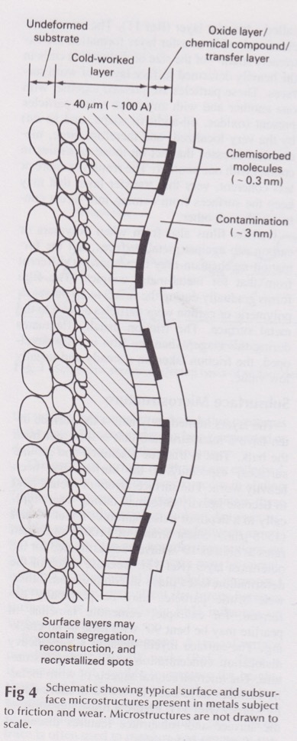
Surface and subsurface micro structurs in metals

Slide 11
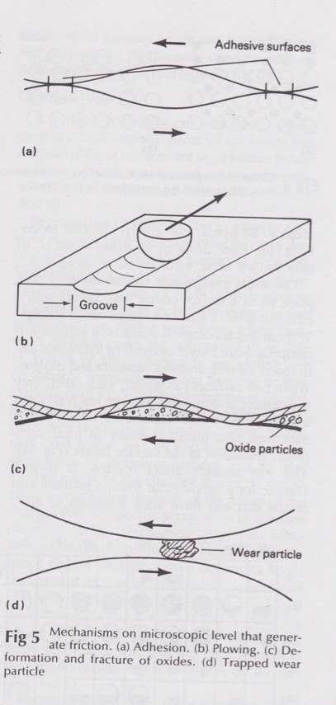
Mechanisms which generate friction
Adhesion
Plowing
Defomation fracture of oxides
Trapped wear particles
ASM Handbook vol 18 (1992)

Slide 12
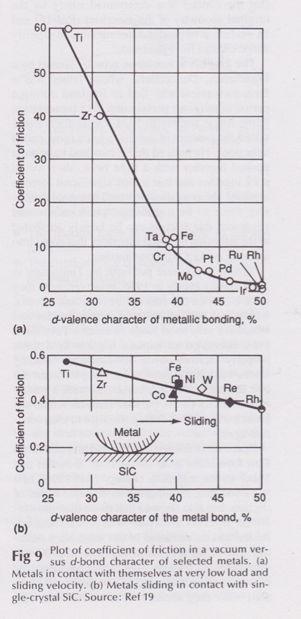
Co-efficient of friction of metals vs. d-bond character
ASM Handbook vol 18 (1992)

Slide 13
Wear

Slide 14
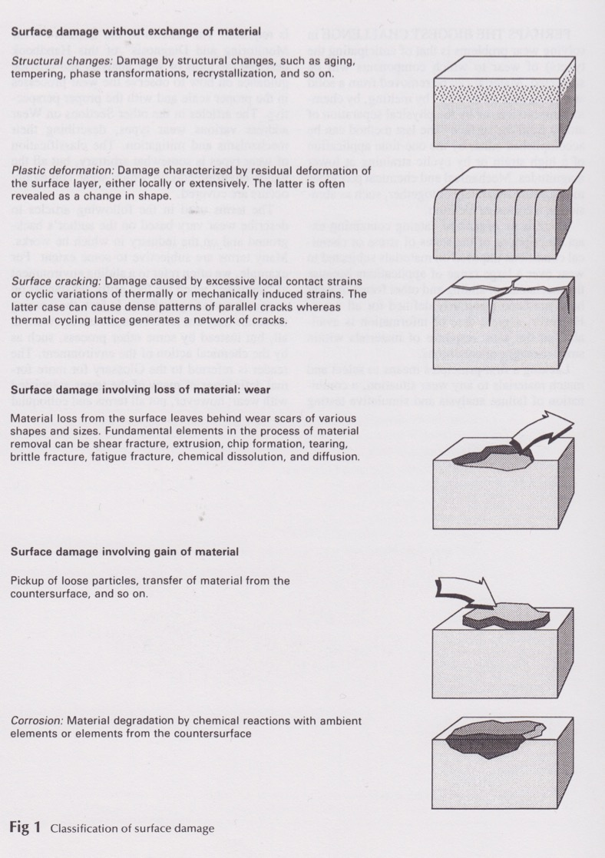
Surface damage:
Changes to
microstructure
Plastic deformation
Cracks
Loss of material
Gain of material
Corrosion
ASM Handbook vol 18 (1992)

Slide 15
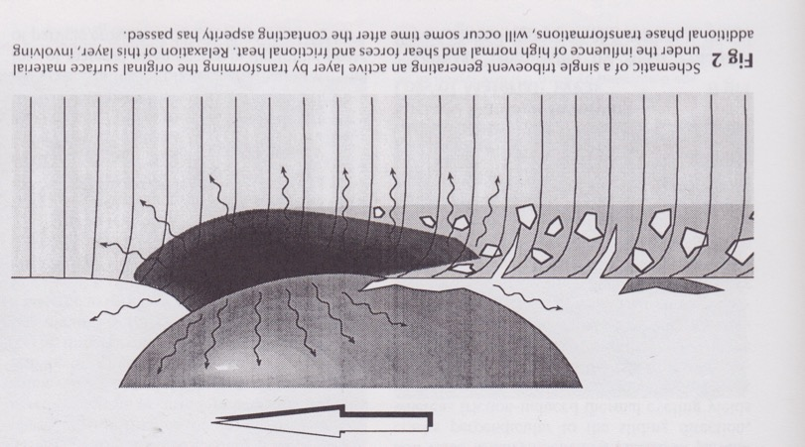
Tribo events in sliding contact
ASM Handbook vol 18 (1992)

Slide 16
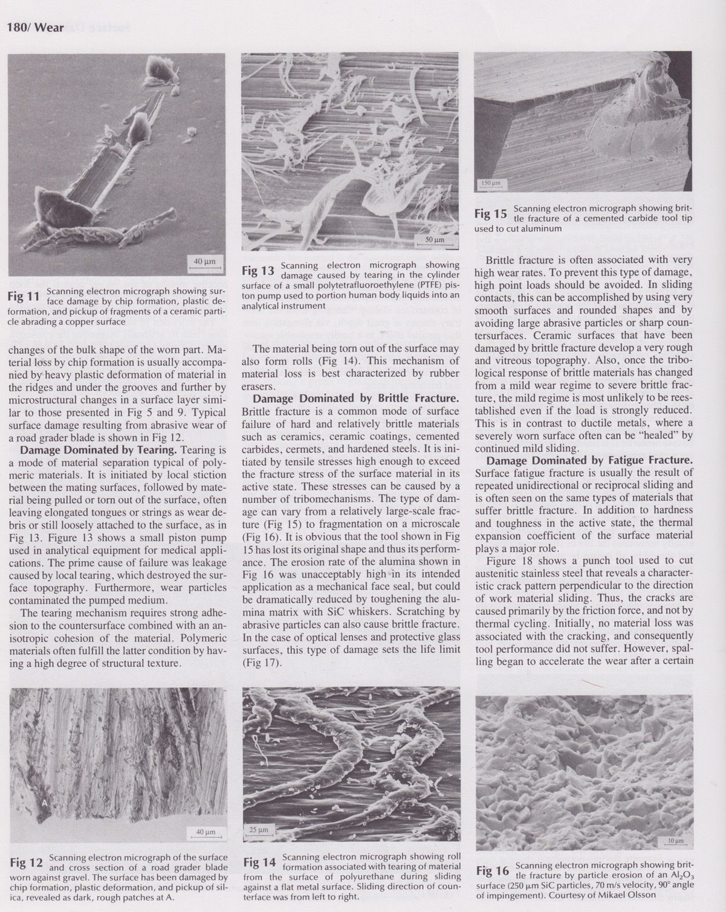
Wear hard against soft
- chip formation
- plastic deformation
- pickup of ceramic particles
ASM Handbook vol 18 (1992)

Slide 17
Wear metal against gravel
- chip formation
- plastic deformation
- pickup of silica
ASM Handbook vol 18 (1992)

Slide 18
Soft against hard
- tearing
ASM Handbook vol 18 (1992)

Slide 19
Soft against hard
- rolling
ASM Handbook vol 18 (1992)

Slide 20
Brittle fracture
ASM Handbook vol 18 (1992)

Slide 21
Brittle fracture of
Al₂O₃
_{due to SiC particle erosion}
ASM Handbook vol 18 (1992)

Slide 22
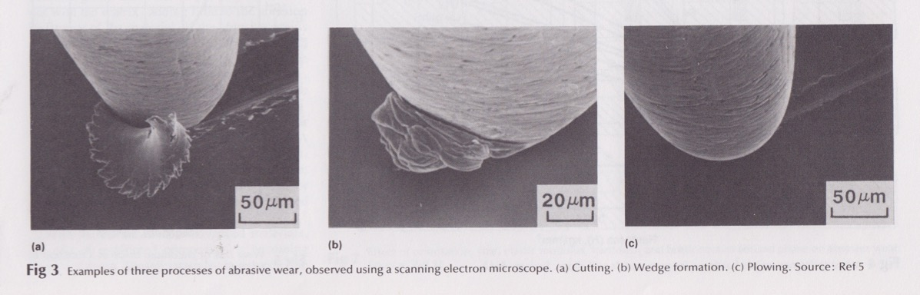
Types of abrasive wear
Cutting
Wedge formation
Plowing
ASM Handbook vol 18 (1992)

Slide 23
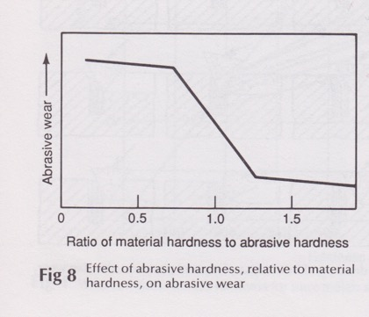
Abrasive wear vs. hardness
Hardnesses
H_{surface}/H_{abrasive}
ASM Handbook vol 18 (1992)

Slide 24
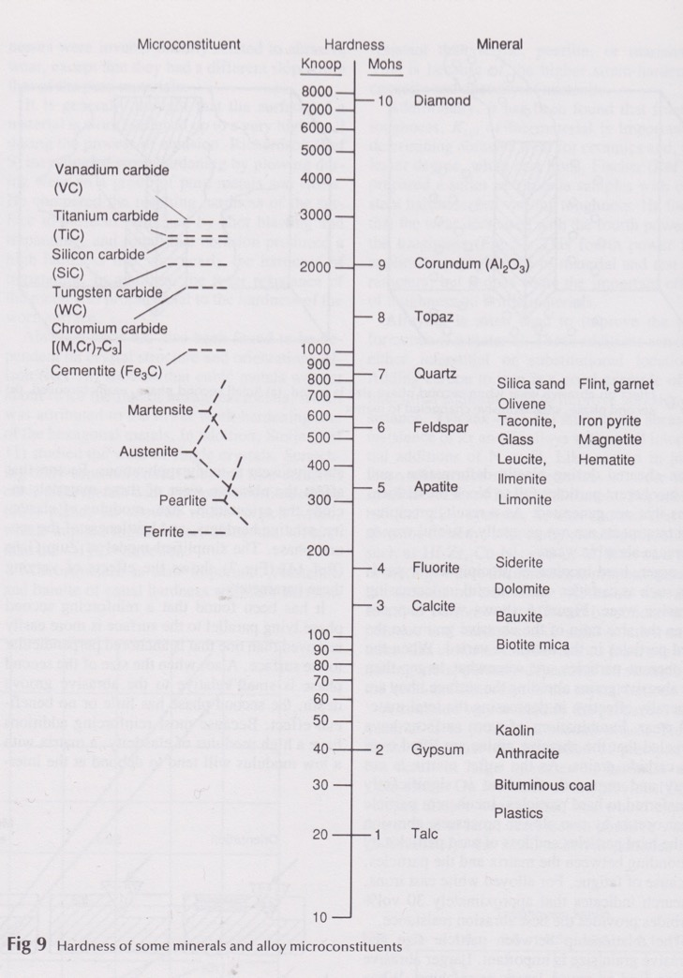
Hardness of materials
ASM Handbook vol 18 (1992)

Slide 25
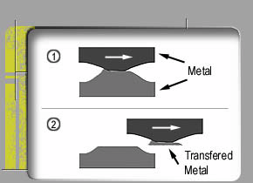
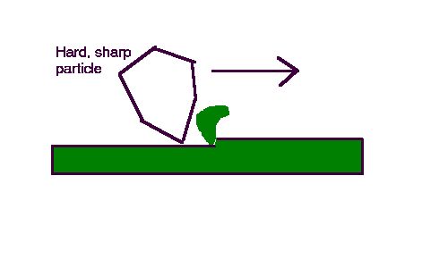
Basic types of Wear
Adhesive
Abrasive

Slide 26
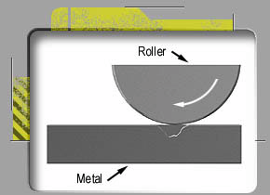
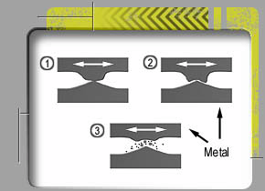
Basic types of Wear
Fatique
cyclic loading
Fretting
cyclic loading
minute relative movement

Slide 27
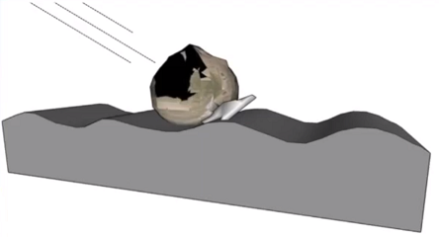
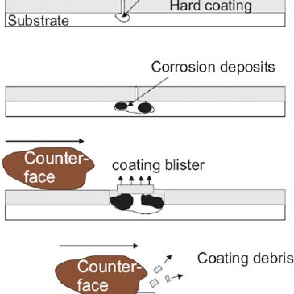
Basic types of Wear
Erosion
particle impact, cyclic loading
deformation, cracking
https://www.cbmconnect.com/erosion-wear/
Chemical wear
corrosion + wear
Robert Wood, researchgate.net

Slide 28
Lubricated contact

Slide 29
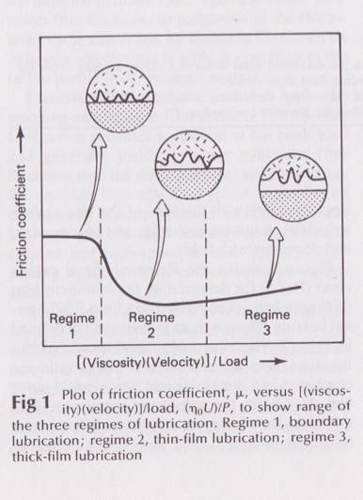
Lubricated contact modes of lubrication
Boundary lubrication
Thick-film
or
full film lubrication
Thin-film lubrication
or
Mixed lubrication

Slide 30
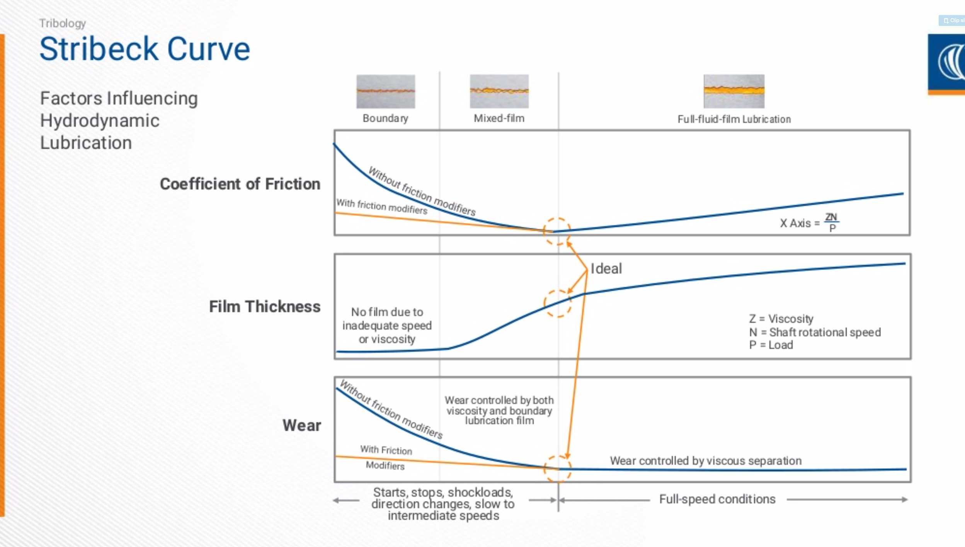
Modes of lubrication: boundary- mixed- full film
Mike Ramsey Noria Corporation 2019

Slide 31
Boundary lubrication

Slide 32
Decrease of viscosity
Problems begin when fluid lubrication breaks down
  May be caused by:
    Breakage of the molecules
    Heat produced by dissipation decrease viscosity
Partially problem with the viscosity change can be solved by viscosity modifiers
  Decrease the reduction of viscosity due to temperature rise
Timo.J. Hakala VTT 2012

Slide 33
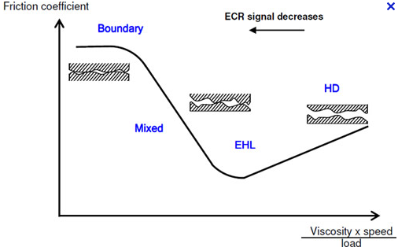
Lubrication regimes
Stribeck’s curve
Timo.J. Hakala VTT 2012
Notes:
With decreasing sliding speed and increasing load, lubricant film becomes thinner and thinner and the asperities begin to break lubricant film -> asperity contacts...
Importance of surface roughness. More rough surface breaks the lubricant film more easily

Slide 34
Boundary lubrication
Low speeds, low viscosity or high contact pressure/load situations
Increase in surface rougness increase asperity contacts
Lubrication mechanisms depend on
  Molecule
  Temperature
  Load
  Surface material
Timo.J. Hakala VTT 2012

Slide 35
Adsorption lubrication
Timo.J. Hakala VTT 2012

Slide 36
Adsorption lubrication
Lubricity by surface adhered polar molecules (Friction modifiers)
  Alcohols
  Amines
  Fatty acids
  Paraffins
  Esters
Lubricating molecules adsorbed onto the surface and prevent contact between surfaces
  Physisorption
  Chemisorption
Timo.J. Hakala VTT 2012
Notes:
Polar molecules have OH-end group (Stachowiak)
Bowden and Tabor: Temperature limit for adsorption lubrication depends on the melting point (alcohols and hydrocarbons). For fatty acids lubrication temperatures may be much higher than the melting point.

Slide 37
Adsorption lubrication
Lubrication mechanisms can be divided into two categories
  Multilayer lubrication
    Low load (contact pressure few MPa’s)
    Low temperature
  Monolayer lubrication
    High load ( contact pressure up to few GPa’s)
    Low temperature
Timo.J. Hakala VTT 2012
Notes:
Depending on the molecule monolayer may reduce friction well. In some cases multilayered systems are required. It depends on the molecule itself and surface lubricated (Bowden and tabor). For example steric acid requires 3 layers on stainless steel but over 10 on platinum.

Slide 38
Multilayered films
Timo.J. Hakala VTT 2012
Notes:
Viscosity change
Requires low contact pressures

Slide 39
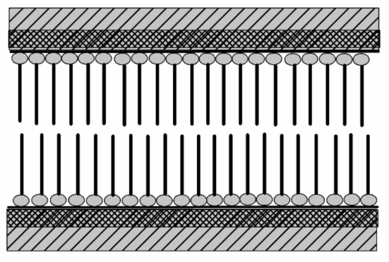
Monolayer film
Timo.J. Hakala VTT 2012
Notes:
Slip plane between molecule layers.
Occasionally on the surface e.g. in water lubrication

Slide 40
Important film properties
Adhesion and surface coverage
  Prevents direct asperity contacts and heat formation
Repulsion
  Between molecule layers
  Reduce friction between sliding surfaces
Cohesion
  Within the molecule layer
  Prevents film breakage
Timo.J. Hakala VTT 2012
Notes:
Reactive metals easier to lubricate, Formation of strong dipole interactions or hydrogen bonding
E.g. stainless steel hard to lubricate because of inert Cr₂O₃ compared to steel containing Fe₂O₃ oxides
Lähde: Bowden and Tabor
Lähde: R.M. Mortier & S.T. Orszulik, Chemistry and technology of lubricants

Slide 41
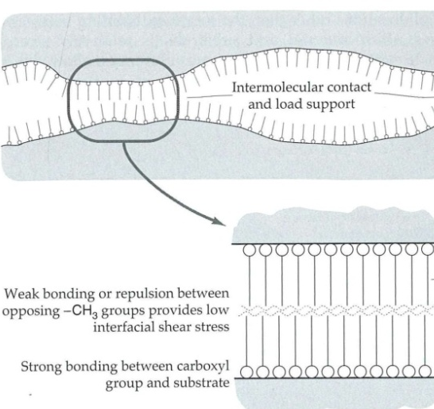
Timo.J. Hakala VTT 2012
Stachowiak, G. W. and Batchelor, A. W. Engineering tribology, 3rd edition, 2005, p. 801 (Elsevier, Amsterdam, The Netherlands)
Notes:
Alcohols are not as good additives compared to fatty acids because of weak adsorption onto surface and weaker lateral forces [Bowden and Tabor s. 223-225.
Also alcohols, esters etc. Are not capable to form lubricating soaps on reactive metal surfaces.

Slide 42
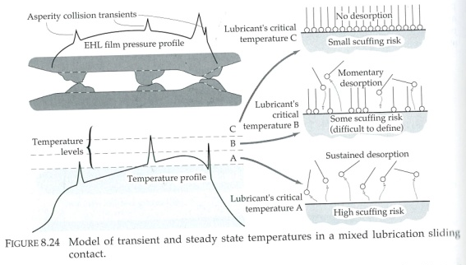
Adsorped film in contact
Timo.J. Hakala VTT 2012
Stachowiak, G. W. and Batchelor, A. W. Engineering tribology, 3rd edition, 2005, p. 801 (Elsevier, Amsterdam, The Netherlands)
Notes:
At points where surfaces are in contact, temperature rises and adsorption lubrication layer may desorb.

Slide 43
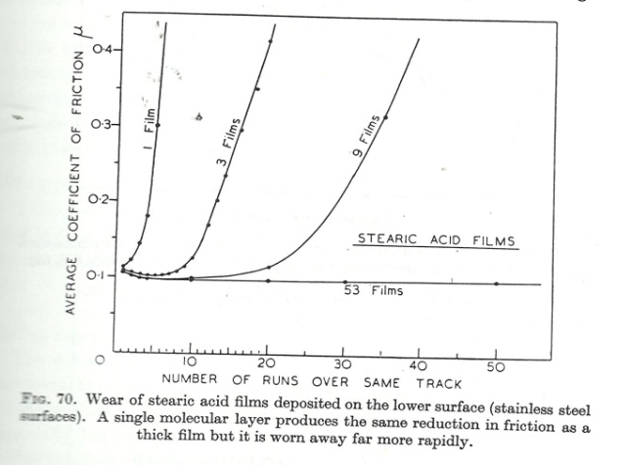
Effect of amount of molecular films
Timo.J. Hakala VTT 2012
F.P. Bowden, D. Tabor. The Friction and Lubrication of Solids. Great Britain: Clarendon Press, Oxford; 1986
Notes:
Molekyylit irtoavat kontaktissa, pitää olla lisää molekyylejä öljyssä, readsorptio jne.
Single molecular layer reduces friction as effectively as multilayered system. However, the effect lasts shorter time (Bowden and tabor). The effect was obtained with steric acid, with cholesterol monomolecular layer did not reduce friction as effectively as multilayered films.
That’s why concentration affect the lubrication! READSORPTION!!!!!!!!!!!!
ÄLÄ SEKOITA multilayer lubricaatioon, eri asia!

Slide 44
Effect of molecule structure
Chain length
  Polarity
  Cohesion forces
Linear structured molecules lubricates better than brached molecules
  Branching reduces cohesive forces
  Area / molecule higher, less surface coverage
Silanes can form polymerized structures
  Covalent bonds between molecules
  Increased cohesion
Timo.J. Hakala VTT 2012
Notes:
Chain length: limitation solid state. Ominaisuudet paranee ketjun pidentyessä niin kauan kuin molekyyli pysyy nestemäisessä tilassa.
Polymerisaatiossa molekyylien välille syntyy kovalenttisia sidoksia.

Slide 45
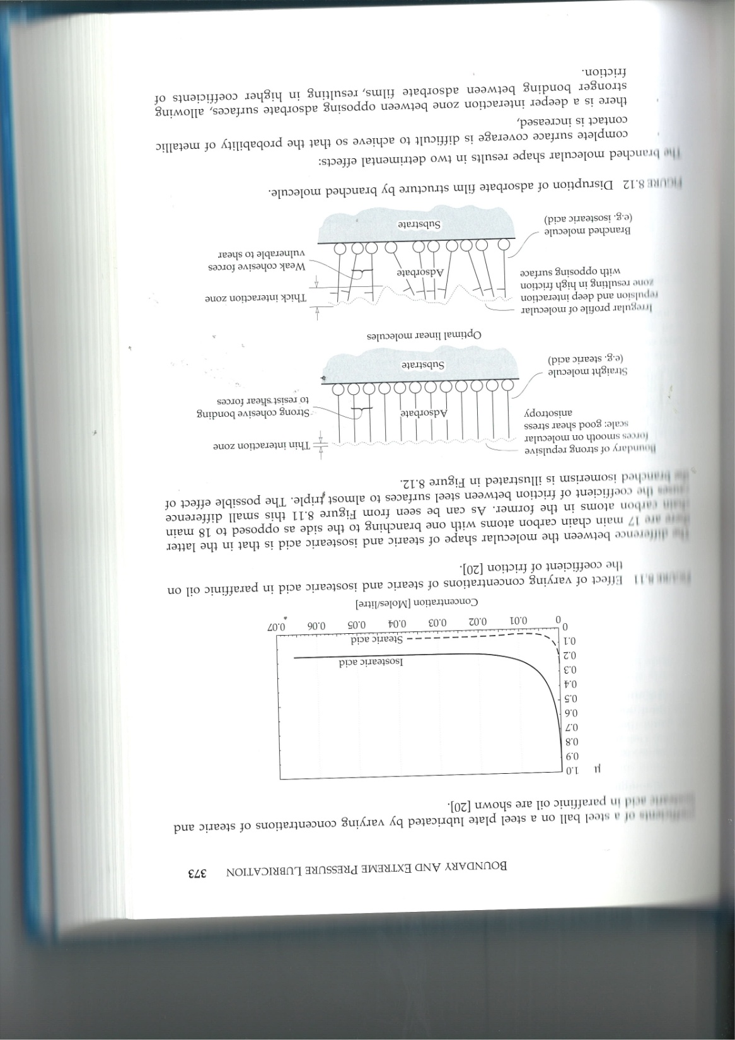
Effect of branched molecules
Timo.J. Hakala VTT 2012
Stachowiak, G. W. and Batchelor, A. W. Engineering tribology, 3rd edition, 2005, p. 801 (Elsevier, Amsterdam, The Netherlands)
Notes:
Branched molecules:
Interaction zone
Irregular profile
Weak cohesive forces

Slide 46
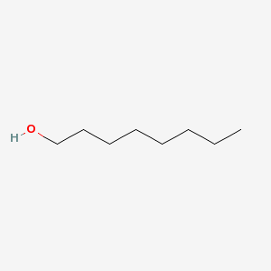
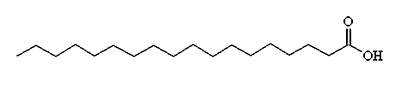
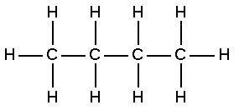
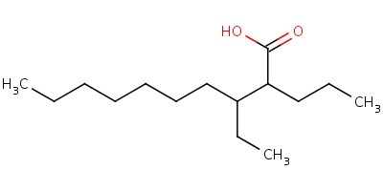
Examples of molecules
Alcohol molecules
Linear acid molecules
Octanol
Stearic acid
Hydrocarbon molecules
Branched acid molecules
Butane
3-ehtyl-2-propyl-decanoic acid
Timo.J. Hakala VTT 2012
Notes:
Acid molecules have good adhesion (acid group), strong lateral forces and certain reactivity with the surface!
Other molecules such as alcohols and hydrocarbons are lack of some of these properties.

Slide 47
Limitations for adsorption lubrication
High temperature
  Adsorption isoterm, molecules deadsorbed (usually 80 to 150 ˚C)
  Molecules break down
  Lubricant film melts
Nascent surfaces
  Catalyses and gasification of the adsorbed molecules
Timo.J. Hakala VTT 2012
Notes:
Bowden and Tabor: Temperature limit for adsorption lubrication depends on the melting point (alcohols and hydrocarbons). For fatty acids lubrication temperatures may be much higher than the melting point.

Slide 48
High temperature – medium load lubrication mechanisms
Timo.J. Hakala VTT 2012

Slide 49
Thick film of soapy or amorphous material
Chemical reaction between additive molecule and metallic surface
  Layer thickness normally 100 – 1000 nm
Soap layers
  Reaction between metal hydroxide and fatty acid
  Do not form on the surface of noble metals because required chemical reaction
Amorphous layers
  Very fine particles or molecule structures
  E.g. phosphate together with iron and zinc can form amorphous solid layer on the surface
Timo.J. Hakala VTT 2012

Slide 50
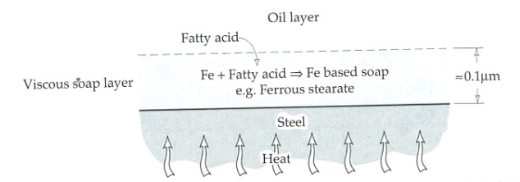
Soap layer formation
Timo.J. Hakala VTT 2012
Stachowiak, G. W. and Batchelor, A. W. Engineering tribology, 3rd edition, 2005, p. 801 (Elsevier, Amsterdam, The Netherlands)
Notes:
Usually adsorption lubrication is limited to the melting point of the lubricant molecules. However, polar fatty acids were observed to lubricate 50 to 70 C higher temperatures than melting temperature due to formation of soap layers. [Bowden and Tabor]
Formation of soap layers required reactive surfaces! [Bowden and Tabor].
Water and oxides supports the formation of soap layers [B&T s. 211-214]

Slide 51
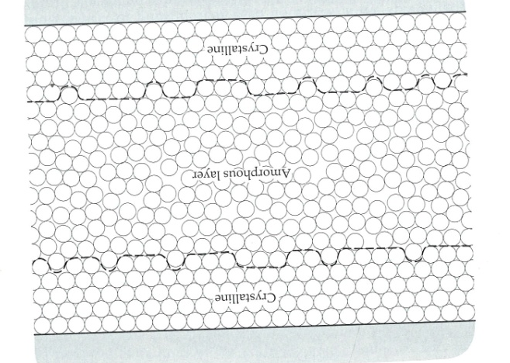
Amorphous layers
Timo.J. Hakala VTT 2012
Notes:
For example layers of zinc and iron atoms (zinc from ZnDDP)

Slide 52
High temperature – high load lubrication mechanisms
Timo.J. Hakala VTT 2012

Slide 53
Extreme pressure lubrication
High temperature lubrication
  Adsorbed molecules desorbed
  Lubrication by sacrificial films e.g. FeS
Sacrificial film formed by reaction between nascent surface and sulphur, phosphorus and chlorine containing additives
  Reduction of adhesion between contacting surfaces
  Easily shearing layer
  No scuffing
  Growth dependent on oxygen, time...
Controlled corrosion process
Timo.J. Hakala VTT 2012
Notes:
e.g. iron chloride which has lamellare structure

Slide 54
EP film formation mechanism by EP-additives
Release of electron from nascent surface (Kramer electron)
Electron ionize additive molecules
Ionic radicals (ionized molecules) adsorb onto positive points on the surface
Timo.J. Hakala VTT 2012

Slide 55
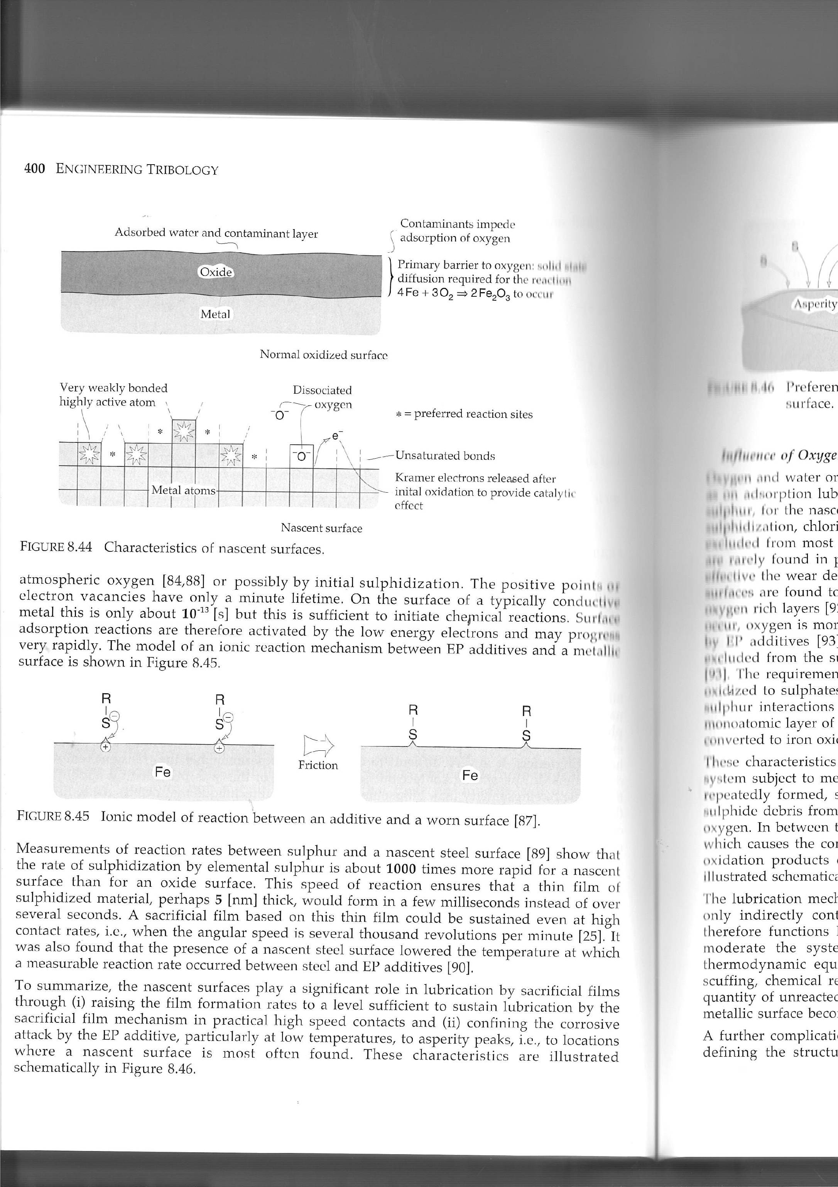
EP film formation mechanism by EP-additives
Lubricant
Substrate
Timo.J. Hakala VTT 2012
Stachowiak, G. W. and Batchelor, A. W. Engineering tribology, 3rd edition, 2005, p. 801 (Elsevier, Amsterdam, The Netherlands)

Slide 56
Mechanism of film formation by milder EP additives
Additive chemisorption onto the surface
  Similar to adsorption lubrication
Decomposition of the additive molecule by temperature, sliding speed or load
Reaction between active element and surface
Timo.J. Hakala VTT 2012

Slide 57
Mechanism of film formation by milder EP additives
Timo.J. Hakala VTT 2012
Stachowiak, G. W. and Batchelor, A. W. Engineering tribology, 3rd edition, 2005, p. 801 (Elsevier, Amsterdam, The Netherlands)

Slide 58
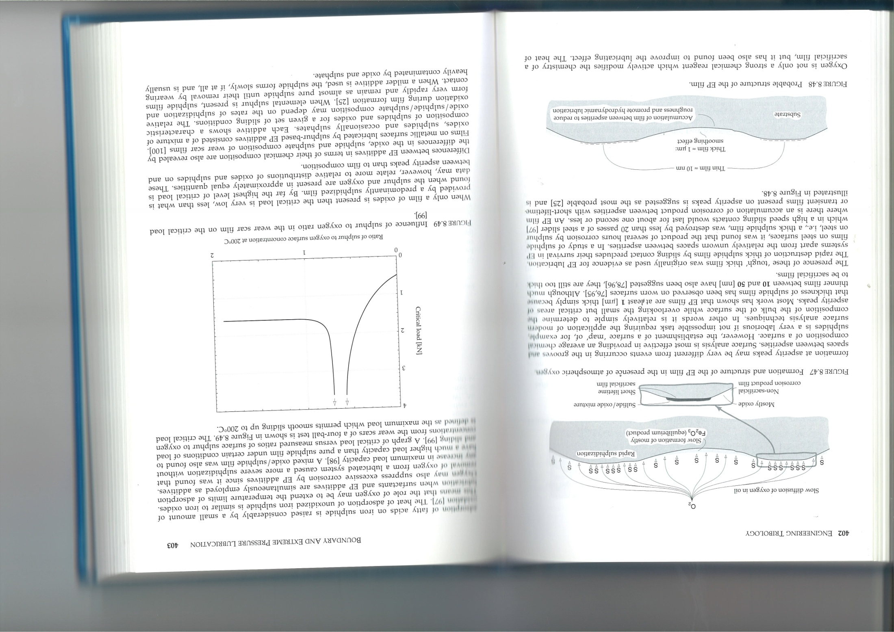
EP – film structure
Timo.J. Hakala VTT 2012
Stachowiak, G. W. and Batchelor, A. W. Engineering tribology, 3rd edition, 2005, p. 801 (Elsevier, Amsterdam, The Netherlands)
Notes:
Corrosion products accumulates between surface asperities.
Sacrificial film is formed onto the contacts spots much faster than outside, because nascent surface is more reactive than for example iron oxide.

Slide 59

Anti-wear and EP - additives
Anti-wear additives used in mild conditions and high temperatures
Adhered to surface by chemisorption
  Additives such as ZnDDP
Reactivity of the EP - additives depend on molecule structure as well
  For example all sulphur containing molecules do not react with iron surface to form FeS
Timo.J. Hakala VTT 2012
Notes:
ZnDDP can even increase wear in high temperatures and under high loads.
Korvaavia esim Organic borates = more environmentally friendly additives

Slide 60
Nanoparticle additives
Nanoparticles (~1 – 100 nm) can be added into oil, water or emulsions to improve lubrication properties
Usually reduced friction and wear is related to mechanically/chemically formed thin film layer onto the surface
For example Nickel oxythiomolyblate (NiMoO₂S₂) improved lubrication properties of synthetic oil when temperature was abowe 300 ˚C
Novel solutions for extreme lubrication without corrosiveness
Timo.J. Hakala VTT 2012

Slide 61
Summary
Lubrication mechanisms are different in different load and temperature regimes
Different types of additives used in different lubrication regimes
  Adsorption additives
  Anti-wear additives
  Extreme pressure (EP) additives
Timo.J. Hakala VTT 2012

Slide 62
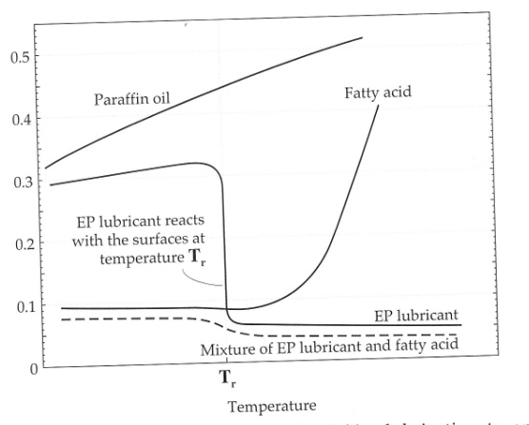
Summary
µ
Timo.J. Hakala VTT 2012
Stachowiak, G. W. and Batchelor, A. W. Engineering tribology, 3rd edition, 2005, p. 801 (Elsevier, Amsterdam, The Netherlands)

Slide 63
HIGH
TEMPERATURE
EP additives
Sulphus
Phosphorus
Chlorine
LOW
LOAD
Soap formation
Depris layers
Amorphous layers
HIGH
LOAD
Adsorped molecules
Monolayer
Reactions between molecules and surface
Adsorped molecules
Monolayer
Multilayer
Physisorption
Chemisorption
LOW
TEMPERATURE
Timo.J. Hakala VTT 2012

Slide 64
Conclusions
Boundary lubrication has different regimes
Different types of additives function in different conditions
In real applications several boundary lubrication regimes can be obtained
In oil lubrication more than one type of boundary additives are needed
Timo.J. Hakala VTT 2012

Slide 65
Title

Slide 66
Title

