Slide 1
Surfaces and Films CHEM-E5150
Tribology
Jari Koskinen

Slide 2
Tribology
Tribology is
  science and technology of interacting surfaces in relative motion
  origin in the Greek word tribos meaning rubbing
  friction, lubrication, and wear of engineering surfaces
  understanding surface interactions in detail and then prescribing improvements in given applications.

Slide 3
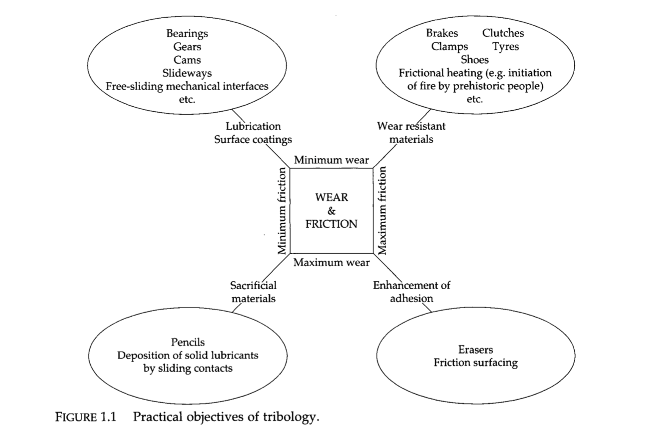
Practical objectives of tribology
G.W. Stachowiak, A.W. Bachelor, Engineering tribology 3rd edition, 2005

Slide 4
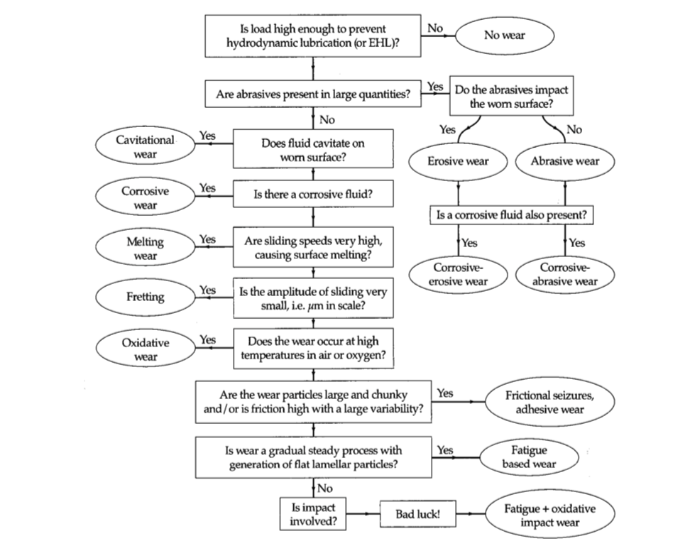
Operation conditions and type of wear
Flowchart
G.W. Stachowiak, A.W. Bachelor, Engineering tribology 3rd edition, 2005

Slide 5
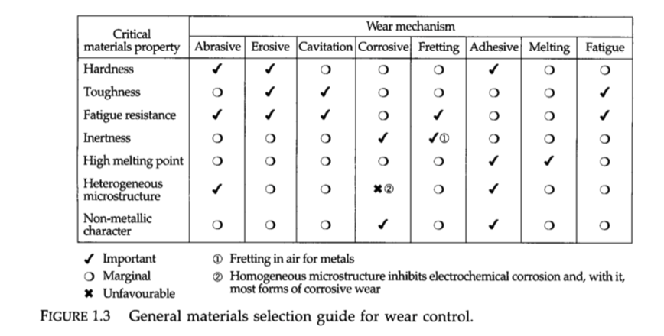
Materials selection quide for wear control
G.W. Stachowiak, A.W. Bachelor, Engineering tribology 3rd edition, 2005

Slide 6
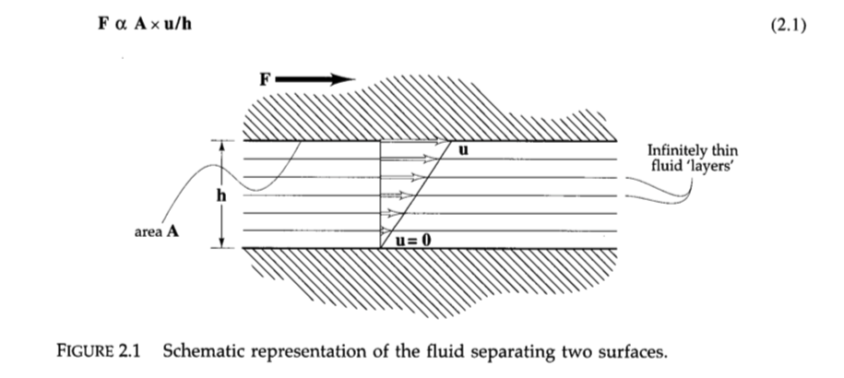
Dynamic viscosity

Slide 7
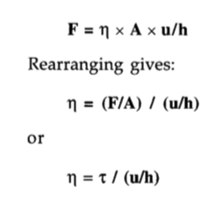
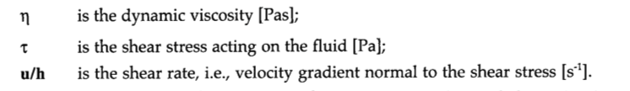

Dynamic viscosity
“Poise”

Slide 8
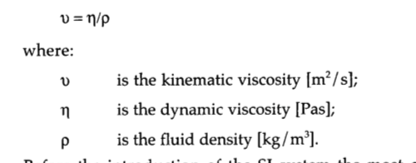
Kinematic viscosity
“Stoke”

Slide 9

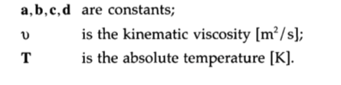
Viscosity-temperature

Slide 10
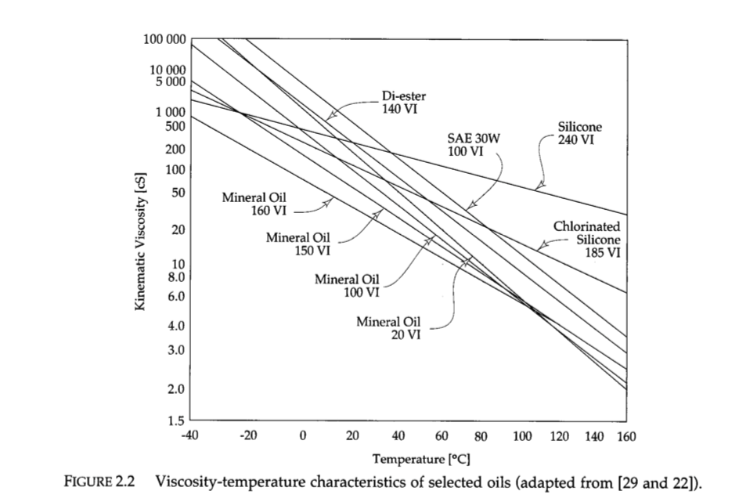
Viscosity – temperature of selected oils

Slide 11
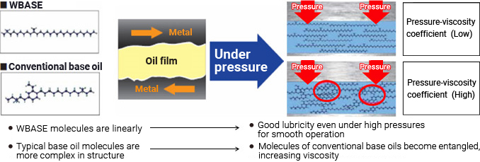
Pressure -Viscosity
https://www.eneos.co.jp/english/company/rd/intro/lubricants/kudokei.html

Slide 12
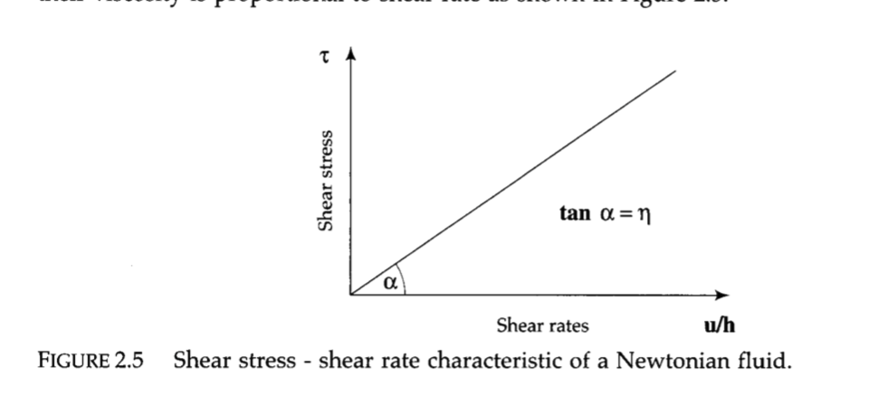
Viscosity – shear rate Newtonian fluid

Slide 13
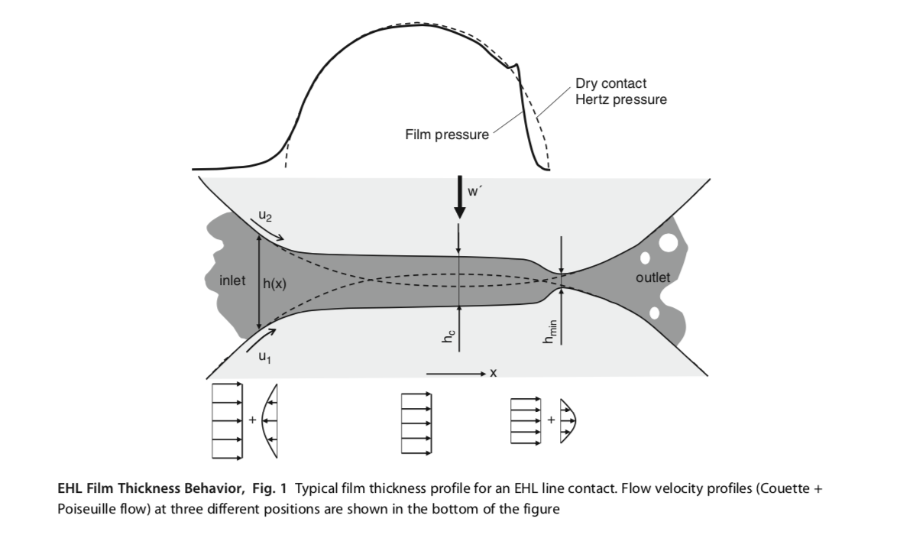
Elasto hydrodynamic lubrication
ƞ = ƞ₀exp(⍺p). (Barus 1893)
ƞ viscosity
ƞ₀ viscosity at normal pressure
p pressure
⍺ pressure-viscosity coefficient

Slide 14
Pressure -Viscosity
https://www.eneos.co.jp/english/company/rd/intro/lubricants/kudokei.html

Slide 15
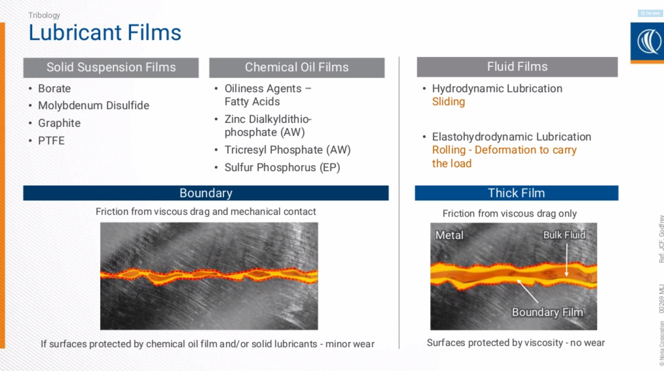
Title
Mike Ramsey Noria Corporation 2019

Slide 16
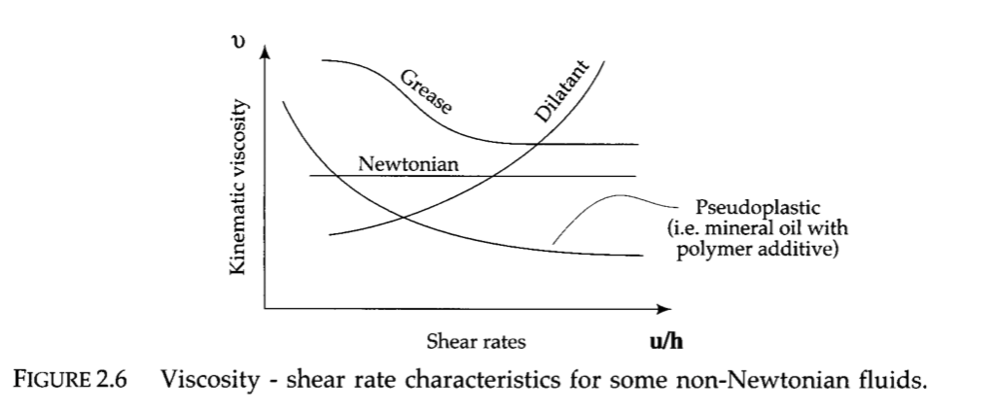
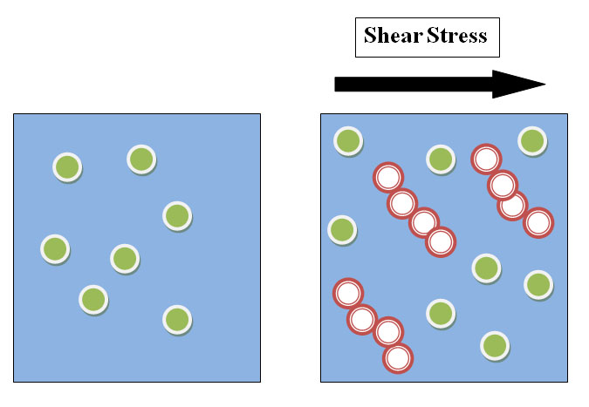
Viscosity non-Newtonian fluids
Typically colloids, e.g. cornstarch

Slide 17
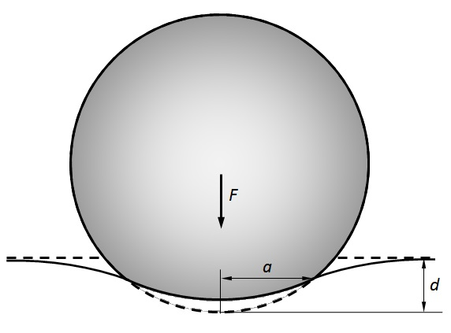
Contact mechism
Herzain contact
Contact mechanism Wiki

Slide 18
Assumptions in Hertzian theory
  The following assumptions are made in determining the solutions of Hertzian contact problems:
  The strains are small and within the elastic limit.
  The surfaces are continuous and non-conforming (implying that the area of contact is much smaller than the characteristic dimensions of the contacting bodies).
  Each body can be considered an elastic half-space.
  The surfaces are frictionless.

Slide 19
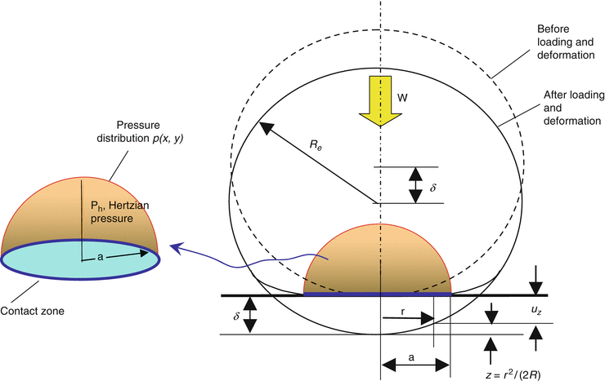


Herzian pressure (sphere on flat)
MAXIMUM PRESSURE:
F
https://media.springernature.com

Slide 20


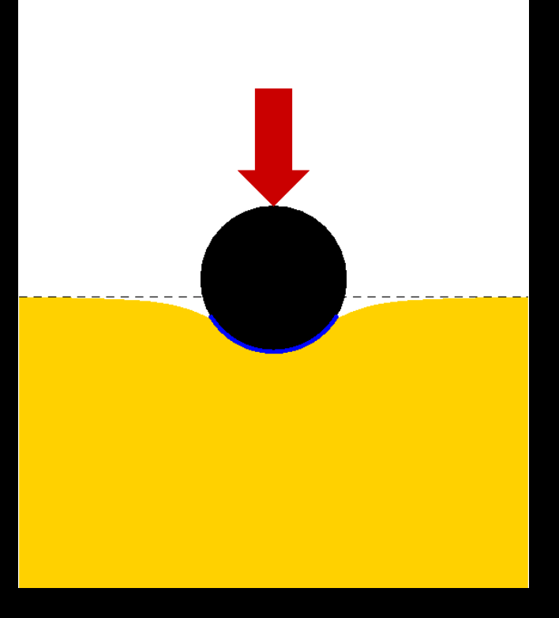
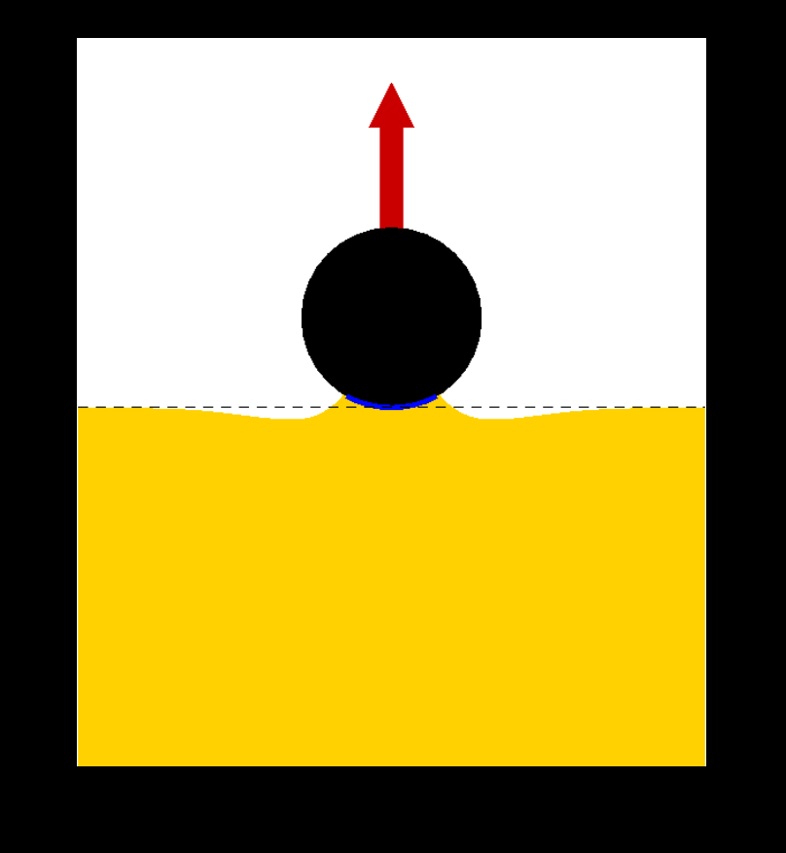
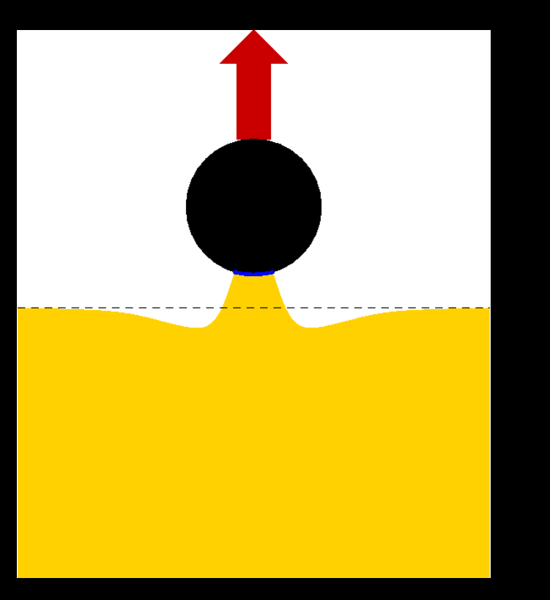
Johnson-Kendall-Roberts (JKR) model of elastic contact
incorporate the effect of adhesion in Hertzian contact

Slide 21
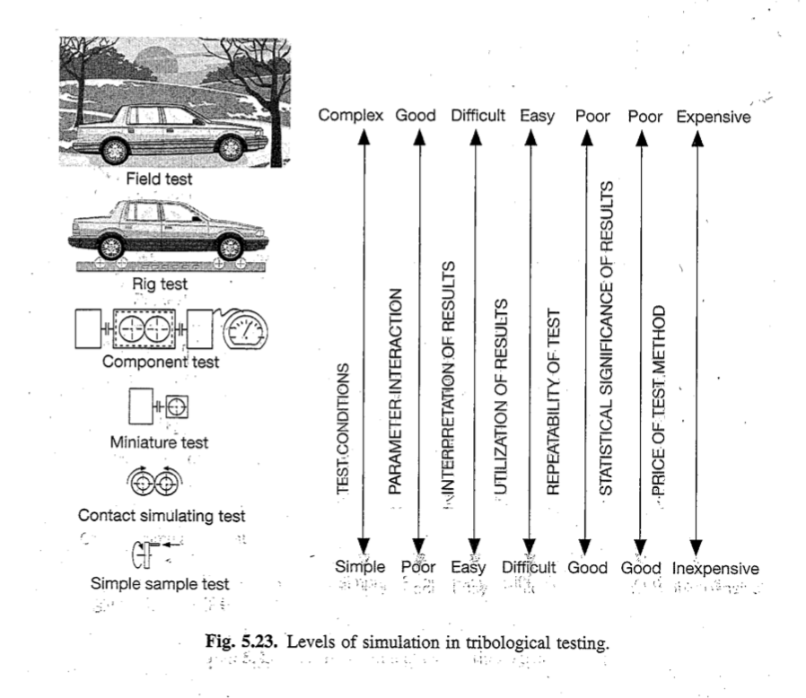
Levels of tribological testing

Slide 22
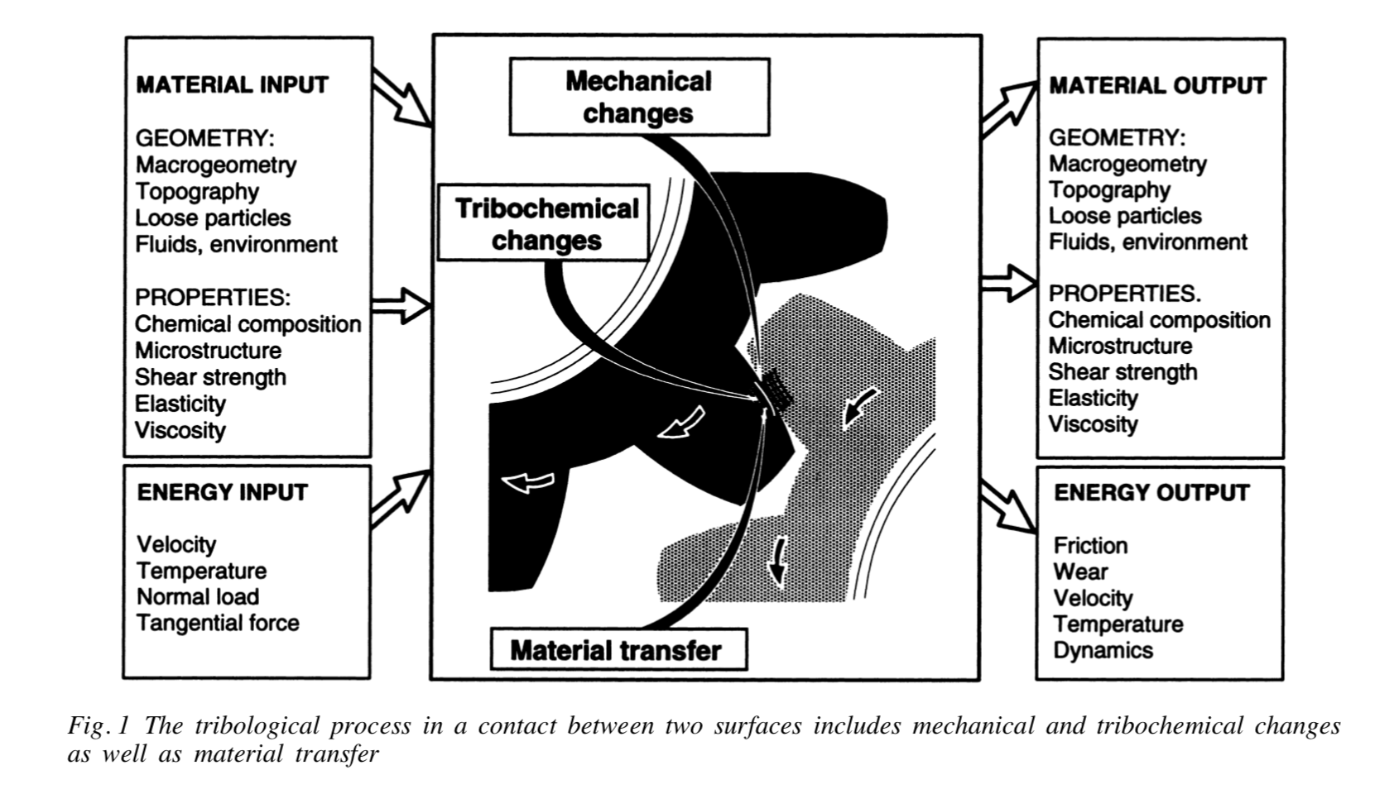

Slide 23
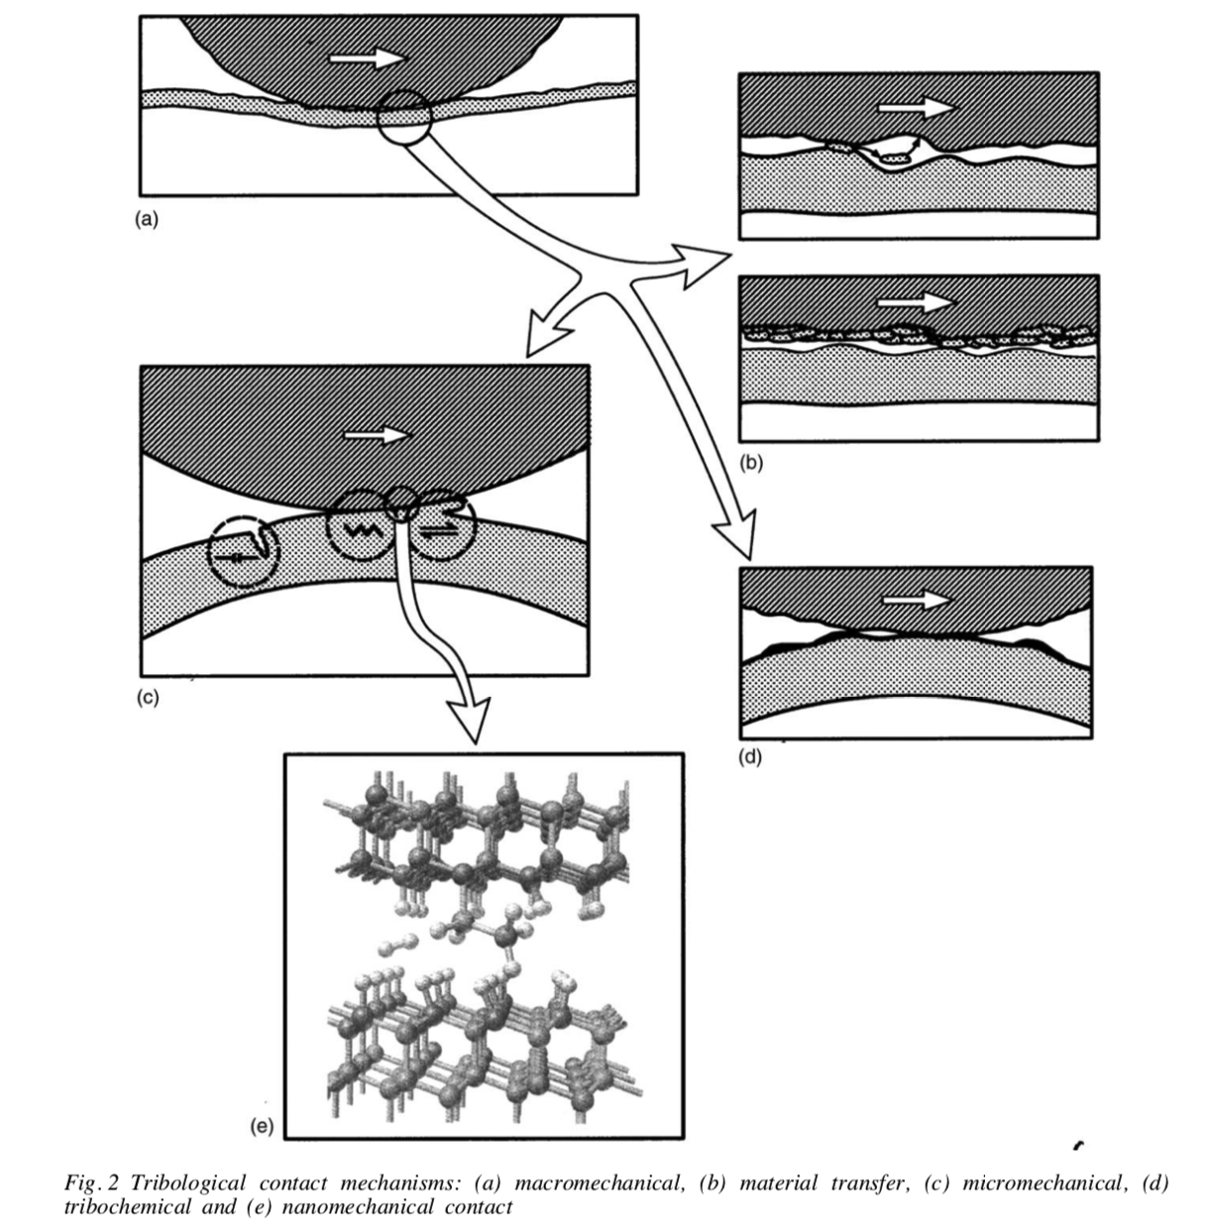

Slide 24
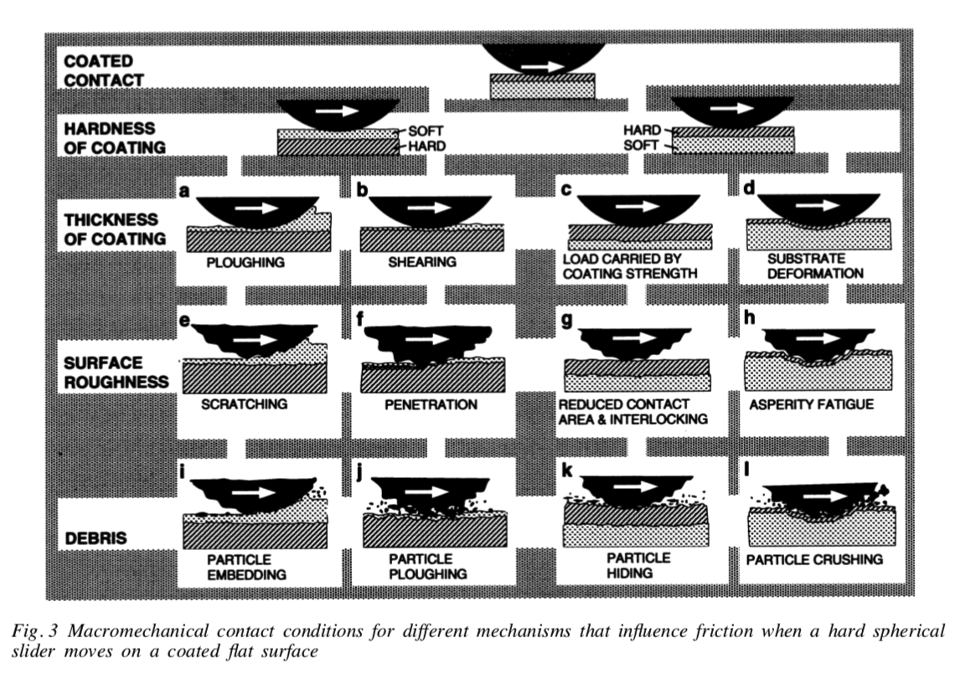

Slide 25
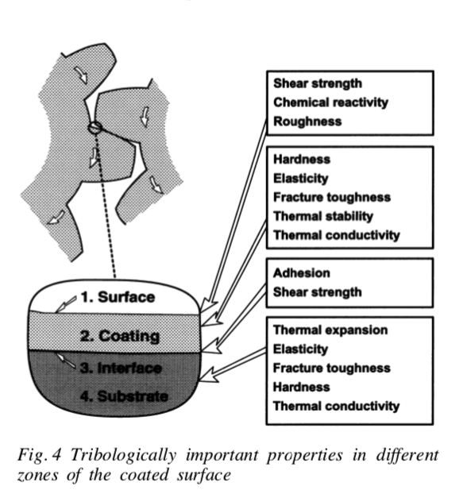

Slide 26
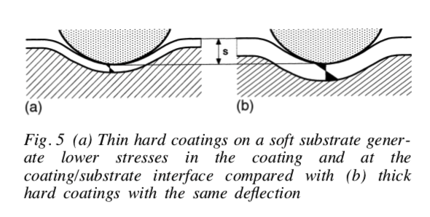

Slide 27
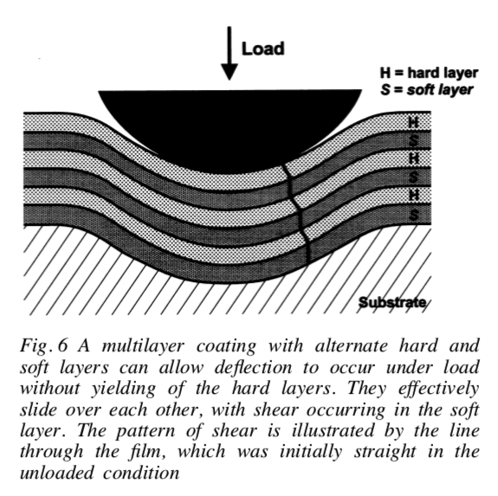

Slide 28
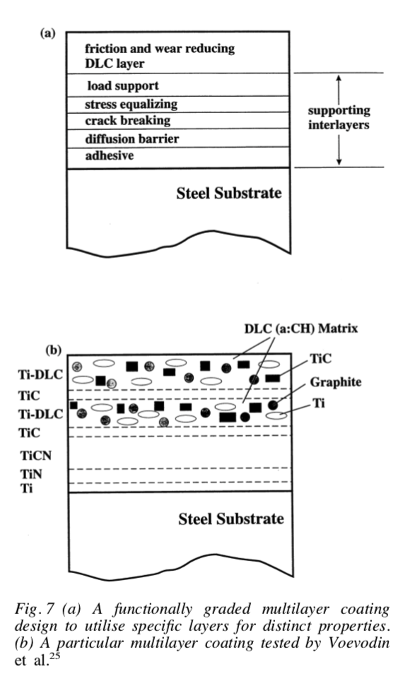

Slide 29
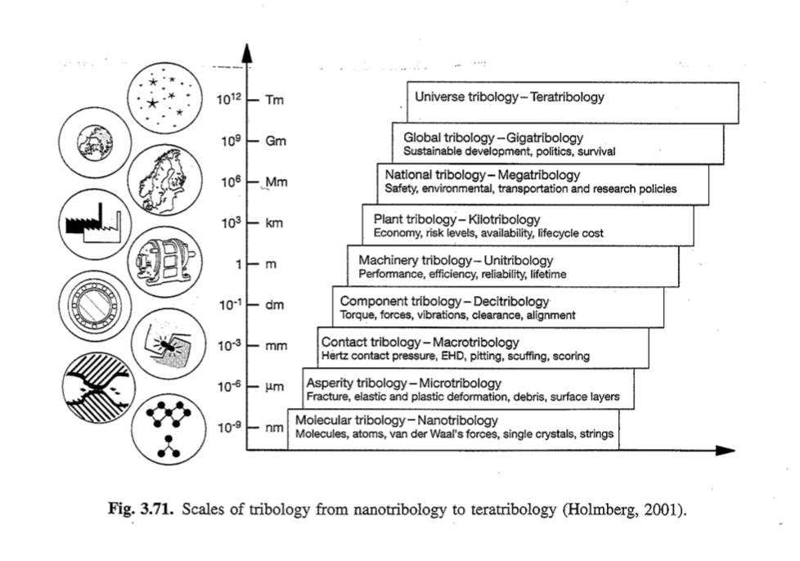
Scrach testing - adhesion

Slide 30
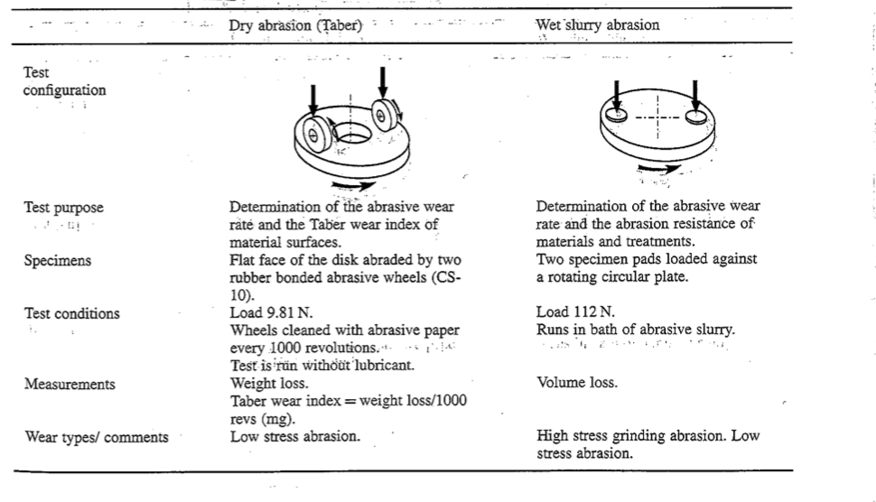

Slide 31
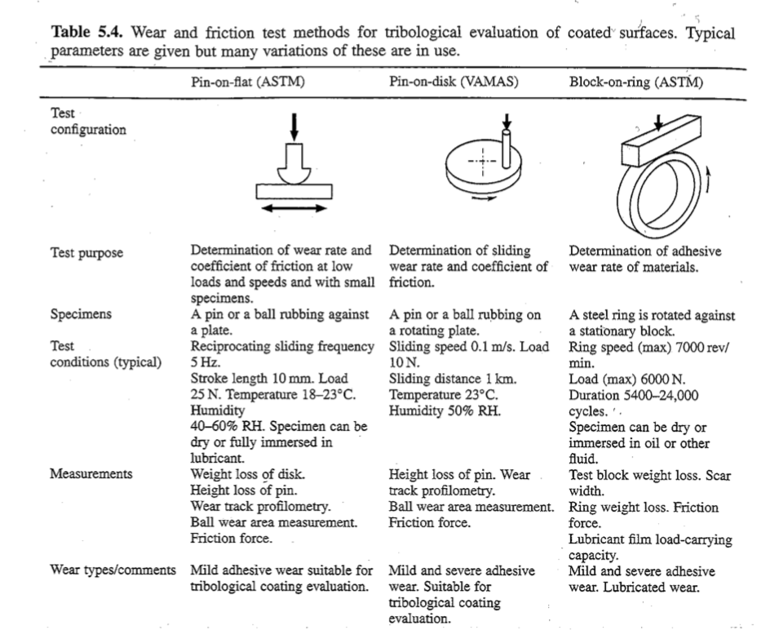

Slide 32
Tribology Testing - Overview
Ball/Pin
Disk
“Simple” system and highly reproducible measurement
Simulate real frictional conditions
  Contact pressure
  Movement mode
  Sliding speed
  Static partner (size, geometry, mechanical properties, etc)
  Lubrication
  Environmental condition (temperature, vacuum, humidity, etc)

Slide 33
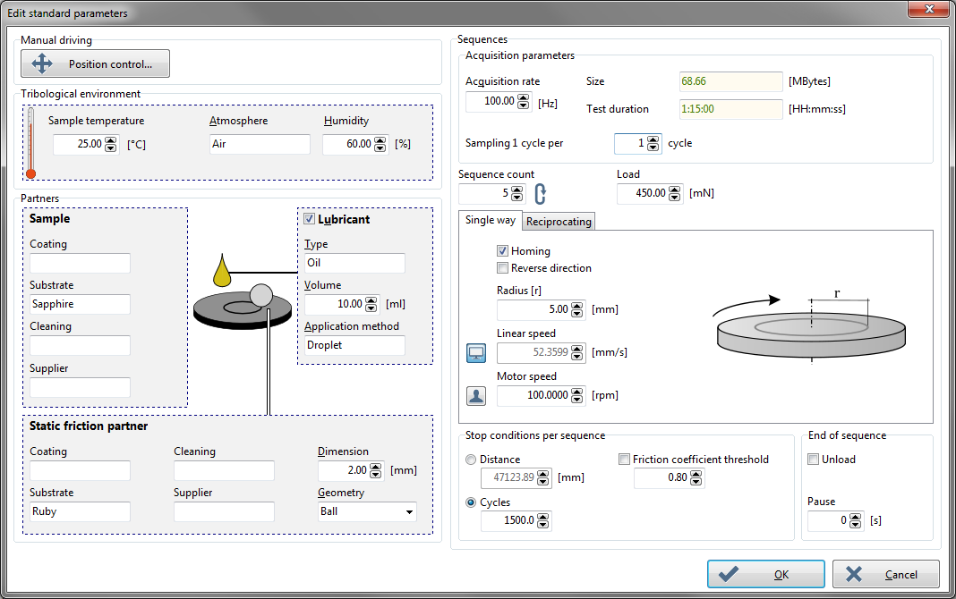
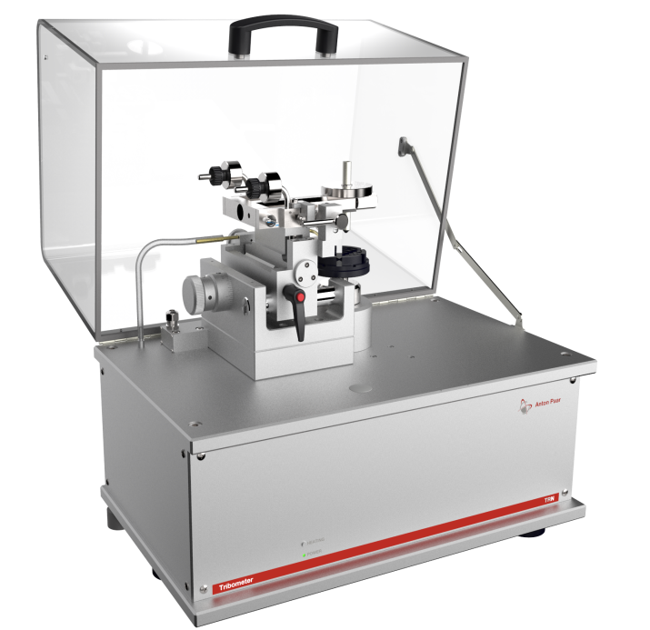
Tribology Testing - Overview

Slide 34
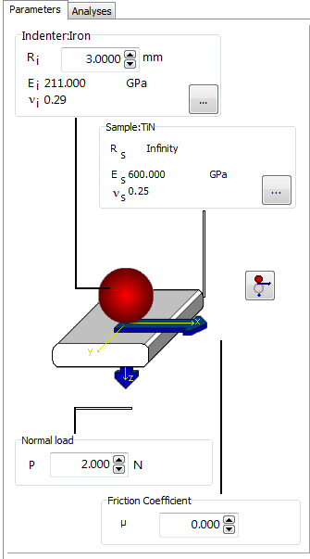
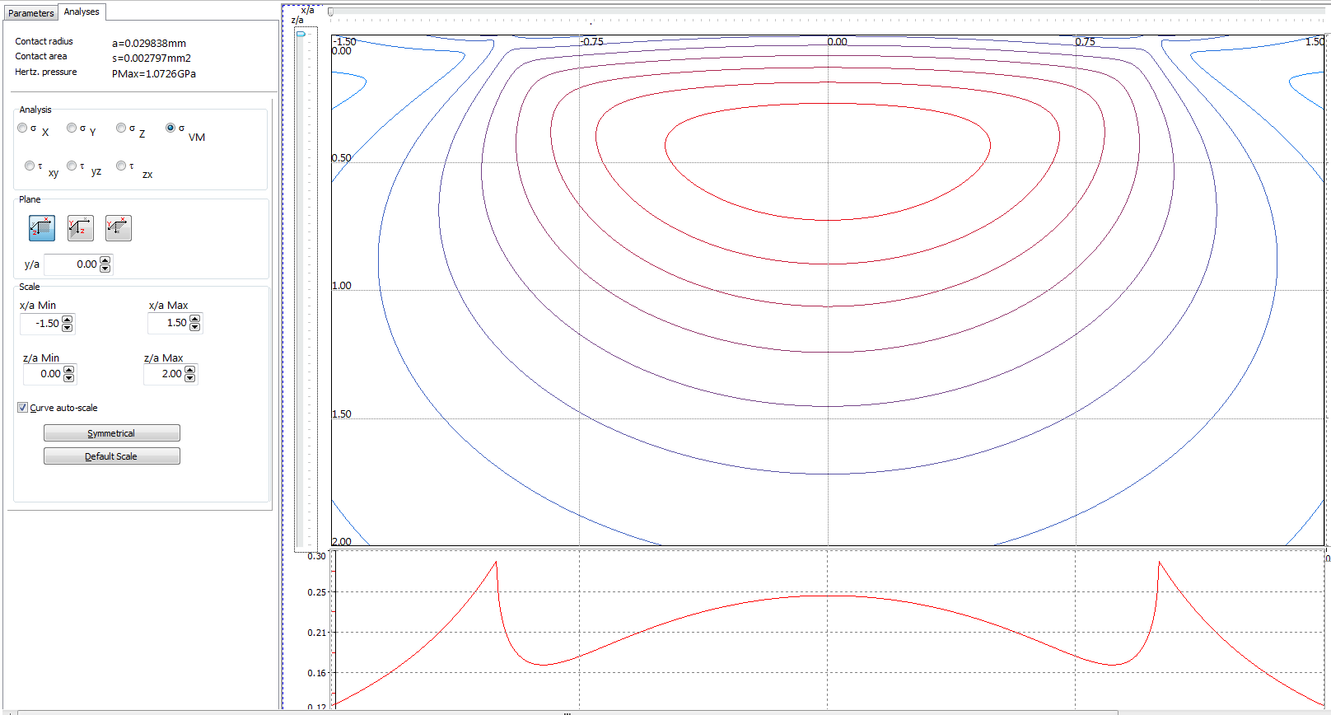
Tribology Testing - Contact Mechanics Modeling
Modeling software included inside every Anton Paar Tribometer package

Slide 35
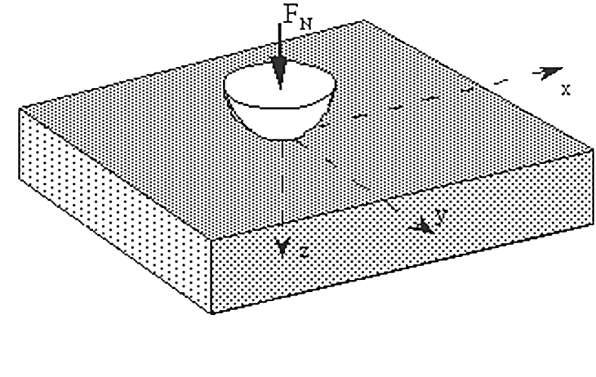

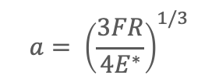
Tribology Testing - Contact Mechanics Modeling
Hertz contact model (ball on flat)
a
0.0
0.5
max
~ 0.5 a
1.0
z/a
2.0
$$a= {\left(\frac{3FR}{4E^{∗}}\right)}^{1/3}$$
3.0
Von Mises
iso-stresses
Contact Radius
y=0
µ=0
4.0
-2.0
-1.0
0.0
1.0
2.0
$$P_{m}=\left(\frac{4E^{∗}}{3π}\right)\frac{a}{R}$$
x/a
Mean Contact Pressure
For coated materials, max Von Mises stress is important
F: normal load, R: ball radius, E*: reduced modulus

Slide 36
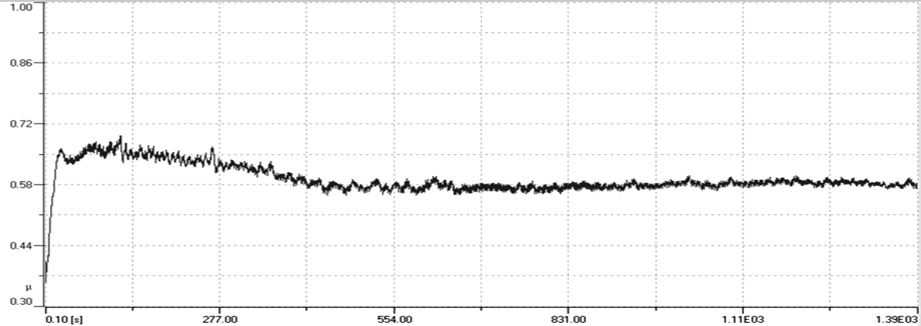
Tribology Testing - Coefficient of Friction
100Cr6 Steel ball against TiN coated steel

Slide 37
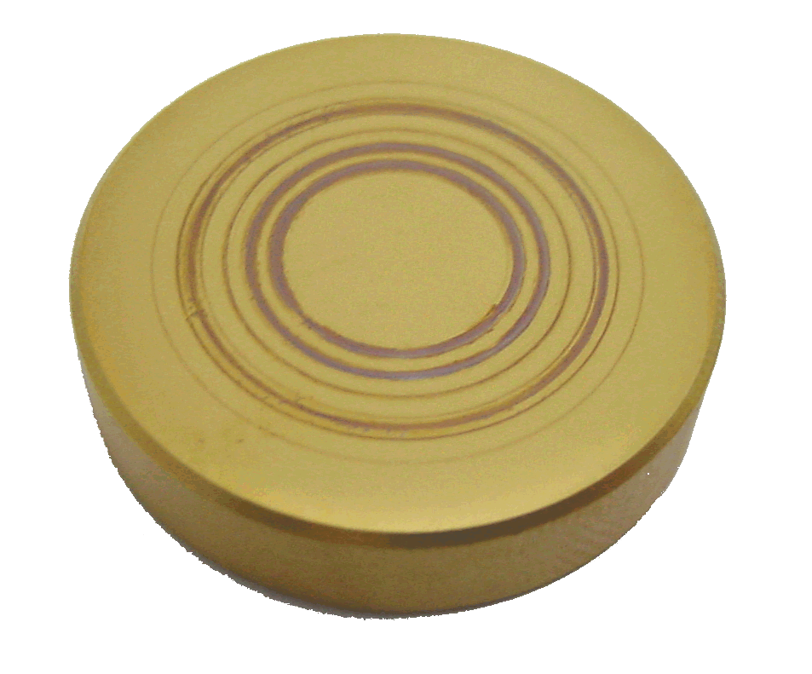
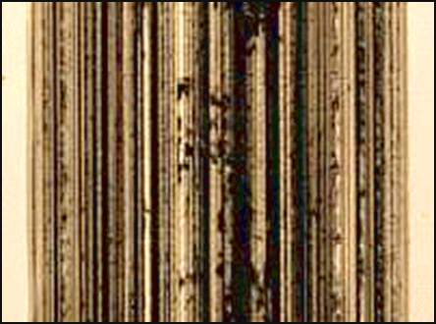
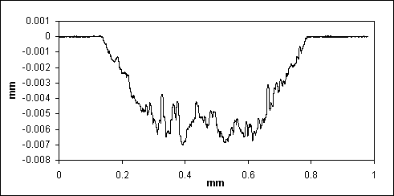
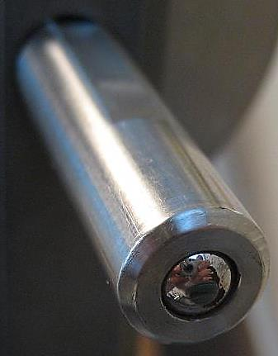
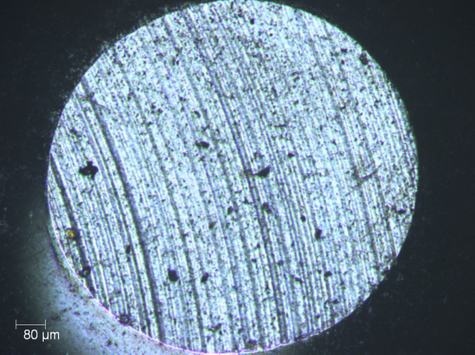
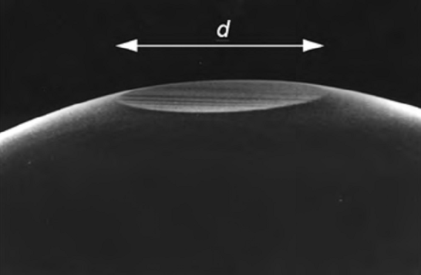
Tribology Testing - Wear
Wear of Sample
Wear of Ball

Slide 38
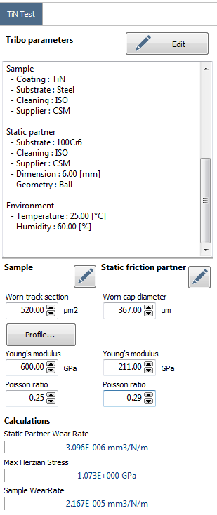
Tribology Testing - Wear
Sample wear volume = Cross section area * wear track circumference
Ball wear volume = Volume of the worn cap
$$K=\frac{V}{Fl}$$
Wear Rate
V: wear volume, F: normal load, l: sliding distance

Slide 39
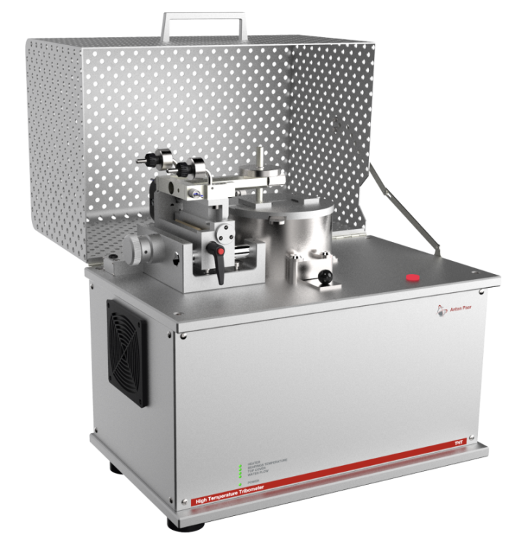
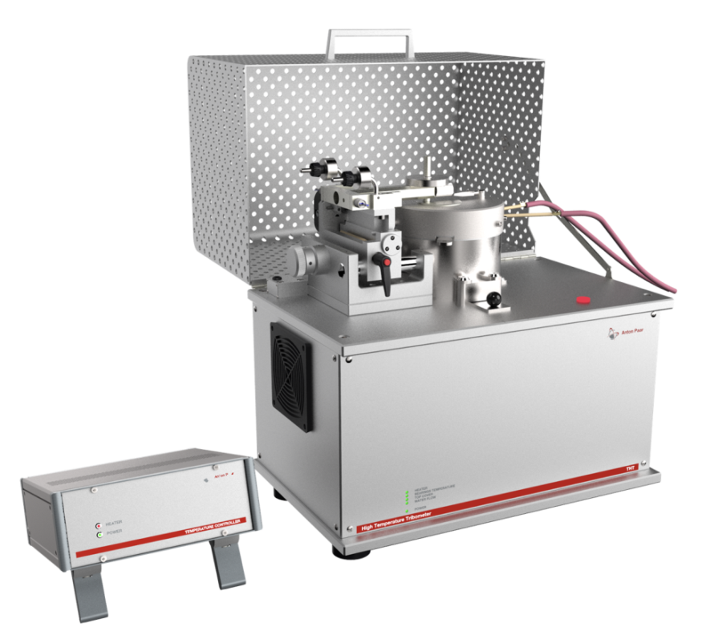
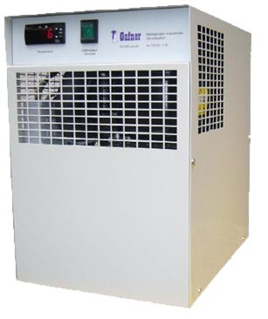
High Temperature Tribometer (THT)
Water chiller included
for all THT
THT up to 800°C
THT up to 1000°C

Slide 40
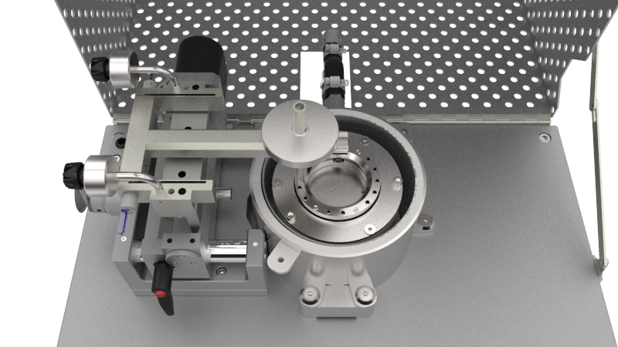
High Temperature Tribometer (THT)
Double LVDT sensors to cancel thermal drift error
Cylinderical Oven for homogenous sample heating
Water cooling system for efficient temperature control and safe utilization
Elastic Arm
Double LVDT sensors for Friction Force
Monolithic machining with extremly high linearity
Differential measurement by double LVDT sensors to avoid thermal drift on Ft
Sample thermal couple
(for THT 800°C)
Direct contact with the sample for precise temperature measurement
Cylindrical Oven
Homogenous sample heating
Certified Weights
Stable normal load application without problem of thermal drift (vs. Servo loop control)
Water cooling system
Efficient circulating water cooling system

Slide 41
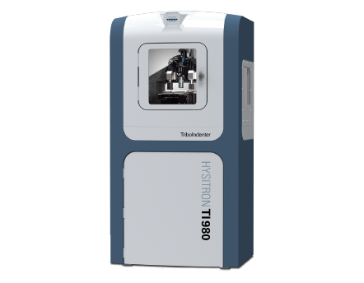
Nano tribology

Slide 42

Diamond tip (Berkovich) wear of ALD TiO2 on a silicon substrate
Jussi Lyytinen et al., Volumes 342–343, 15 November 2015, Pages 270-278

Slide 43

Effect of ALD processing temperature to abrasive nano wear
Jussi Lyytinen et al., Volumes 342–343, 15 November 2015, Pages 270-278

