Slide 1
Final Pitch Briefing
Date: 08-12-2020 Time: 9AM – 1 PM EET
Contact us if needed
Notes:
A lot of you guys may heard some teasers from myself during the last couple of week involving the final pitch. Well now is the time to reveal the Finale!

Slide 2
Notes:
Matchbox. The first of its kind.
Happening on the 8th of December from 9Am to 1Pm Finland time.
It is a bit earlier than the normal schedule and I notice how some of you come later than the normal time so please be on time or early for this event. The opening session starts at exactly 9 AM sharp and I expect there will be no latecomers.

Slide 3
What’s happening?
Final Pitches from 11 teams of Startup Experience
Panel discussion and networking event
Guest list will involve experts from the startup and innovation ecosystem
We will announce more info on who will be present on the day so you can prepare!
No More Zoom. We will introduce the new platform soon. *Fingers crossed*
Notes:
Matchbox will be featuring the final pitches of the 11 teams of Startup Experience. We are really looking forward to the efforts and progress made by everyone here right now. Matchbox will also be featuring a panel discussion from experts within the startup and innovation ecosystem. After delivering the final pitches, teams will have an opportunity to network with a wide range of guests, from accelerators to corporations and experts from different fields.
There will be more information regarding this later on. I want you guys to consider this as an opportunity and a playground. We rarely get to organize such an event and I want all of you guys to have fun. This is also our first time organizing this so feedback is always welcomed.

Slide 4
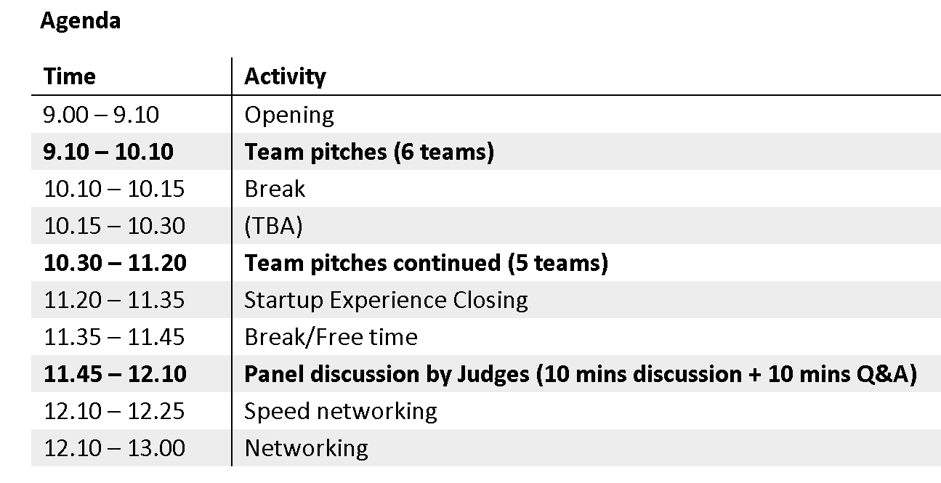
Agenda

Slide 5
Final Pitch
3 mins format
No reading from papers and need to be well prepared.
Teams will be expected to answer 3 questions from the judges and SE teaching team.
7 mins for Q&A. 10 mins in total

Slide 6
Awards
Public Vote: audience will vote their most favourite team/idea. You may vote for teams other than yourself.
Teachers’ Choice (To be decided)
Teachers will pick the teams that make the most progress and come up with the best final output. Maybe announced after the event

Slide 7
Judges
Rainer Sternfeld – Managing Partner, NinjaNordic
Timo Erho - Head of Innovation Ecosystems, Aalto University
Razi Tarif – Lab Manager, United Nations Technology Innovation Labs (UNTIL)
And more!

Slide 8
Collect team info
Every team will send me an email before the end of this week.
Team name
Logo
Team topic 2-5 words
Topic description: 1-2 sentences.
SDG(s)
Also, if you have mentors for this project, you can invite them to this event.

